Slide 1
Recent Studies Demonstrating the Effects of a Ketogenic Nutritional Intervention on Mental Health

Slide 2
The overall prevalence of any mental illness among U.S. adults is approximately 23.4% (more than 1 in 5 adults), while 5.6% experience a serious mental illness.
Prevalence by Specific Condition (Annual / Past-Year Estimates)
Anxiety Disorders (including GAD): ~19.1% of U.S. adults experience an anxiety disorder each year (lifetime prevalence is around 31.1% to 31.6%).
Major Depressive Disorder: ~8.3% to 15.5% of U.S. adults experience major depression annually depending on the specific diagnostic scope and survey year.
Posttraumatic Stress Disorder (PTSD): ~4.1% to 5.0% of U.S. adults experience PTSD annually.
Bipolar Disorder: ~2.8% of U.S. adults experience bipolar disorder overall (with specific breakdowns like Bipolar I at ~1.5% to 1.8%).
Schizophrenia / Schizophrenia Spectrum Disorders: Schizophrenia affects less than 1% (<1%) of U.S. adults, while broader schizophrenia spectrum disorders affect about 1.2%

Slide 3
How often do individuals with a mental health diagnosis have some evidence of disrupted metabolic health?

Slide 4
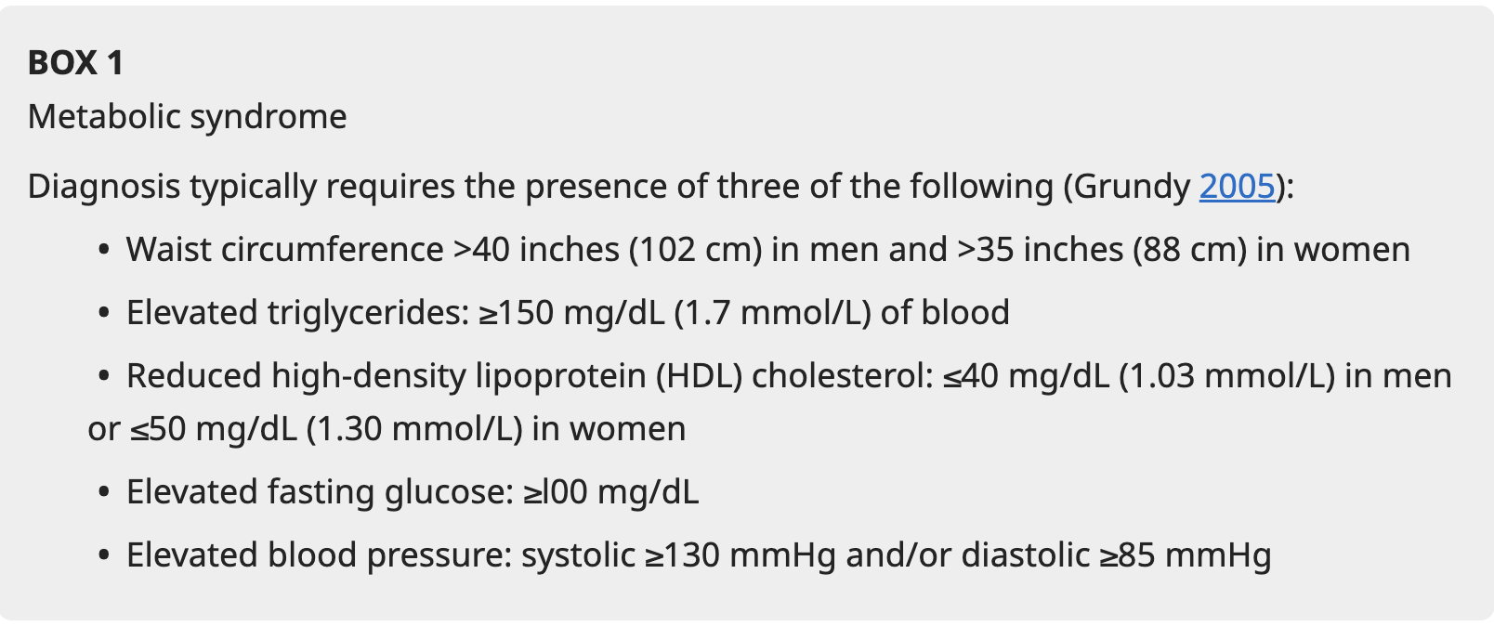
BJPsych Advances (2025), vol. 31, 201–210 doi: 10.1192/bja.2024.52

Slide 5
Roughly 48.6% to over 60% of adults with severe or major mental health diagnoses (such as schizophrenia, bipolar disorder, and major depressive disorder) show evidence of disrupted metabolic health or metabolic syndrome, compared to roughly 24% to 38% of the general adult population.
• Metabolic Syndrome Prevalence: Studies published in BMC Psychiatry and BJPsych Advances place the rate of metabolic syndrome in individuals with severe mental illness (SMI) at approximately 48.6%—nearly double the rate found in the general population.
• General Metabolic Dysfunction: Broader estimates across various psychiatric conditions (including anxiety, depression, and severe mental illnesses) indicate that up to 88% of the general population has some degree of poor metabolic health, with even higher clustering and risk factors observed in psychiatric cohorts. [
• Obesity and Comorbidity: Research published in PubMed and PMC reviews note that obesity and metabolic syndrome co-occur in roughly 45% of individuals with major mental health disorders, driven by a combination of shared neurobiological/inflammatory pathways, lifestyle factors, and the metabolic side effects of certain psychotropic medications.
• Bidirectional Risk: Data highlighted by Stanford Medicine shows that developing a metabolic disorder like insulin resistance can double a person's risk of depression, while pre-existing metabolic issues frequently worsen psychiatric treatment resistance
Dialogues Clin Neurosci. 2018 Mar;20(1):63–73.
BJPsych Advances (2025), vol. 31, 201–210 doi: 10.1192/bja.2024.52

Slide 6
How often do individuals with mental health diagnosis on treatment develop disrupted metabolic health as a consequence of their treatment?

Slide 7
The percentage of adults who develop disrupted metabolic health as a direct consequence of mental health medications varies drastically depending on the specific class of medication prescribed. When assessing the incidence of medication-induced metabolic syndrome (MetS)—defined by a cluster of abdominal obesity, hypertension, insulin resistance, and dyslipidemia—the data is sharply divided between antipsychotics and antidepressants:
Antipsychotics carry the highest and most aggressive risk profile for metabolic disruption.
• Overall Rate: Between 32% and 68% of adults treated with long-term antipsychotics develop full clinical metabolic syndrome.
• Highest-Risk Agents: Medications like clozapine and olanzapine cause the most severe dysregulation, with up to 45% to 58% of patients meeting the criteria for metabolic syndrome. These drugs directly alter liver function, trigger de novo lipogenesis (fat accumulation), and impair insulin secretion.
• Lower-Risk Agents: Medications like aripiprazole, lurasidone, and ziprasidone are considered more "metabolically friendly," though risk is still elevated compared to non-medicated populations
J Pharmacol Pharmacother. 2013 Jul-Sep;4(3):176–186. doi: 10.4103/0976-500X.114596
Metab Syndr Relat Disord. 2023 Aug;21(6):294-305. doi: 10.1089/met.2023.0003.
Explor Endocr Metab Dis. 2025;2:101450 DOI: https://doi.org/10.37349/eemd.2025.101450

Slide 8
Antidepressants
While antidepressants are generally lower risk than antipsychotics, long-term use still presents a significant metabolic burden.
Overall Incidence: Prospective cohort studies tracking adults placed on antidepressants for Major Depressive Disorder (MDD) show a metabolic syndrome incidence rate of 12% after 3 months and 17% after 6 months of treatment.
Long-Term Weight Gain: Over extended periods, up to 55% to 65% of patients experience long-term weight gain on antidepressants, which acts as a primary driver for downstream insulin resistance and type 2 diabetes.
Explor Endocr Metab Dis. 2025;2:101450 DOI: https://doi.org/10.37349/eemd.2025.101450

Slide 9
Class Differences:
Tricyclic Antidepressants (TCAs) and Mirtazapine: Carry the highest risk of significant metabolic shifts due to strong antihistaminergic properties that cause severe carbohydrate cravings and a lowered basal metabolic rate.
SSRIs (e.g., paroxetine, escitalopram): Typically show mild to moderate risk, often presenting as a slow annual increase in metabolic dysfunction over years of continuous use.
NDRIs (Bupropion): Form an exception and are largely considered metabolically neutral or can even promote mild weight loss.
Can Fam Physician. 2020 Dec;66(12):898–900. doi: 10.46747/cfp.6612898
Arch Clin Biomed Res. Author manuscript; available in PMC: 2025 May 29.

Slide 10
Are Ketogenic Nutritional Interventions Beneficial in Individuals with a MH Diagnosis?
Several significant subject reviews and meta-analyses published in 2025 and 2026 evaluate the effects of ketogenic nutritional interventions on mental health outcomes. The literature reflects a major shift toward treating psychiatric conditions through a metabolic lens, a field known as metabolic psychiatry.

Slide 11
The largest and most comprehensive overview to date is a systematic review and meta-analysis published in JAMA Psychiatry.
Scope: Included 50 studies encompassing 41,718 adult participants across 15 countries.
Depression Outcomes: Pool data from 10 randomized controlled trials (RCTs) demonstrated a modest but statistically significant reduction in depressive symptoms (SMD = -0.48). The antidepressant effects were substantially stronger in protocols that verified a state of biochemical ketosis through testing, utilized very low-carbohydrate metrics (<10% of total calories), or evaluated non-obese individuals.
Anxiety Outcomes: Across 9 RCTs, the evidence regarding anxiety symptoms remained inconclusive and statistically non-significant (SMD = -0.03). However, data from quasi-experimental (non-randomized) studies showed consistent self-reported improvements in both depression and anxiety.
Janssen-Aguilar R, Vije T, Peera M, et al. Ketogenic diets and depression and anxiety: a systematic review and meta-analysis. JAMA Psychiatry. Published online November 5, 2025. doi:10.1001/jamapsychiatry.2025.3261

Slide 12
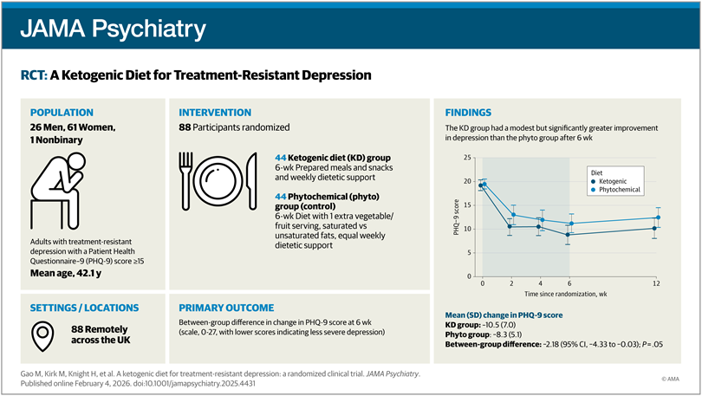

Slide 13
Systematic Review on Depression and Anxiety (2026)
Published in The Journal for Nurse Practitioners, this systematic review focused specifically on the implications of low-carbohydrate and ketogenic diets for clinical psychiatric practice.
Scope: Reviewed peer-reviewed studies published up through recent cohorts, identifying distinct trials utilizing standardized metrics (such as the PHQ-9, GAD-7, and HAM-D).
Key Findings: The review concluded that ketogenic metabolic therapy demonstrates a clear signal for reducing symptom severity in mood disorders.
Clinical Application: The authors highlighted its particular promise as an adjunctive strategy for individuals suffering from treatment-resistant psychiatric conditions or those with co-occurring metabolic dysregulations (such as insulin resistance or metabolic syndrome).
Neiling, K., Cooper, N., Fenton, A., Ndzi, M., & Humphrey, K. (2026). The Ketogenic Diet for Depression and Anxiety: Implications for Practice. The Journal for Nurse Practitioners, 22(6), Article 105816.

Slide 14
Ketosis for Severe Mental Illness: A Critical Review (2026)
Published in Current Psychiatry Reports, this review critically appraised both clinical and preclinical data for severe mental illnesses (SMI), including schizophrenia, bipolar disorder, and major depression.
Focus on Ketosis: The review scrutinized whether the metabolic state of ketosis itself drives psychiatric stabilization.
Key Findings: It recognized that emerging open-label data and pilot trials show highly encouraging psychiatric and metabolic improvements. However, the authors maintained a cautious tone, noting that early trials are heavily vulnerable to expectation bias and short-term dietary support tracking. It called for longer, fully controlled RCTs to definitively isolate the psychiatric durability of the diet from general weight-loss or lifestyle trial attention.
Curr Treat Options Psychiatry. 2026;13(1):20. doi: 10.1007/s40501-026-00394-z

Slide 15
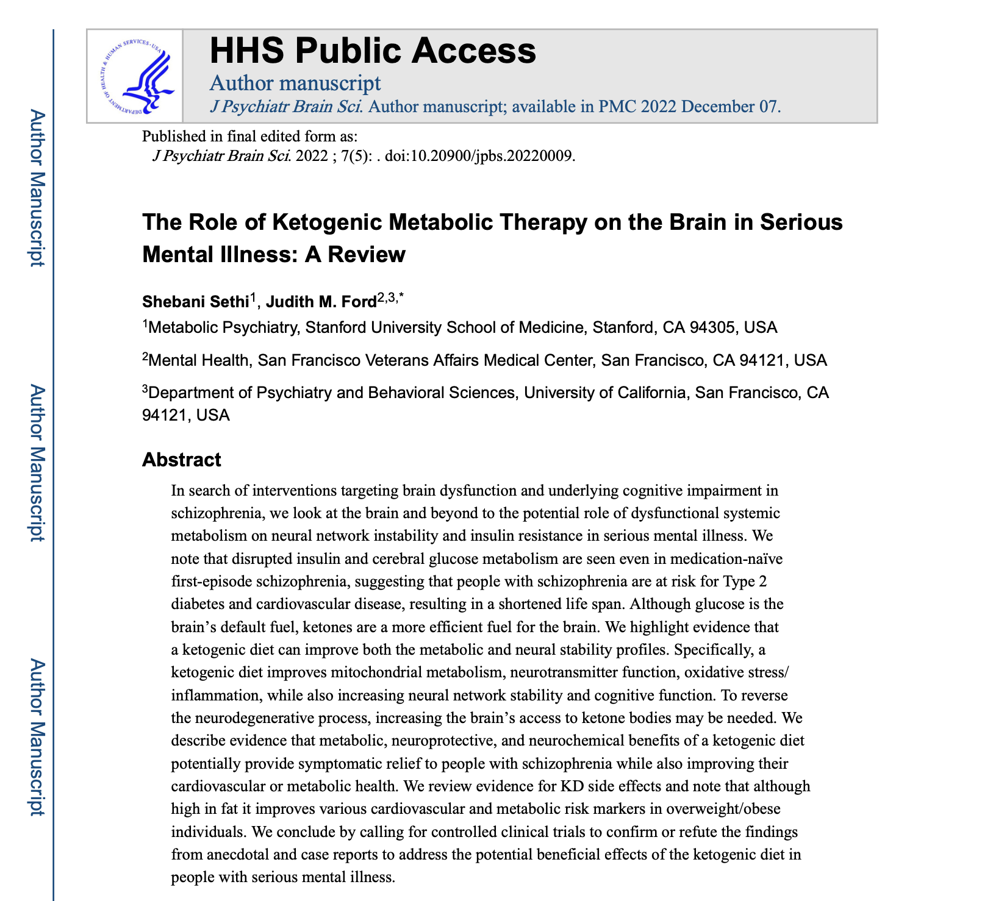

Slide 16
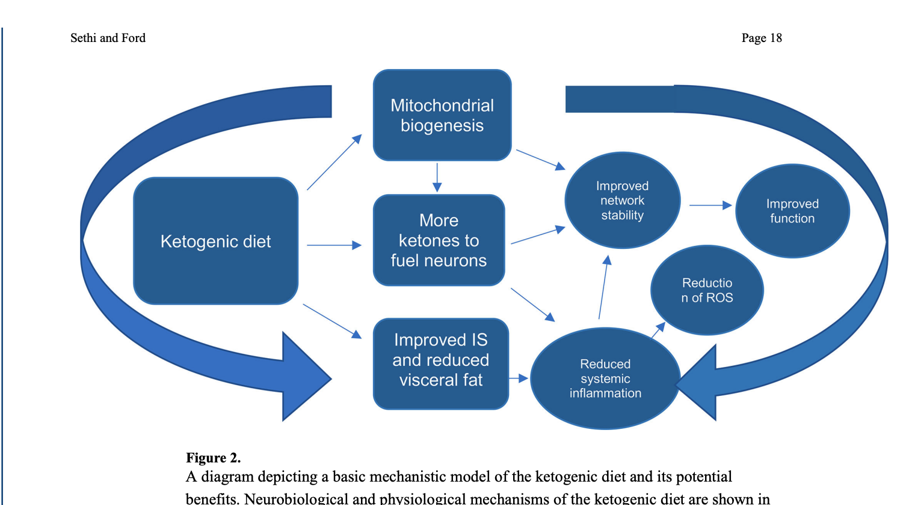

Slide 17
