Slide 1


Slide 2
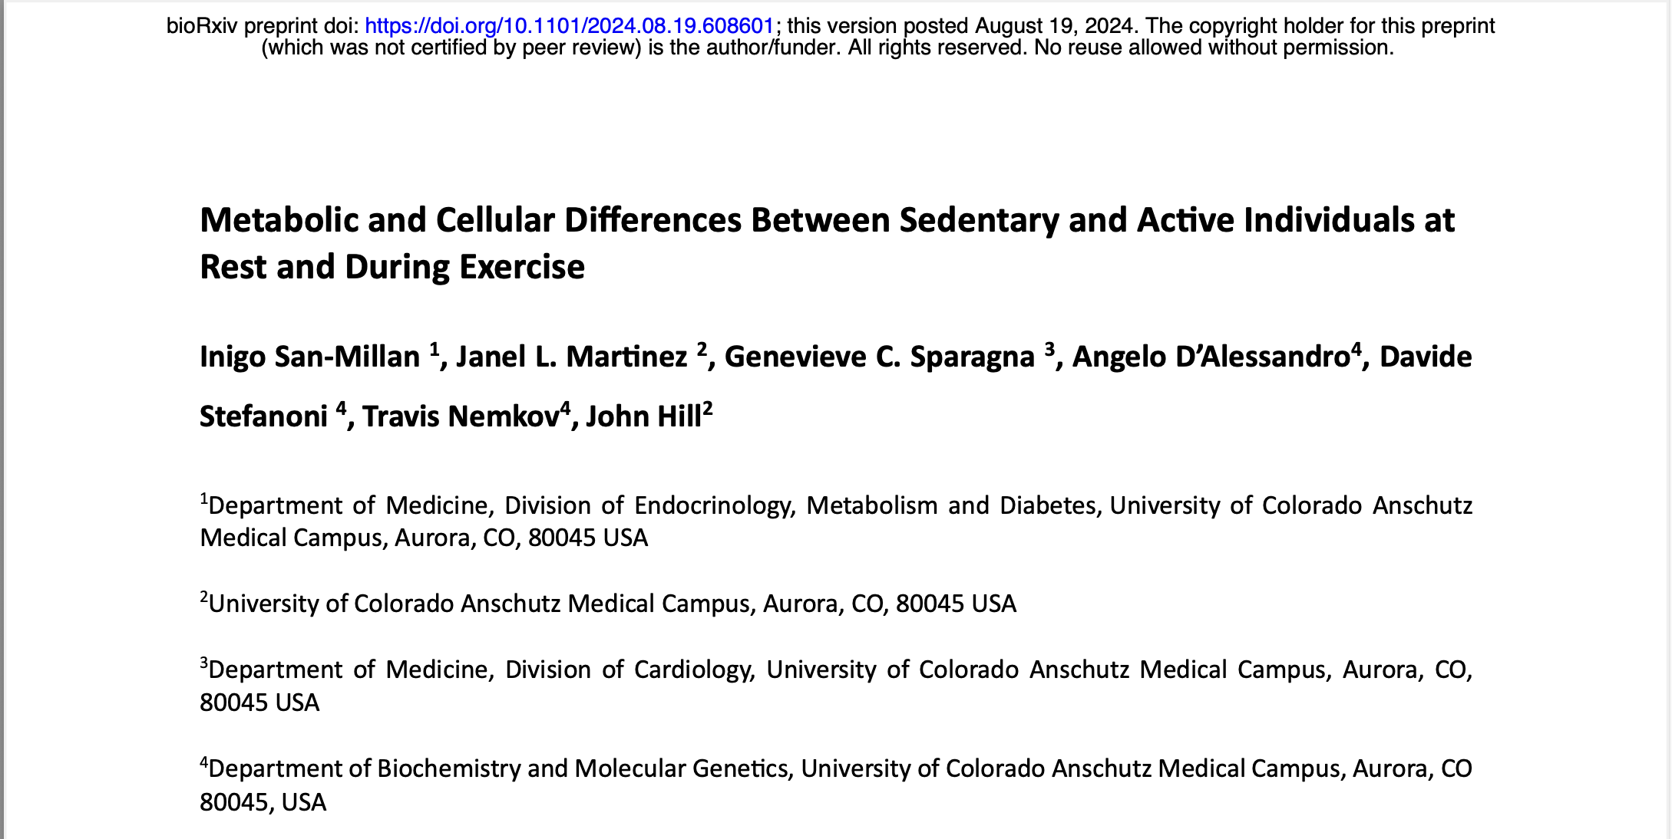

Slide 3
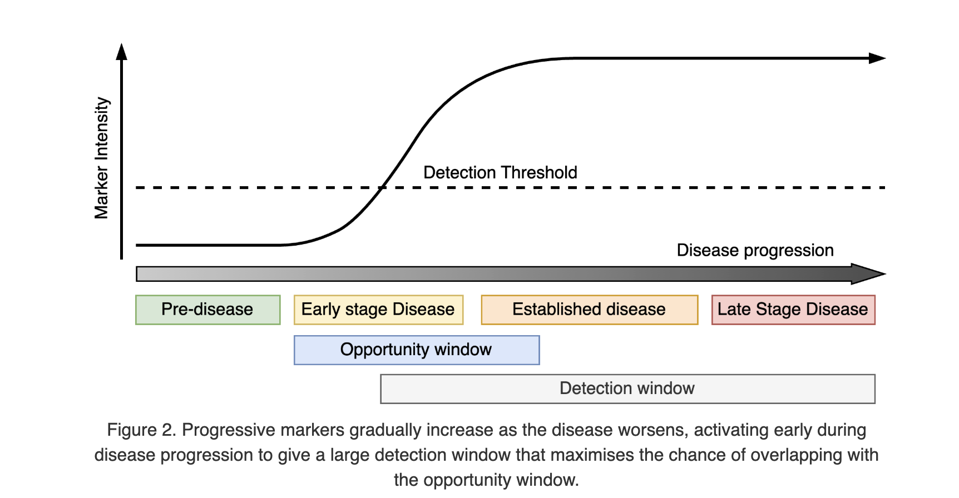

Slide 4
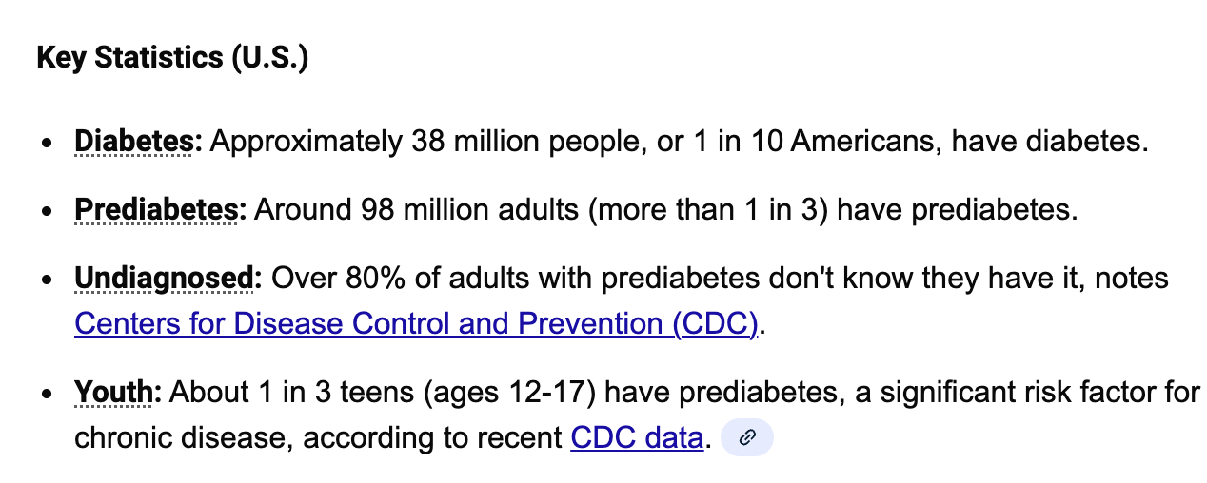

Slide 5
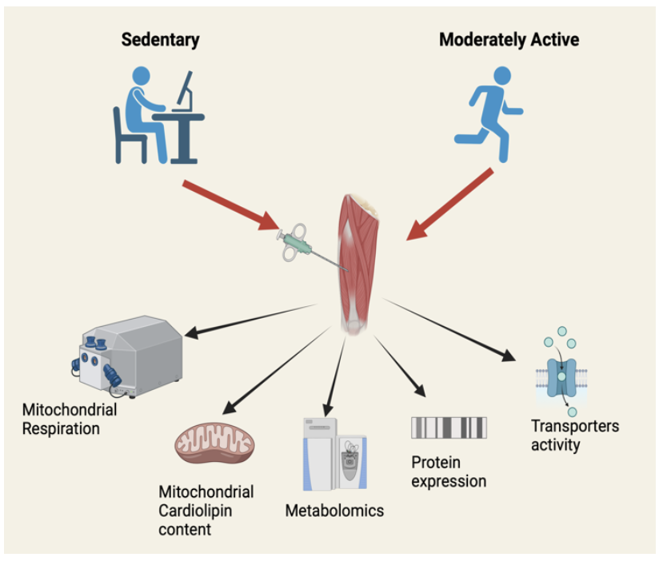

Slide 6
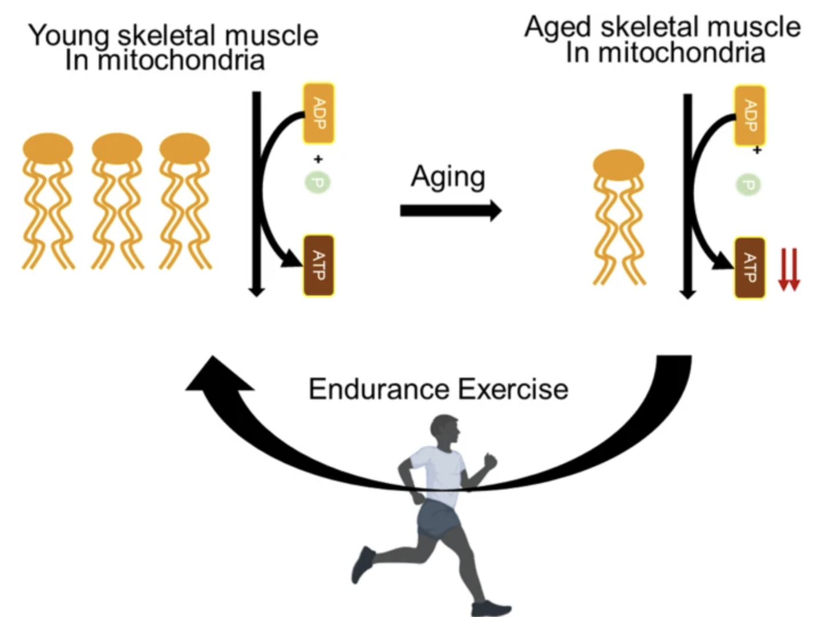
Yoo, Y., Yeon, M., Yoon, MS. et al. Role of cardiolipin in skeletal muscle function and its therapeutic implications. Cell Commun Signal 23, 36 (2025). https://doi.org/10.1186/s12964-025-02032-2

Slide 7
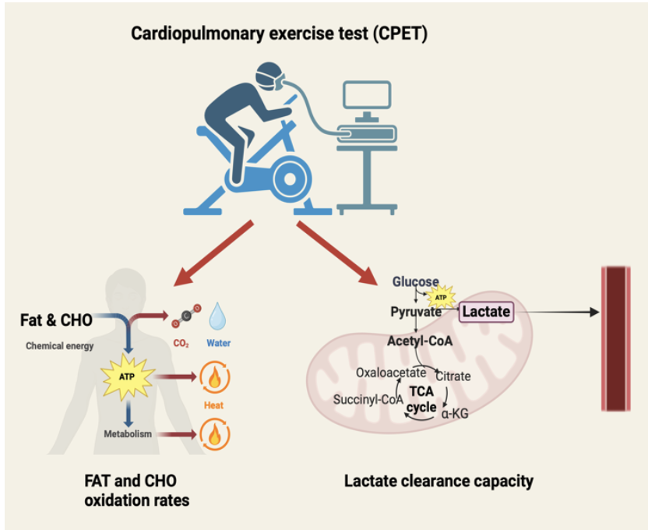

Slide 8
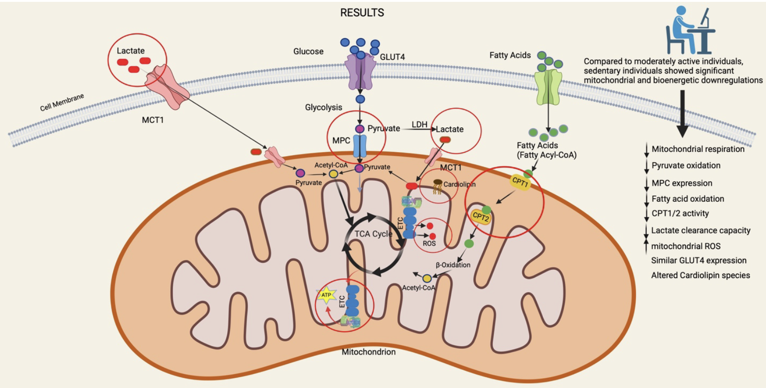

Slide 9
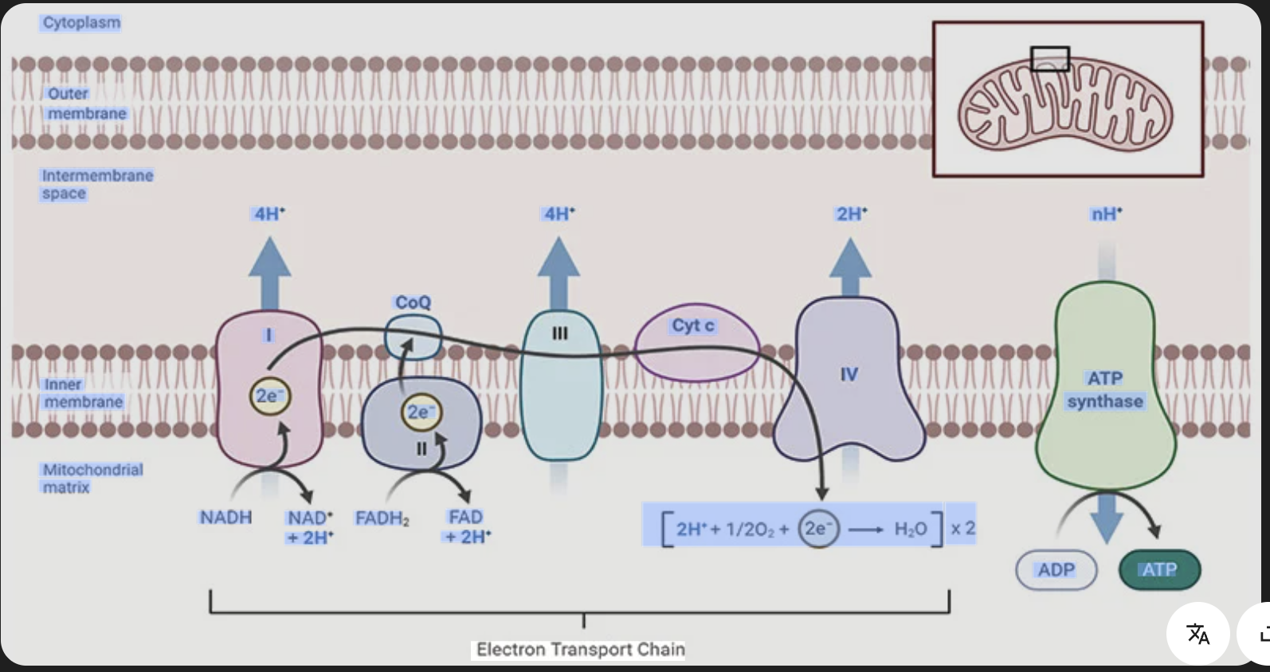
Mitochondria Electron Transport Chain

Slide 10
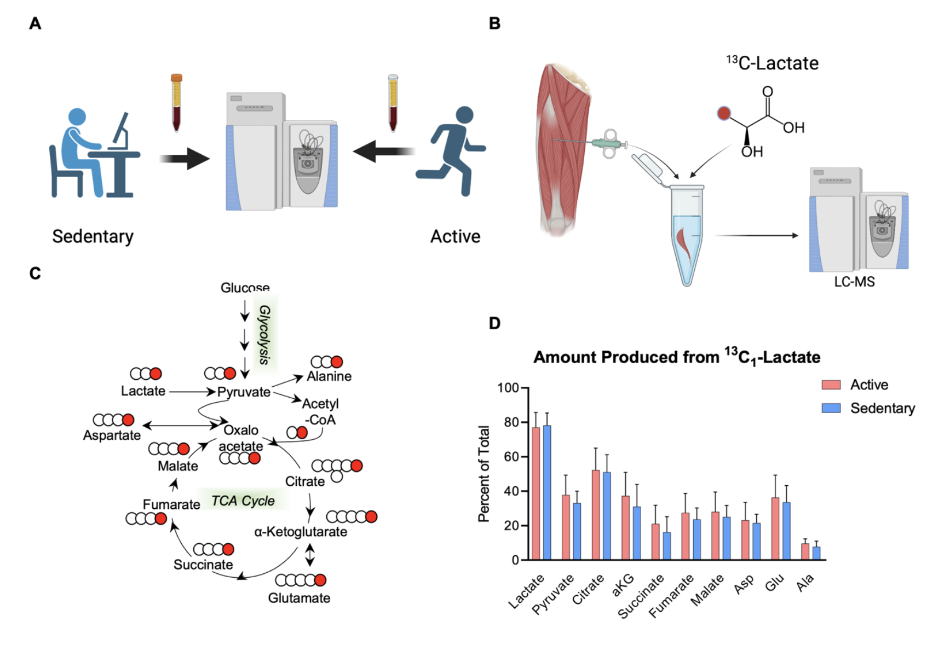

Slide 11
