Slide 1
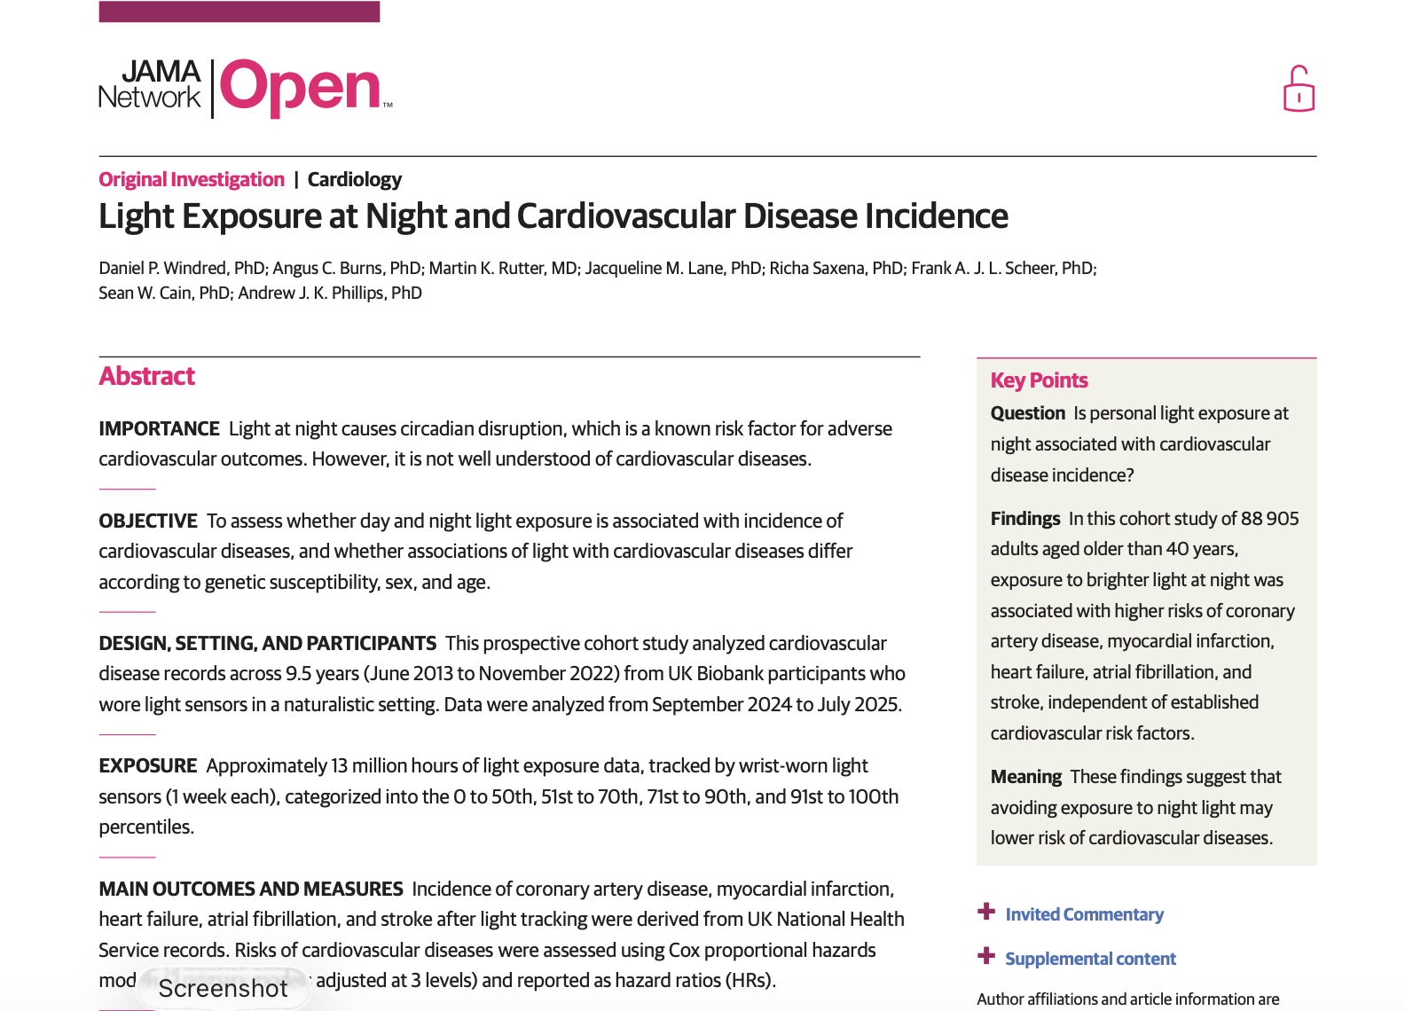

Slide 2
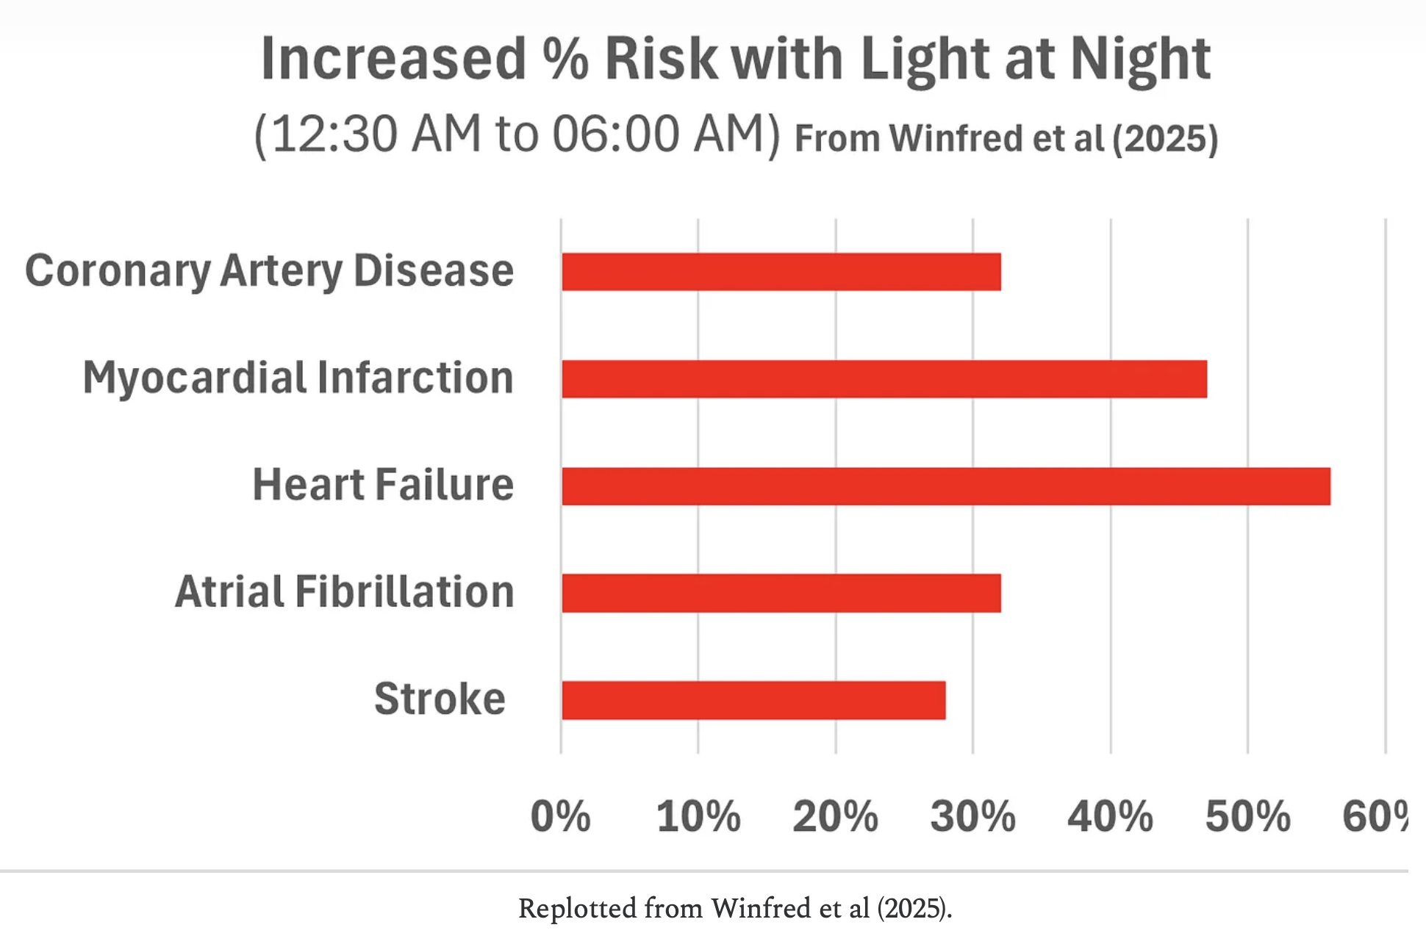

Slide 3
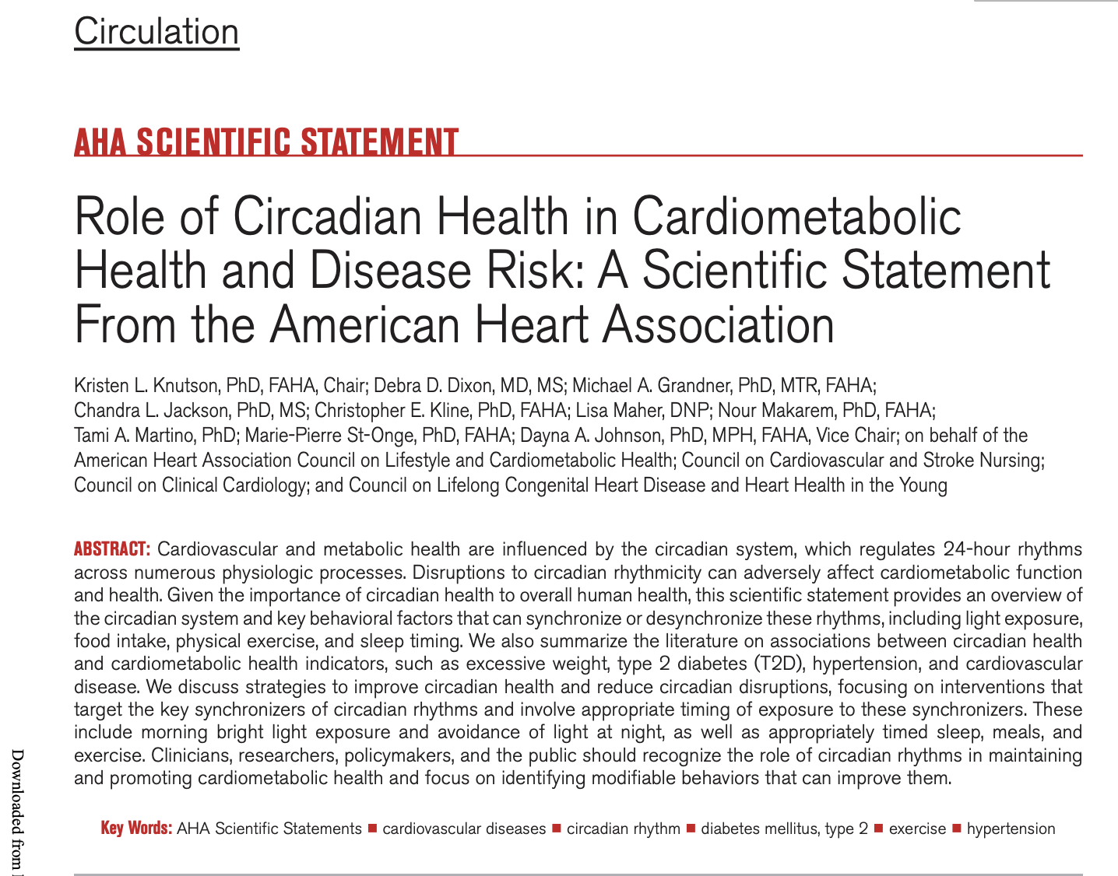

Slide 4
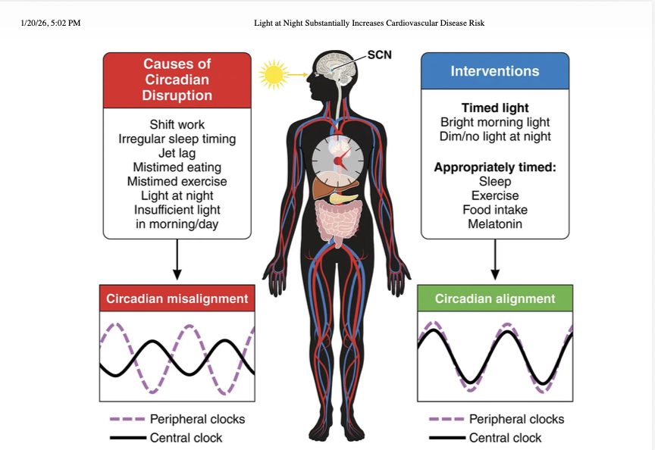
Circulation. 2025;152:e408–e419. DOI: 10.1161/CIR.0000000000001388 November 25, 2025

Slide 5
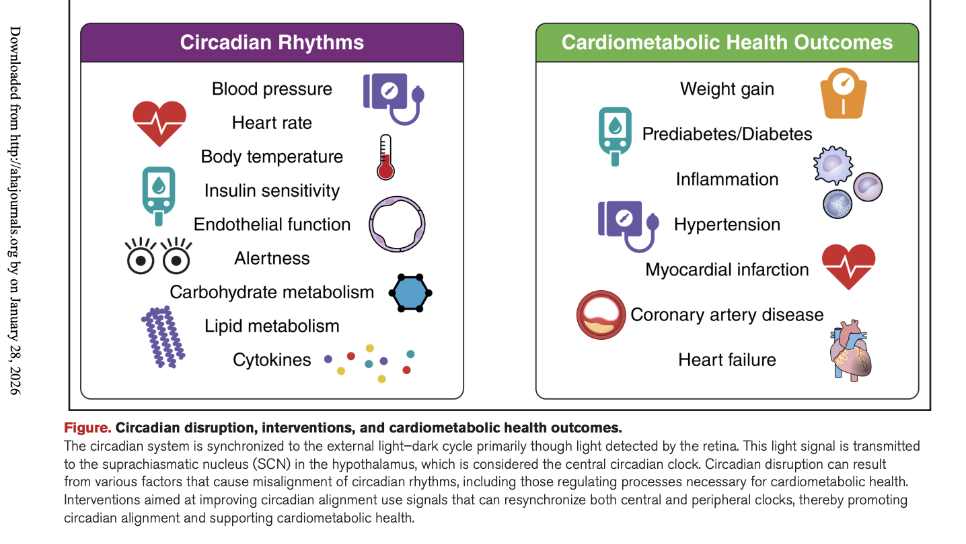
Circulation. 2025;152:e408–e419. DOI: 10.1161/CIR.0000000000001388 November 25, 2025

Slide 6
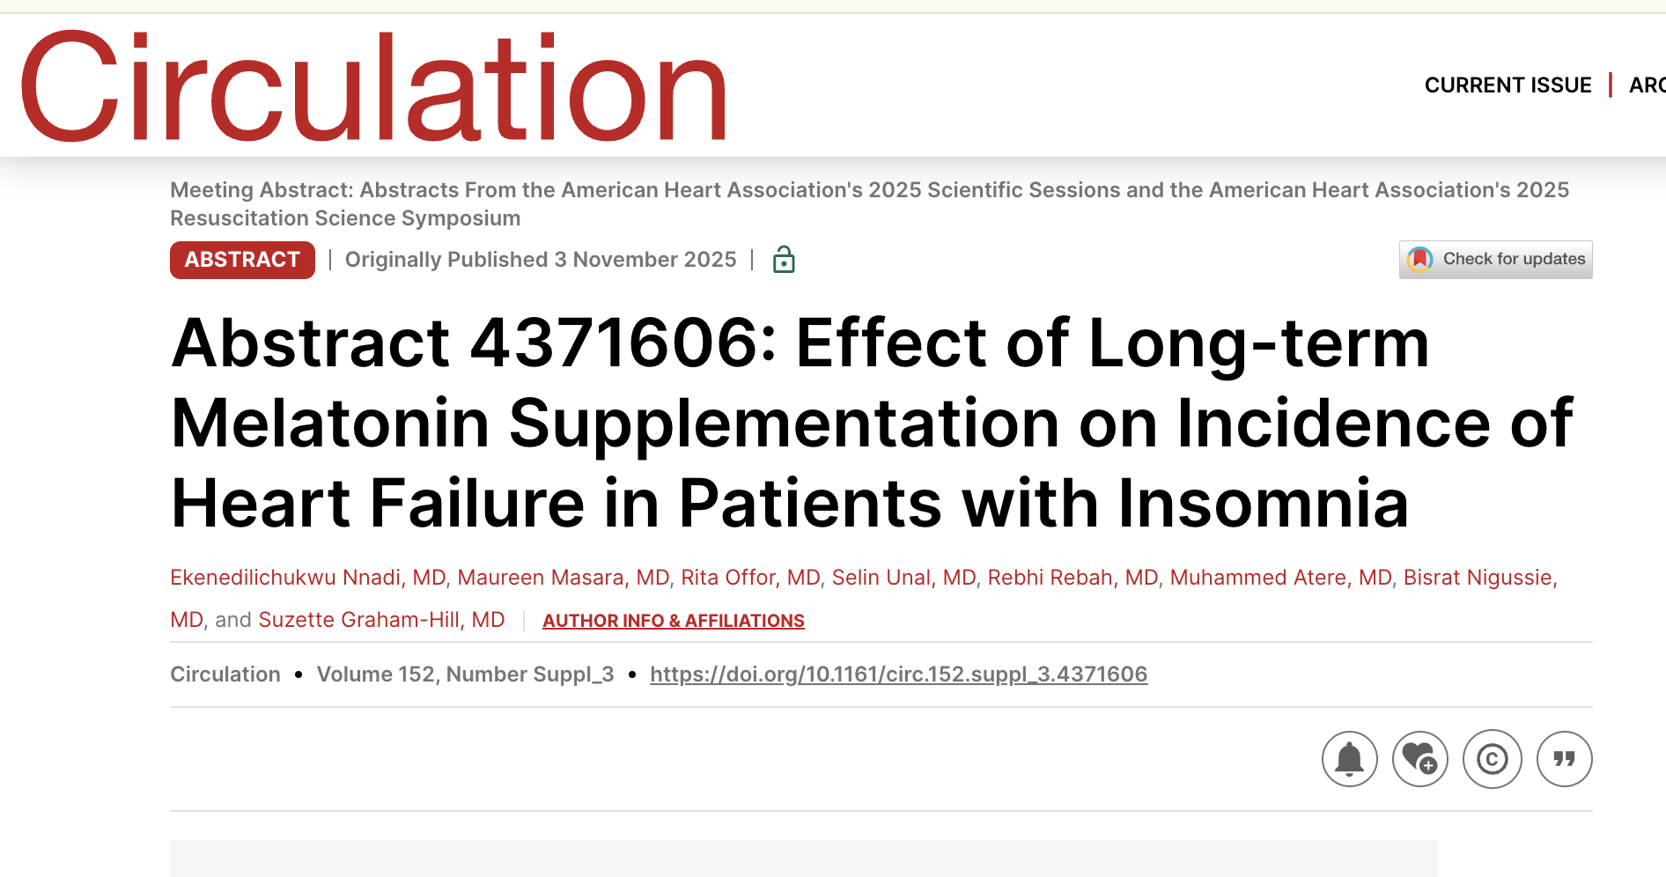

Slide 7
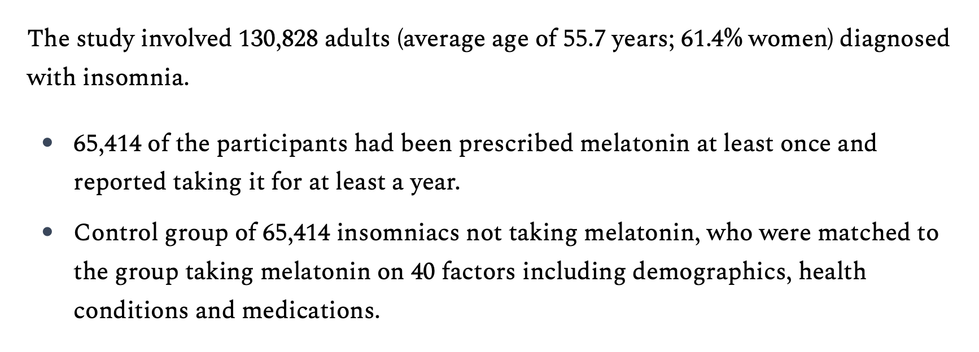

Slide 8
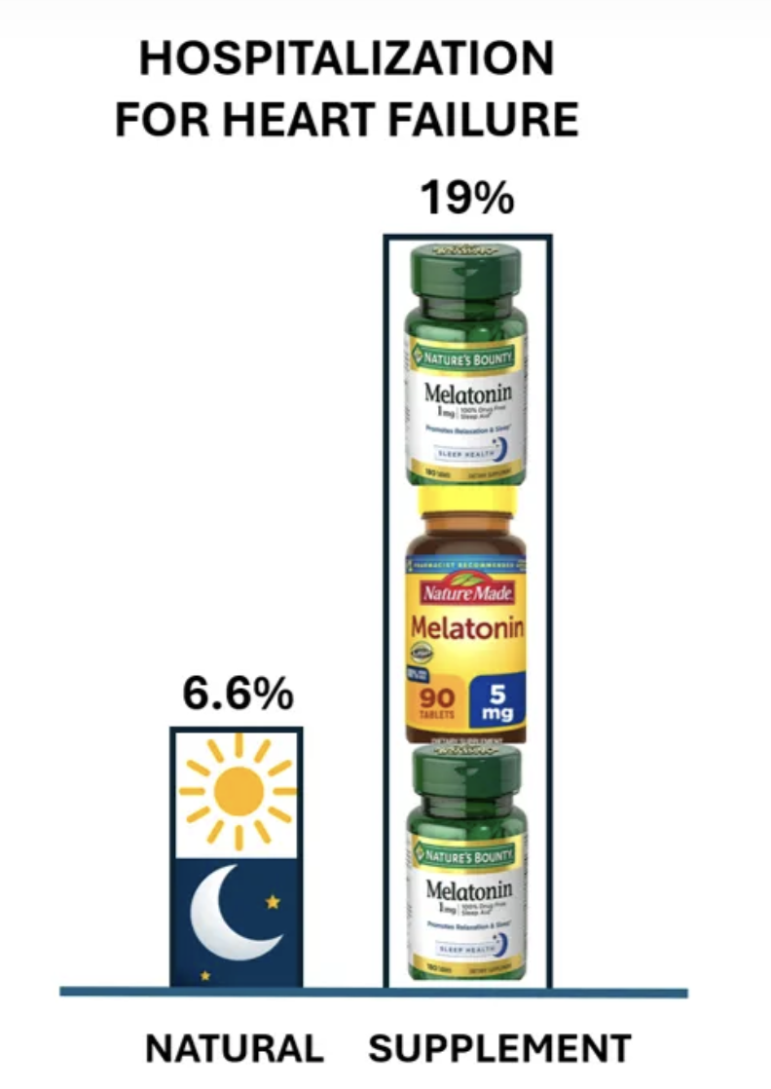
Martin Moore-Ede MD

Slide 9
Results
Participants taking melatonin were nearly 3.5 times as likely to be hospitalized for heart failure when compared to those not taking melatonin (19.0% vs. 6.6%, respectively).
Participants in the melatonin group were nearly twice as likely to die from any cause than those in the non-melatonin group (7.8% vs. 4.3%, respectively) over the 5-year period.

Slide 10
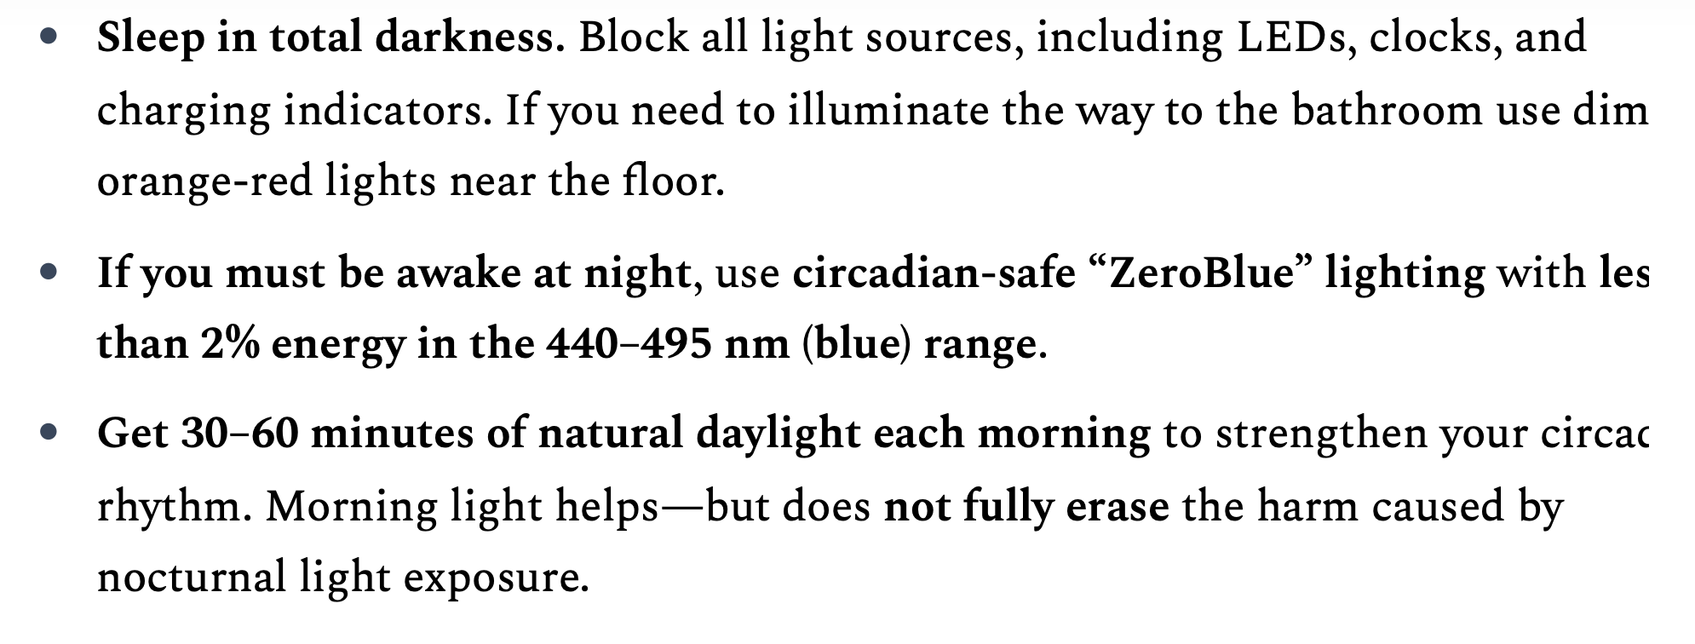

Slide 11
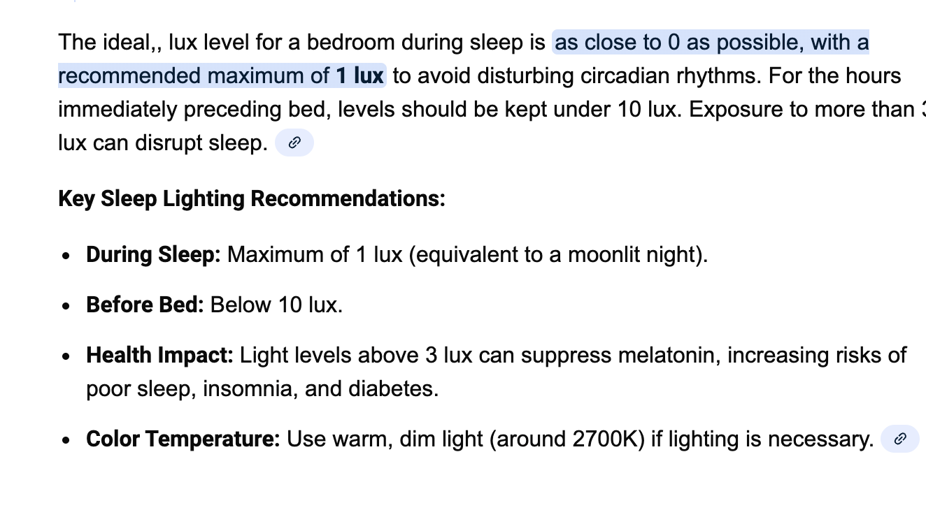

Slide 12
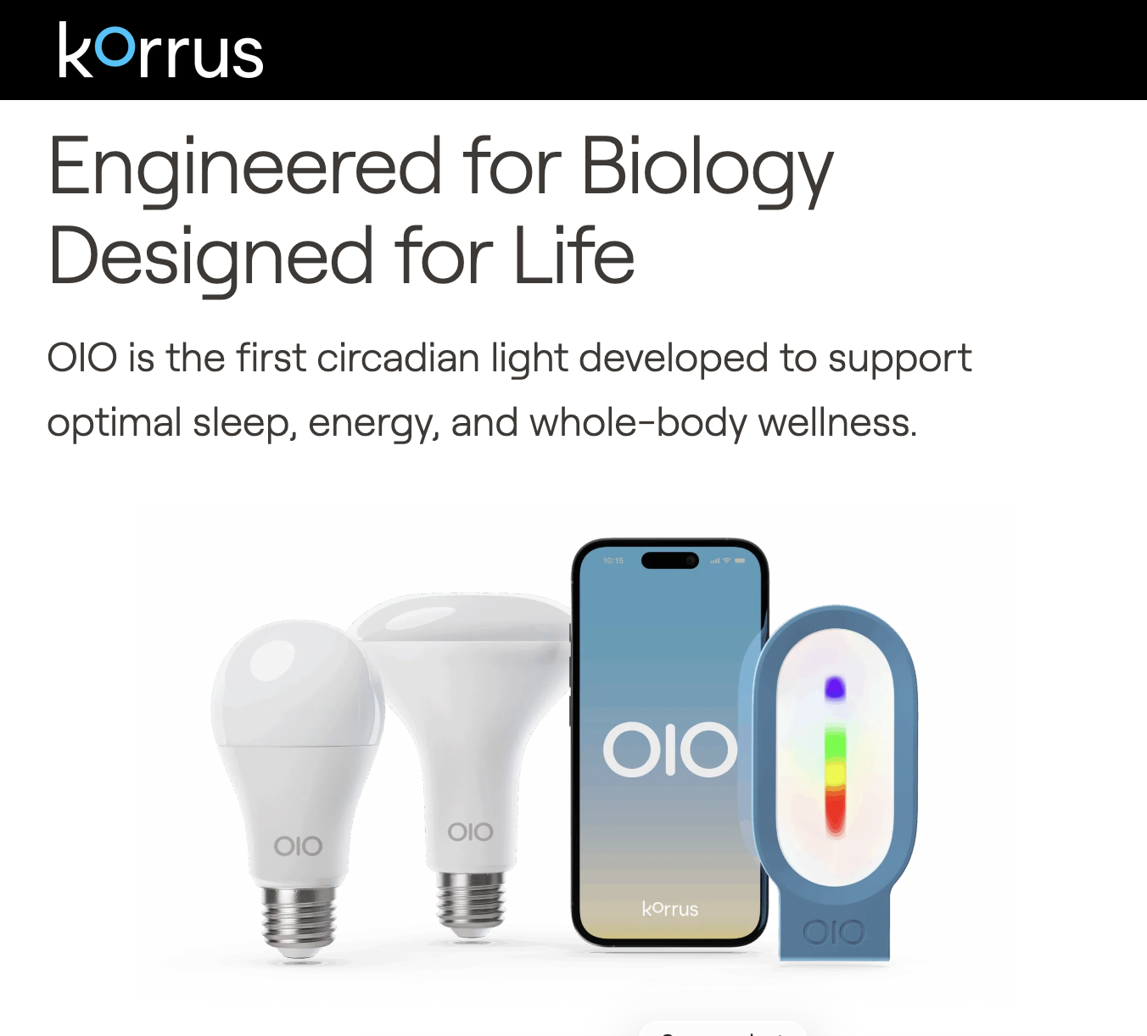

Slide 13
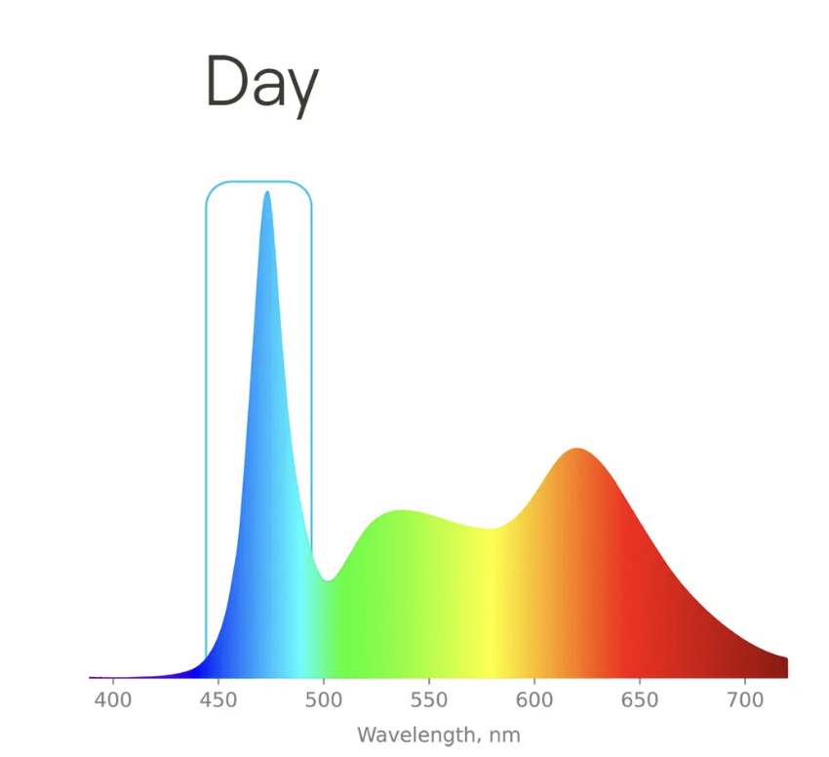
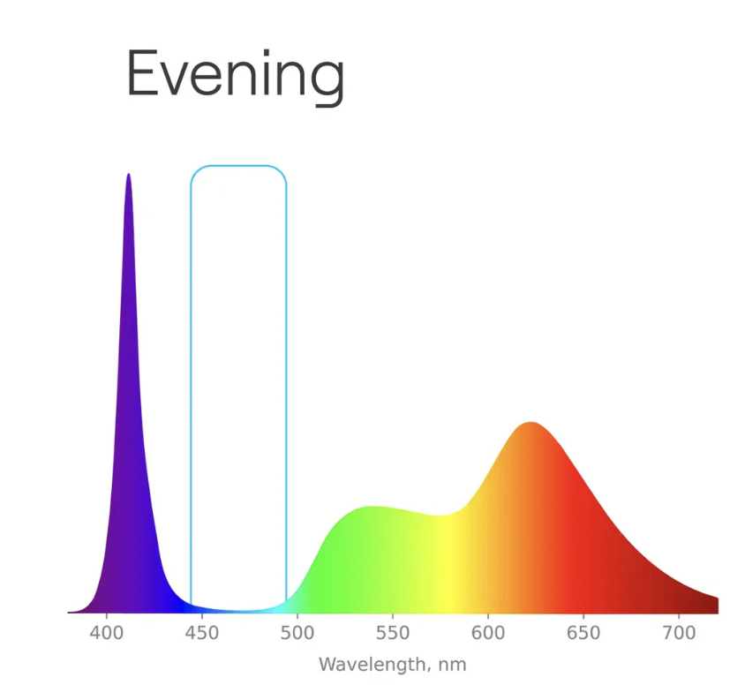

Slide 14
