Slide 1
The Importance of Redox Balance
Redox homeostasis is important in human health because it is a dynamic equilibrium essential for all fundamental biological processes, including energy production, cell signaling, and immune response. Maintaining this balance between oxidants (like reactive oxygen species, ROS) and antioxidants is critical; imbalances in either direction can lead to cell damage, disease, and aging.
Oral Sci Homeost Med , 2025, 1, 9610003

Slide 2
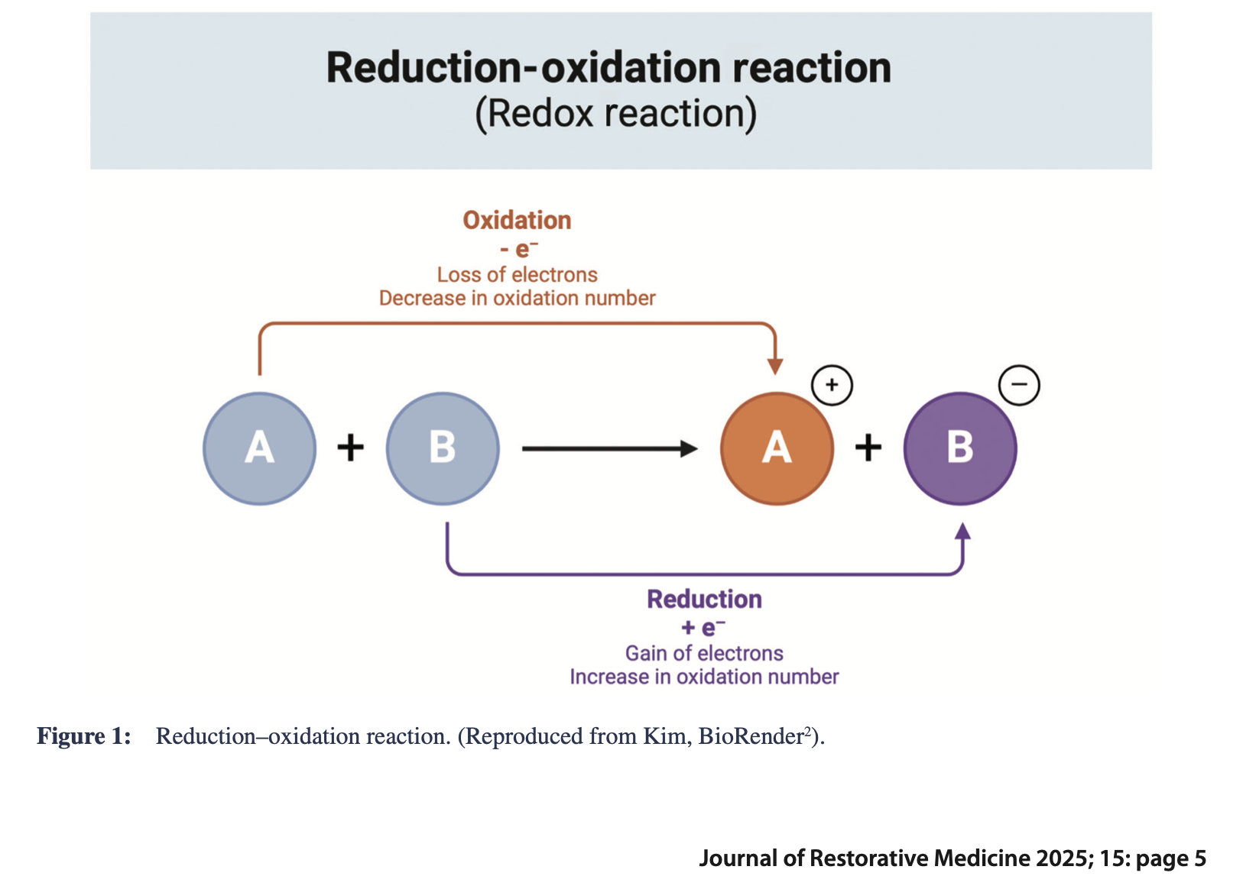

Slide 3
Key Roles in Human Health
Energy Production: Redox reactions, primarily in the mitochondria, are fundamental to cellular respiration and the synthesis of adenosine triphosphate (ATP), the body's main energy currency.
Cell Signaling and Regulation: Low, physiological levels of ROS act as crucial signaling molecules (second messengers) that modulate the function of various proteins, enzymes, and transcription factors (e.g., Nrf2 and NF-κB). This fine-tuning is vital for processes like cell proliferation, differentiation, and the immune response.
Oral Sci Homeost Med , 2025, 1, 9610003

Slide 4
Defense Against Damage: The body possesses a complex network of endogenous antioxidant systems (such as the glutathione and thioredoxin systems, and enzymes like superoxide dismutase and catalase that neutralize excess reactive species, preventing damage to essential macromolecules like DNA, proteins, and lipids.
Immune Function: The controlled production of ROS by immune cells like macrophages is vital for microbial defense. Redox homeostasis ensures that this necessary immune response doesn't cause excessive tissue damage.
Maintaining Genomic Stability: Redox signaling influences DNA repair mechanisms and epigenetic modifications, which are critical for preserving genomic integrity and preventing mutations that could lead to diseases like cancer.
Oral Sci Homeost Med , 2025, 1, 9610003

Slide 5
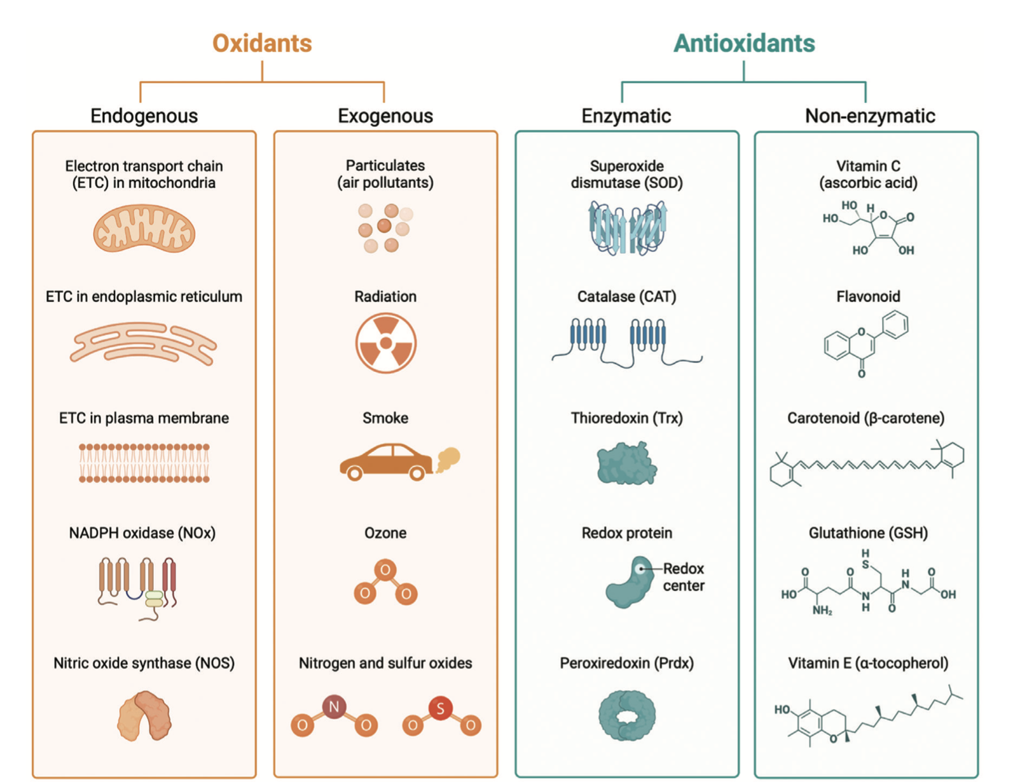
Journal of Restorative Medicine 2025; 15: page 4

Slide 6
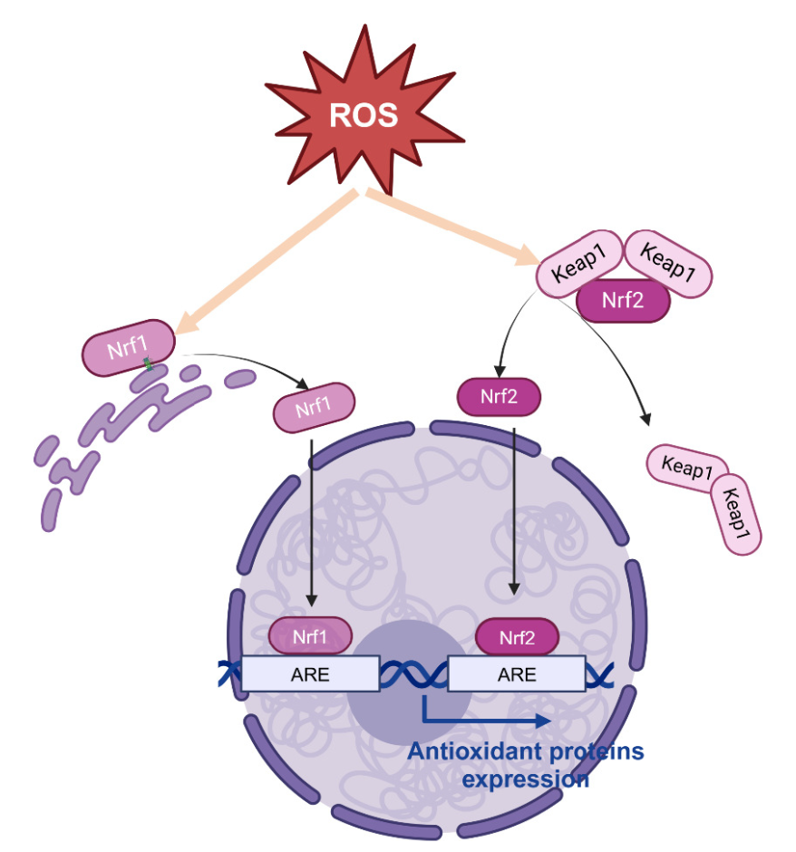

Slide 7
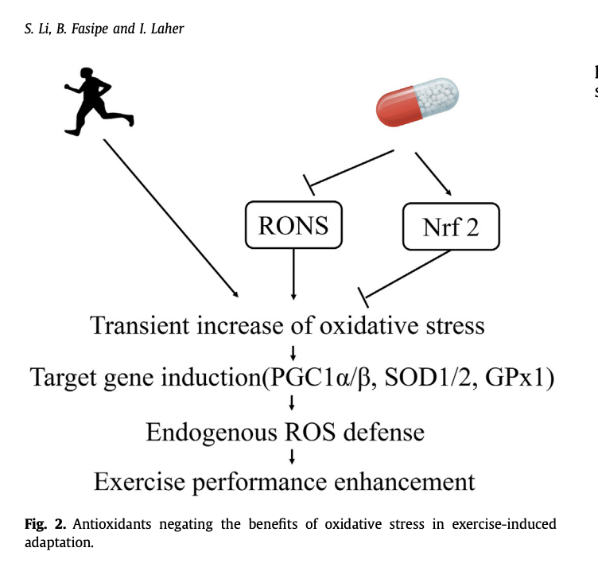

Slide 8
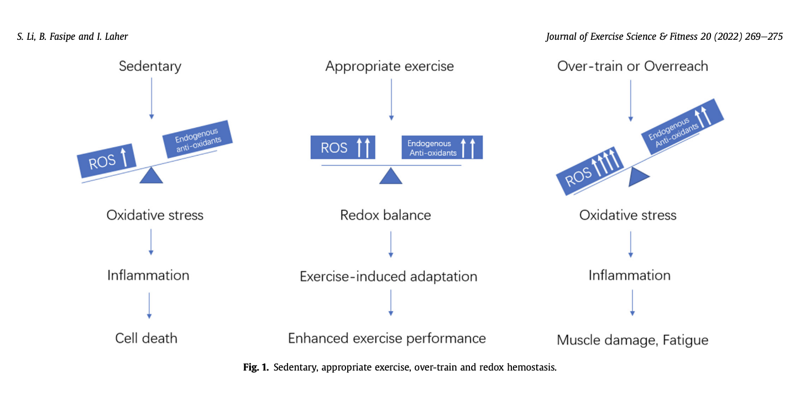

Slide 9
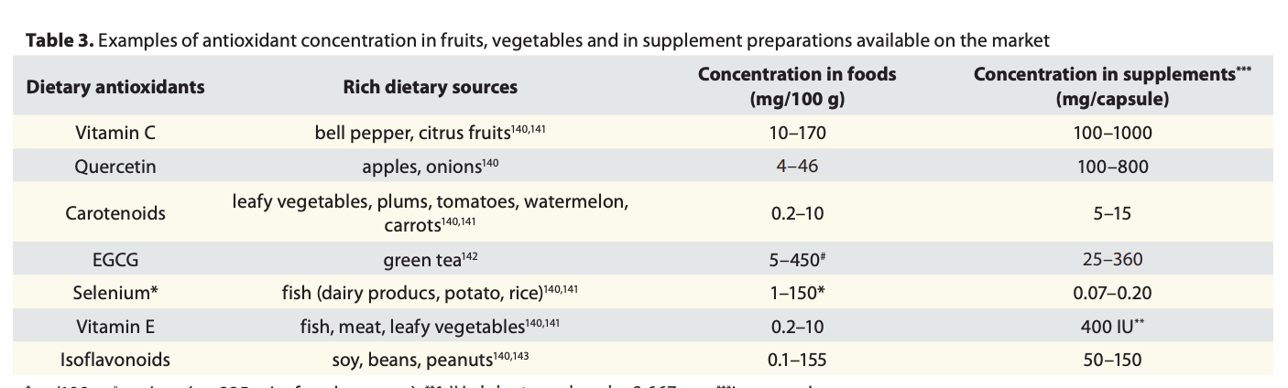
Oxidative Medicine and Cellular Longevity 3:4, 228-237; July/August 2010;

Slide 10
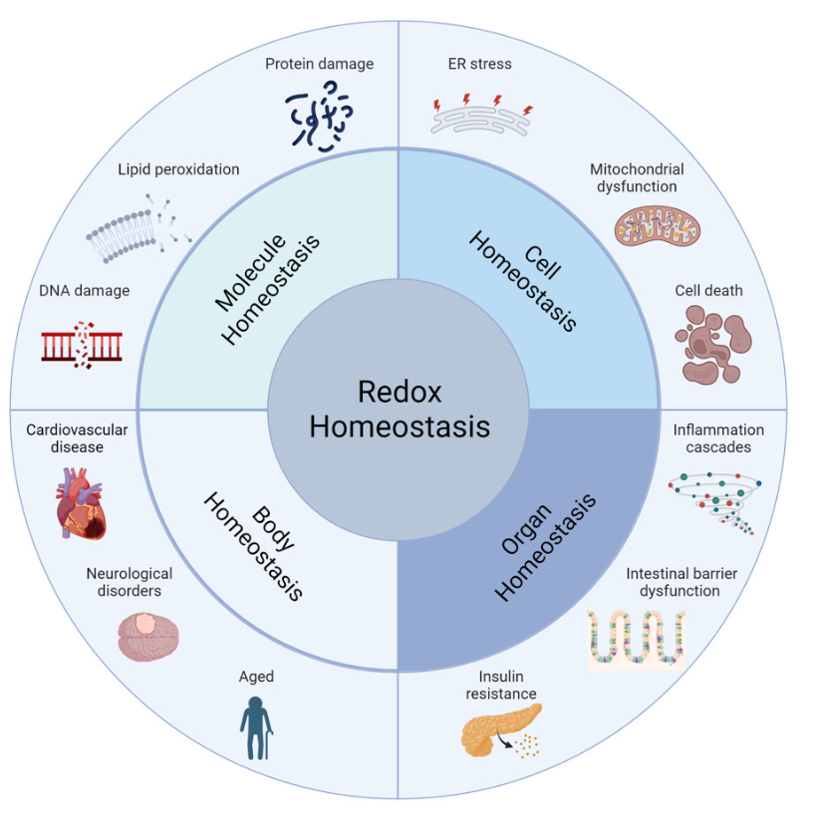
Oral Sci Homeost Med , 2025, 1, 9610003

Slide 11
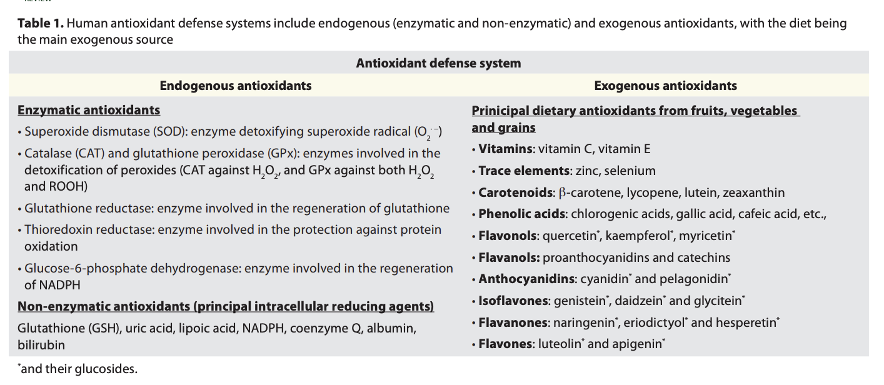
Oxidative Medicine and Cellular Longevity 3:4, 228-237; July/August 2010;

Slide 12
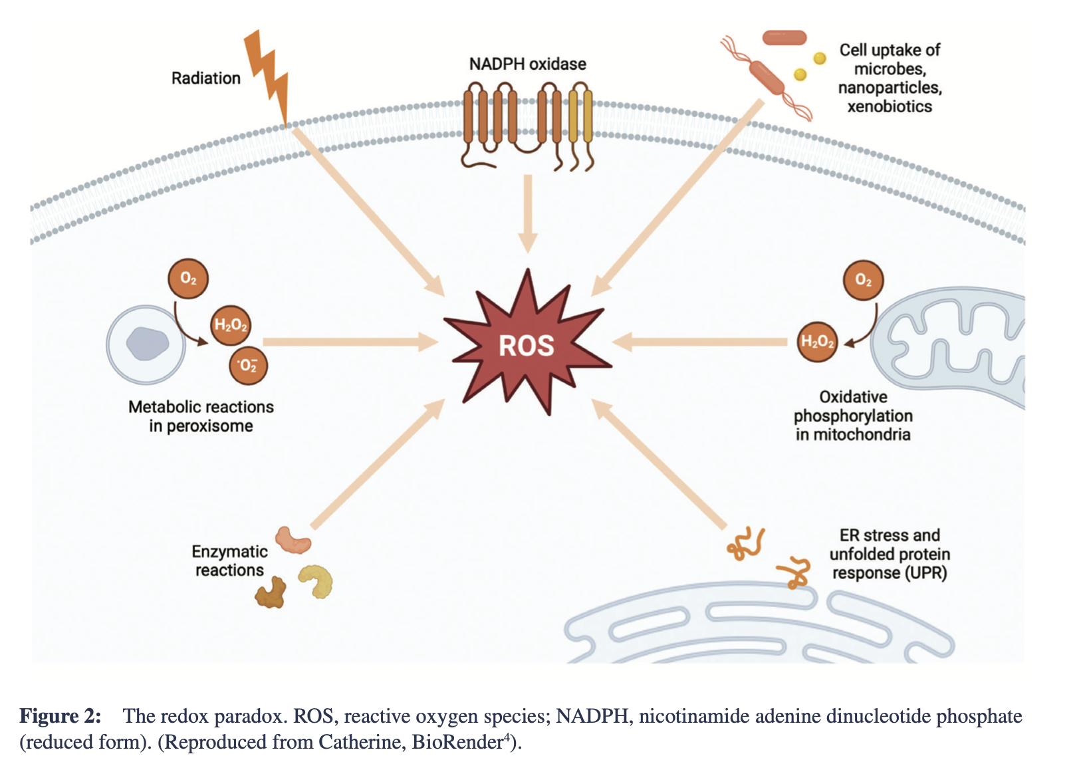

Slide 13
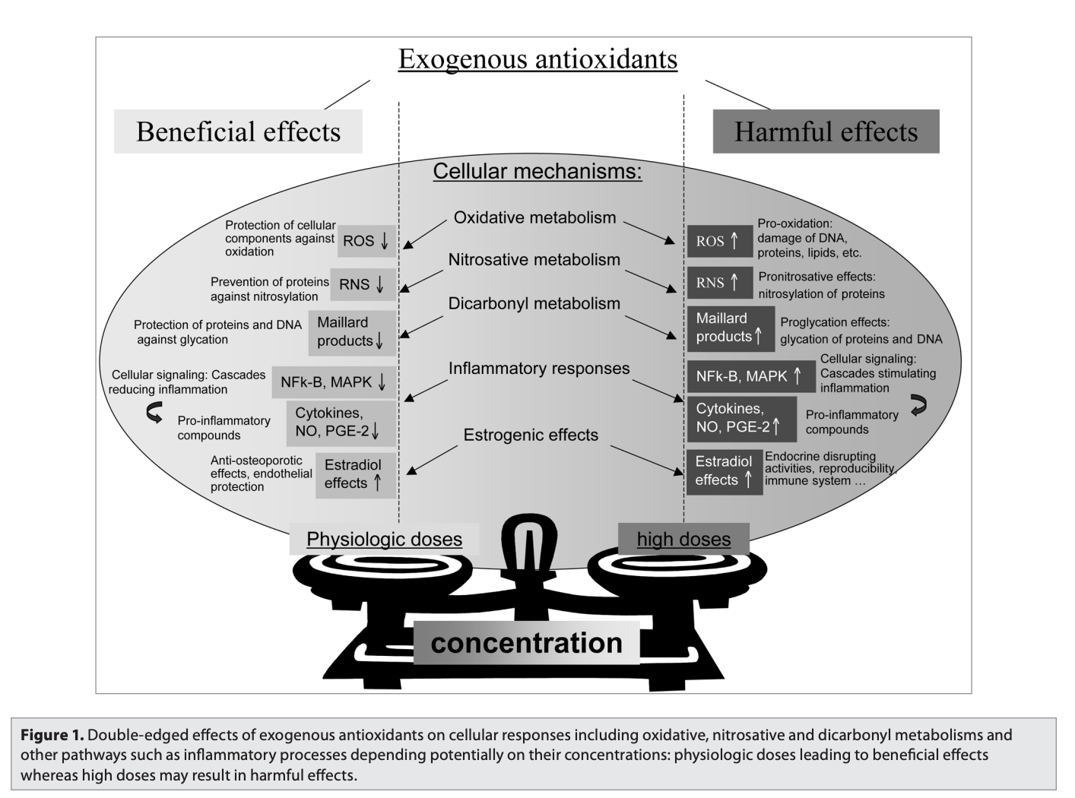
Oxidative Medicine and Cellular Longevity 3:4, 228-237; July/August 2010;

Slide 14
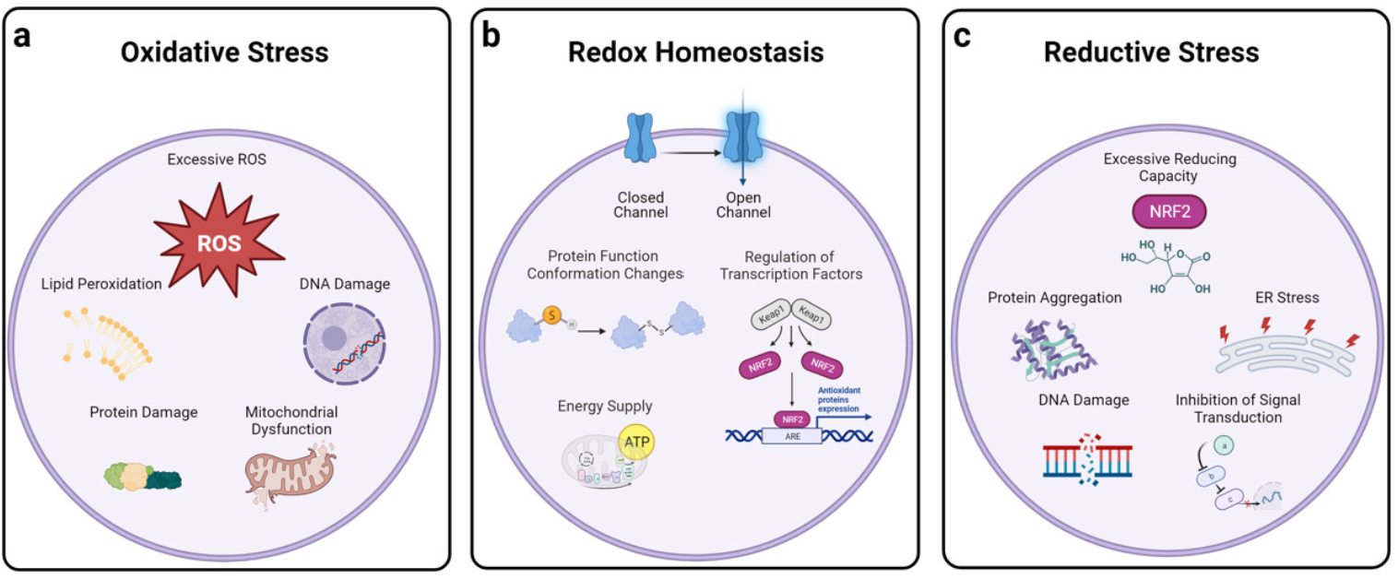
Oral Sci Homeost Med , 2025, 1, 9610003

Slide 15
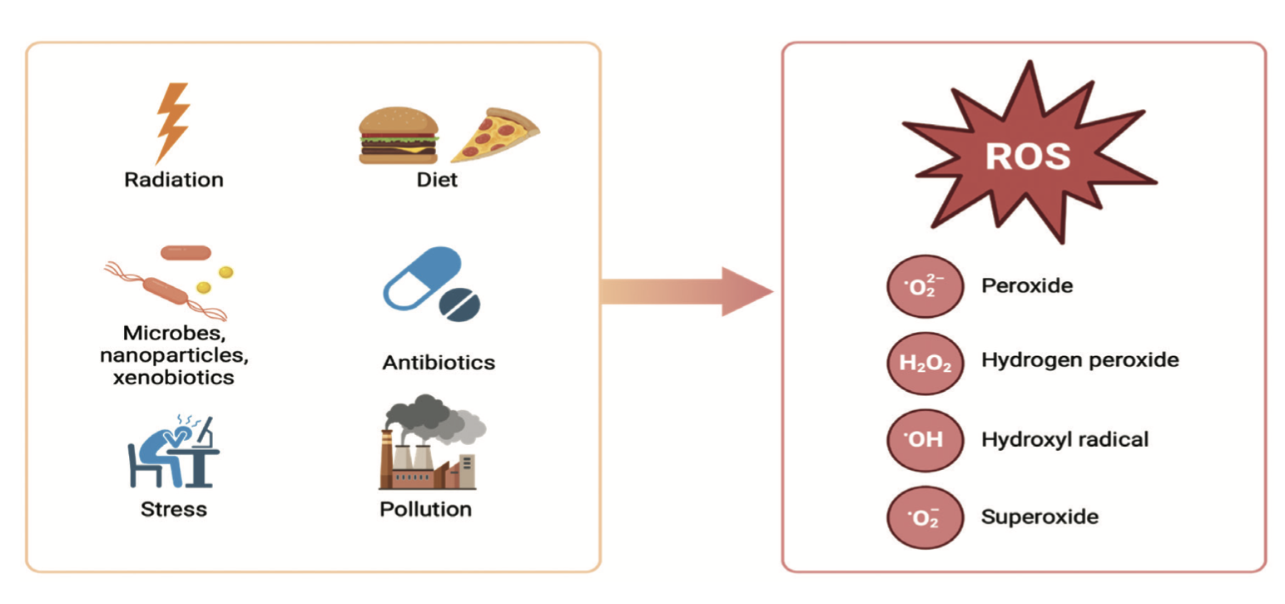
Journal of Restorative Medicine 2025; 15: page 4

