Slide 1
Why is uric acid important?
It is rising in America and globally
It is associated with insulin resistance, metabolic syndrome, degenerative neurologic disease, mental health disruption, poor health span and accelerated aging.
It is an important example of gene-environment mismatch as a driver of poor health.
The greatest drivers from the SAD are sugar, high-glycemic simple, processed carbs, fructose, alcohol, and insufficient alkalinity.
There are many easy and accessible interventions to lower production that also greatly improve metabolic health.

Slide 2
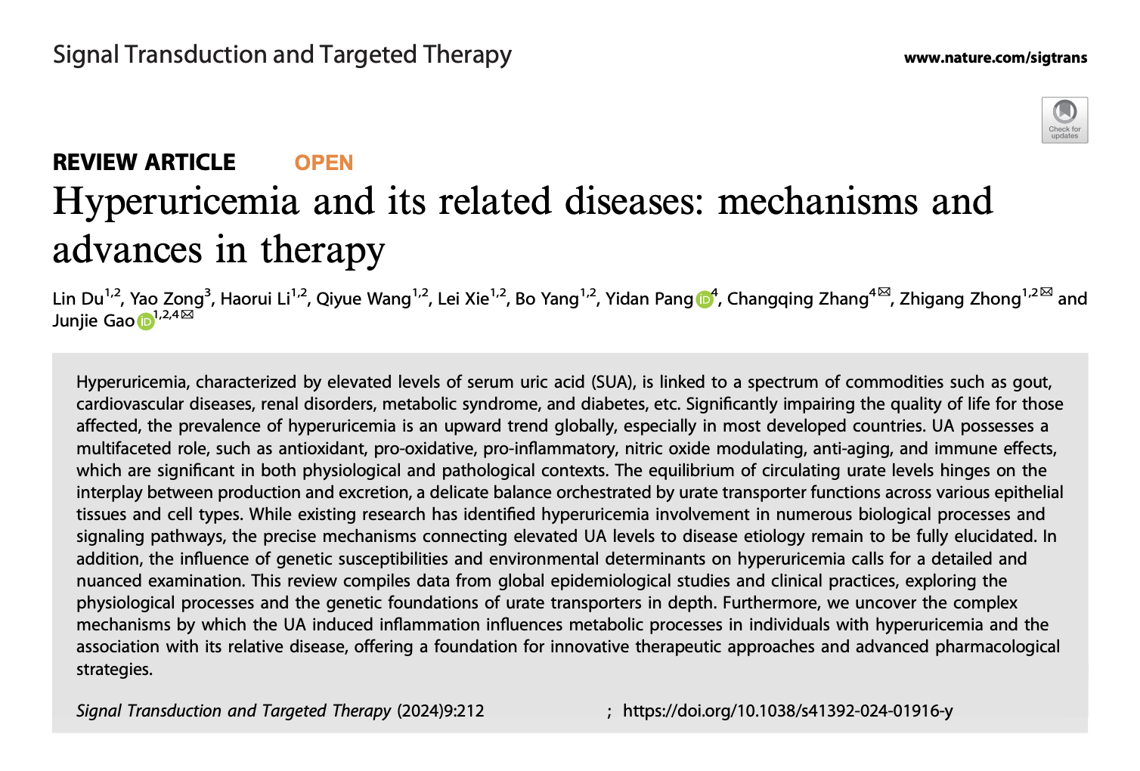

Slide 3


Slide 4
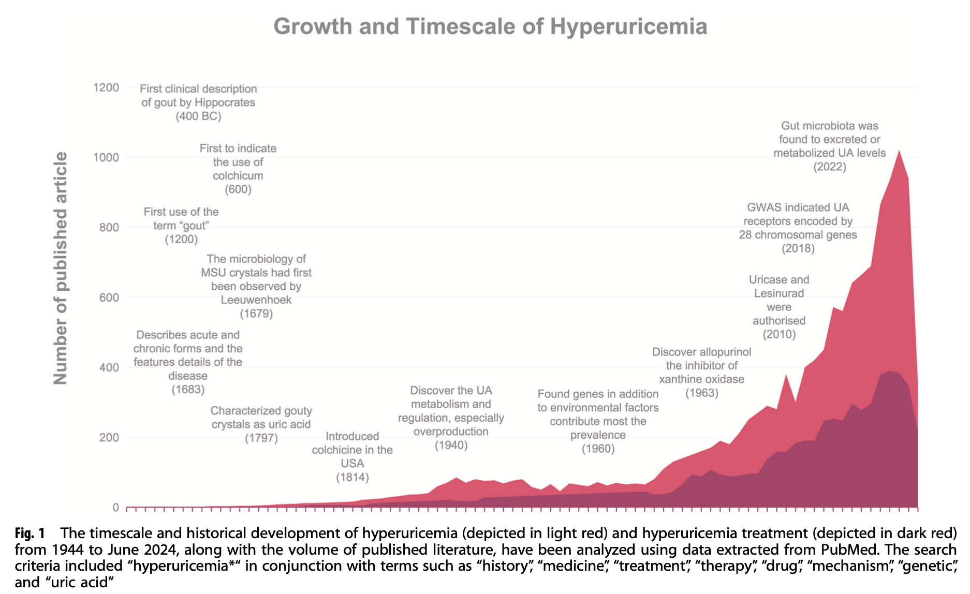

Slide 5
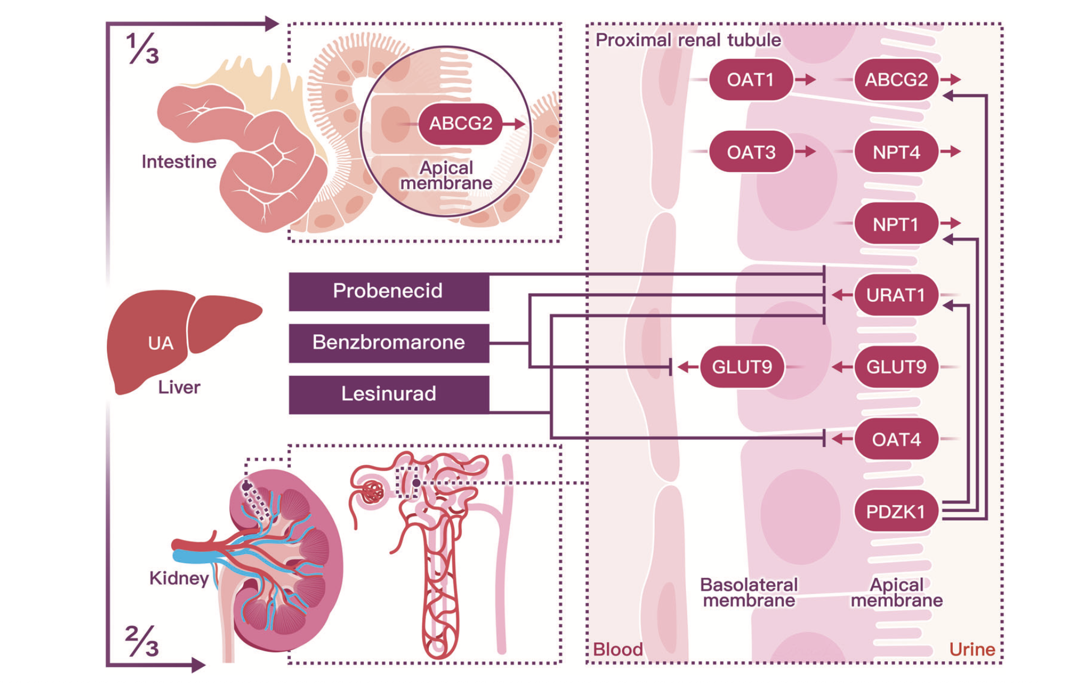

Slide 6
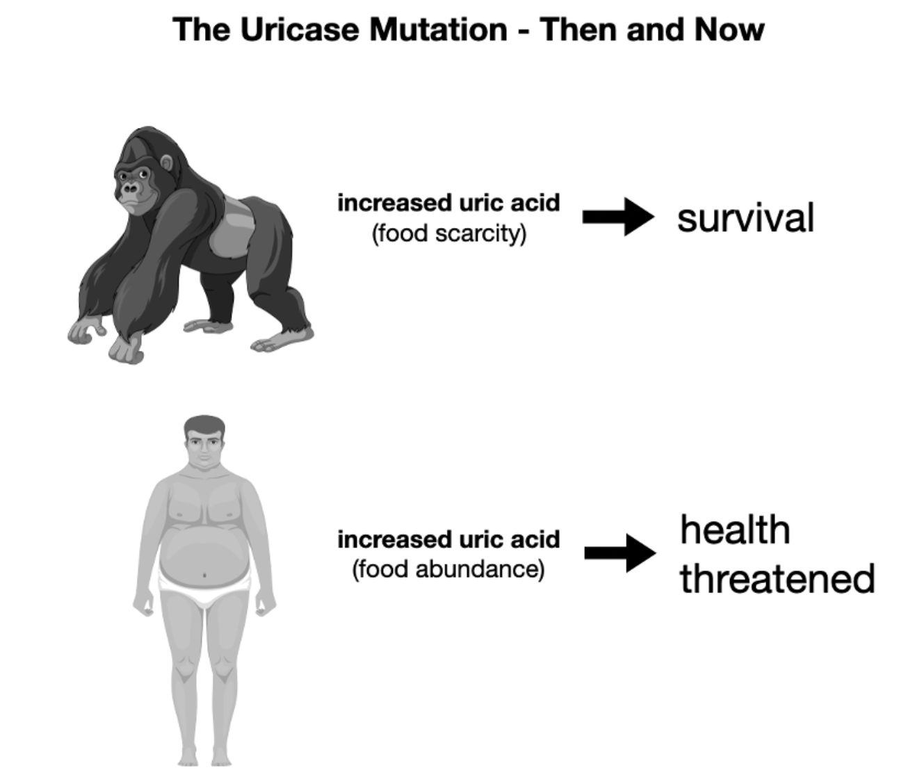
Human lineage: Apes and humans lost functional uricase due to gene mutations, leading to higher uric acid levels.

Slide 7
The evolutionary importance of uricase (or its loss) in humans centers on its role in purine metabolism, where losing functional uricase allowed higher uric acid levels, providing a survival edge for ancestral apes during food scarcity by enhancing fat storage from fructose, but now contributes to modern metabolic diseases like obesity and gout, acting as a classic "thrifty gene" adaptation. This beneficial ancestral trait, allowing energy conservation via fat synthesis, became detrimental with abundant sugar, highlighting uric acid's "double-edged sword" nature as both an antioxidant and a potential health risk.

Slide 8
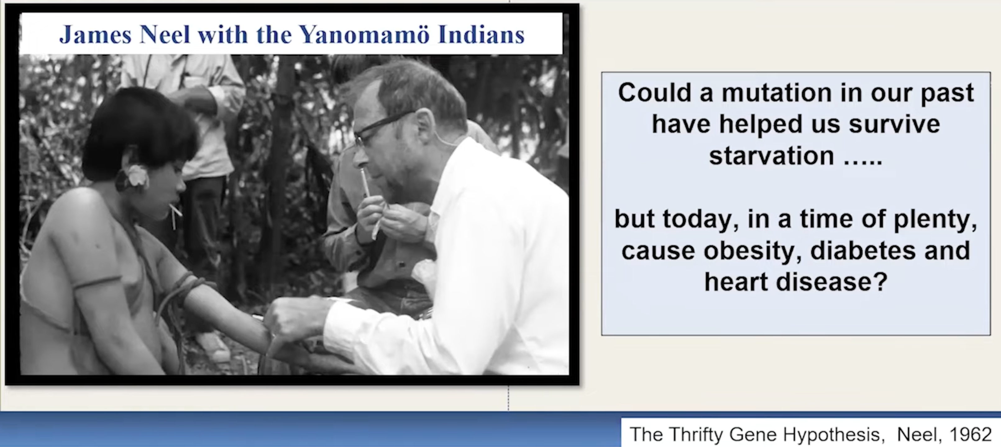

Slide 9
Evolutionary Advantage (The "Thrifty Gene")
Energy storage: Higher uric acid levels, resulting from uricase loss, helped ancestors efficiently store energy (fat) from fructose (fruit sugar) during periods of famine.
Environmental stress: This adaptation was crucial for survival when food, especially fruit, became scarce due to global cooling and changing environments.
Antioxidant properties: Uric acid also acts as an antioxidant, offering protection against oxidative stress, which could have been beneficial.

Slide 10
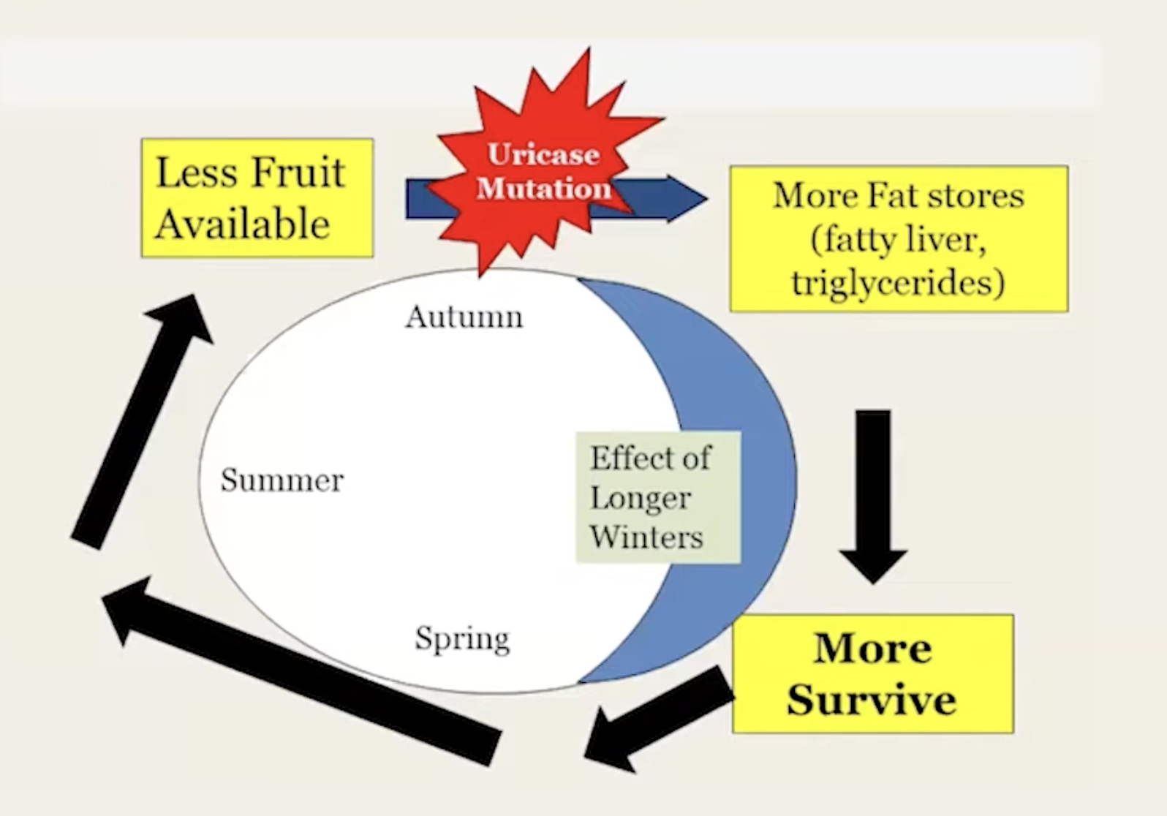
Dr. Richard Johnson

Slide 11
The Core Mechanism
Fructose and Energy Depletion
The primary trigger for the fat switch is fructose. Unlike glucose, which provides immediate cellular fuel, fructose metabolism causes a unique drop in cellular energy
ATP Depletion
Fructose breakdown rapidly consumes adenosine triphosphate (ATP), the cell's energy currency, without immediately replacing it.
Mitochondrial "Stunning: This process generates uric acid and oxidative stress within the mitochondria. This temporarily stuns the mitochondria, reducing their ability to produce more ATP and burn fat.
The Hunger Signal: When cellular energy (ATP) levels drop, the body perceives it as a starvation state. This triggers biological signals to: Increase appetite and foraging behavior. Slow down metabolism to conserve energy.
Store excess calories as fat rather than burning them.

Slide 12
How Fructose Disrupts Mitochondria
Oxidative Stress: Fructose metabolism generates reactive oxygen species (ROS), leading to oxidative stress that damages mitochondrial components, including DNA.
Energy Production Failure: It inhibits enzymes crucial for the citric acid cycle and fatty acid breakdown, reducing ATP (energy) production and impairing respiratory complex activity.
Fatty Liver (NAFLD): The liver becomes less efficient at burning fat, converting it to triglycerides, which are then stored, contributing to non-alcoholic fatty liver disease.
Inflammation & Apoptosis: Mitochondrial damage triggers inflammatory responses and can lead to programmed cell death (apoptosis) in cells like liver and muscle cells.
• Brain Effects: Even short-term fructose intake can impair hippocampal plasticity and mitochondrial function in the brain, potentially affecting learning and memory.

Slide 13
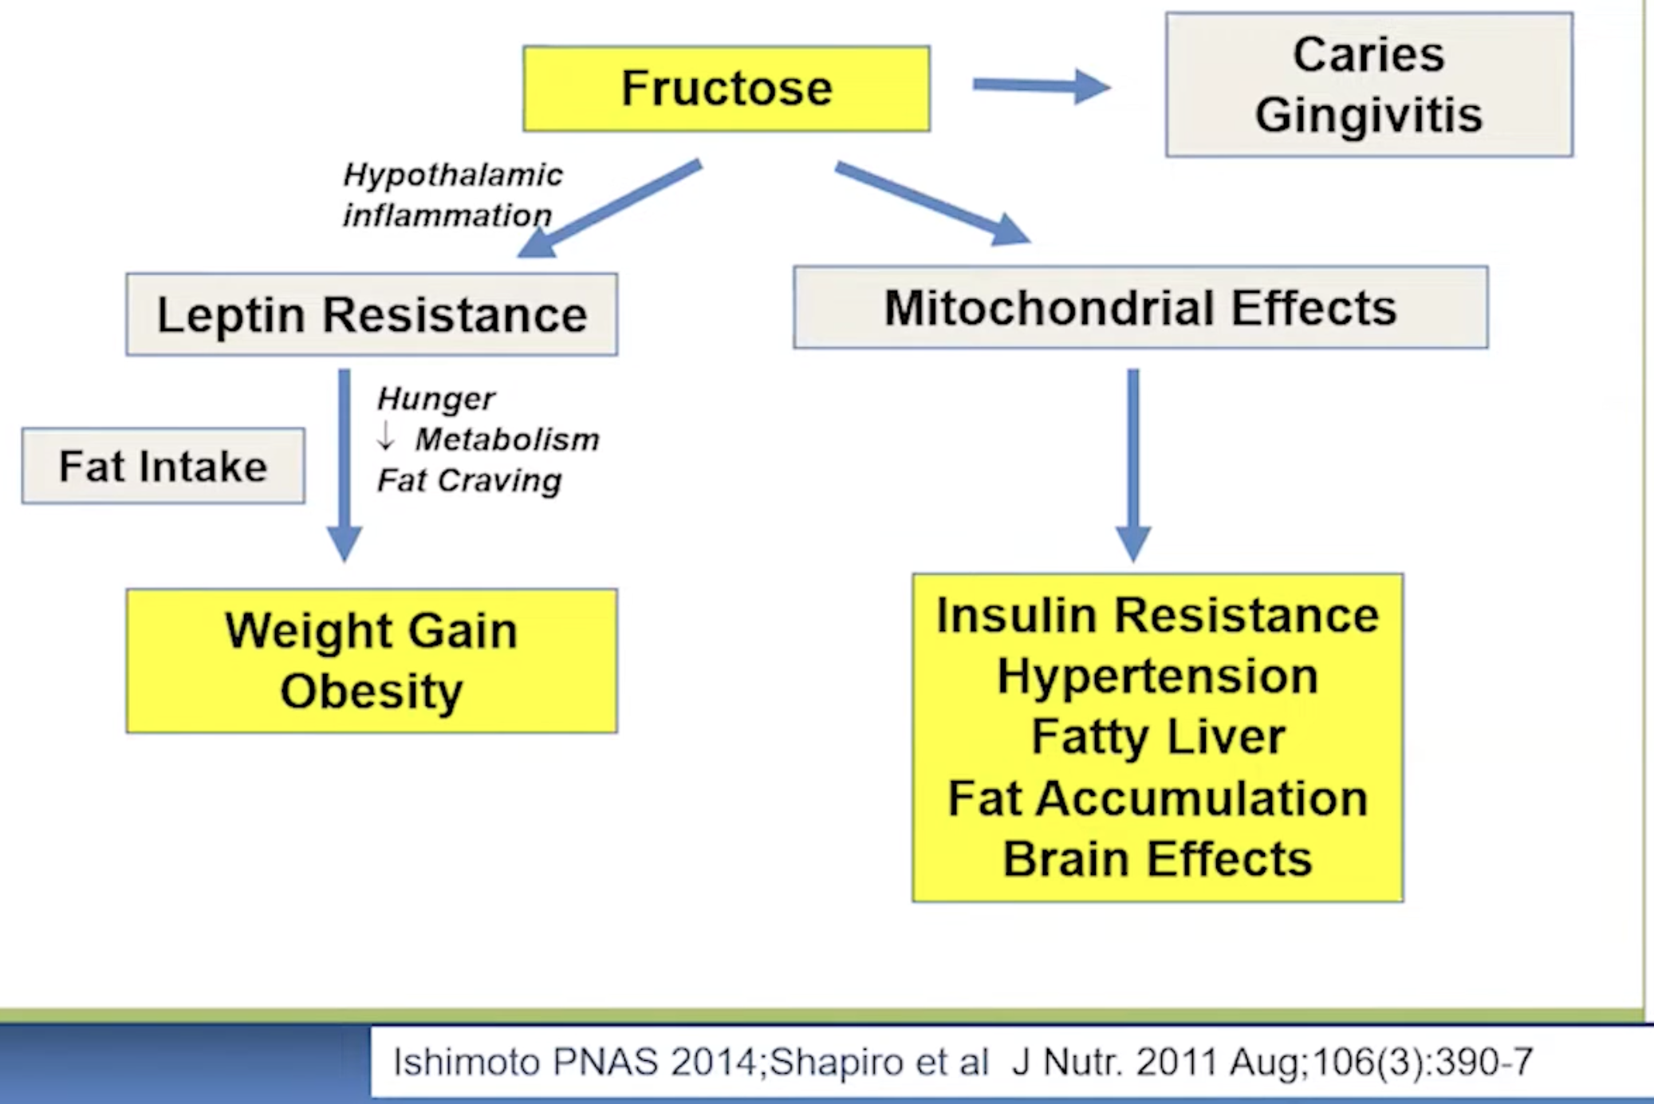
Dr. Richard Johnson

Slide 14
Other Triggers of the Switch
While dietary fructose is the main culprit, other factors can activate this same metabolic pathway:
Endogenous Fructose: High intake of glucose or high-glycemic carbohydrates can cause the body to produce its own fructose.
.
Salt and Dehydration: High salt intake increases blood concentration, which can trigger the conversion of glucose into fructose and activate the switch.
Umami and Alcohol: Foods rich in purines (savory meats, shellfish) and beverages like beer increase uric acid, which contributes to the activation of the pathway.
Dr. Richard Johnson

Slide 15
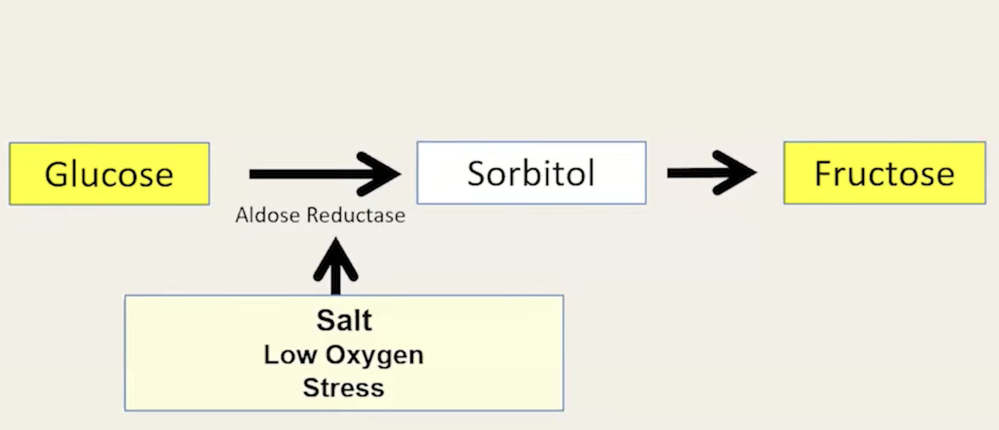
Endogenous Fructose
Dr. Richard Johnson

Slide 16
Modern Consequences
Metabolic disease: In today's environment of abundant sugar and fructose, the same mechanism promoting fat storage contributes to epidemics of obesity, insulin resistance, and type 2 diabetes.
Gout: Humans' inability to efficiently clear uric acid makes them prone to hyperuricemia, leading to gout, a painful condition from uric acid crystal deposits.

Slide 17
Strategies to "Turn Off" the Switch
Reduce Fructose: Limit added sugars (sucrose and high-fructose corn syrup) and liquid sugars like fruit juices.
Stay Hydrated: Drinking water, especially before meals, can prevent salt-induced activation of the switch.
Support Mitochondria: Regular aerobic exercise helps grow and repair mitochondria, improving the body's ability to produce energy and burn fat.
Low-Carb or Ketogenic Diet: These diets can help regulate weight by preventing the spike in glucose that leads to endogenous fructose production.
Increase Alkaline, mineral-rich foods e.g. greens, sweet potatoes, yogurt

Slide 18
