Slide 1
Atrial Fibrillation
Atrial fibrillation (AFib) affects over 10 million U.S. adults (about 1 in 22), a number three times higher than previously thought, with prevalence rising significantly with age (up to 10% over 80) and increasing due to an aging population and risk factors like hypertension.
It's the most common arrhythmia, raising stroke risk and costing billions, with projections showing millions more cases by 2050, affecting more men but with a lifelong risk for 1 in 3 White Americans and 1 in 5 Black Americans.
CDC 2025

Slide 2
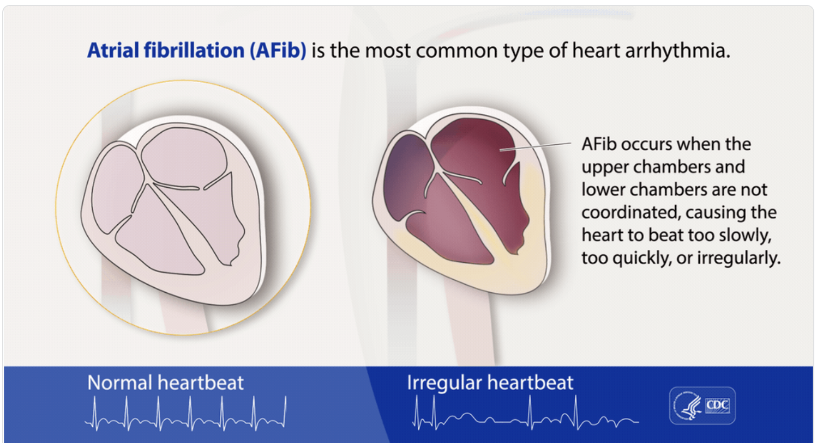

Slide 3
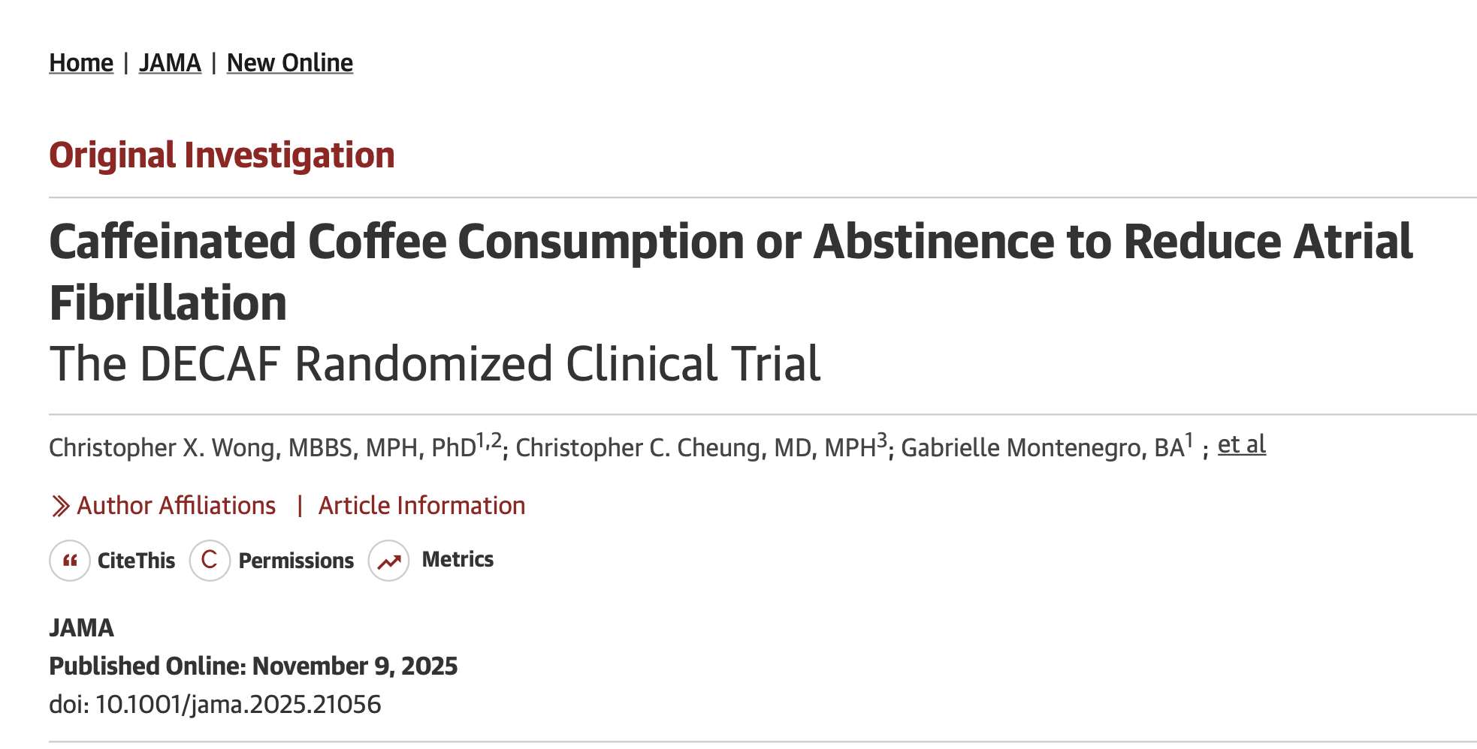

Slide 4
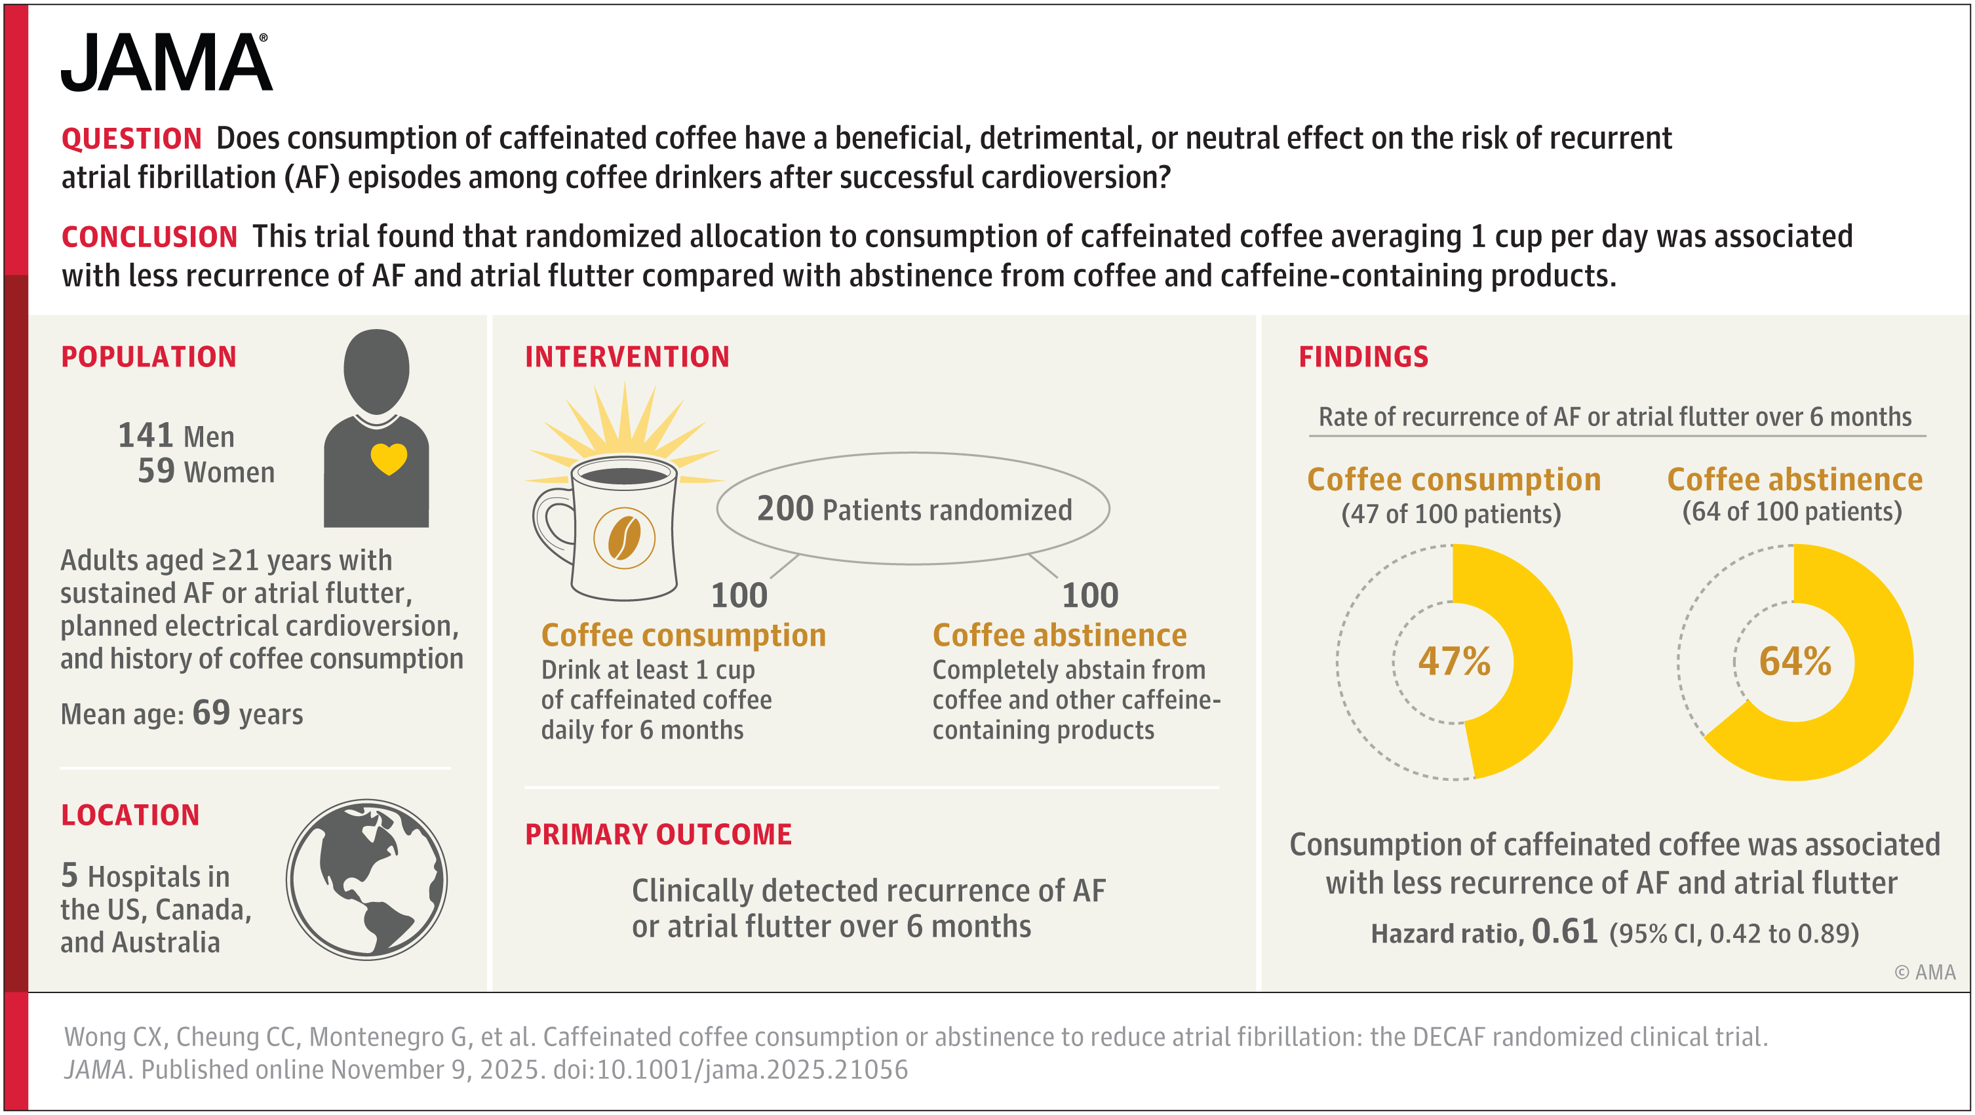

Slide 5
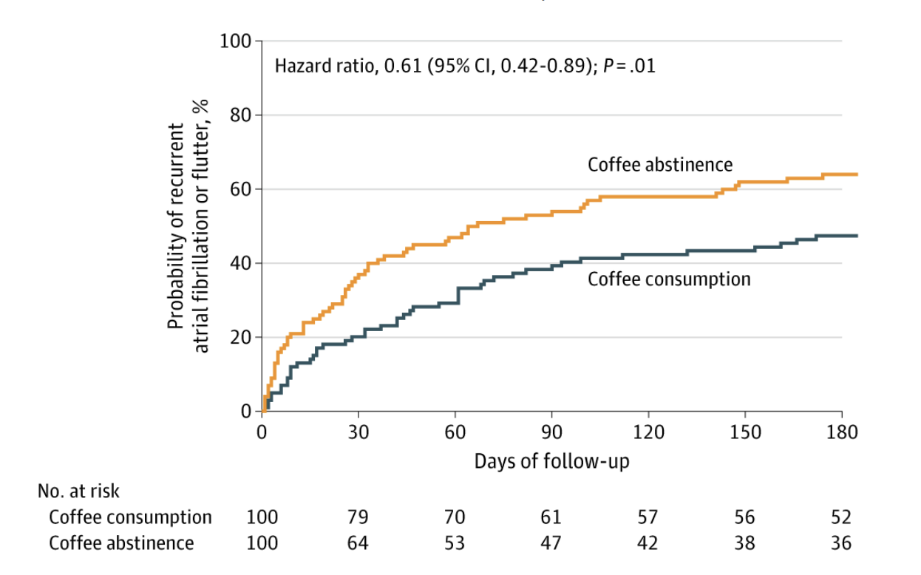

Slide 6
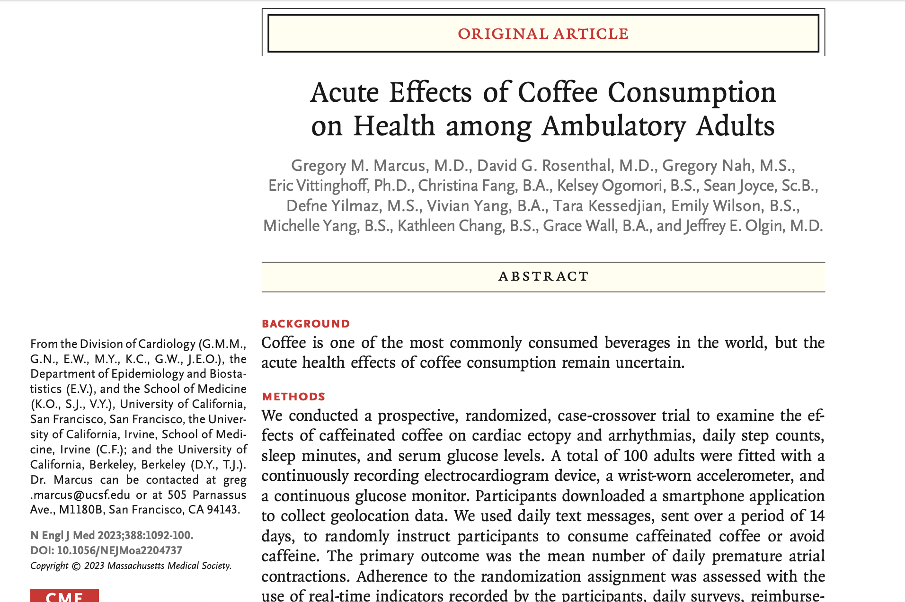

Slide 7
