Slide 1
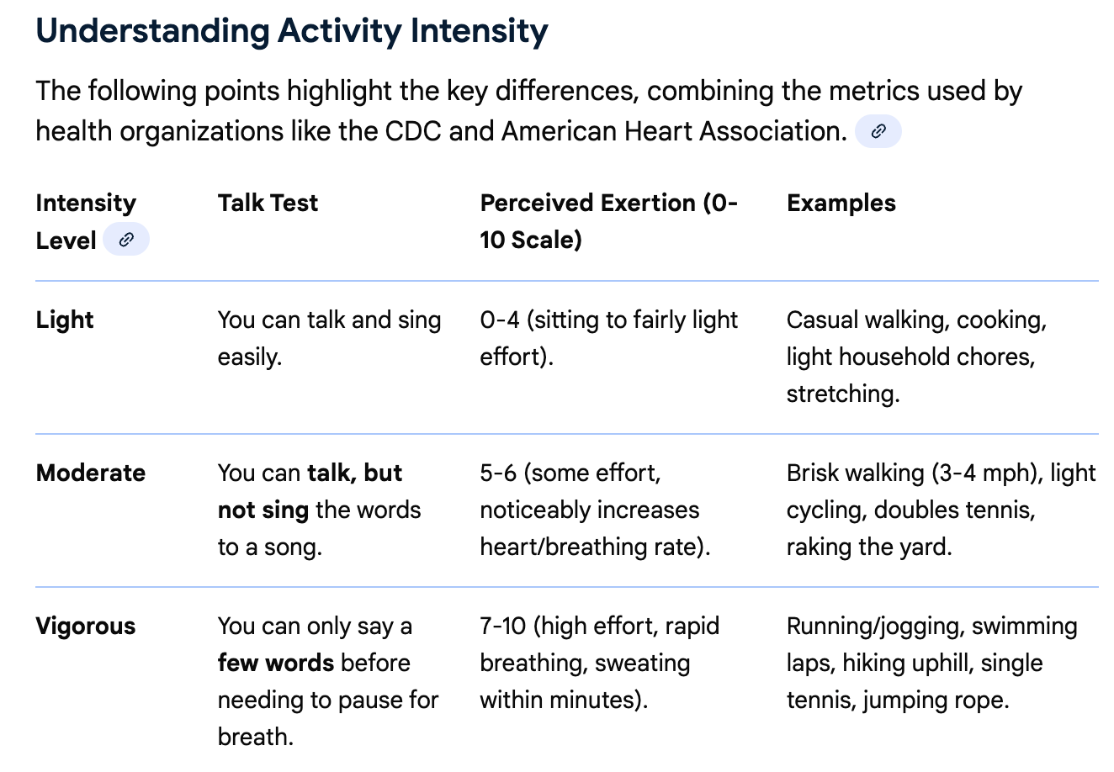

Slide 2
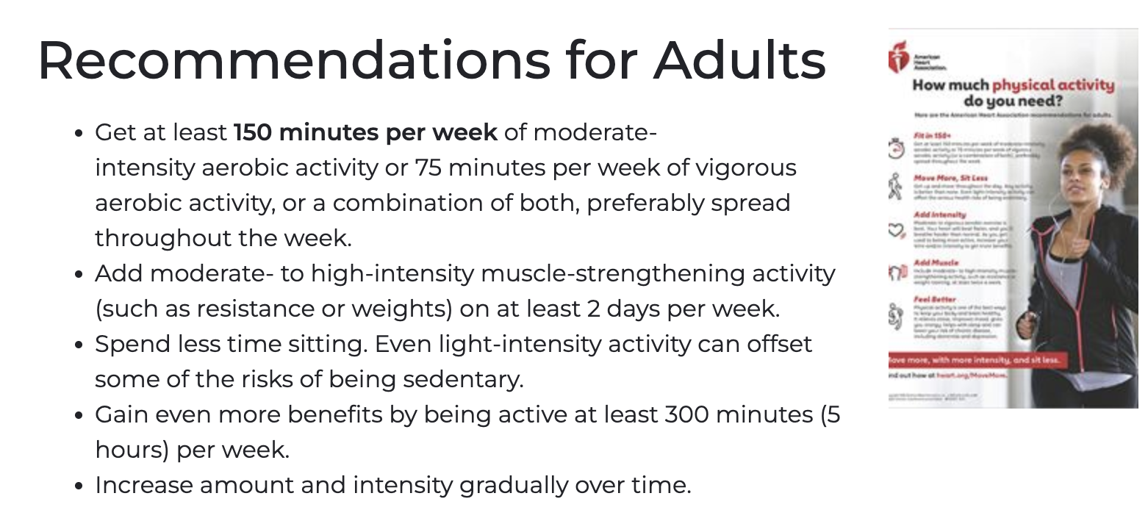

Slide 3
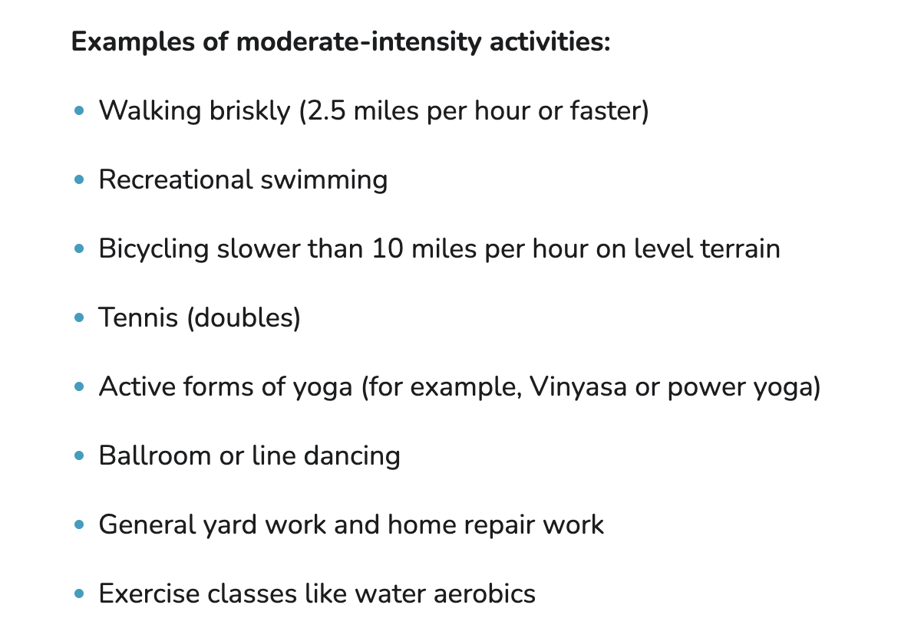

Slide 4
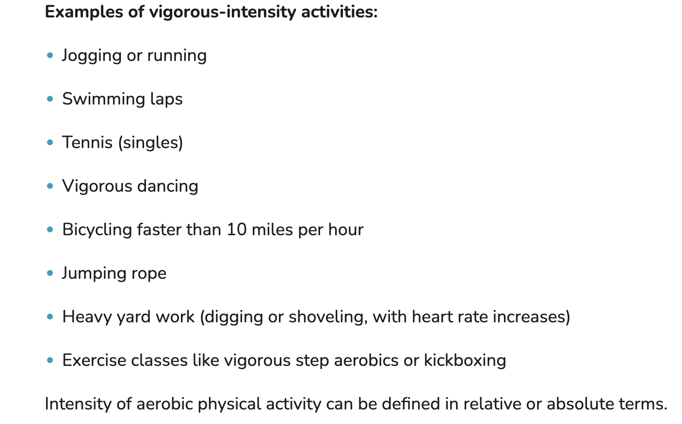

Slide 5
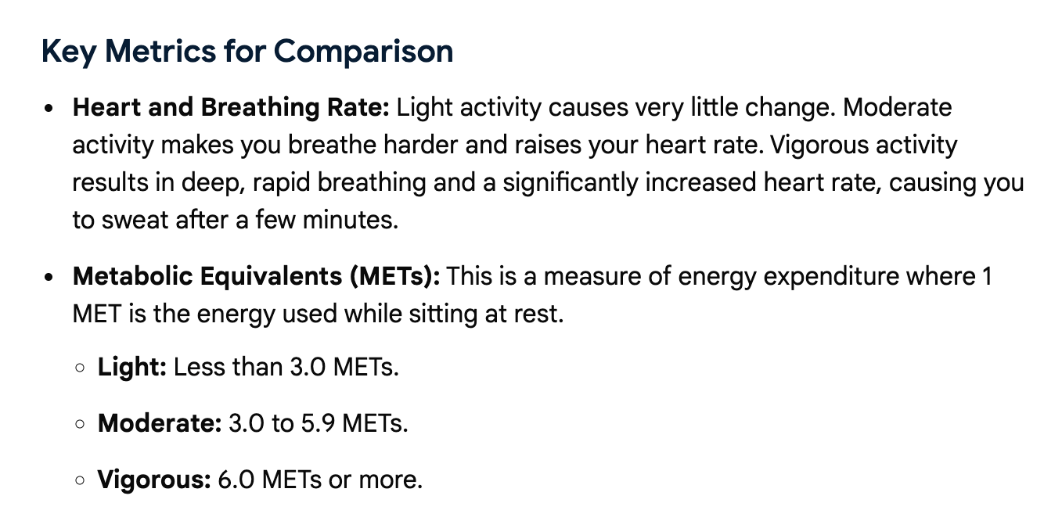

Slide 6
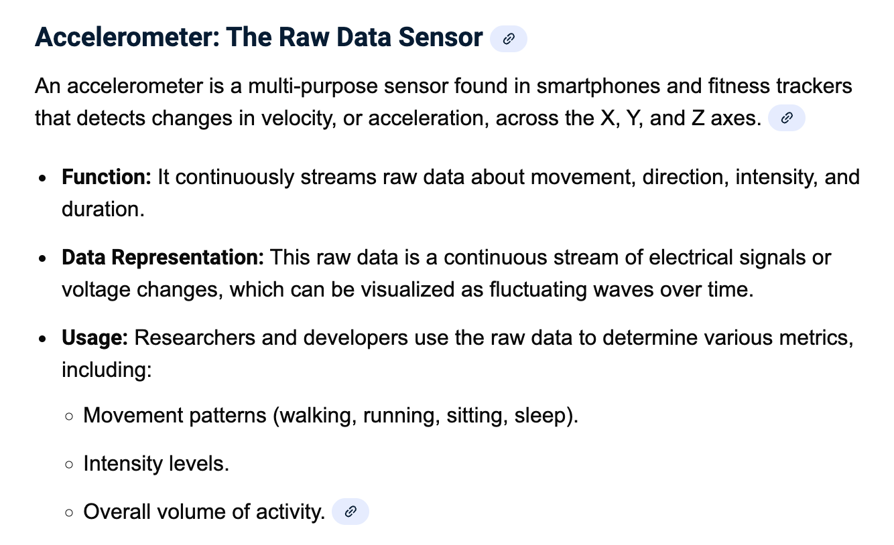

Slide 7
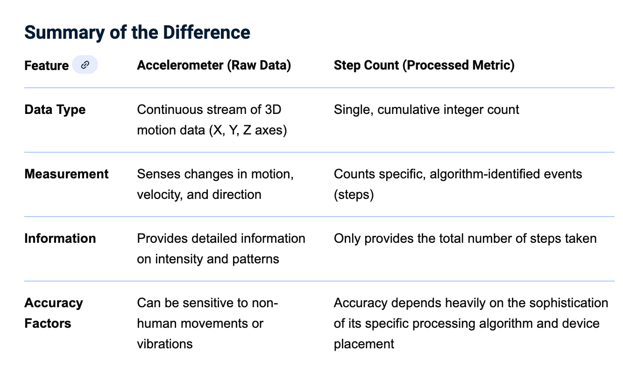

Slide 8
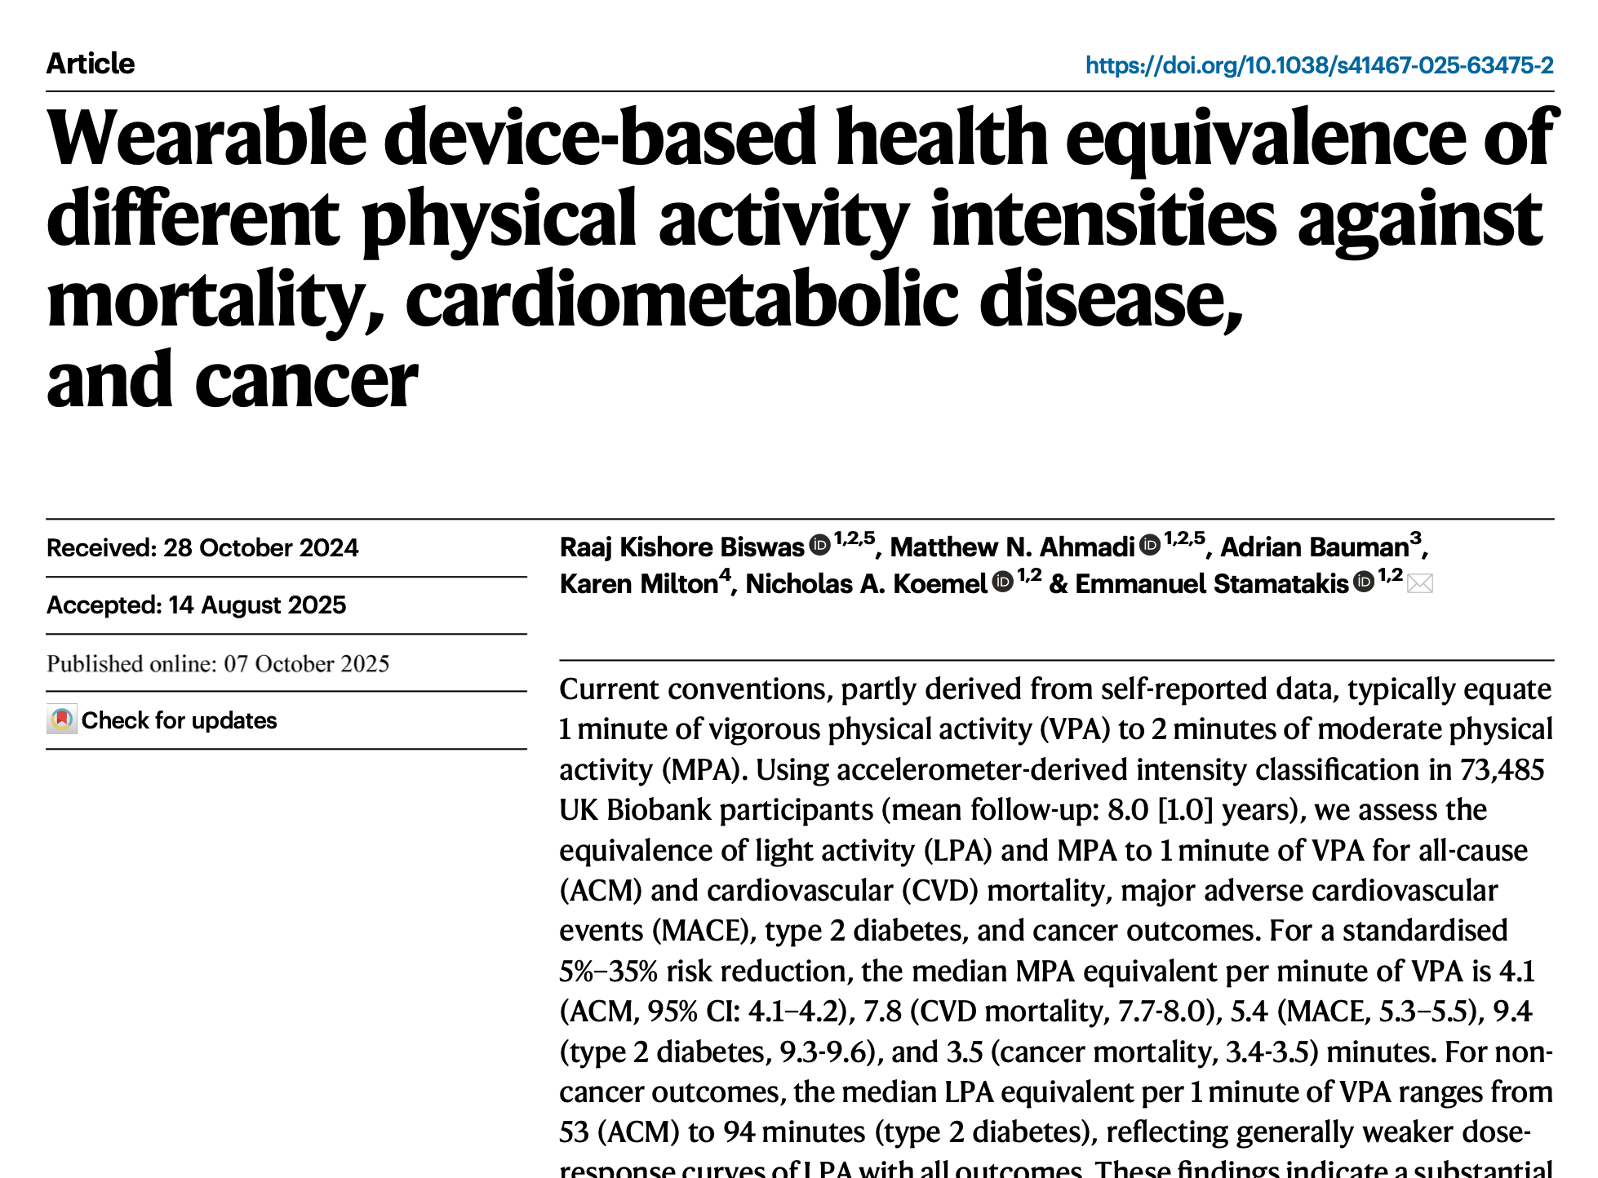

Slide 9
Based on historical self-reported data, 1 minute of vigorous activity equates to 2 minutes of moderate activity
Accelerometer-derived intensity in 73,458 UK Biobank participants
Mean f/u 8 years
Assessed the equivalence of light activity (LPA) and moderate activity (MPA) to 1 minute of VPA for all-cause mortality, CVD mortality, MACE, type 2 DM and cancer outcomes.
Standardized ACM 5-35% risk reduction
1 minute VPA = 4 minutes MPA all-cause mortality risk reduction
1 minute VPA = 7.8 minutes MPA for CVD mortality risk reduction
1 minute VPA = 9.4 minutes MPA for DM risk reduction
1 minute VPA = 3.5 minutes MPA for Cancer risk reduction
1 minute VPA = 53 minutes LPA (ACM)

Slide 10
