Slide 1
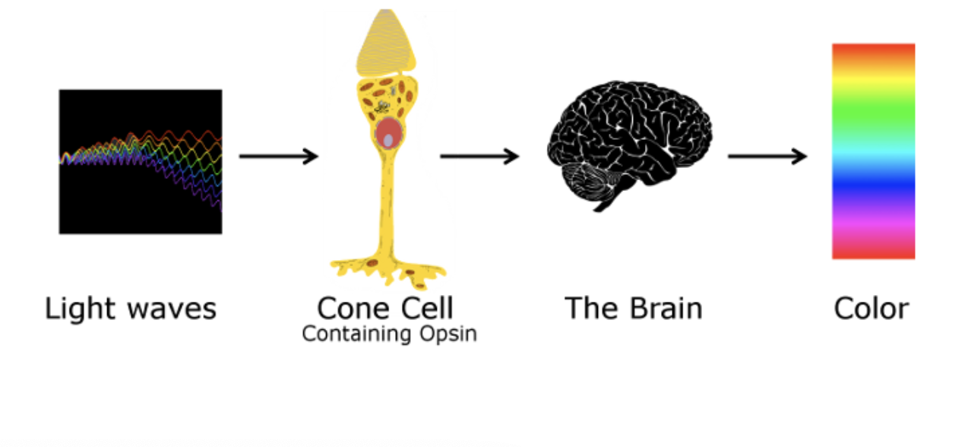
Opsins
© 2025 EvoEd.

Slide 2
Opsins
Opsins are a family of proteins that detect light, playing a crucial role in vision by converting light into biochemical signals within photoreceptor cells. Beyond vision, opsins have diverse functions, such as regulating circadian rhythms, controlling pupil size, and even sensing temperature, and are found in both eyes and other parts of the body. When light hits an opsin, the protein changes shape, which triggers a cascade of reactions leading to a physiological response.

Slide 3
Function in vision
Initiating sight: In the retina, opsins are the protein components of photopigments that absorb photons.
Color perception: Different types of opsins are sensitive to different wavelengths of light, allowing for color vision. For instance, mammals typically have two types of cone opsins, while humans and some other primates have three for full trichromatic color vision.
Night vision: Rod cells use a specific type of opsin called rhodopsin for vision in low-light conditions.

Slide 4
Functions beyond vision
Circadian rhythm: Melanopsin, a type of opsin in the eye, is involved in regulating the body's internal clock and the pupillary light reflex.
Body temperature: Some opsins, like neuropsin, are located deep in the brain and help control body temperature by sensing light.
• • Other roles: Opsins also have other functions, including acting as enzymes that help regulate melanin production, transporting lipids, and guiding other proteins to their correct locations within a cell.

Slide 5
How they work
Light absorption: An opsin protein in its resting state absorbs a photon of light.
Conformational change: This absorption causes the opsin to change its shape.
Signal cascade: The shape change activates a signaling pathway (often involving a G protein) that results in a change in the cell's electrical charge.
Physiological response: This electrical change is transmitted as a signal to the brain, leading to a specific response like seeing an image, adjusting the pupil, or regulating a bodily function.

Slide 6
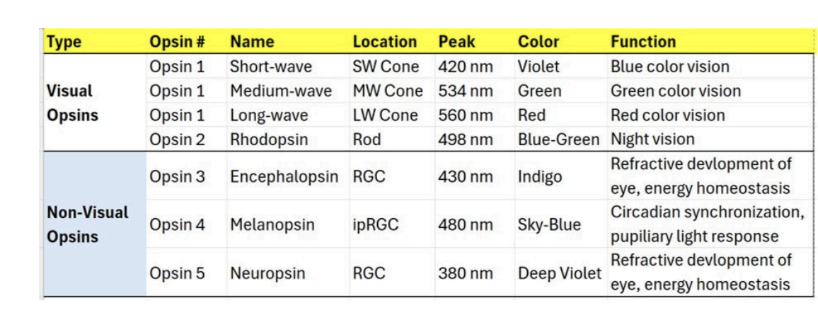

Slide 7
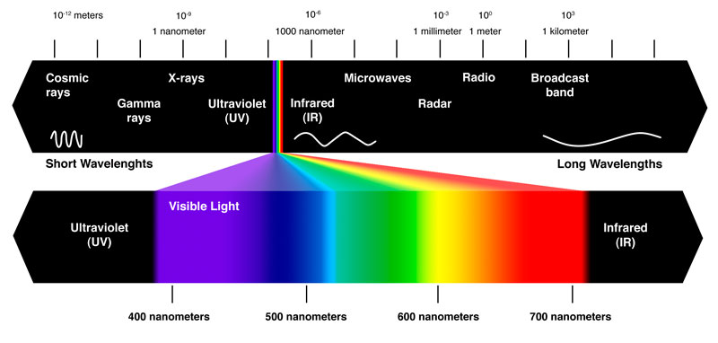
Mitochondrial
UVA and NO
Photosynthesis
Wound healing
Bilirubin
Collagen
UVB and Vit D
Nitric Oxide
Chronoactivity
Sulfation
Antimicrobial
EZ Water

Slide 8
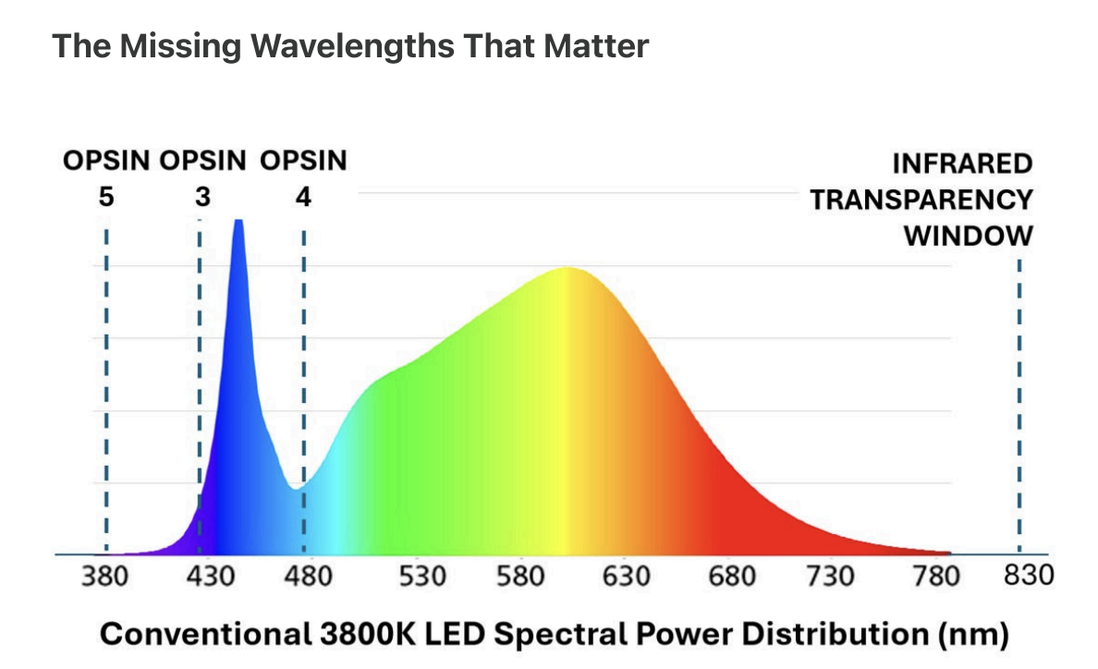

Slide 9
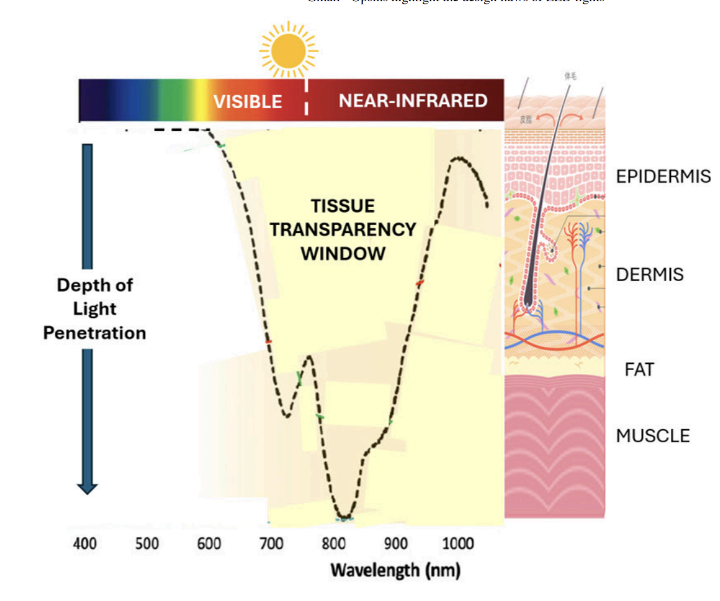

Slide 10
