Slide 1
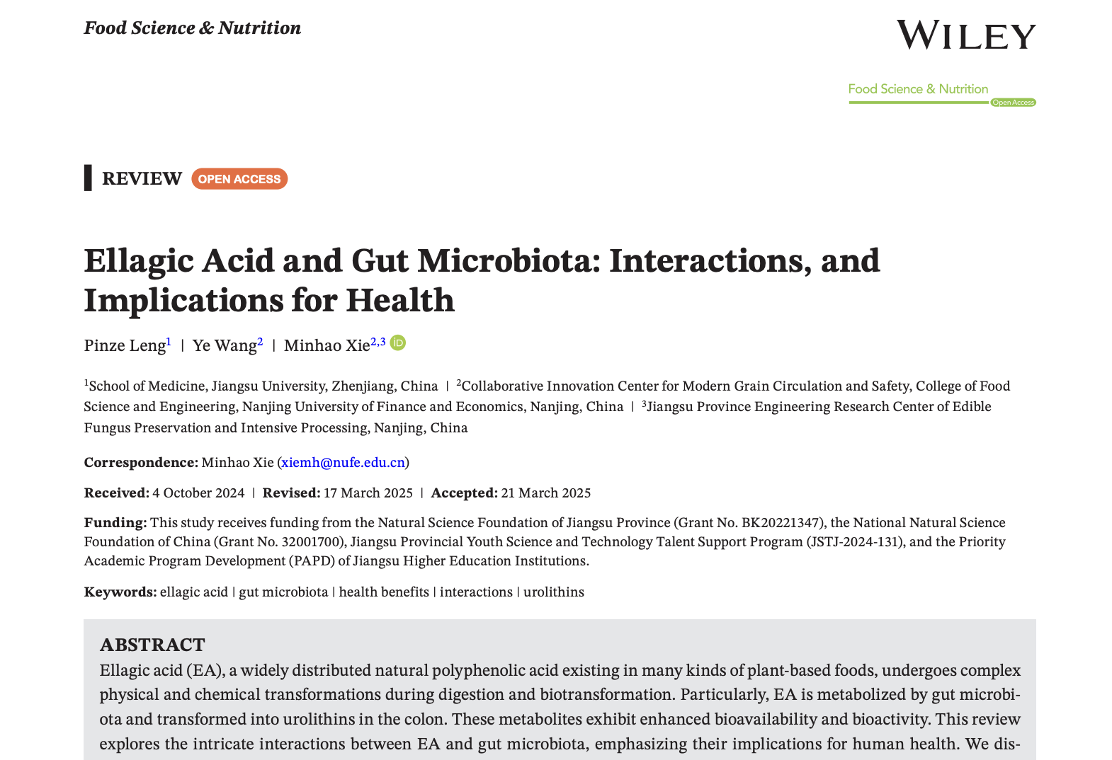

Slide 2
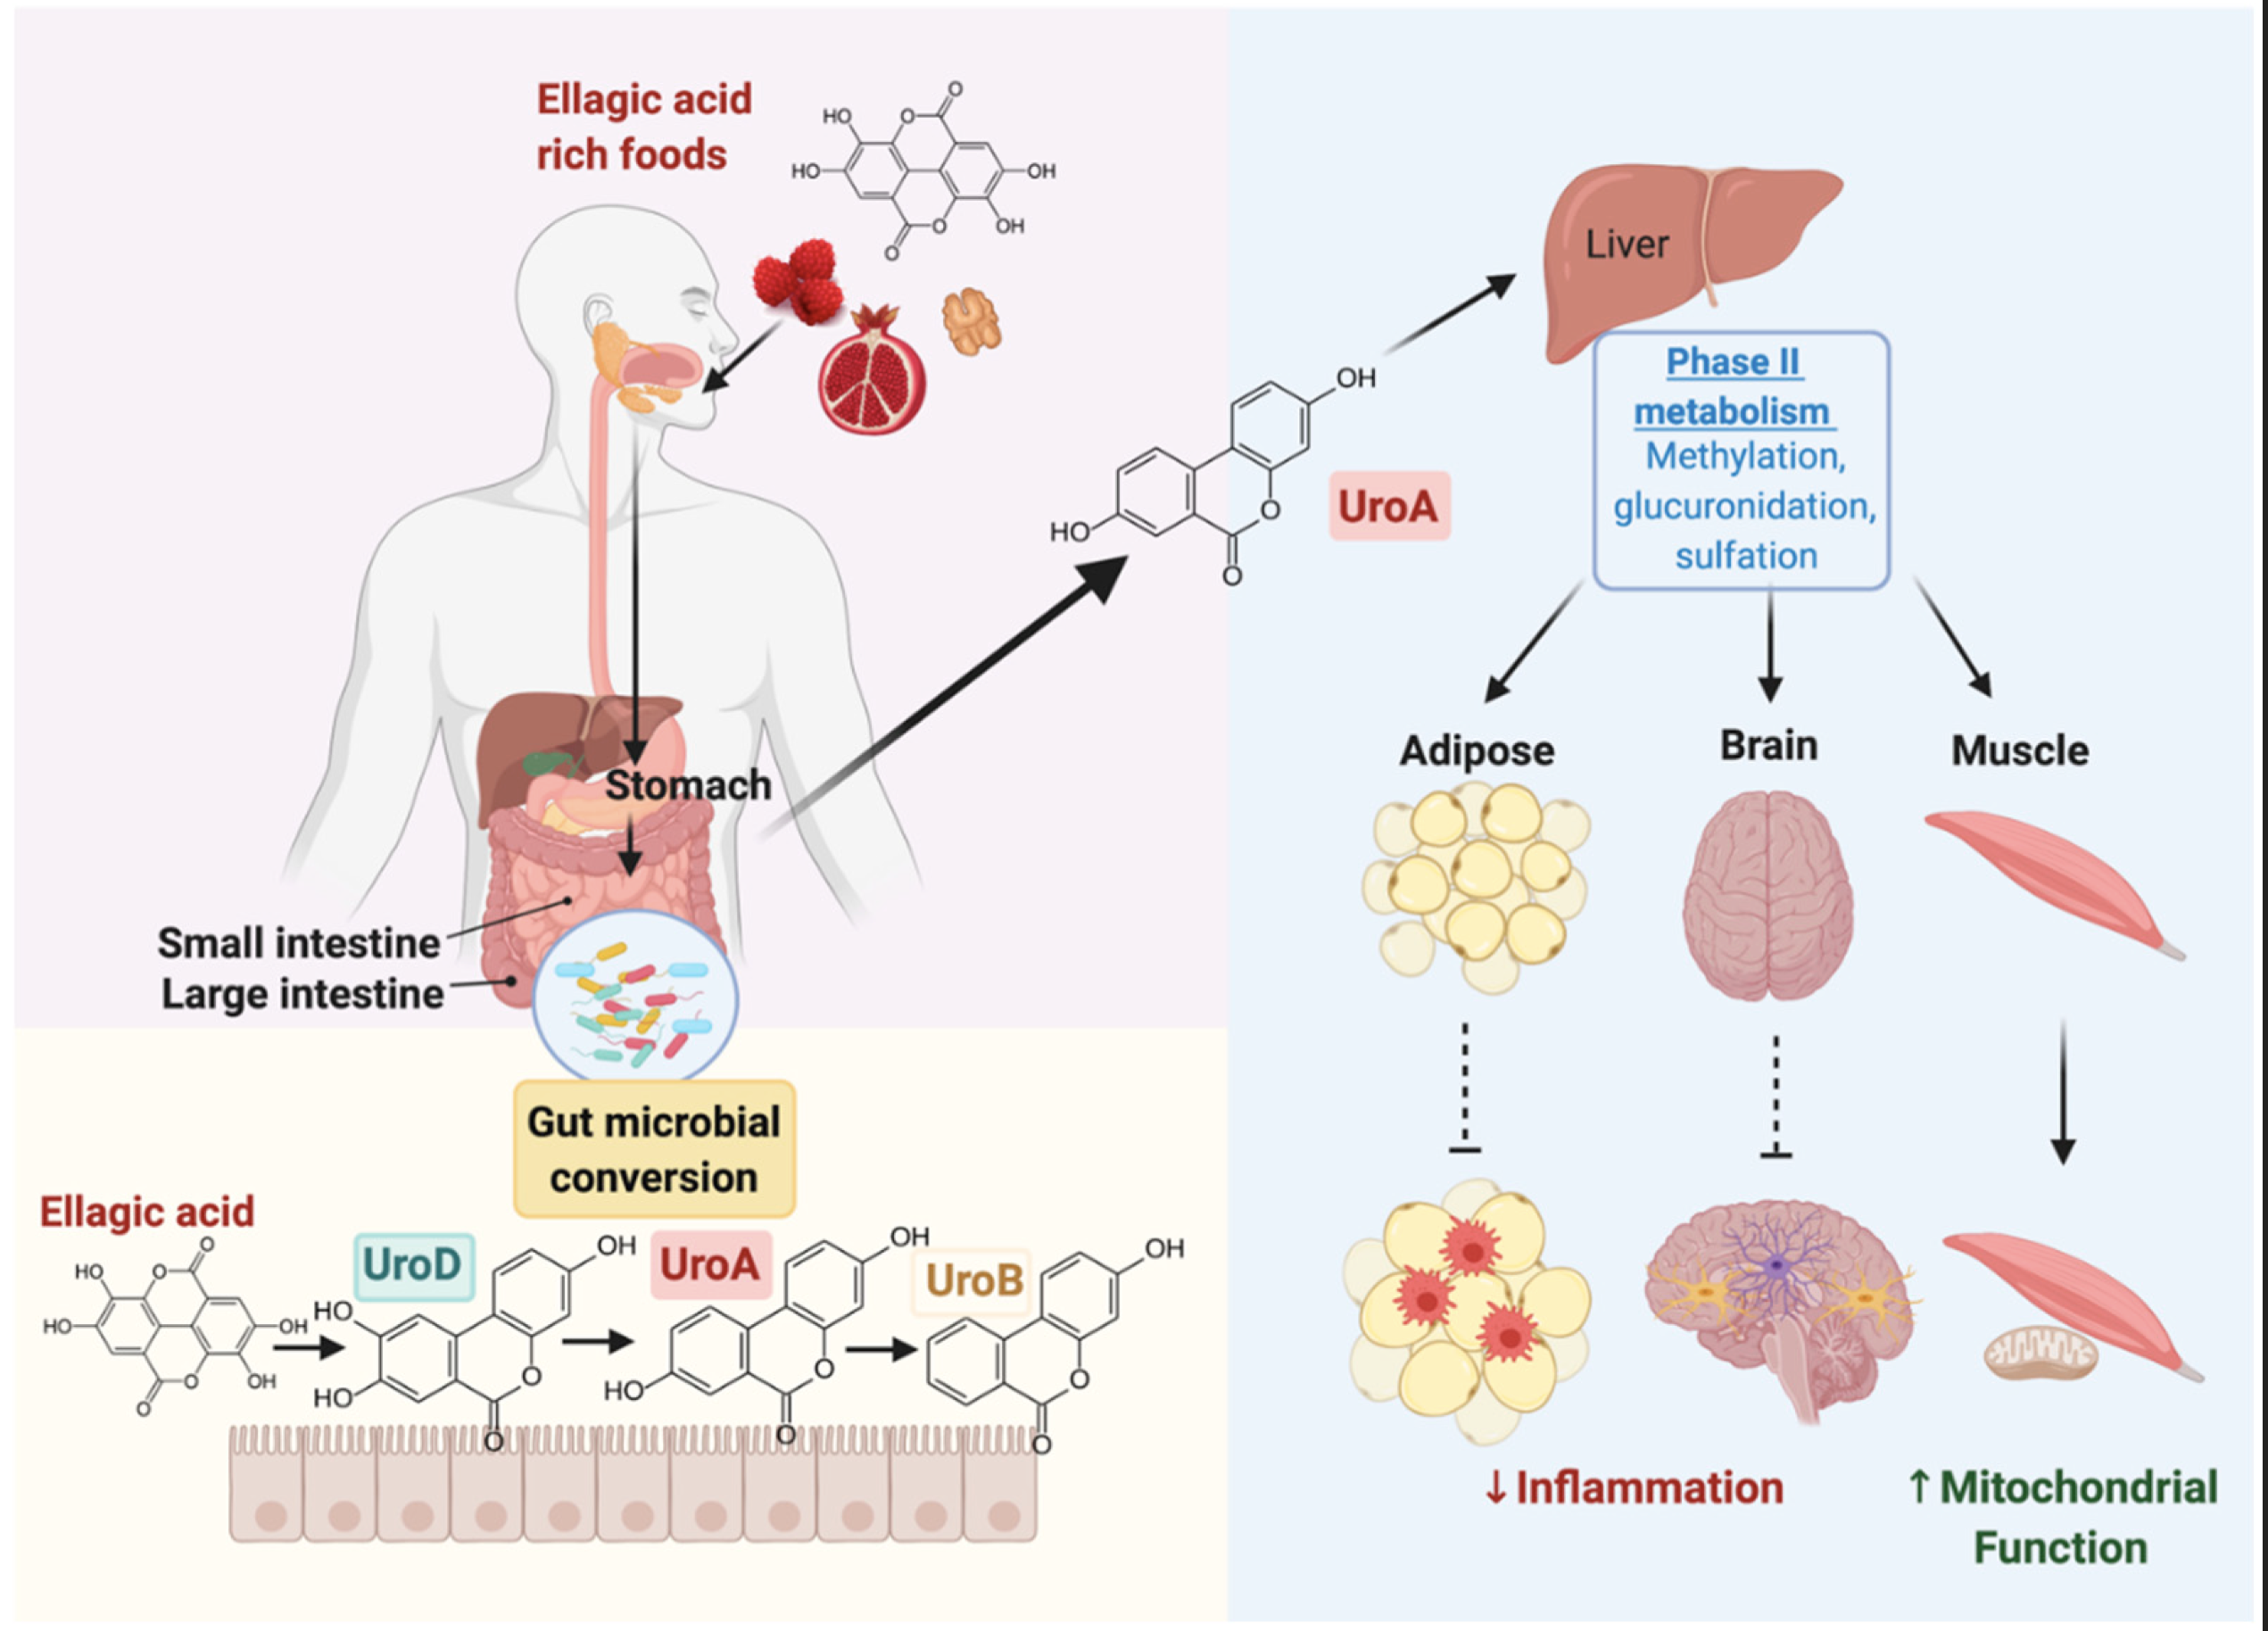

Slide 3
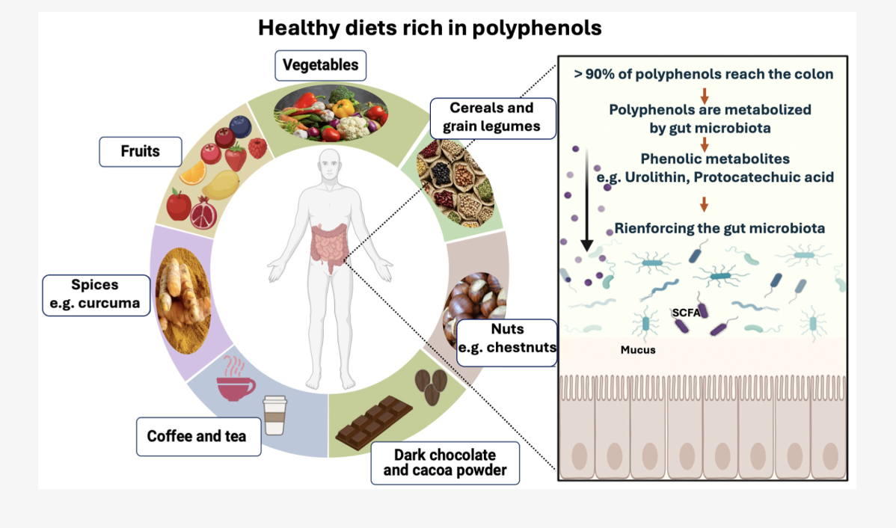
Microorganisms 2024, 12, 1570

Slide 4
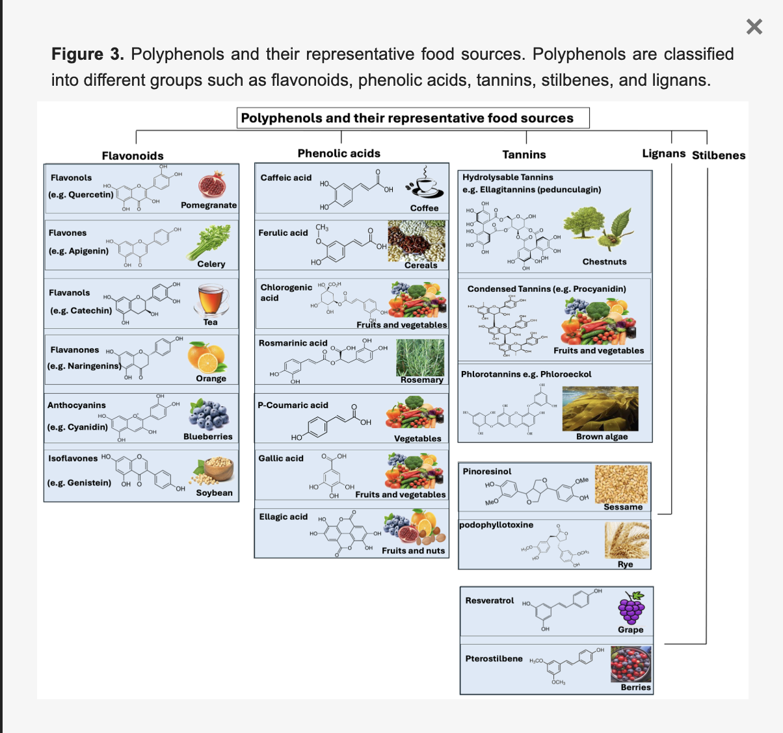
Microorganisms 2024, 12, 1570

Slide 5
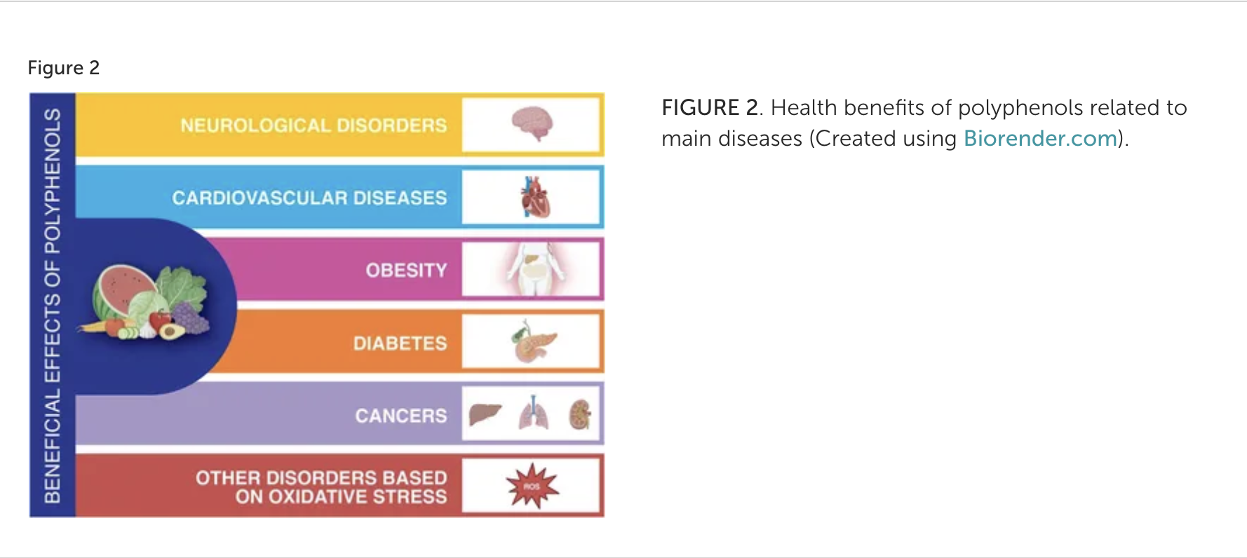
Rispo et al.
Frontiers in Cell and Developmental Biology
10.3389/fcell.2023.1305835
04 January 2024

Slide 6
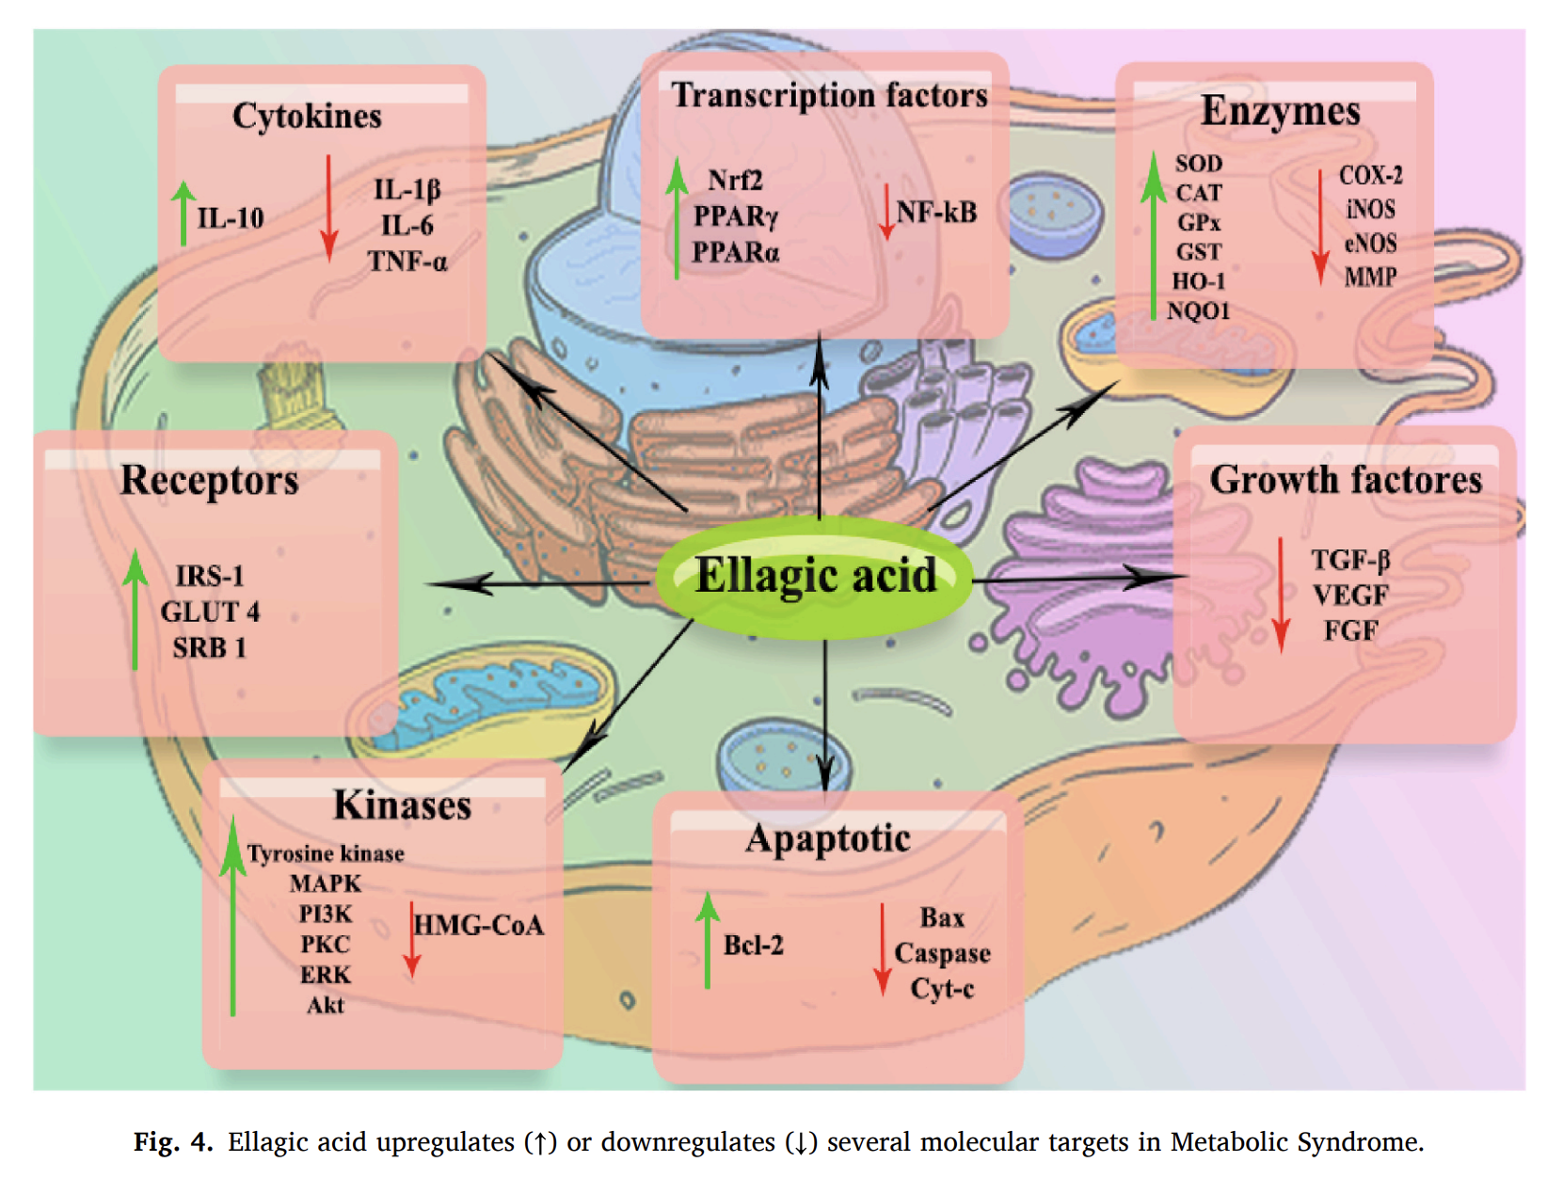
K. Naraki et al.
Heliyon 9 (2023) e21844

Slide 7
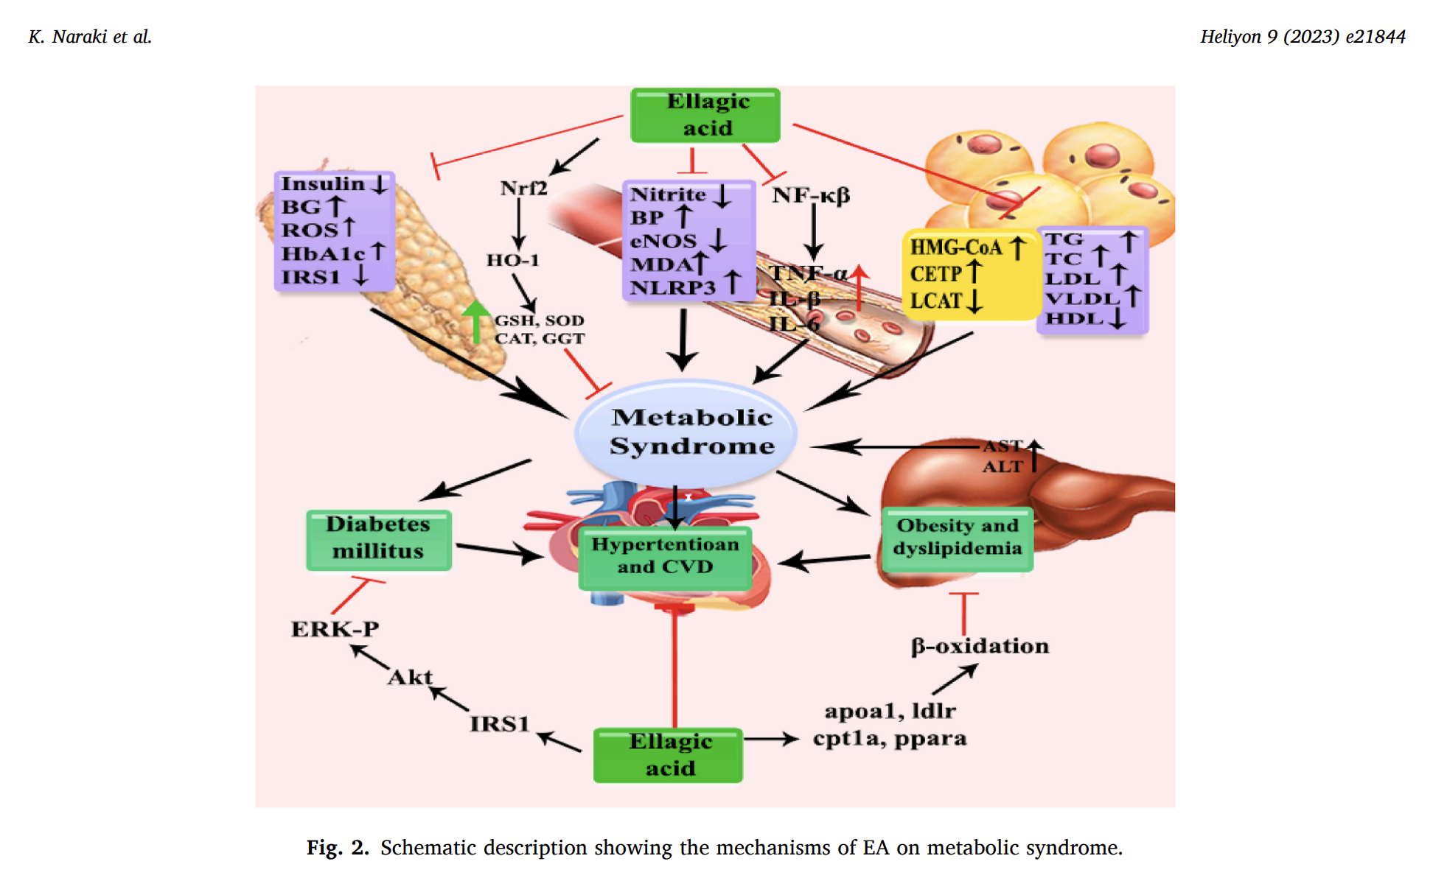
K. Naraki et al.
Heliyon 9 (2023) e21844

