Slide 1


Slide 2
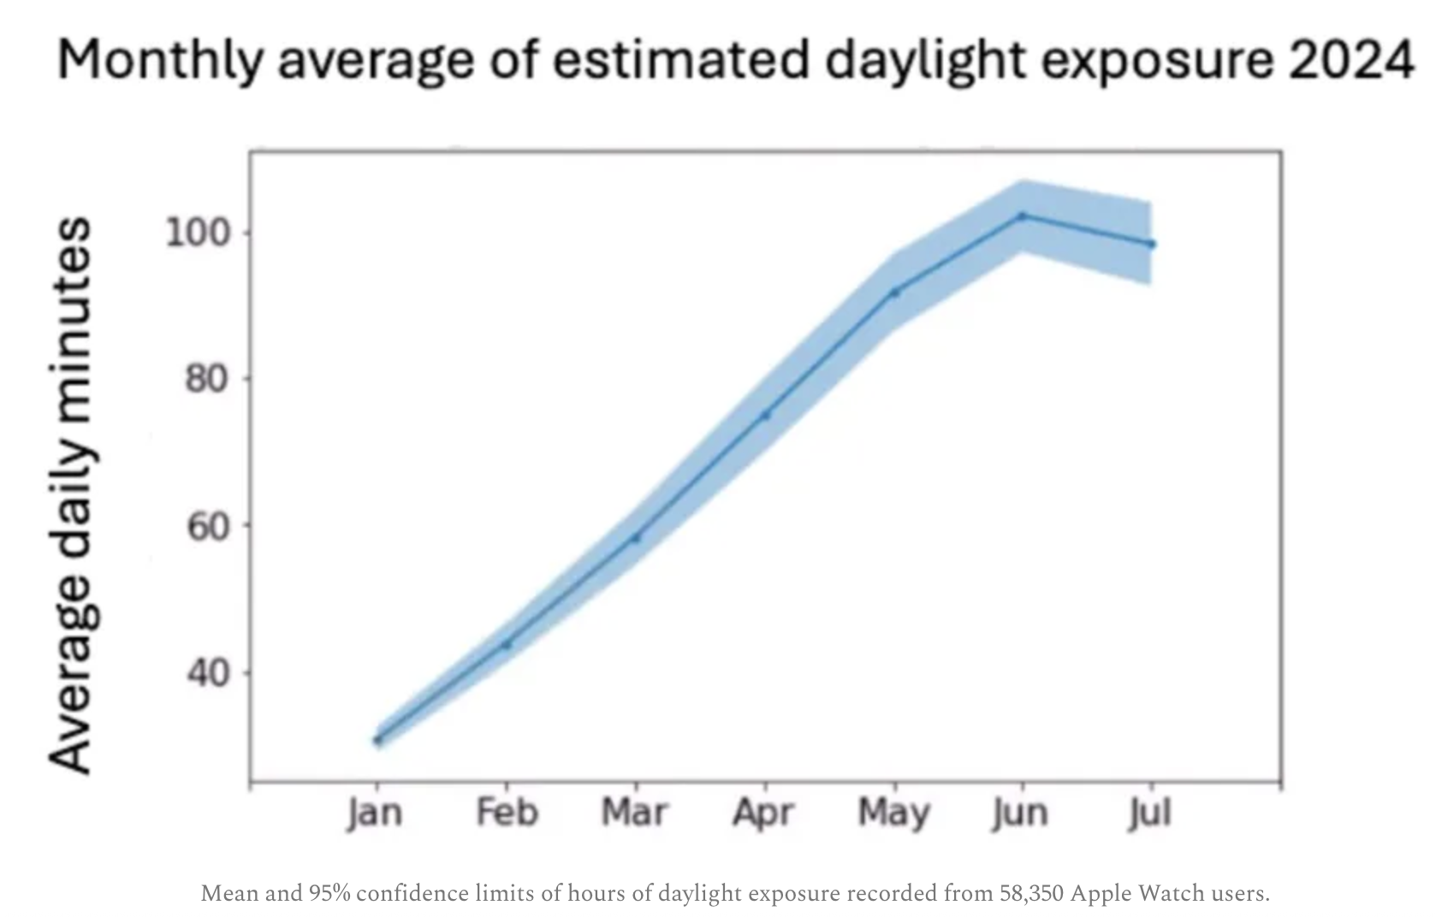
Martin Moore-Ede MD, PhD

Slide 3
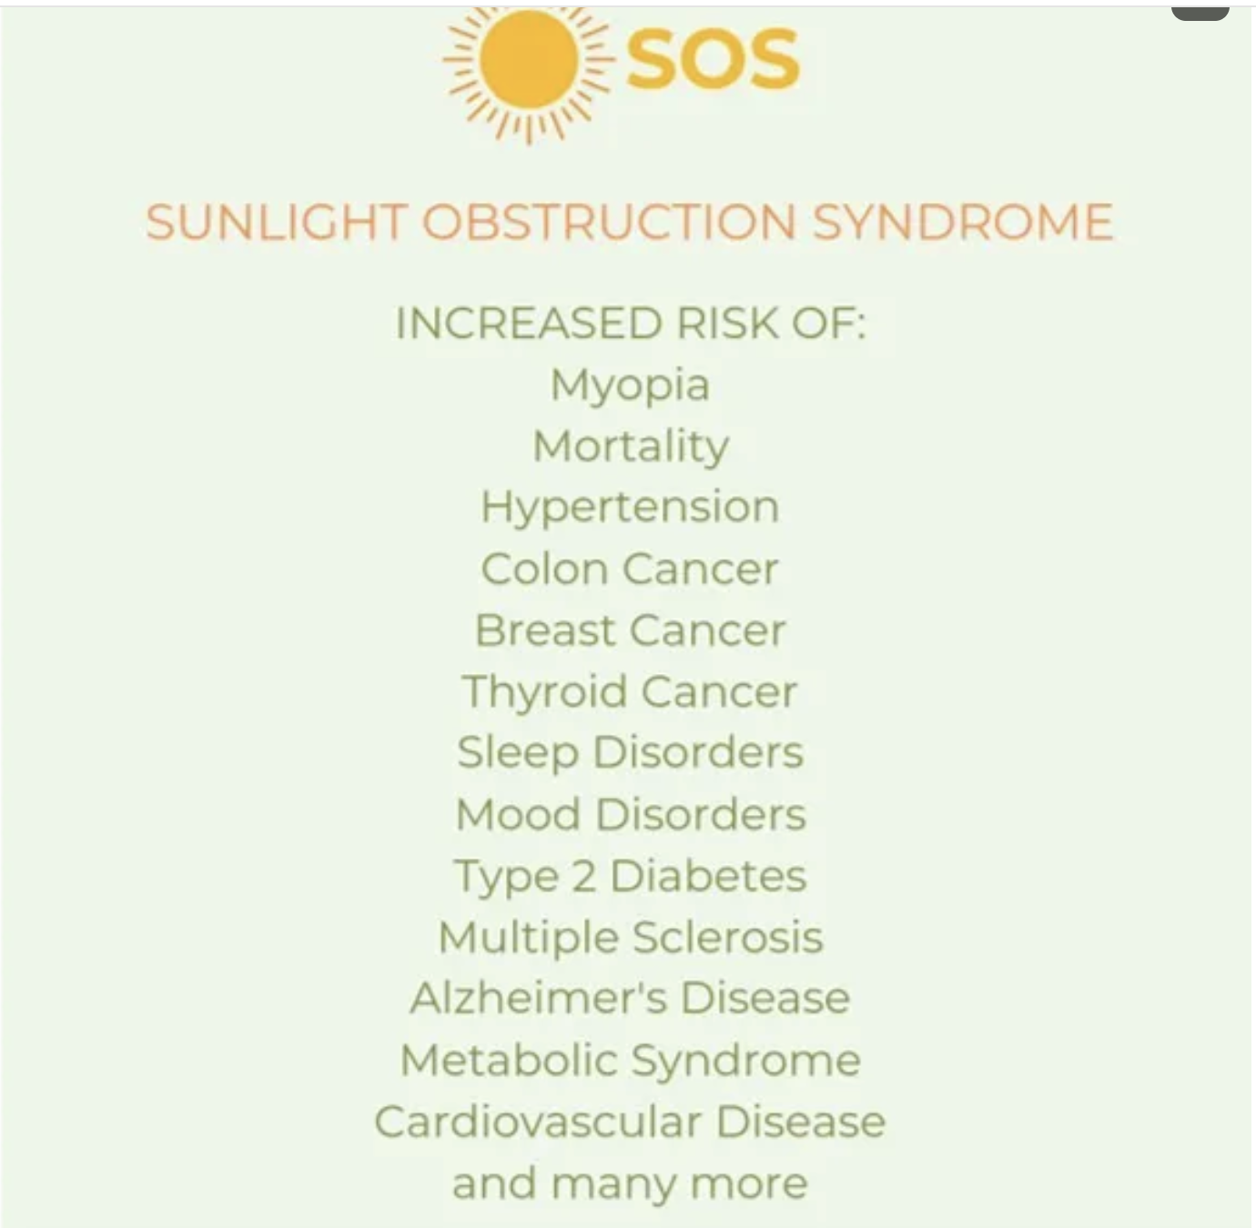
Martin Moore-Ede MD, PhD

Slide 4
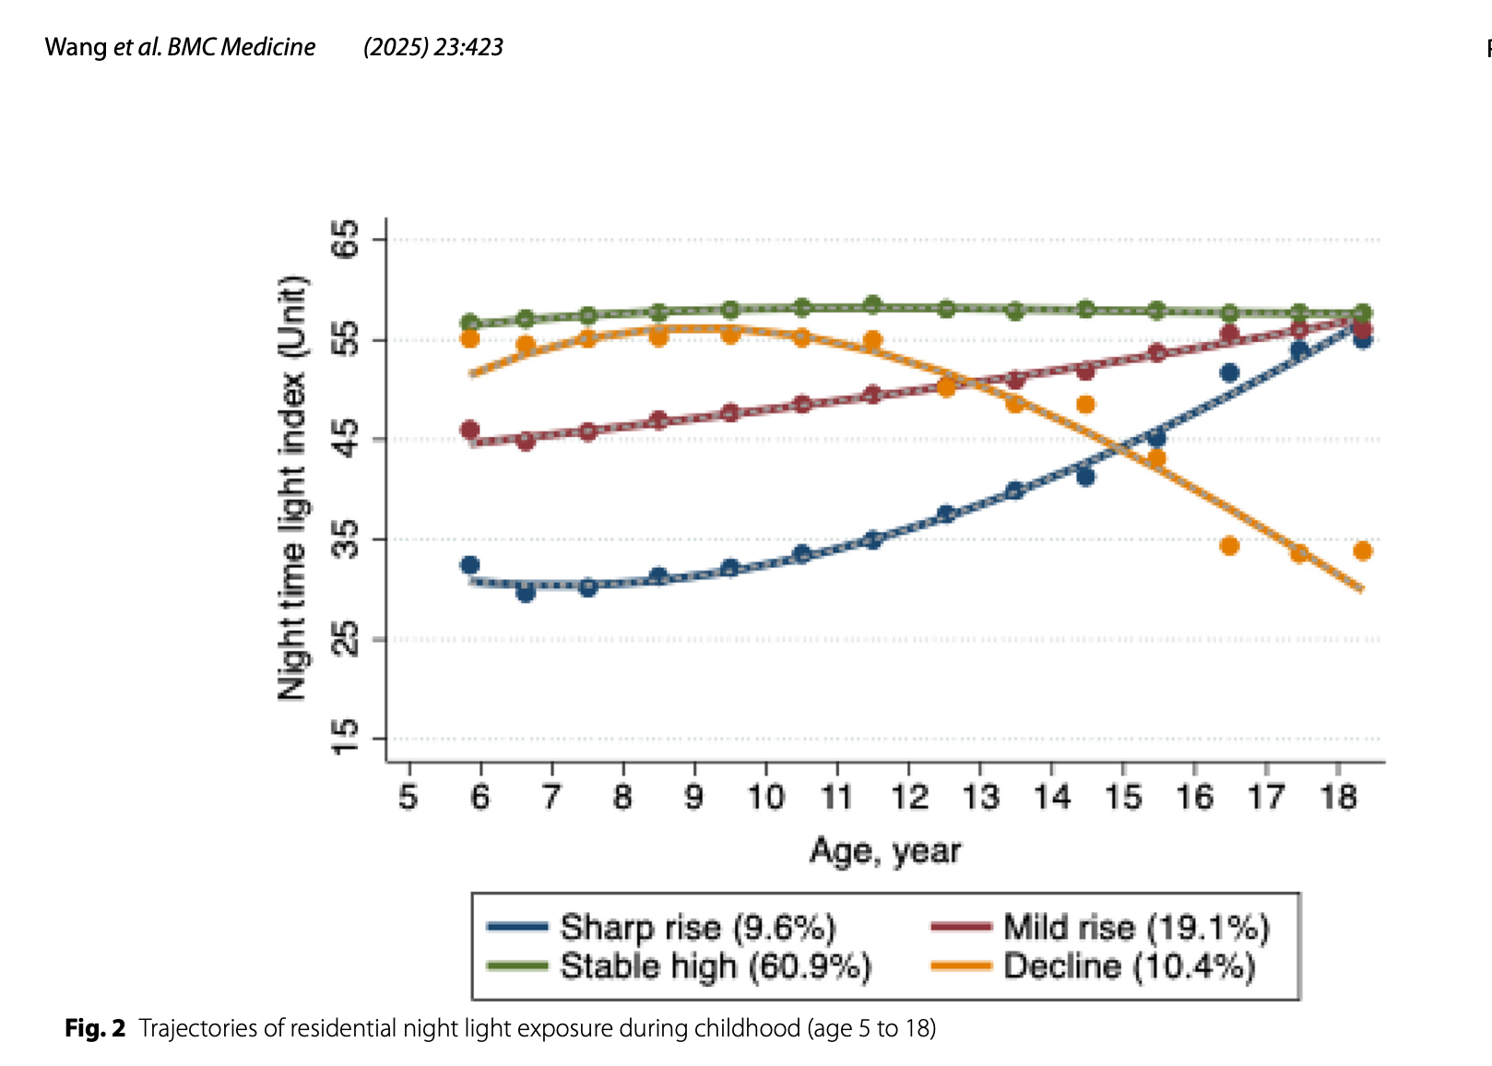

Slide 5


Slide 6


Slide 7
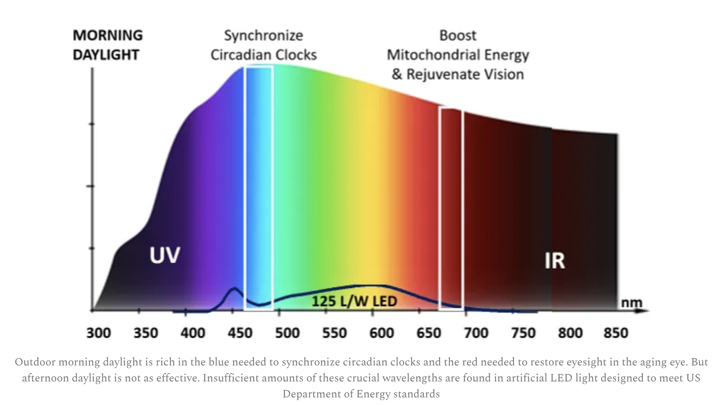

Slide 8


Slide 9


Slide 10
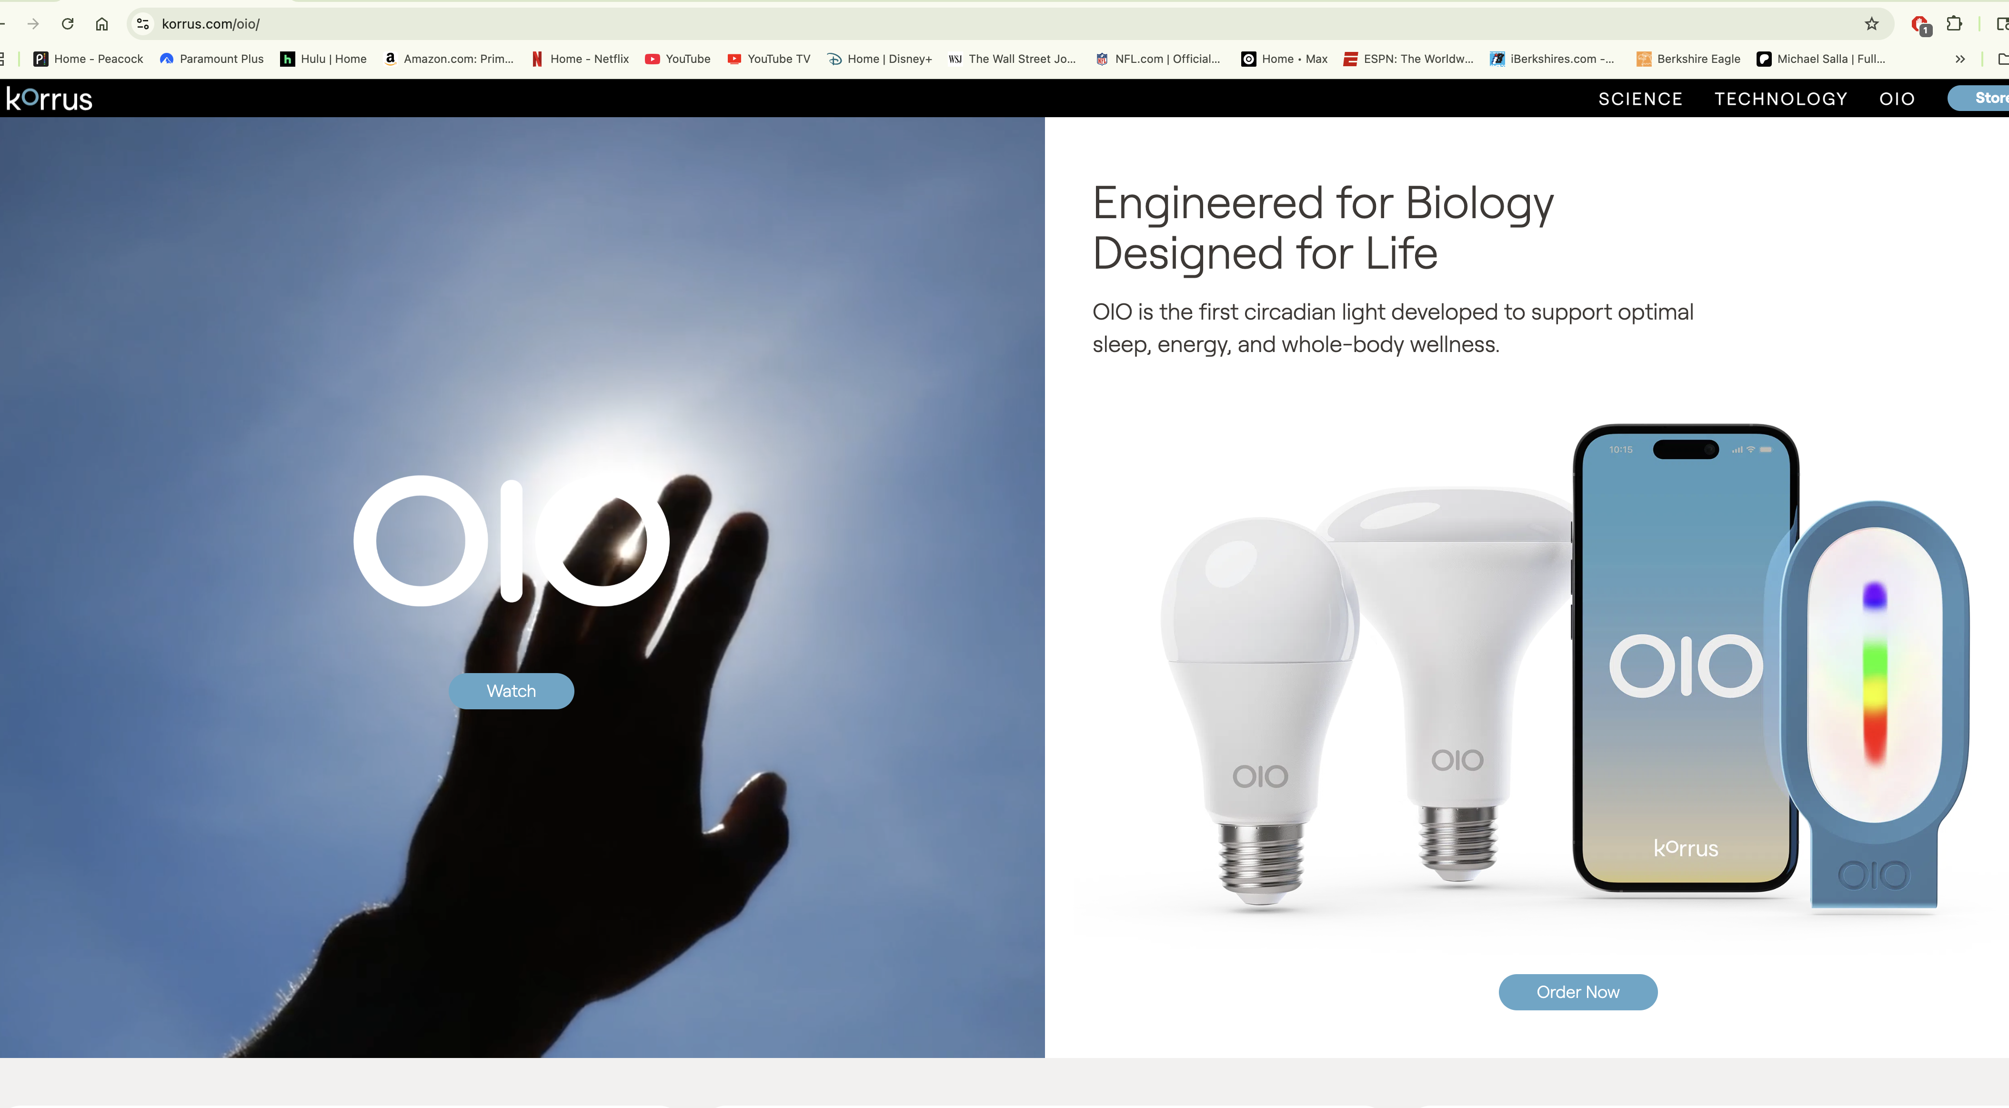

Slide 11
