Slide 1
A Lifestyle-Nutritional Model for Promoting-Sustaining Brain-Mind-Mood Health
Mark Pettus MD
Medical Director Essential Provisions
Associate Professor of Medicine
University of Massachusetts Chan School of Medicine

Slide 2
Learning Objectives
Review the role lifestyle and environment play as drivers of mind and mood health.
Explore the concept of allostatic load i.e. the biologic effects of chronic stress.
Examine the core metabolic disruptors of mind and mood e.g. inflammation, insulin resistance and circadian rhythm disruption.
Provide specific lifestyle strategies that can improve and sustain a healthy brain, mind, mood and quality of life.
Notes:
It is said that 1 in 4 Americans has a mental illness…so I think of three of my closest friends…they’re ok…then it strikes me….it must be me.

Slide 4
Nutrition and Stress Resilience

Slide 5
Nutritional Principles
Whole foods
Diversity
Nutrient – density
Low– Glycemic
Fiber – rich
Meal-timing
Metabolic Effects
Neuroplasticity
Anti-inflammatory
Increased Insulin sensitivity
Gut biome diversity-fermentation
Epigenetic modulation
Upregulate resiliency pathways

Slide 7
Sugar, flour and high-glycemic carbohydrates

Slide 8
Investigated the diet-AD relations in a prospective study of 923 participants, ages 58 to 98 years, followed on average 4.5 years. Diet was assessed by a food frequency questionnaire.
Followed for 4.5 years
High adherence to the diet resulted in a 54% lower risk
Moderate adherence to the MIND diet put participants at 35% lower risk of developing the disease.

Slide 9
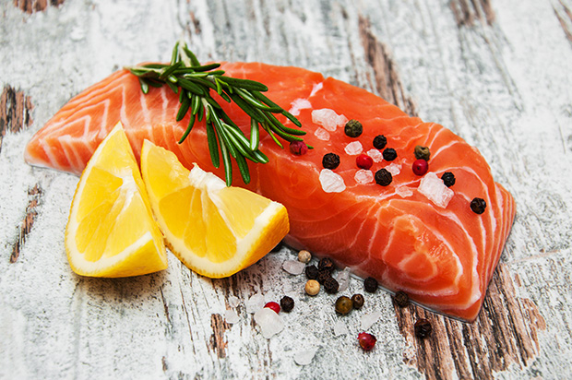
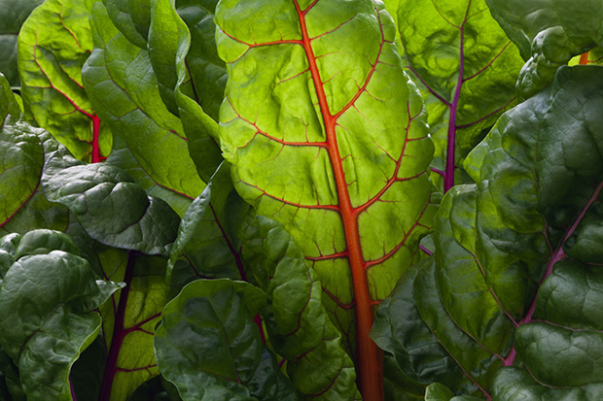
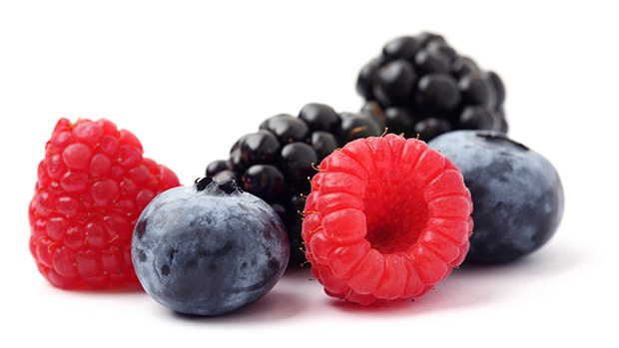
MIND DIET COMPONENTS:
6 servings of leafy greens/week
2 servings fatty fish/week
2-3 servings of berries/week
3 servings whole grains/day
1-2 servings fish/week
2 servings of poultry/week
5 servings nuts/week
3-4 servings legumes-beans/week

Slide 10
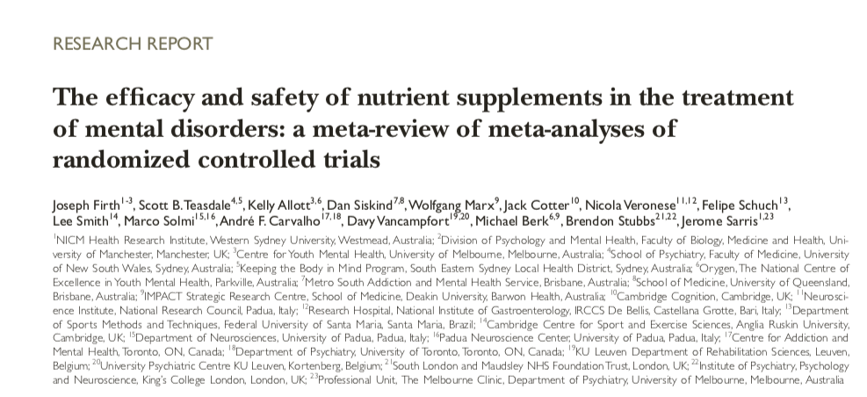
World Psychiatry. 2019 Oct;18(3):308-324. doi: 10.1002/wps.20672.

Slide 11
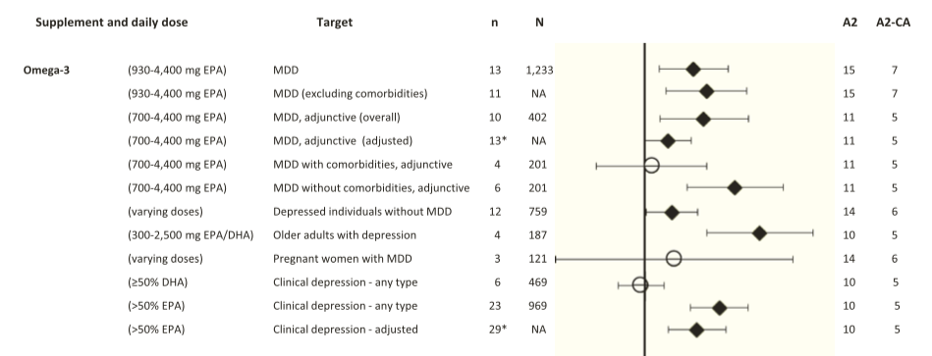

Slide 12
Brain Derived Neurotropic Factor (BDNF)
Exercise
Caloric Restriction
Meditation
Curcumin
Green tea
Coffee
DHA
Intermittent Fasting/TRE
Probiotics
SAD
Stress
Inflammation
Insulin resistance
Circadian Disruption
Sedentary states
Social Isolation
BDNF
Bredesen. AGING, June 2016, Vol. 8 No.6

Slide 13
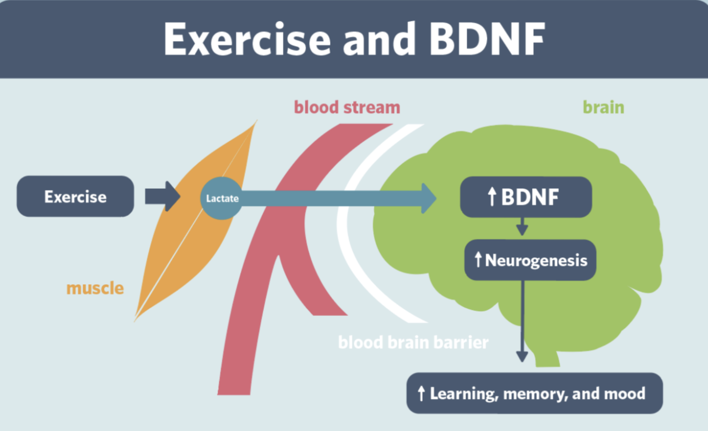
Rhonda Patrick PhD

Slide 14
Motion is the lotion !

Slide 15
Forest Bathing
Shinrin-Yoku
Global health and quality of life improvements
Improvements in mind and mood
Lower inflammation
Improved sleep
www.shinrin-yoku.org
Int. J. Environ. Res. Public Health 2017, 14, 851; doi:10.3390/ijerph14080851

Slide 16
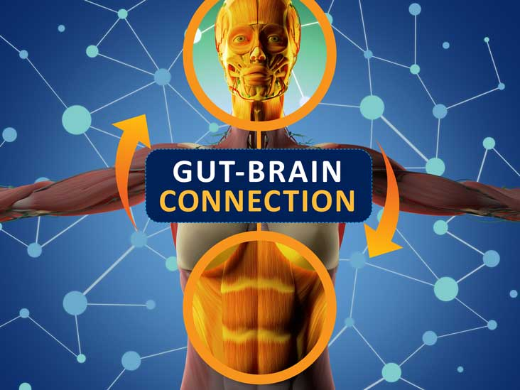

Slide 17
Saunas
Really good for health promotion and disease prevention
Up-regulates defense/resiliency mechanisms
30” minutes 3-4x/week
Steam or infrared
Laukkanen T, Khan H, Zaccardi F, Laukkanen JA. Association between sauna bathing and fatal cardiovascular and all-cause mortality events. JAMA Intern Med. 2015;175(4):542-548
Sauna bathing and incident hypertension: A prospective cohort study. Am J Hypertens. 2017; Nov 1;30(11):1120-1125.
Sauna bathing is inversely associated with dementia and Alzheimer's disease in middle-aged Finnish men. Age Ageing. 2016; Mar 1;46(2):245-249.

Slide 18
Mental Health and Metabolic Flexibility
An Ancestral Blueprint for 21st Century Life
Turning Back the Biologic Clock of Time
Logan et al. Journal of Physiological Anthropology (2015) 34:9

Slide 20
Lifestyle Considerations for Healthy Mind & Mood
Liberal outdoor, full-spectrum light exposure; 10k lux full-spectrum light box over fall-winter months
Sauna (steam or IR)
Connection with others (group visits)
Motion is the lotion!
HPA management e.g. yoga, tai chi, music, breath, meditation, HRV biofeedback
Healing the gut-immune barrier function e.g. elimination diet, pre-probiotics
Sleep hygiene; consider OSA evaluation
Notes:
(Stephanie Senef PhD: Entropy 2012, 14, 2265-2290; doi:10.3390/e14112265) GMO

Slide 21
Lifestyle Considerations for Healthy Mind & Mood
Whole foods with reductions in high-glycemic sugar, refined grain-based flour, acellular carbohydrate dense foods
Elimination 30-day trials sugar, gluten-grains; dairy-casein; processed seed vegetable oils (high O-6/prone to oxidative stress)
More healthy fats e.g. olive oil, coconut oil, full-fat dairy, nuts, avocados, butter, fatty fish, eggs, pasture-raised meats
Plant-based fiber and high polyphenol intake for biome diversity
Specific Nutrients: Vitamin D, Zinc, Magnesium, B-complex, methyl-folate; NAC, higher dosed omega-3/krill oil
Notes:
(Stephanie Senef PhD: Entropy 2012, 14, 2265-2290; doi:10.3390/e14112265) GMO

