Slide 1
Nature Deficit Syndrome and Health
Mark Pettus MD, FACP, ABOIM
Medical Director Essential Provisions
Associate Professor of Medicine
University of Massachusetts Chan Medical School

Slide 2
Forest Bathing: Learning Objectives
Humans as part of a holistic ecosystem
Many benefits of full spectrum sunlight
Explore the science connecting time outdoors with global health outcomes
www.shinrin-yoku.org

Slide 3
The Great Illusion of Separateness
In this life we are not separate from nature. We are a part of nature, part of a complex ecosystem.
Our biology is synchronized with the rhythms of nature.
When we become disconnected from our innate diurnal rhythms our biology becomes disrupted.
Over time, this impacts our health and quality of life at many levels.

Slide 4
Int. J. Environ. Res. Public Health 2017, 14, 851;

Slide 5
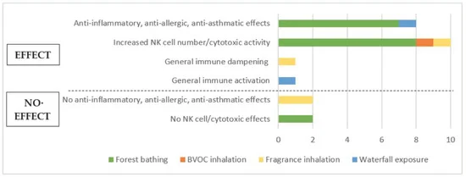
Immune System Effects
Int. J. Environ. Res. Public Health 2021, 18(4), 1416;

Slide 6
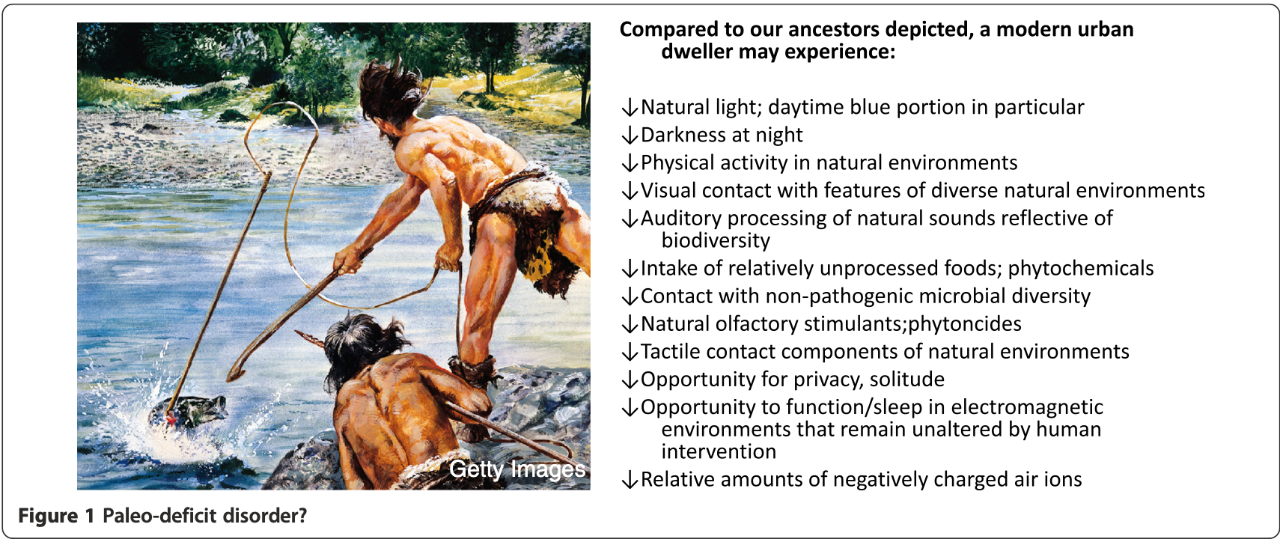
Paleo-deficit Disorder
Logan et al. Journal of Physiological Anthropology (2015) 34:9

Slide 7
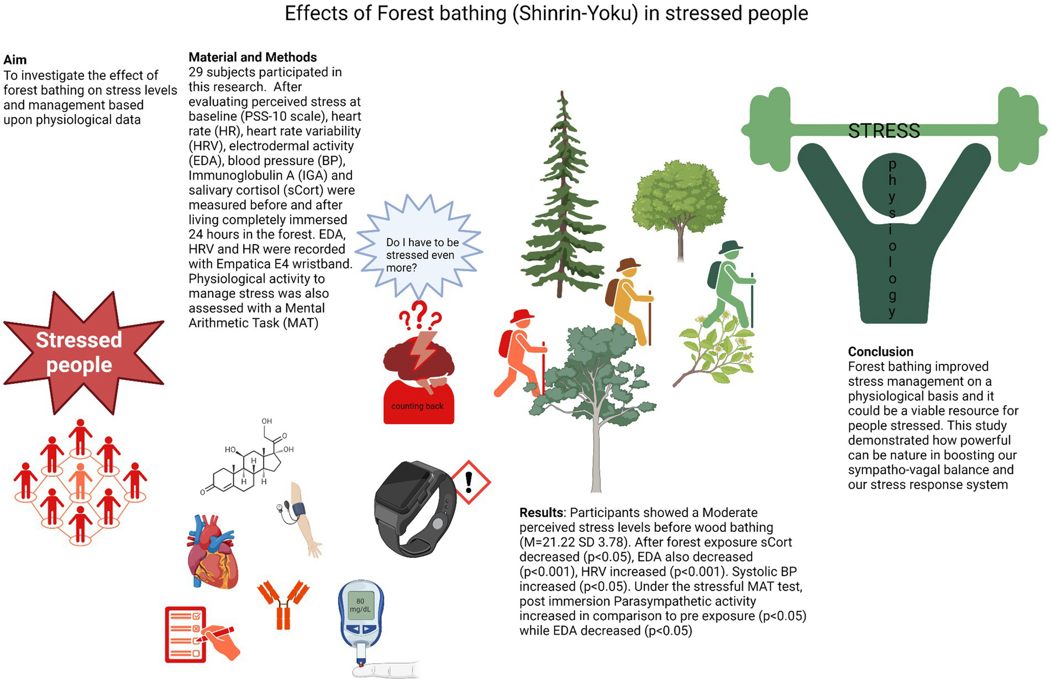
Time in Nature and the Stress Response
Front. Psychol. , 31 October 2024

Slide 8
Summary of Benefits of Forest Bathing
﻿﻿ Stress reduction: Shinrin-yoku has been shown to lower cortisol levels, a stress hormone.
﻿﻿ Improved mood: Spending time in nature can boost mood and increase feelings of happiness.
﻿﻿. Enhanced immune system: Studies suggest that forest bathing may enhance the body's immune response.
﻿﻿. Reduced blood pressure: Research indicates that shinrin-yoku can lower blood pressure.
﻿﻿ Increased creativity and focus: Spending time in nature can promote cognitive function and improve concentration.

Slide 9
How to Practice:
﻿﻿ Find a forest: Choose a quiet, natural forest with plenty of trees.
﻿﻿. Walk slowly: Take your time and wander through the forest, paying attention to your surroundings.
﻿﻿ Engage your senses: Observe the trees, smell the air, listen to the birds, and feel the ground beneath your feet.
﻿﻿. Breathe deeply: Focus on your breath and inhale the fresh forest air.
﻿﻿. Disconnect from technology: Avoid using your phone or other electronic devices.
Bring a friend-pet

