Slide 1
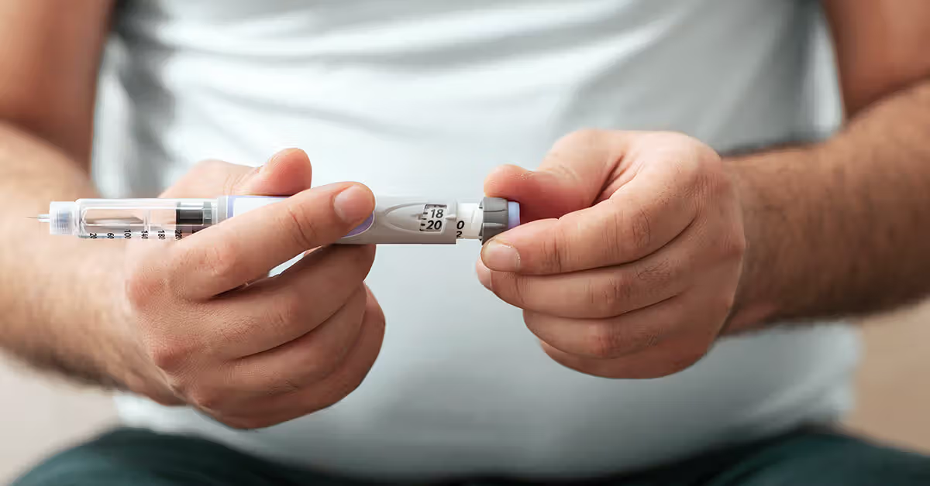
Nutritional and Lifestyle Approaches to Enhancing GLP-1 Activity
Mark Pettus MD, FACP, ABOIM
Medical Director Essential Provisions
Associate Professor of Medicine
University of Massachusetts Chan medical School

Slide 2
Learning Objectives
What is the role of quality protein in GLP-1 production?
Understand the emerging role of dietary fiber, the gut microbiome and GLP-1 production.
Understand why circadian rhythm alignment is important to optimize natural GLP-1 production

Slide 3
Important considerations
Very effective for weight loss and metabolic health
Limited long-term data beyond 2 years
Adopting more “natural” lifestyle-nutritional strategies to optimize one’s own GLP-1 production
Limiting muscle mass loss with general weight loss
Exit/transition strategy?

Slide 4
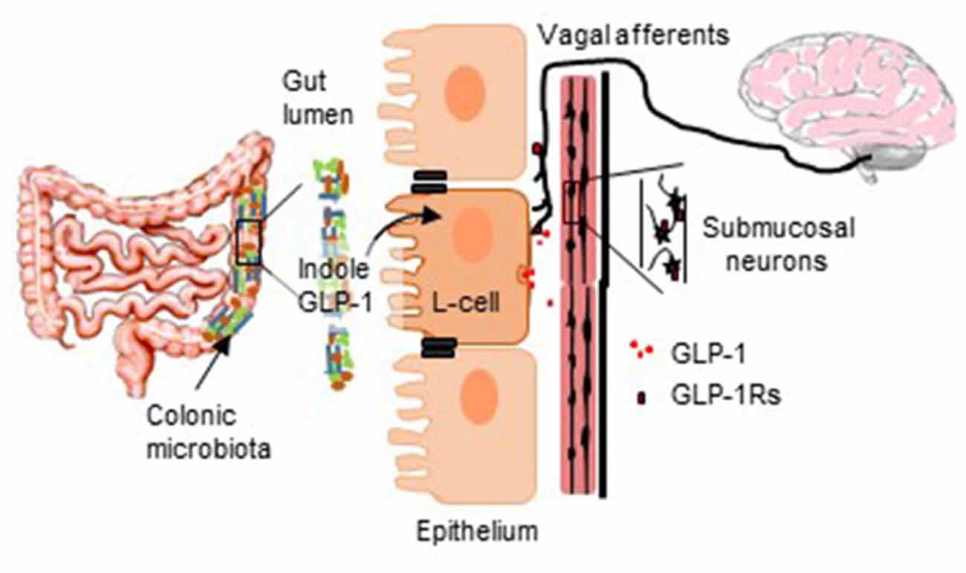
Front. Cell. Neurosci. , 29 April 2020

Slide 5
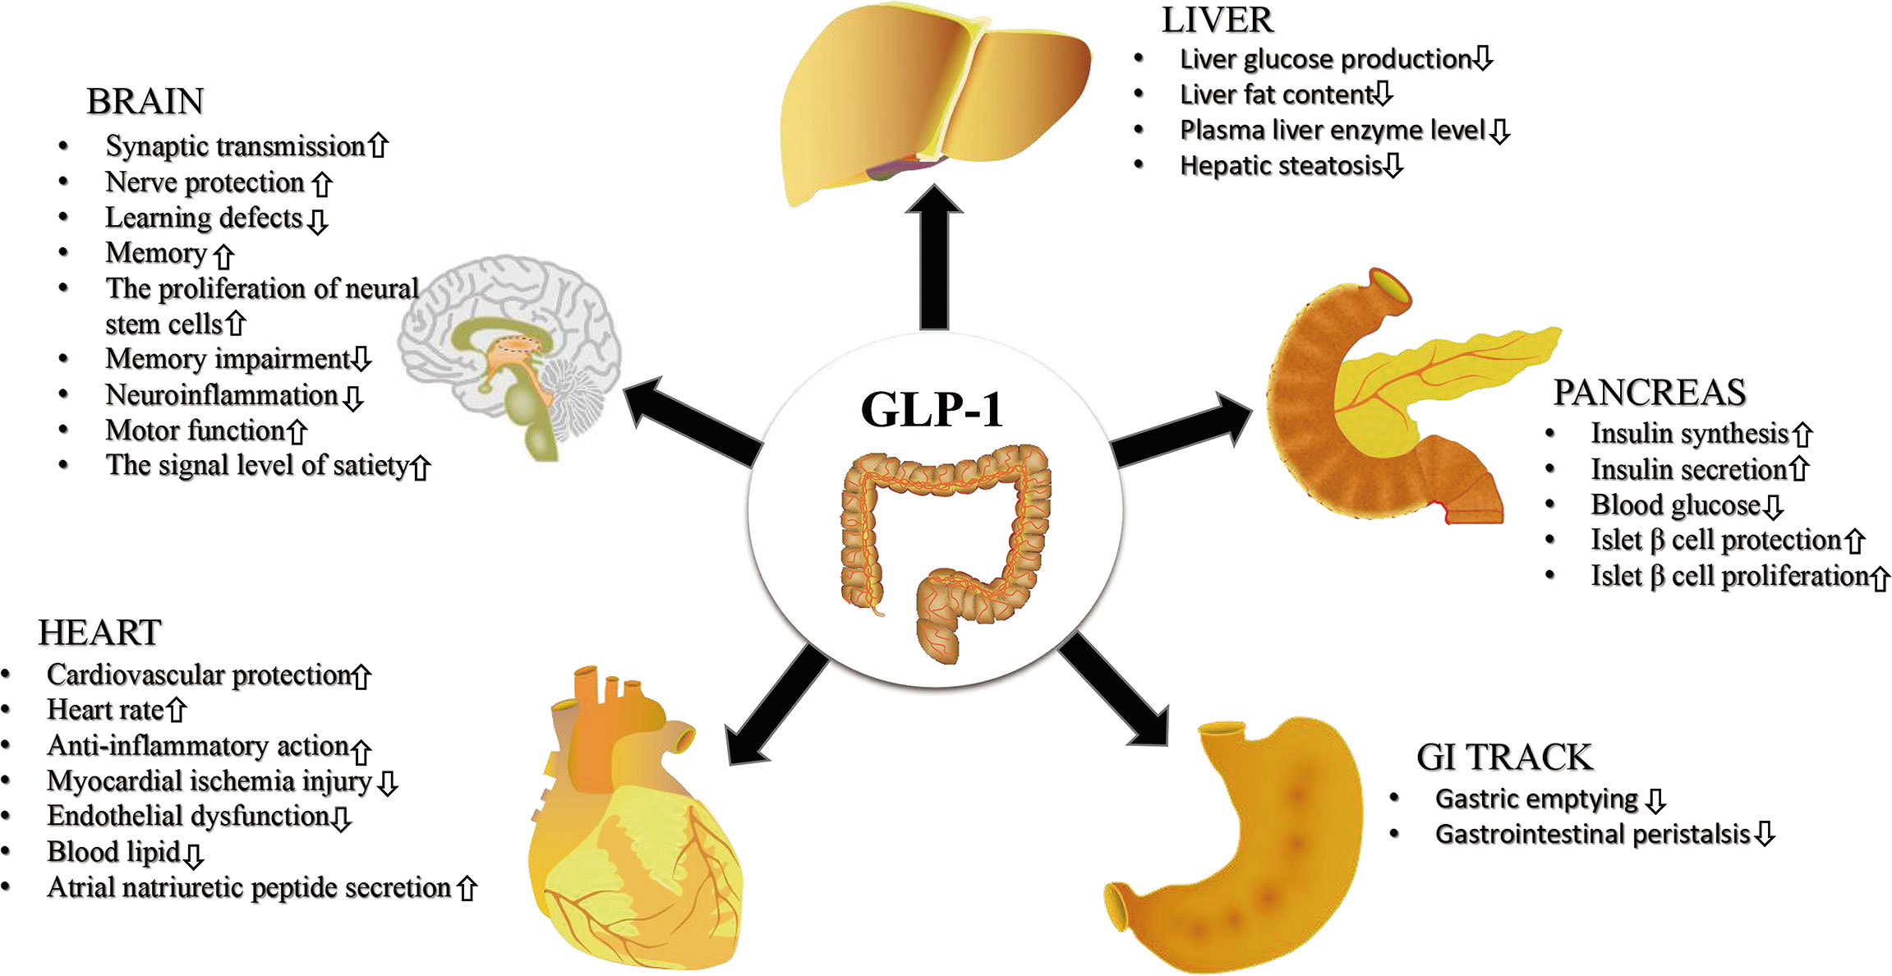
Front. Endocrinol. Vol 22 August 2021

Slide 6
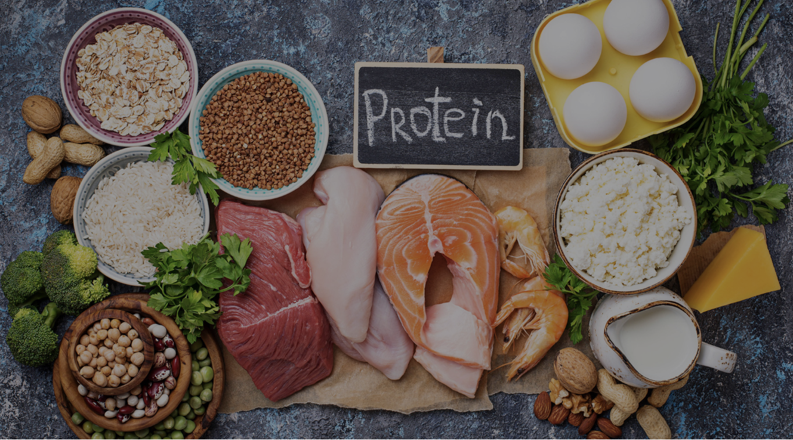
Protein and GLP-1
Ingesting protein and amino acids can trigger the release of GLP-1.
Studies suggest that meals with higher protein content may be more effective at enhancing GLP-1 secretion compared to meals with lower protein content.
Some studies have shown that specific amino acids, like L-valine, can be powerful stimulators of GLP-1 secretion.
1.2-1.6 g/kg divided throughout the day

Slide 7
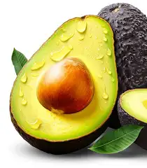
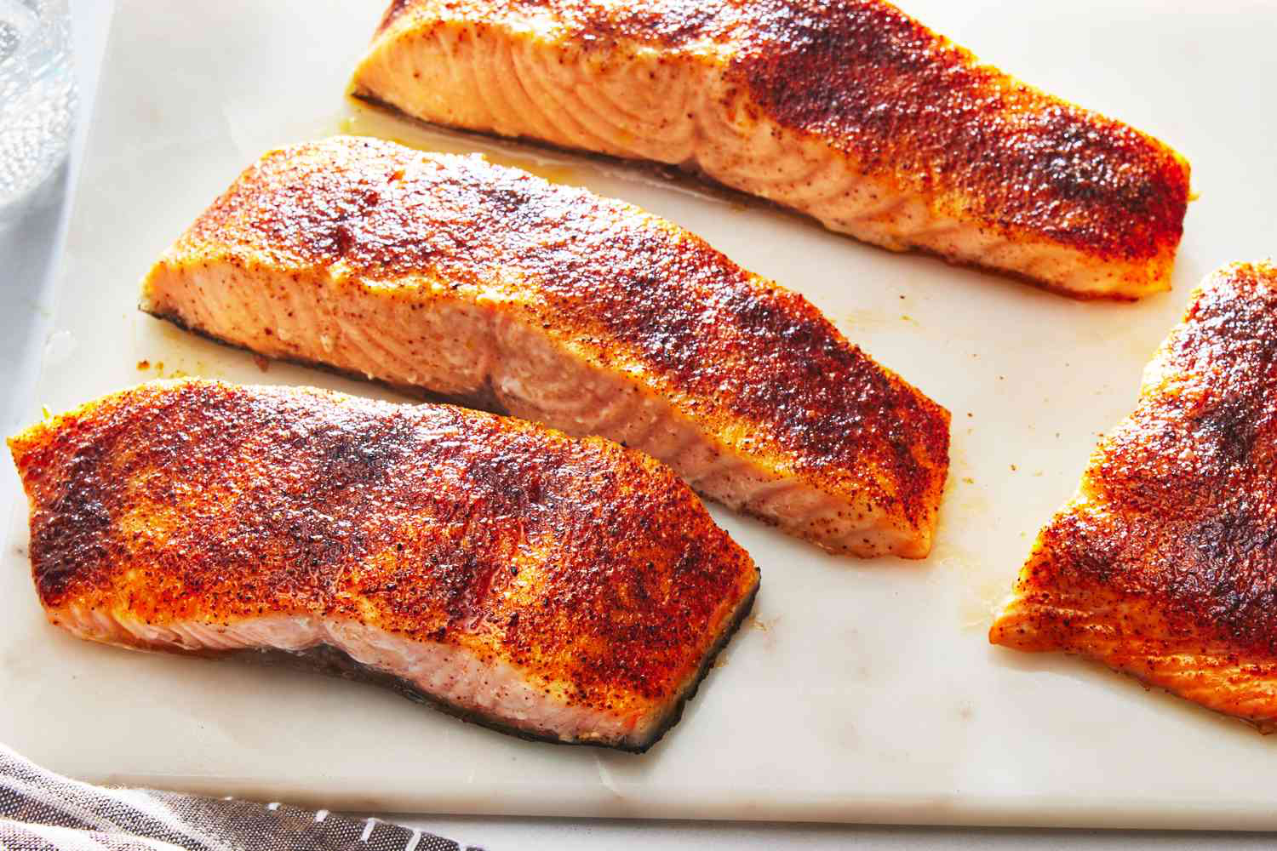

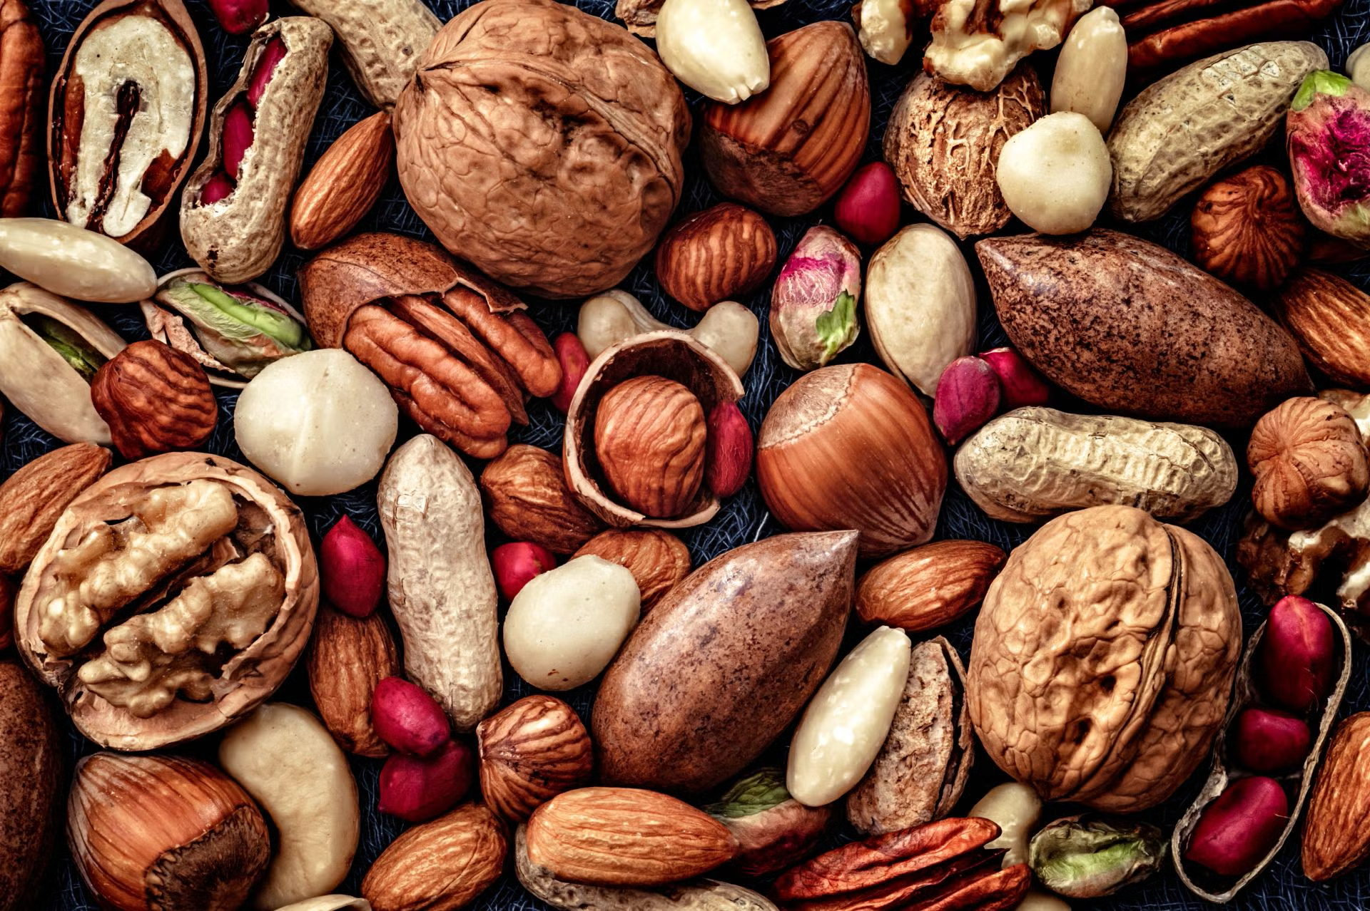
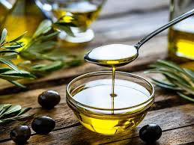

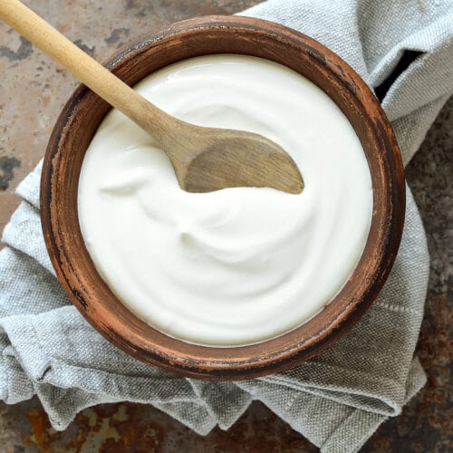
Quality Fats and GLP-1
To naturally increase GLP-1 levels, focus on incorporating foods rich in healthy fats like eggs, fatty fish, avocados, nuts, seeds, grass fed/finished meats, yogurt and olive oil.
Fats stimulate bile acid production which raises GLP-1 production

Slide 8
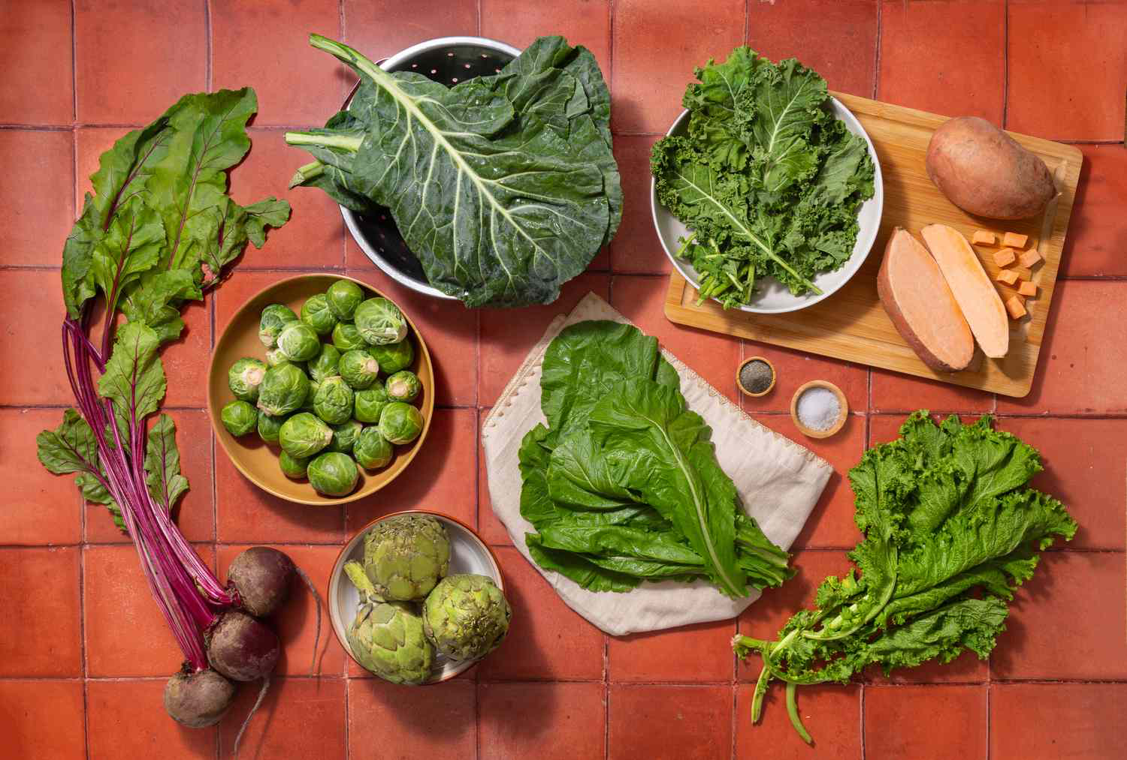
Plant-Based Fiber and the Microbiome
Fermentable Fiber: These fibers, found in foods like broccoli, Brussels sprouts, berries, apples, lentils, beans, and peas, act as food for beneficial gut bacteria.
Gut Microbiome: A healthy gut microbiome, fostered by a high-plant-based diet, can stimulate GLP-1 secretion.
Short-Chain Fatty Acids (SCFAs): Fermentation of fiber by gut bacteria produces SCFAs, which can influence GLP-1 production.
Examples of Fermentable Fiber:
  Vegetables: Broccoli, Brussels sprouts, carrots
  Fruits: Berries, apples
  Legumes: Lentils, beans, peas
  Whole Grains: Barley, oatmeal
  Seeds: Flaxseeds, chia seeds

Slide 9
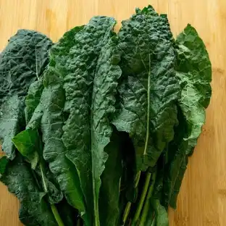
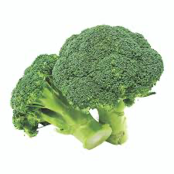
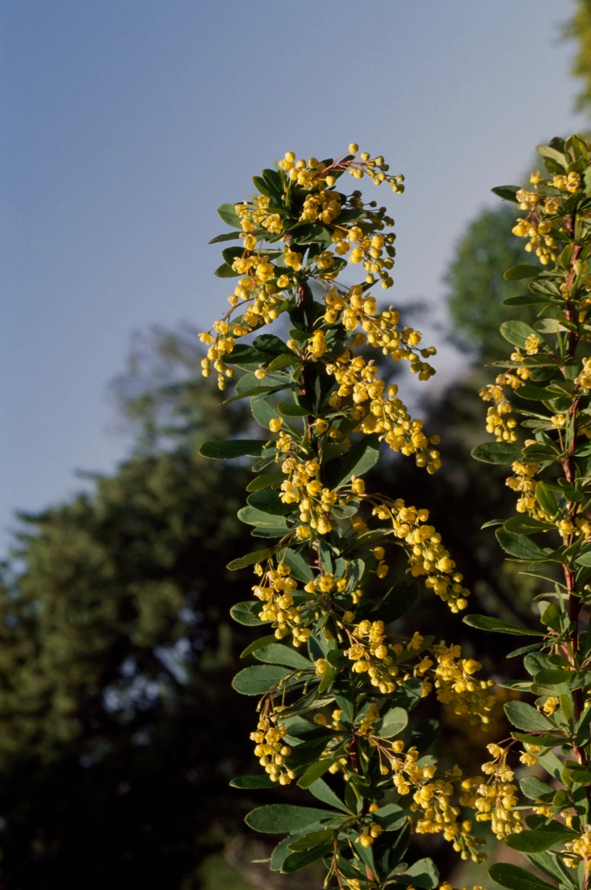
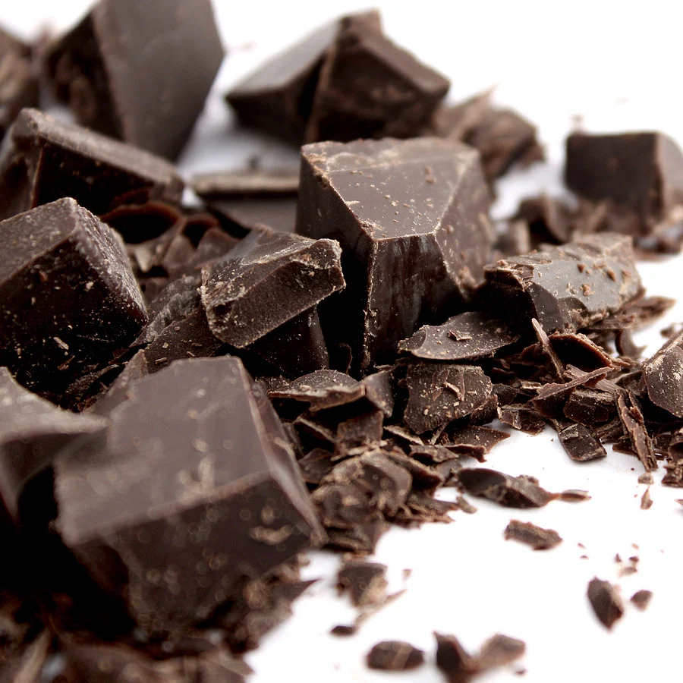
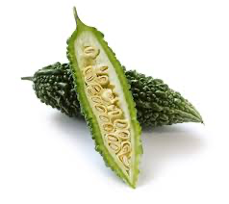
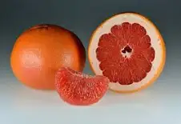
Bitters and GLP-1
Bitter substances activate bitter taste receptors in the gut, triggering the release of glucagon-like peptide 1 (GLP-1), which plays a role in regulating blood sugar and appetite.
Bitter Taste Receptors and GLP-1:
Bitter taste receptors (TAS2Rs) are present on enteroendocrine cells in the gut.
When bitter compounds bind to these receptors, it signals the release of GLP- 1
Examples of Bitter Compounds and their Effects:
Berberine: Found in various bitter plants, berberine has been shown to stimulate GLP-1 secretion.
Bitter Melon: Studies suggest that bitter melon extract can increase GLP-1 levels.
Other Bitter Substances: A range of bitter substances, including certain flavonoids and herbal extracts, have been shown to stimulate GLP-1 release.

Slide 10


GLP-1 and Circadian Rhythms
Environmental light quality and timing are drivers of circadian rhythm.
Meal timing appears to be an important driver of circadian rhythm
Sensible sunlight e.g. 15-20” in am (7-10a) and later afternoon/evening (4-7p) without protection or sunglasses
Spend as much time outdoors as possible e.g. forest bathing
Warm halogen/LEDs as substitutes for CFUs in rooms where you spend time after sunset
Blue blocker glasses after sunset when exposed to bright light e.g. watching television.
Full-spectrum/dawn light at 10k lux for 30” for seasonal affective disorder, sleep disruption, improved cognition.
Blue-blocker settings on tech devices

