Slide 1
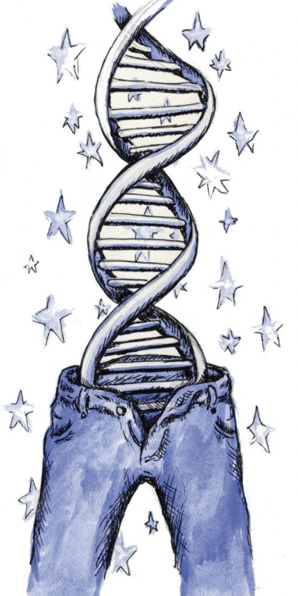
Epigenetics and Health
How well do you fit into your genes?
Mark Pettus MD
Medical Director Essential Provisions
Associate Professor of Medicine
University of Massachusetts Chan Medical School

Slide 2
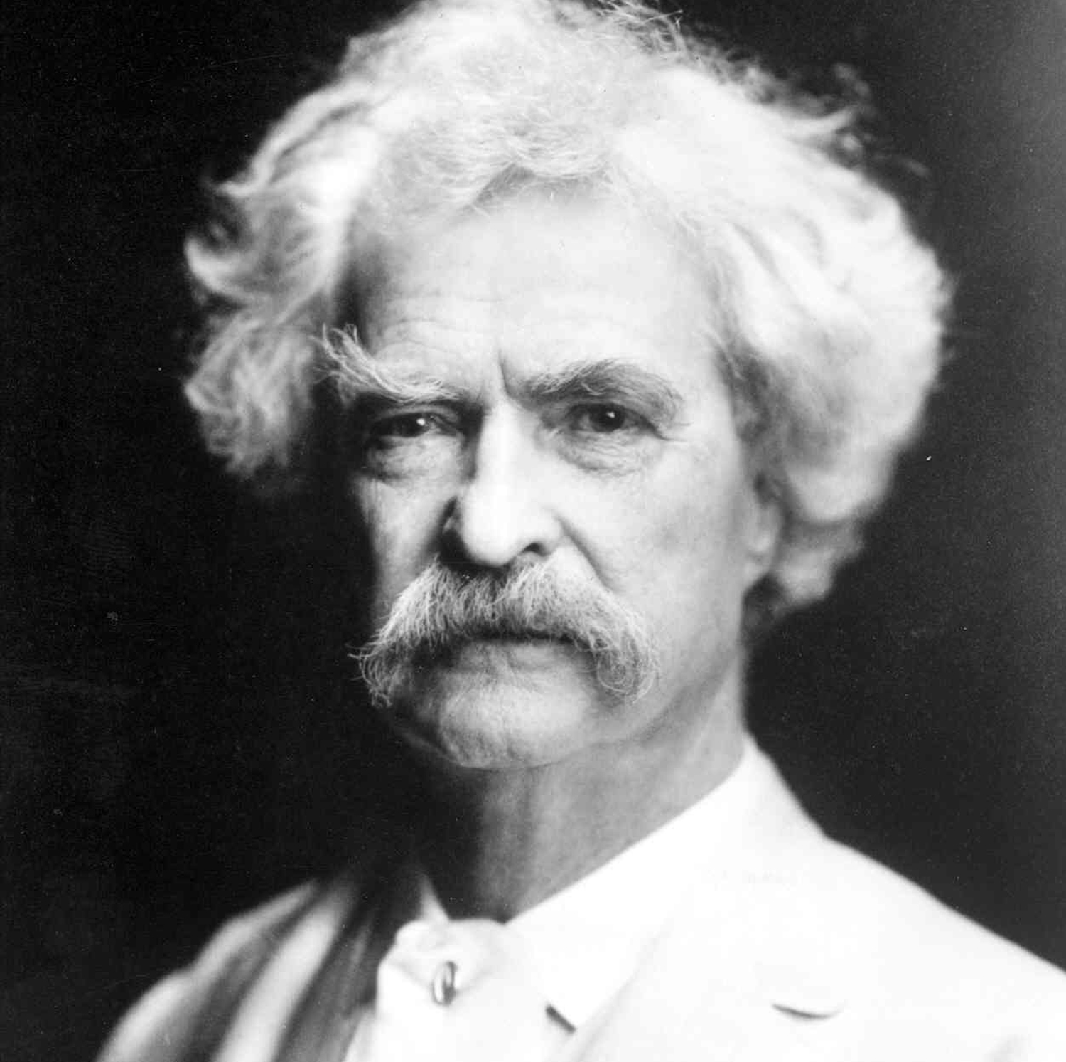
“It’s not what we don’t know that gets us into trouble, it’s what we know that ain’t so”
Mark Twain

Slide 3
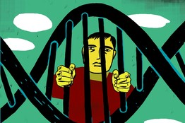
So what do we know that ain’t so?
You are not a prisoner of your DNA

Slide 4
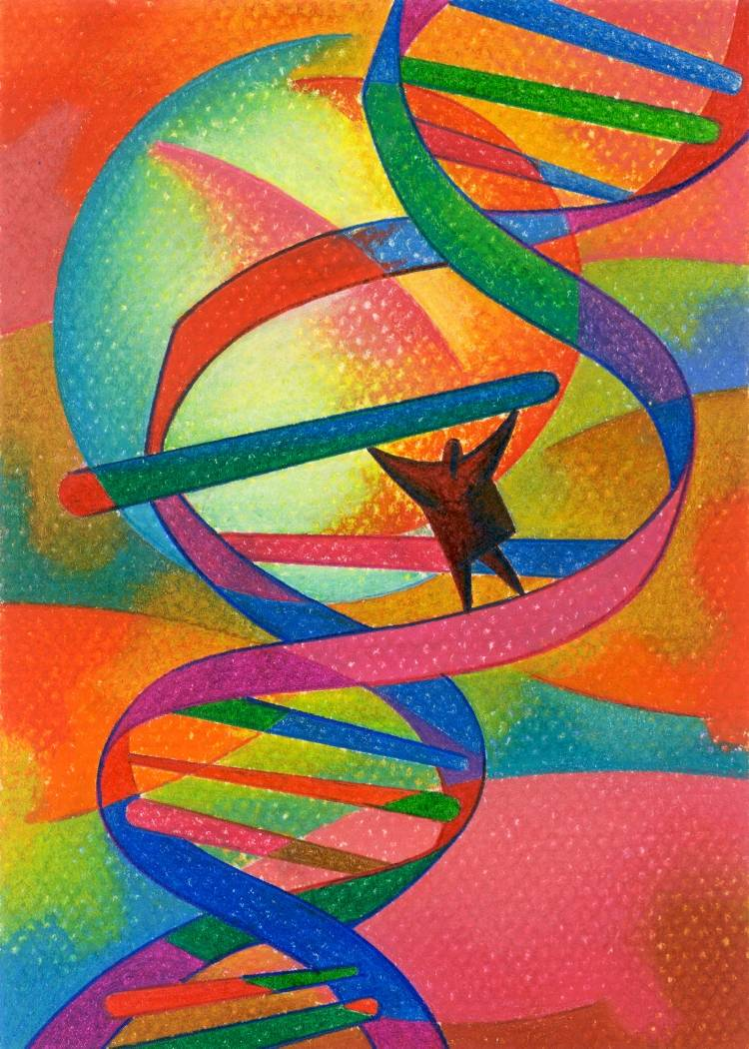
The Emerging Evidence
All health and disease are byproducts of complex individualized gene-environment interactions that go back more than a generation before conception and continue throughout our lives.
Your DNA i.e., your “Book of Life” have a Stone Age imperative, not often compatible with 21st century environmental inputs.
This incompatibility creates a disrupted metabolic drivers that forms the basis of chronic complex disease.
Through proven lifestyle medicine interventions, our gene expression patterns can be transformed to promote optimal function and health.

Slide 5
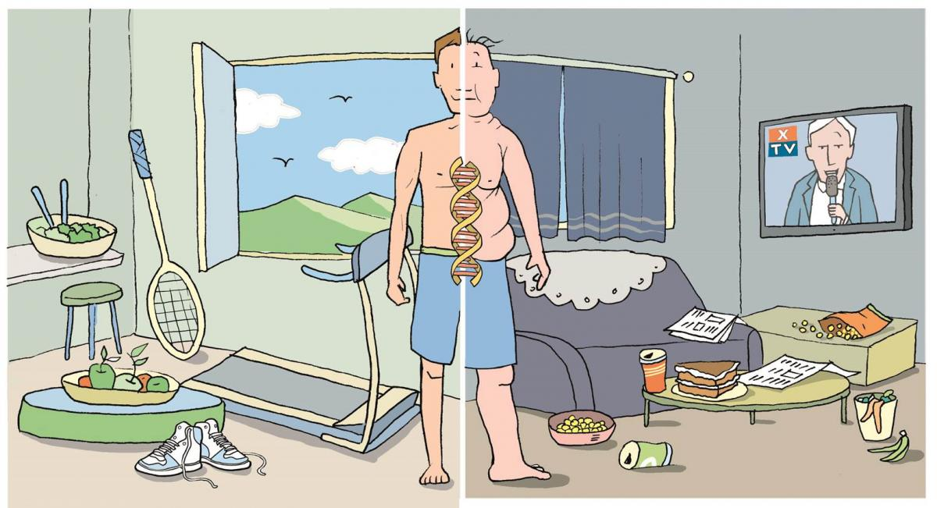
Epigenetics: A life with many possibilities.

Slide 6
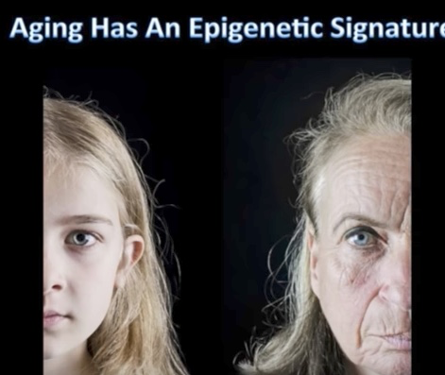
Aging has an Epigenetic Signature

Slide 7
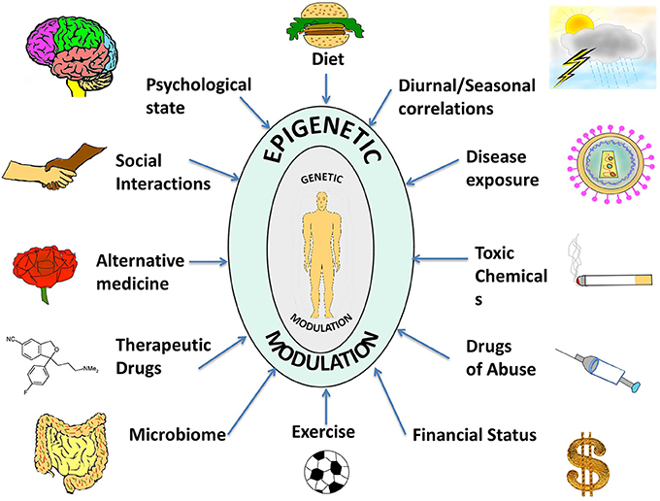

Slide 8
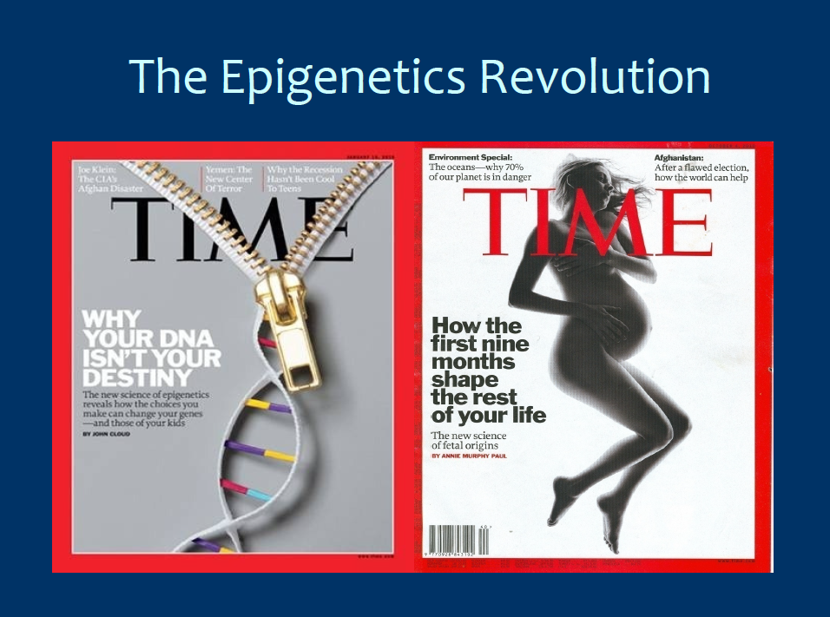


Slide 9
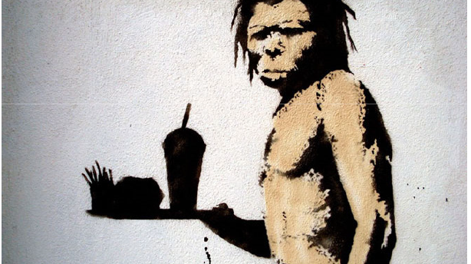
Health as a byproduct of gene-environmental compatibility

Slide 10
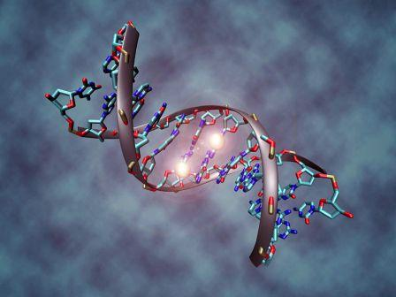
Representative Clinical Conditions Suggested to Have Epigenetic Origins
Obesity
Type 2 DM and Metabolic Syndrome
Coronary artery disease
Autoimmune Diseases
Cancer
Allergic Disorders
Depression
Neurologic: Alzheimer’s, PD, ALS, Autism

Slide 11
Lifestyle-Behavioral Factors Shown to Have Health-Promoting Epigenetic Influences
Whole, unprocessed foods
Movement
Mindfulness practices
Bonding-social connection
Reduction in Environmental Toxin exposure
Microbiome diversity
Natural environments
Purpose-meaning

Slide 12
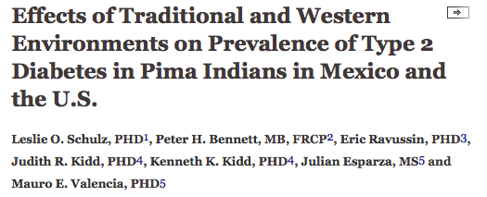
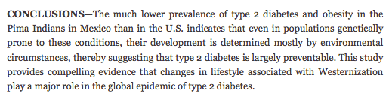
Prevalence of type 2 DM 5 times higher in Arizona Pima’s compared to Mexican Pima’s.
Diabetes Care August 2006 vol. 29 no. 8 1866-1871

Slide 13
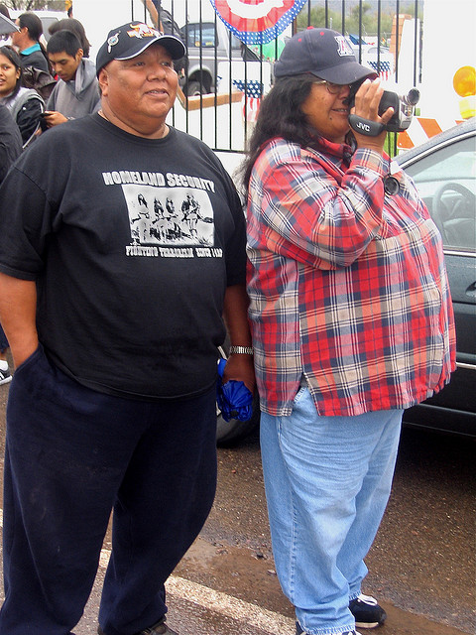



Slide 14
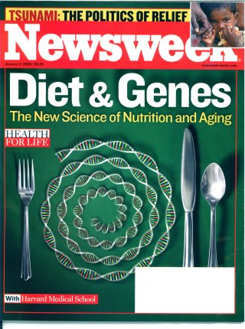

Slide 15
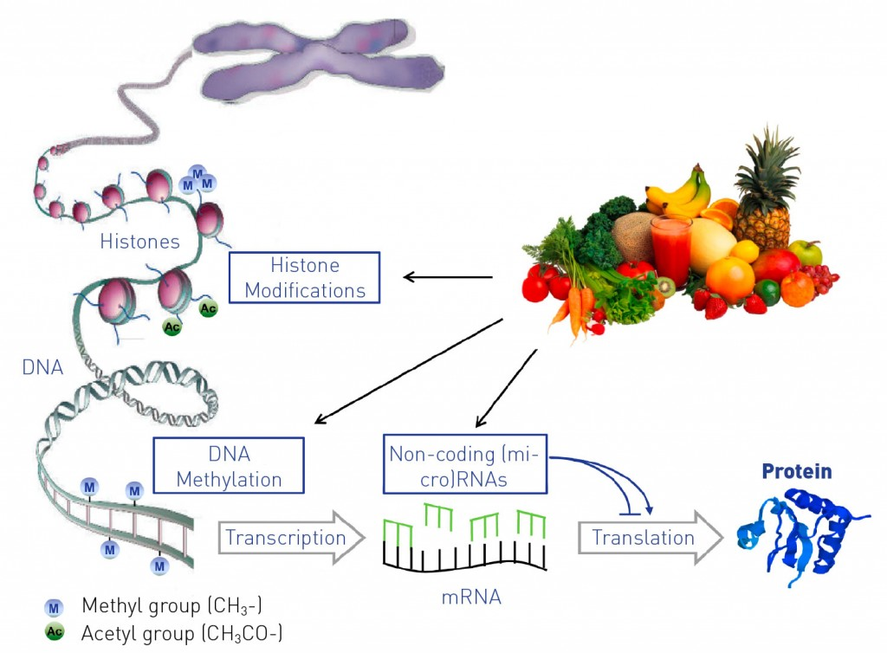
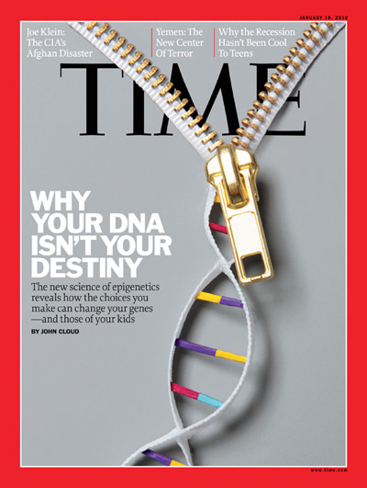

Slide 16
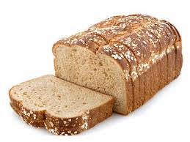
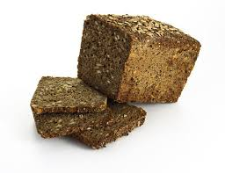
Different carbohydrates produce unique genomic responses
high glycemic carbs low glycemic carbs
62 genes up-regulated 71 genes down-regulated
linked to oxidative stress, regulating insulin signaling
Cytokine mediated immunity and and adipocyte cell size
Interleukin pathways Improved insulin index
Source: Kallio et al. Am J Clin Nutr;2007:851:1417-27
Notes:
47 subjects with metabolic syndrome, 12 weeks trial. No wt loss. Isocaloric.
II = change in I/change in G

Slide 17
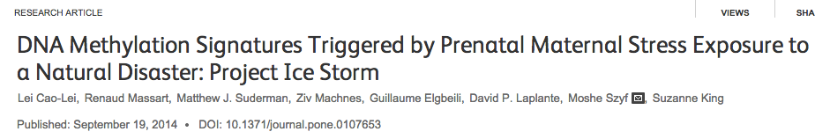
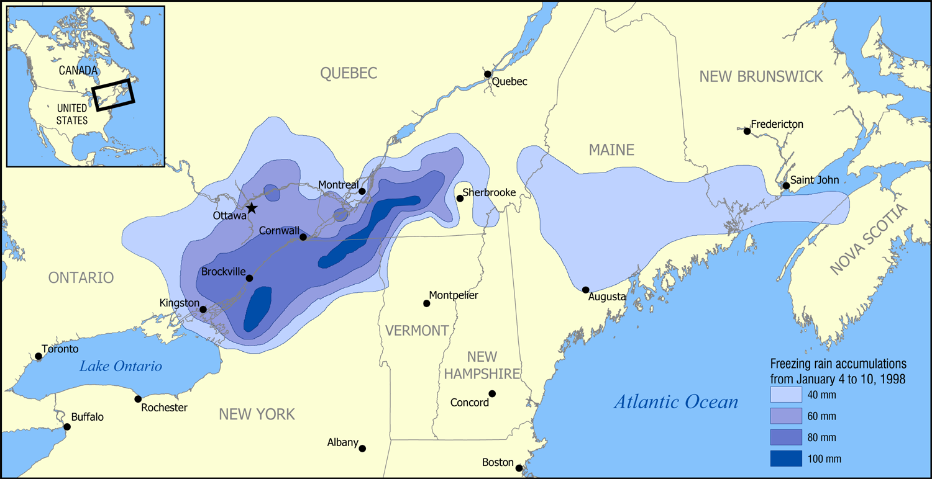
Conclusions
“These data provide first evidence in humans supporting the conclusion that PNMS results in a lasting, broad, and functionally organized DNA methylation signature in several tissues in offspring. We can infer that the epigenetic effects found in Project Ice Storm are due to objective levels of hardship experienced by the pregnant women.”

Slide 18
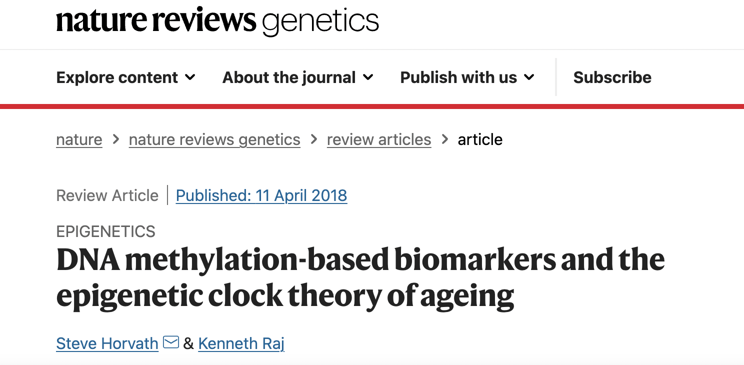

Slide 19
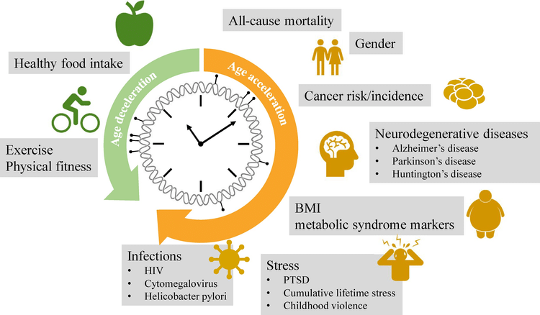
Back to the future: Epigenetic clock plasticity towards healthy aging
January 2018 Mechanisms of Ageing and Development DOI:10.1016/j.mad.2018.01.002

Slide 20
Epigenetic Reprogramming

Slide 21
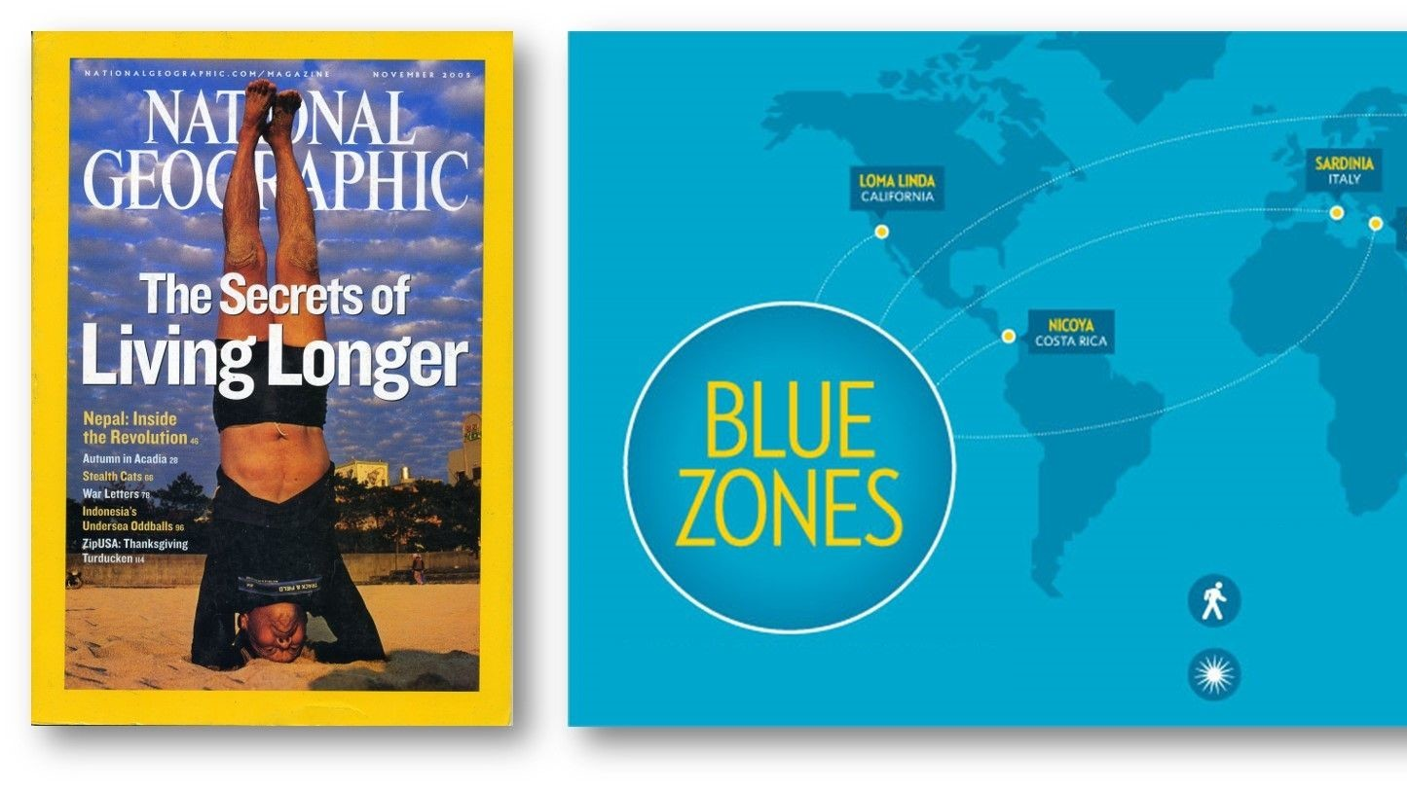

Slide 22
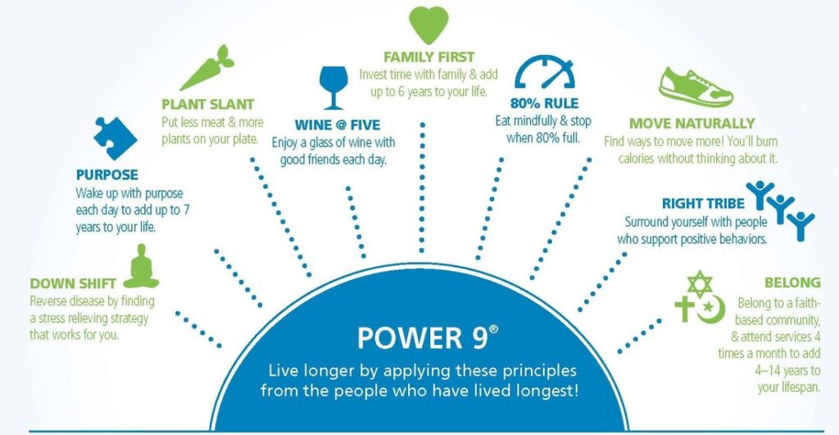

Slide 23


