Slide 1

Predictors of Longevity and Healthspan
MVO2
Lean Body Mass (LBM)
Strength e.g. hand grip
Lean Body Mass (LBM) is like a Metabolic Health Retirement Account. It’s never too late to start building that balance!

Slide 2
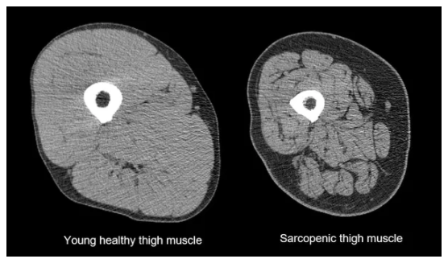
Sarcopenia is a major cause of reduced quality of life in older adults.
Often occurs with obesity, making diagnosis difficult.
The prevalence of sarcopenia among adults is increasing rapidly worldwide.
Cruz-Jentoft AJ, Bahat G, Bauer J, et al. Sarcopenia: revised European consensus on definition and diagnosis [published correction appears in Age Ageing. 2019 Jul 1;48(4):601]. Age Ageing. 2019;48(1):16-31.
Sobestiansky, S., Michaelsson, K. & Cederholm, T. Sarcopenia prevalence and associations with mortality and hospitalisation by various sarcopenia definitions in 85–89 year old community-dwelling men: a report from the ULSAM study. BMC Geriatr 19, 318 (2019).

Slide 3
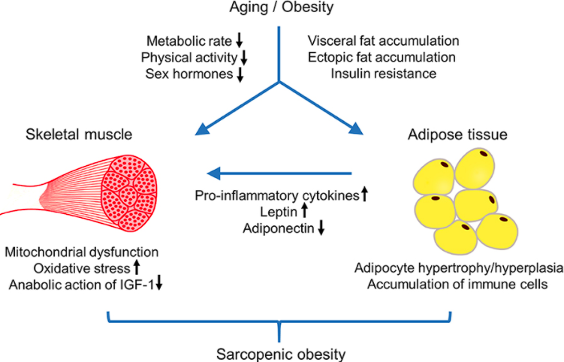
Roh E, Choi KM. Health Consequences of Sarcopenic Obesity: A Narrative Review. Front Endocrinol (Lausanne). 2020 May 21;11:332.

Slide 4
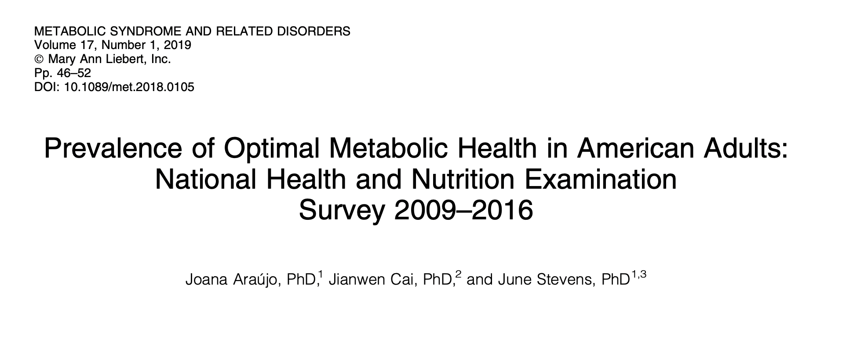
8721 individuals
Metabolic Health as defined by:
Waist circumference < 40” in men and < 36” women
BP 120/80 or less
FBS < 100; HbA1c < 5.7
TGA/HDL ratio < 3
No Meds
Only 12.2% individuals met all criteria
Disrupted metabolic health greatly accelerates aging, reduces longevity and diminishes health span.

Slide 5
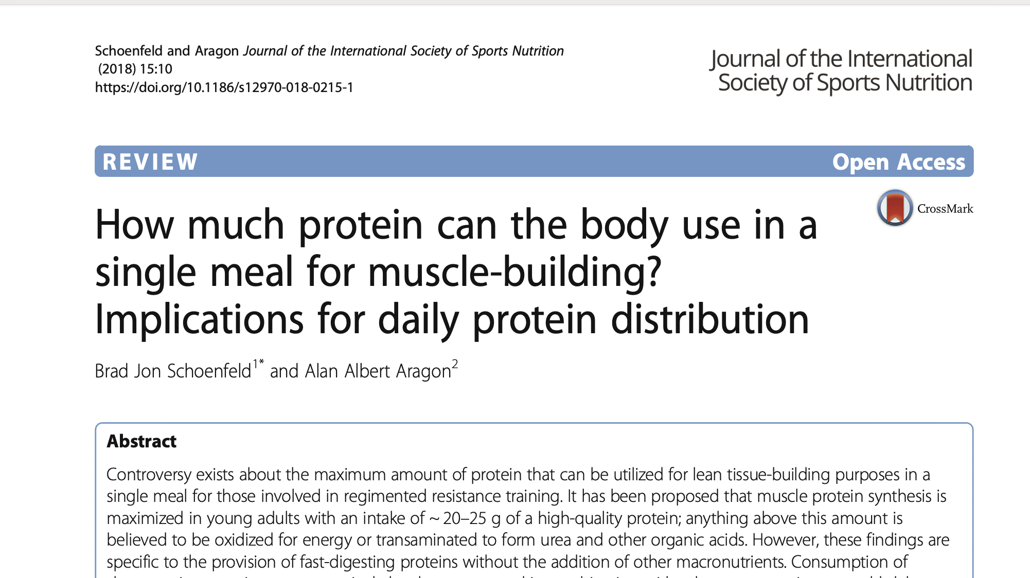
Based on the current evidence, we conclude that in order to maximize anabolism one should consume protein at a target range of 1.6 – 2.2 gm/kg/day

Slide 6
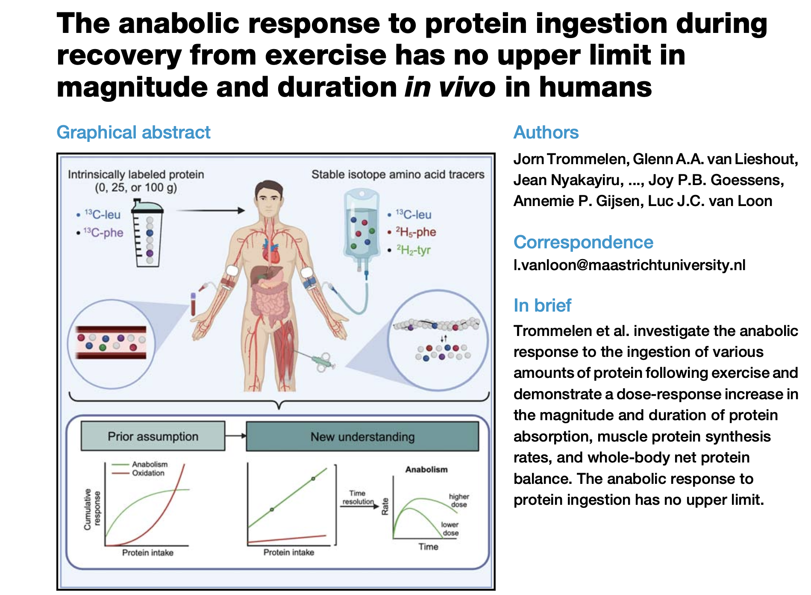

Slide 7
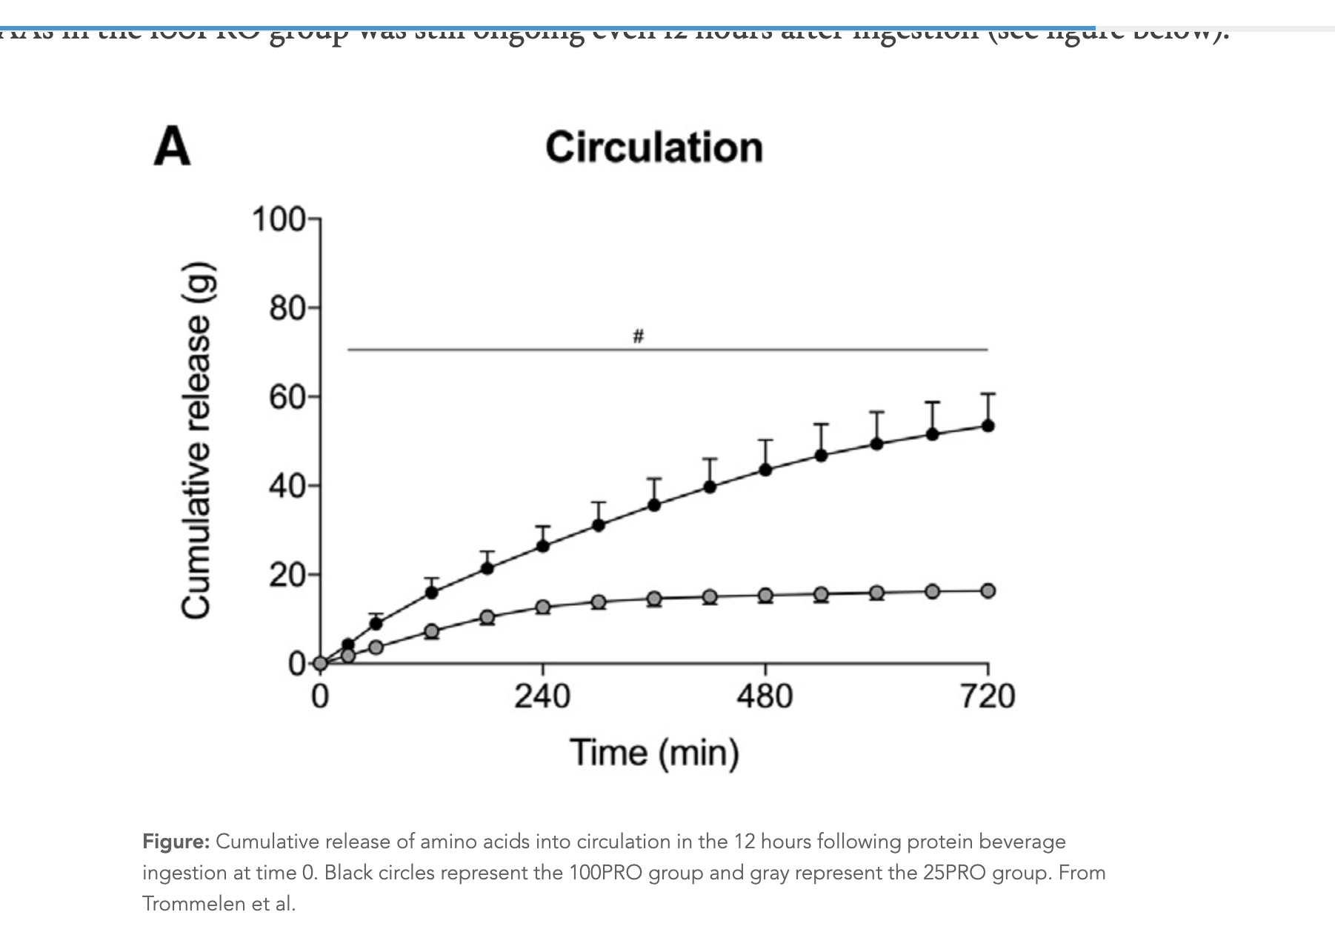

Slide 8
Summary
The historical RDA of 0.8 gms/kg/day may be too low for many who are losing weight (and LBM) and adults as they age and confront more anabolic resistance. 1.2 -1.6 g/kg/day seems a more appropriate target for most.
Daily ranges of 1.6 -2.2 gm/kg/day protein more optimal for promoting anabolism (overcoming anabolic resistance), maintaining lean body mass and promoting metabolic health.
Spreading daily protein intake over the day, including evening hours may best support muscle protein synthesis including the overnight fasting state.
At doses of 100 g/serving there does not appear to be a ceiling with respect to maximal protein bioavailability, integration and muscle protein synthesis (MPS)
Animal protein is more complete with respect to anabolic-promoting AA balance e.g. more leucine, isoleucine, glycine, and methionine with greater bioavailability. Plant-based proteins can be designed to meet these needs though requires more careful meal planning to assure both quality and quantity sufficient to meet metabolic demand.

Slide 9
Summary
There is an important difference between protein needs for muscle protein synthesis as compared with amino acid (AA) needs for daily protein turnover, meeting metabolic demands, and restoration and repair. Higher daily protein intakes result in minimal AA oxidation. In other words, most is utilized and not ”wasted”.
Lean body mass is like a metabolic retirement account. All aspects of human health, performance, health span and longevity are strongly correlated with higher lean body mass and lower body fat stores.

Slide 10
Emerging Evidence
Current RDA of 0.8 gm/kg/day appears insufficient to meet the optimal metabolic needs of many subgroups e.g. children, older adults, active adults who wish to develop-maintain more lean body mass (LBM); individuals with high metabolic-demand e.g. inflammation, insulin resistance, visceral adipose, etc.
Sarcopenia (and osteoporosis) has reached epidemic proportions and has profound implication for disease-mortality risk and costs of care.
More recent isotope techniques and more accurate measures of beta-oxidized amino acids suggest high protein turnover @ 300 gms/day in normal sedentary adults and higher in active, anabolic metabolic states.

Slide 11
Emerging Evidence
Isotope and muscle biopsy analysis, in response to a high protein load e.g. 100 grams suggests MPS to peak in 2-3 hours and continue for up to 12 hours. It appears there is no ceiling with ongoing MPS as long as AA levels (leucine, isoleucine, glycine and methionine) are adequate.
At high protein loads, there is minimal beta-oxidation. Most is used for systemic protein turnover-synthesis.
Difference between MPS demands and Total Body AA demands.

Slide 12
History of RDA Development
Acceptable Macronutrient Distribution Range (AMDR) was set at 10-35% for protein
10% of 2000 kcal results in 50g of protein/day (the absolute lowest level of the AMDR and the current DV used for protein)
Recommended total dietary protein intakes for adults have remained constant for over 40 years and individual amino acid intake recommendations have not been updated since reports published in the 2005–2007 timeframe
Only 14 individuals over the age of 65 (7 men, 7 women) were used in a nitrogen balance study to determine if elderly populations should have a higher RDA
Major disagreement amongst protein experts regarding regression models of analysis Bi-phase linear regression as opposed to a linear regression model
Same data used to establish the RDA for protein at 0.8gm/kg/day
1. Rand WM, Pellett PL, Young VR. Meta-analysis of nitrogen balance studies for estimating protein requirements in healthy adults. Am J Clin Nutr (2003) 77:109–27.
2. Humayun MA, Elango R, Ball RO, Pencharz PB. Reevaluation of the protein requirement in young men with the indicator amino acid oxidation technique. Am J Clin Nutr (2007) 86:995–1002.

Slide 13
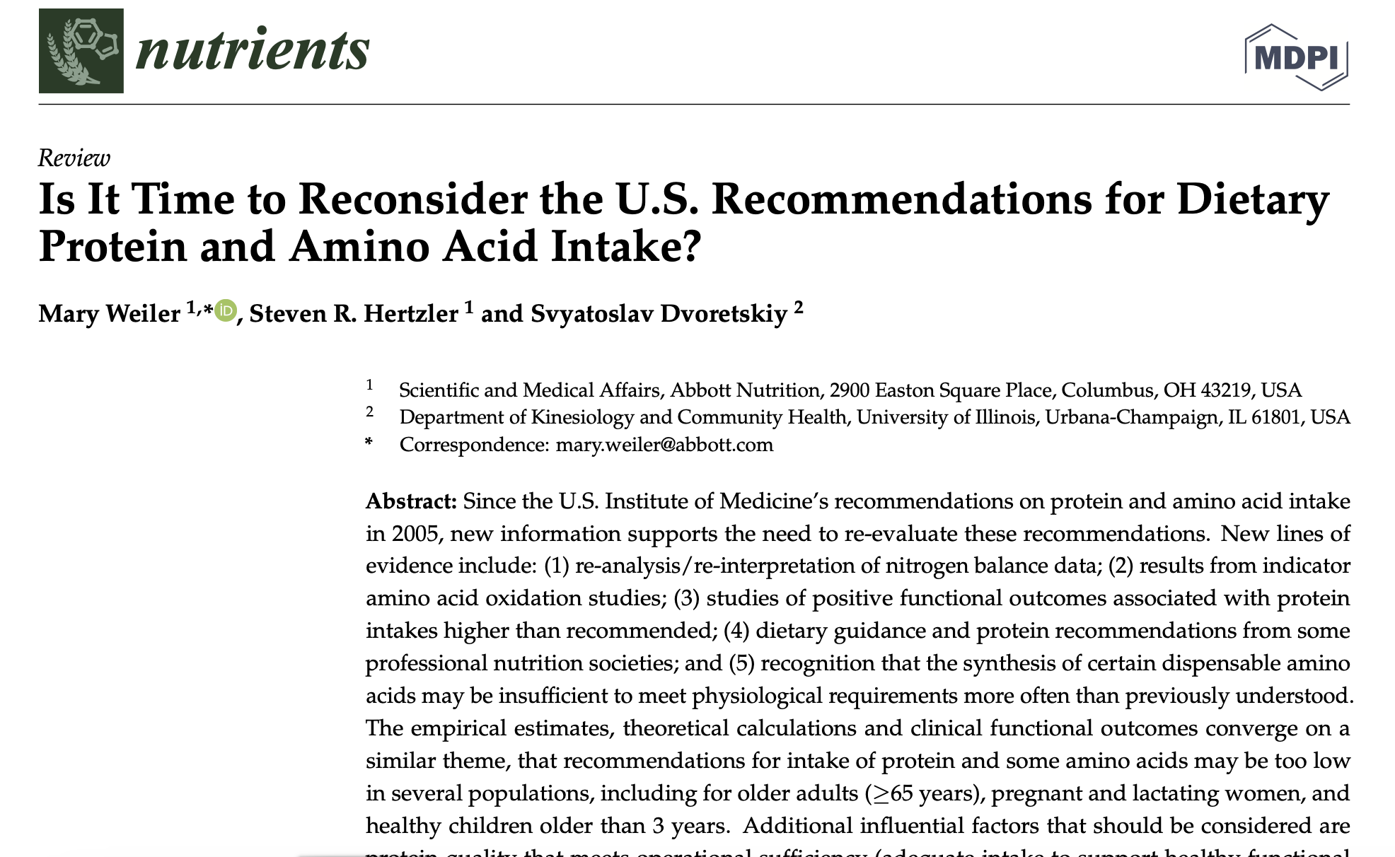
Nutrients 2023, 15, 838. https://doi.org/10.3390/nu15040838

Slide 14
Challenges with Nitrogen Balance Testing as a Measure of Protein Needs
There are multiple difficulties associated with the nitrogen balance methodology regarding not only the technical aspects of how to measure it, but also the interpretation of the data.
Whole-body protein turnover, as evidenced by enzyme kinetics of the urea and citric acid cycles, strongly suggests that the components of protein turnover, including amino acid oxidation, are affected and may even be regulated by changes in amino acid supply and/or amino acid concentration
Evidence of alternative roles of amino acids beyond their role as subunits of protein synthesis indicate that a competitive scenario for the available amino acid pool could likely impact the homeostasis measured in a nitrogen balance study
In addition, metabolic adaptation to low protein intakes complicates the interpretation of nitrogen balance data
Finally, studies on histidine demand have shown that nitrogen balance is not equivalent to amino acid balance
These considerations, along with the understanding that the nitrogen balance technique has many limitations including overestimation of nitrogen intake and an underestimation of nitrogen excretion, have led to alternative approaches to understanding protein needs.
In the latest Dietary Reference Intakes (DRI) [3] and WHO/FAO report [4] on protein and amino acid intake recommendations, it was acknowledged that the 24-h indicator amino acid oxidation (IAAO) and balance method was considered the gold-standard method to estimate amino acid requirements. New studies using this methodology have supported increased needs for both total protein and for some amino acids for some populations. With the understanding that nitrogen balance is not equivalent to amino acid balance, this review also explored whether information on usual recommended intakes of protein versus those exceeding the Recommended Dietary Allowance (RDA) support improved health or functional outcomes, as this is the public health aim for setting a nutrition requirement, to determine if these lines of alternative evidence further validate the current U.S. DRI for protein or lend credence to increasing the RDA
Nutrients 2023, 15, 838. https://doi.org/10.3390/nu15040838

Slide 15
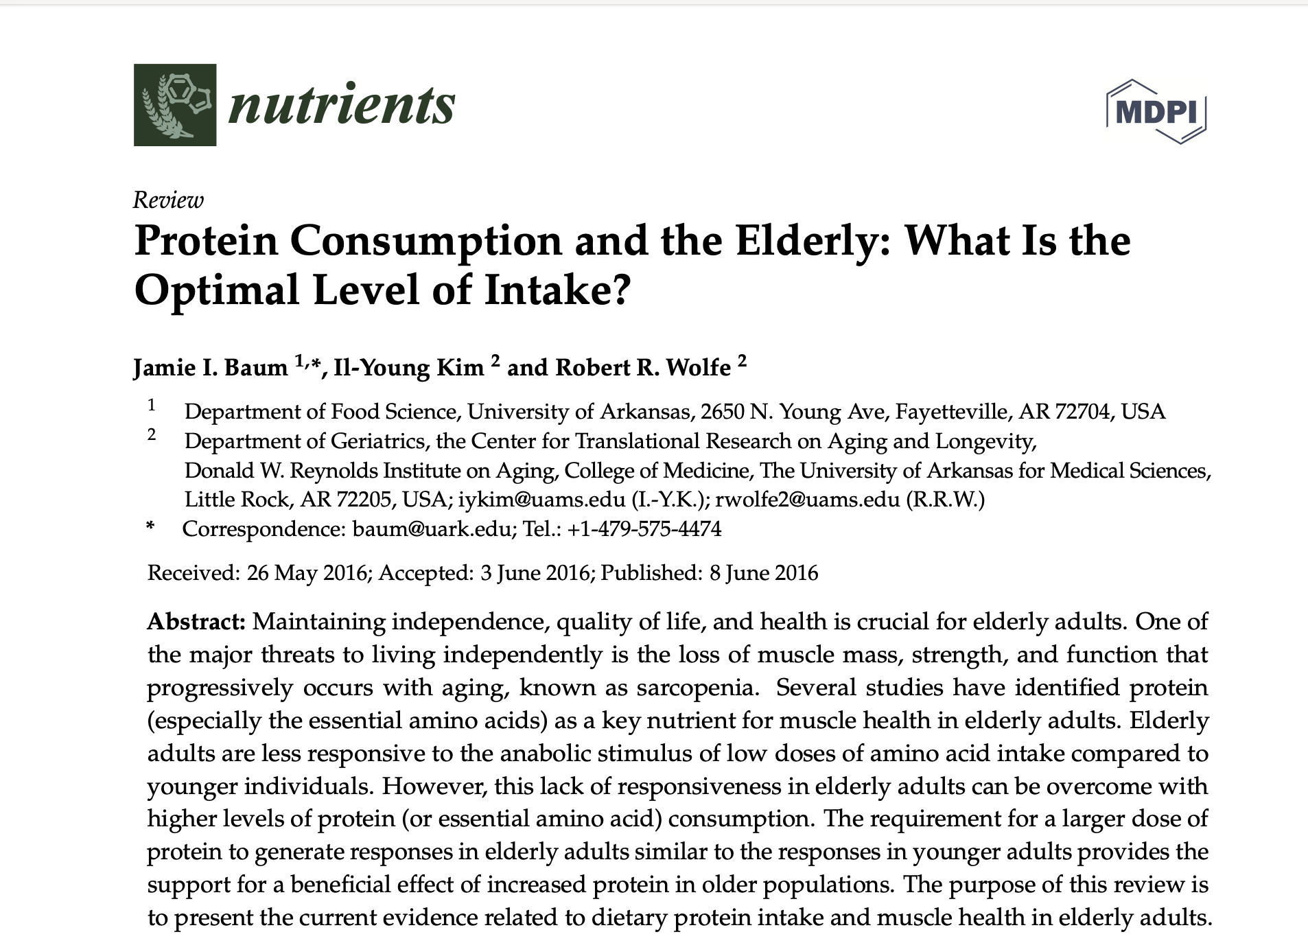
Elderly adults are less responsive to the anabolic stimulus of protein-amino acid intake compared to younger adults. However, this lack of responsiveness in elderly adults can be overcome with higher levels of protein consumption. This is also reflected in studies comparing varying levels of protein intake. This suggests that the lack of muscle responsiveness to lower doses of protein in older adults can be overcome with a higher level of protein intake. The requirement for a larger dose of protein to generate responses in elderly adults similar to the responses in younger adults provides the support for a beneficial effect of increased protein in elderly populations. The consumption of dietary protein consistent with the upper end of the AMDRs (as much as 30%–35% of total caloric intake) may prove to be beneficial.

Slide 16
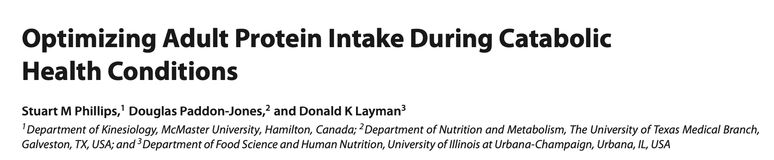
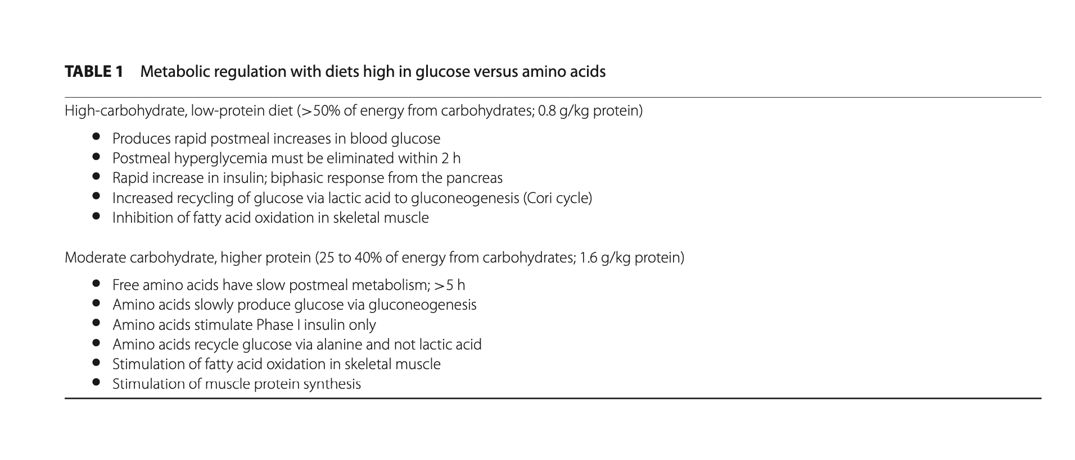
AdvNutr 2020;11:S1058–S1069.

Slide 17
AdvNutr 2020;11:S1058–S1069.

Slide 18
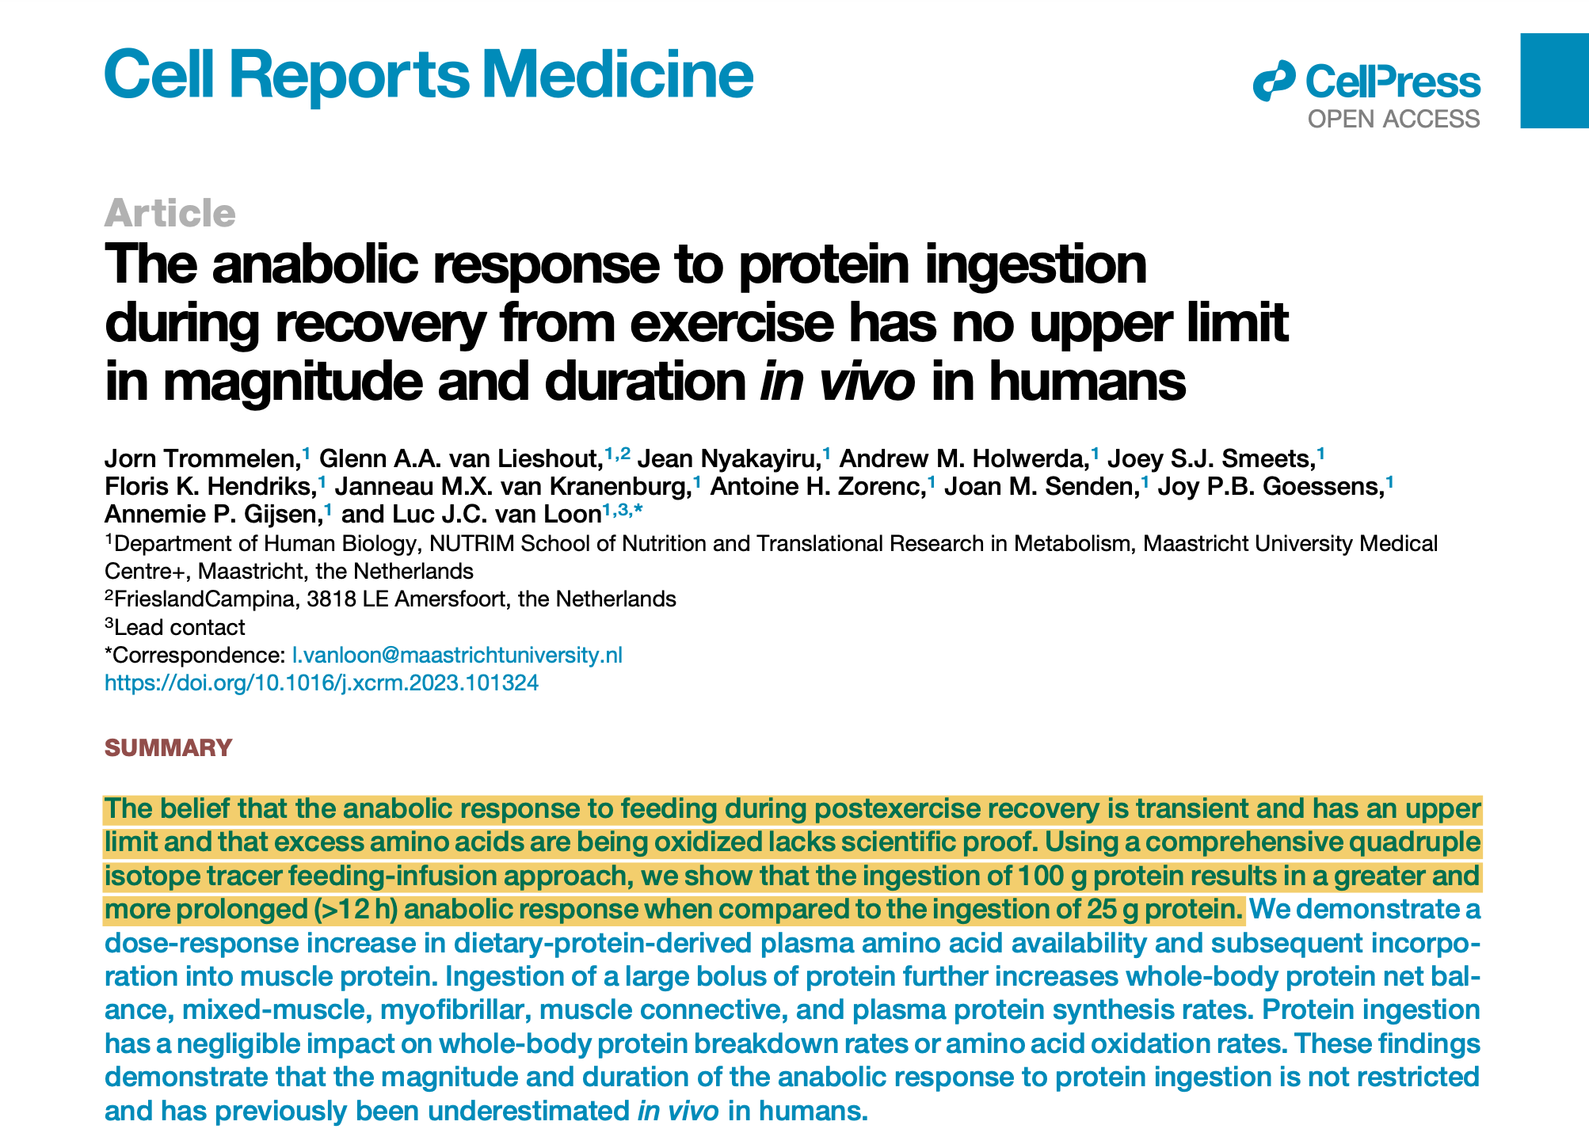
The belief that the anabolic response to feeding during postexercise recovery is transient and has an upper limit and that excess amino acids are being oxidized lacks scientific proof. Using isotope tracers we show that the ingestion of 100 g of protein results in a greater and more prolonged 9>12 h) anabolic response when compared to ingestion of 25 g protein.

