Slide 1
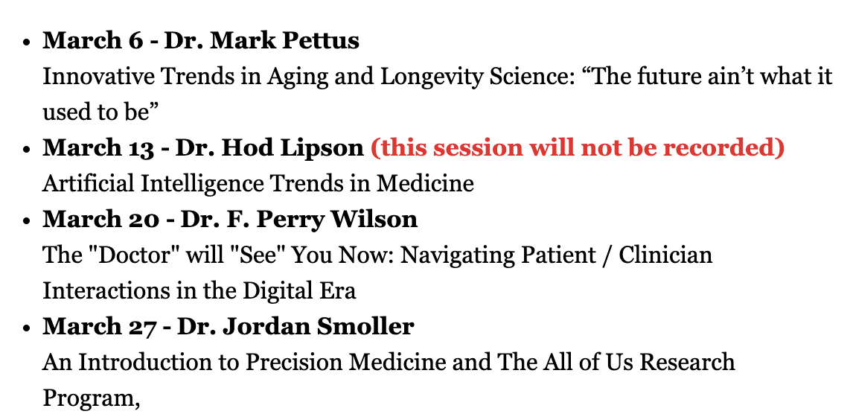

Slide 2
Innovative Trends in Aging and Longevity Science:
“The future ain’t what it used to be”
Mark Pettus MD
Associate Professor of Medicine
University of Massachusetts Chan Medical School
March 6, 2024

Slide 3
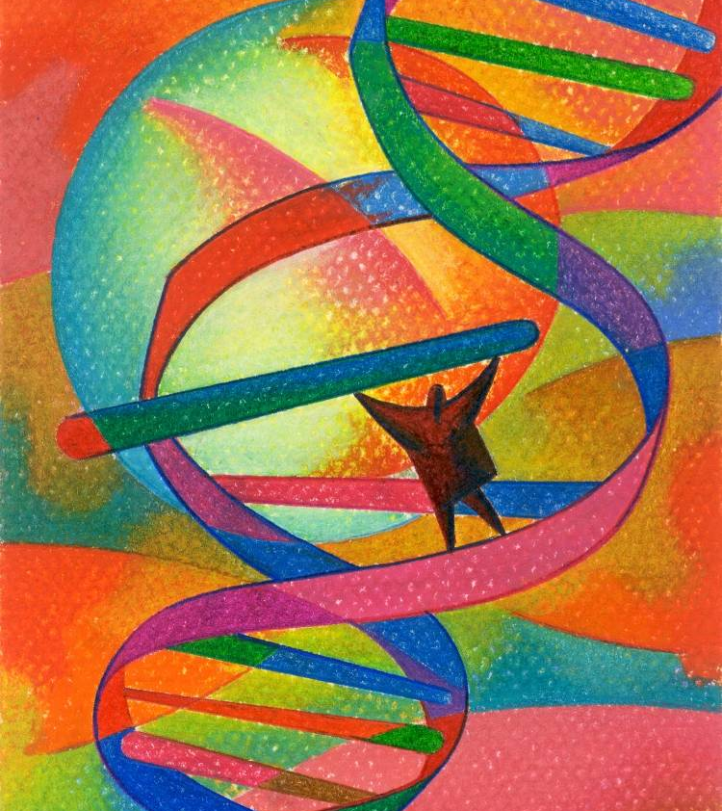
Questions for consideration:
Is our longevity genetically predetermined?
What is the difference between health span and lifespan?
What is the difference between chronologic age and biologic age?
Is aging a disease?
As age is most strongly associated with all advanced chronic diseases, should we focus on treating diseases or treating aging?
Can biologic age be regressed?

Slide 5
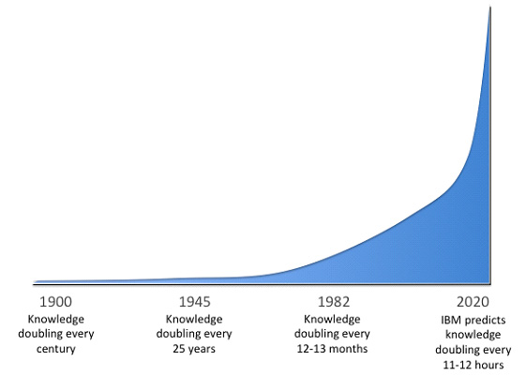
The Knowledge Doubling Curve
We are in the midst of a knowledge revolution. Computational capacity and AI are essential tools to leverage this knowledge explosion in a personalized and effective way!
Buckminster Fuller, in his book Critical Path (1982), describes the “knowledge-doubling curve,” explaining that new knowledge, which had doubled every century until 1900, is now estimated to double every 12 hours!

Slide 6
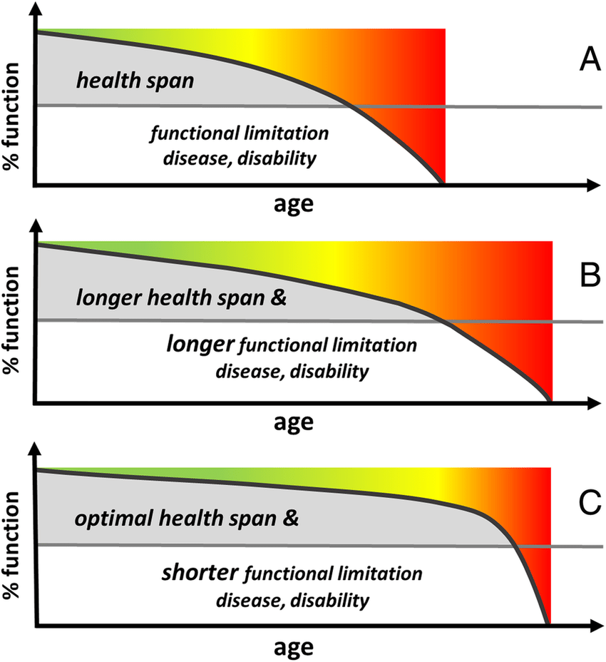
Longevity
and
Healthspan

Slide 7
Environment
Lifestyle
Longevity
Healthspan
Epigenetics/
Genetics
Microbiome
Consciousness-Spirituality-Meaning

Slide 8
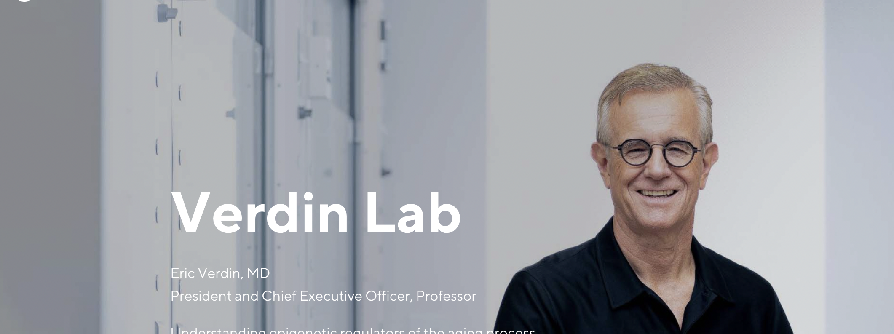
“Only 8% of what contributes to longevity can be traced to genetics. Over 90% of what contributes to longevity and healthy aging is lifestyle.”
Eric Verdin MD
President and CEO, Buck Institute

Slide 9
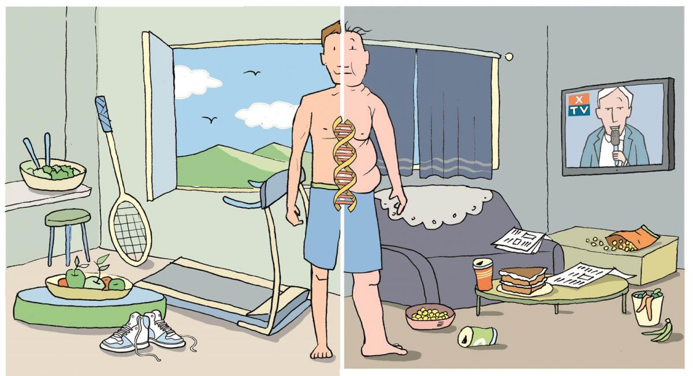
Epigenetics: A life with many possibilities.

Slide 10
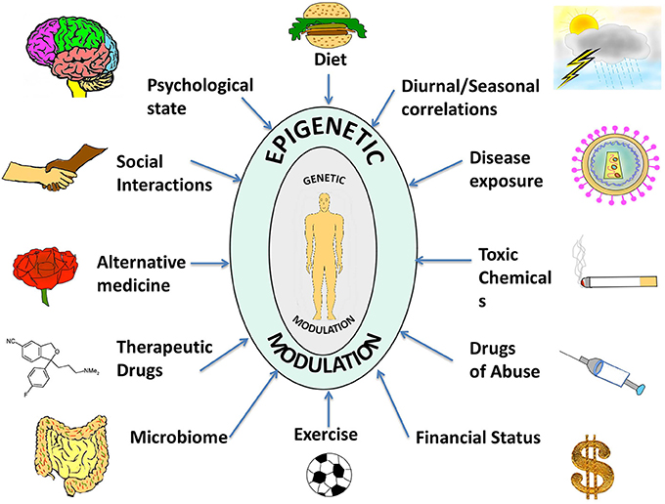

Slide 11
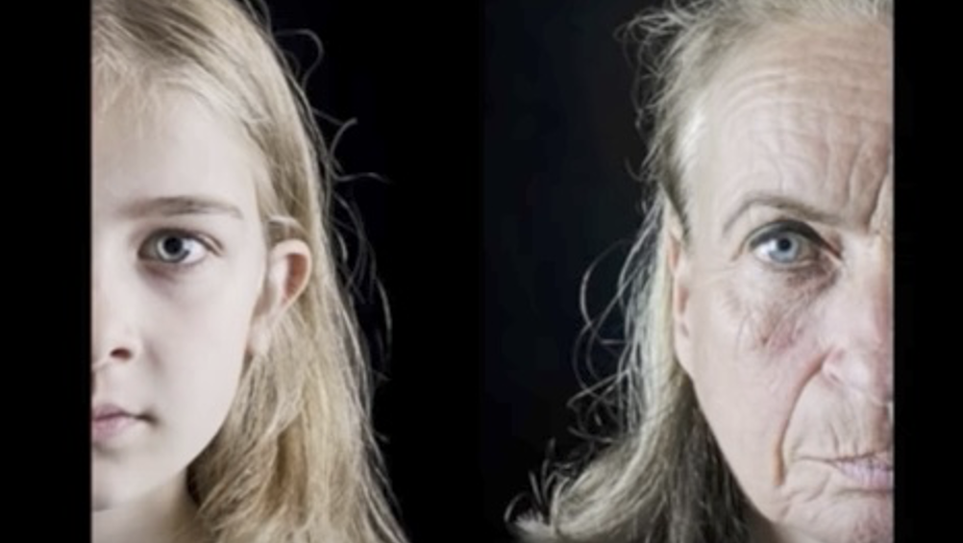
Aging Has an Epigenetic Signature

Slide 12
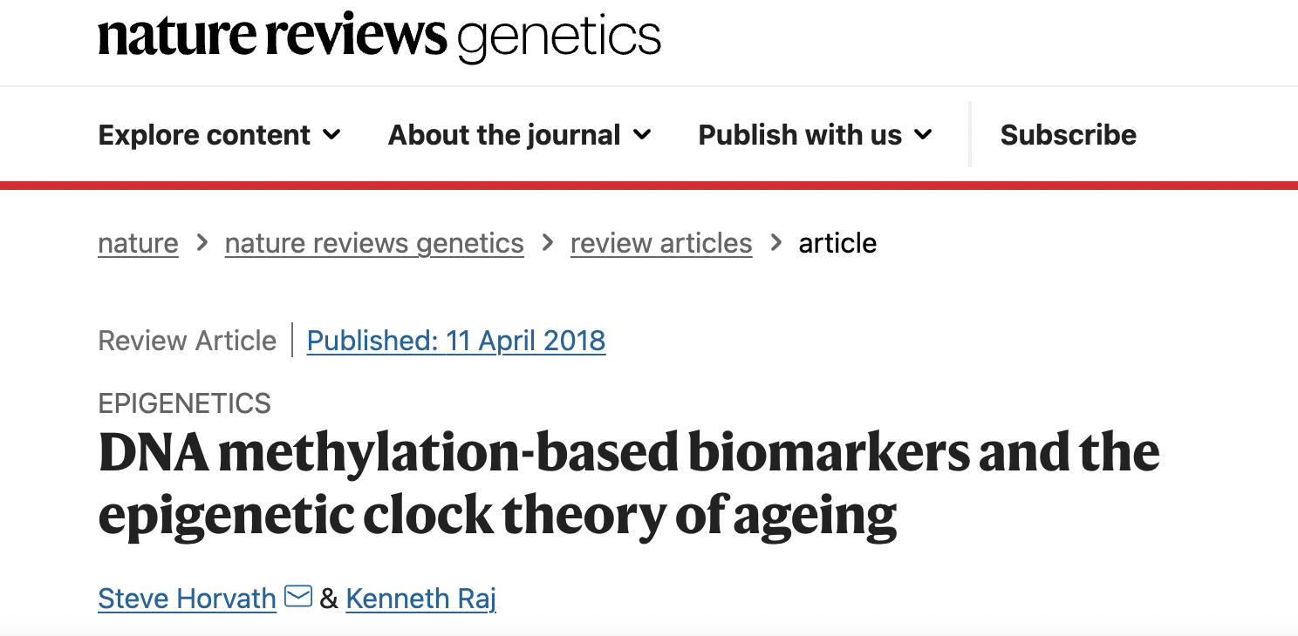

Slide 13
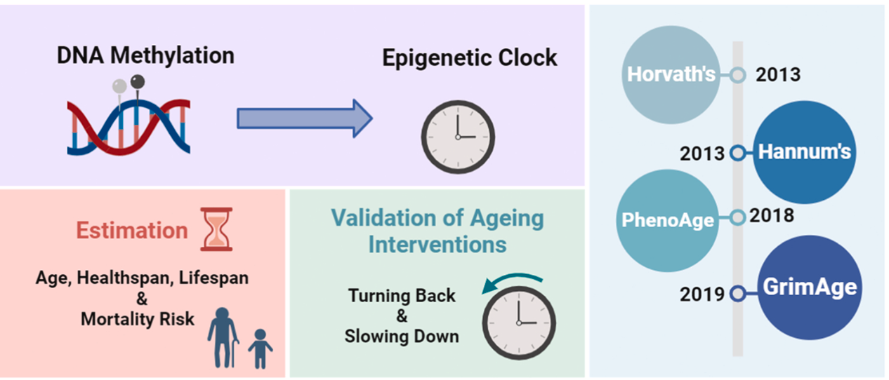

Slide 14
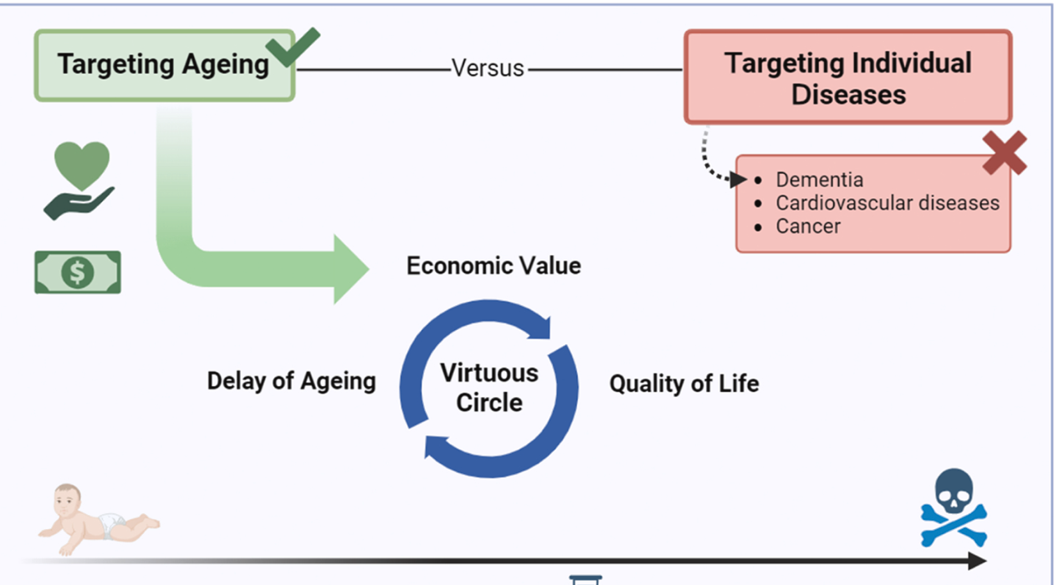

Slide 15
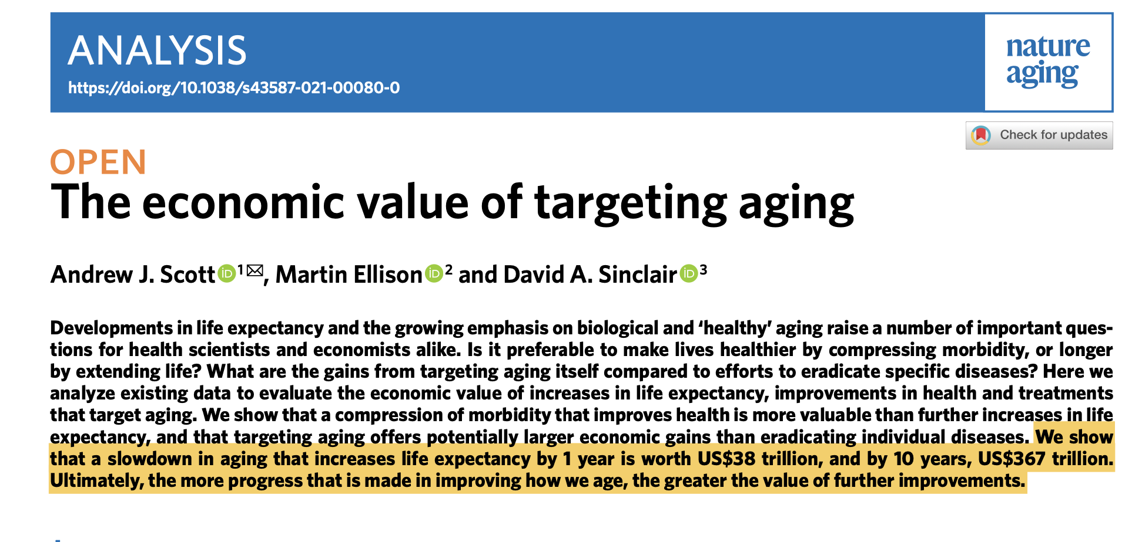
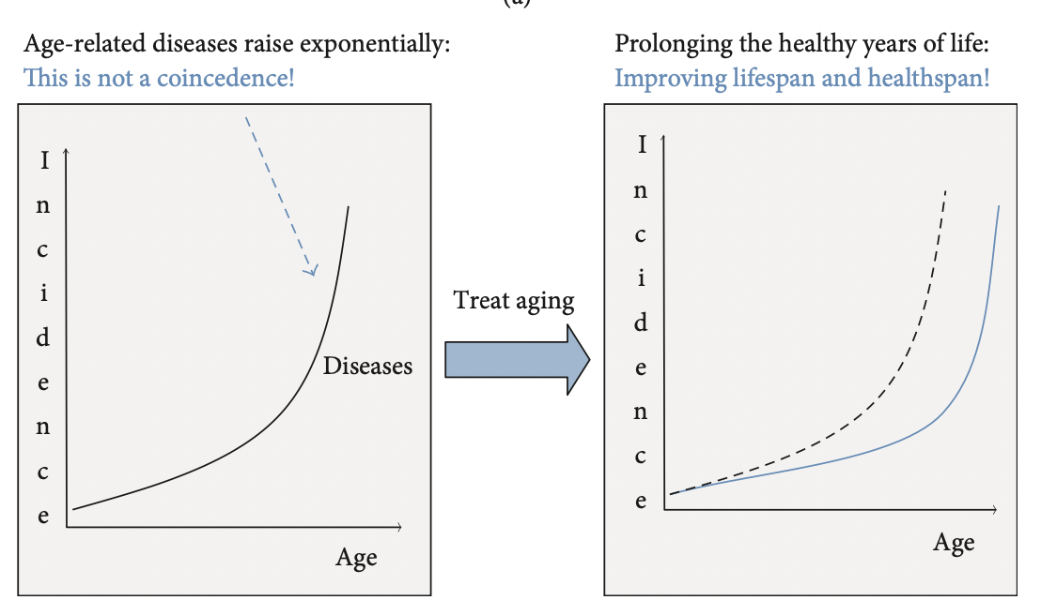
Treating Diseases vs. Treating Aging
Nature Aging | VOL 1 | JULy 2021 | 616–623 | www.nature.com/nataging

Slide 16
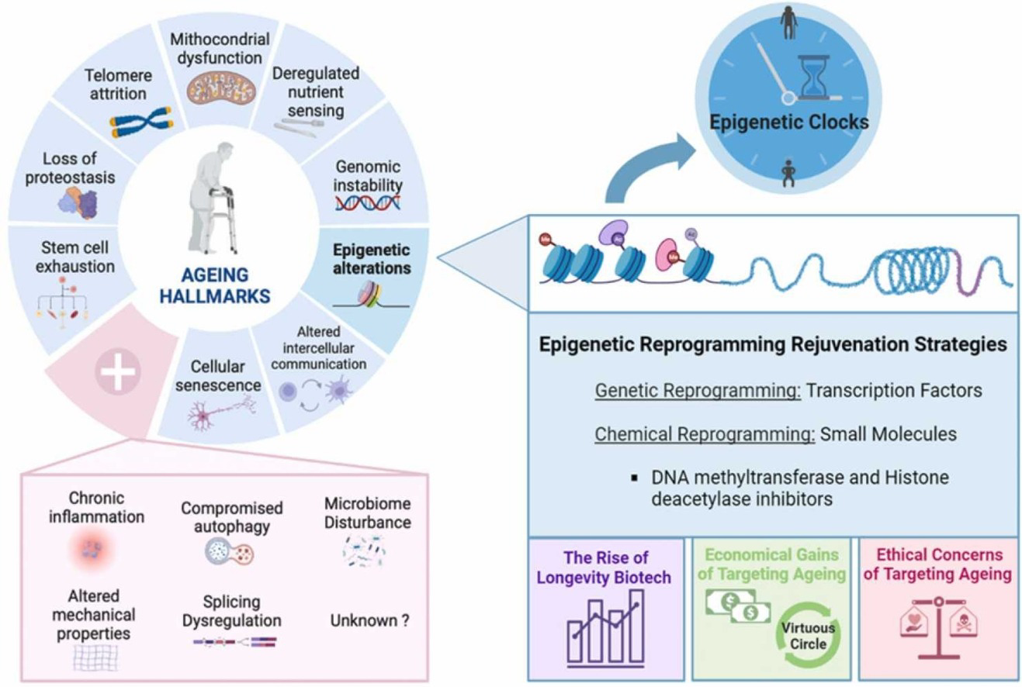
Ageing Research Reviews Volume 95, March 2024, 102204

Slide 18
Epigenetic Reprogramming

Slide 19
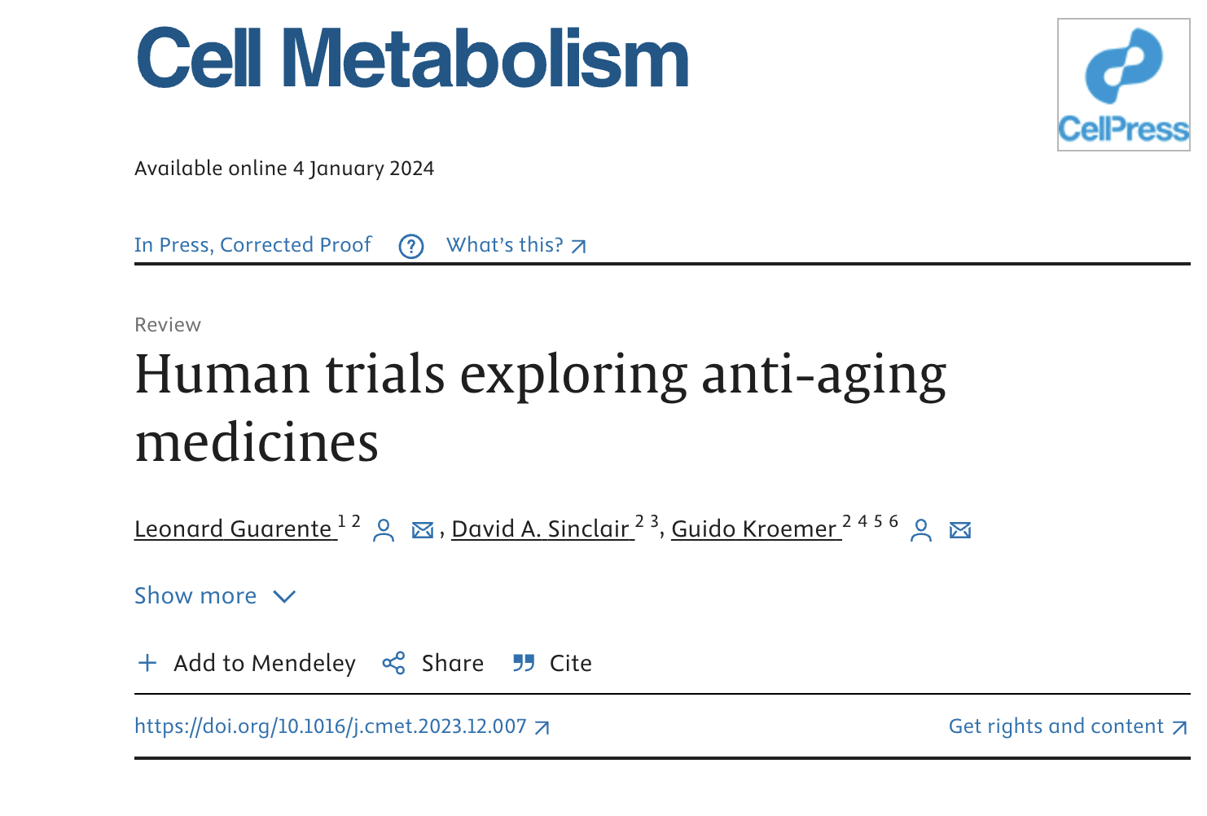

Slide 20
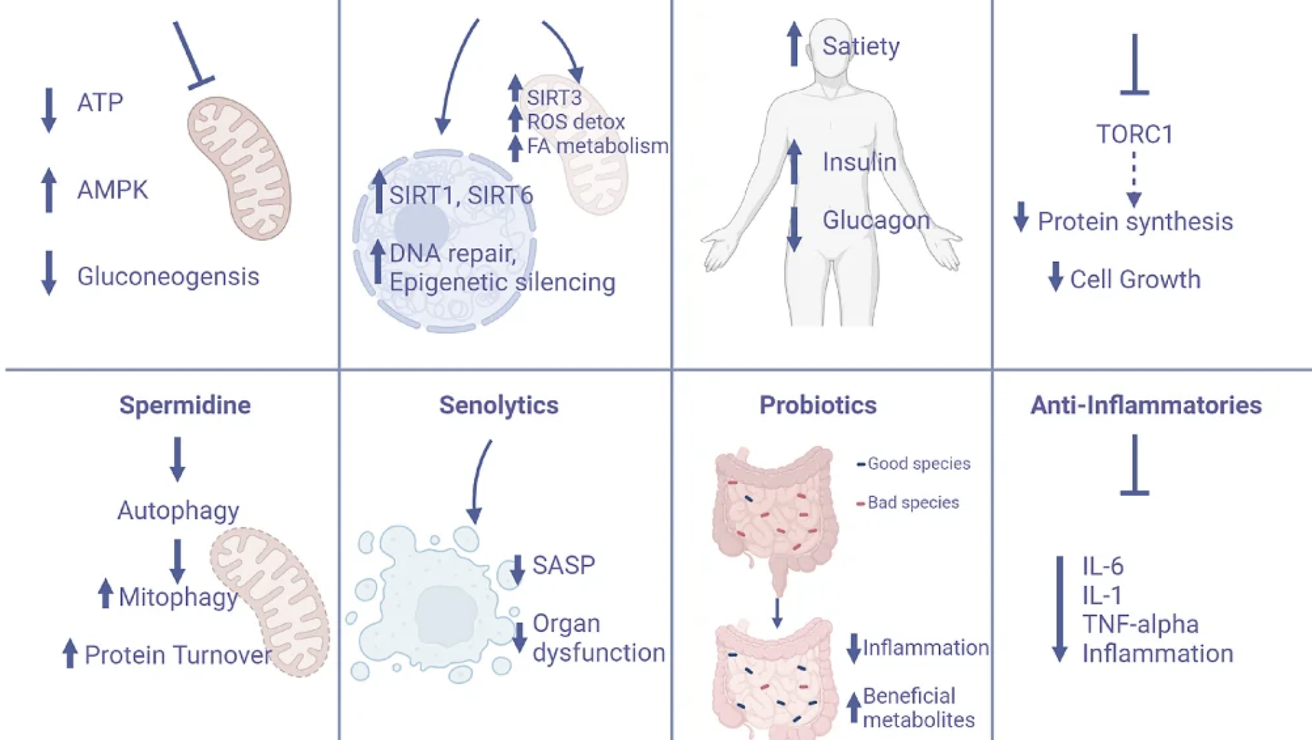
Sensitivity
Metformin
NAD Boosters NR/NMR
GLP-1 Agonists
Rapamycin
Curcumin

Slide 21
Hallmarks of Aging Associated with Cellular depletion of NAD+
Altered DNA repair (PARP activity NAD-dependent)
Altered epigenetics
Mitochondrial dysfunction
Disrupted metabolic-nutrient sensing e.g. Insulin resistance with glucose intolerance
Cellular senescence
Decreased autophagy

Slide 23
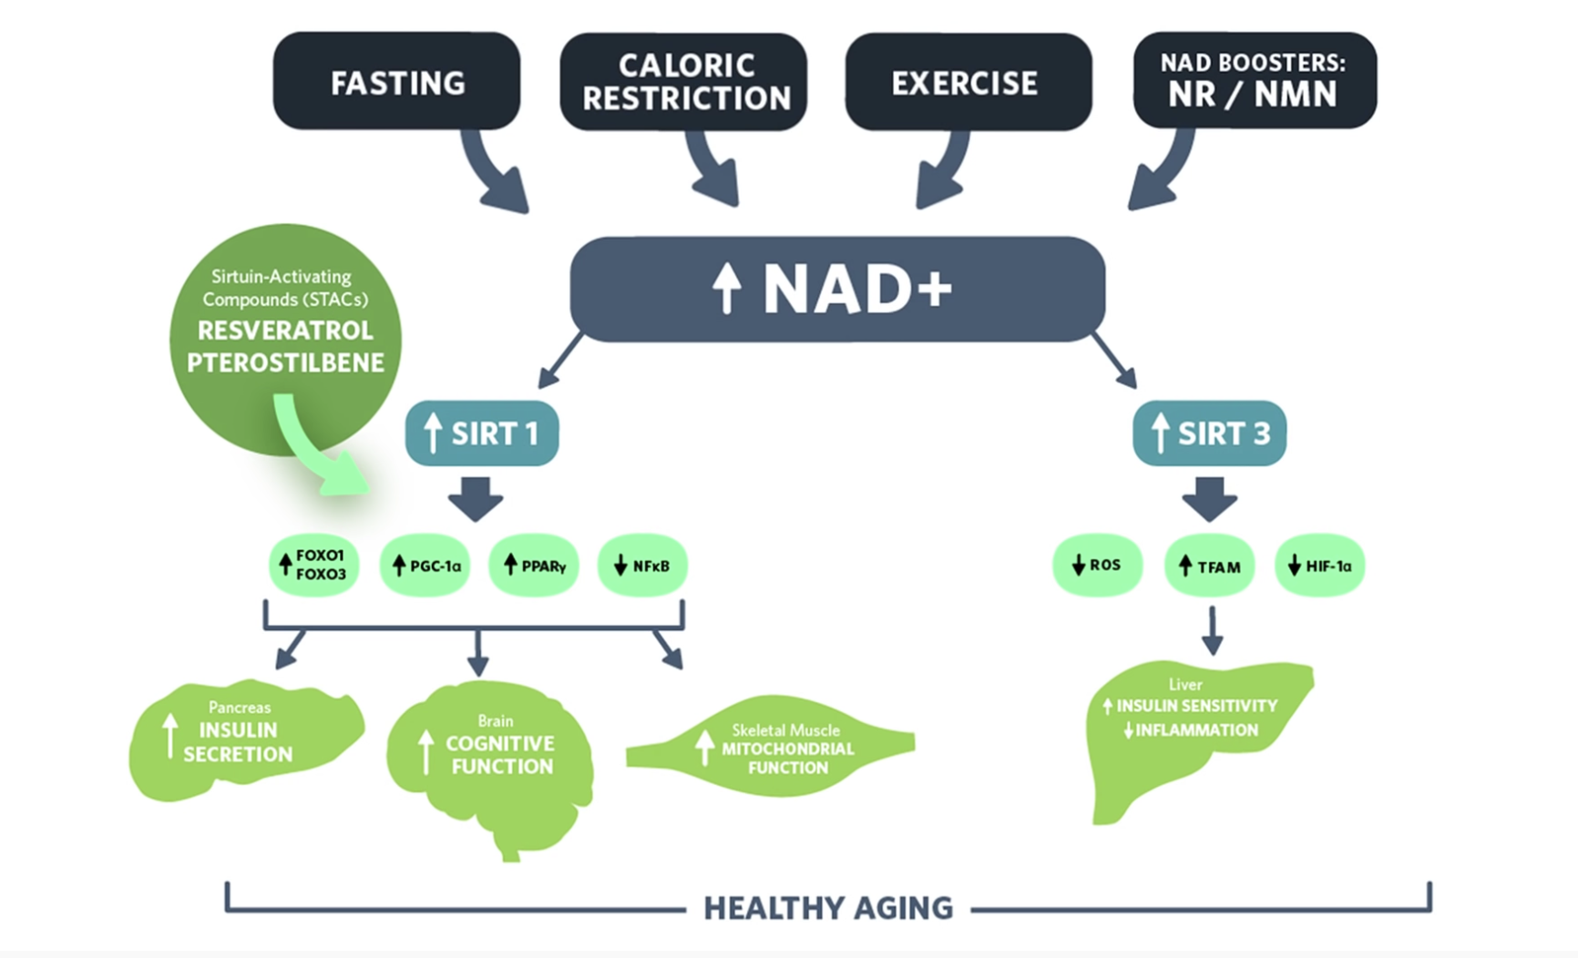
Rhonda Patrick PhD

Slide 24
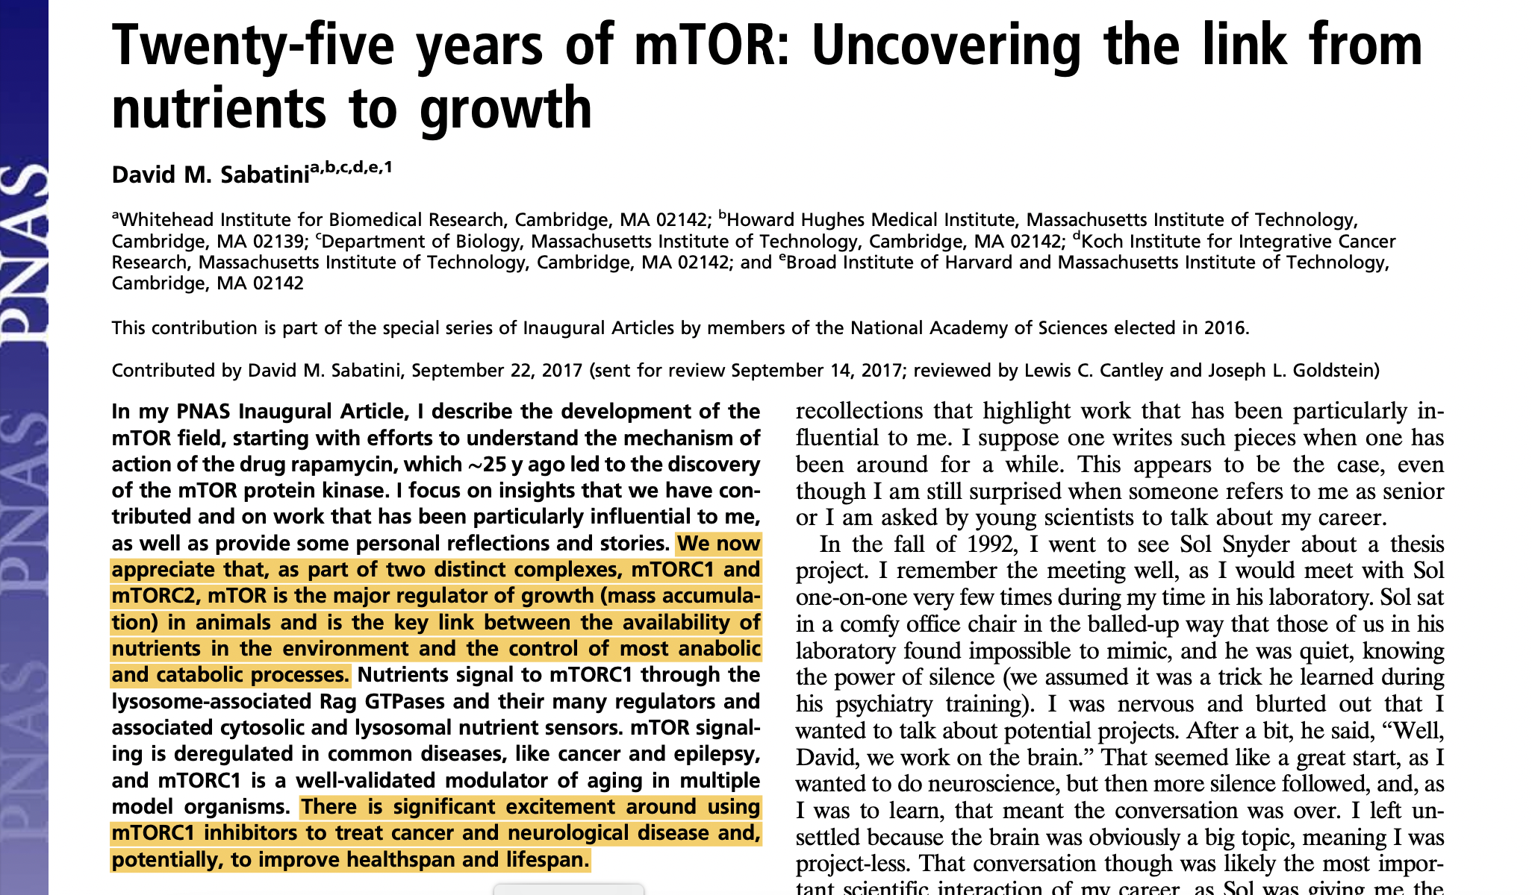
mTOR – Mammalian Target of Rapamycin
mTOR is the major nutrient-sensitive regulator of growth in animals and plays a central role in physiology, metabolism, the aging process, and common diseases.
11818–11825 | PNAS | November 7, 2017 | vol. 114 | no. 45

Slide 25
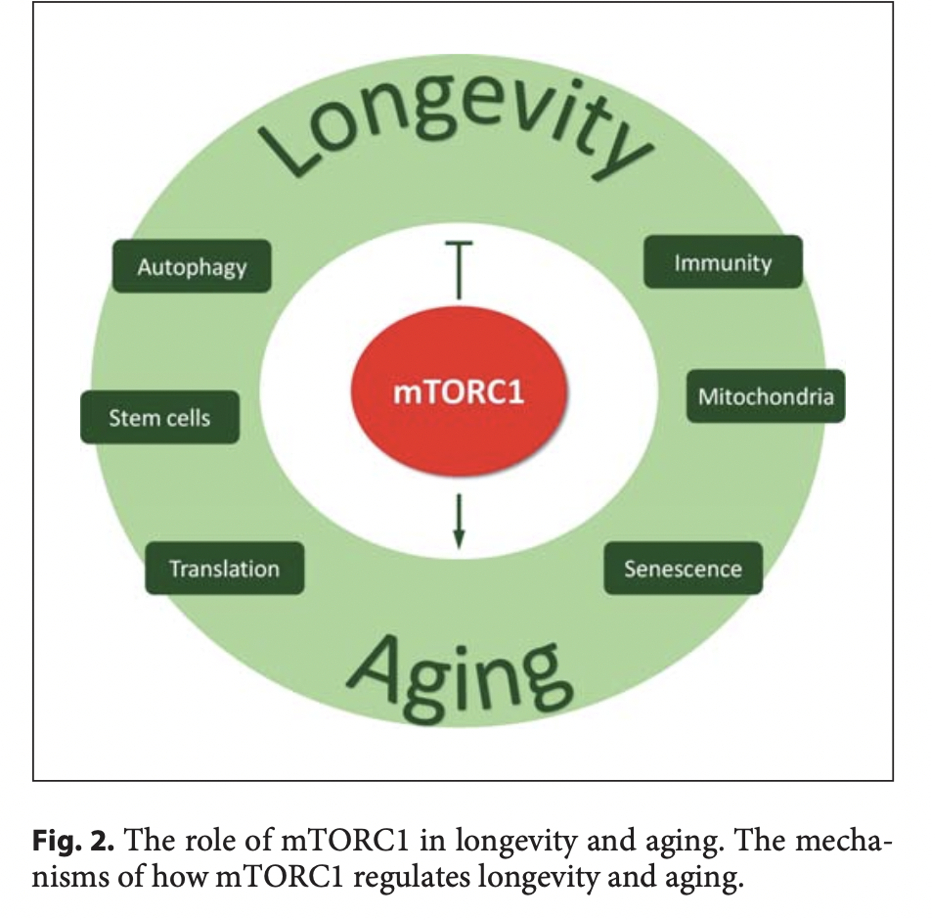
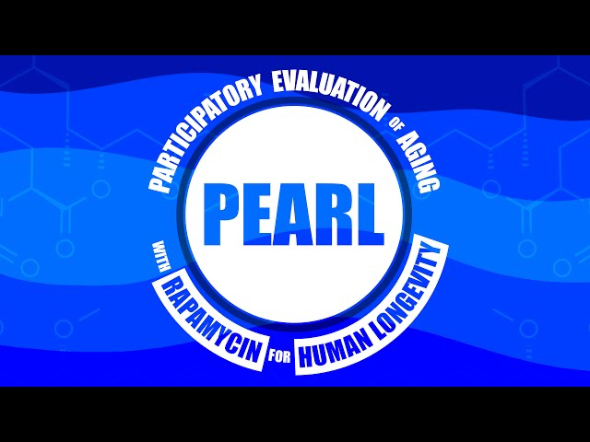
Gerontology 2018;64:127–134

Slide 26
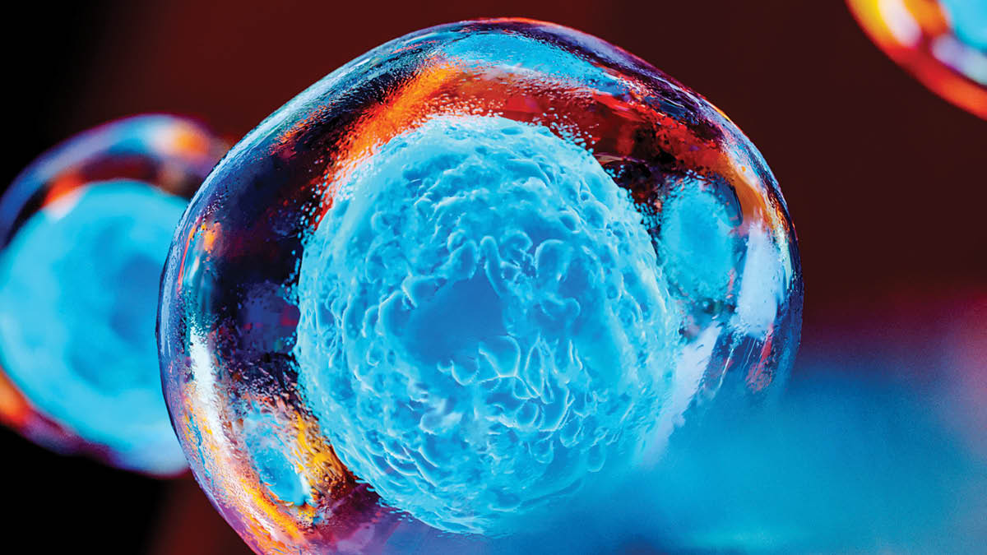
Stem cells and regenerative medicine
Embryonic: pluripotent, can form almost any cell type in the human body
Tissue specific: can form only limited types of cells
Induced pluripotent: engineered by scientists to behave like embryonic stem cells

Slide 28
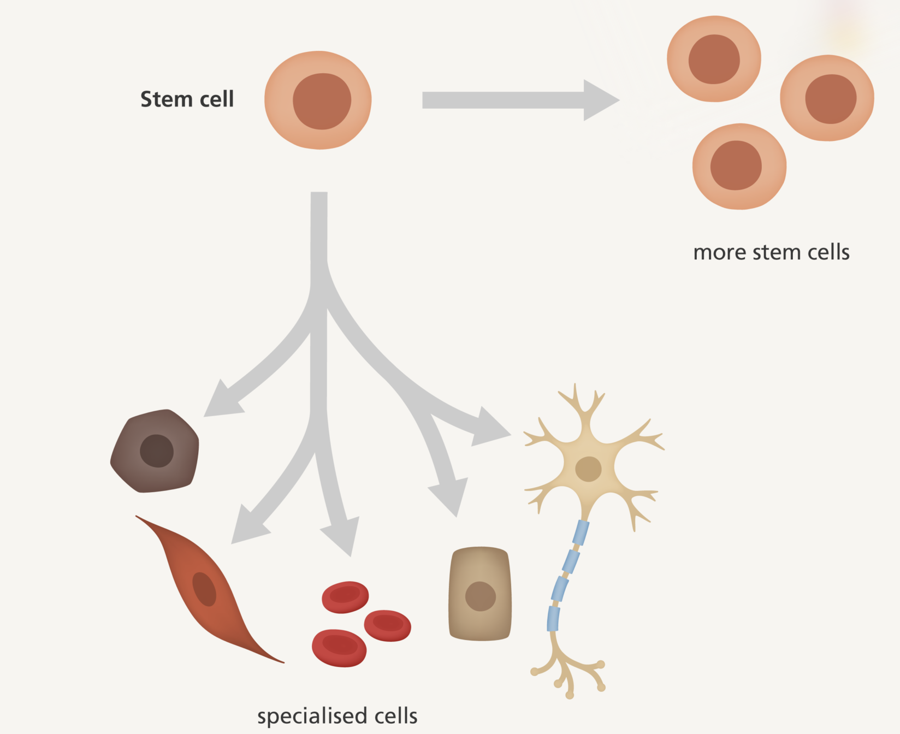
Diseases that stem cells have the potential to treat
Blood diseases
Heart diseases
Parkinson’s
Alzheimer’s
ALS
Multiple sclerosis
Macular degenerations
Cancer
HIV/AIDS
Spinal cord injury
Stroke

Slide 29
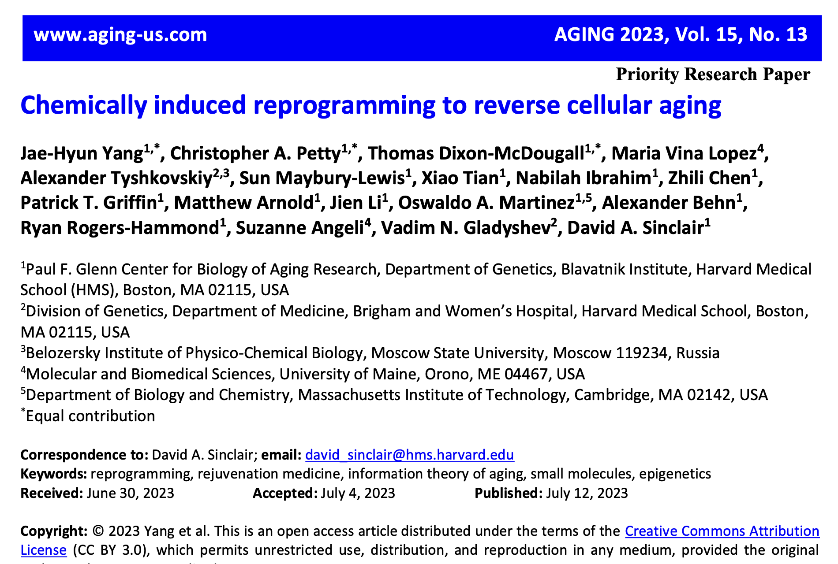

Slide 31
David Sinclair PhD, Harvard Medical School

Slide 32
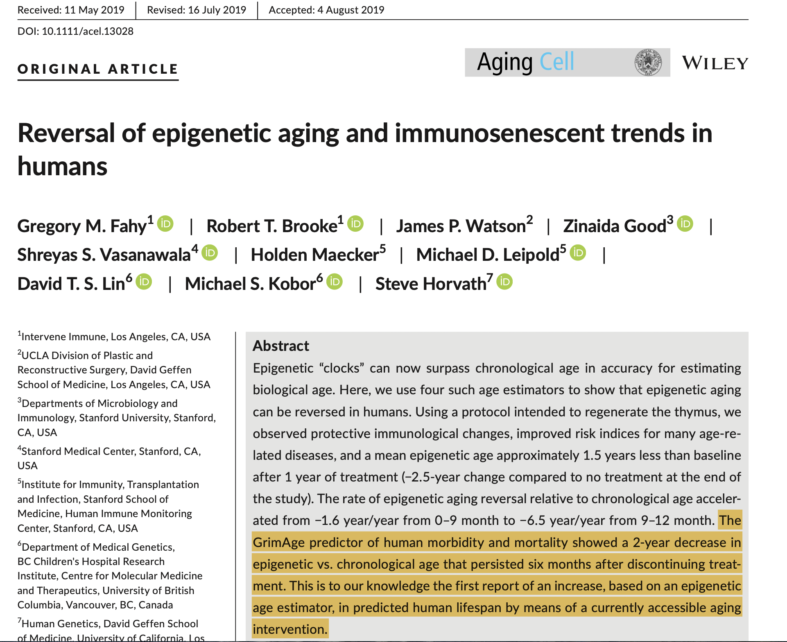

Slide 33
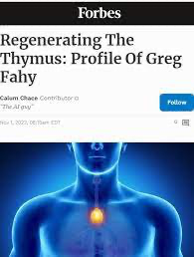

Slide 34
Greg Fahey MD, UCLA

Slide 35
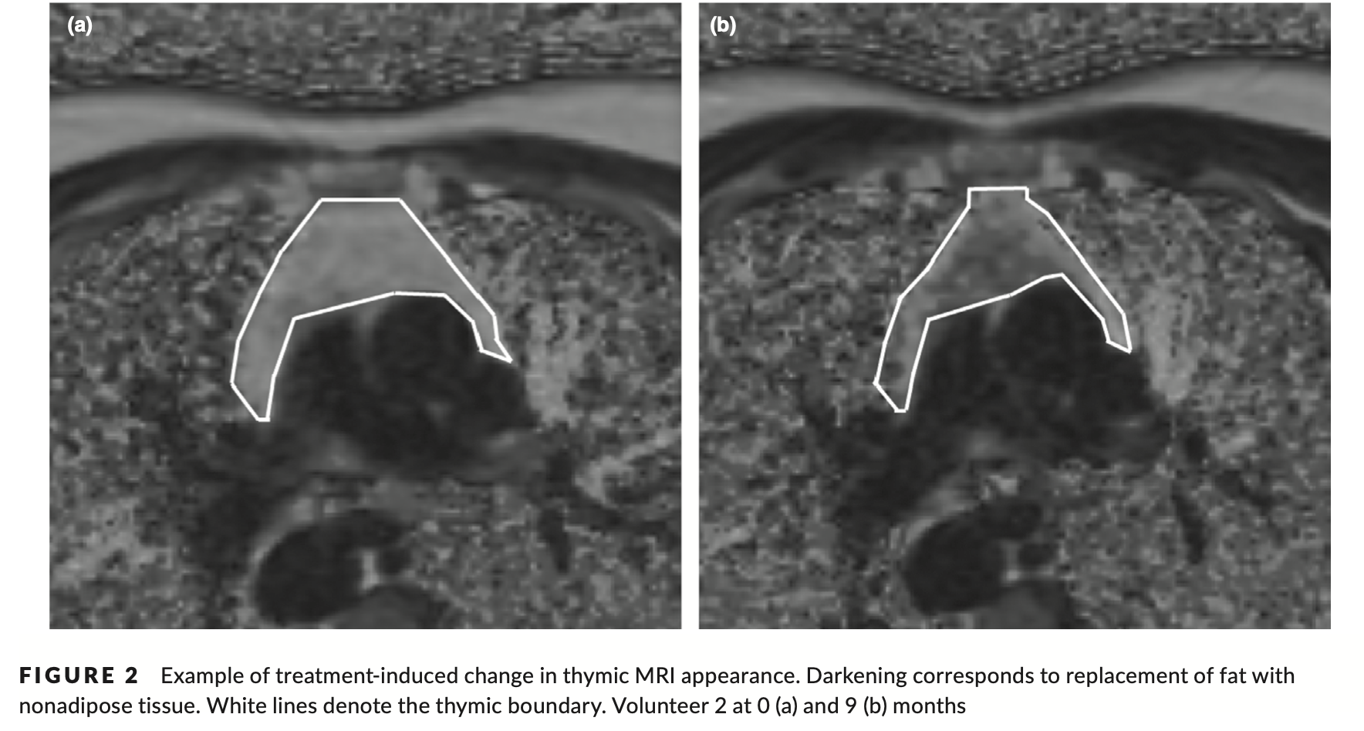
Aging Cell. 2019;18:e13028.

Slide 36
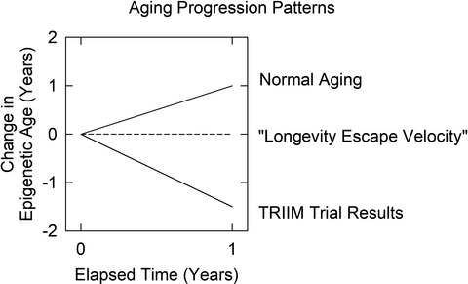
Biological escape velocity i.e., where tissues can be repaired faster than aging can damage them.

Slide 37
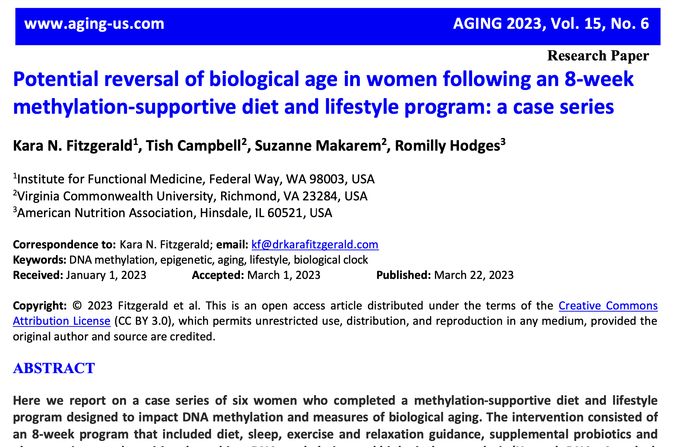

Slide 38
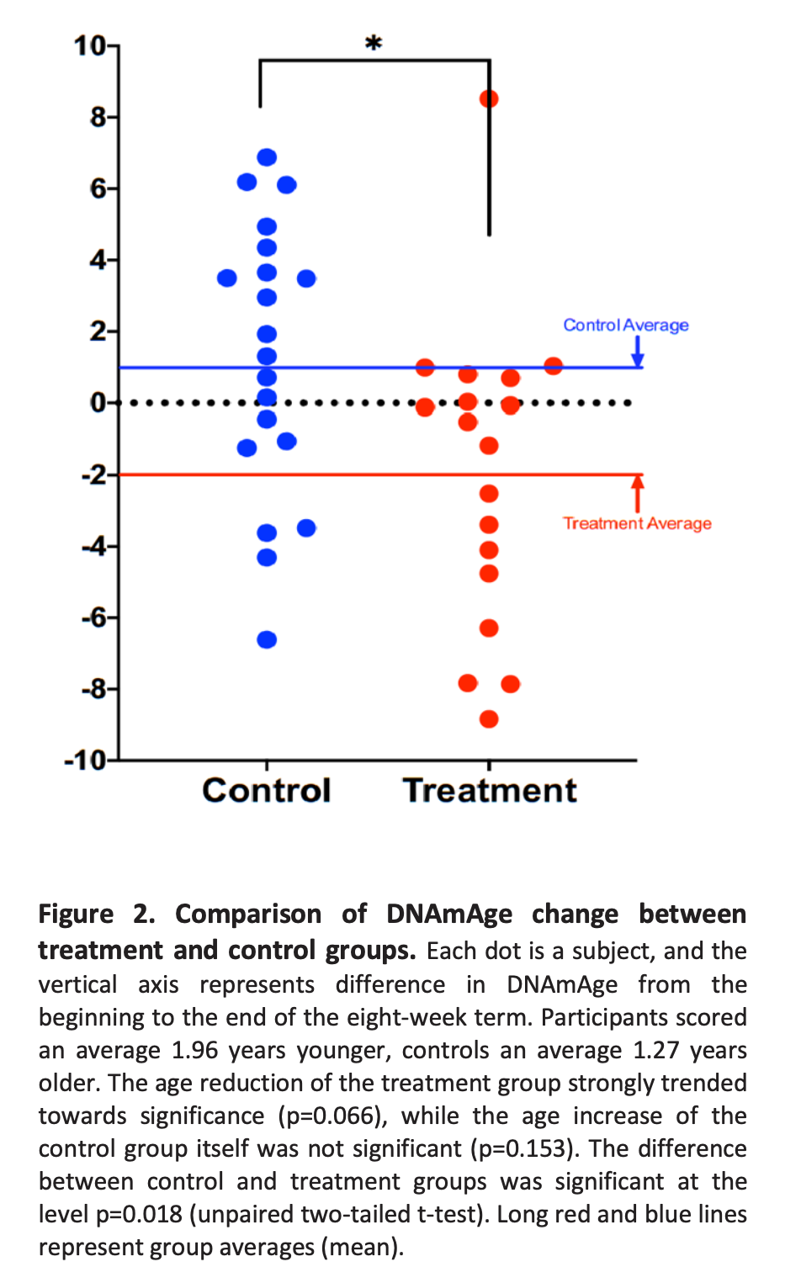
After 1-year, treatment group with healthy lifestyle interventions regressed biologic age 1.96 years compared to control group who aged 1.27 years

Slide 39
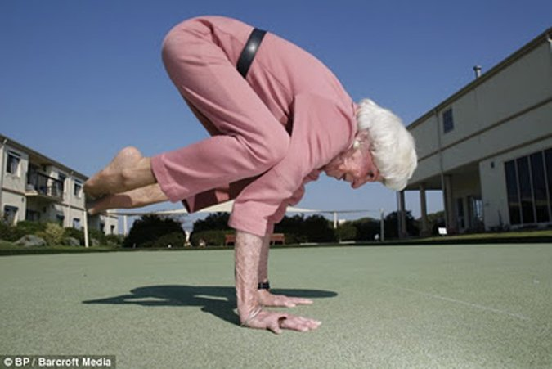
How can I translate this science into my day-to-day routine in 2024?

Slide 40
Health as a byproduct of gene-environmental compatibility

Slide 41
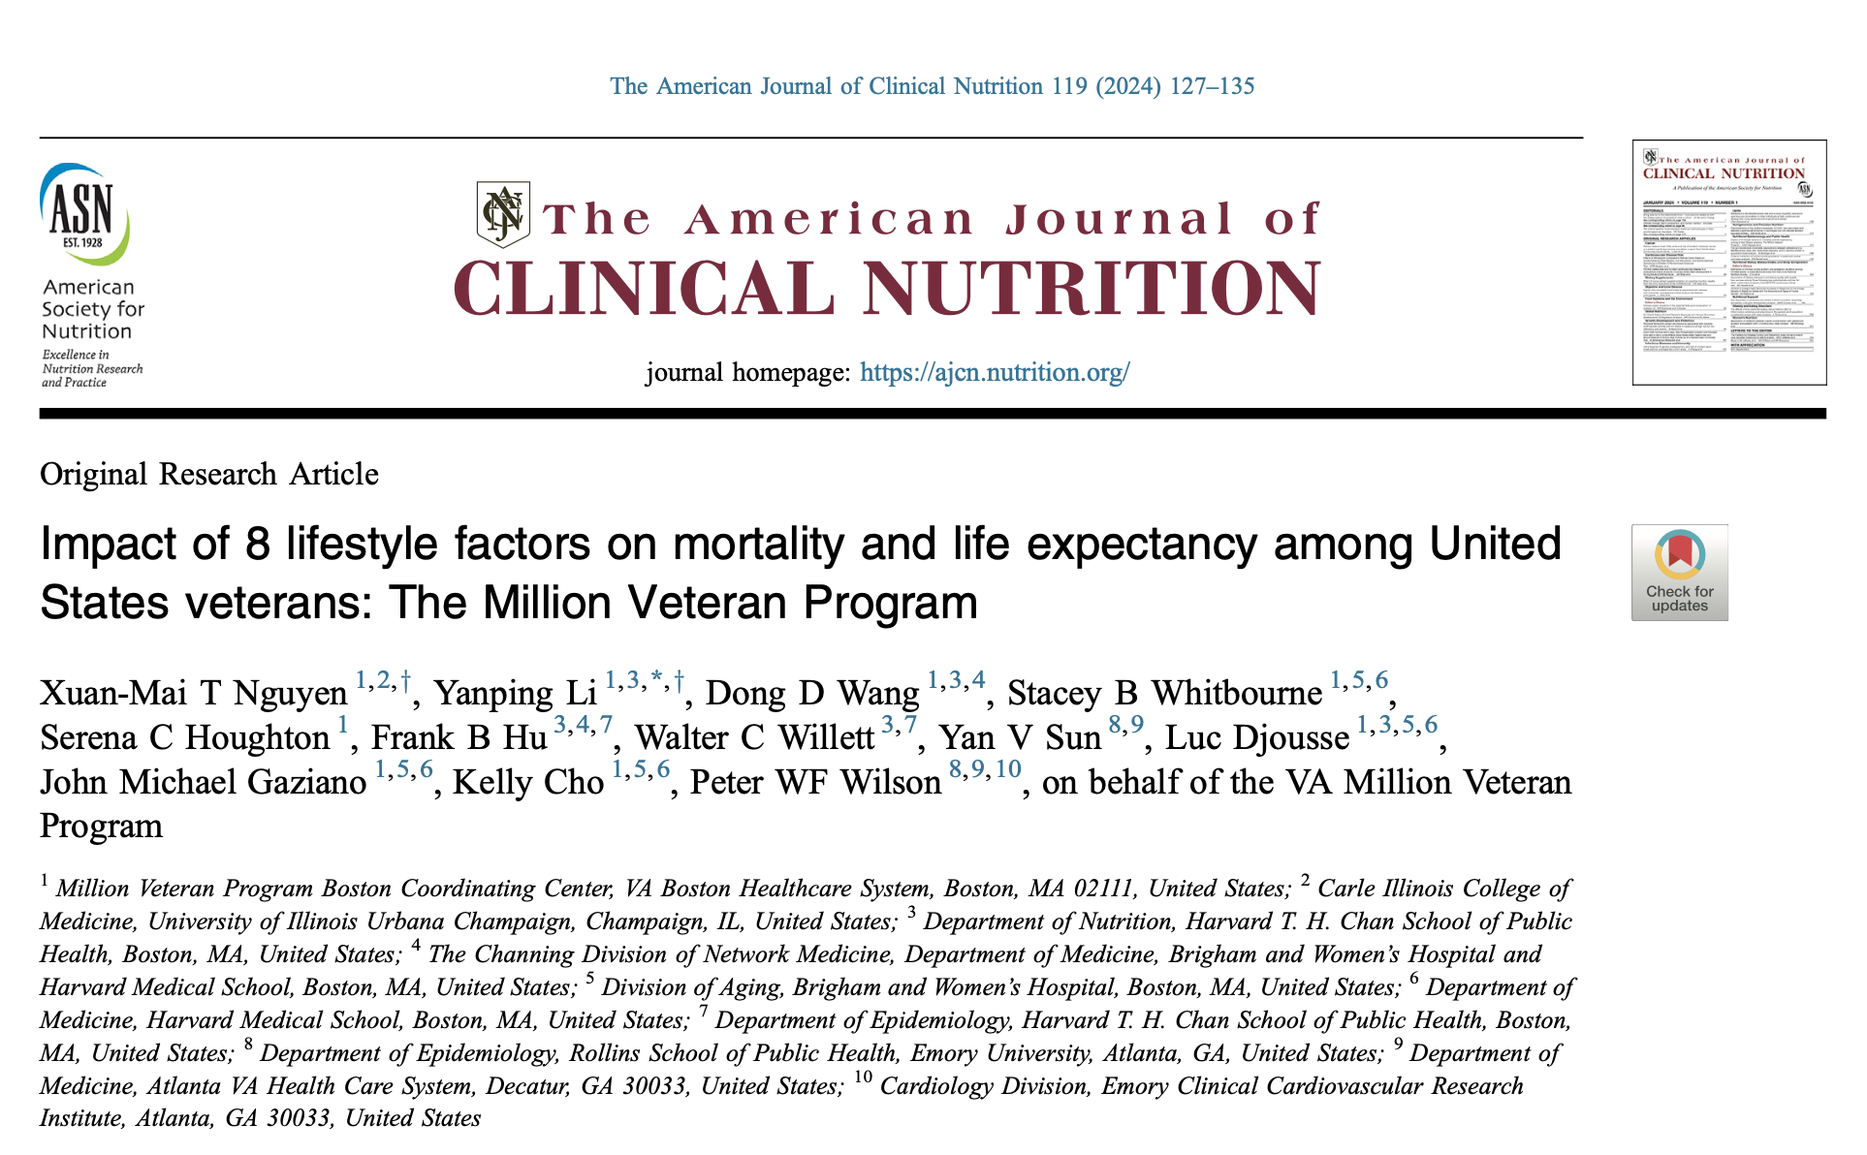
The 8 lifestyle factors
never smoking,
physical activity,
no excessive alcohol consumption,
restorative sleep,
nutrition,
stress management,
social connections,
no opioid use disorder.

Slide 42
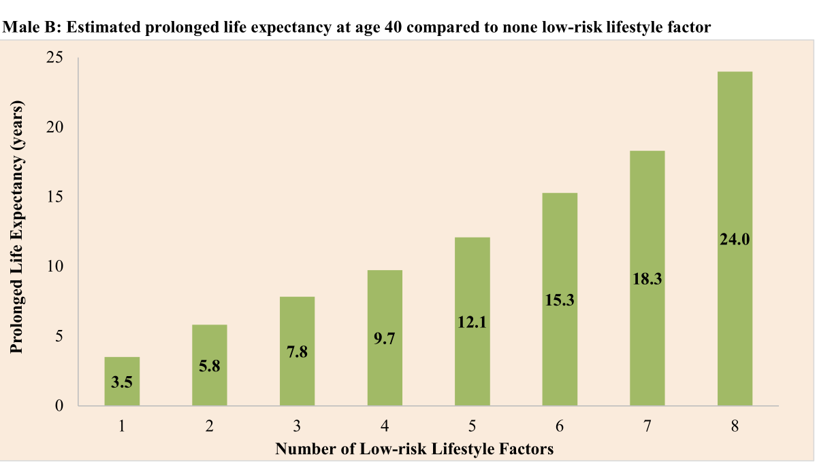
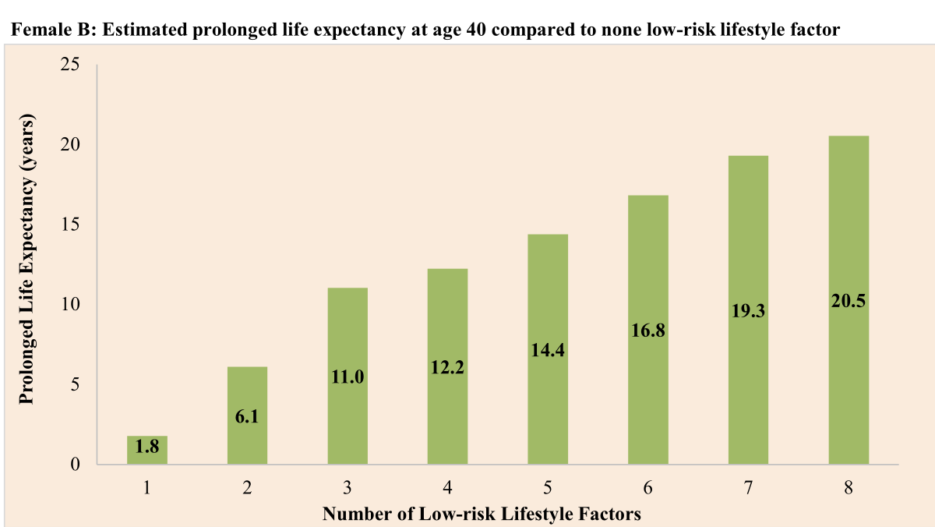
Added years to life expectancy at age 40
Average age of death with 0 low-risk factors 63 years
Average age of death with 8 low-risk factors 87 years
Average age of death with 0 low-risk factors 67 years
Average age of death with 8 low-risk factors 87 years
The American Journal of Clinical Nutrition 119 (2024) 127–135

Slide 44
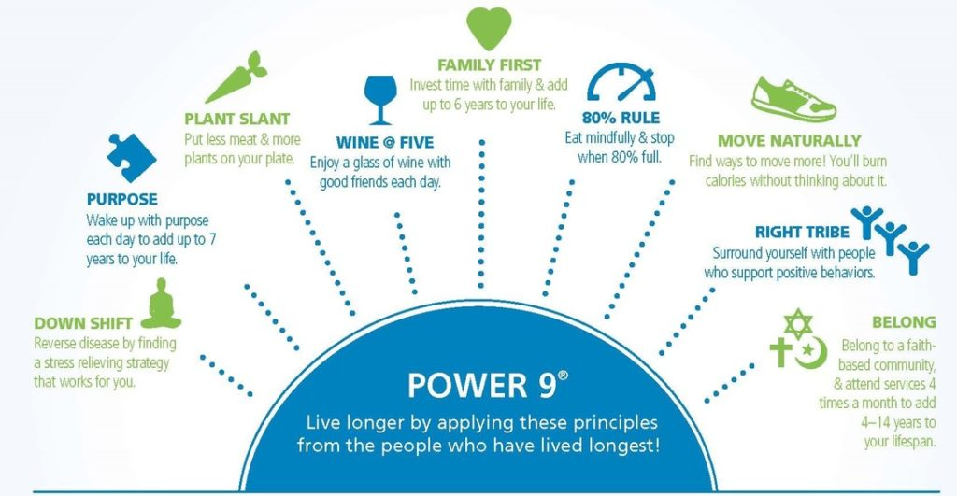

Slide 45
Metabolic Flexibility
An Ancestral Blueprint for 21st Century Life
Turning Back the Biologic Clock of Time

Slide 46
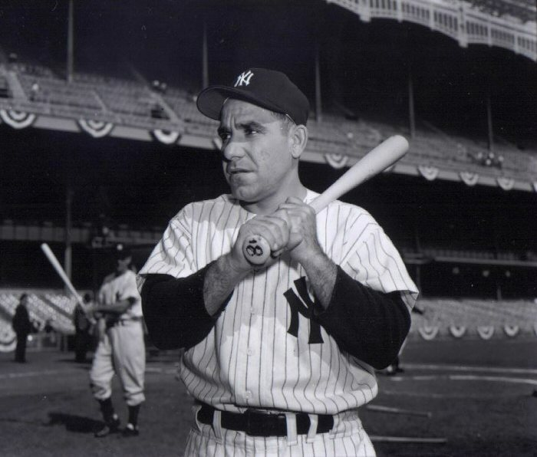
“The future ain’t what it used to be.” Yogi Berra

Slide 47
Love Yourself and Have Fun….
(preferably outdoors)

