Slide 1
Advances in Medicine

Slide 2
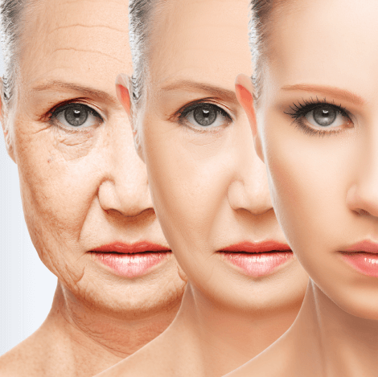
Aging Young: Turning Back the Biologic Clock of Time
Mark Pettus MD
Associate Professor of Medicine
University of Massachusetts Chan Medical School
January 26, 2024

Slide 3
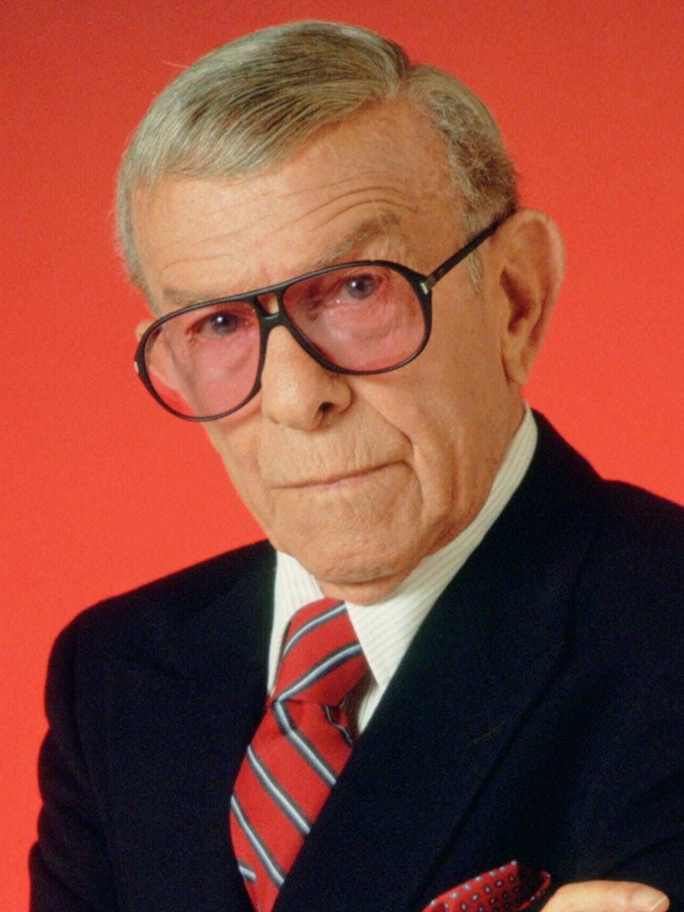
“First you forget names, then you forget faces. Next you forget to pull up your zipper and finally, you forget to pull it down.”
George Burns
1896 - 1996

Slide 4
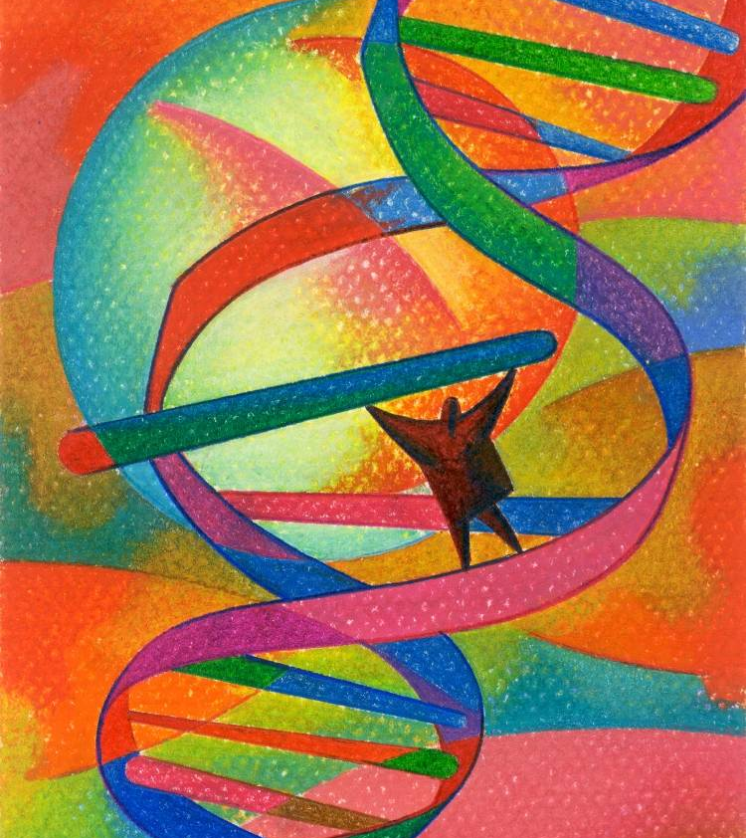
Learning Objectives
Review the current hallmarks (drivers) of aging.
Review current research on “information theory of aging” and epigenetic clocks
Distinguish chronologic age from biologic age
Review the evidence to support health-promoting lifestyle on the modification of biologic age

Slide 5
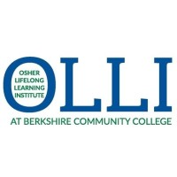
Questions for consideration:
How long can humans actually live?
Is getting old always synonymous with poor quality of life?
What is the difference between chronologic age and biologic age?
Is aging a disease?
If so, can it be “treated”?
As age is most strongly correlated with all advanced chronic diseases, should we focus on treating diseases or treating aging?
Can age be regressed?

Slide 6
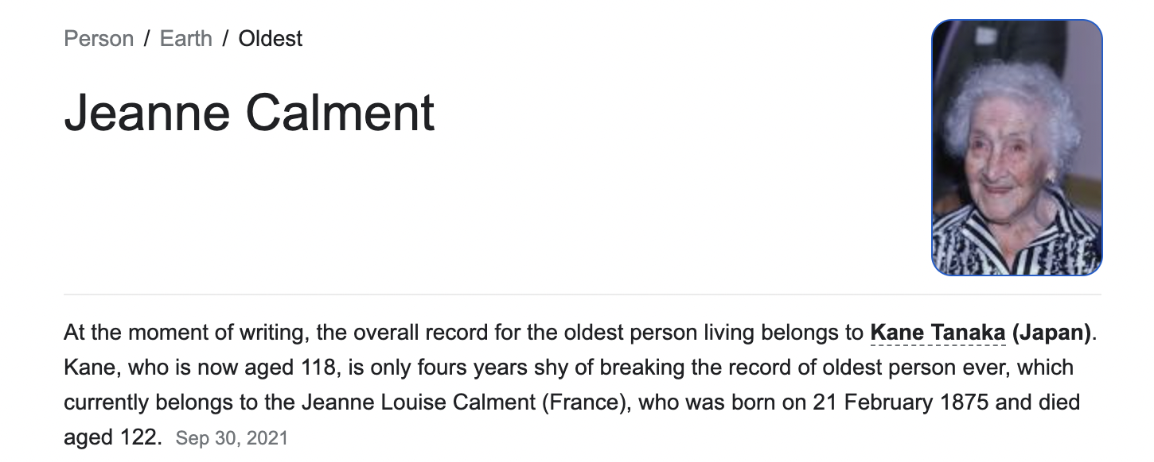

Slide 7
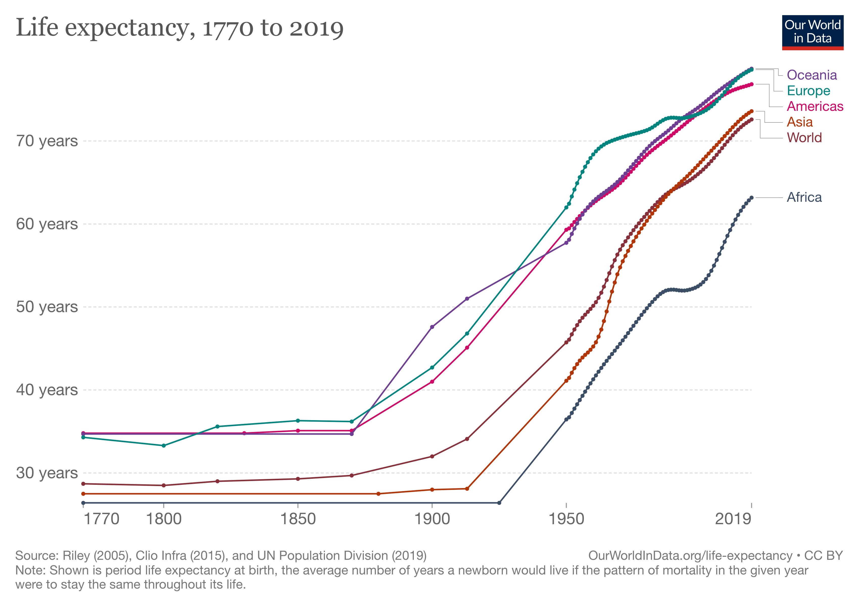

Slide 9
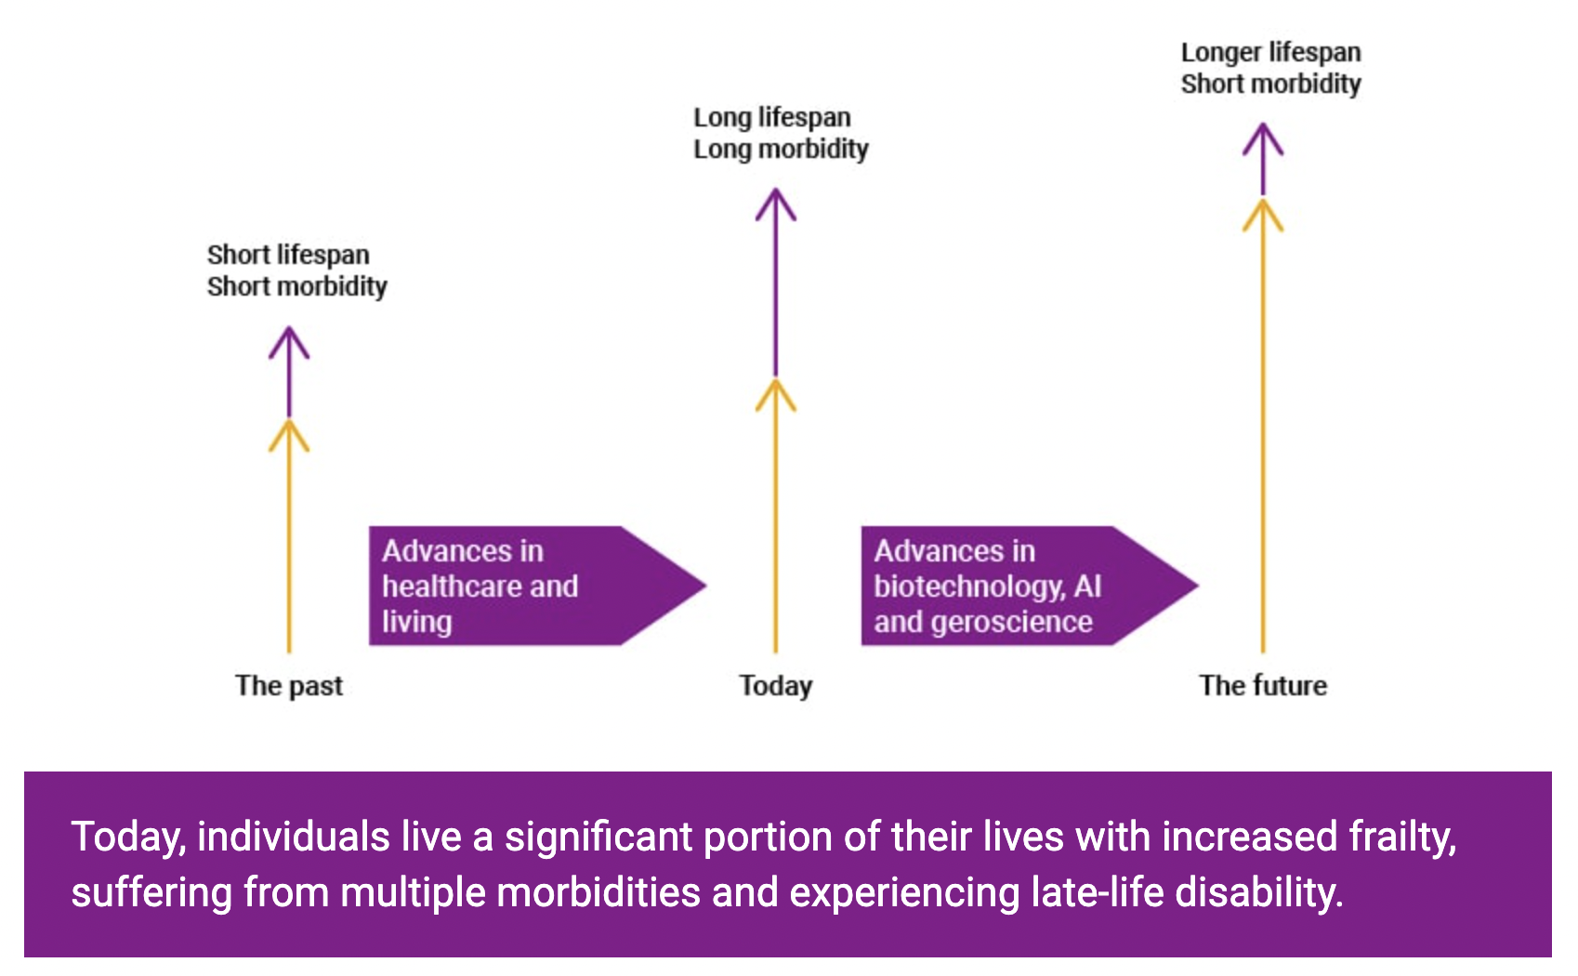

Slide 10
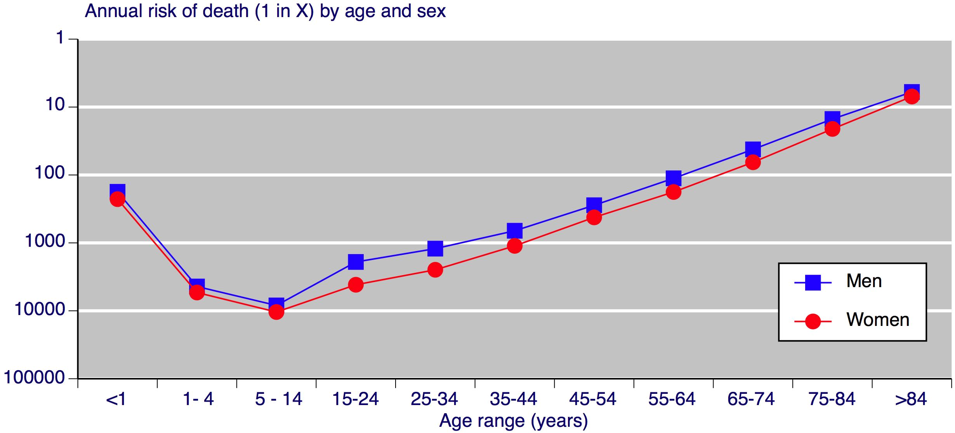
At ages 80+ 1/10 mortality risk
At age 40, 1/1000 mortality risk

Slide 13
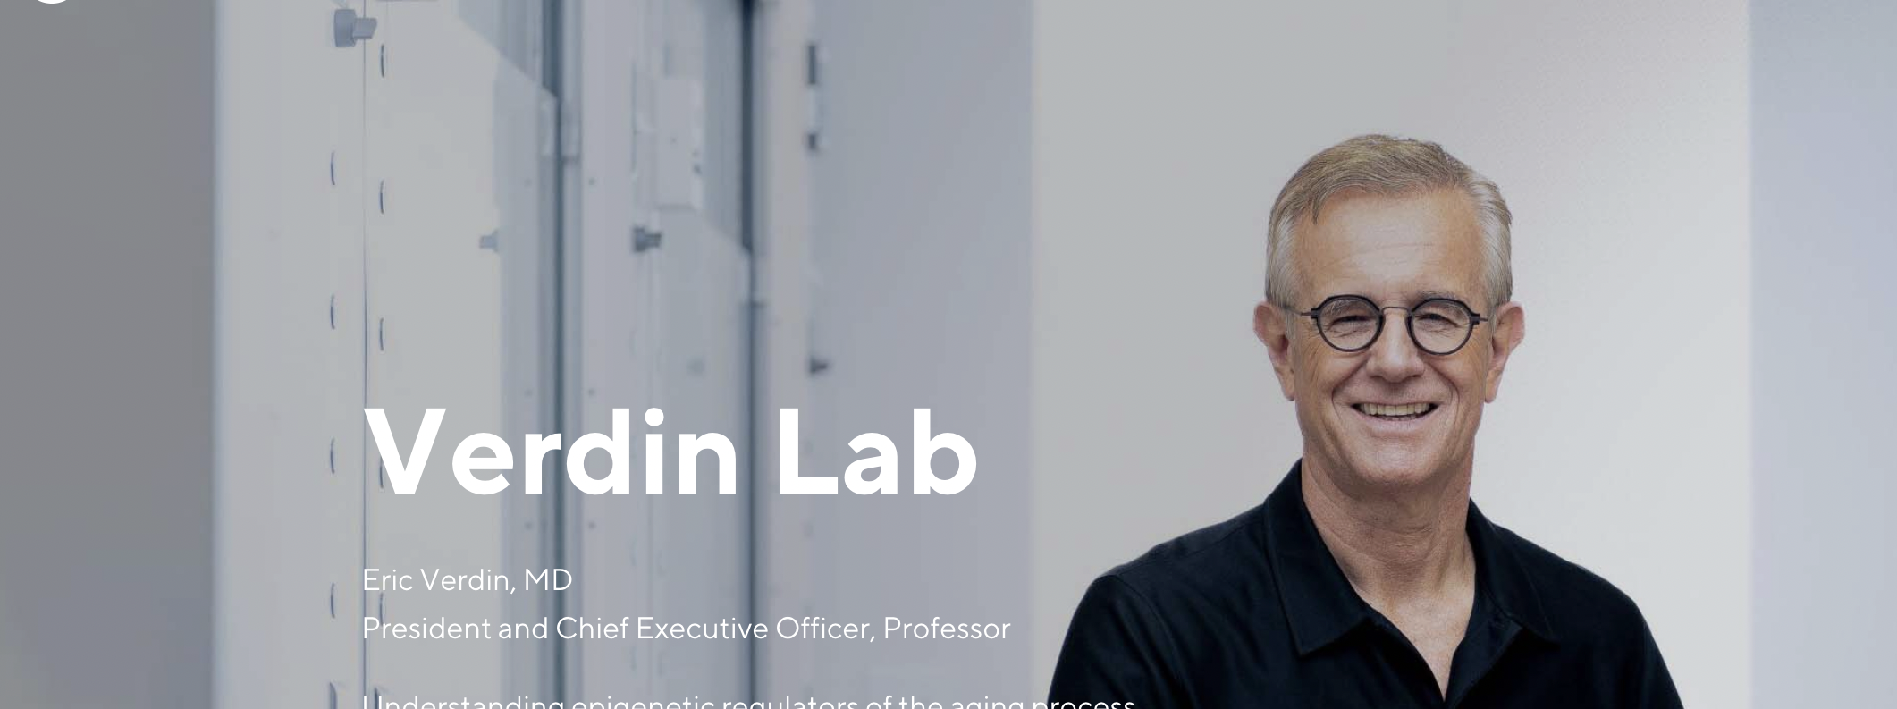
“Only 8% of what contributes to longevity can be traced to genetics. Over 90% of what contributes to longevity and healthy aging is lifestyle.”
Eric Verdin MD
President and CEO, Buck Institute

Slide 14
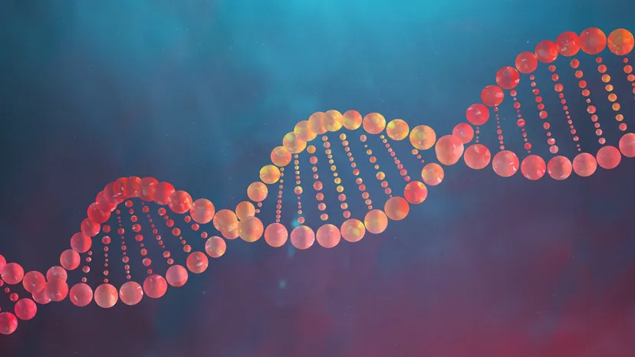
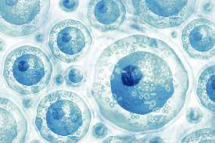
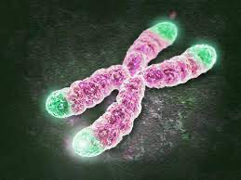
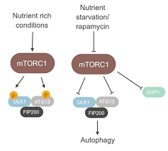
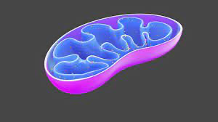
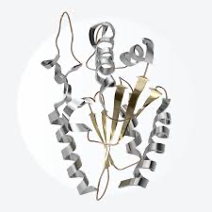
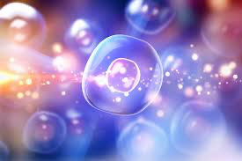
Genetics
Environment
+
Epigenetic Regulation
Genomic Instability
Stem cell
depletion
Telomere attrition
Deregulated
Nutrient Sensing
Mitochondrial
Bioenergetics
Altered Intercellular Communication
Loss of Proteostasis
Cellular Senescence

Slide 15
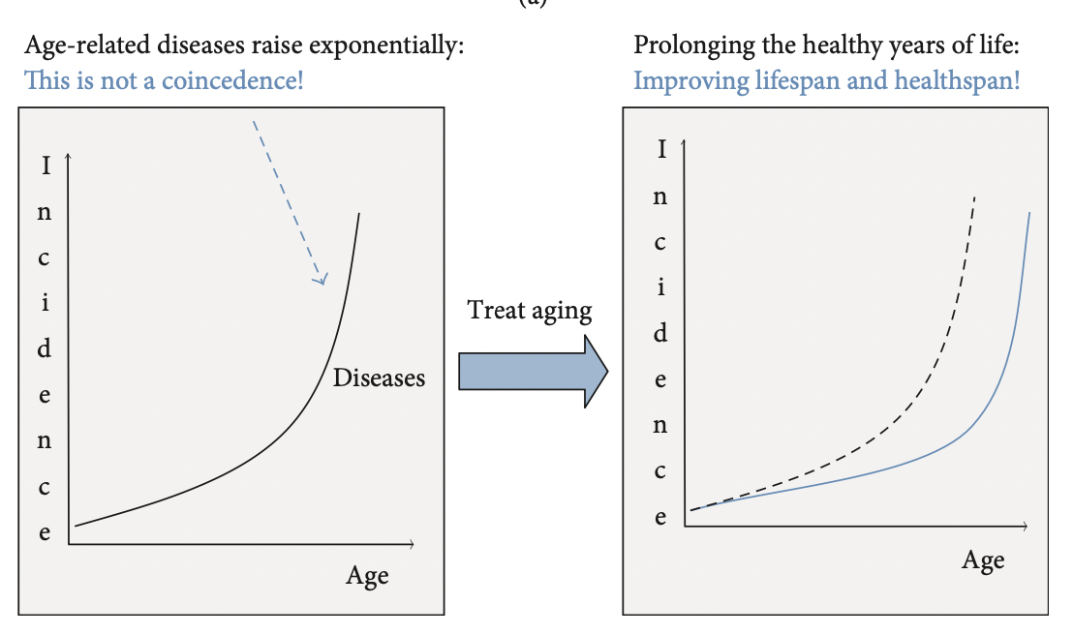
Treating Diseases vs. Treating Aging

Slide 16
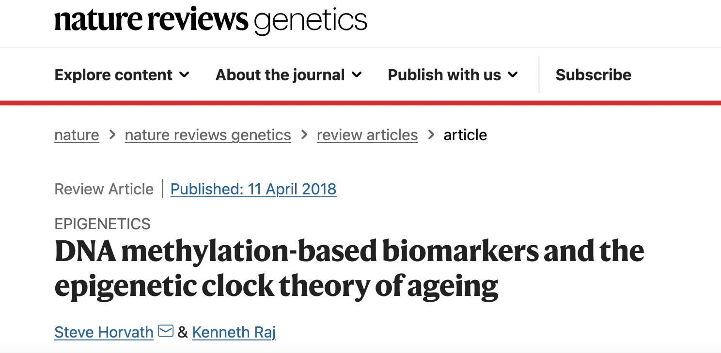

Slide 17
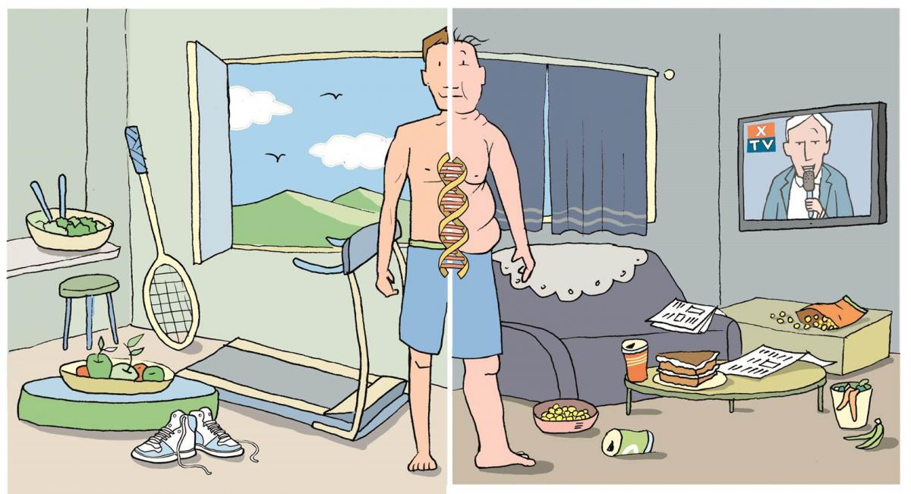
Epigenetics: A life with many possibilities.

Slide 18
Health as a byproduct of gene-environmental compatibility

Slide 19
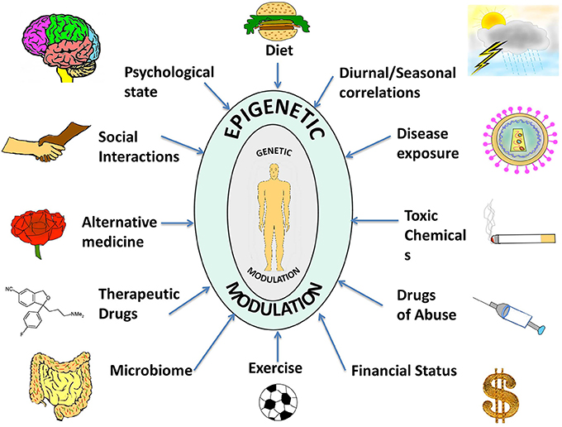

Slide 20
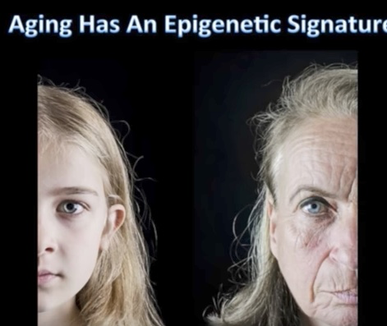
Aging has an Epigenetic Signature

Slide 21
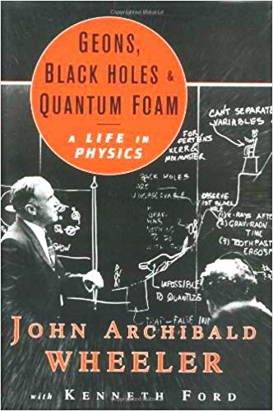
“It from bit symbolizes the idea that every item of the physical world has at bottom…an immaterial source and explanation…that all things physical are information-theoretic in origin and that this is a participatory universe”
John Archibald Wheeler
Particles….Energy….Information
Notes:
﻿“Everything is Particles” evolved to “Everything is Fields” which eventually evolved to “Everything is Information”.
Virk, Rizwan. The Simulation Hypothesis: An MIT Computer Scientist Shows Why AI, Quantum Physics and Eastern Mystics All Agree We Are In a Video Game . Bayview Books. Kindle Edition.

Slide 23
Epigenetic Reprogramming

Slide 24
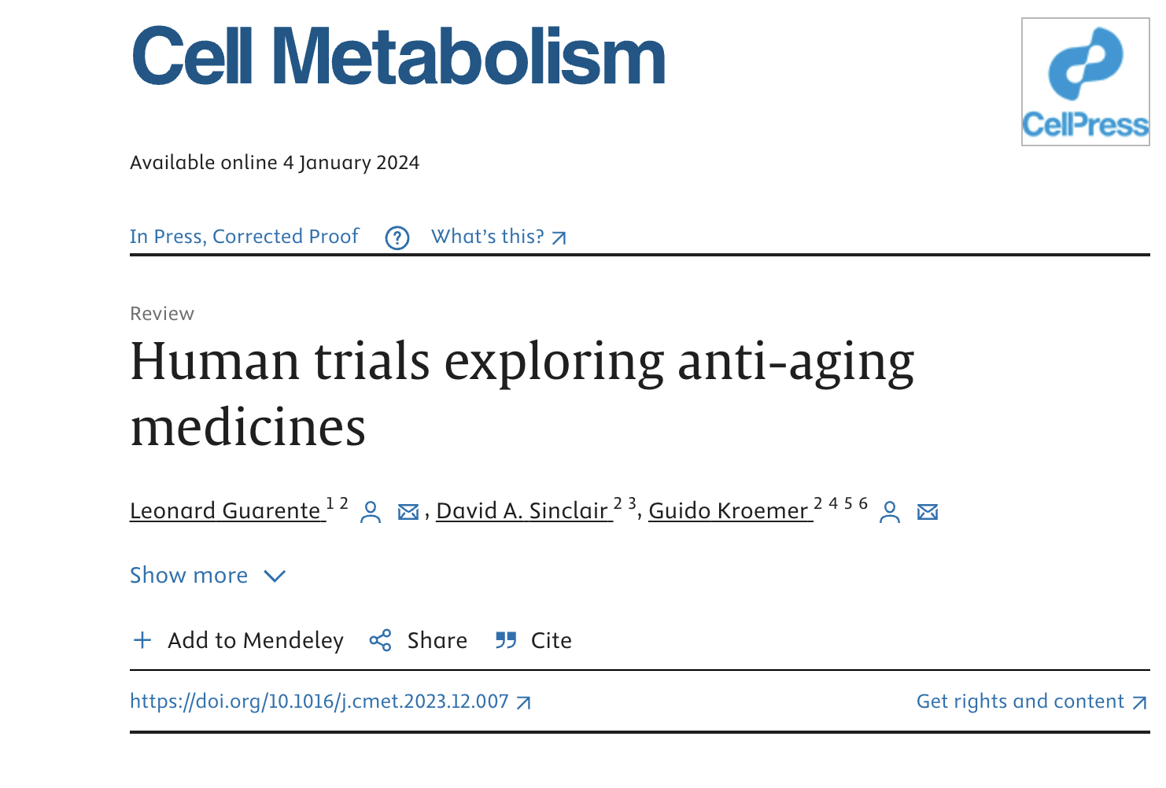

Slide 25
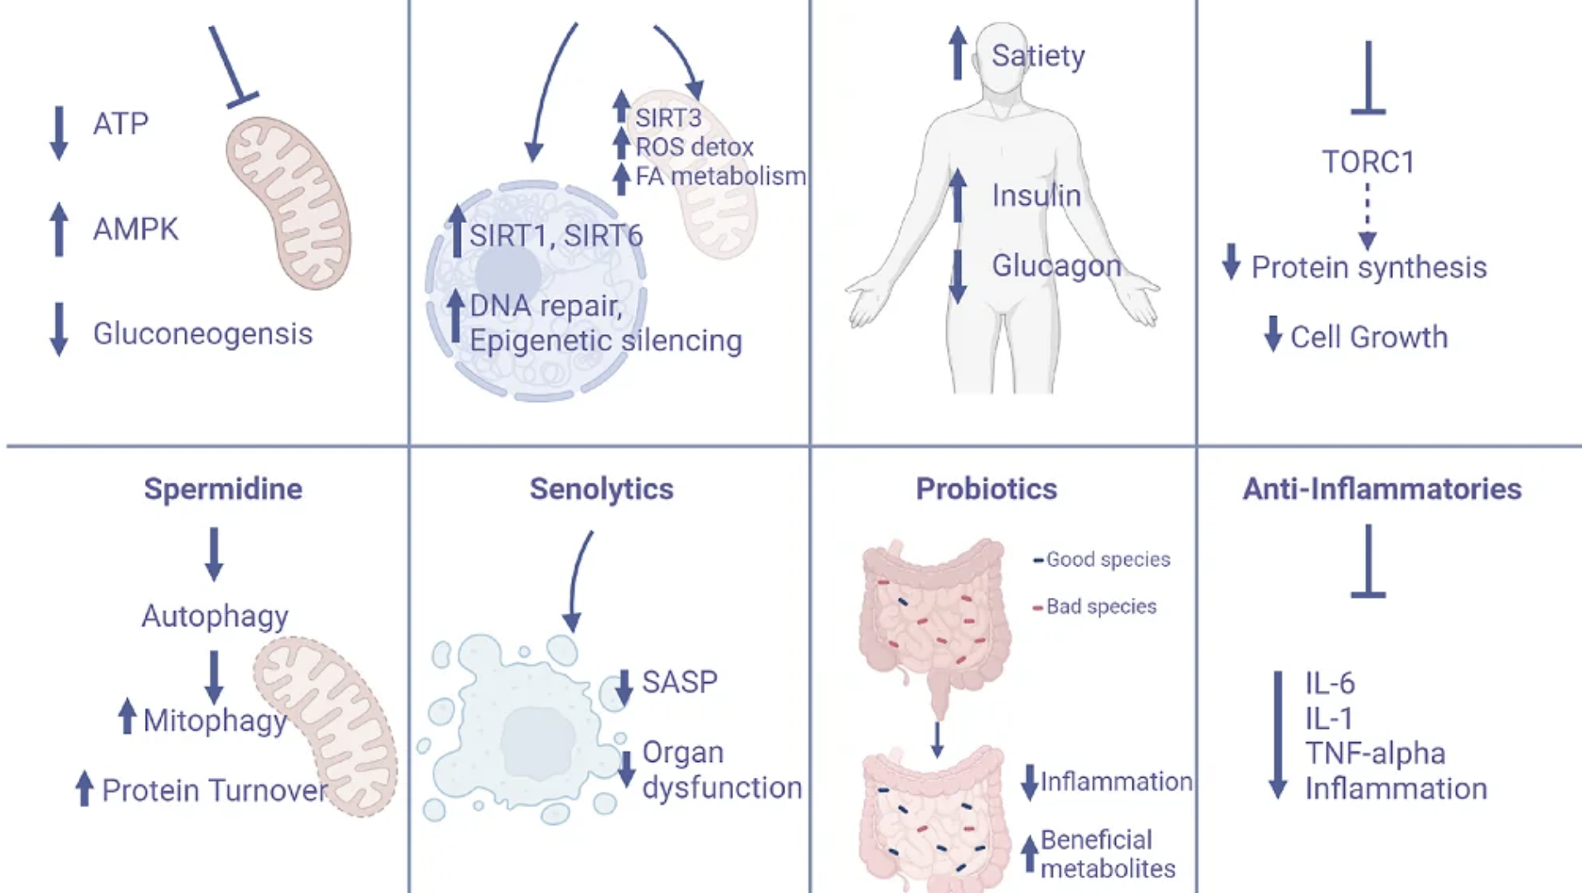
Sensitivity
Metformin
NAD Boosters NR/NMR
GLP-1 Agonists
Rapamycin

Slide 26
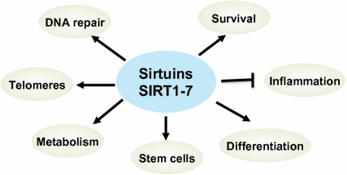
Sirtuins
A class of enzymes that influence aging and longevity through multiple molecular pathways. Sirtuins regulate a variety of metabolic processes, including the release of insulin, response to stress, and modulation of lifespan. They also influence circadian clocks and mitochondrial biogenesis. Sirtuins are activated when NAD levels rise. Plant-based molecules e.g. resveratrol, pterostilbene and quercetin can activate sirtuins, designated as Sirt1 to Sirt7.

Slide 27
Hallmarks of Aging Associated with Cellular depletion of NAD+
Altered DNA repair (PARP activity NAD-dependent)
Altered epigenetics
Mitochondrial dysfunction
Disrupted metabolic-nutrient sensing e.g. Insulin resistance with glucose intolerance
Cellular senescence
Decreased autophagy

Slide 29
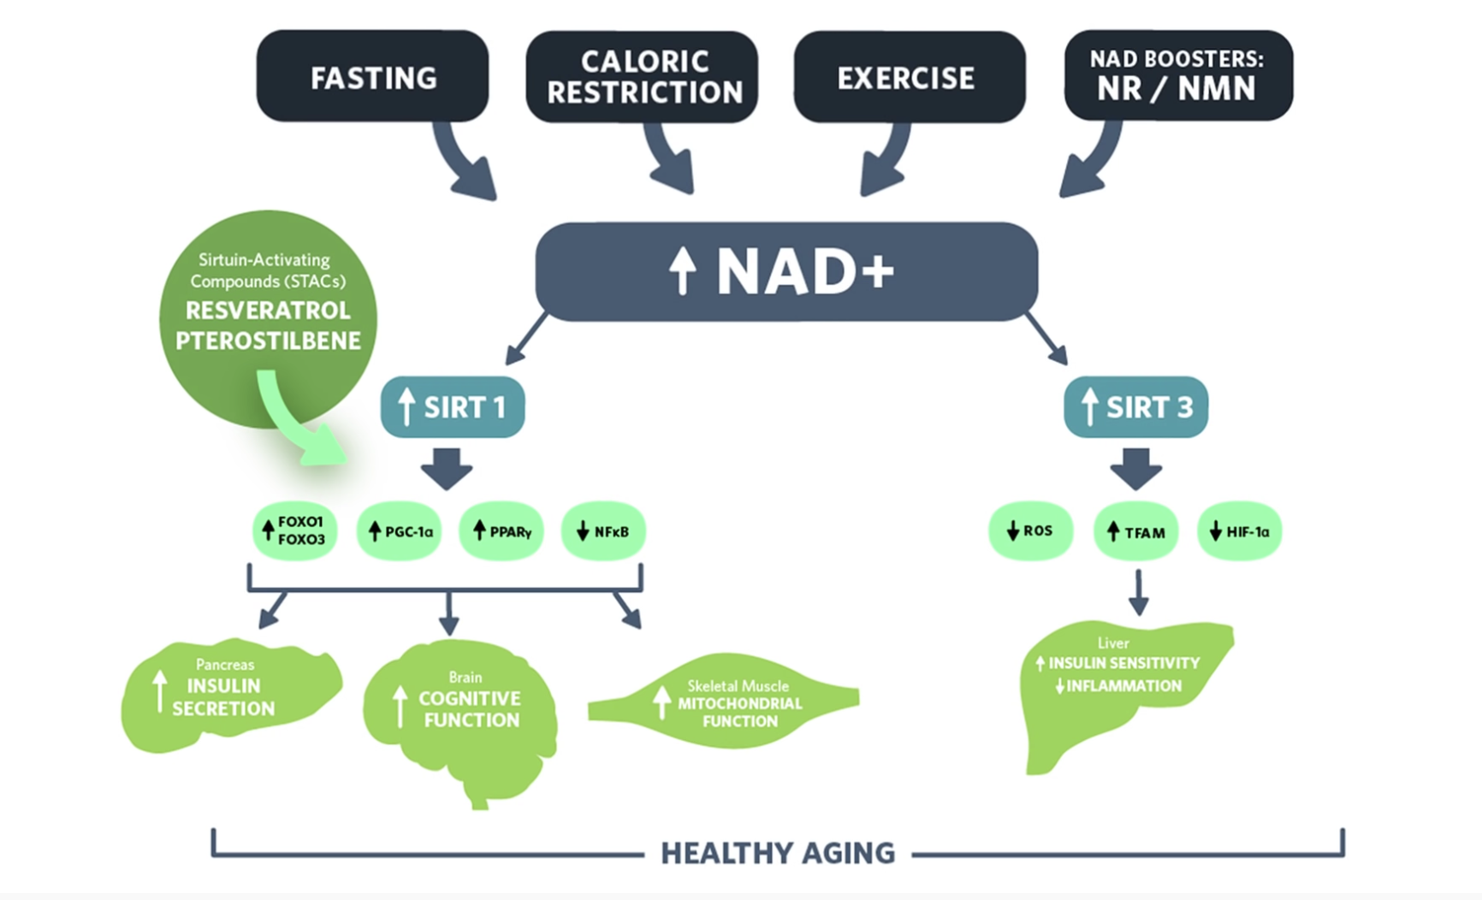

Slide 30
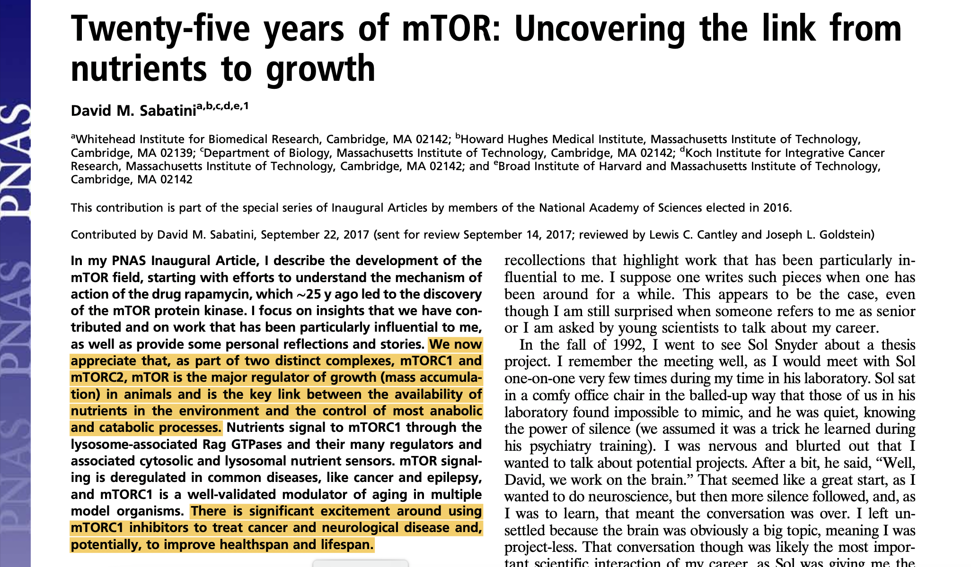
mTOR – Mammalian Target of Rapamycin
mTOR is the major nutrient-sensitive regulator of growth in animals and plays a central role in physiology, metabolism, the aging process, and common diseases.
11818–11825 | PNAS | November 7, 2017 | vol. 114 | no. 45

Slide 31
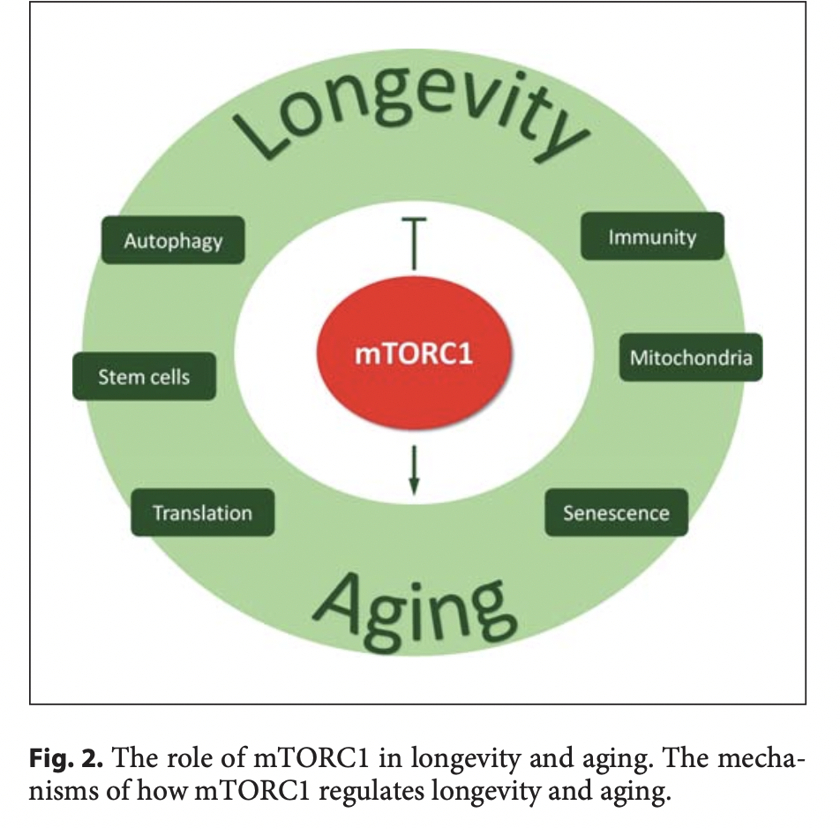
Gerontology 2018;64:127–134

Slide 32
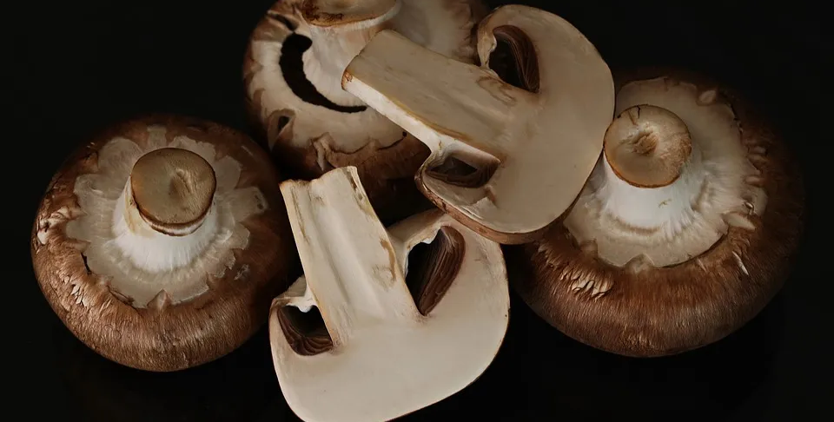
Spermadine
Polyamine that is found in foods and produced endogenously
May have effects of delayed aging in humans (Aging. 2018 Aug; 10(8): 2209-2211.)
Autophagy is upregulated and may be an anti-aging mechanism
All-cause Mortality inversely related to spermidine intake in observational studies (Am J Clin Nutr. 2018 Aug 1;108(2): 371-380)
Improved cognition in older adults (Alzheimer’s Res Ther. 2019;11:36.)
SmartAge Study recruitment
Dietary sources are plant and fungi derived (Ann Rev Nutr. 2020 Sep 23;40:135-159)
Great sources include vegetable sprouts, mushrooms, peas, legumes, broccoli, cauliflower
Safety and tolerability in older adults at doses 1.2 mg/day (Aging. 2018 Jan; 10(1): 19-33)

Slide 33
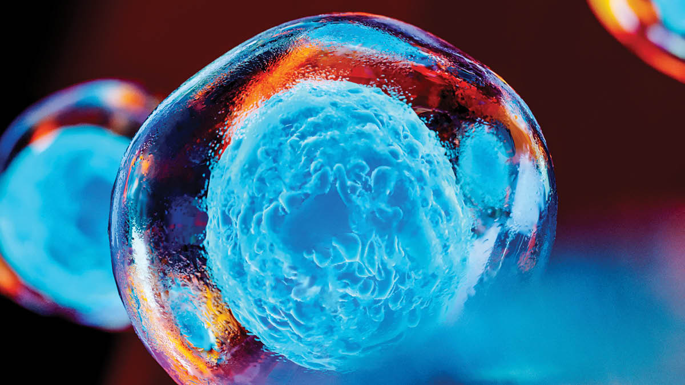
Stem cells and regenerative medicine
Embryonic: pluripotent, can form almost any cell type in the human body
Tissue specific: can form only limited types of cells
Induced pluripotent: engineered by scientists to behave like embryonic stem cells

Slide 34
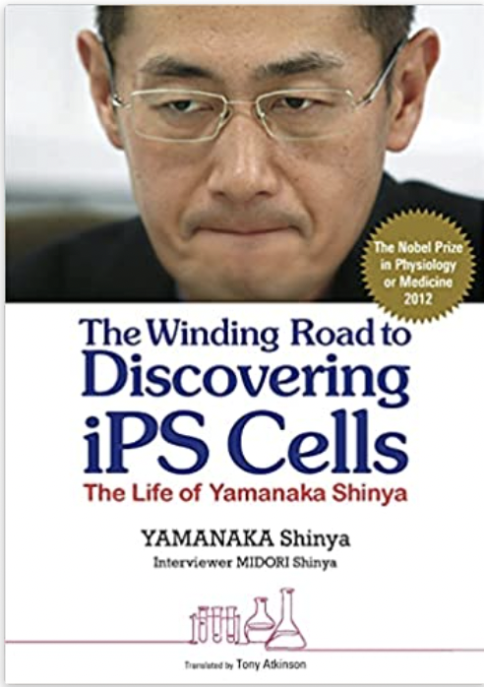

Slide 35
Diseases that stem cells have the potential to treat
Blood diseases
Heart diseases
Parkinson’s
Alzheimer’s
ALS
Multiple sclerosis
Macular degenerations
Cancer
HIV/AIDS
Spinal cord injury
Stroke

Slide 36
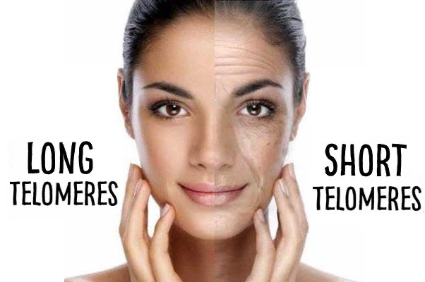
Telomere Attrition
Too much telomere erosion causes cells to malfunction and die.
Telomeric DNA partially shortens during the decades of human lifetimes

Slide 37
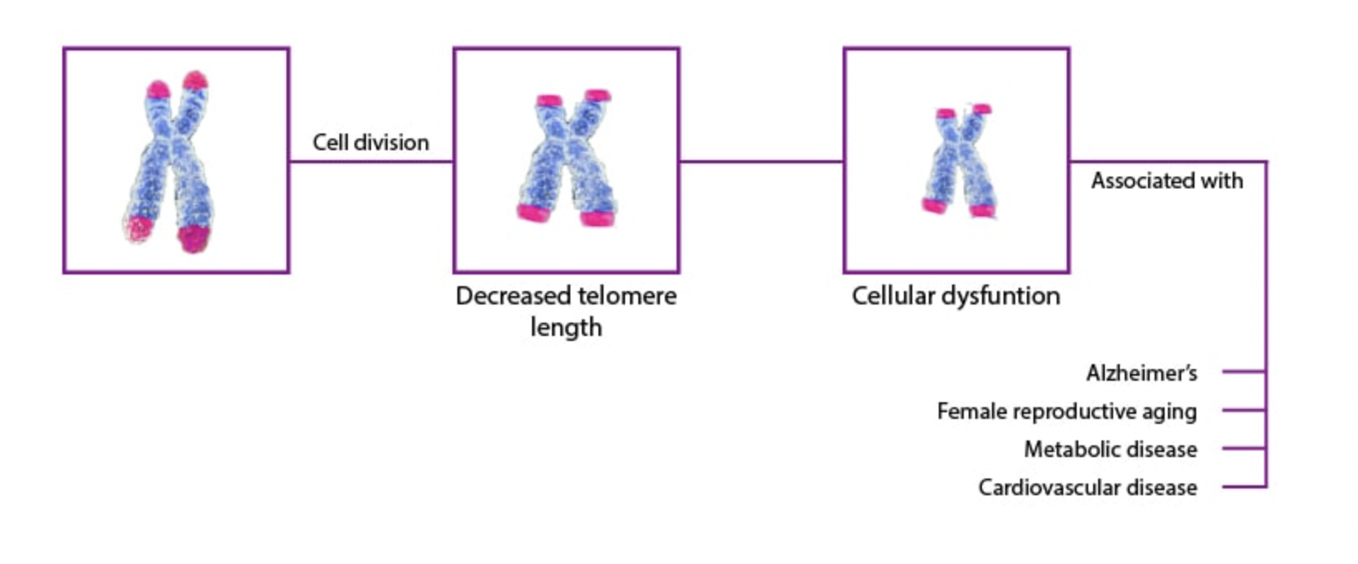

Slide 39
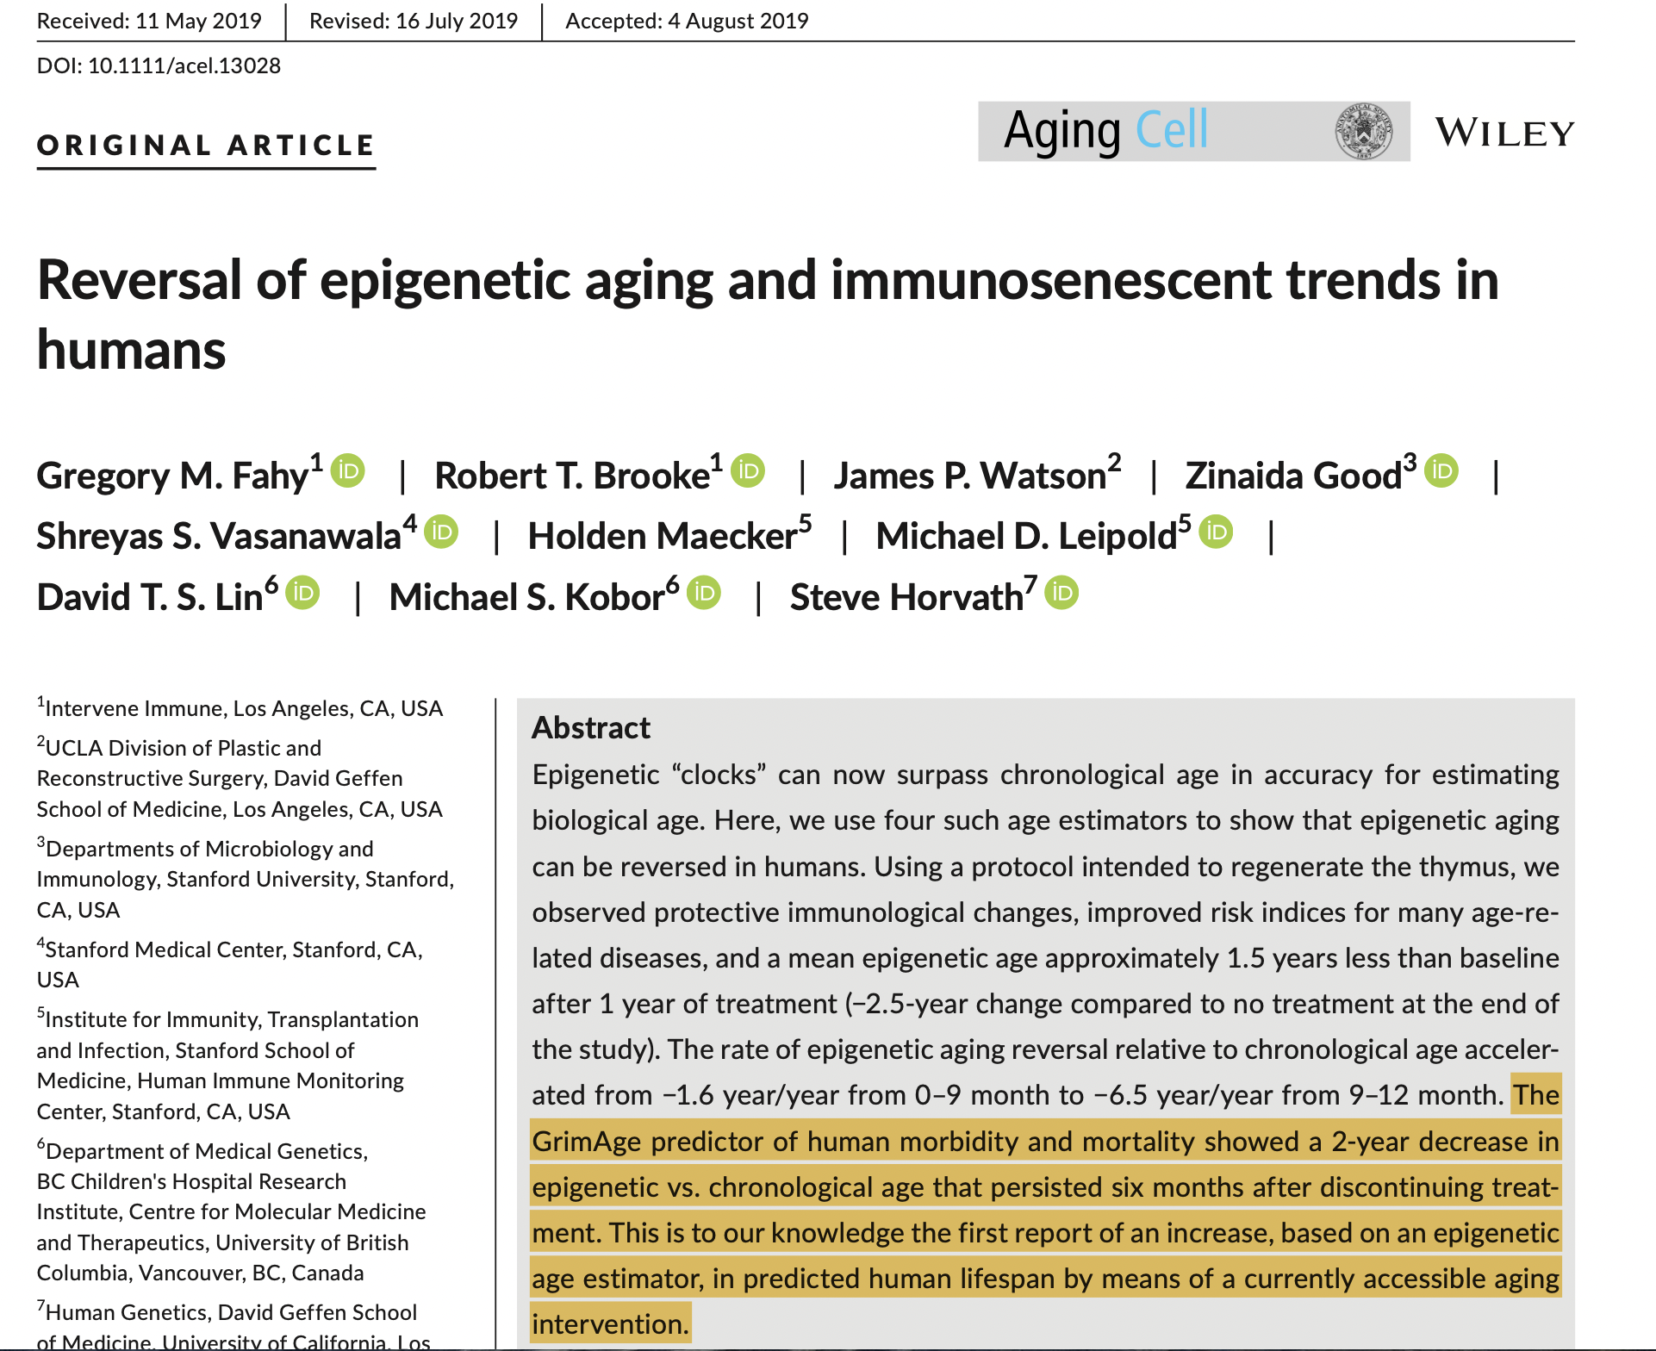

Slide 40
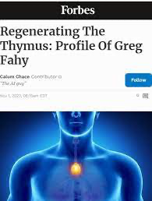

Slide 41
Greg Fahey MD, UCLA

Slide 42
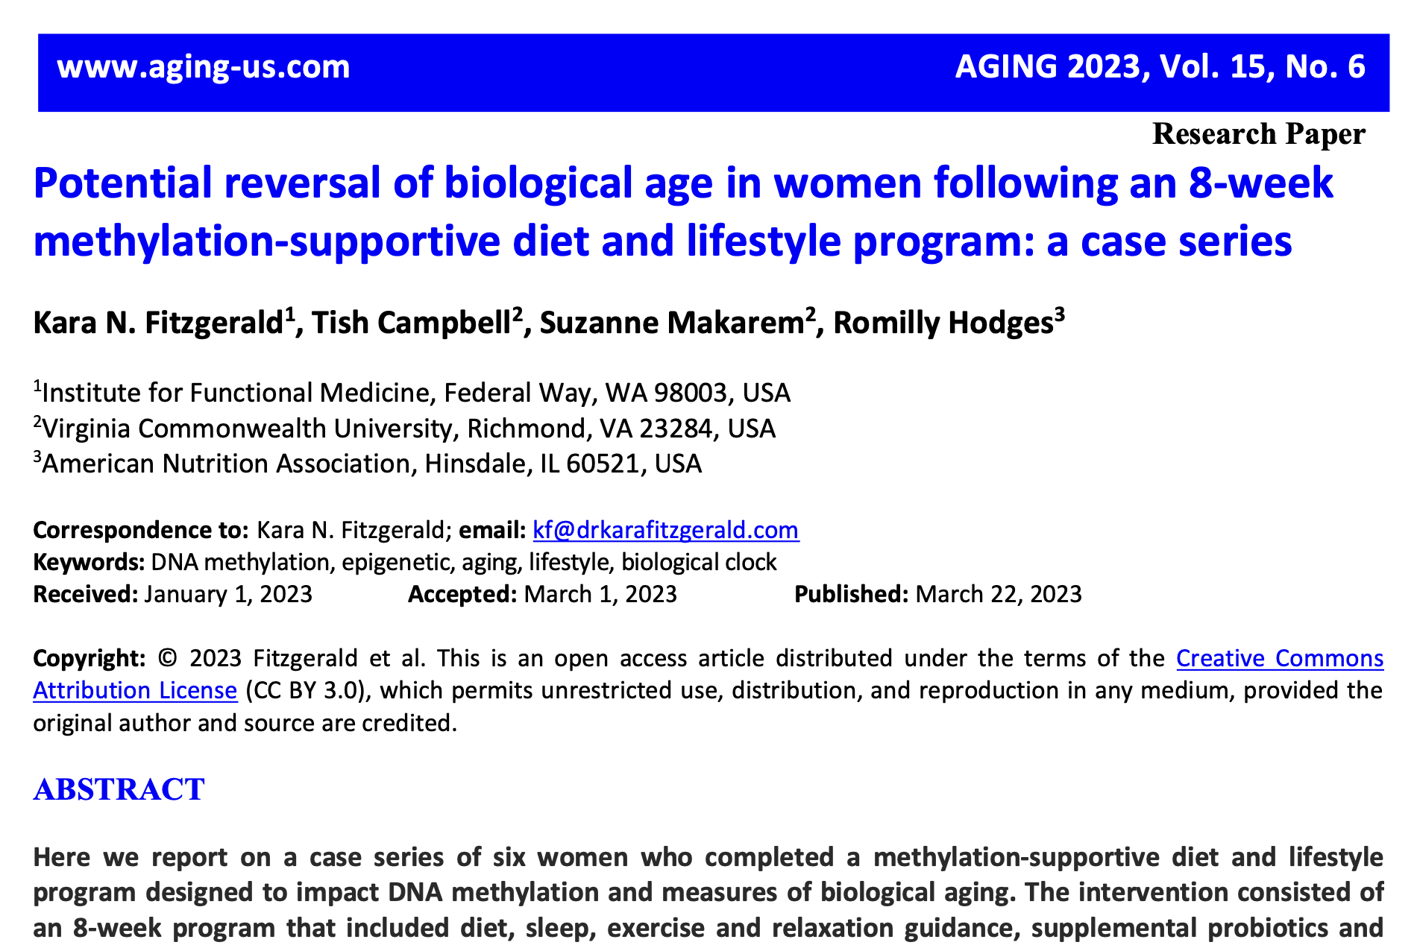

Slide 43
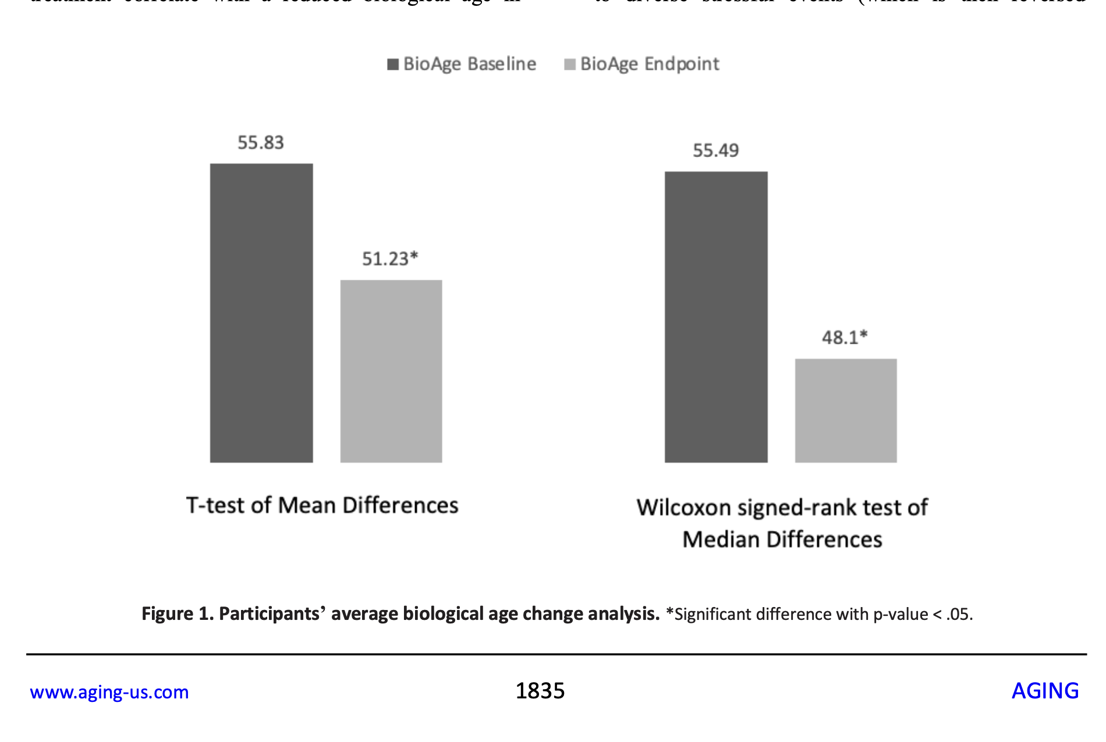

Slide 44
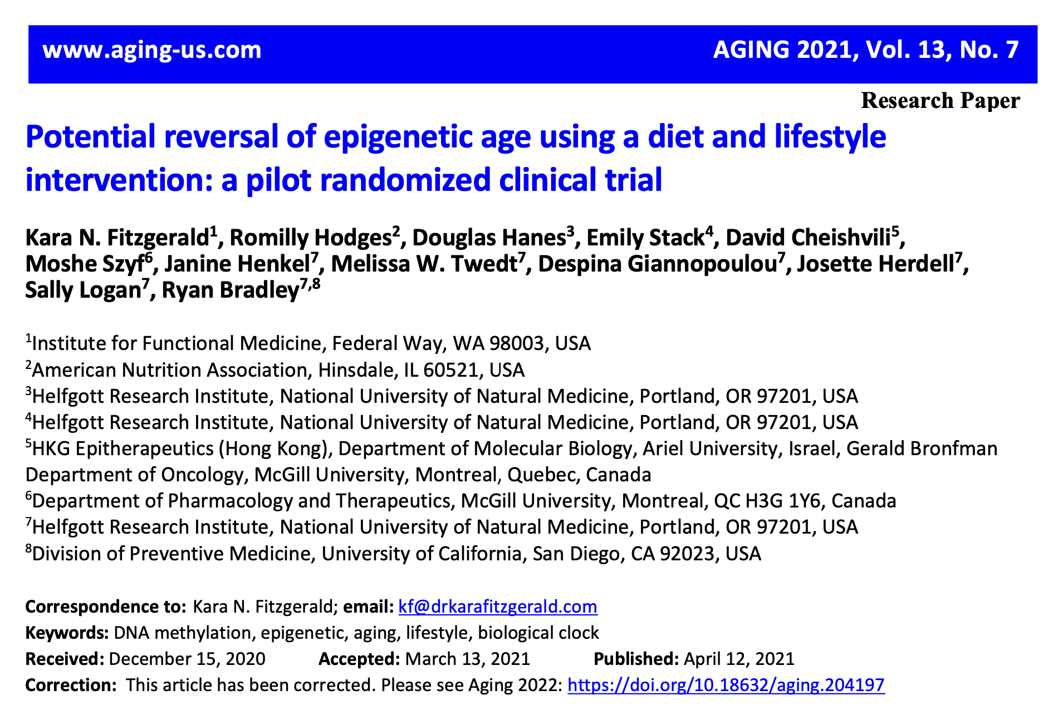

Slide 45
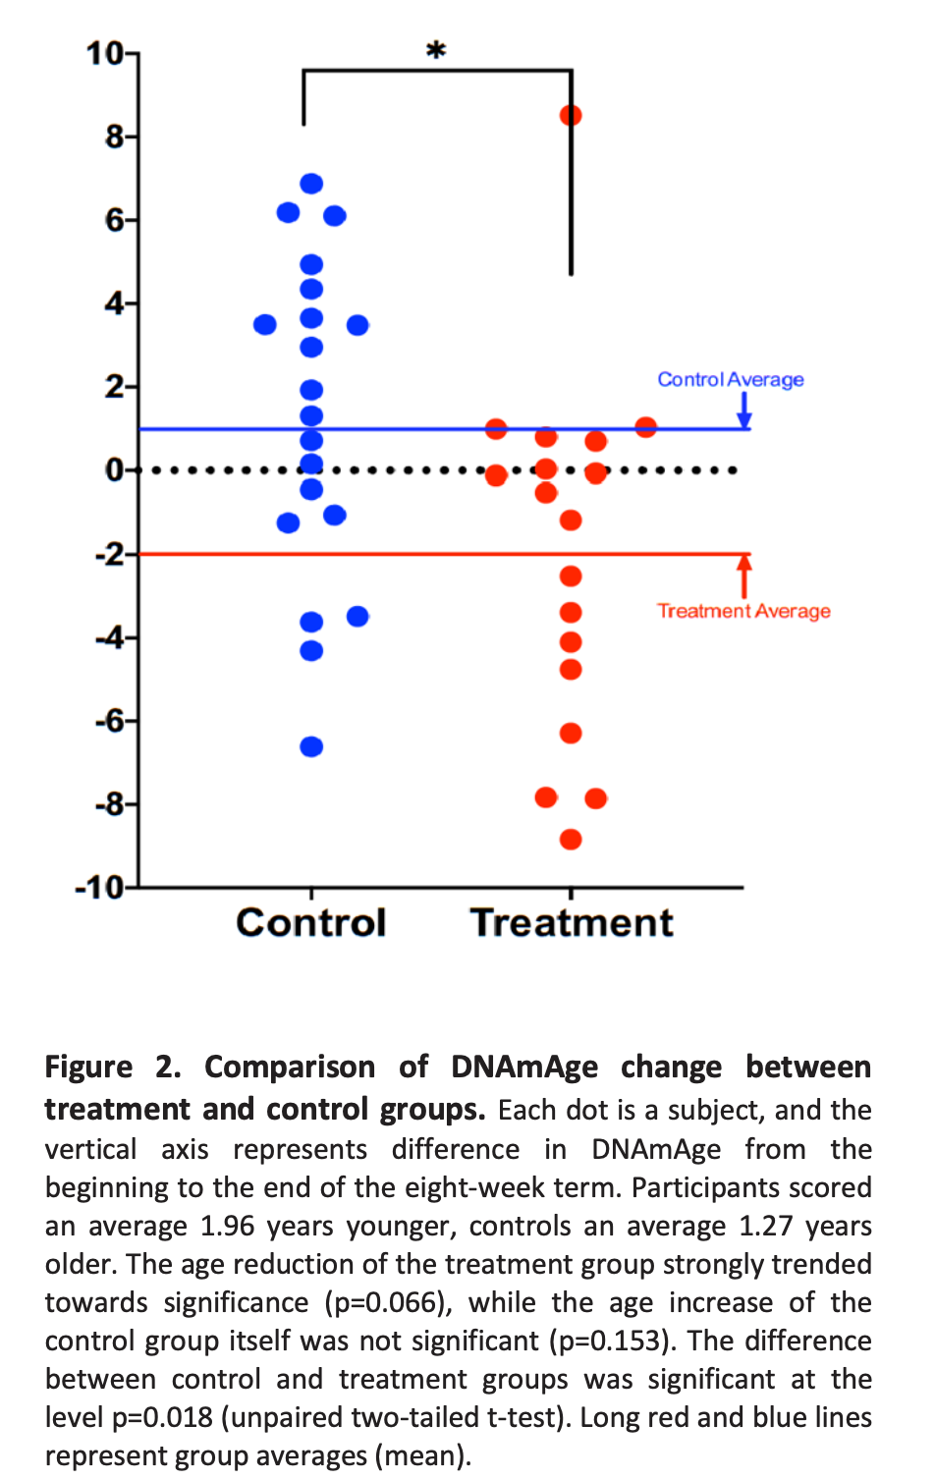
After 1-year, treatment group with healthy lifestyle interventions regressed biologic age 1.96 years compared to control group who aged 1.27 years

Slide 46
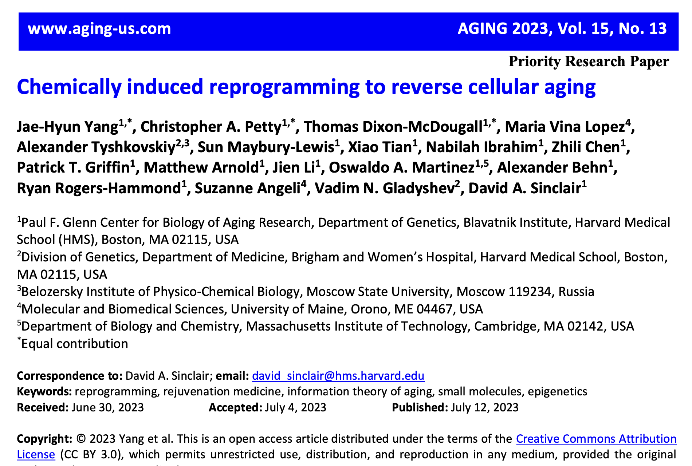

Slide 47
David Sinclair PhD, Harvard Medical School

Slide 48
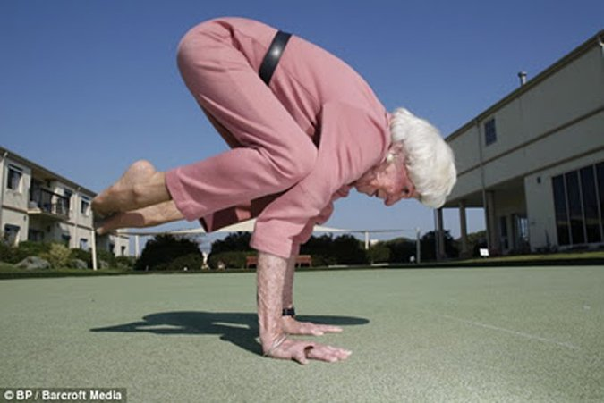
How can I translate this science into my day-to-day routine in 2024?

Slide 50
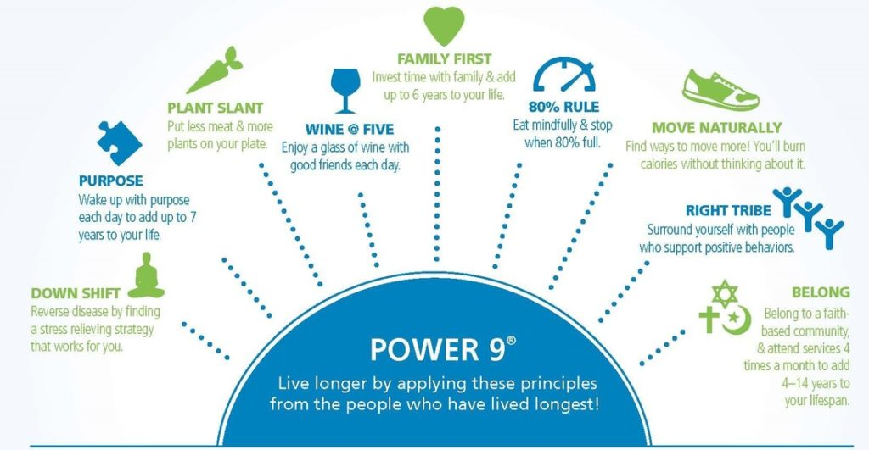

Slide 51
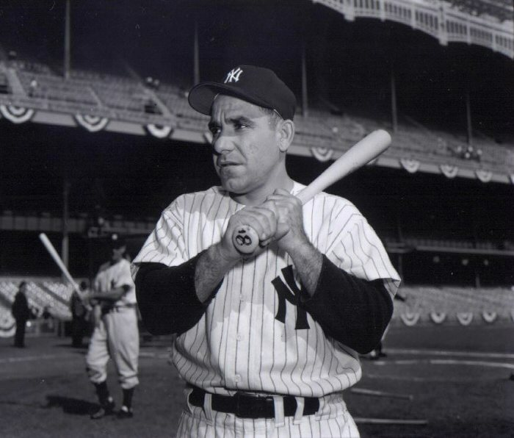
“The future ain’t what it used to be.” Yogi Berra

