Slide 1
The Origins of Health
Systems Biology
Obesity, Pre-diabetes, Diabetes, HBP, Lipids, Heart Disease, Stroke, Degenerative Neurologic, Depression, Arthritis Alzheimer’s, Cancer, Autoimmunity
Core Metabolic Imbalances (what drives them)
High Insulin levels
Inflammation
Gut-Barrier Function/Microbiome
Circadian Rhythms- Entrainment
Mitochondrial Disruption
Chronic stress-Allostatic Load
Root Causes (what are their origins)
Environment + Epigenome/genes+ Microbiome
Beliefs-Emotions-Thoughts-Behaviors
Nutrition Movement Interpret-Response to stressors, Environmental toxins Sleep Social Connection Trauma Conflict Management Forgiveness Mindfulness Spirituality-Meaning
Light quality-entrainment
Social Determinants of Health

Slide 2
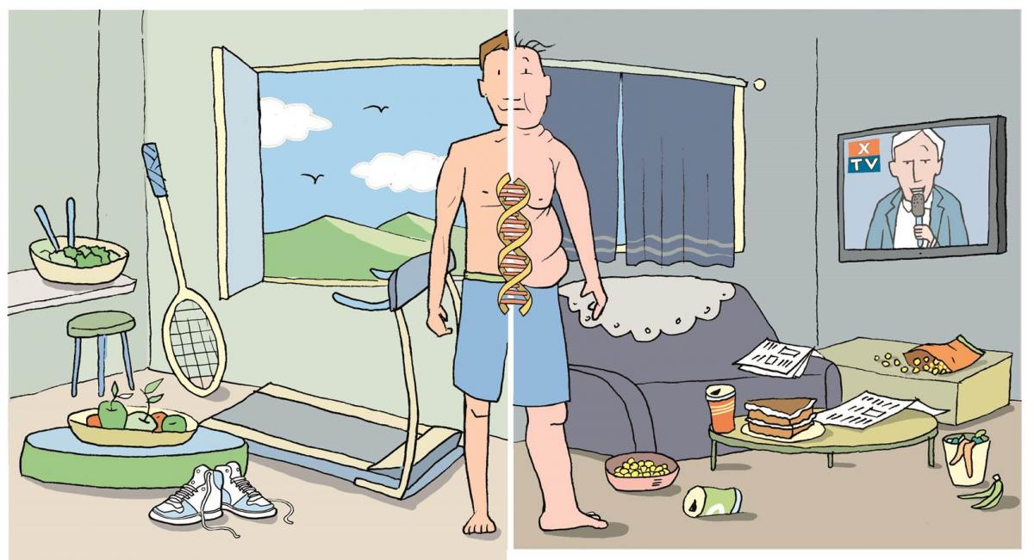
Epigenetics: A future of possibility

Slide 3
Insulin-Inflammation-Obesity Link
High Glycemic Carbohydrate-Dense Foods
Processed fats (vegetable oils/hydrogenated)
Sedentary States
Stress Response
Disrupted Sleep
Social isolation
Lack of Meaning in work, love, play
Environmental Toxins e.g. mold biotoxins
Poor quality light
Meal timing
Weight
Insulin
Insulin
Resistance
And Inflammation
Notes:
Endocrine disruptors tied to 300billion in annual healthcare costs
Organophophate disruptors; glyphosate; BPA; pthalates; PTFO flame retardants

Slide 4
From: Increasing Adiposity: Consequence or Cause of Overeating?
JAMA. 2014;():. doi:10.1001/jama.2014.4133
Copyright © 2014 American Medical Association. All rights reserved.

Slide 5
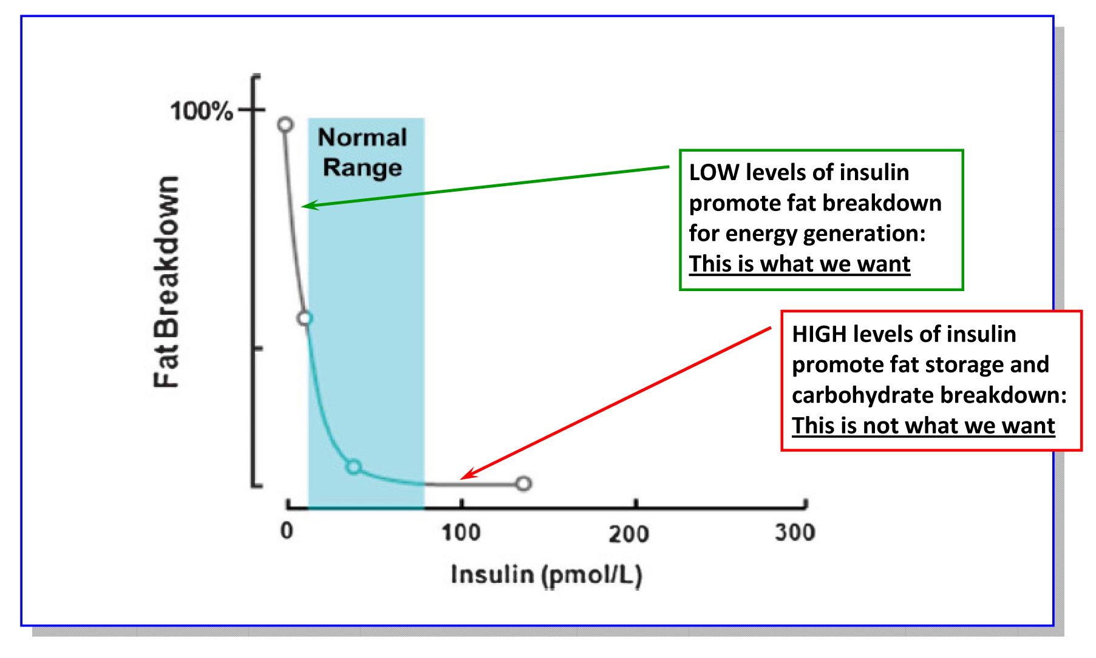
Lipolysis vs. Lipogenesis

Slide 6
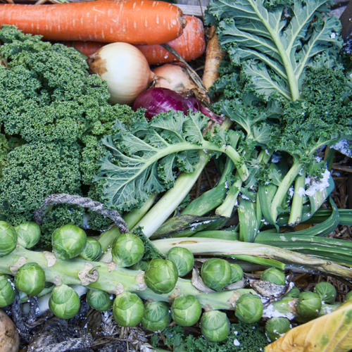
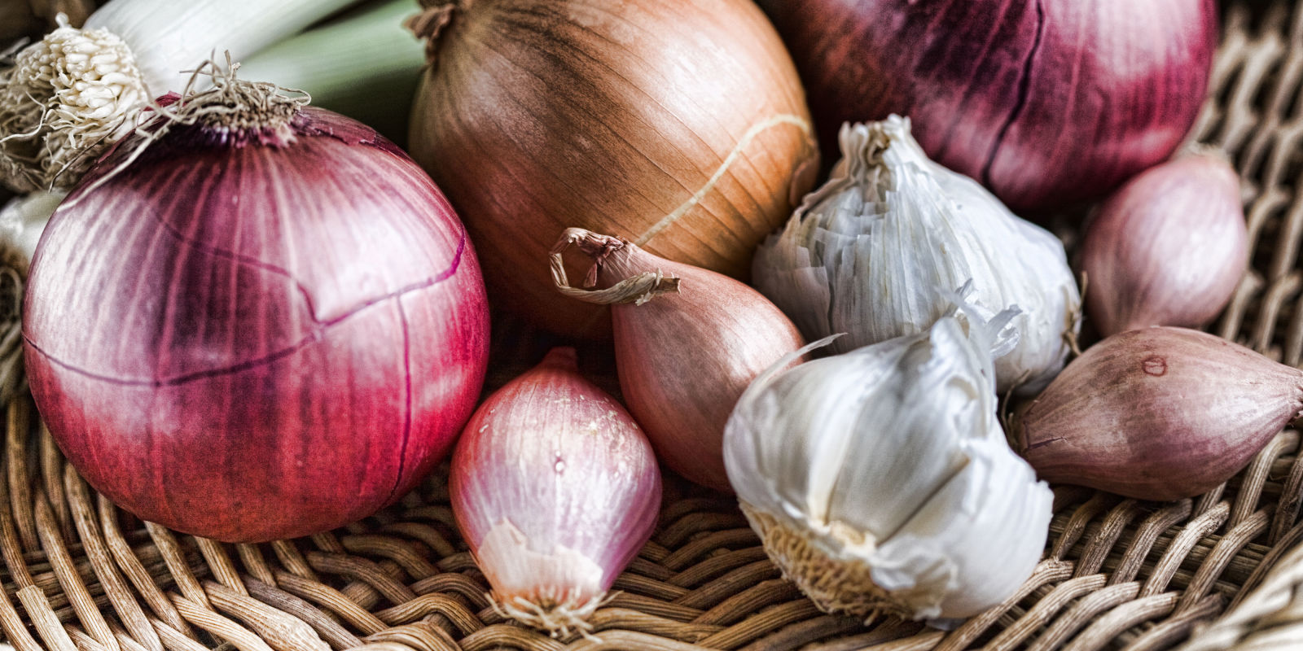
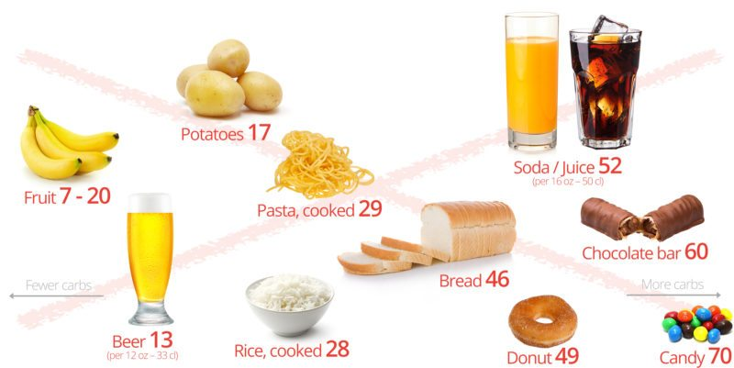
Sugar, Fructose and High-Glycemic Processed Grains
High-Quality Plant-Based Carbs
Oral and Gut
Microbiome
Inflammation
Neurotransmitter disruption
Insulin Resistance
Weight and Metabolism
Mitochondria-Oxidative stress
HPA axis –Stress Response
Protection from:
Inflammation
Diabetes
Cancer
Obesity

Slide 7
Poor Quality Carbs
Acellular carbohydrate density
Inflammation
Stress
Sleep disruption
Altered gut-permeability/microbiome
Social isolation
Toxin excess
Sedentary states
VAT
Excess Insulin
VAT Fat storage-lipogenesis
Down-regulation of insulin receptors
Insulin Resistance
Leptin resistance
Eat more and do less

Slide 8
Epigenetics
Lifestyle/Environment
Beliefs/Thoughts
Food quality
Movement
Sleep quality
Stress load
Trauma
Circadian rhythm
Love and connection
Meaning and purpose
Natural light/time outdoors
Beliefs-thoughts
Socioeconomics
Education
Life
Metabolic
Health
Longevity
Health span
Resilience
Gene Expression
Microbiome
Consciousness-Spirituality

