Slide 1
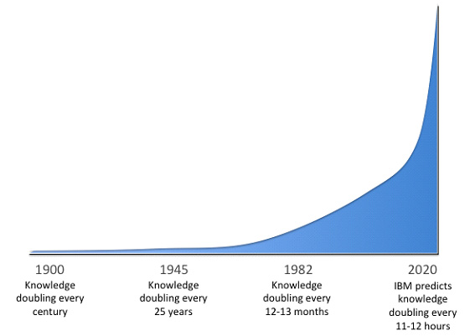
Buckminster Fuller, in his book Critical Path (1982), describes the “knowledge-doubling curve,” explaining that new know-ledge, which had doubled every century until 1900, is now estimated to double every 18 months.

Slide 2
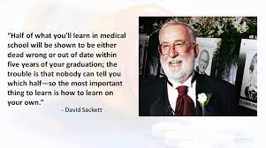

Slide 3
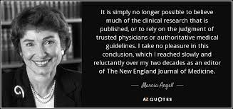

Slide 4
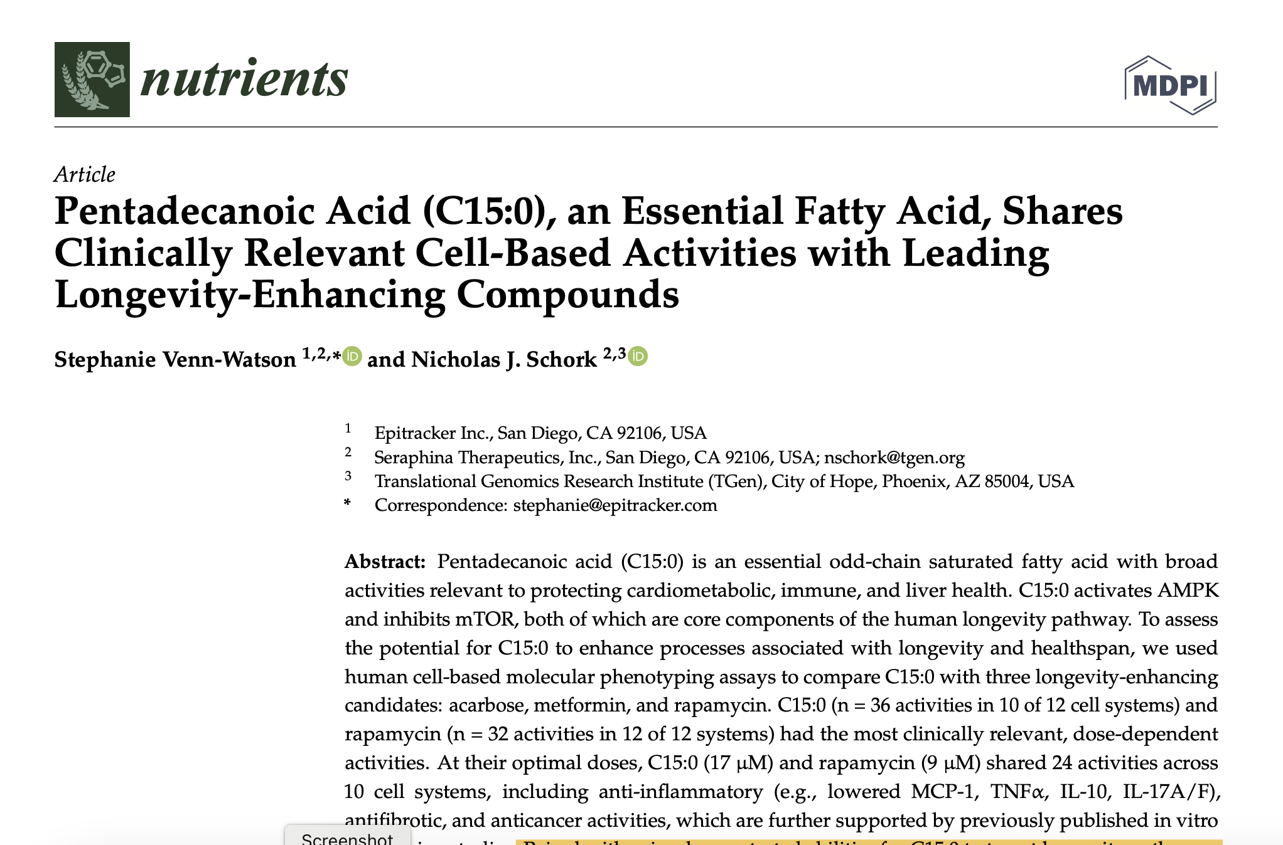
Nutrients 2023, 15, 4607. https://doi.org/10.3390/nu15214607

Slide 6
Pentadecanoic Acid
12 cell systems studied
Pentadecanoic acid compared with metformin and rapamycin
Comparable to Rapamycin and better than metformin
Activates AMPK - AMP Kinase
Inhibits mTOR – mammalian target of Rapamycin
Anti-inflammatory metabolome
Anti-fibrotic
Anti-cancer
Targets most metabolic “hallmarks of aging” which is favorable for mitigating diabetes, heart disease, cancer and NAFLD risk

Slide 7
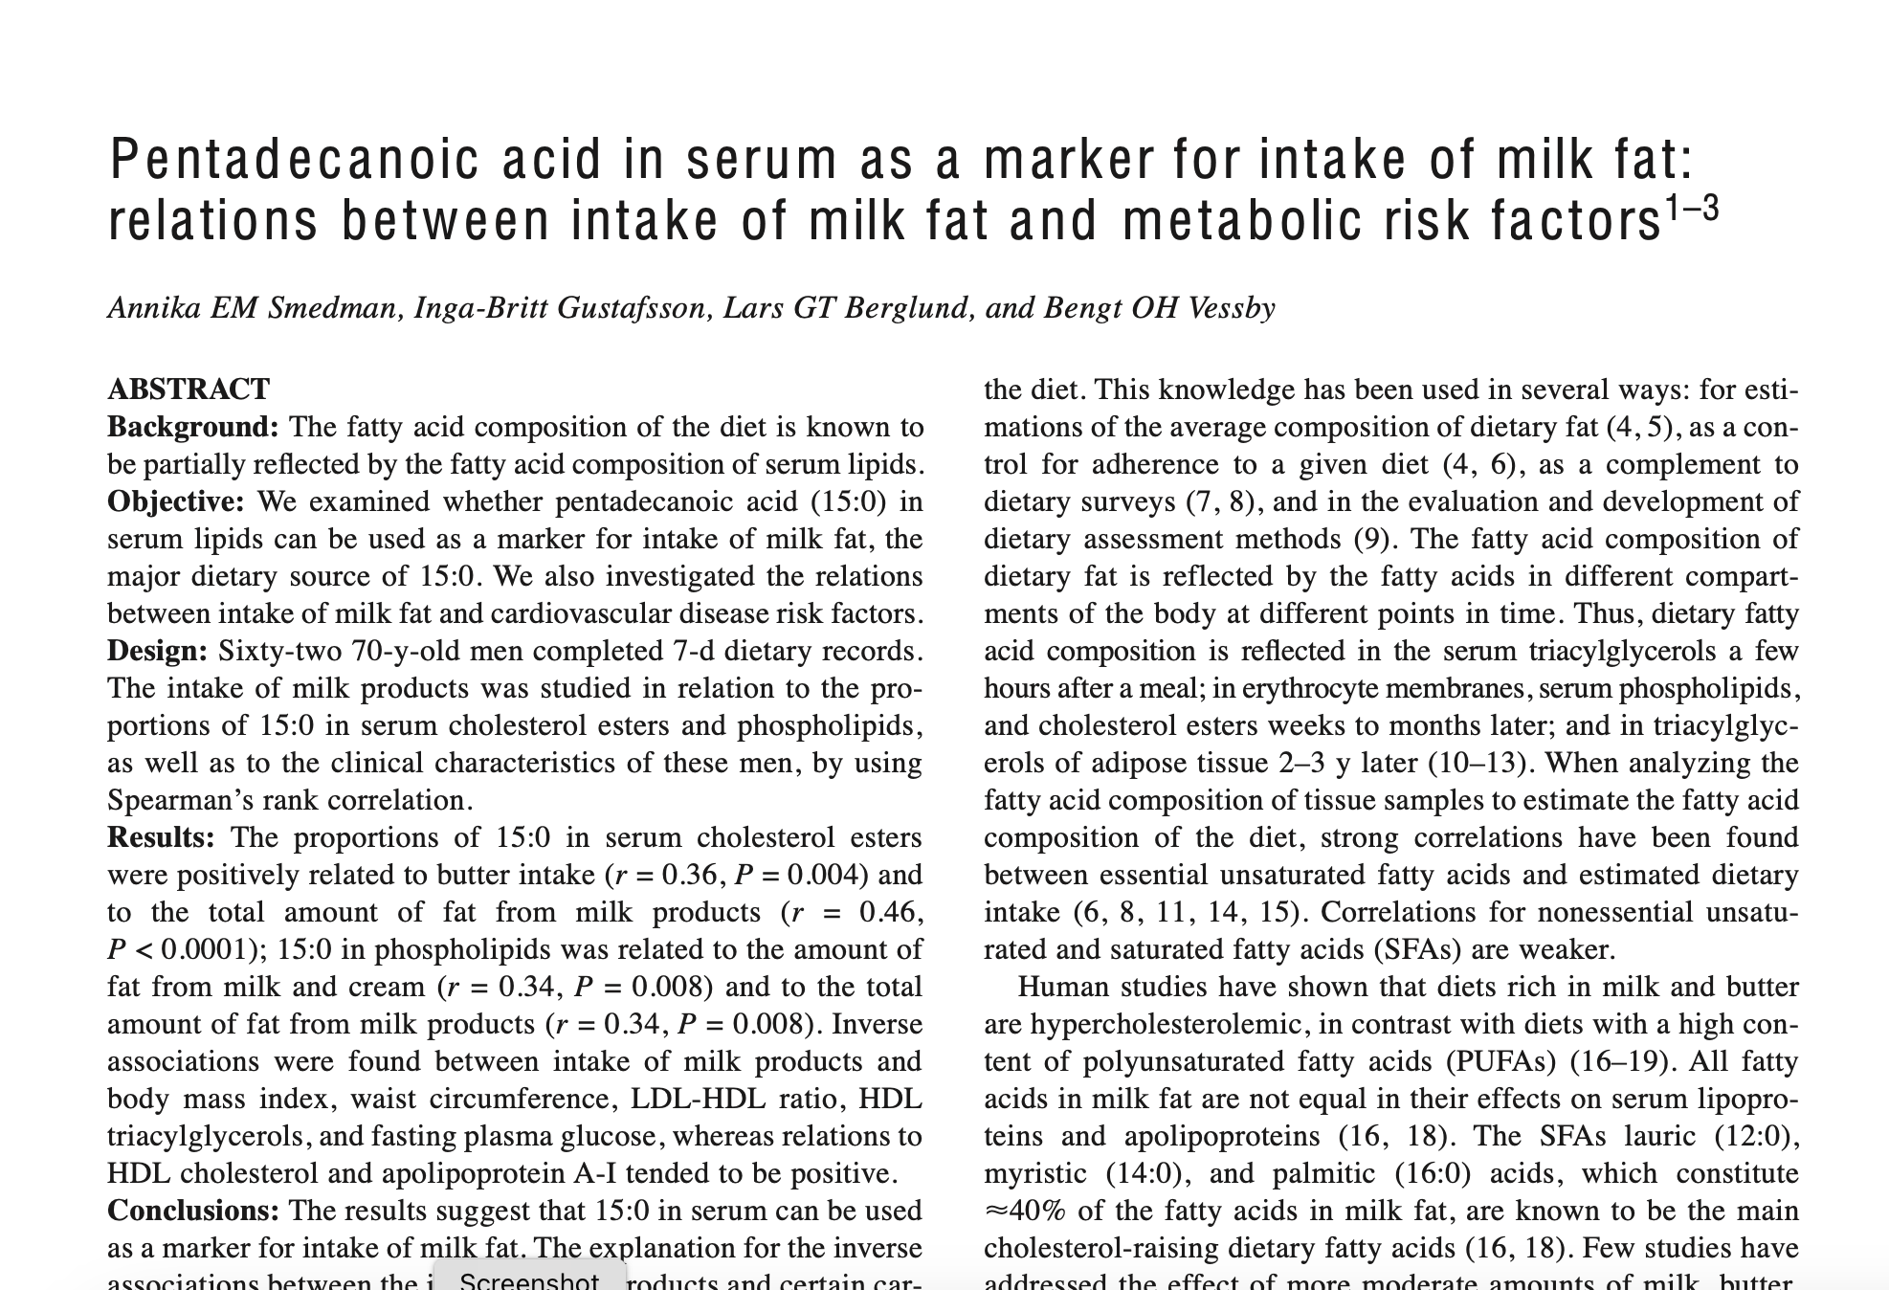
Inverse associations were found between intake of milk products and body mass index, waist circumference, LDL-HDL ratio, HDL triacylglycerols, and fasting plasma glucose, whereas relations to HDL cholesterol and apolipoprotein A-I tended to be positive!
m J Clin Nutr 1999;69:22–9. Printed in USA. © 1999 American Society for Clinical Nutrition

Slide 8
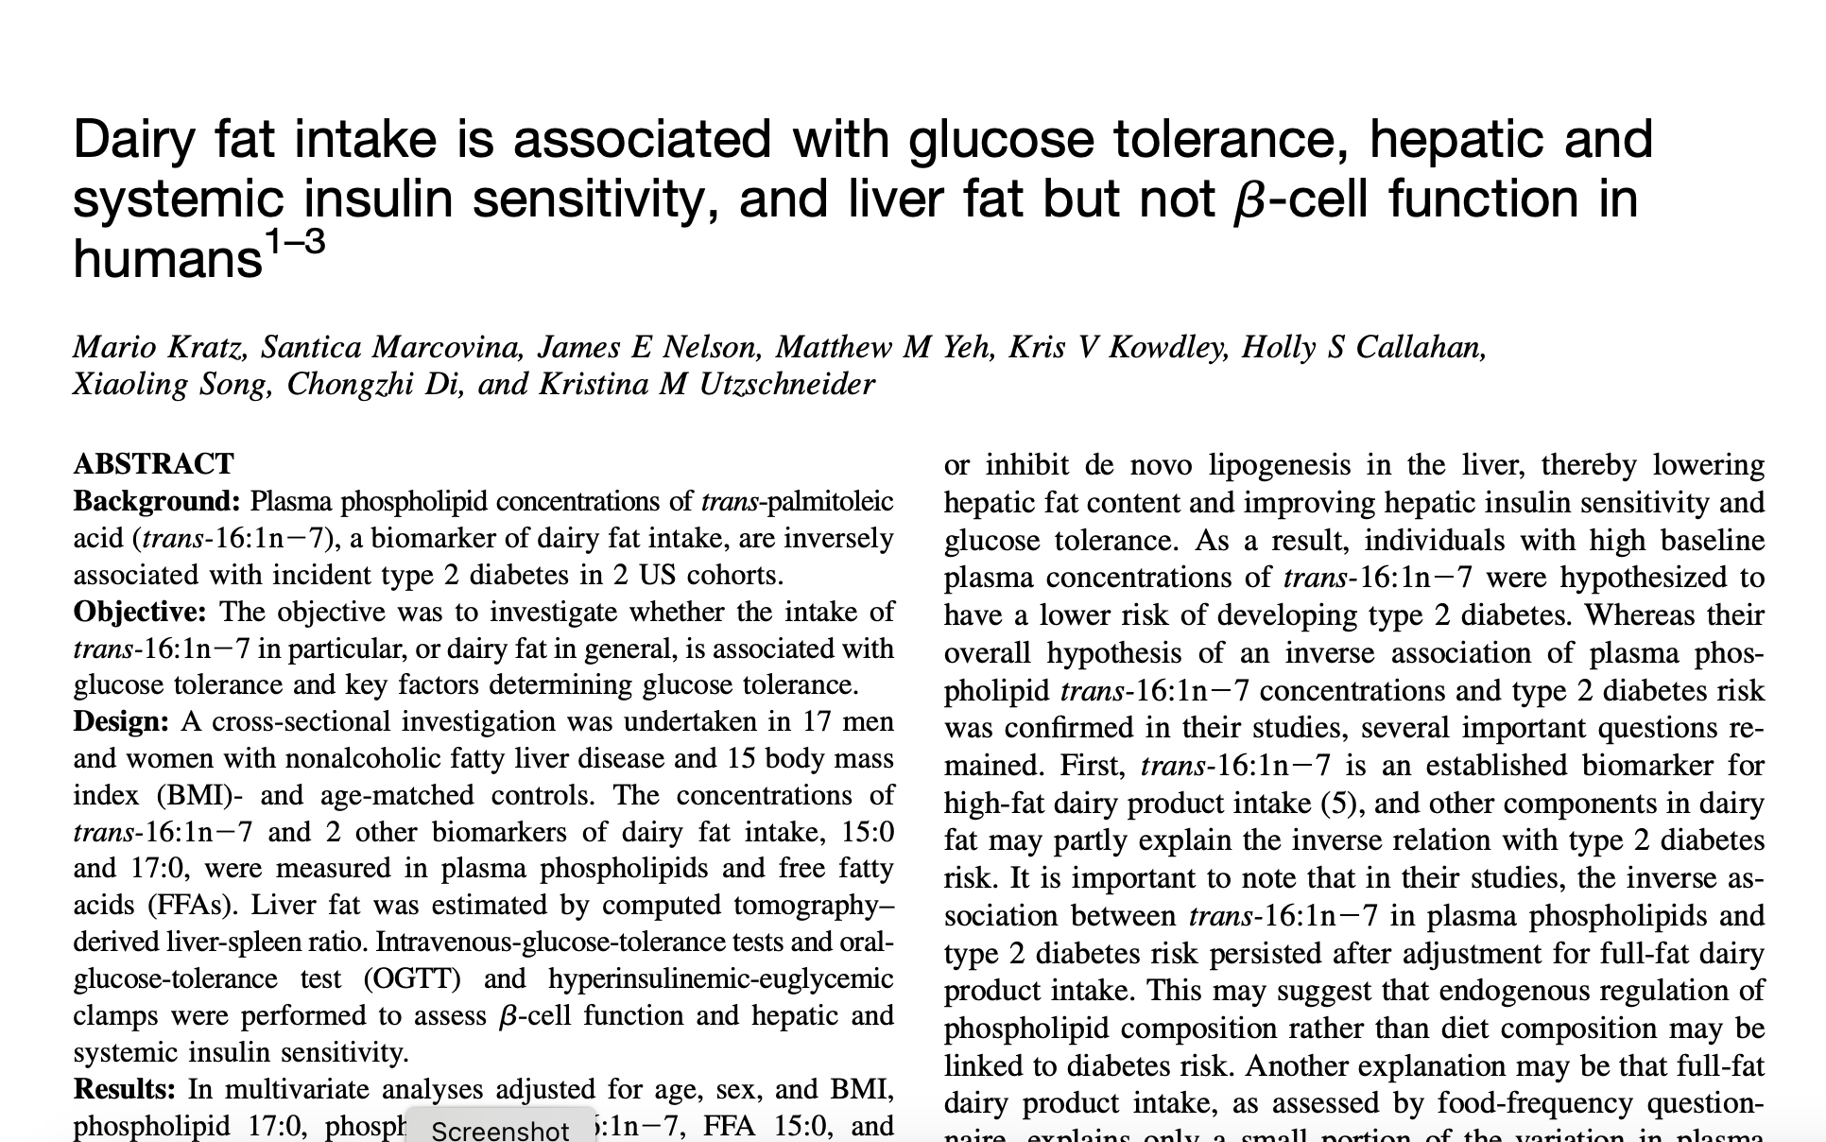
these data support the hypothesis that dairy fat improves glucose toler- ance, possibly through a mechanism involving improved hepatic and systemic insulin sensitivity and reduced liver fat.
Am J Clin Nutr 2014;99:1385–96. Printed in USA. Ó 2014 American Society for Nutrition

Slide 9
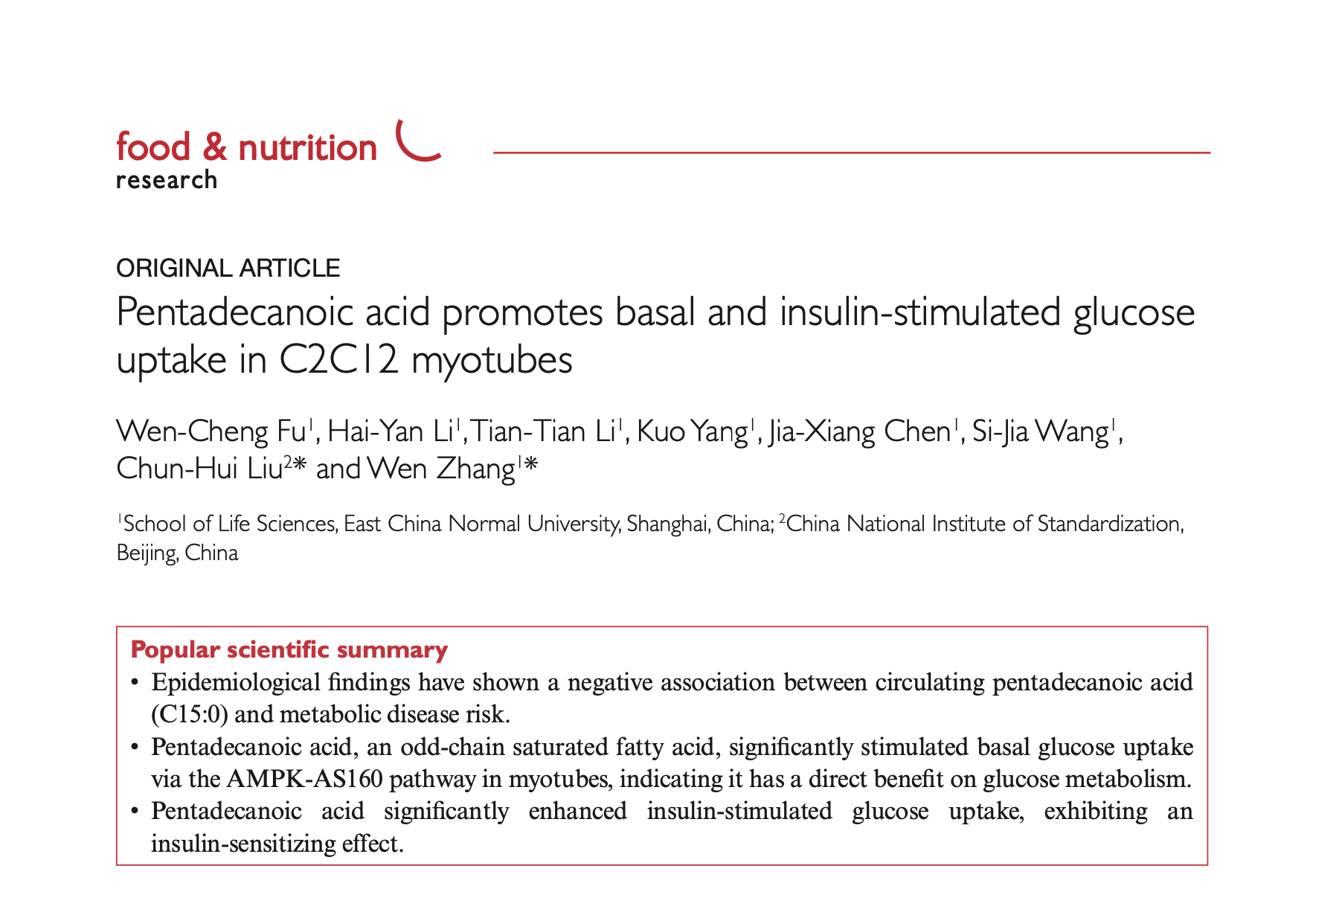
Citation: Food & Nutrition Research 2021, 65: 4527 - http://dx.doi.org/10.29219/fnr.v65.4527

Slide 10
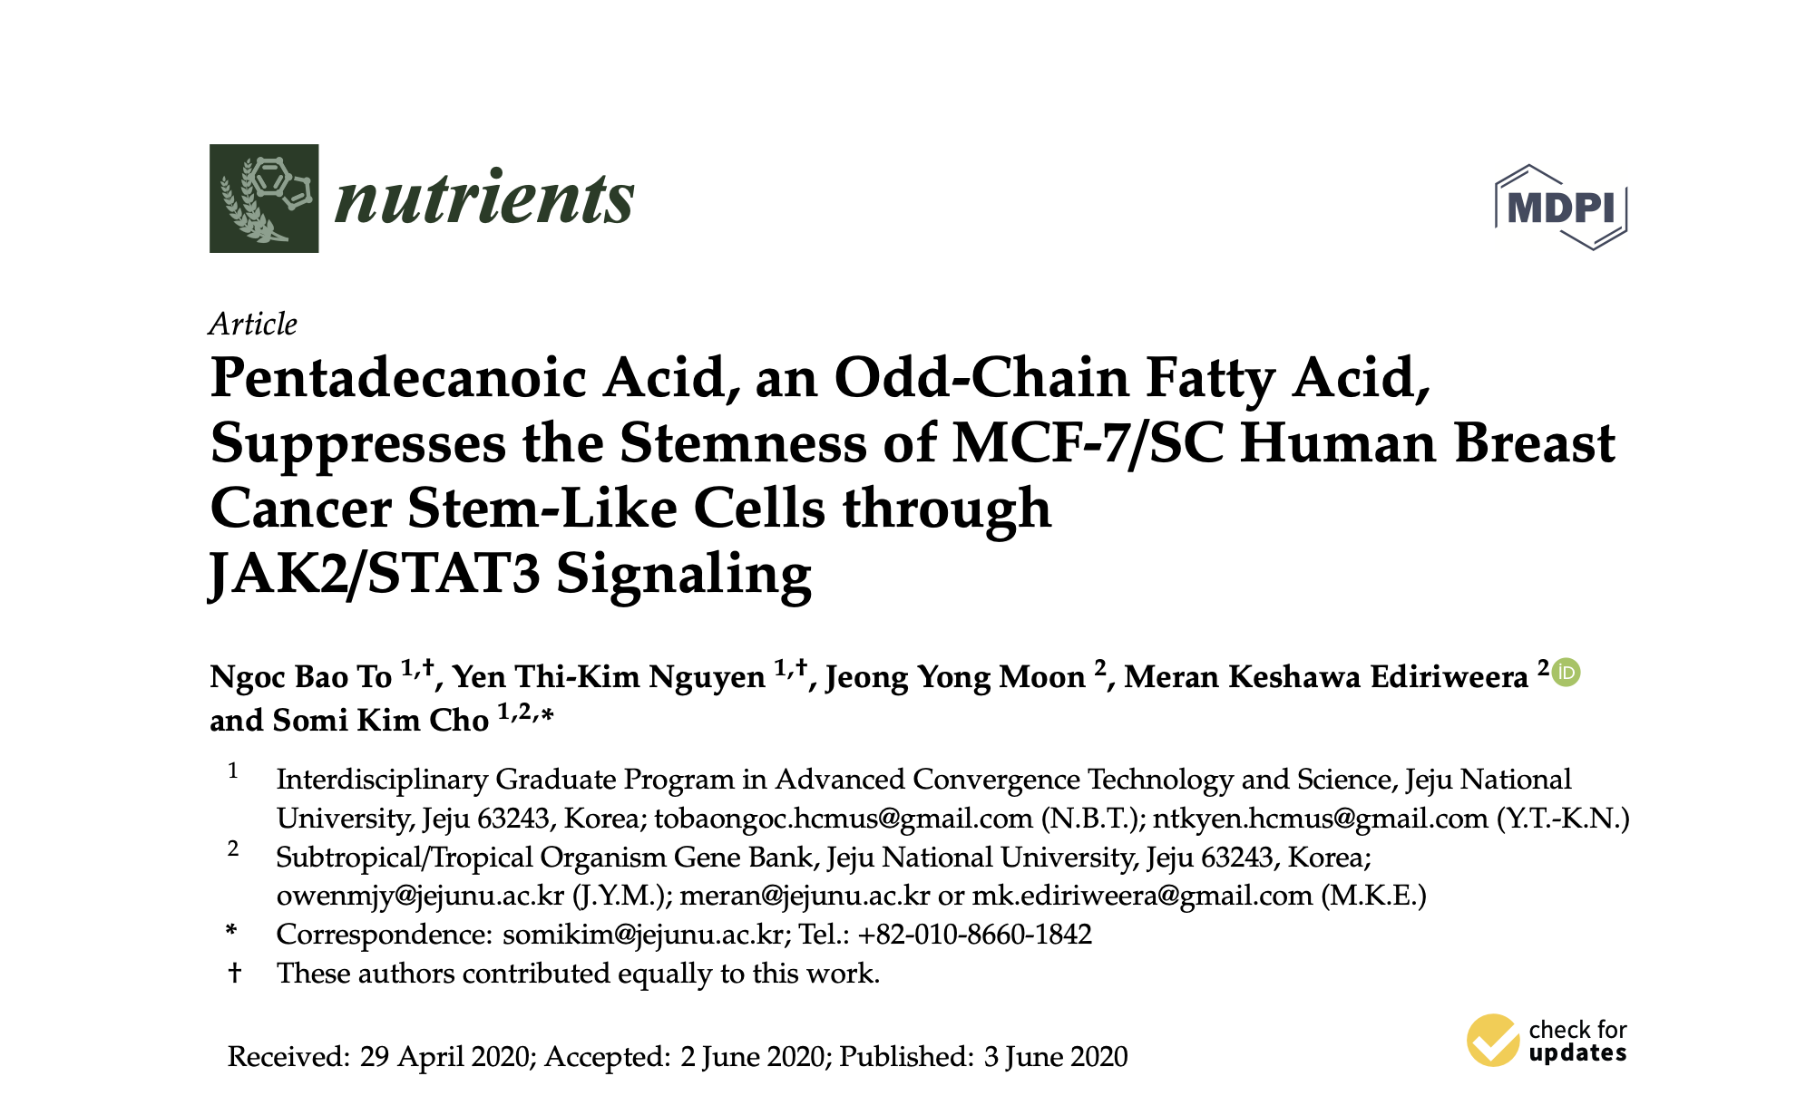

Slide 11
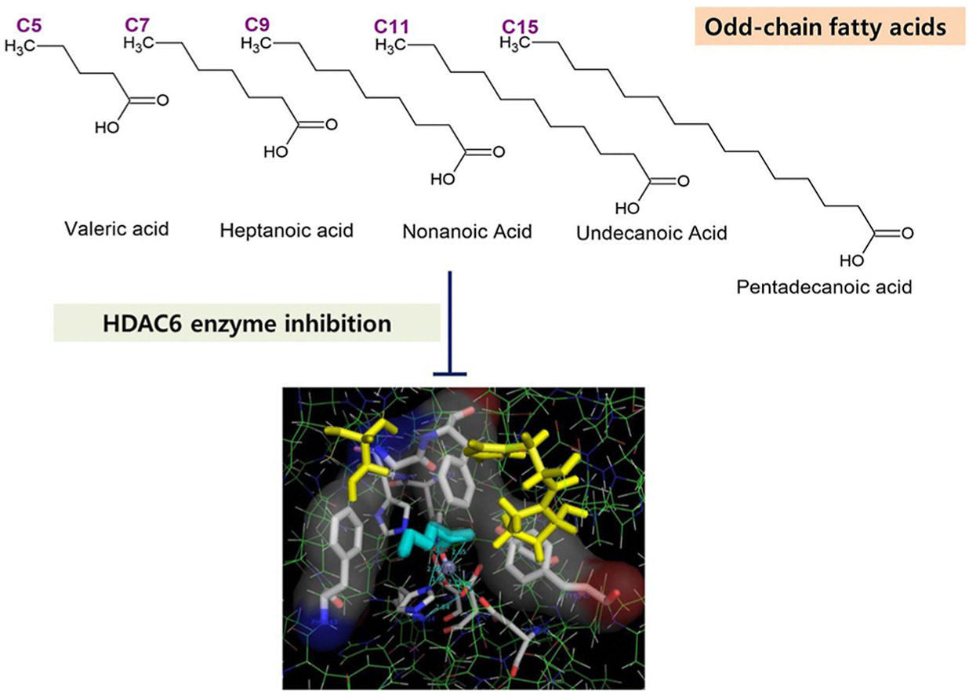
Epigenetic Effects

Slide 12
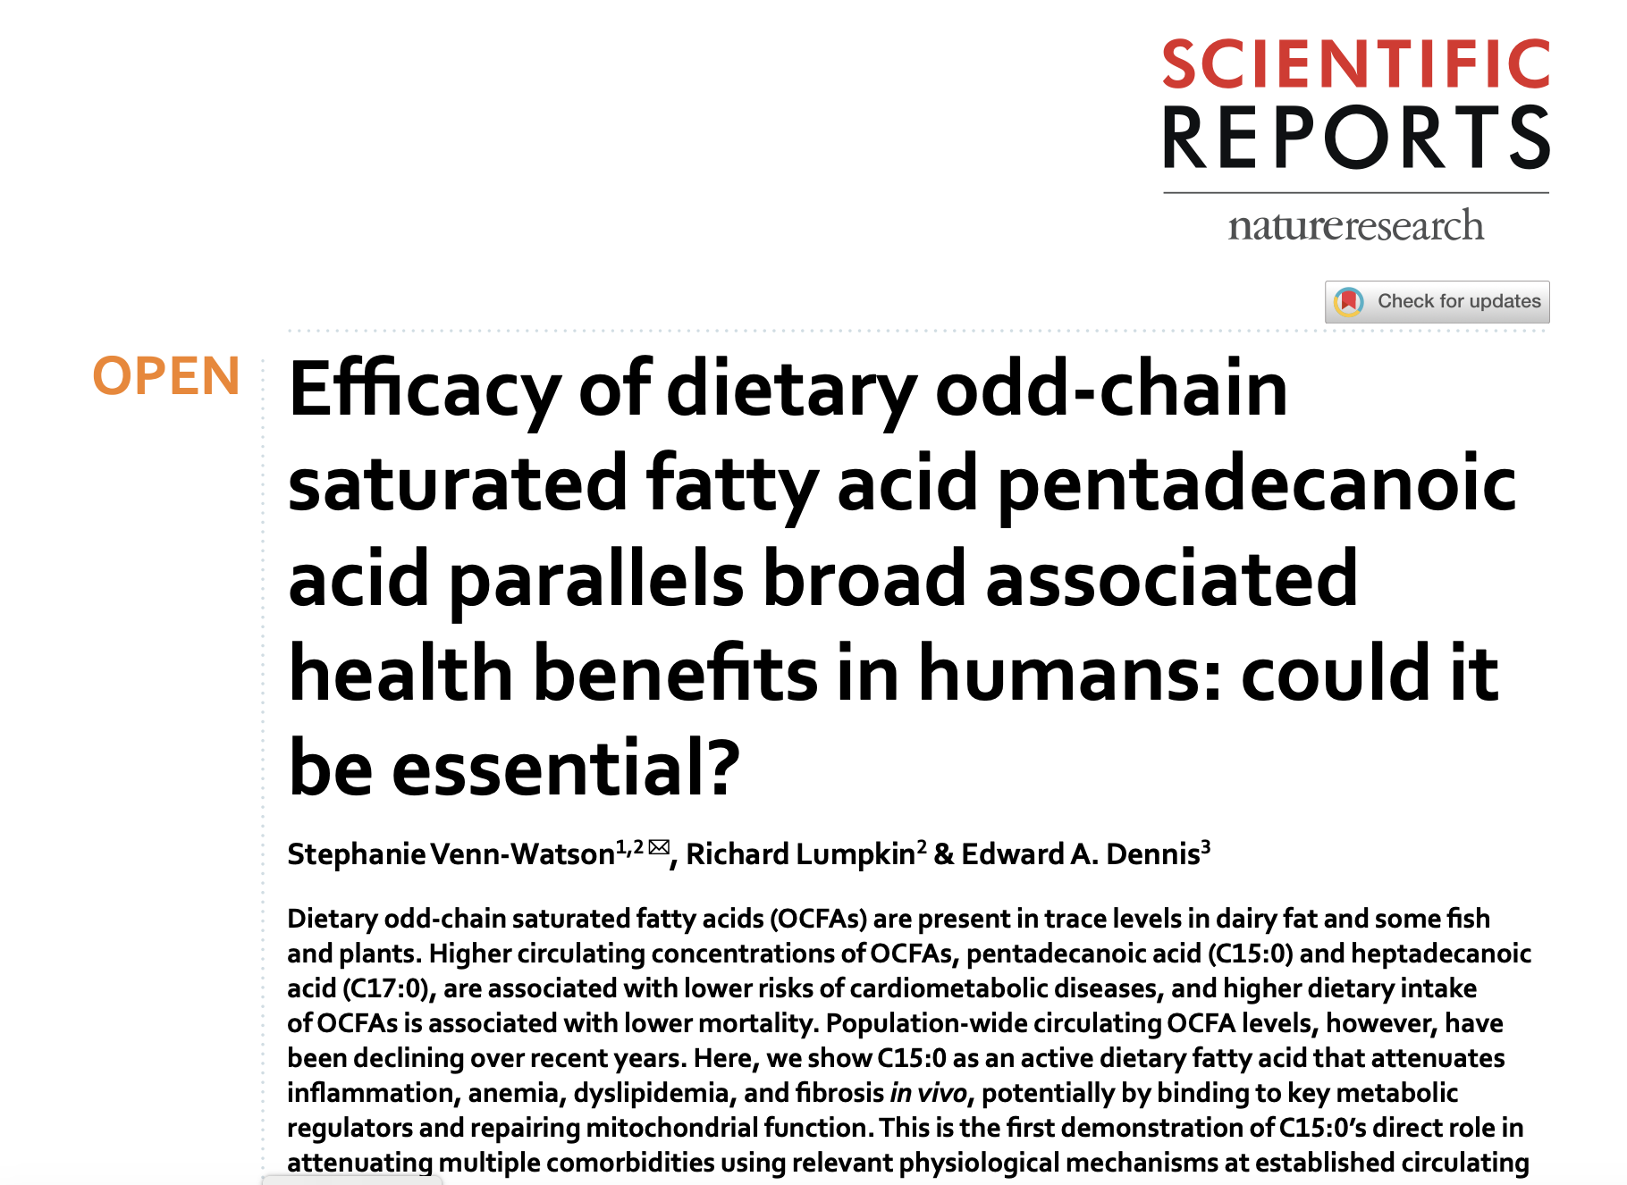
This is the first demonstration of C15:0’s direct role in attenuating multiple comorbidities using relevant physiological mechanisms at established circulating concentrations. Pairing our findings with evidence that (1) C15:0 is not readily made endogenously, (2) lower C15:0 dietary intake and blood concentrations are associated with higher mortality and a poorer physiological state, and (3) C15:0 has demonstrated activities and efficacy that parallel associated health benefits in humans, we propose C15:0 as a potential essential fatty acid. Further studies are needed to evaluate the potential impact of decades of reduced intake of OCFA-containing foods as contributors to C15:0 deficiencies and susceptibilities to chronic disease.
Scientific RepoRtS |
(2020) 10:8161 | https://doi.org/10.1038/s41598-020-64960-y 1

