Slide 1
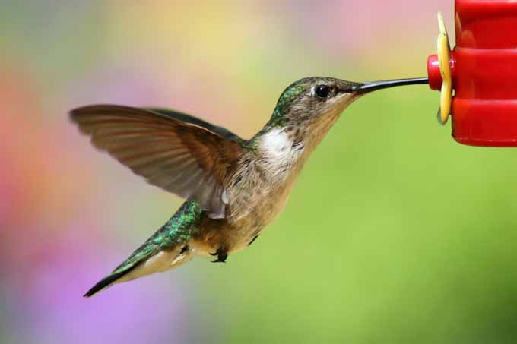
Lifestyle Science: Top Lifestyle Medicine Interventions Emerging Possibilities in an Era of Self-Care

Slide 2
The turning point !

Slide 3
Integrative Health- Metabolic Resilience
Breaking the Fall
Opportunity
Population Health
Notes:
Rectangularize the health curve
Healthspan…organ reserve

Slide 4
Lifestyle/Environment
Life
Genetics/Epigenetics
Microbiome
Consciousness-Spirituality-Meaning

Slide 5
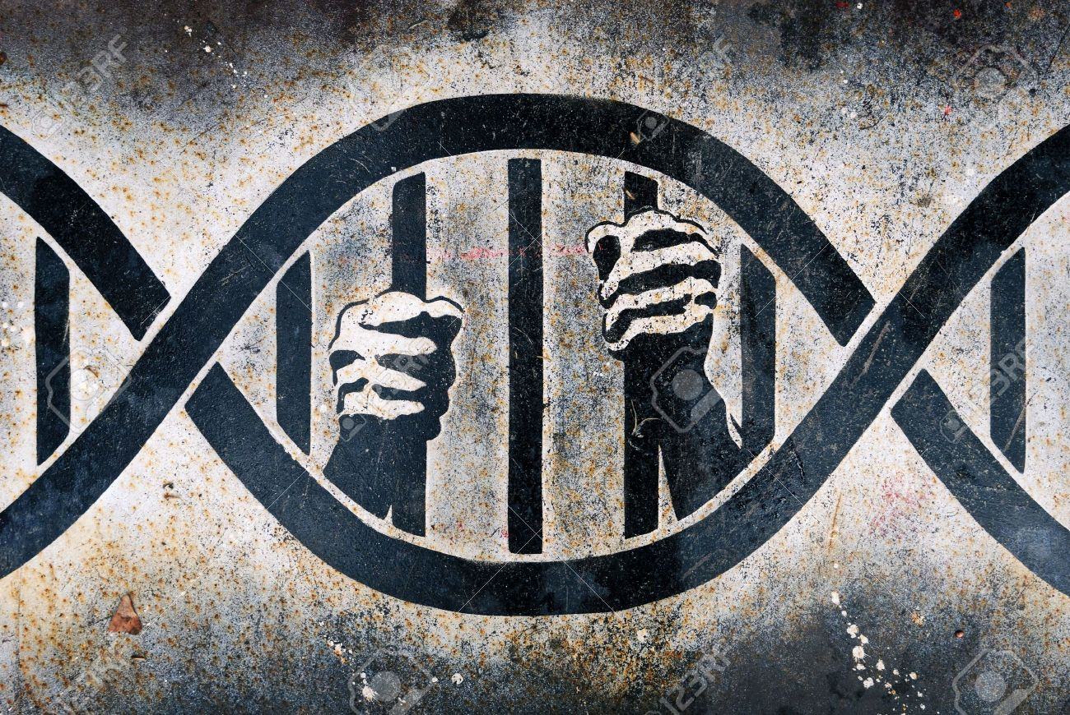
We do not have to be prisoners of our DNA!

Slide 6
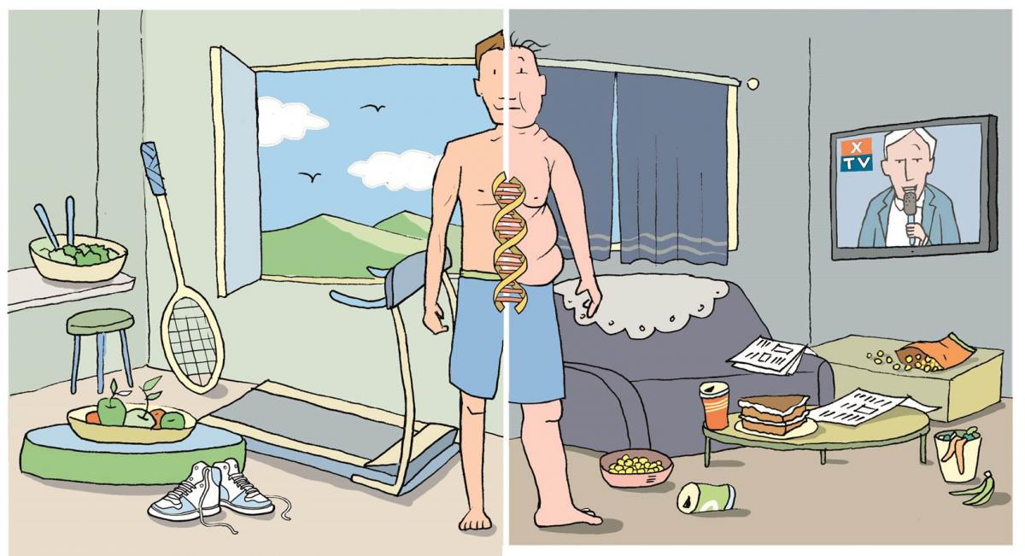
Epigenetics: A life with many possibilities.

Slide 7
Health as a byproduct of environmental-gene-microbiome compatibility

Slide 8
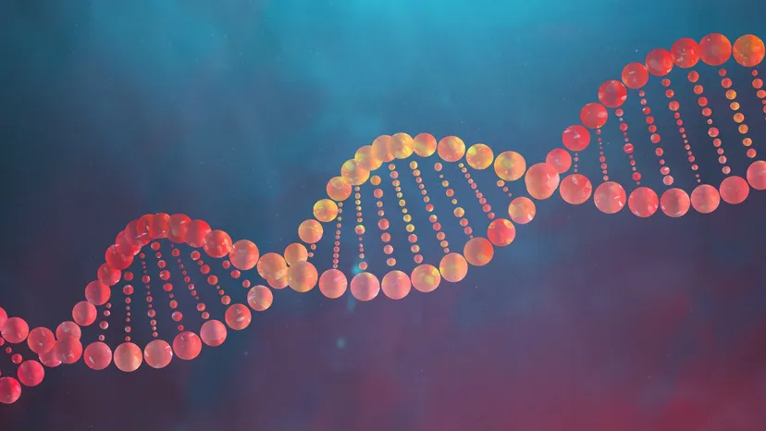
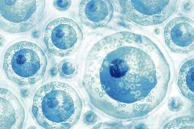
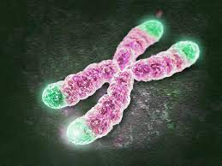
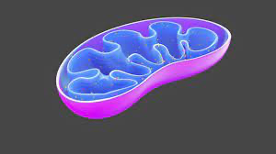
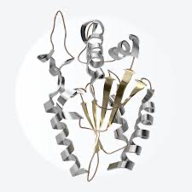
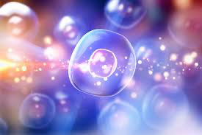
Genetics
Environment
+
Epigenetic Regulation
Genomic Instability
Stem cell
depletion
Telomere attrition
Inflammation
Mitochondrial
Bioenergetics
Altered Intercellular Communication
Loss of Proteostasis
Cellular Senescence

Slide 9
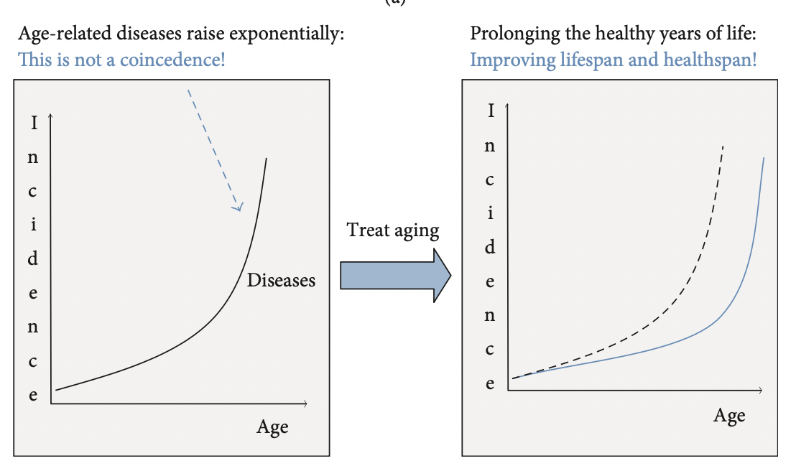
Treating Diseases vs. Treating Aging

Slide 10
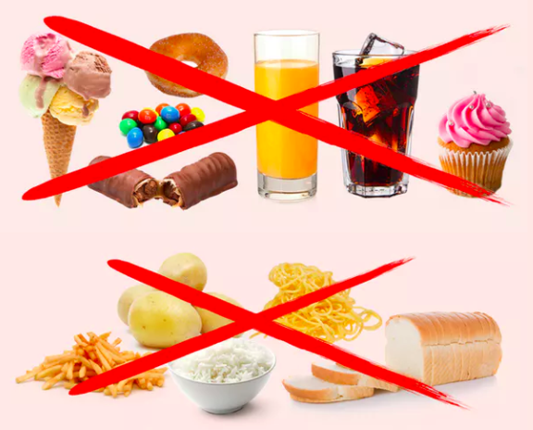
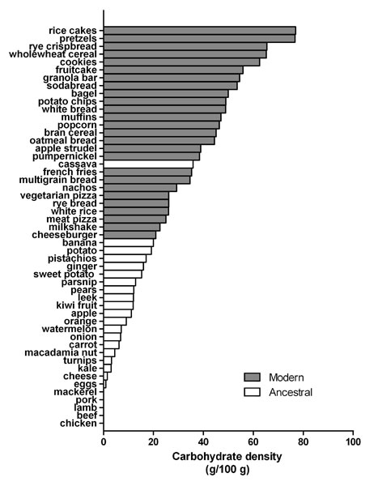
Reduce processed carbohydrate-dense foods
Major contributor of obesity, insulin resistance, dyslipidemia, and inflammation.
A huge area of opportunity in individuals with increased visceral fat, pre-diabetes or diabetes…these are phenotypes of carbohydrate intolerance.
For most, sugar and refined, grain-based foods are problematic: eliminate and observe.

Slide 11
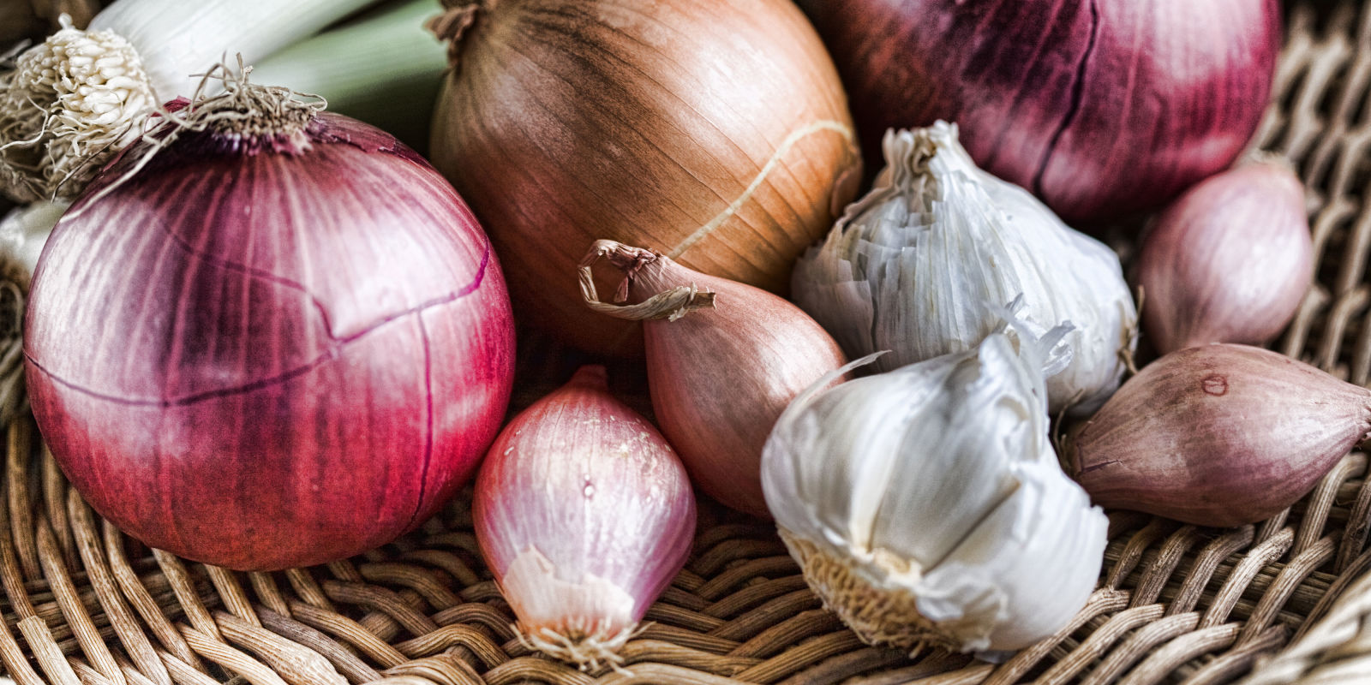
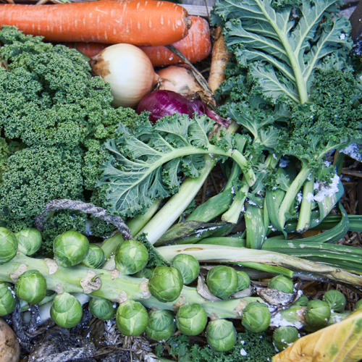
Sugar, Fructose and Carbohydrate-Dense Grains e.g. flour
High-Quality Plant-Based Carbs
Oral and Gut
Microbiome
Inflammation
Altered neurotransmitters
Insulin Resistance
Weight and Metabolism
Mitochondria-Oxidative stress
HPA axis –Stress Response
Protection from:
Inflammation
Diabetes
Cancer
Obesity

Slide 12
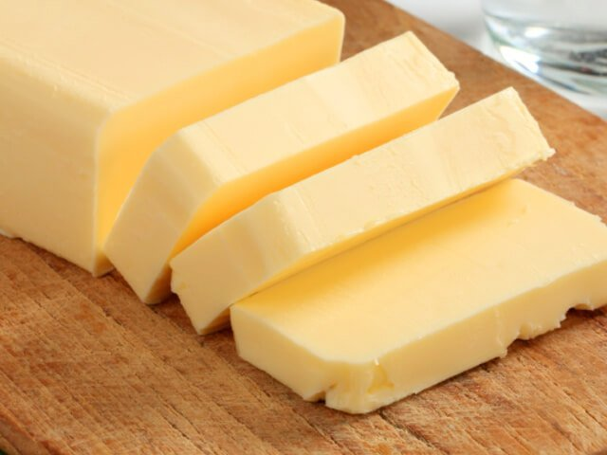
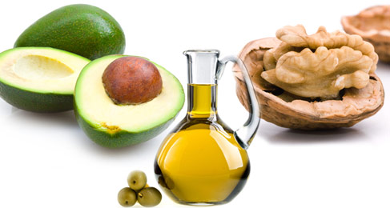
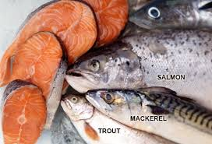
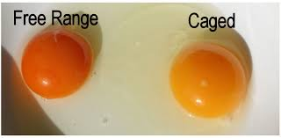
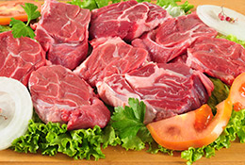
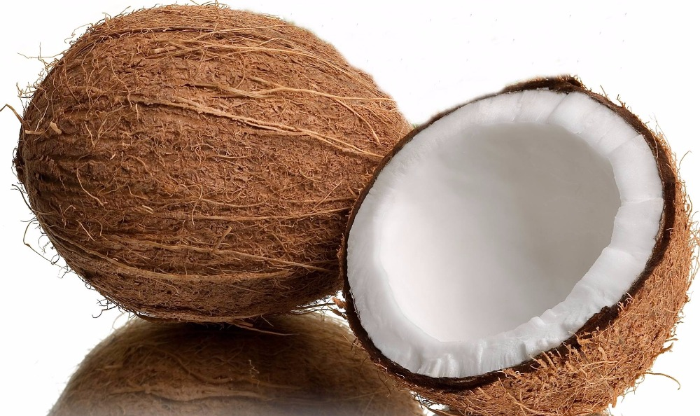
More quality fat sources
Pasture-raised eggs
Fatty fish e.g. salmon, sardines, mackerel
Grass-fed butter
Ghee
Pasture-raised meats
Shellfish
Whole fat yogurt, kefir
Extra virgin olive oil
Extra virgin coconut oil
Avocados, olives
Nuts - almonds, macademia, walnuts

Slide 13
Take care of your microbiome
An emerging major contributor to human health and disease
Be prudent with antibiotics
Prebiotics are critical: Fermentable plant-based fiber
Probiotics for some
Cleaner sources e.g. USDA organic and GMO-free have fewer residues known to effect the gut ecosystem

Slide 14
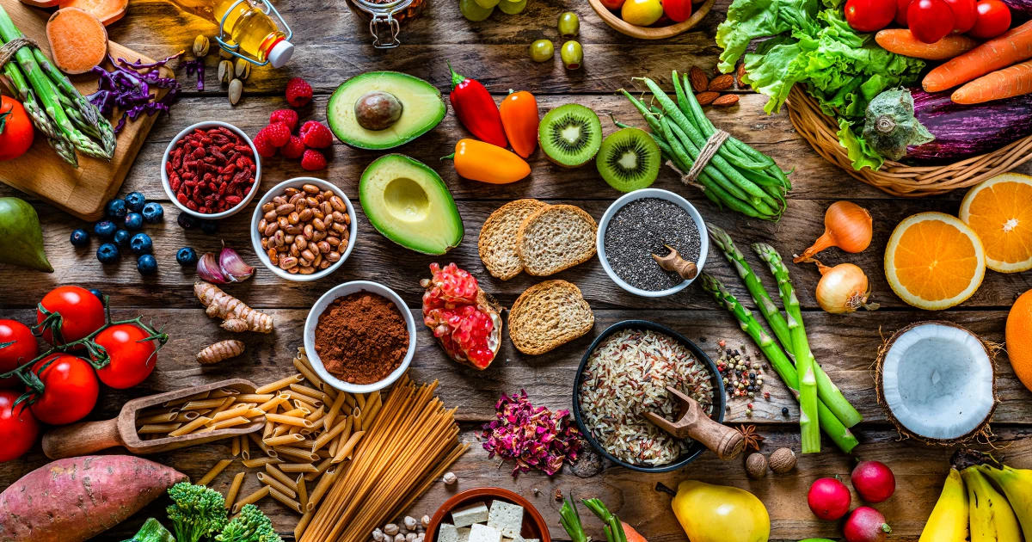
Phytonutrient Rich and High-Fiber Foods (Prebiotics)
…produce an “anti-inflammatory” gut microbiome

Slide 15
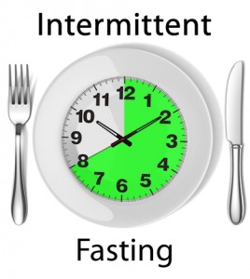
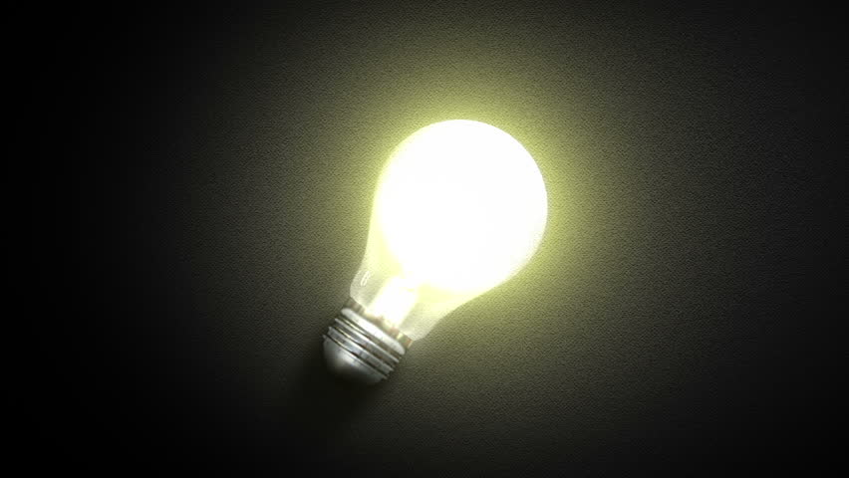
Circadian Entrainment
Loss of circadian synchronization-entrainment as a major contributor to disease risk and diminished quality of life
Circadian genes
Maximally darkened room
Consistent timing
Filter blue light after sundown (f•lux, IRIS, Night Shift); Blue-Blocker glasses
Incandescent, warm LEDs better than CFU lighting
Cooler temp: 64-65°
No caffeine after 2p
Time Restricted Eating e.g. meals within a 10-hour window. No food consumption within 2-3 hrs of bedtime
Relaxation tools

Slide 16
Embracing the moment you are in: What do you believe to be true?
Mindfulness practices powerfully proven to reduce disease risk
Epigenetic effects shown to reduce inflammation, improve insulin sensitivity
Improved mood, resilience, reduced anxiety
Improved performance, creativity and problem-solving capacity
MBSR, meditation, prayer, yoga, journaling, tai chi

Slide 17
Play Outdoors (and don’t be afraid to get dirty)
Loss of circadian entrainment associated with a host chronic health challenges and quality of life.
Full spectrum light exposure associated with a host of health benefits including improved mood, pain reduction, diminished inflammation, and greater health resiliency.
Connection between soil and human microbiome

Slide 18
Social Connection and Health
From an evolutionary biologic perspective we are born to bond
Reduced stress states
Improved coping and resiliency
Reductions in disease risk
Greater longevity and quality of life

Slide 19
Motion is the Lotion
Walk continuously
Be efficient with exercise dose-response e.g. small doses of higher exertion; functional resistance with emphasis on core.
Dance to the music you love!
The Holy Grail from a disease risk-reduction perspective
Prolonged sitting is dangerous and not “undone” with regular exercise
Improved mood, resilience, less pain, less inflammation, improved insulin sensitivity, decreased anxiety

Slide 20
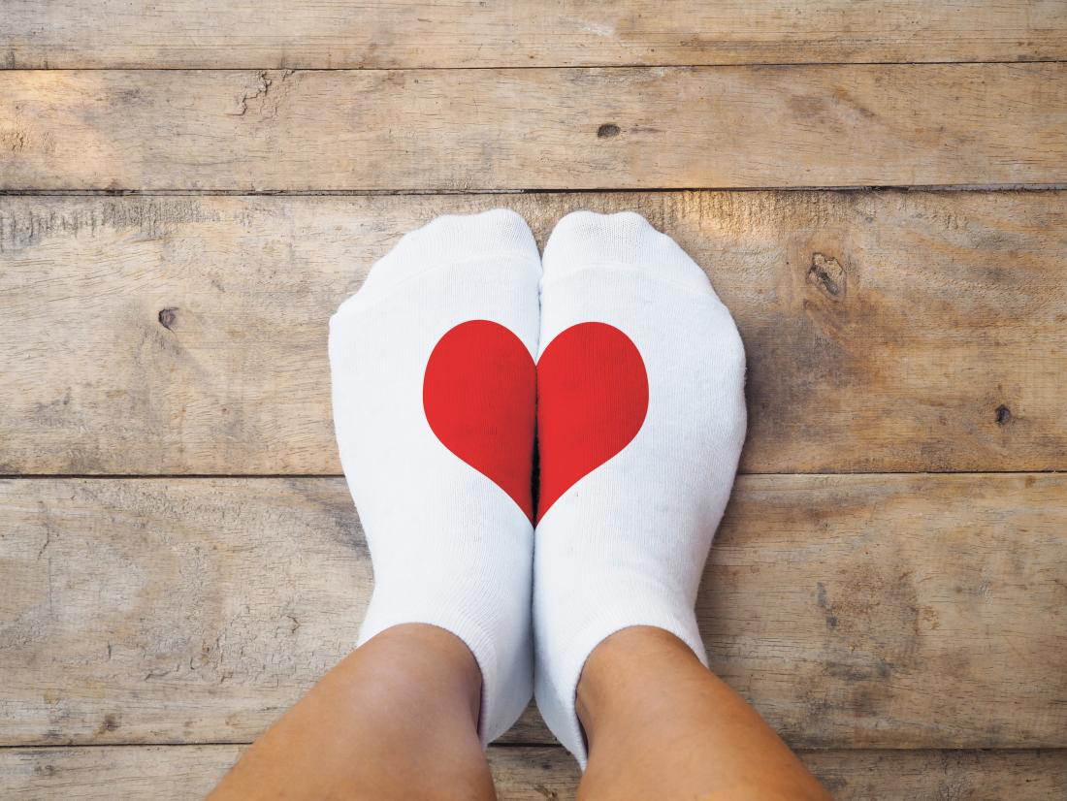
Love and Laughter Really is Good Medicine
It all begins with self-love
Social connection greatly enhanced
Lower markers of inflammation, pain, and anxiety
Enhanced secretory IgA production

Slide 21
Consider Organic for the Dirty Dozen and go to town with the Clean 15
Environmental Working Group ewg.org

Slide 22
Epigenetic Reprogramming

Slide 23
Thank You!

