Slide 2
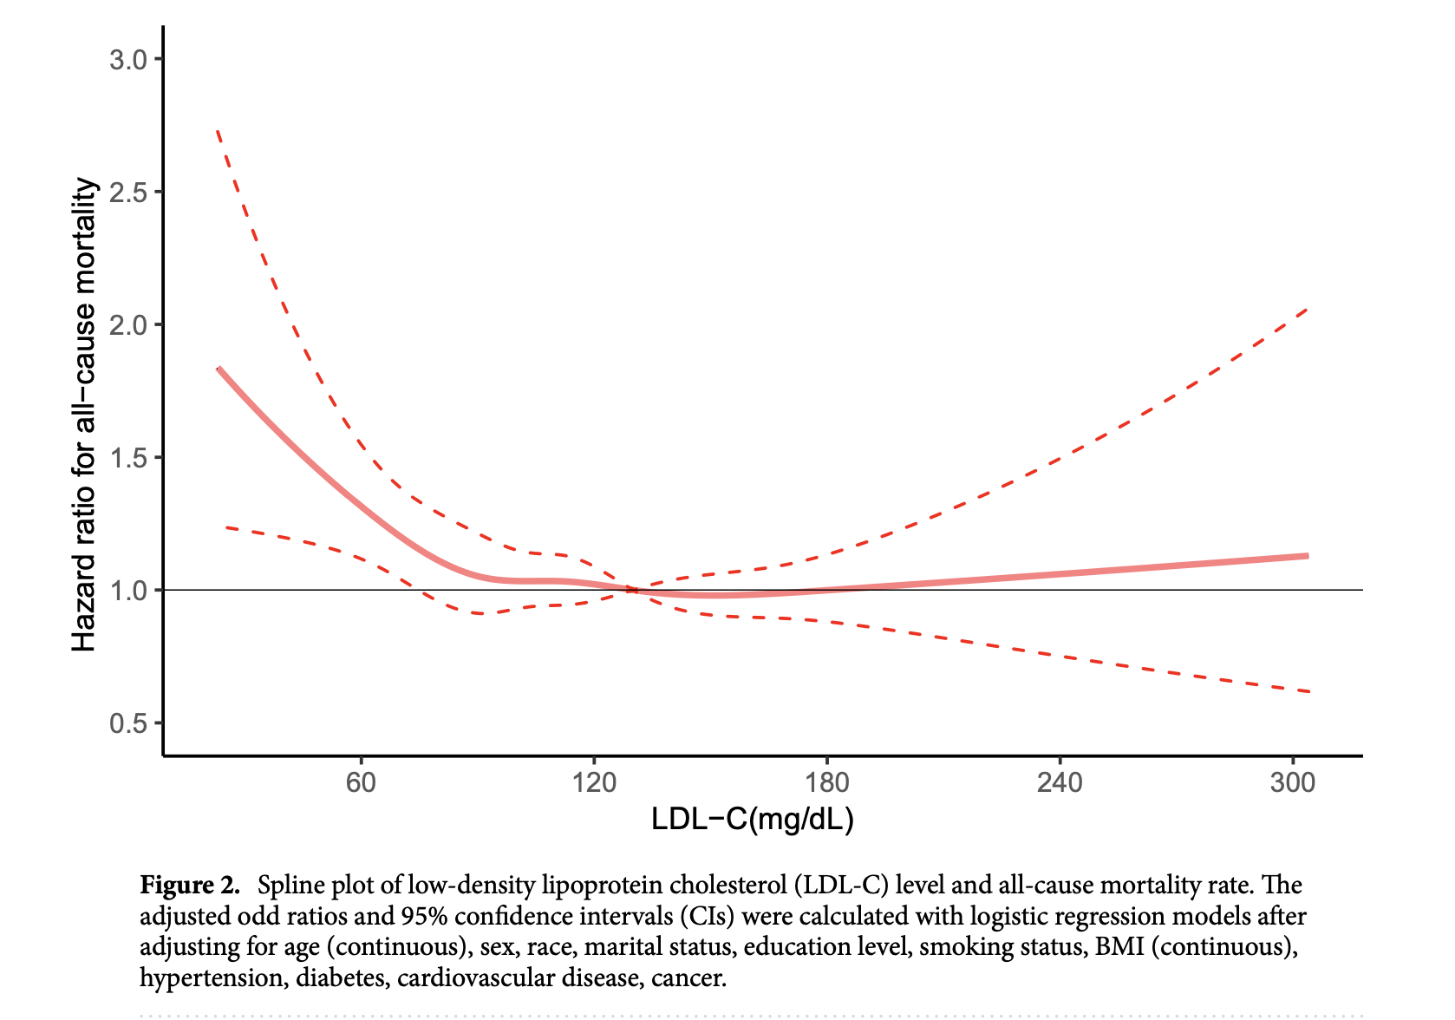

Slide 3
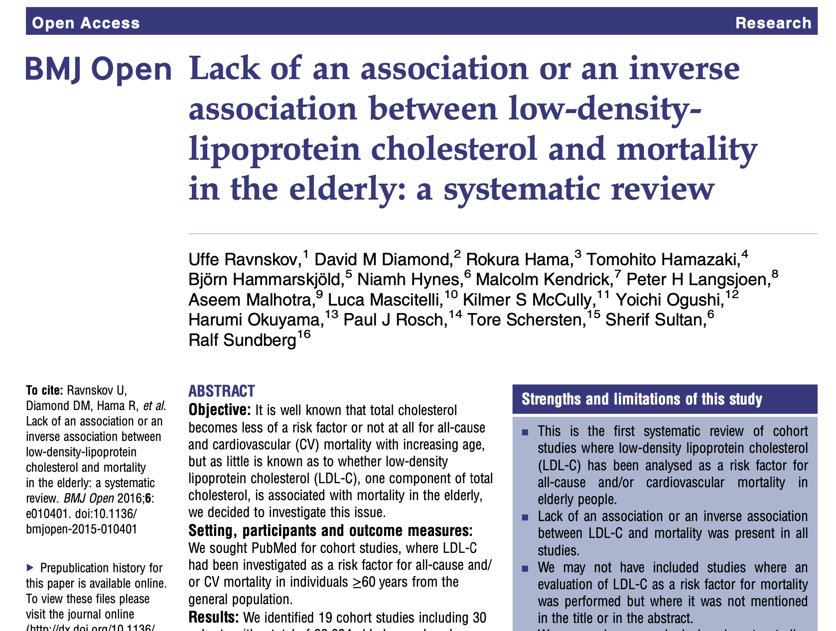

Slide 4
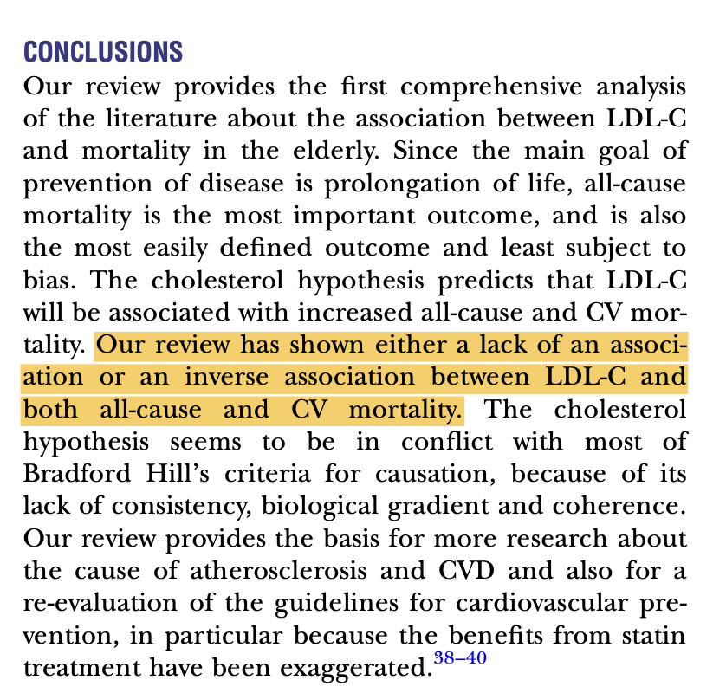

Slide 5
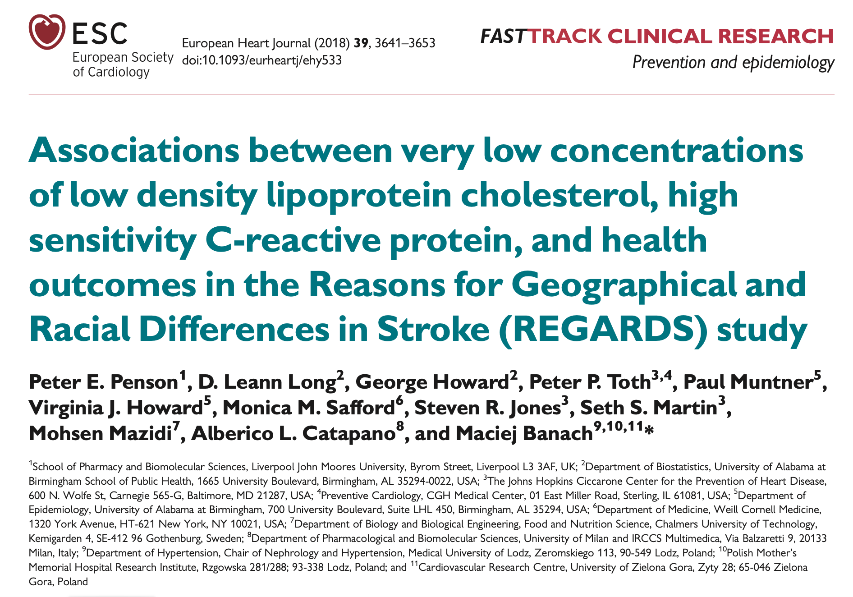

Slide 7
Other risk stratification considerations
Measures of insulin resistance e.g. HOMA-IR and CGM
hsCRP
Apo B/Apo A
LDL particle #
Homocysteine
Uric Acid
Coronary Calcium score

