Slide 1
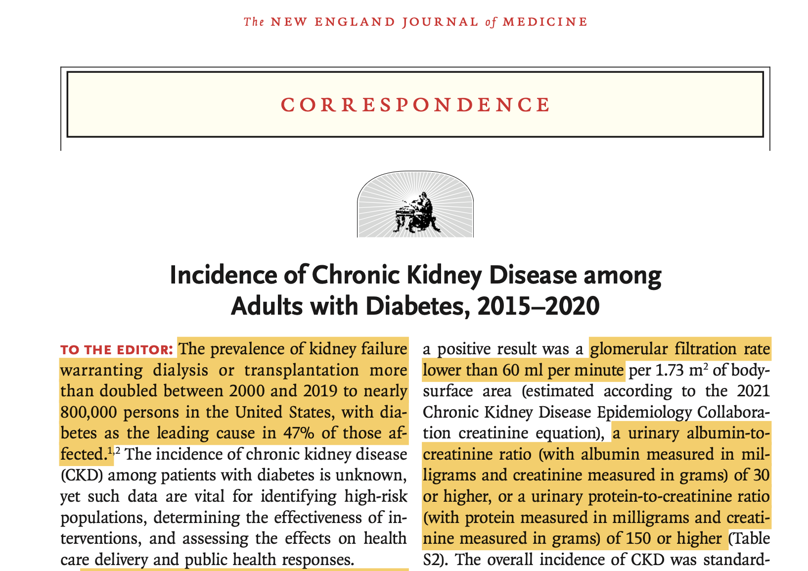
n engl j med 387;15 nejm.org October 13, 2022

Slide 3
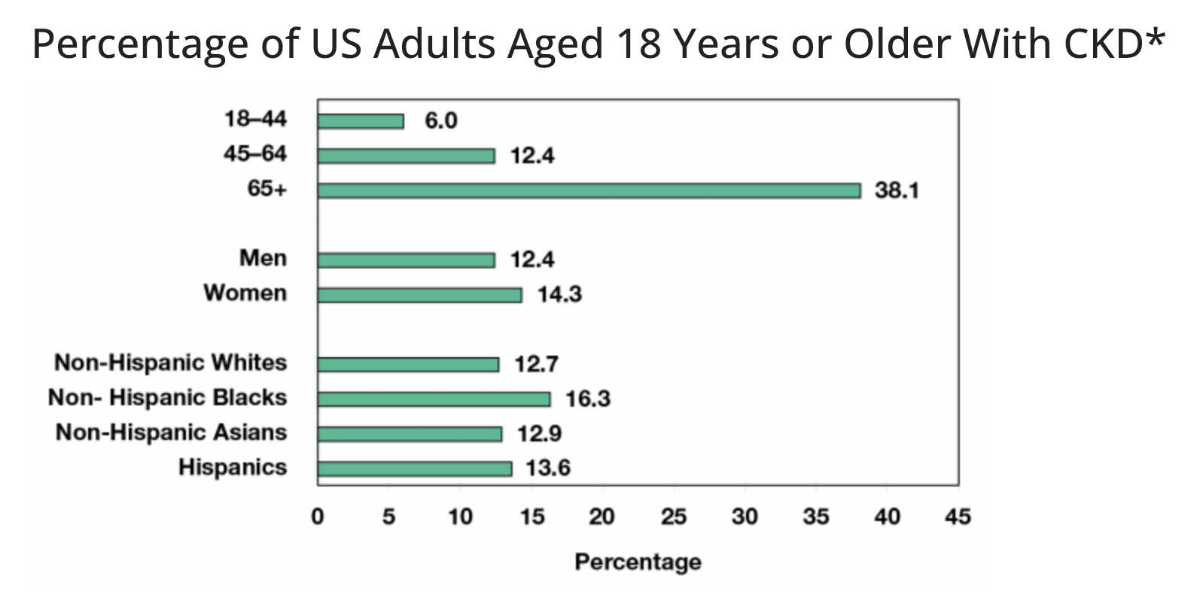

Slide 4
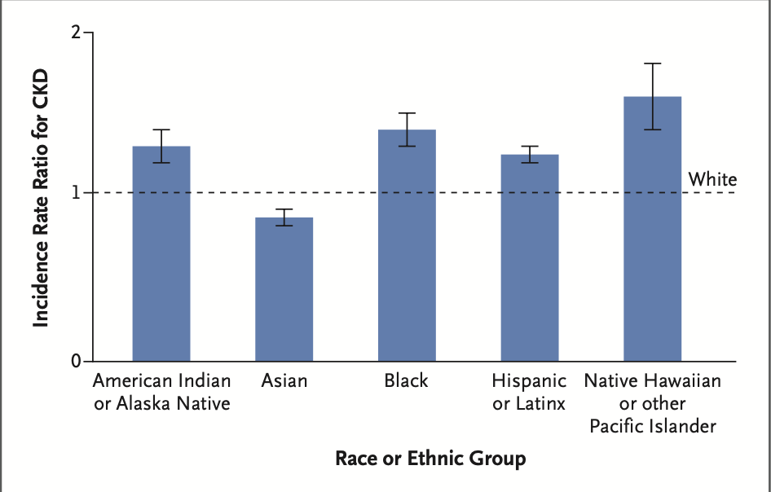
CKD and Diabetes
The prevalence of kidney failure warranting dialysis or transplantation more than doubled between 2000 and 2019 to nearly 800,000 persons in the United States,
diabetes is the leading cause in 47% of those affected.

