Slide 1
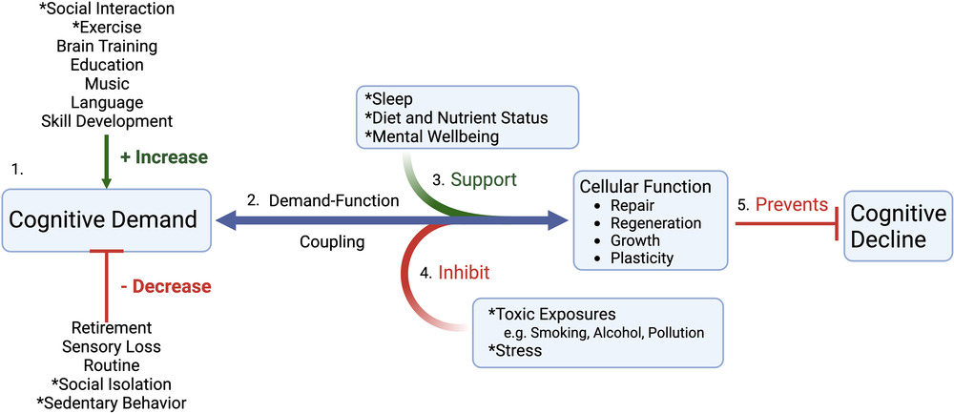
Is the lack of appropriate cognitive demand the primary driver of dementia risk?
Lifestyle Medicine, Volume: 3, Issue: 4, First published: 09 October 2022, DOI: (10.1002/lim2.70)
Notes:
Cognitive demand as the critical upstream determinant of cognitive function and decline. (1) Cognitive demand is beneficially increased or detrimentally decreased as a result of numerous individual and societal factors that affect the entire cascade of brain health. Two of the lifestyle medicine pillars (physical activity and healthy relationships, asterisked) directly positively or negatively influence cognitive demand based on their presence or absence from an individual's lifestyle. (2) As a result of direct demand–function coupling, cellular and organ responses down/upregulate homeostatic processes that can either increase or decrease brain function. The four remaining asterisked lifestyle medicine pillars (sleep, healthy diet, mental wellbeing and toxin exposures) can either support (3) or inhibit (4) the brain's capacity to upregulate function in the face of increased cognitive demand, with any resulting increases in function then preventing cognitive decline (5). Adapted from Turknett and Wood,4 and made with Biorender.com
IF THIS IMAGE HAS BEEN PROVIDED BY OR IS OWNED BY A THIRD PARTY, AS INDICATED IN THE CAPTION LINE, THEN FURTHER PERMISSION MAY BE NEEDED BEFORE ANY FURTHER USE. PLEASE CONTACT WILEY'S PERMISSIONS DEPARTMENT ON PERMISSIONS@WILEY.COM OR USE THE RIGHTSLINK SERVICE BY CLICKING ON THE 'REQUEST PERMISSIONS' LINK ACCOMPANYING THIS ARTICLE. WILEY OR AUTHOR OWNED IMAGES MAY BE USED FOR NON-COMMERCIAL PURPOSES, SUBJECT TO PROPER CITATION OF THE ARTICLE, AUTHOR, AND PUBLISHER.

