Slide 1

Creating Health: Applying the Science of Lifestyle Medicine
Mark Pettus MD
Week 1: Epigenetics and Health: How well do you fit into your genes?
Week 2: Inflammation: The bad gift that keeps giving
Week 3: Metabolic Health: How to become a member of this exclusive club.
Week 4: Circadian Rhythms and Health: Riding the rhythms of life

Slide 2

Circadian Rhythm and Health:
Riding the rhythm of life
Mark C. Pettus MD
Associate Professor of Medicine
University of Massachusetts Medical School
October 14, 2022

Slide 3
Key Considerations
Acute-chronic disruption of circadian entrainment are drivers of acute care outcomes and perhaps all chronic, complex disease.
We are living in a modern environment more disconnected from our evolved, entrained biologic systems.
Greater attention to alignment between light quality, timing and exposure are accessible interventions for current-future consideration.

Slide 4
In this life we are not separate from nature. We are a part of nature, part of a complex ecosystem.
Our biology is synchronized with the rhythms of nature.
When we become disconnected from our innate diurnal rhythms our biology becomes disrupted.
Over time, this impacts our health and quality of life at many levels.

Slide 5


Slide 6


Slide 7

Earth, at the equator is spinning approximately 1,000 miles/hour around its axis
Earth is orbiting the sun, moving approximately 66,600 miles/hour
Diurnal rhythm is central to the existence of all life on our planet

Slide 9
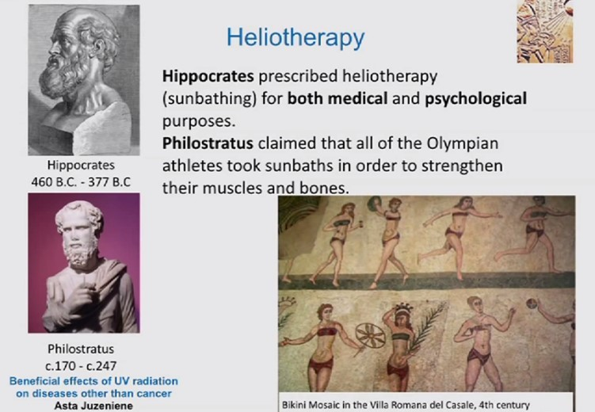

Slide 10
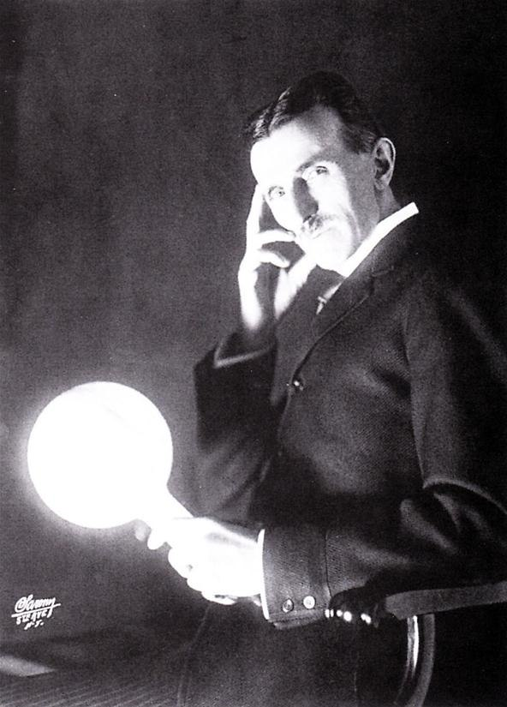
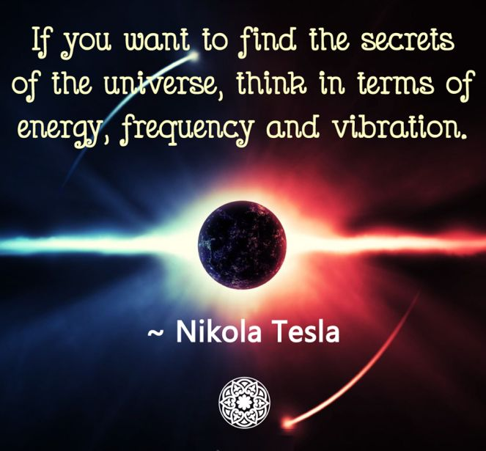

Slide 11
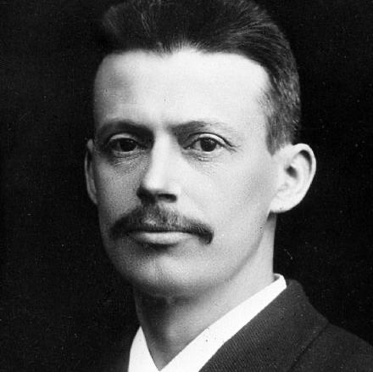
Neils Ryberg Finsen
Islandic physician-scientist awarded the 1903 Nobel Prize in Medicine for his
“contribution to the treatment of challenging diseases especially e.g. lupus vulgaris with concentrated radiation from light. He has opened a new avenue for medical science.”

Slide 12
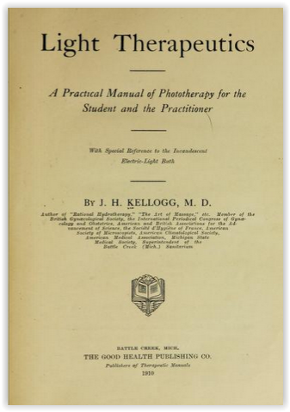
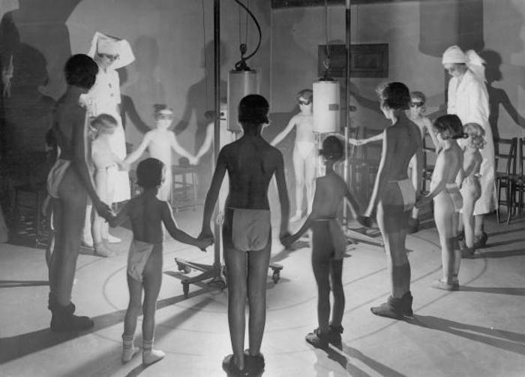

Slide 13
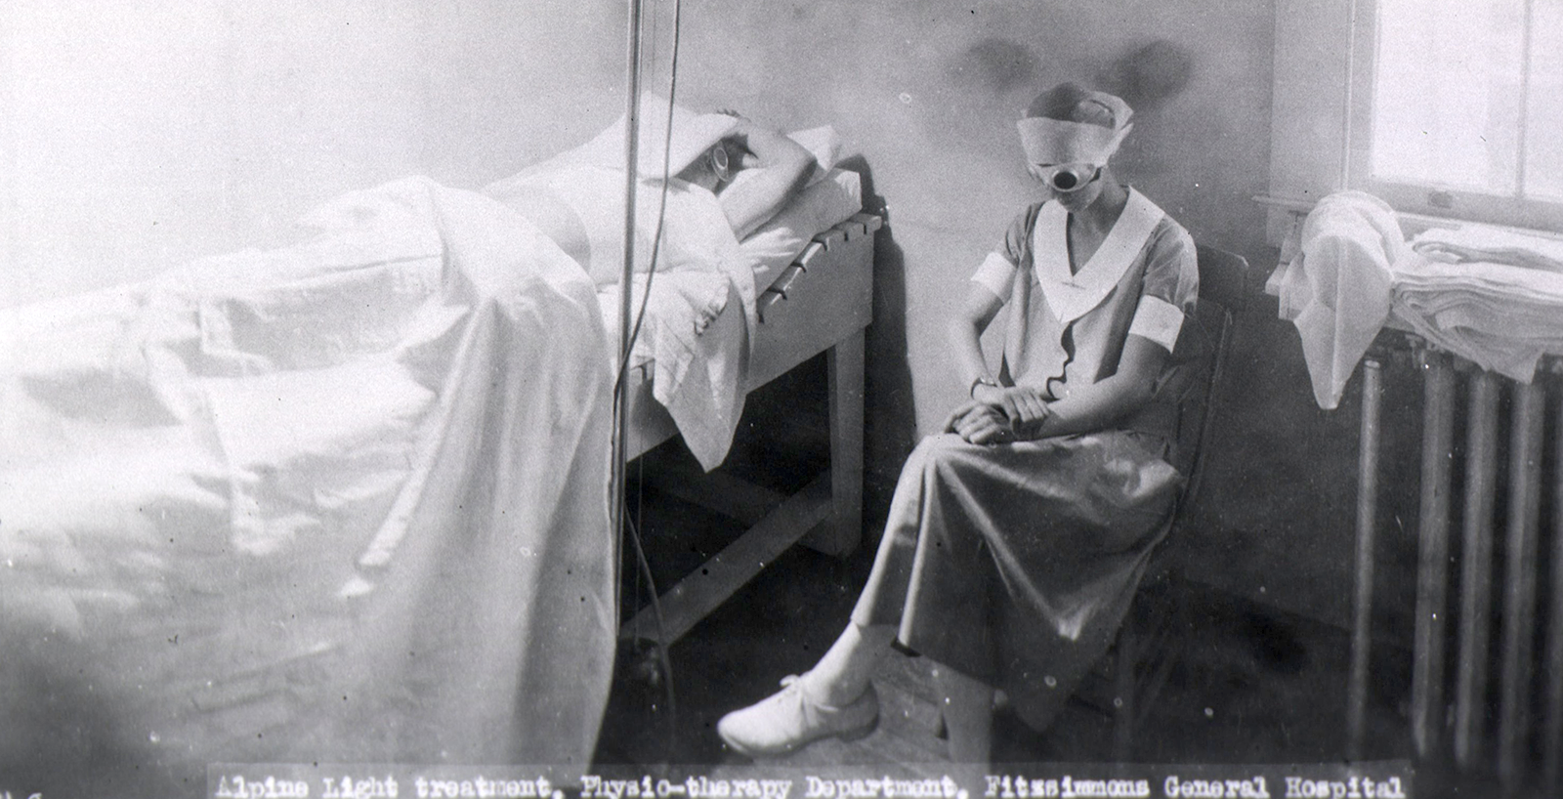

Slide 14


Heliotherapy
By the year 1933, there were over 165 diseases for which sunlight proved to be a beneficial treatment
Old studies revealed exposing patients to controlled amounts of sunlight cured some infections, lowered blood pressure, lowered blood sugar, and increased the # of wbc.
Treatment for gout and rheumatoid arthritis
Treatment of anemia
Eczema, acne, herpes
Lupus
Sciatica
Wounds, burns

Slide 15
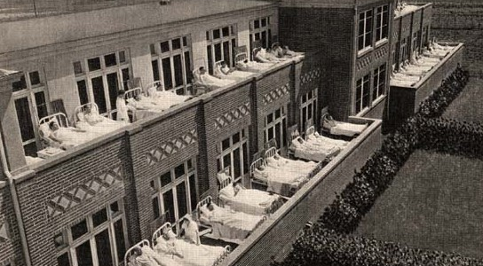

Slide 16
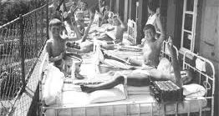
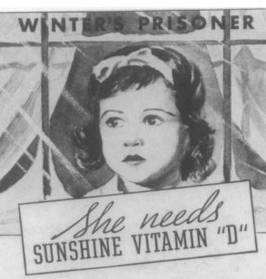
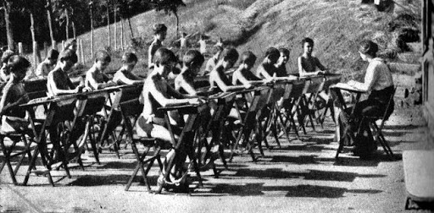

Slide 17
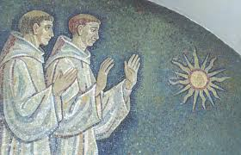

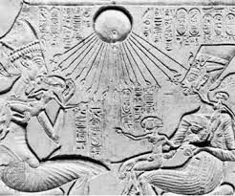

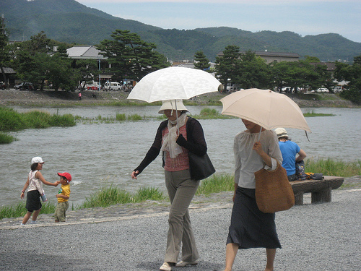
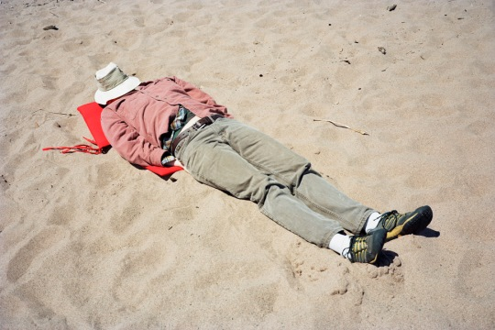

Slide 18
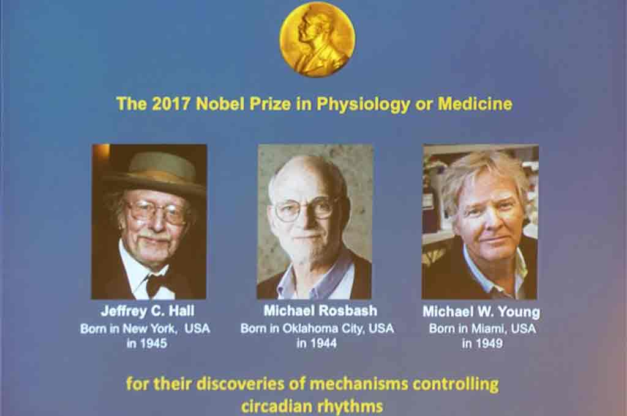

Slide 19
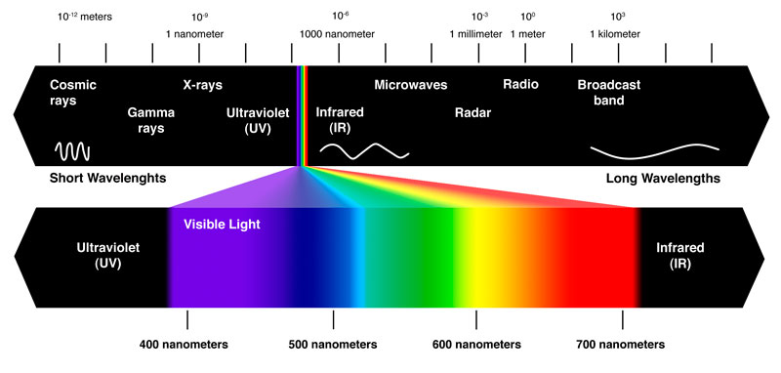
Mitochondrial
UVA and NO
Photosynthesis
Wound healing
Bilirubin
Collagen
UVB and Vit D
Nitric Oxide
Chronoactivity
Sulfation
Antimicrobial
EZ Water

Slide 20
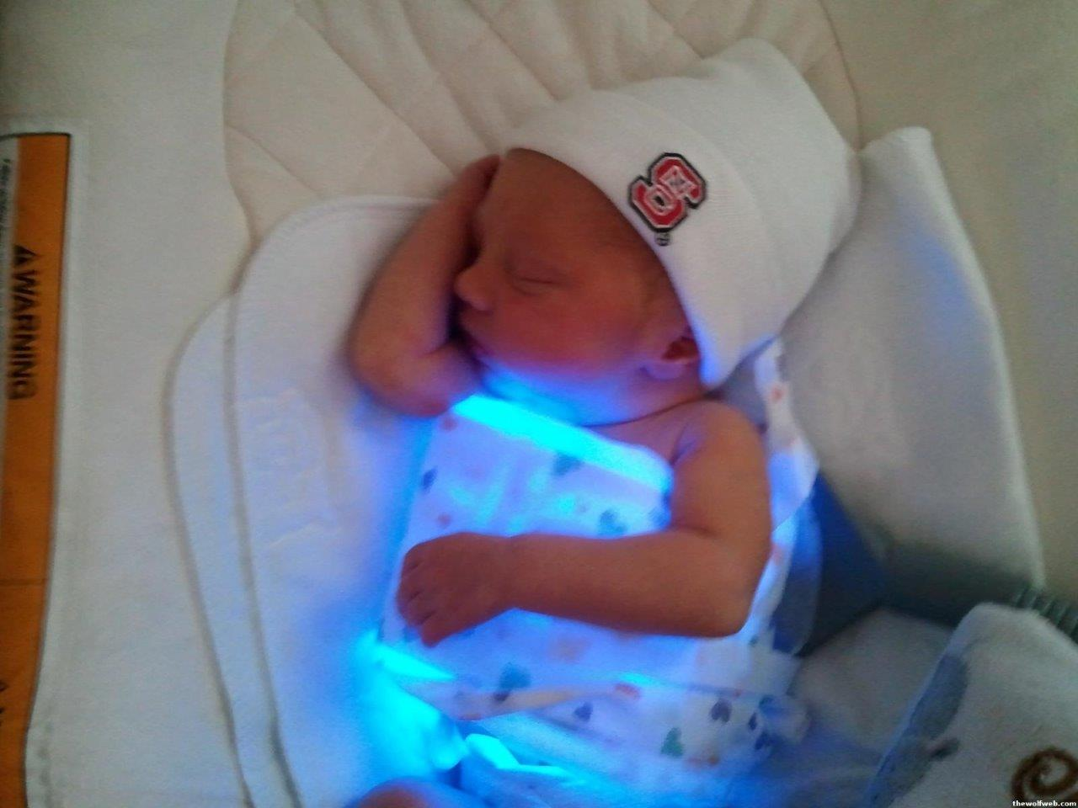
Cytochrome P450 – absorbs light at 450nm (blue) for high billirubin

Slide 21
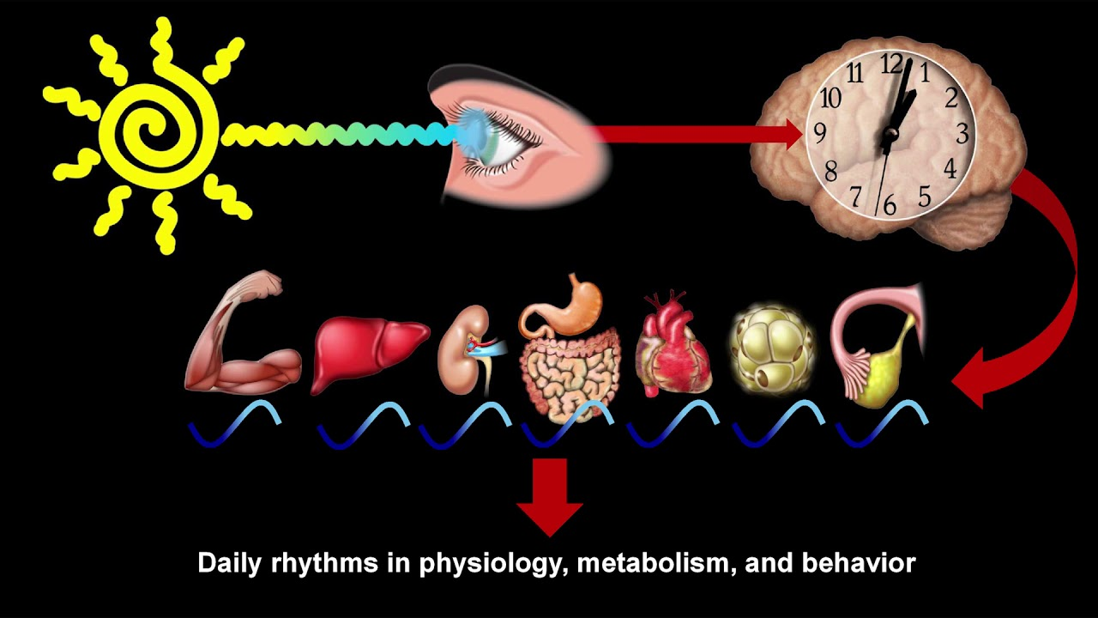
Satchin Panda PhD, The Salk Institute

Slide 22
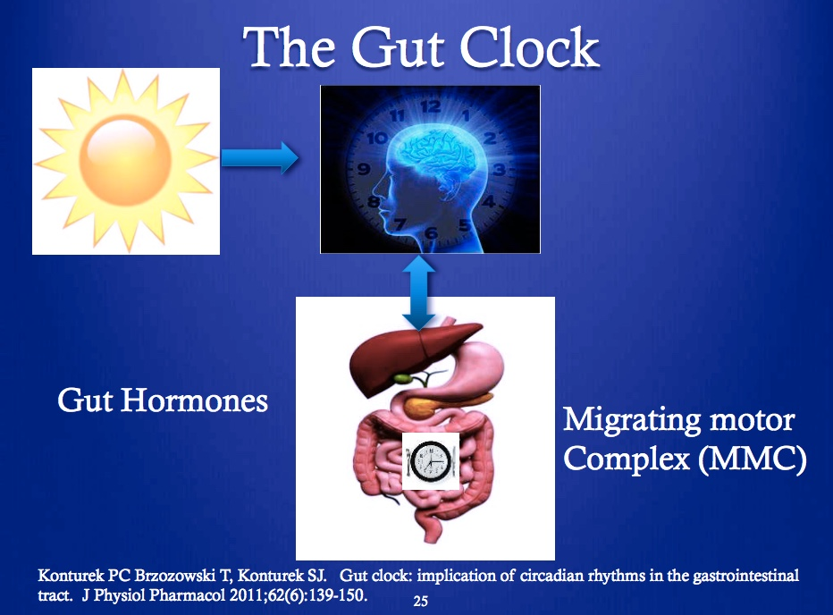

Slide 23
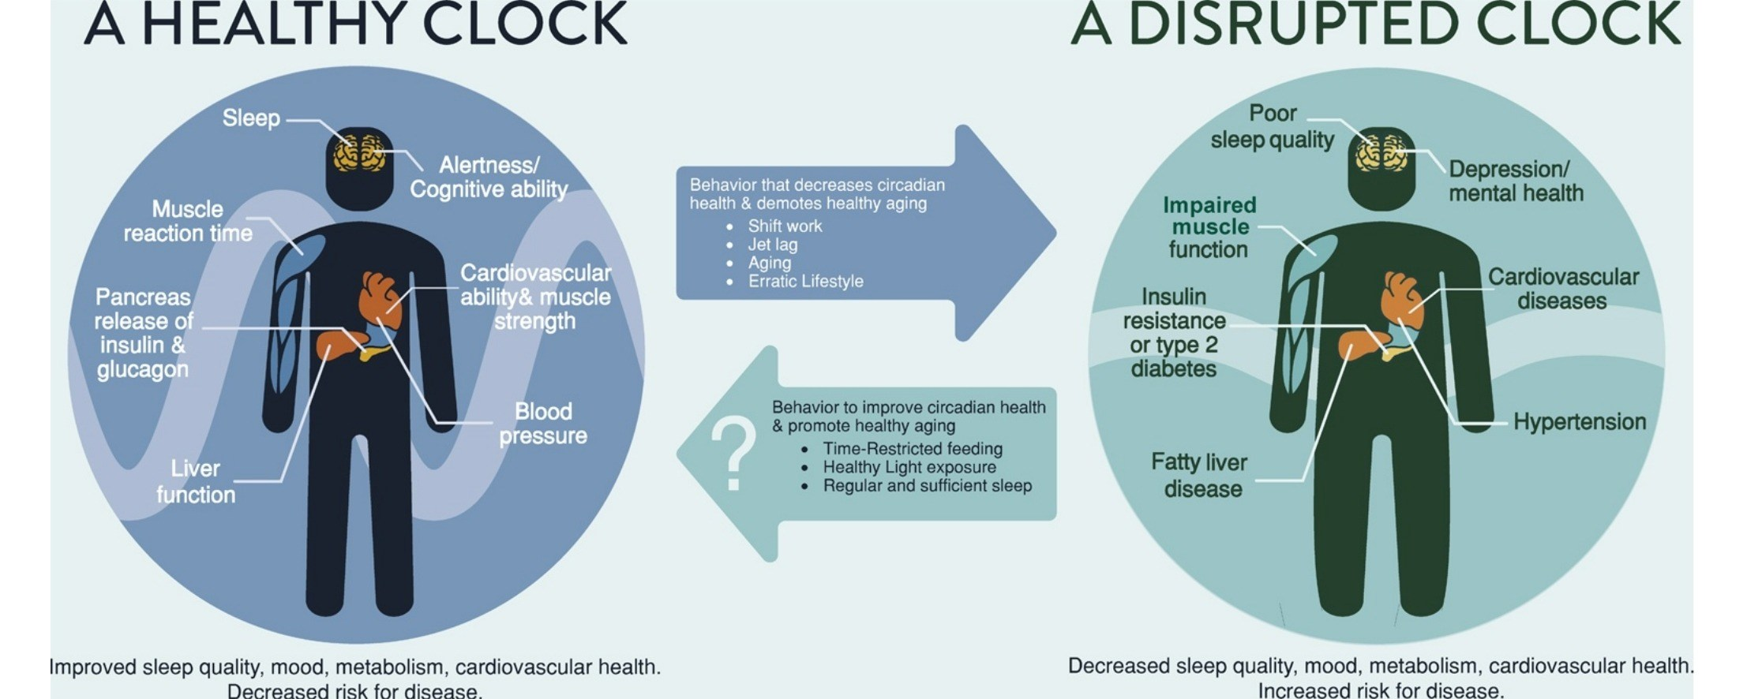
Satchin Panda PhD, Salk Institute

Slide 24
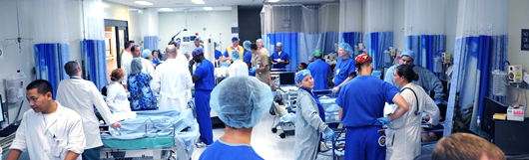
Fluorescent Lights and Night Shift Workers
NHS- Nurses Health Study (Harvard)
120,000 nurses followed 30+ years
30% increase of breast cancer after 15 years of night work
Other studies have shown increased risk up to 60%

Slide 25
Circadian Rhythm and Health
MI, angina, stent thrombosis, stroke, arhythmia, aortic dissection more common in early morning hours
Infarct size larger in morning hours
Increased cancer and cardiovascular disease risk in night-shift workers.
ICU delirium and ”post hospital syndrome”
Obesity and insulin resistance
Behavioral health: Depression, PTSD, GAD, BPD

Slide 26
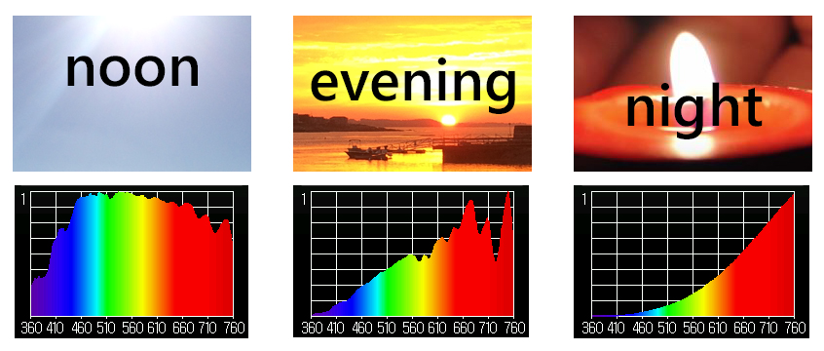
Sunlight and Circadian Entrainment
Blue Light: Turns on our circadian clocks in morning hours
Orange-Red: Healing frequencies that turn clocks off in evening-overnight

Slide 27
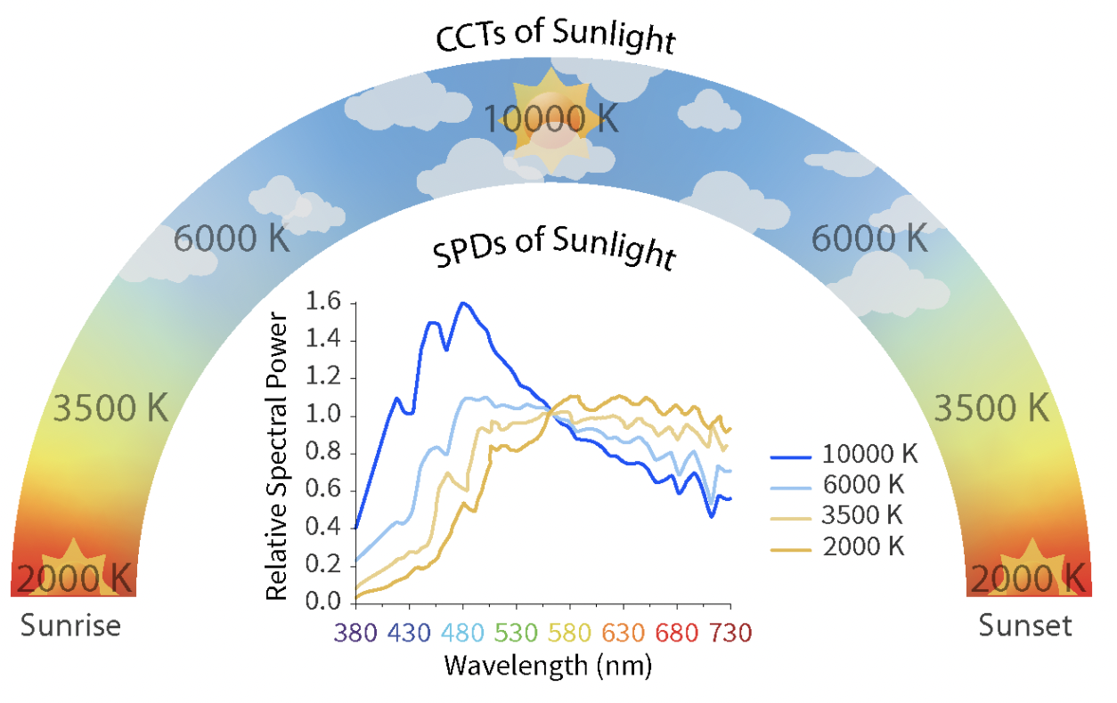

Slide 28
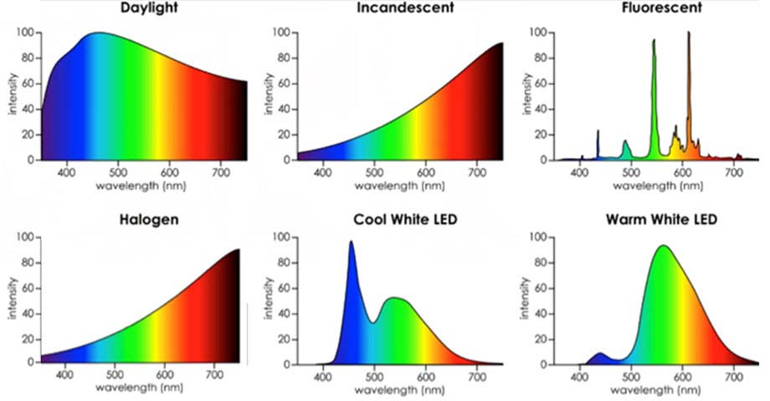
Desire Color Rendering Index (CRI) 95+ %
Color Temperature 2700-3000k

Slide 29
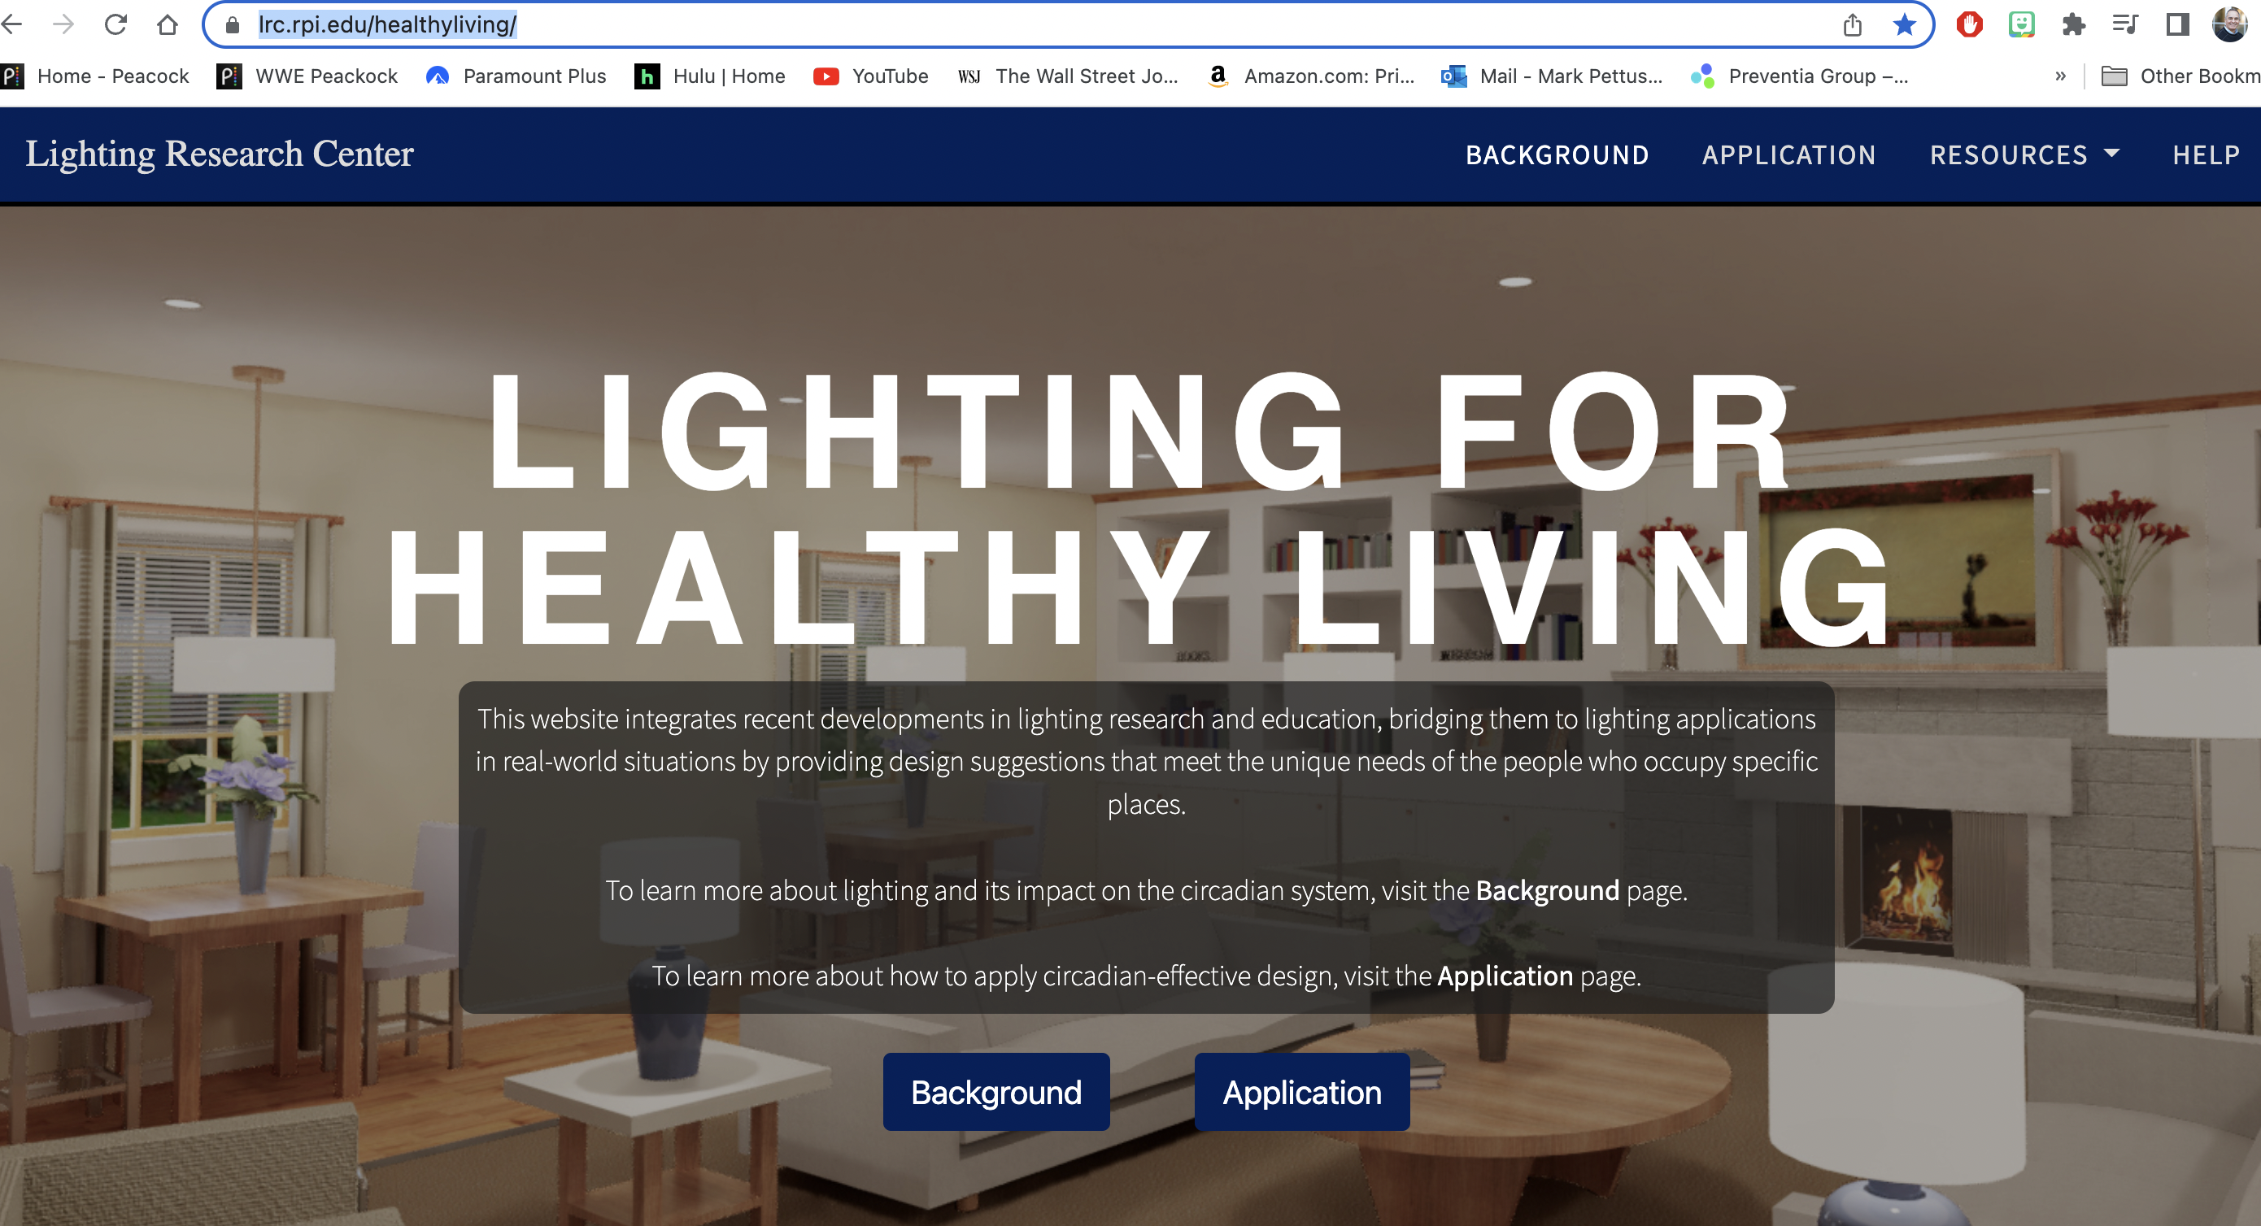
https://www.lrc.rpi.edu/healthyliving/

Slide 30
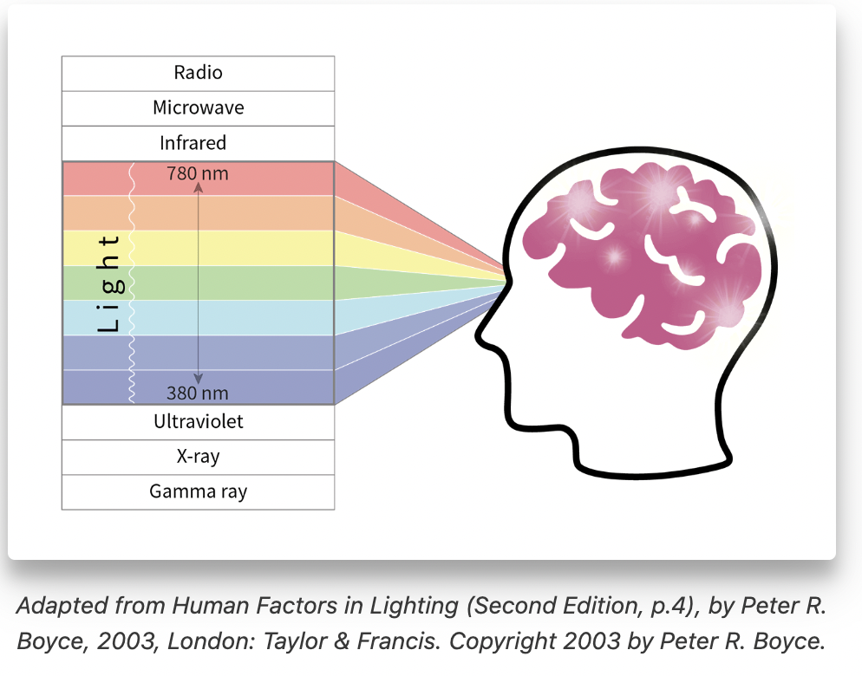
https://www.lrc.rpi.edu/healthyliving/

Slide 31
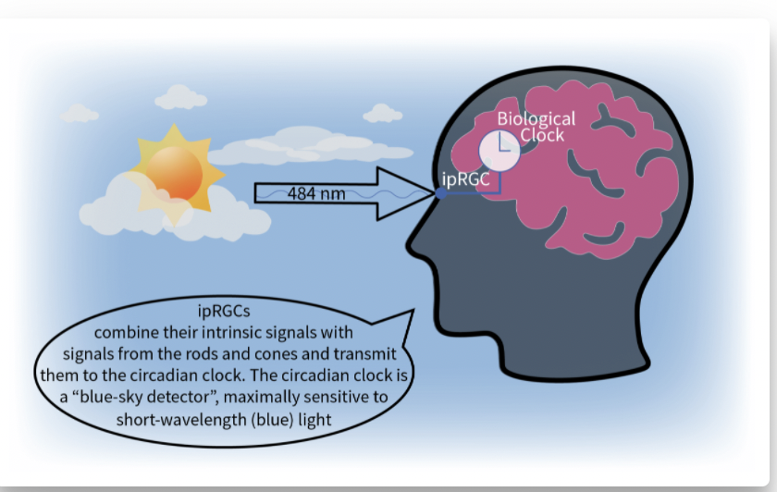
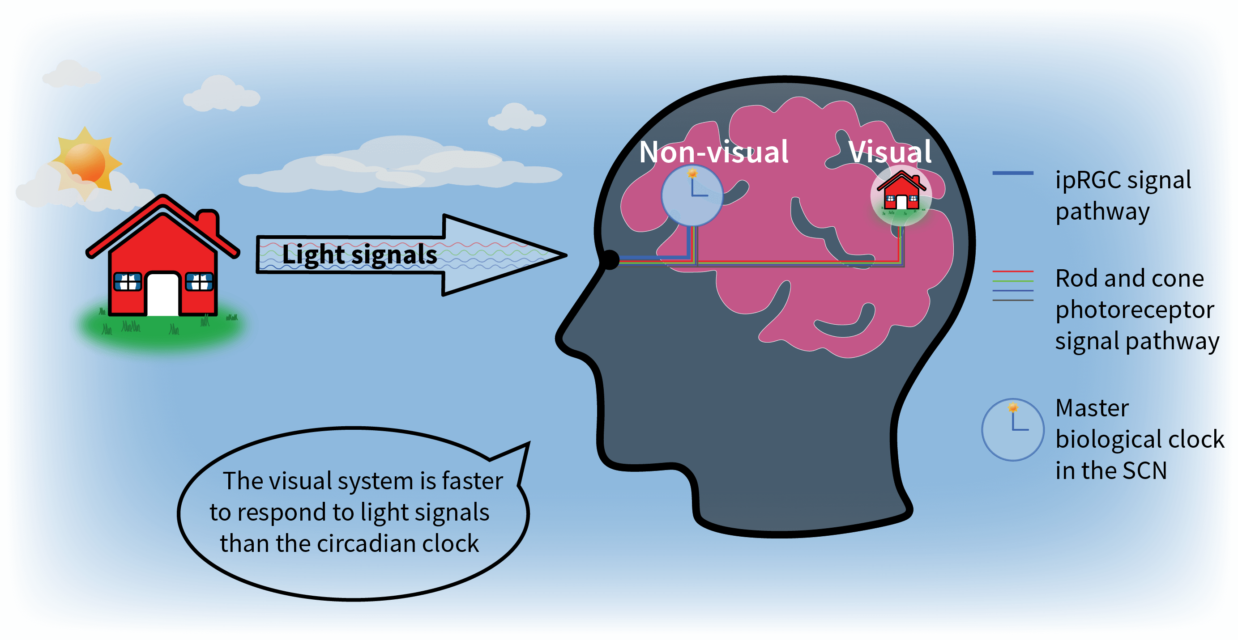
https://www.lrc.rpi.edu/healthyliving/

Slide 32
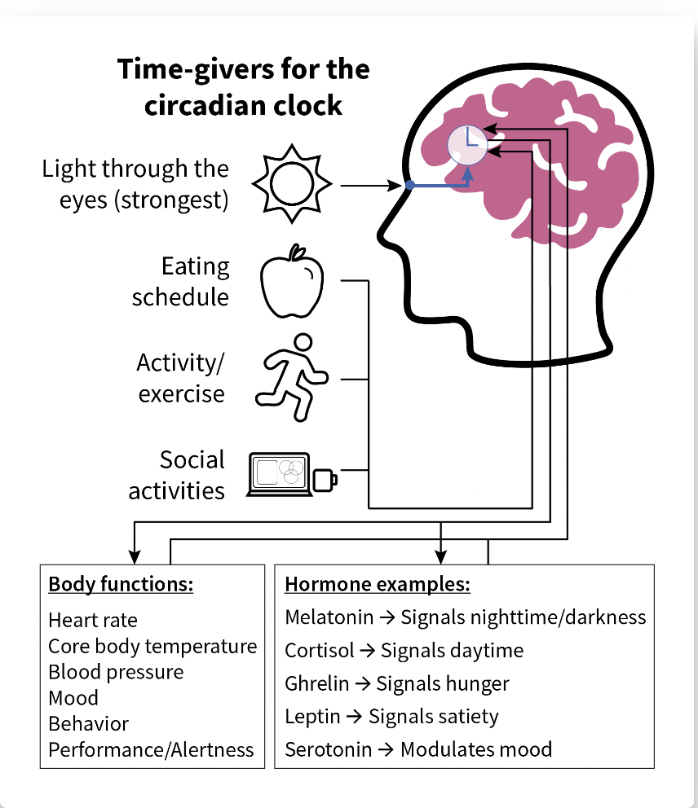
https://www.lrc.rpi.edu/healthyliving/

Slide 33
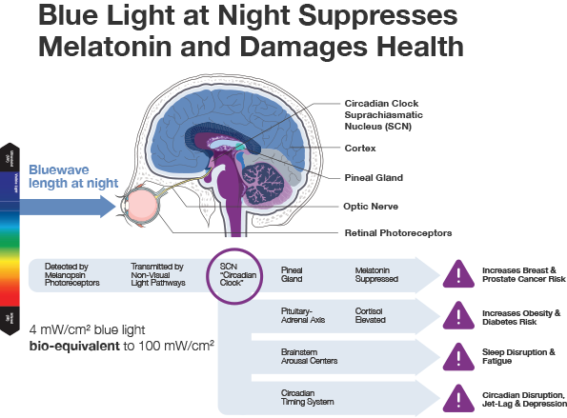
Aging and Mechanisms of Disease (2017) 3:9 ;

Slide 34
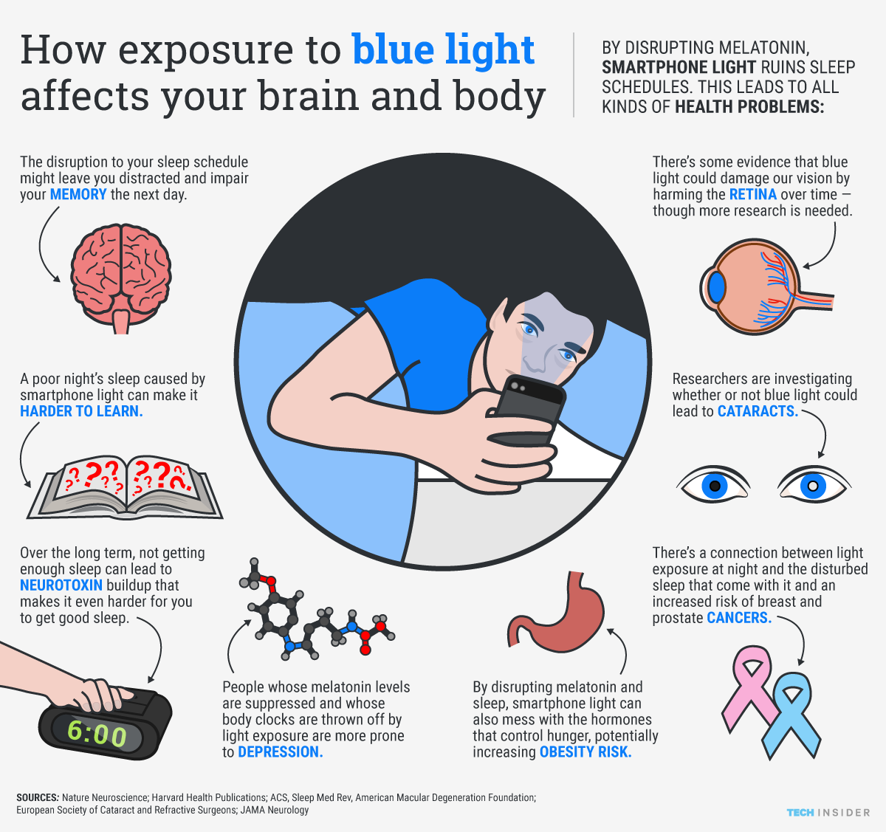
Aging and Mechanisms of Disease (2017) 3:9 ;

Slide 35
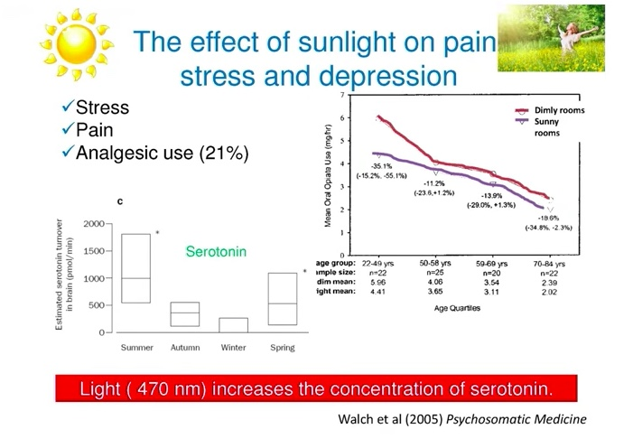

Slide 36
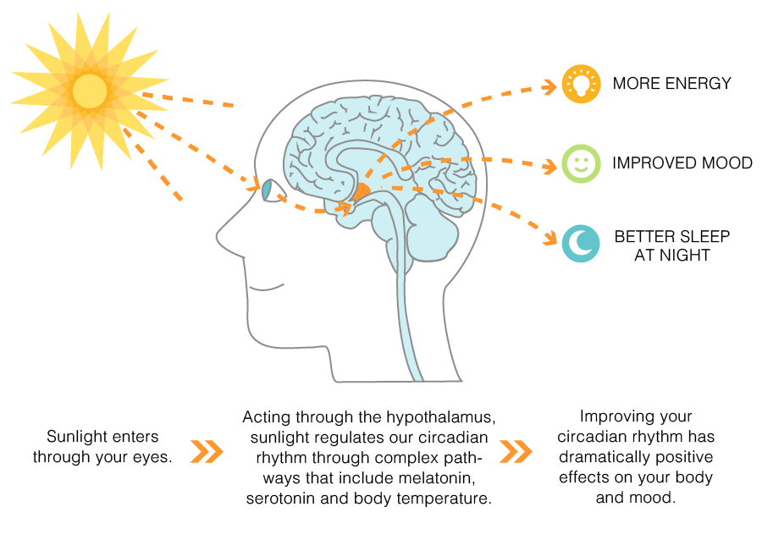

Slide 37
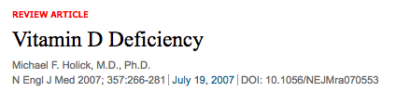
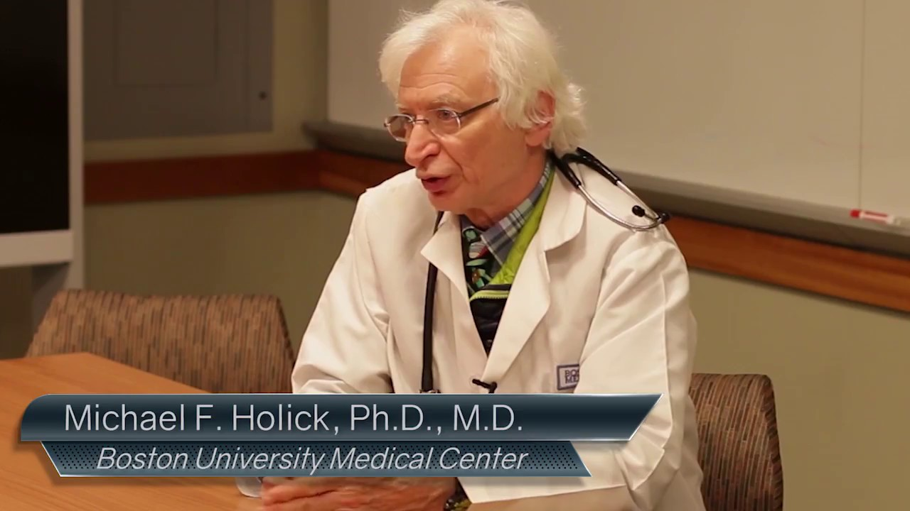
Author of the UV Advantage
Sunblocks with factor 15+ reduce sulfated cholcalciferol by 99.9%
More thoughtful dosed sunlight exposure could reduce cancer incidence in USA by as much as 50%
Melanoma risk significantly reduced with occupational sun exposure

Slide 38
Forest Bathing
Shinrin-Yoku
Global health and quality of life improvements
Improvements in mind and mood
Grounding
Lower inflammation
www.shinrin-yoku.org
Int. J. Environ. Res. Public Health 2017, 14, 851; doi:10.3390/ijerph14080851

Slide 39
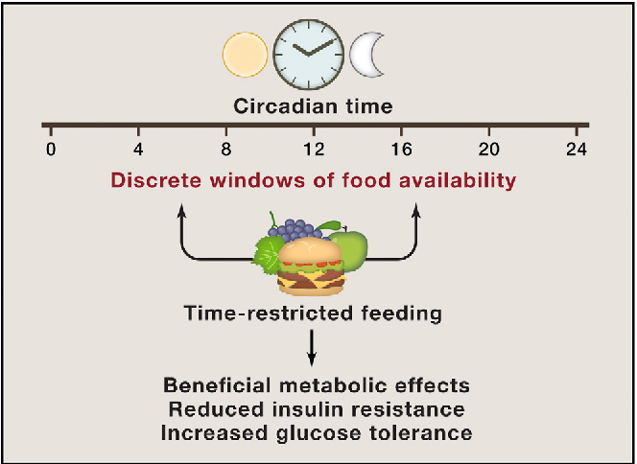
Improved Sleep

Slide 40
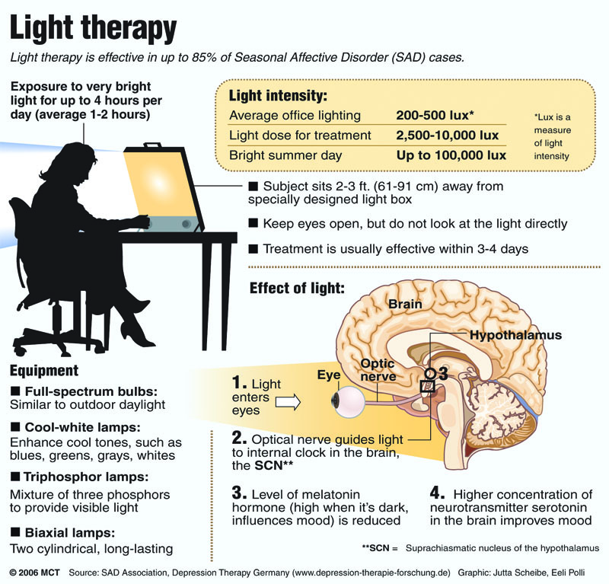
SAD
Full spectrum
10k lux
30”
Dawn exposure

Slide 41
Sleep Hygiene
Regular schedule-consistency
Limit daytime napping
Complete darkness
Cooler temperature
Bedroom for sleep and sex
Relaxing rituals (Epsom salts bath, lavender)
Limit screen time in the bedroom
Maximize comfort
Ideally not food consumption 2+ hours before bedtime
Minimize stimulants e.g. caffeine, alcohol

Slide 42
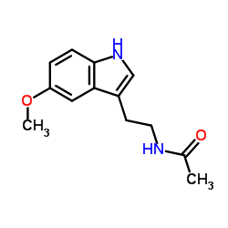
Melatonin
Hormone of darkness
Very sensitive to blue light
Facilitates sleep cycle
Increases cell regeneration
Anti-oxidant activity; ROS scavenger
Antagonizes Aromatase and lowers estrogen production in tissues
Modulates immune regulatory function
Antagonizes cortisol
Key substance for chronobiologic adaptation (day/night and summer/winter)

Slide 43
Supplements to Assist Sleep
Melatonin 1-3 mg
L-theanine 200-400 mg
Chamomile, Passionflower tea (Sleepy Time)
Glycine 3-5 grams
CBD/THC

Slide 44

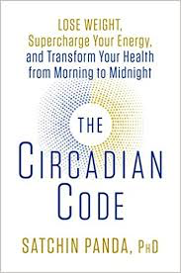
Summary
Environmental light quality and timing are drivers of circadian rhythm.
Meal timing appears to be a major driver of circadian rhythm
Sensible sunlight e.g. 15-20” in am (7-10a) and later afternoon/evening (4-7p) without protection or sunglasses
Spend as much time outdoors as possible e.g. forest bathing
Warm halogen/LEDs as substitutes for CFUs in rooms where you spend time after sunset
Blue blocker glasses after sunset when exposed to bright light e.g. watching television.
Full-spectrum/dawn light at 10k lux for 30” for seasonal affective disorder, sleep disruption, improved cognition.
Blue-blocker settings on tech devices

Slide 45

Thank You

Slide 46
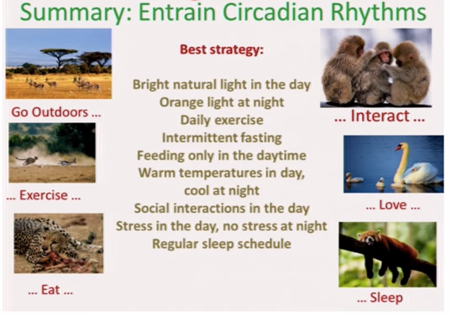
Zeitgebers

