Slide 1
Creating Health: Applying the Science of Lifestyle Medicine
Mark Pettus MD
Week 1: Epigenetics and Health: How well do you fit into your genes?
Week 2: Inflammation: The bad gift that keeps giving
Week 3: Metabolic Health: How to become a member of this exclusive club.
Week 4: Circadian Rhythms and Health: Riding the rhythms of life

Slide 2
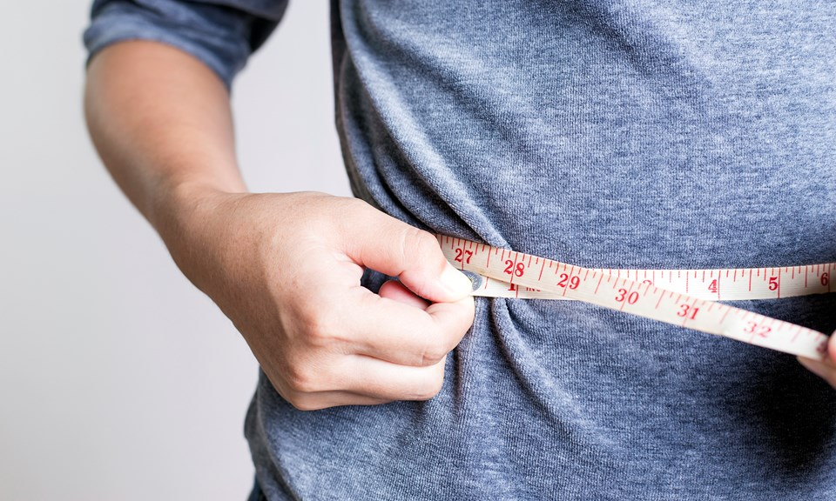
Metabolic Health:
How to become a member of this exclusive club.
Mark Pettus MD
October 7, 2022

Slide 4
Learning Objectives
Understand the parameters that constitute metabolic health
Understand the connection between poor metabolic health and an increased risk for MOST chronic, complex, contemporary diseases
Understand the lifestyle disrupters of metabolic health
Explore lifestyle medicine strategies to create improved metabolic health

Slide 5
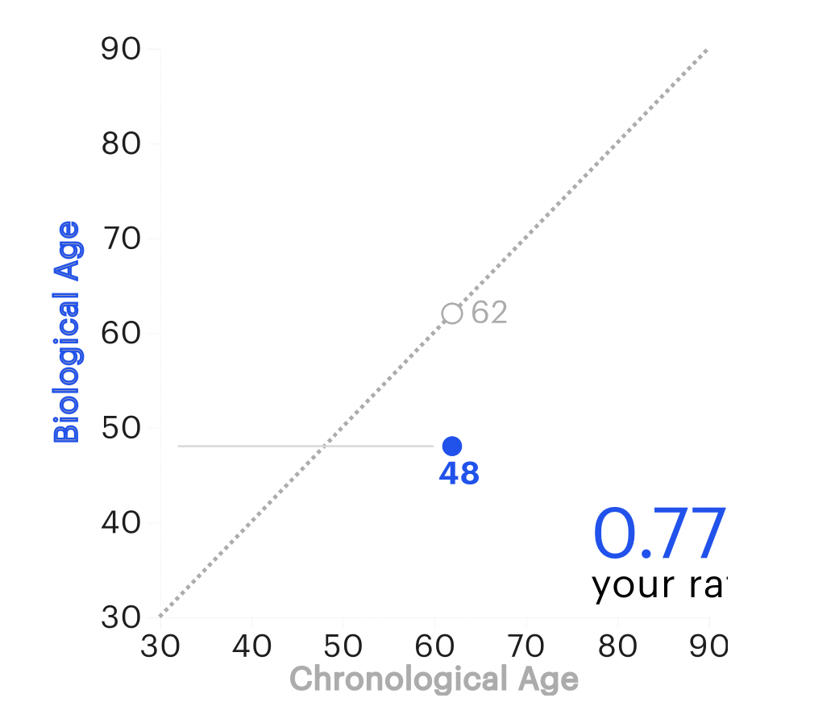
Epigenetic Clocks and Biologic Aging
Steven Horvath- EpiAging biologic clock: https://www.epiagingusa.com/ $169
Elysium Index- https://www.elysiumhealth.com/ $499
True Diagnostic- https://trudiagnostic.com/products/truage-complete-epigenetic-collection $499

Slide 6
Epigenetics
Lifestyle/Environment
Beliefs/Thoughts
Food quality
Movement
Sleep quality
Stress load
Trauma
Circadian rhythm
Love and connection
Meaning and purpose
Natural light/time outdoors
Beliefs-thoughts
Socioeconomics
Education
Life
Metabolic
Health
Longevity
Health span
Resilience
Gene Expression
Microbiome

Slide 7
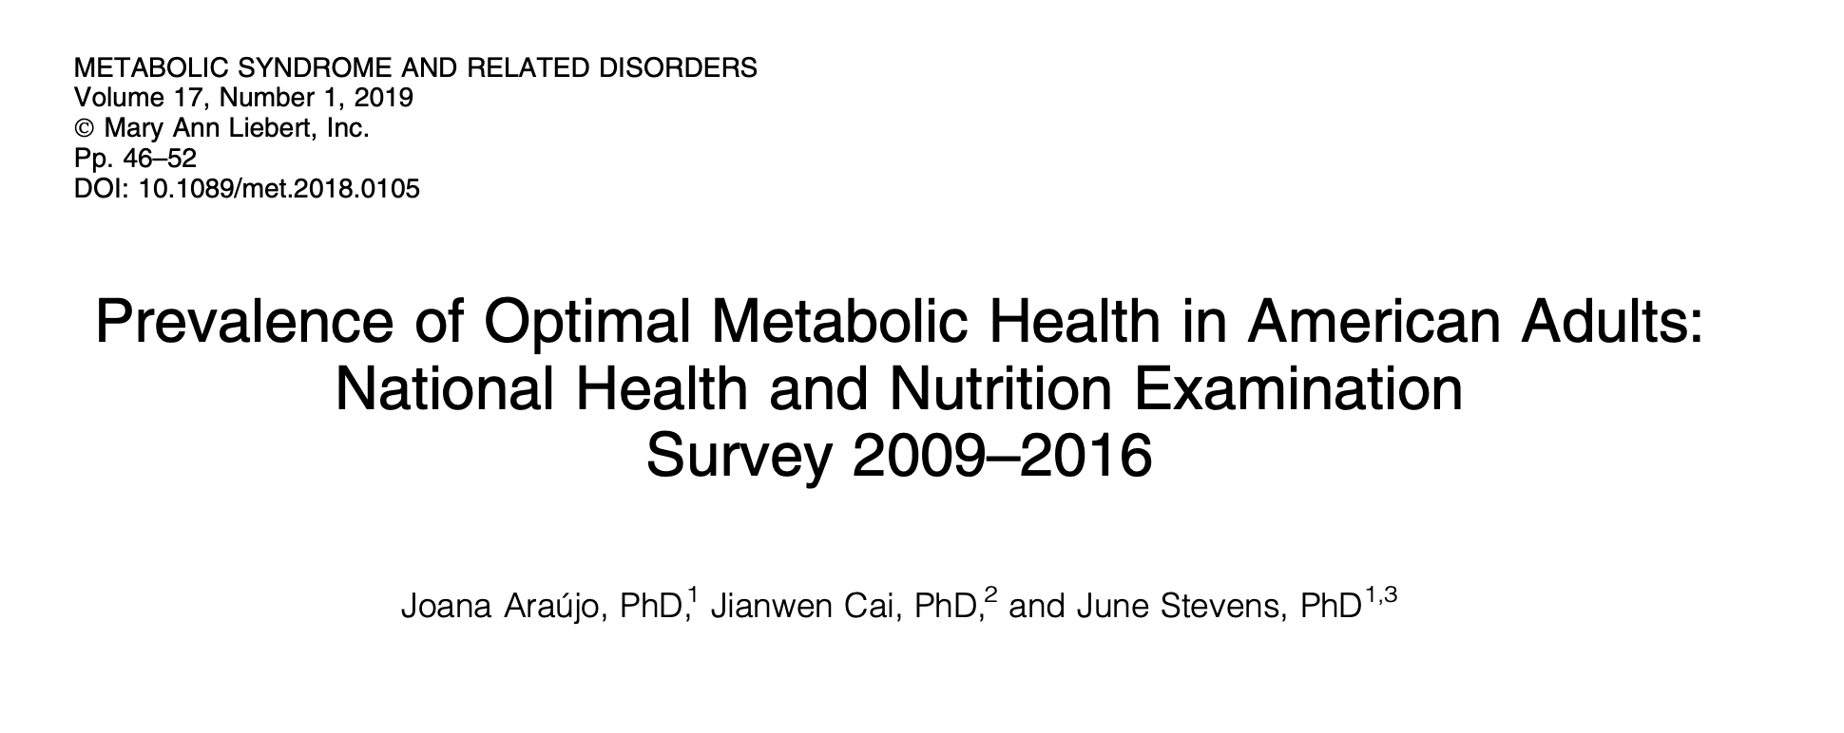
8721 individuals
Metabolic Health: Waist circumference < 40”; BP 120/80 or less;
FBS < 100; HbA1c < 5.7; TGA/HDL ratio < 3; No Meds
12.2% individuals met all criteria
Disrupted metabolic health greatly accelerates aging, reduces longevity and diminishes health span.

Slide 8
8721 individuals
Metabolic Health as defined by:
Waist circumference < 40” in men and < 36” women
BP 120/80 or less
FBS < 100; HbA1c < 5.7
TGA/HDL ratio < 3
No Meds
Only 12.2% individuals met all criteria
Disrupted metabolic health greatly accelerates aging, reduces longevity and diminishes health span.

Slide 9
Prevailing View
Obesity occurs when a person consumes more calories from food than he or she burns.
National Institute of Health
Overweight is the result of caloric imbalance (too few calories expended for the amount of calories consumed) and is mediated by genetics and health.
US Surgeon General

Slide 10
Emerging View
A calorie is not a calorie
Macronutrients i.e., carbs, fats and protein, elicit different metabolic effects (food as information)
Quality of macronutrients e.g. sugar and refinement of grains will substantially impact metabolic effects
Quality of calories more important (and interesting) than quantity of calories
Quality fat sources less harmful than thought
Poor-quality carbs and sugar are more harmful than thought
Metabolic health is a two-way street, driven by environmental-epigenetic mismatch

Slide 12
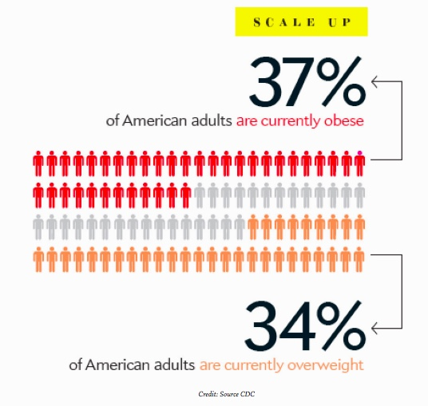

Slide 14
Limitations of Weight and BMI
BMI of limited value with higher lean body mass
Body composition (lean body mass and fat stores)
VAT vs. SAT
TOFI – “thin outside, fat inside”
Most adipose is VAT
Most adipose is SAT
Same weight and waist circumference:
Different metabolic risks!
Notes:
Need to build lean body mass in addition to reduction of fat stores

Slide 15
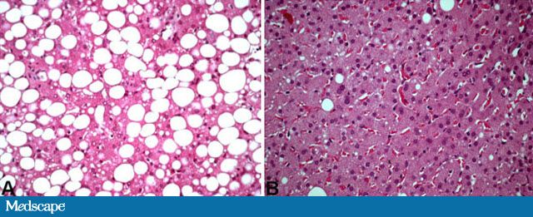
NAFLD Non-alcohol fatty liver disease
Has become one of the most common diseases in America from not having been described until 1980.
45% of all Latinos
33% of all Caucasians
25% of all African Americans
5% of all progress to NASH
25% NASH progress to cirrhosis
Preventable

Slide 16
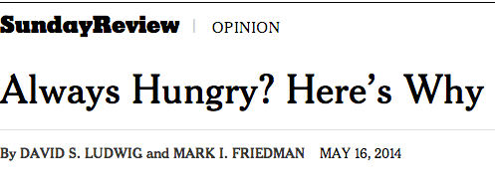
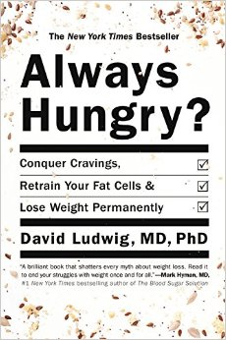
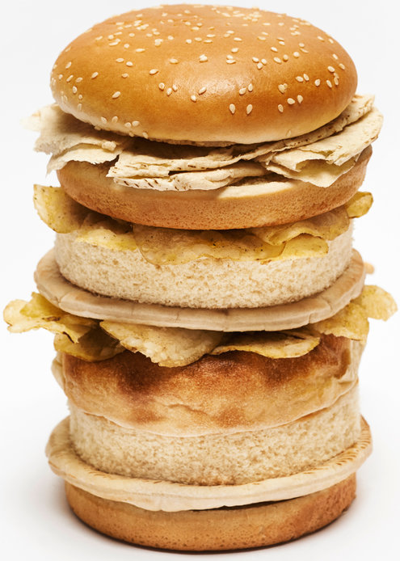
“ Are we fat because we eat too much or do we eat too much because we are fat ?”

Slide 17
From: Increasing Adiposity: Consequence or Cause of Overeating?
JAMA. 2014;():. doi:10.1001/jama.2014.4133
Copyright © 2014 American Medical Association. All rights reserved.

Slide 18
Poor Quality Carbs
Acellular carbohydrate density
Inflammation
Stress
Sleep disruption
Altered gut-permeability/microbiome
Social isolation
Toxin excess
Sedentary states
VAT
Excess Insulin
VAT Fat storage-lipogenesis
Down-regulation of insulin receptors
Insulin Resistance
Leptin resistance
Eat more and do less

Slide 21
Five hour rule after eating a meal
Am I hungry again within a few hours?
Am I tired and ready for a nap?
Does my mind feel sharp, attentive and focused?
Am I experiencing bloating, gas, cramping?
…if the answer to any of these questions is consistently “yes” then there are significant problems with what you are eating!

Slide 22
Reduce poor quality, processed, carbohydrate-dense foods
Added Sugar
Grain-based flour e.g. breads, cereal grains, pasta, pastries, desserts, bagels, chips, pretzels, granola bars.
Whole grains are still high-glycemic
Gluten-Free food options
Dried fruits e.g. raisins, apricots, cherries
Sweetened soft drinks
Beer is liquid bread
Lowered insulin and reduced inflammation “unlock” fat burning
All Carbs
Low
Glycemic

Slide 25
www.dietdoctor.com

Slide 26
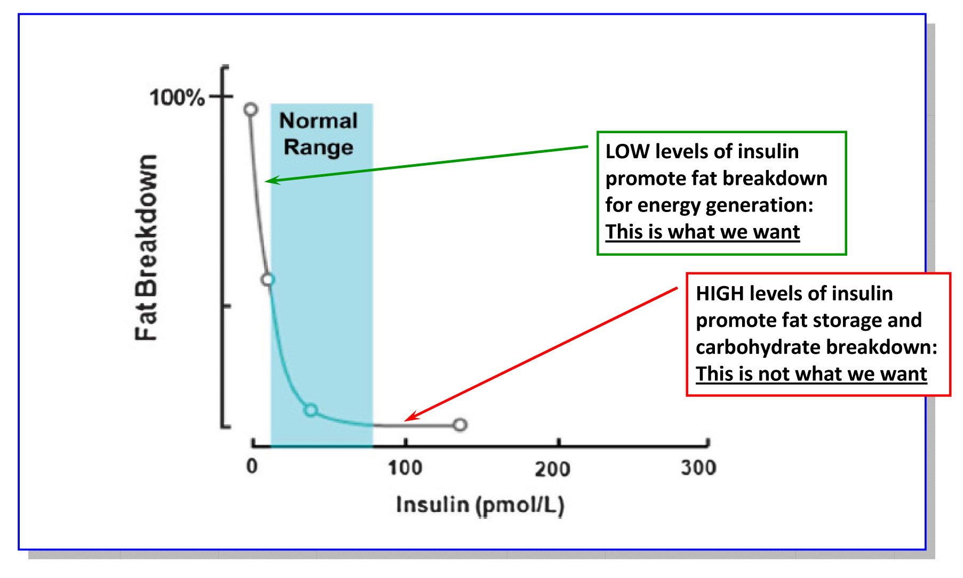
Lipolysis vs. Lipogenesis

Slide 27
USDA National Nutrient Database. The amount of sugar is higher in the low-fat and fat free foods compared to “regular” full-fat foods. P=0.00001

Slide 28
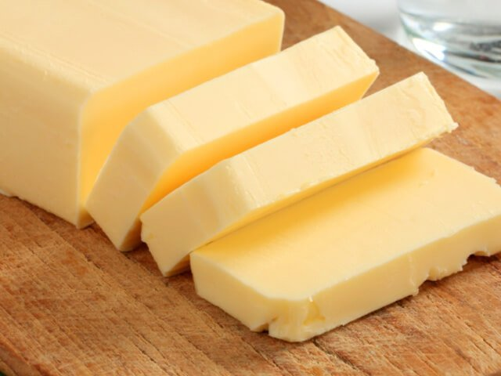
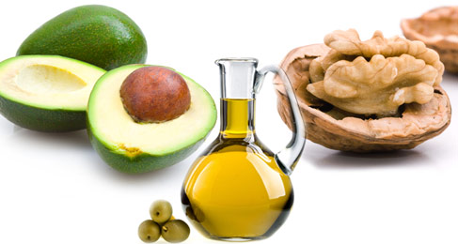
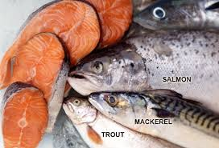
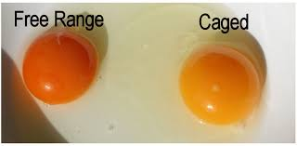
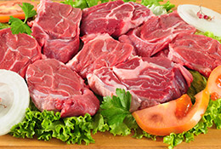
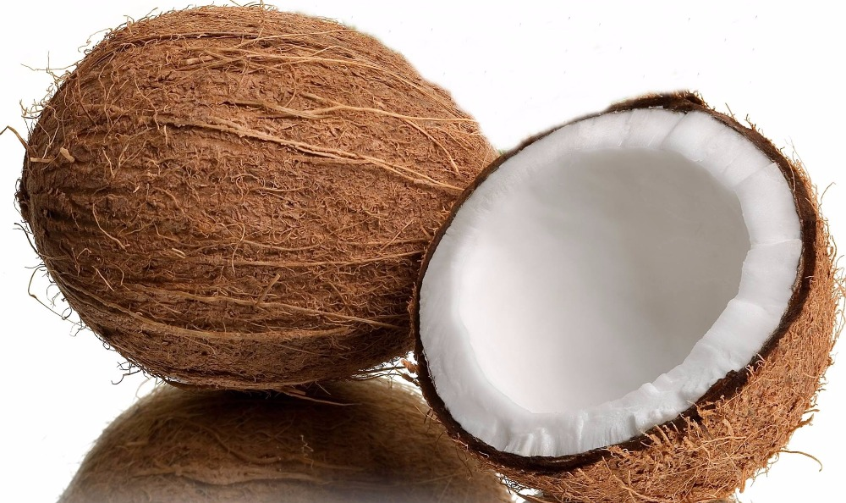
More quality fat sources
Pasture-raised eggs
Fatty fish e.g. salmon, sardines, mackerel
Grass-fed butter
Ghee
Pasture-raised meats
Shellfish
Whole fat yogurt, kefir
Extra virgin olive oil
Extra virgin coconut oil
Avocados, olives
Nuts - almonds, macadamia, walnuts

Slide 29
A calorie is not a calorie…
Effects of Dietary Composition on Energy Expenditure During Weight-Loss Maintenance
Cara B. Ebbeling, PhD; David S. Ludwig, MD, PhD et al
Conclusion: Among overweight and obese young adults compared with pre–weight-loss energy expenditure, isocaloric feeding following 10% to 15% weight loss resulted in decreases in REE and TEE that were greatest with the low-fat diet, intermediate with the low–glycemic index diet, and least with the very low-carbohydrate diet.
Remarkable range between individuals
TEE: - 423 [–606 to –239] kcal/d for low fat diet
- 57 [–281 to 86] kcal/d for low carb diet
Equivalent of 1-hr moderate effort cardio difference
JAMA. 2012;307(24):2627-2634. doi:10.1001/jama.2012.6607
Notes:
TEE differed by approximately 300 kcal/d between these low fat and low carb diets, an effect corresponding with the amount of energy typically expended in 1 hour of moderate-intensity physical activity.

Slide 31
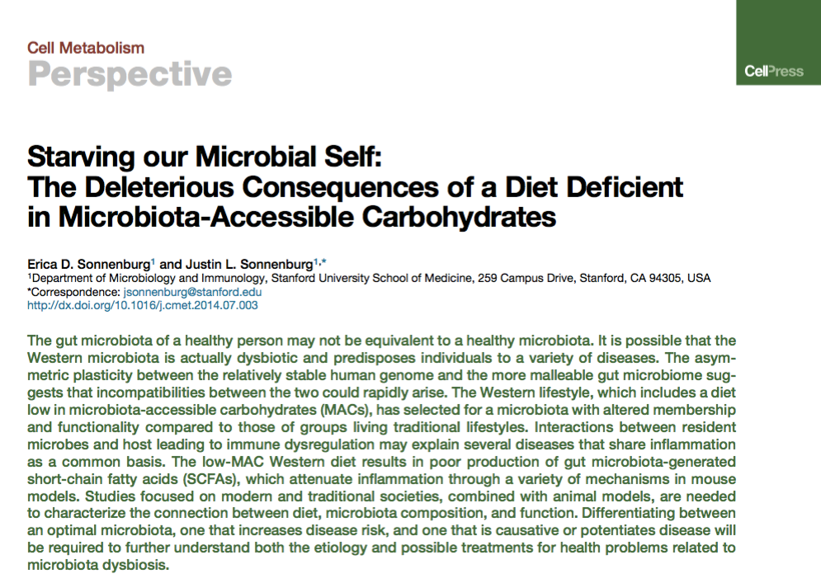
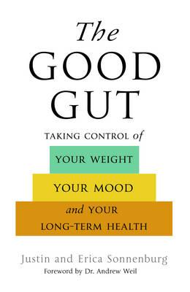

Slide 32
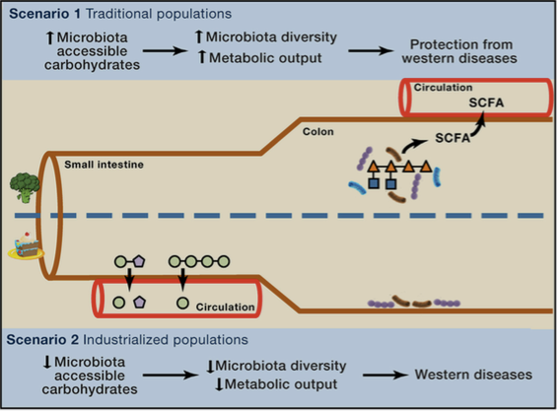

Slide 33
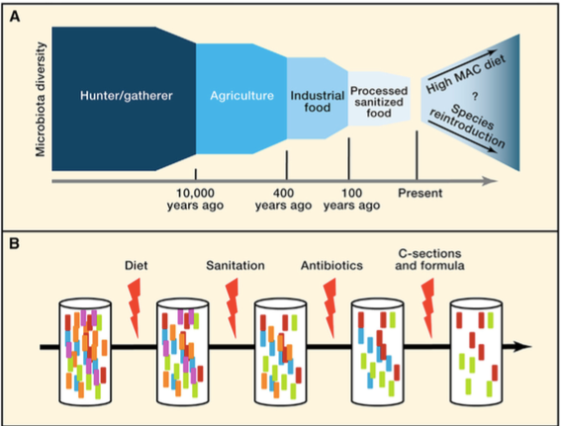

Slide 34
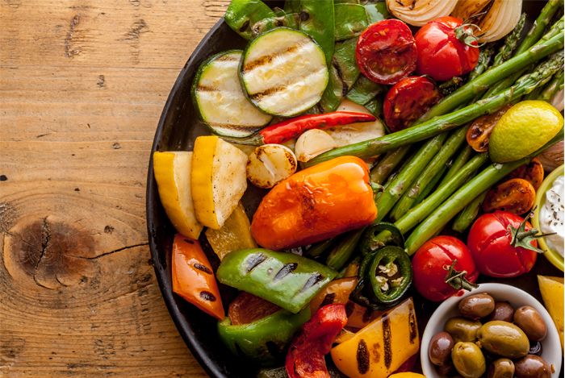
Plant-based foods
Fill half of plate with vegetables
2 cups greens/day is a nice goal
Cruciferous e.g. broccoli, cauliflower, collards, cabbage, kale, spinach, asparagus, romaine lettuce, arugula
Allium family e.g. onions, leeks, garlic
Beans and lentils; soaking and pressure cooking can be easier on the gut, reducing lectins
Lower glycemic fruits e.g. berries, grapefruit, kiwi
Anti-inflammatory spices e.g. turmeric, basil, ginger, rosemary, cayenne pepper
Fermentable Fiber essential for gut biome diversity
Fermentable foods e.g. yogurt, sauerkraut

Slide 36
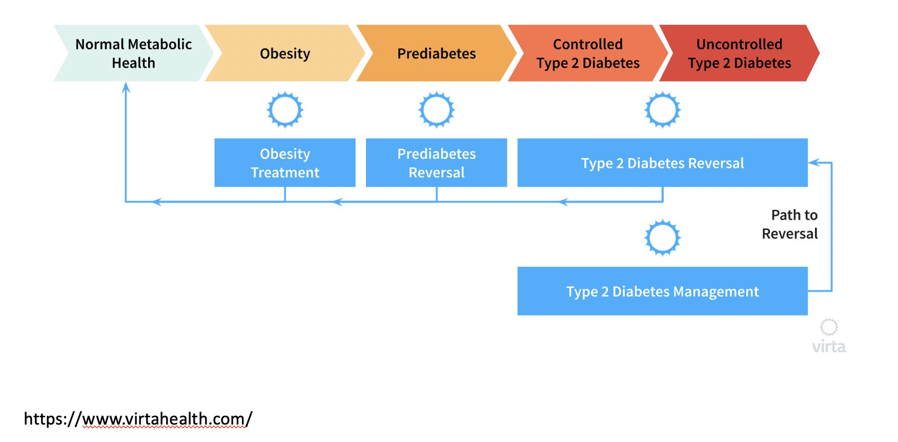

Slide 37
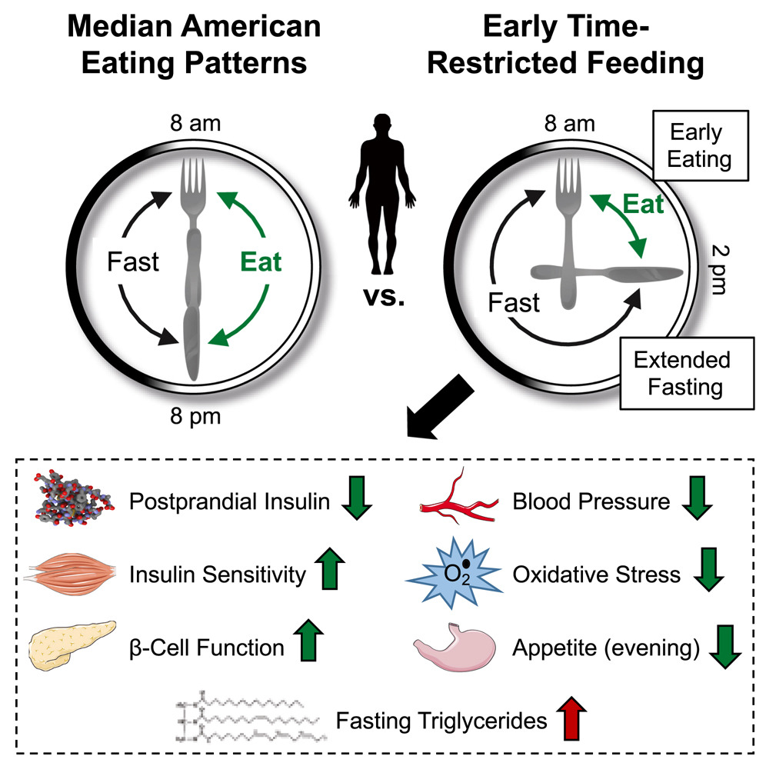

Slide 38
Know your numbers!
Fasting Blood Sugar (< 100)
HOMA IR a test of Insulin Resistance (< 1ideal)
Uric acid (< 5.5 ideal)
Hemoglobin A1c, less than 5.7 ideal
LDL particle #, cardiovascular risk
ApoB, cardiovascular risk
Vitamin D, want to be > 30
hsCRP, a measure of inflammation; < 1 is ideal
Triglycerides < 150, lower is ideal
Triglyceride/HDL ratio <2 ideal
Total and free testosterone levels (want to be at-above 25th-50th percentile

Slide 39
Reclaiming and Maintaining ore Metabolic Health and Flexibility

Slide 40
Thank you!

Slide 41
Summary: Enhancing metabolic efficiency: …. Reduce inflammation, insulin and leptin resistance
Eliminate – reduce sugar in all it’s forms
Eliminate-reduce refined grain flours, and carbohydrate-dense processed foods. Try going wheat-free for a month.
Reduce hydrogenated oils and processed seed oils cooked at high temperatures
OK to consume pasture-raised meats and eggs
More abundant healthy fats sources e.g. extra virgin olive oil, fatty fish, grass-fed butter; eggs; extra virgin coconut oil (MCT Oil); pasture-raised animal fat, ghee, avocados, nuts (almonds, walnuts and macadamia) and nut butters
Plant-based foods with a lot of fiber and nutrient density

