Slide 1
Creating Health: Applying the Science of Lifestyle Medicine
Mark Pettus MD
Week 1: Epigenetics and Health: How well do you fit into your genes?
Week 2: Inflammation: The bad gift that keeps giving
Week 3: Metabolic Health: How to become a member of this exclusive club.
Week 4: Circadian Rhythms and Health: Riding the rhythms of life

Slide 2
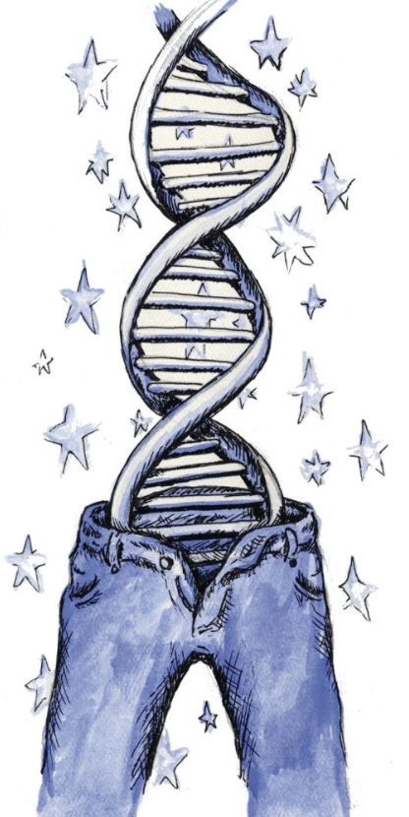
Epigenetics and Health
How well do you fit into your genes?
Mark Pettus MD
Associate Professor of Medicine
University of Massachusetts Medical School
September 23, 2022

Slide 3
Disclosures
Chief Medical Officer
Chief Innovation Officer
President Board of Directors

Slide 4
www.thehealthedgepodcast.com

Slide 5
Learning Objectives
Participant will understand the implication of epigenetics i.e., how lifestyle-environment influence healthspan and longevity.
Participant will understand some examples of nutritional epigenetics i.e., how food influences changes in our gene expression patterns and overall health.
Participant will understand how social connection-bonding alters epigenetic patterns and health throughout the life continuum.

Slide 6
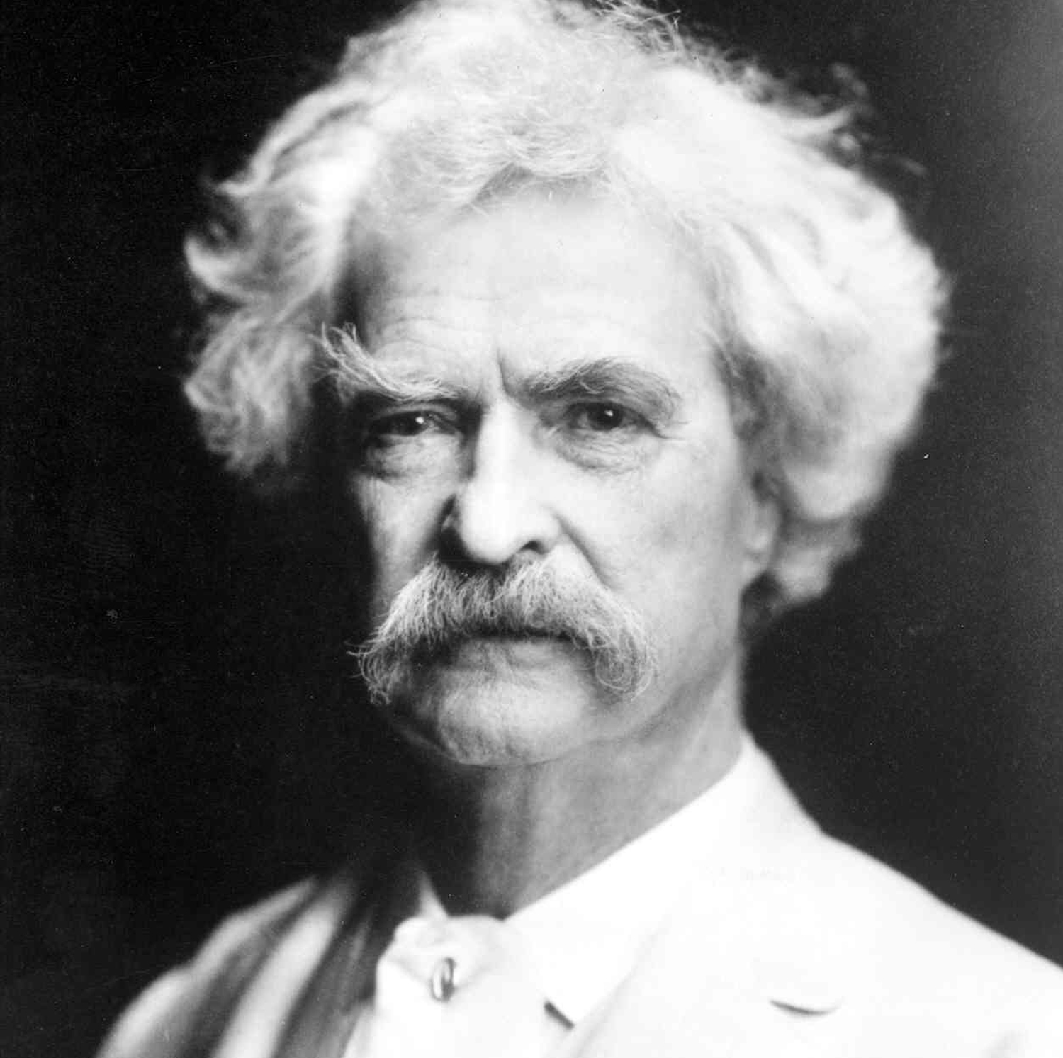
“It’s not what we don’t know that gets us into trouble, it’s what we know that ain’t so”
Mark Twain

Slide 7
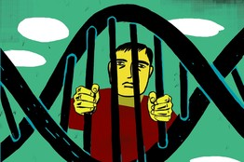
So what do we know that ain’t so?
You are not a prisoner of your DNA

Slide 8
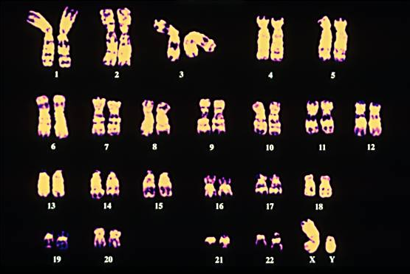
Your
“Book of Life”
in
23 Chapters

Slide 9
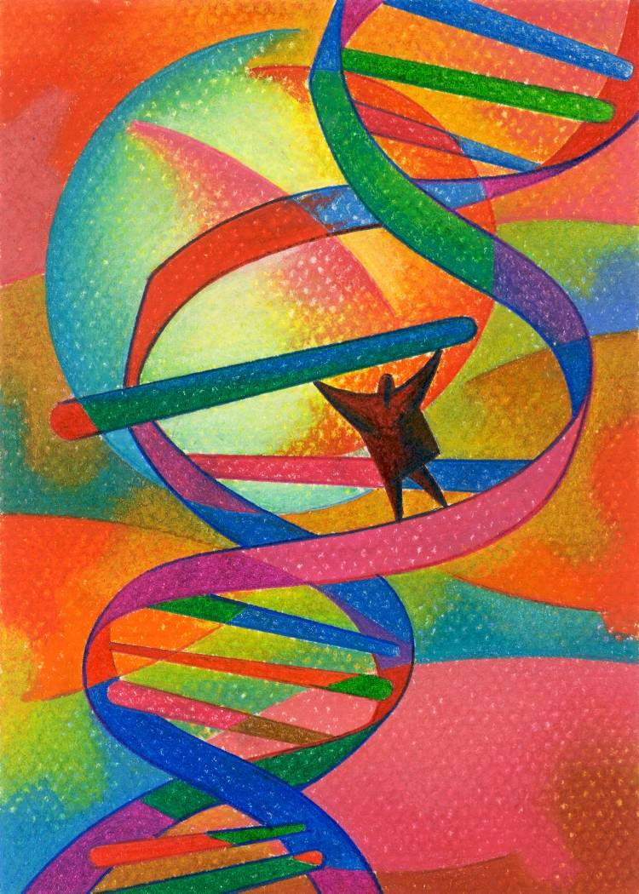
The Emerging Evidence
All health and disease are byproducts of complex individualized gene-environment interactions that may go back more than a generation before conception and continue throughout our lives.
Your DNA i.e., your “Book of Life” has a Stone Age imperative, not often compatible with 21st century environmental inputs.
This incompatibility creates a disrupted metabolic trajectory that forms the basis of chronic complex disease.
Through proven lifestyle medicine interventions, our gene expression patterns can be transformed to promote optimal function and health.
Re-writing ones Book of Life remains possible throughout the age continuum by aligning one’s environmental inputs with that which one’s Book of Life are best suited for.

Slide 10
Healthspan and Longevity
Healthspan
Notes:
Rectangularize the health curve
Healthspan…organ reserve

Slide 11
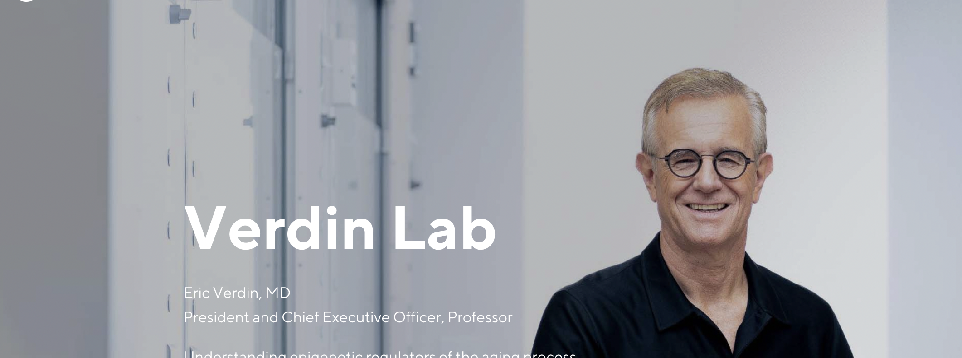
“Only 8% of what contributes to longevity can be traced to genetics. Over 90% of what contributes to longevity and healthy aging is lifestyle.”
Eric Verdin MD
President and CEO, Buck Institute

Slide 12
Environment
Lifestyle
Longevity
Healthspan
Epigenetics-
Genetics
Microbiome
Consciousness-Spirituality-Meaning

Slide 13
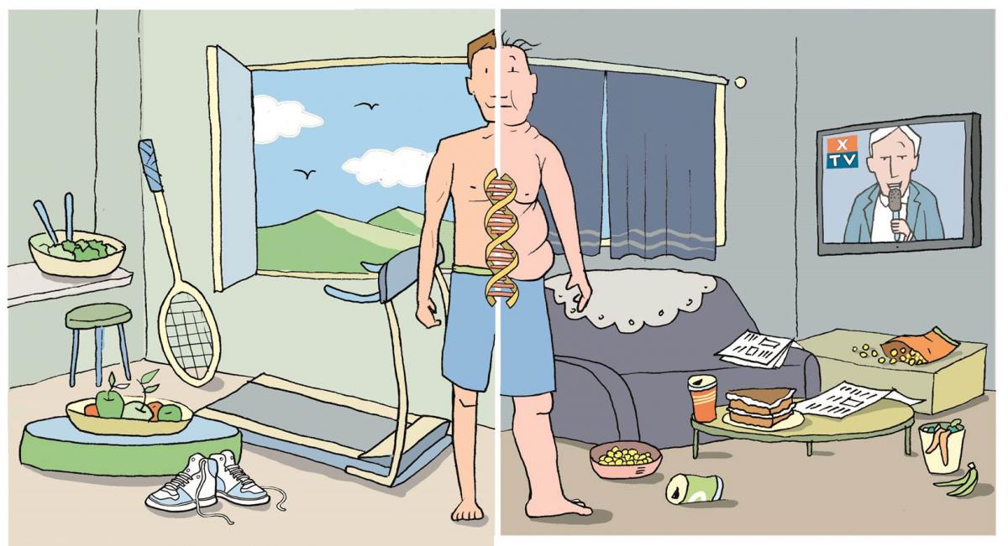
Epigenetics: A life with many possibilities.

Slide 14
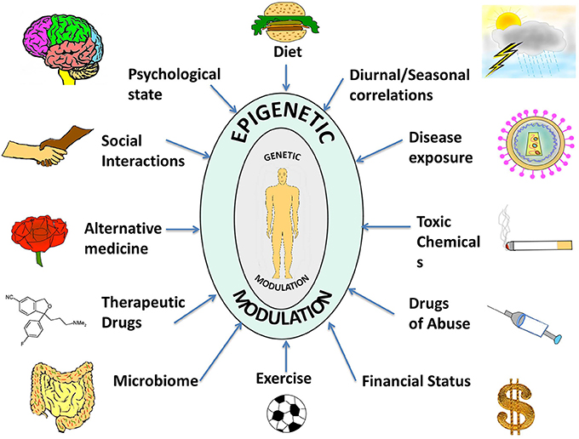

Slide 15
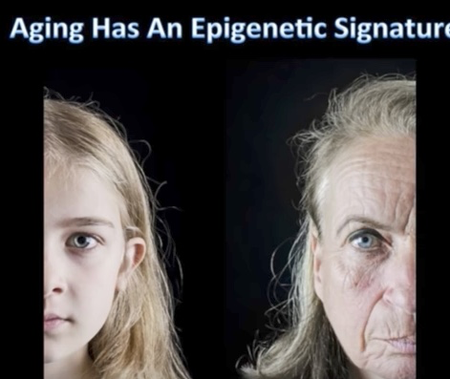
Aging has an Epigenetic Signature

Slide 16
Disease (how things appear)
Pre-diabetes, Diabetes, Obesity, Metabolic Syndrome, Heart Disease, Stroke, Depression, Autoimmunity, Alzheimer’s, Cancer, Fibromyalgia, Chronic fatigue
Integrative Medicine
Core Metabolic Imbalances (what drives them)
Inflammation
High Insulin Levels
Circadian Cycle Disruption
Root Causes (what are their origins)
Genetic-Epigenetic-Lifestyle
Nutrition Movement Stress Response
Environmental toxins Sleep Social Connection Trauma Conflict Management Mindfulness
Meaning in Work, Love, Play
Socioeconomics

Slide 17
Health as a byproduct of gene-environmental compatibility

Slide 18
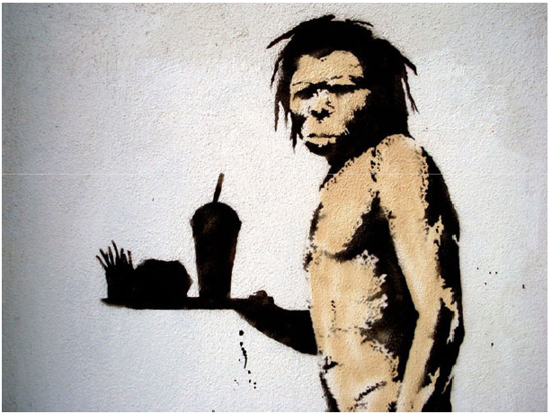
An Ancient Design For Survival in Modern Times …our design has maintained many of the Stone Age imperatives, but life in the fast lane has not.
Then
Now
Fight-flight
Energy conservation
Immunity
Promotion of clotting
Anxiety, PTSD, depression
Metabolic Syndrome
Autoimmunity and allergy
Heart attack and stroke

Slide 19
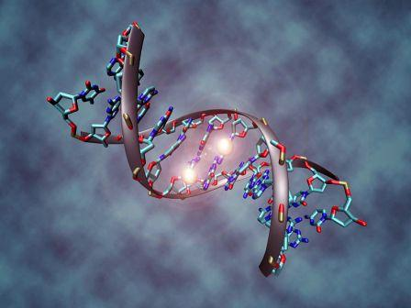
Representative Clinical Conditions Suggested to Have Epigenetic Origins
Obesity
Type 2 DM and Metabolic Syndrome
Coronary artery disease
Autoimmune Diseases
Cancer
Allergic Disorders
Depression
Neurologic: Alzheimer’s, PD, ALS, Autism
Aging

Slide 20
Lifestyle-Behavioral Factors Shown to Have Health-Promoting Epigenetic Influences
Plant-based, unprocessed foods
Movement
Mindfulness practices
Bonding-social connection
Reduction in Environmental Toxin exposure
Microbiome diversity
Natural environments
Purpose-meaning

Slide 21
Epigenetics in Primates
Robert Sapolsky PhD Stanford

Slide 22
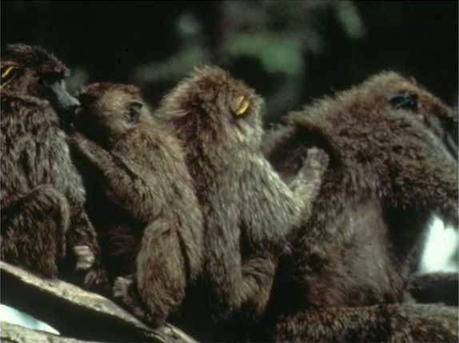
From Robert Sapolsky PhD

Slide 23
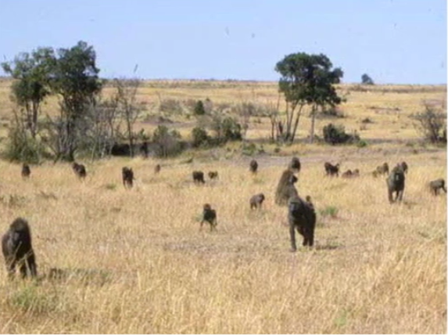
Robert Sapolsky PhD Stanford

Slide 24
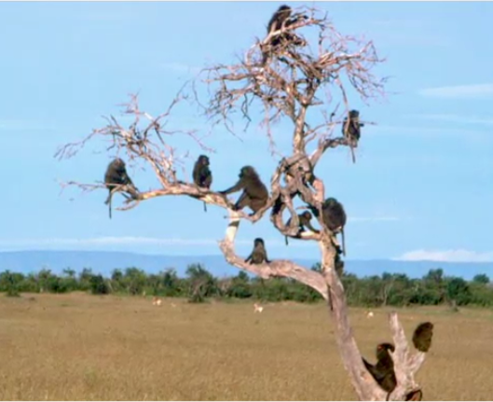
Robert Sapolsky PhD Stanford

Slide 25
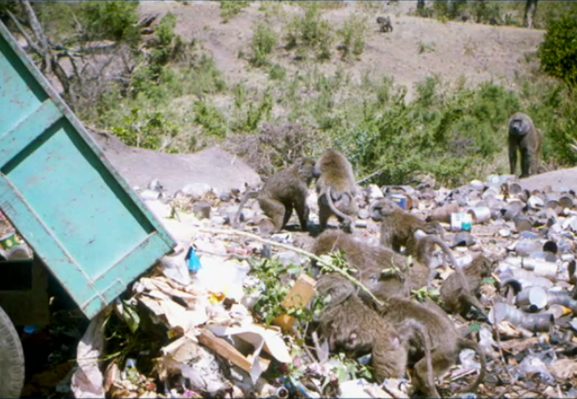
From Robert Sapolsky PhD

Slide 26
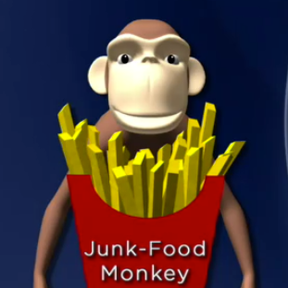
Junk Food Monkeys
Much heavier with more body fat
Metabolic Syndrome
Insulin resistant with elevated fasting
and post-prandial insulin levels
Increased TGAs
Move a lot less
Socialized and play less
High Infertility
Die younger
From Robert Sapolsky PhD

Slide 28
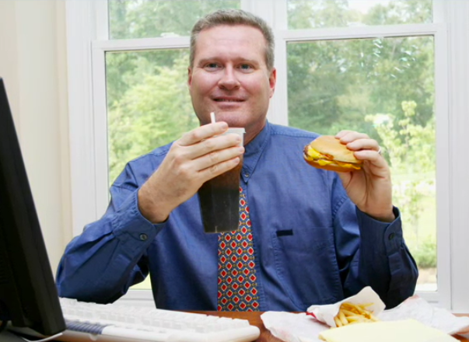

Slide 29
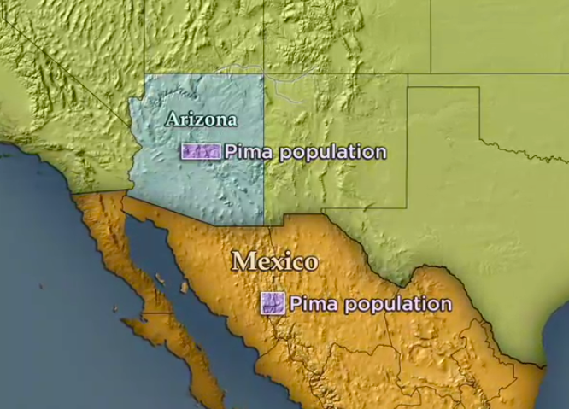
Epigenetics in humans

Slide 30
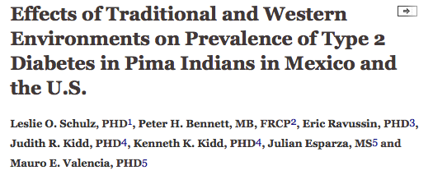
Prevalence of type 2 DM 5 times higher in Arizona Pima’s compared to Mexican Pima’s.
Diabetes Care August 2006 vol. 29 no. 8 1866-1871

Slide 31
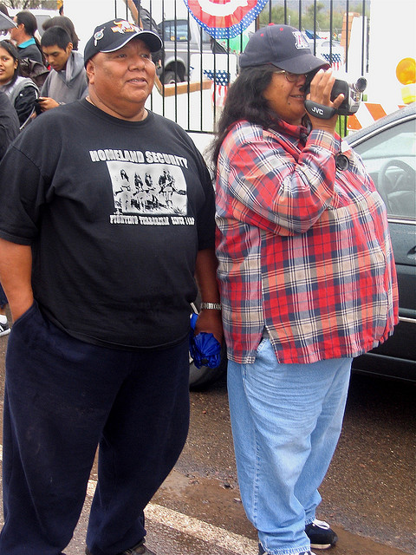
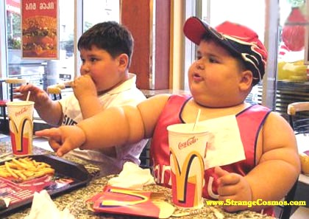

Slide 33
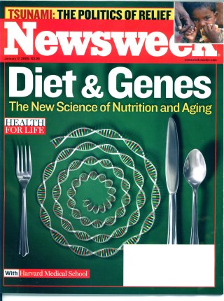

Slide 34
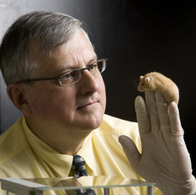
Nutritional Epigenetics
Randy Jirtle PhD
Relationship between nutrition, methylation and gene expression
Protection against BPA toxicity in nutrient-methylation models

Slide 37
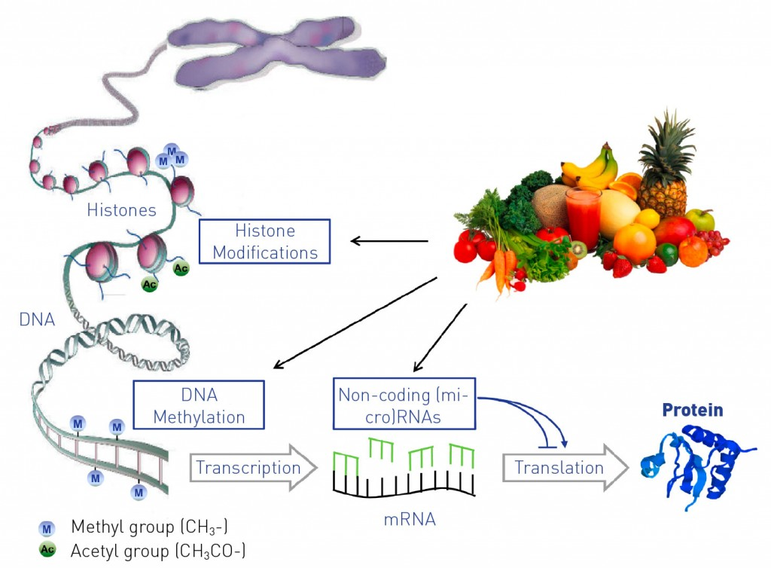
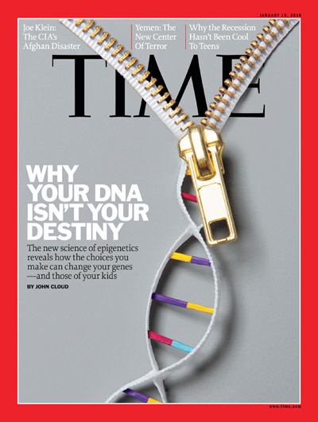

Slide 38
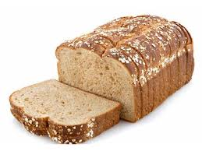
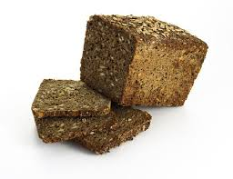
Different carbohydrates produce unique metabolic responses
high glycemic carbs low glycemic carbs
62 genes up-regulated 71 genes down-regulated
linked to oxidative stress, regulating insulin signaling
Inflammatory and adipocyte cell size
Lower insulin levels
Source: Kallio et al. Am J Clin Nutr;2007:851:1417-27
Notes:
47 subjects with metabolic syndrome, 12 weeks trial. No wt loss. Isocaloric.
II = change in I/change in G

Slide 39
Brain Derived Neurotropic Factor (BDNF)
Exercise
Caloric Restriction
Meditation
Curcumin
Green tea
Coffee
DHA
Intermittent Fasting/TRE
Probiotics
SAD
Stress
Inflammation
Insulin resistance
Circadian Disruption
Sedentary states
Social Isolation/trauma
BDNF
Bredesen. AGING, June 2016, Vol. 8 No.6

Slide 40
Environmental Programming of Gene Activity- Bonding
Glucocorticoid Receptor Gene
Traumatic Childhood Events
Bonding
GR Gene
GR Gene
GR Receptors
GR Receptors
Stress Response
Stress Response
McGowan PO, Sasaki A, D’Alessio AC, Dymov S, Labonte B, Szyf M, Turecki G, Meaney MJ. Epigenetic regulation of the glucocorticoid receptor in human brain associates with childhood abuse. Nat Neurosci. 2009;12(3):342-348.

Slide 41
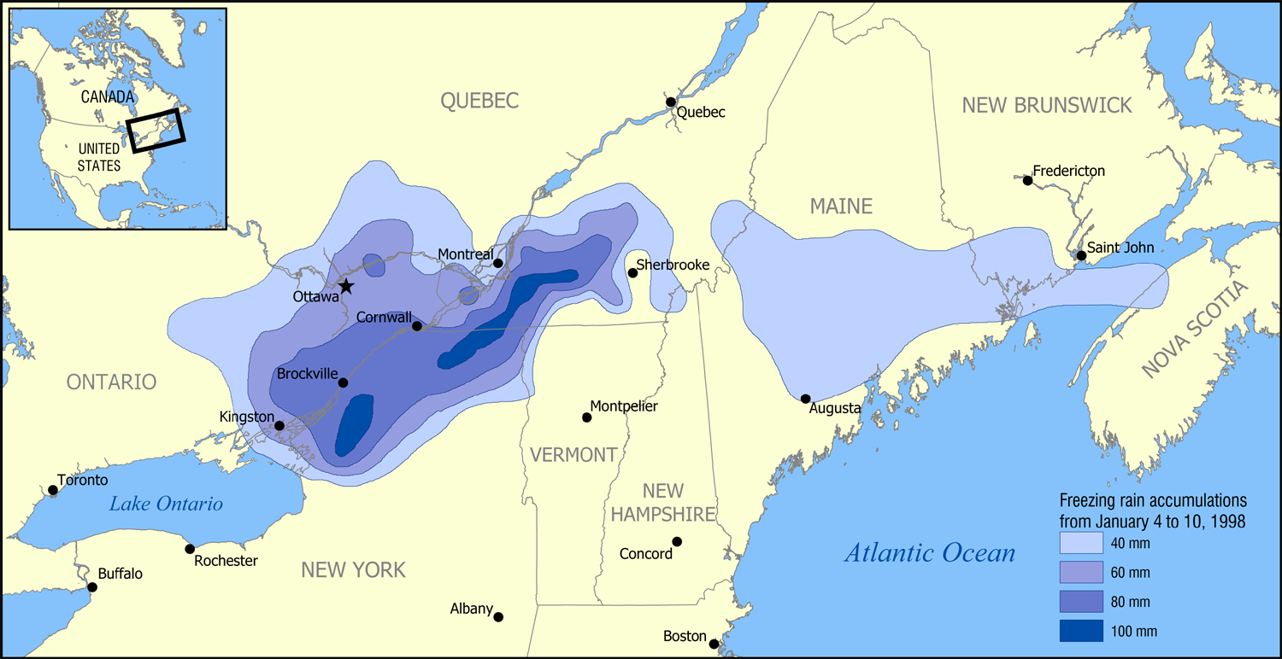
Conclusions
“These data provide first evidence in humans supporting the conclusion that PNMS results in a lasting, broad, and functionally organized DNA methylation signature in several tissues in offspring. We can infer that the epigenetic effects found in Project Ice Storm are due to objective levels of hardship experienced by the pregnant women.”

Slide 42
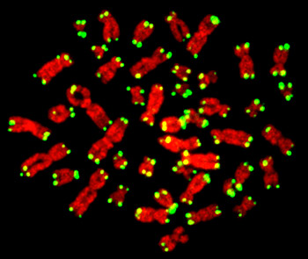

Slide 43
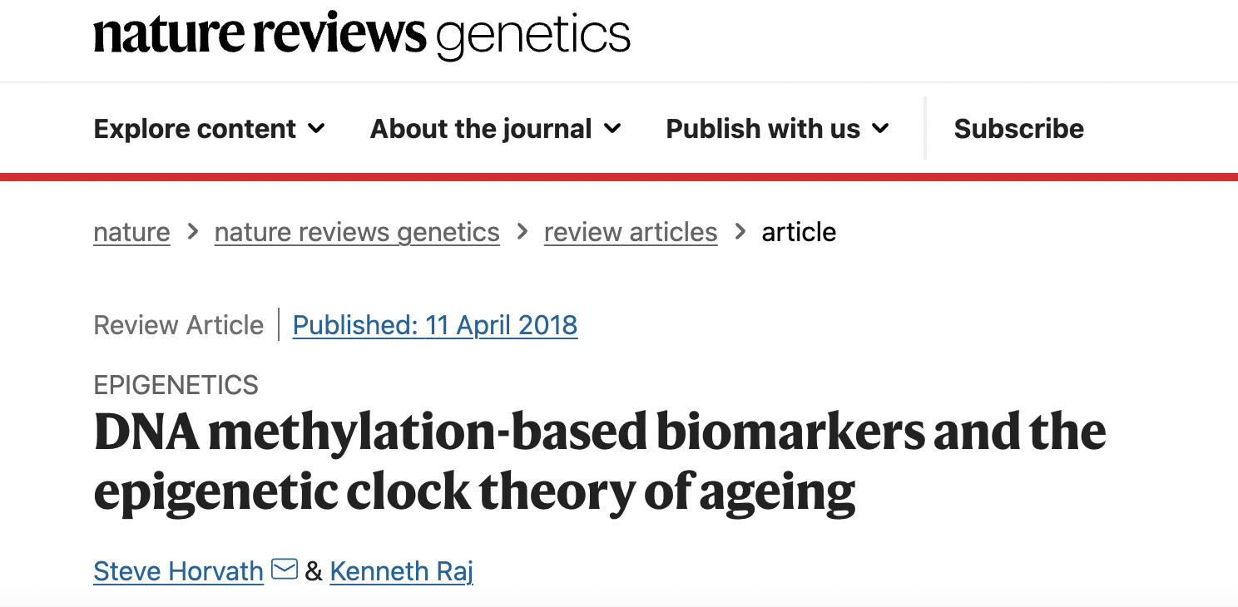

Slide 44
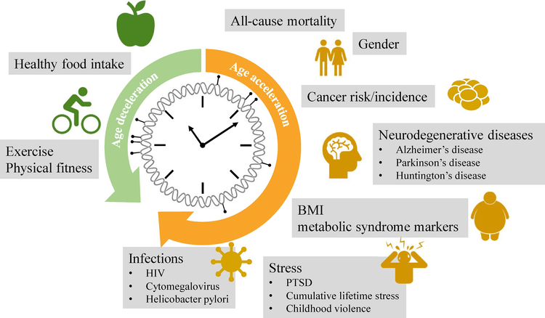
Back to the future: Epigenetic clock plasticity towards healthy aging
January 2018 Mechanisms of Ageing and Development DOI:10.1016/j.mad.2018.01.002

Slide 46
