Slide 1
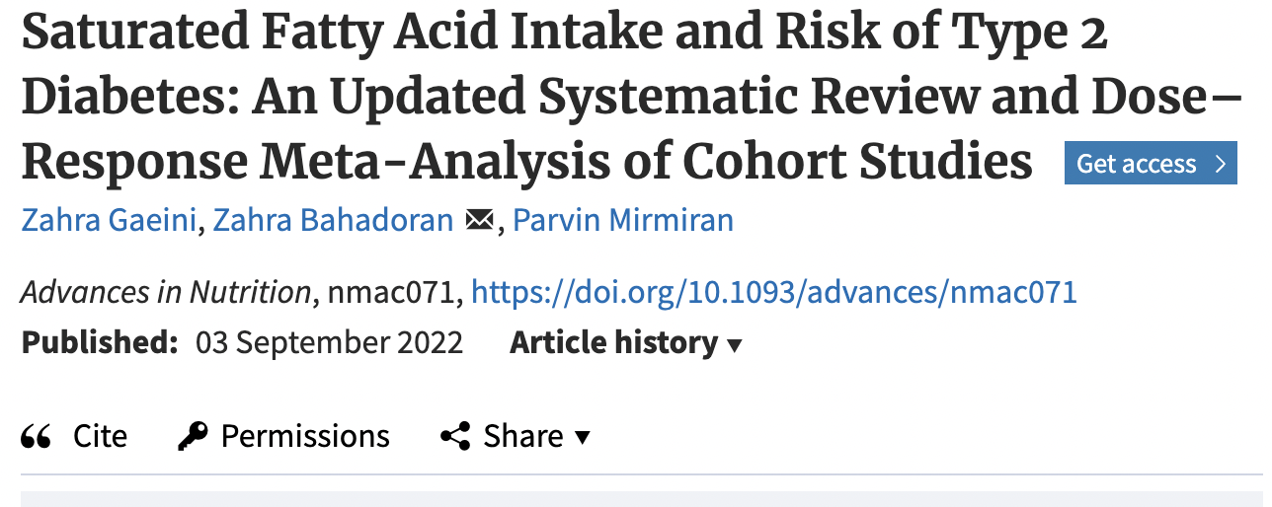

Slide 2
Systematic review and meta-analysis of cohort studies examining the relationship between saturated fat intake and risk of type 2 diabetes
13 studies with 361,686 participants
11,865 individuals with diagnosis type 2 DM
Dietary total SFA intake, as well as palmitic acid (PA) and stearic acid (SA) were not associated with risk of type 2 DM when comparing highest with lowest quintile of intake.
Higher Myristic Acid (MA) and Lauric Acid (LA) intakes were associated with reduction in DM risk (11- 17%).
Our results indicated no significant association between dietary total SFA and risk of type 2 DM. Higher MA and LA intakes were associated with reductions in risk

Slide 3
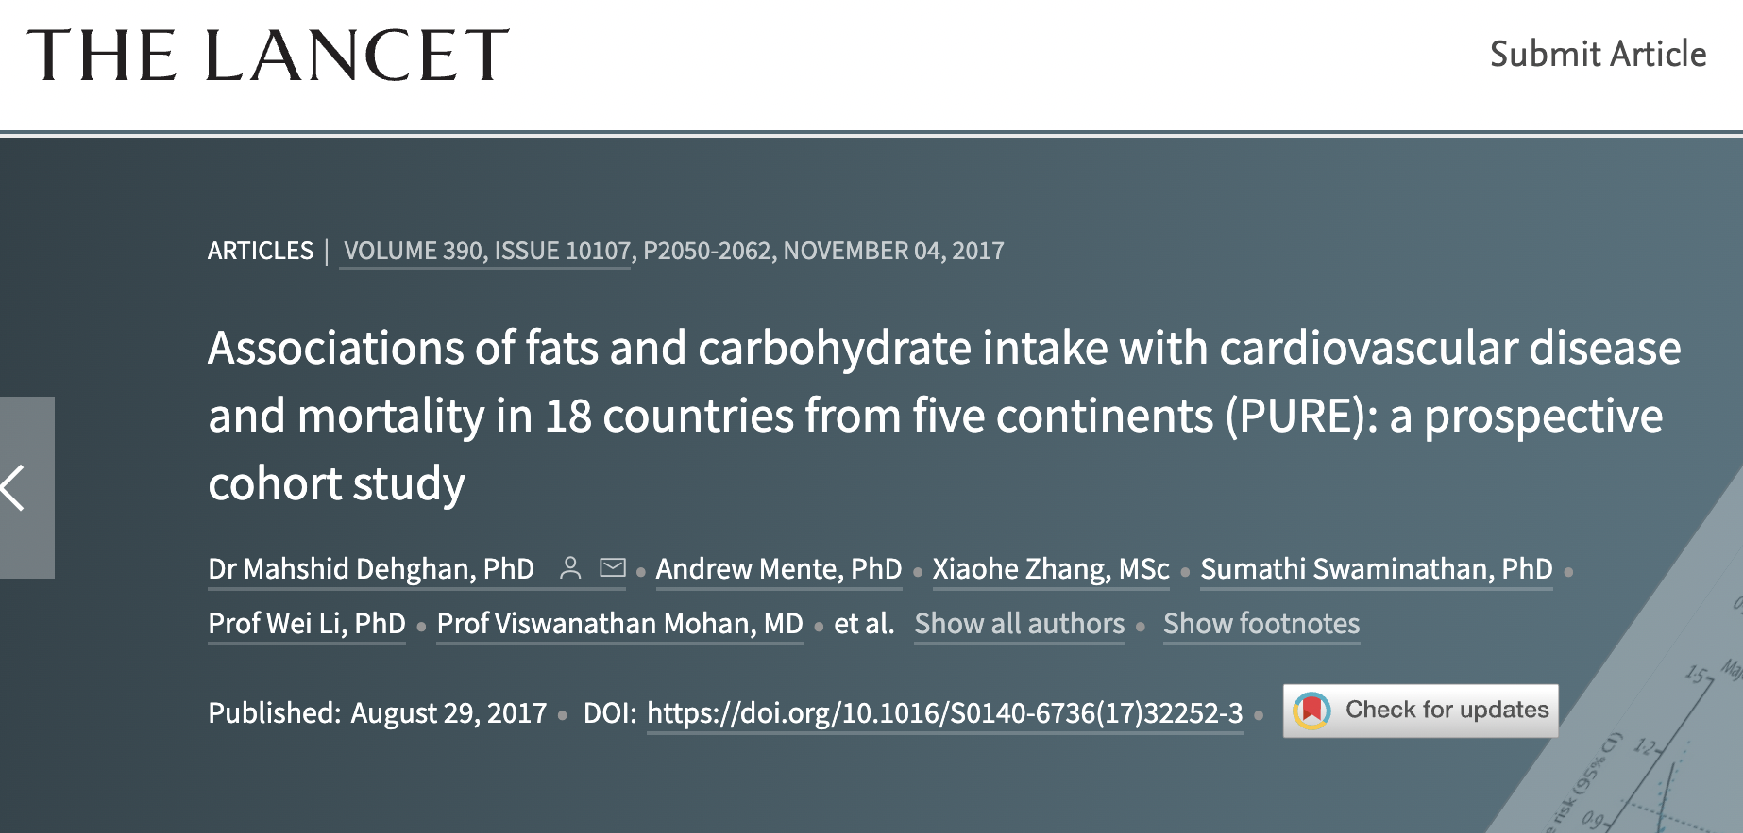

Slide 4
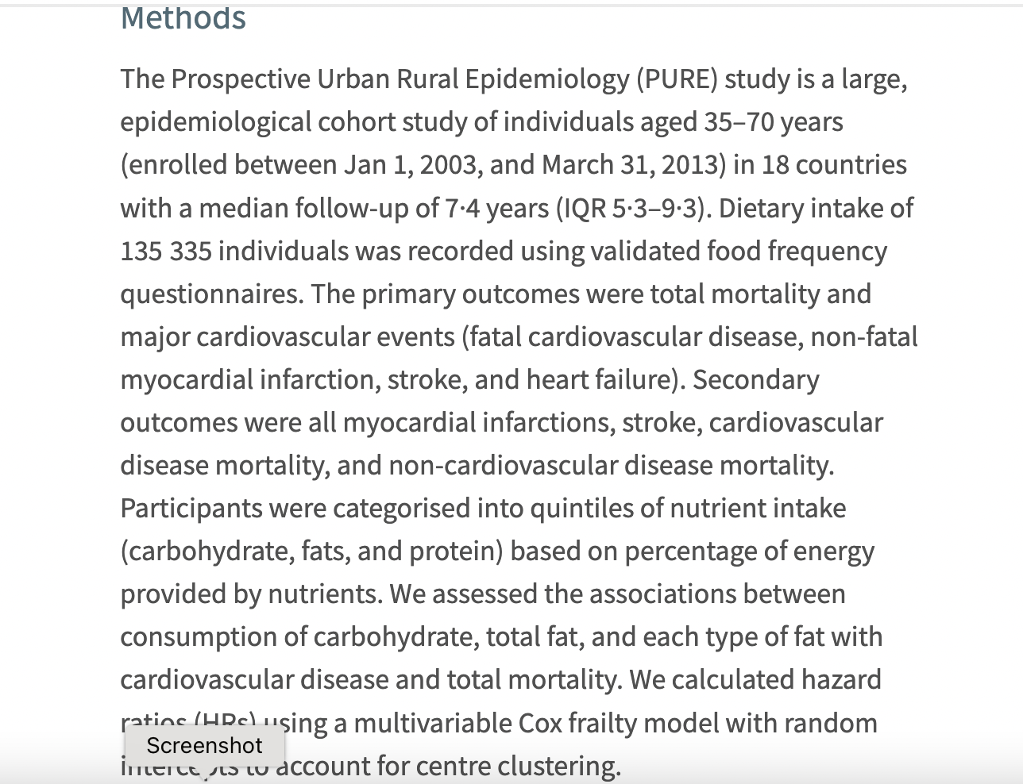
135,335 individuals aged 35-70 from 18 countries
Mean f/u 7.4 years
Primary outcome total and CVD mortality
Secondary outcomes MI, stroke

Slide 5
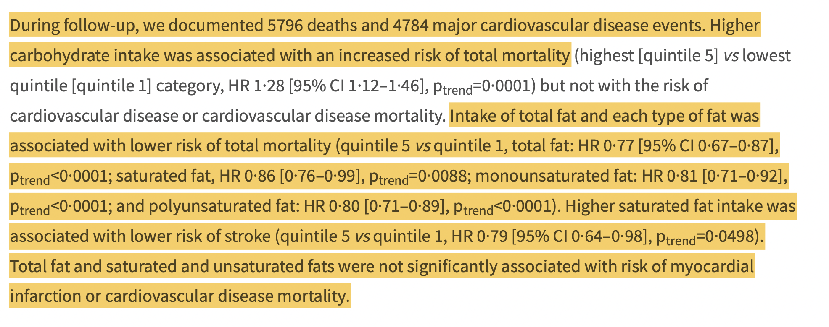

Slide 6
