Slide 1
Creating Health: Applying the Science of Lifestyle Medicine
Mark Pettus MD
Week 1: Epigenetics and Health: How well do you fit into your genes?
Week 2: Inflammation and Health: Are you playing with fire?
Week 3: Metabolic Health: How to become a member of this exclusive club.
Week 4: Circadian Rhythms and Health: Riding the rhythms of life

Slide 2
Inflammation and Health:
Are you playing with fire?
Mark Pettus MD
Associate Professor of Medicine
University of Massachusetts Medical School
September 30, 2022

Slide 3
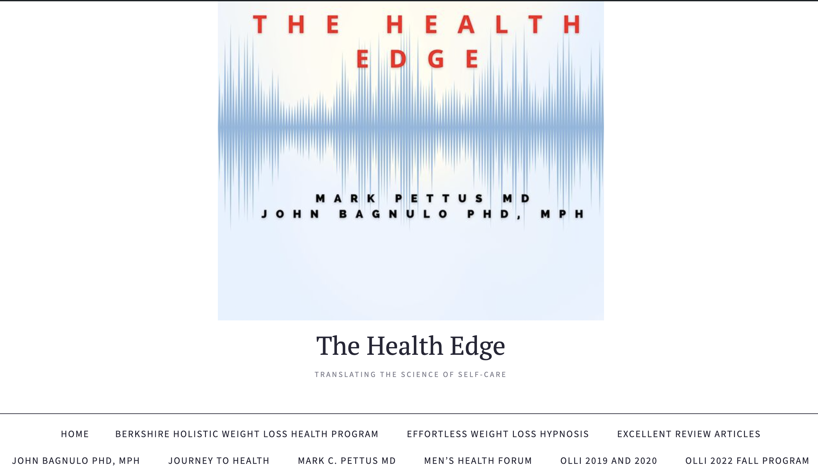
www.thehealthedgepodcast.com

Slide 4
Learning Objectives
Participant will understand the link between inflammation and health, health span and longevity.
Participant will understand the changes in our modern food supply and how they contribute to chronic inflammation.
Participant will acquire actionable lifestyle medicine interventions that will both reduce inflammation and improve quality of life.

Slide 5
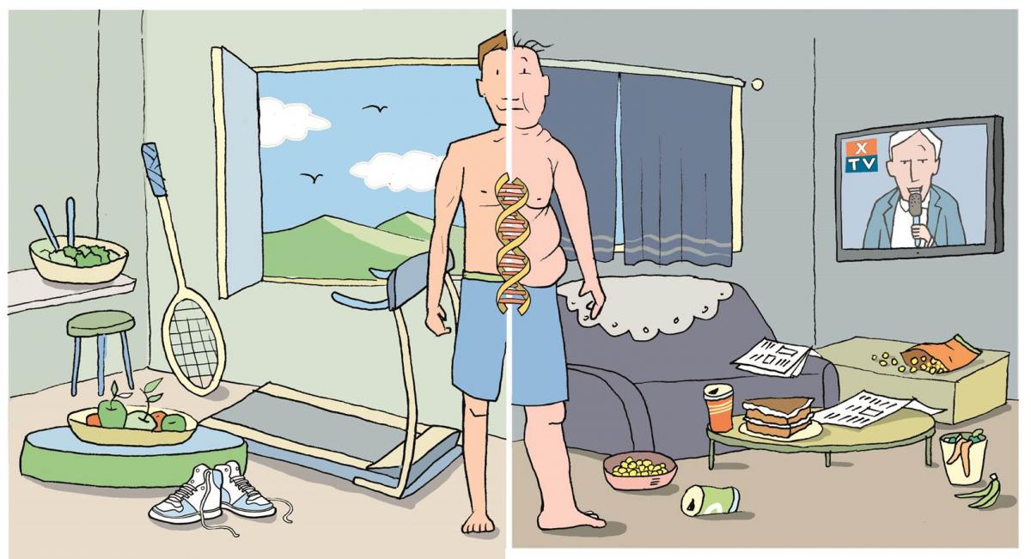
Epigenetics: A life with many possibilities.

Slide 6
Disease (how things appear)
Pre-diabetes, Diabetes, Obesity, Metabolic Syndrome, Heart Disease, Stroke, Depression, Autoimmunity, Alzheimer’s, Cancer, Fibromyalgia, Chronic fatigue
Lifestyle Medicine
Core Metabolic Imbalances (what drives them)
Inflammation
High Insulin Levels
Circadian Cycle Disruption
Root Causes (what are their origins)
Genetic-Epigenetic-Lifestyle Mismatch
Nutrition Movement Stress Response
Environmental toxins Sleep Social Connection Trauma Conflict Management Mindfulness
Meaning in Work, Love, Play
Socioeconomics

Slide 7
“The Cause of Everything?”
“Inflammaging”

Slide 8
Inflammation is a highly evolved response of our immune systems that protects us after injury, from pathogens and is essential for survival. A system well-designed for acute events can become maladaptive when chronically turned-on.

Slide 9
Disease (how things appear)
Pre-diabetes, Diabetes, Obesity, Metabolic Syndrome, Heart Disease, Stroke, Depression, Autoimmunity, Alzheimer’s, Cancer, Fibromyalgia, Chronic fatigue
Core Metabolic Imbalances (what drives them)
Inflammation
High Insulin Levels
Circadian Cycle Disruption
Root Causes (what are their origins)
Genetic-Epigenetic-Environment
Nutrition Movement Stress Response
Environmental toxins Sleep Social Connection Trauma Conflict Management Mindfulness
Meaning in Work, Love, Play
Socioeconomics

Slide 10
Causes of Inflammation
Standard American Diet
Lack of Movement
Chronic stress i.e., allostatic load
Waistline 36+” in women
40+” in men
5. Imbalanced Gut ecosystem-barrier
6. Disrupted sleep (circadian rhythm)
7. Social isolation
8. Environmental toxins e.g. mold,
plastics, glyphosate
9. ? Low vitamin D
Infections e.g. Lyme, covid-19;
periodontal disease

Slide 11
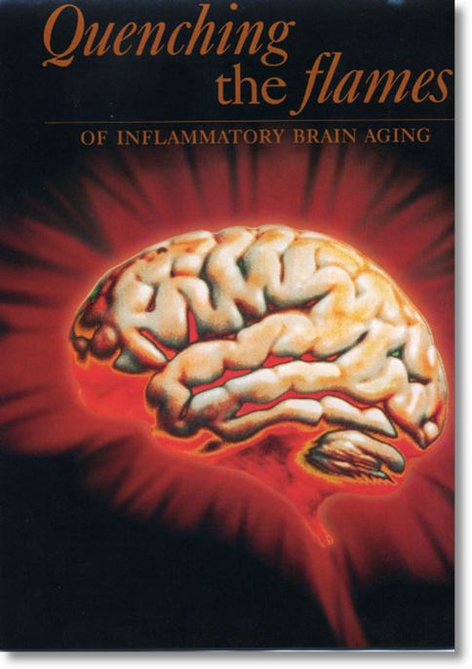
Evidence for increased inflammation in:
Alzheimer’s disease
Depression
Chronic Pain
Parkinson’s Disease
Multiple Sclerosis
ADD and ADDHD
Anxiety and Panic
Autism spectrum

Slide 12
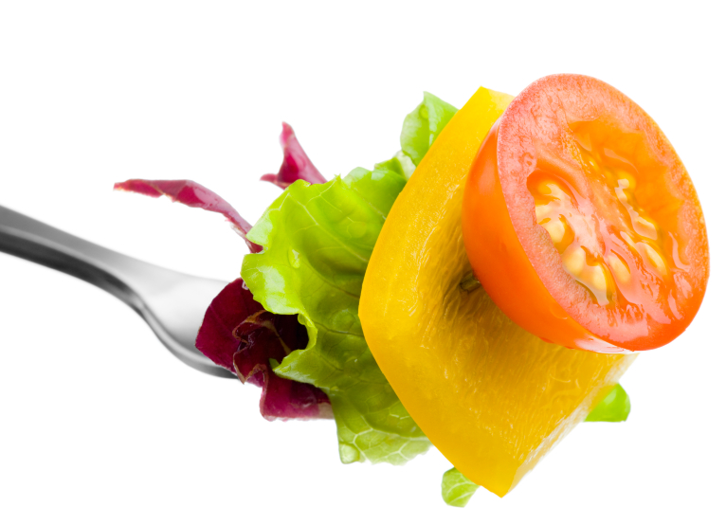
Food and Inflammation

Slide 14
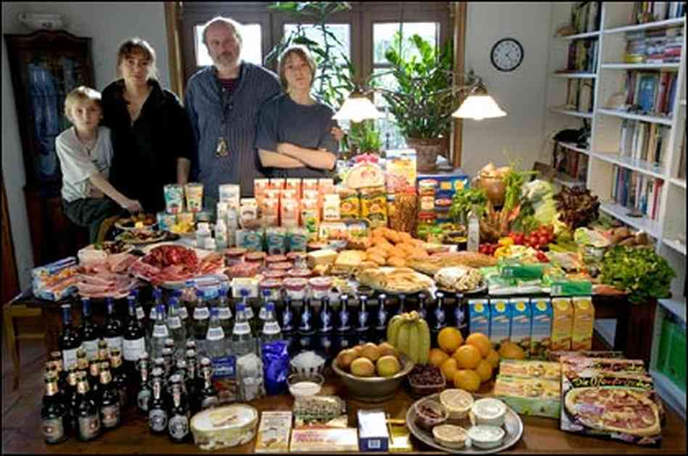

Slide 15
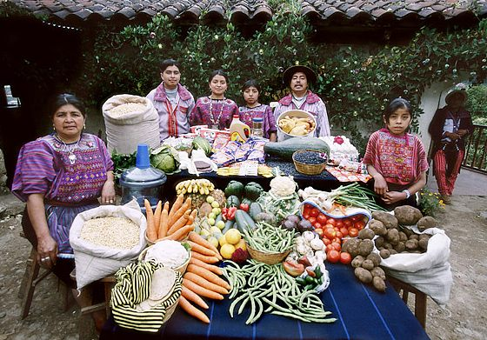

Slide 18
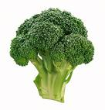
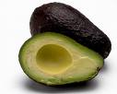
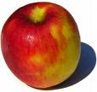
CHANGES IN HUMAN DIETS WITH INTENSIFIED AGRICULTURE, COOKING, AND FOOD PROCESSING
Glycemic Load: More sugar, fructose, flour
Fatty Acid Composition: Omega 3/6 ratio
Macronutrient Composition
Micronutrient Density: Processed foods remove
Sodium-Potassium Ratio: Much too high
Fiber Content: very low- gut microbiome

Slide 19
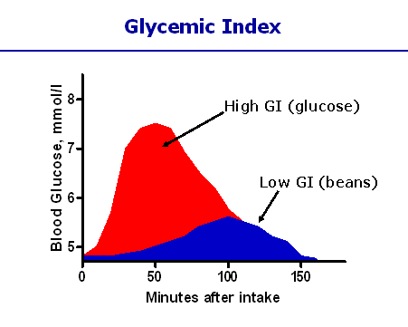
Different carbohydrates produce unique genomic responses!
High Glycemic Carbs Low Glycemic Carbs
62 genes regulating Same genes turned off;
Inflammation, stress, Genes regulating same insulin signaling production turned off. gene responses activated.
Kalle et al. Am J Clin Nutr;2007:851:1417-27

Slide 20
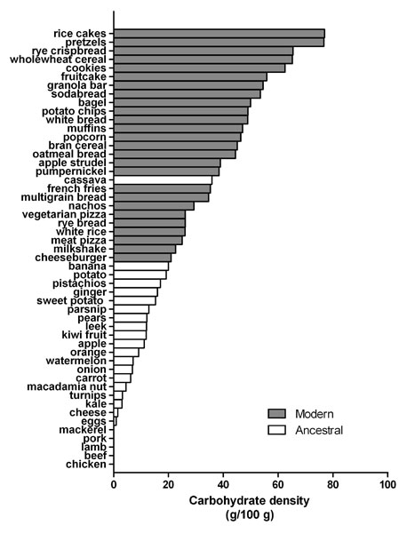
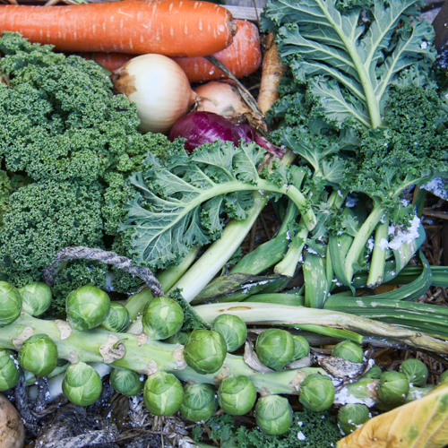
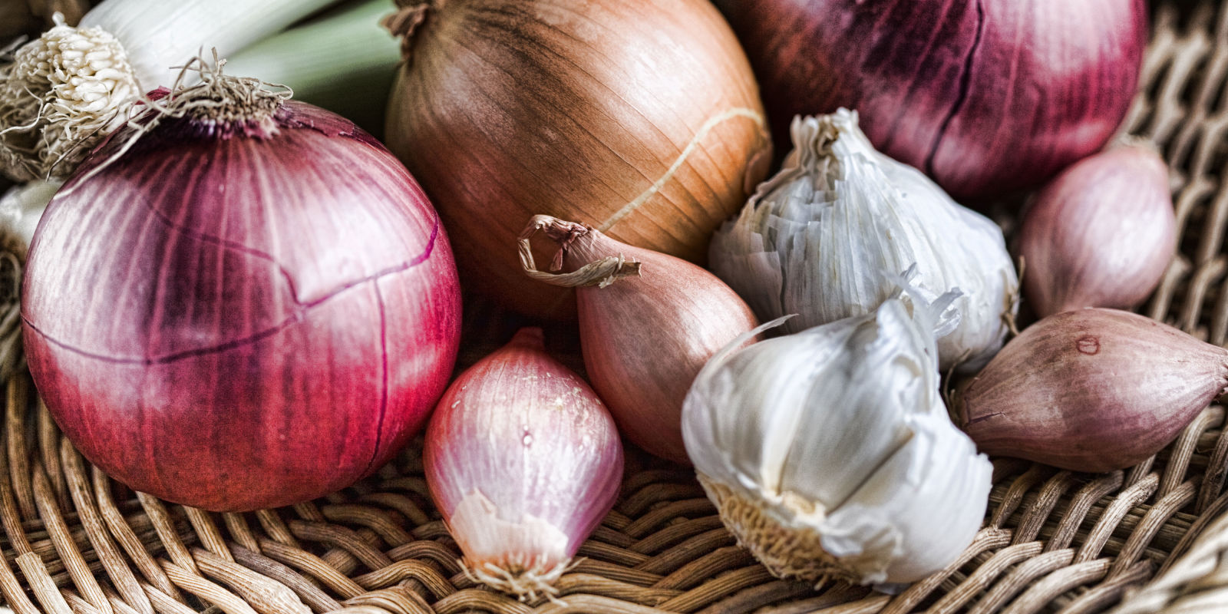
Sugar, Fructose and Carbohydrate-Dense Grains
High-Quality Plant-Based Carbs
Oral and Gut
Microbiome
Protection from:
Inflammation
Diabetes
Cancer
Obesity
Inflammation
Altered neurotransmitters
Insulin Resistance
Weight and Metabolism
Mitochondria-Oxidative stress
HPA axis –Stress Response

Slide 21
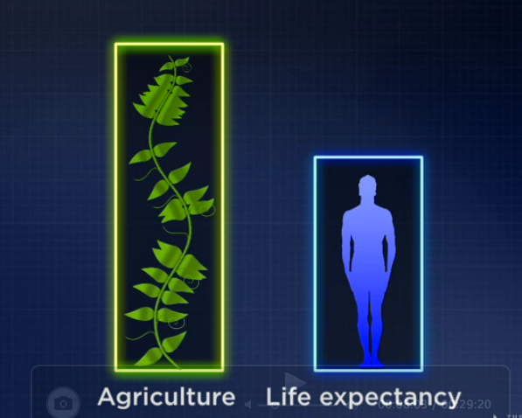
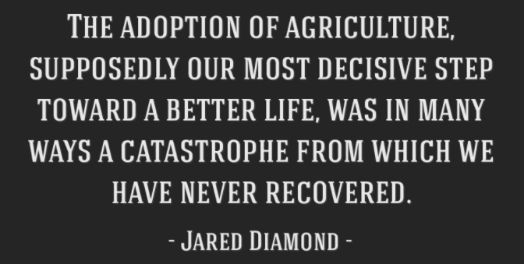

Slide 22
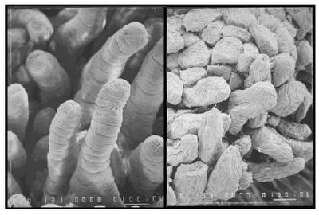
Wheat: Health Considerations
Modern cultivars:
High-Glycemic amylopectin
Changes in Gliadin
Anti-nutrients e.g. lectins wheat germ agglutinin (WGA)
Glyphosate “Round Up” browning – dessication
Effects on microbiome
Deception of “whole grain” labeling
Notes:
References:(i) Ludvigsson JF, Montgomery SM, Ekbom A, Brandt L, Granath F. Small-intestinal histopathology and mortality risk in celiac disease. JAMA. 2009 Sep 16;302(11):1171-8.(ii) Rubio-Tapia A, Kyle RA, Kaplan EL, Johnson DR, Page W, Erdtmann F, Brantner TL, Kim WR, Phelps TK, Lahr BD, Zinsmeister AR, Melton LJ 3rd, Murray JA. Increased prevalence and mortality in undiagnosed celiac disease. Gastroenterology. 2009 Jul;137(1):88-93(iii) Green PH, Neugut AI, Naiyer AJ, Edwards ZC, Gabinelle S, Chinburapa V. Economic benefits of increased diagnosis of celiac disease in a national managed care population in the United States. J Insur Med. 2008;40(3-4):218-28.(iv) Farrell RJ, Kelly CP. Celiac sprue. N Engl J Med. 2002 Jan 17;346(3):180-8. Review.(v) Sedghizadeh PP, Shuler CF, Allen CM, Beck FM, Kalmar JR. Celiac disease and recurrent aphthous stomatitis: a report and review of the literature. Oral Surg Oral Med Oral Pathol Oral Radiol Endod. 2002;94(4):474-478.(vi) Margutti P, Delunardo F, Ortona E. Autoantibodies associated with psychiatric disorders. Curr Neurovasc Res. 2006 May;3(2):149-57. Review.(vii) Ludvigsson JF, Reutfors J, Osby U, Ekbom A, Montgomery SM. Coeliac disease and risk of mood disorders–a general population-based cohort study. J Affect Disord. 2007 Apr;99(1-3):117-26. Epub 2006 Oct 6.(viii) Ludvigsson JF, Osby U, Ekbom A, Montgomery SM. Coeliac disease and risk of schizophrenia and other psychosis: a general population cohort study. Scand J Gastroenterol. 2007 Feb;42(2):179-85.(ix) Hu WT, Murray JA, Greenaway MC, Parisi JE, Josephs KA. Cognitive impairment and celiac disease. Arch Neurol. 2006 Oct;63(10):1440-6.(x) Bushara KO. Neurologic presentation of celiac disease. Gastroenterology. 2005 Apr;128(4 Suppl 1):S92-7. Review.(xi) Millward C, Ferriter M, Calver S, Connell-Jones G. Gluten- and casein-free diets for autistic spectrum disorder. Cochrane Database Syst Rev. 2004;(2):CD003498. Review.

Slide 24
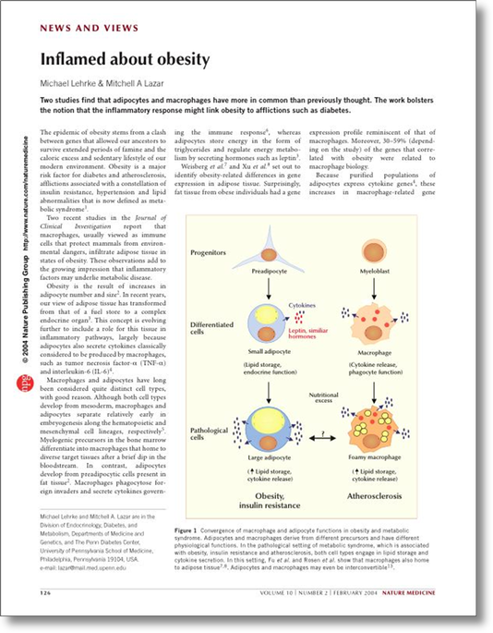
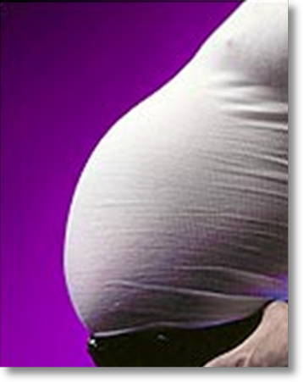
Ideal:
Waist/Hip ratio < 0.9
%Body fat < 25-30%
Waist circumference < 40” or < 36”

Slide 26
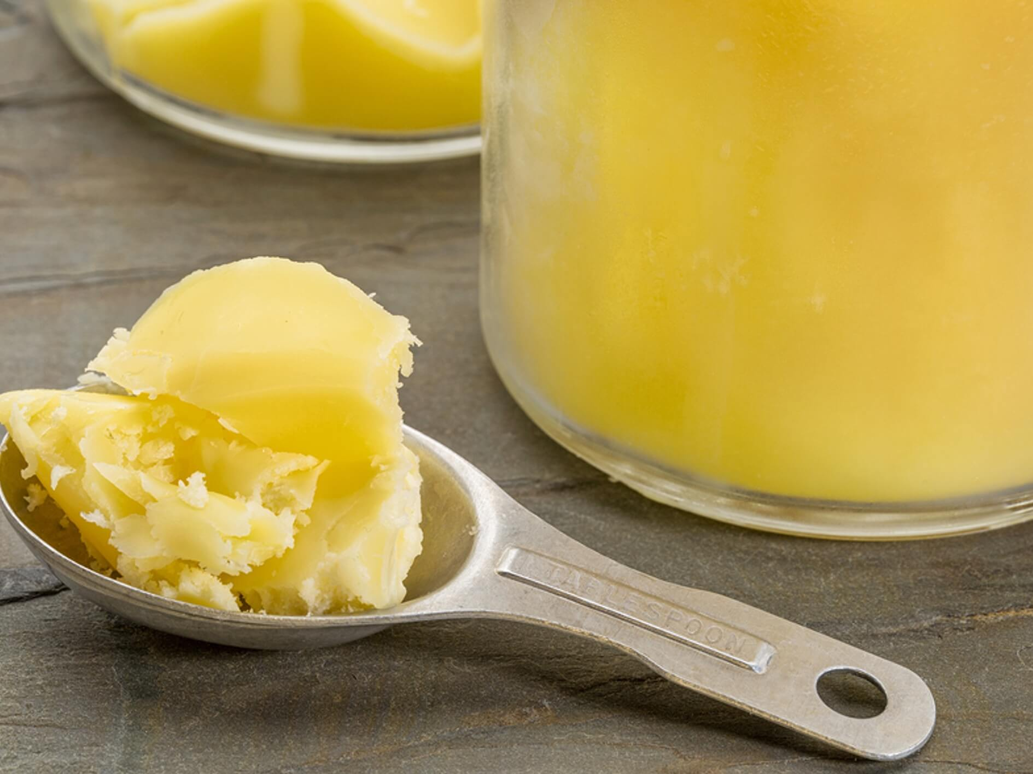
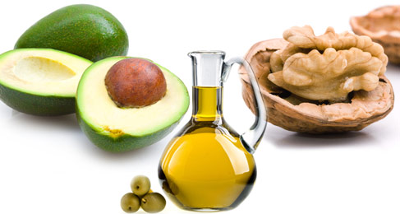
More Quality Fat Sources: The Omega 6:3 Ratio
Pasture-raised eggs
Fatty fish e.g. salmon, sardines, anchovies, mackerel, trout
Ghee
Grass-fed butter
Whole fat dairy, yogurt
Extra virgin olive oil
Extra virgin coconut oil
Avocados, olives
Nuts - almonds, macadamia, walnuts
Pasture-raised and uncured meats

Slide 27
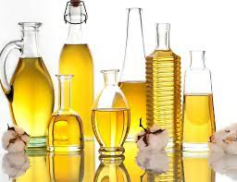
Processed Omega-6 Fats are more inflammatory and prone to oxidative stress
Corn oil
Safflower oil
Canola oil
Sunflower oil
Soybean oil
Cottonseed

Slide 28
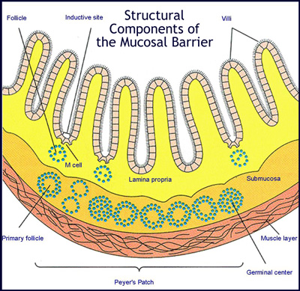
When the barrier breaks down, disease risk increases
Small intestine surface area could cover a doubles tennis court
It is only 1 cell layer thick
Damage can lead to increased permeability of toxins, referred to as “leaky gut” that fuels inflammation

Slide 29
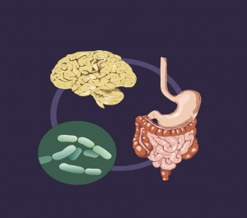
Intestinal Permeability “Leaky Gut” Uncontrolled Trafficking of Molecules
Food sensitivities
Lectins e.g. nightshades
Dysbiosis
Chronic stress
Acid suppression
SIBO
Alcohol
Environmental toxins
Medications e.g. NSAIDs & Antibiotics

Slide 30
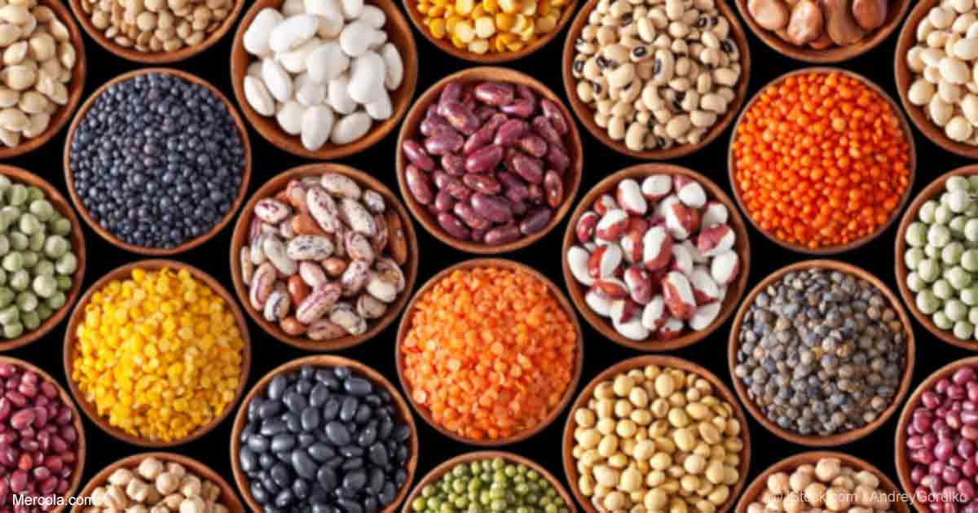
Lectins
Highly evolved plant defense proteins
Whole grains, nightshades, beans, legumes, seeded veggies, unripened fruits/veggies
Enhance gut permeability
Elicit inflammatory response
Disrupt cell signaling, receptor function, endocrine disruption
Examples include WGA, gluten, A1-beta casein
WGA mimics insulin
Additive impact with altered microbiome, stress, sleep, medications, etc.
Strong effect on inflammatory and auto-immune conditions

Slide 31
Mold - Biotoxins
Mold Exposure Risk
25 % people with genetic susceptibility
3-5 % at high risk for illness
50% homes and office buildings with water damage
An overlooked cause of chronic systemic inflammation

Slide 32
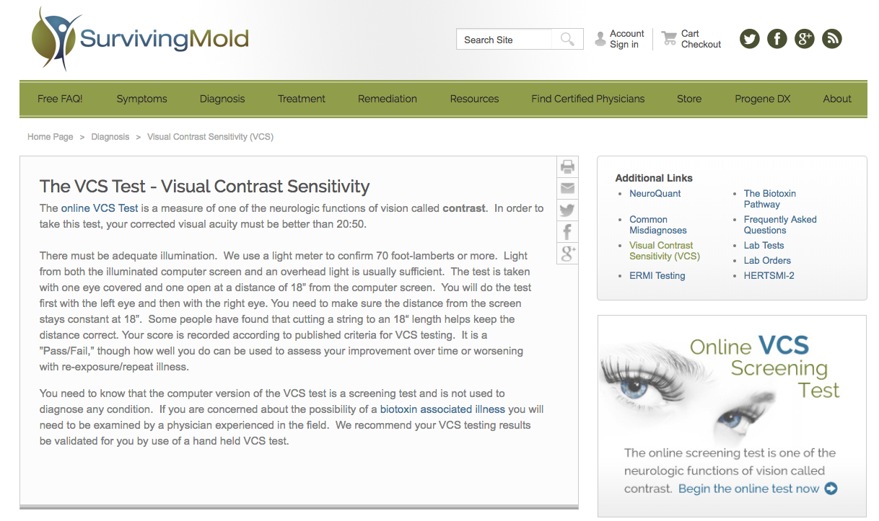
http://www.survivingmold.com/
Dr. Ritchie Shoemaker

Slide 33
hsC-REACTIVE PROTEIN
Detects hidden inflammation though says nothing of the source(s)
Inflammation is connected to every modern disease not just obvious ones such as asthma, arthritis, or infections
It is associated with heart disease, cancer, dementia, diabetes, obesity, and more.
There is a “range” of normal (ideal < 1)
CV risk factor stratification
Useful to monitor as a biomarker of inflammation in response to lifestyle changes so tracking over time is most helpful

Slide 34
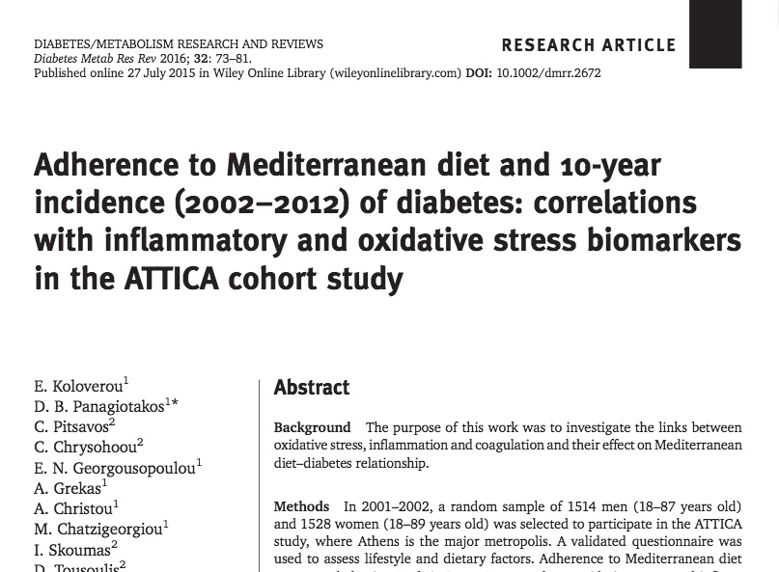
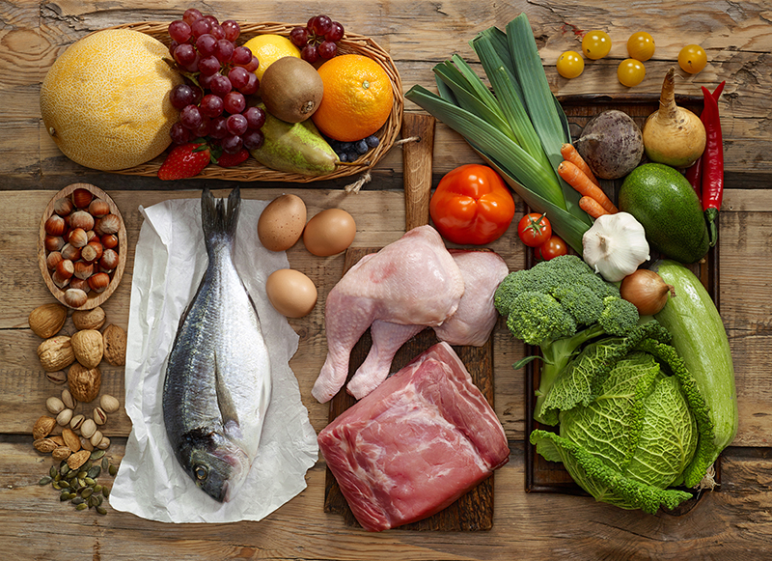

Slide 36
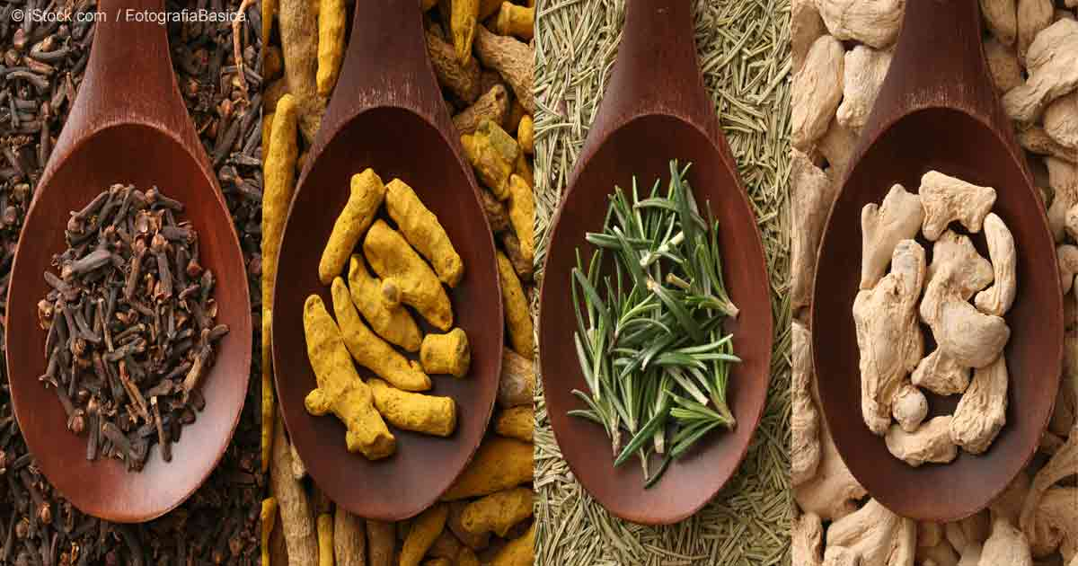
Anti-Inflammatory Spices

Slide 37
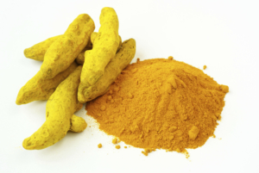
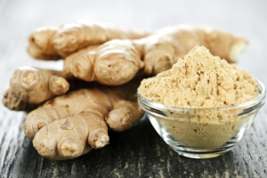
Turmeric
Ginger

Slide 38
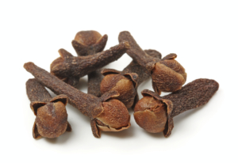
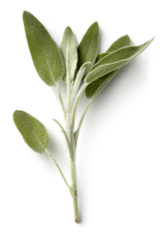
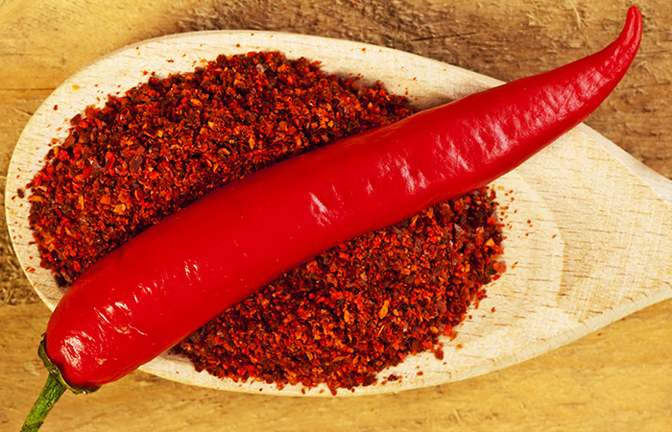
Cloves
Sage
Cayenne Pepper

Slide 39
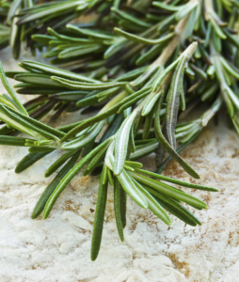
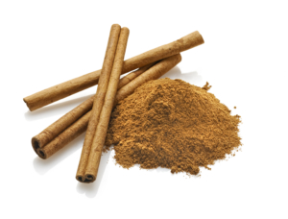
Rosemary
Cinnamon

Slide 40
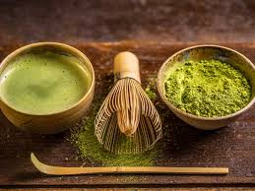
Coffee
Green tea- Matcha

Slide 41
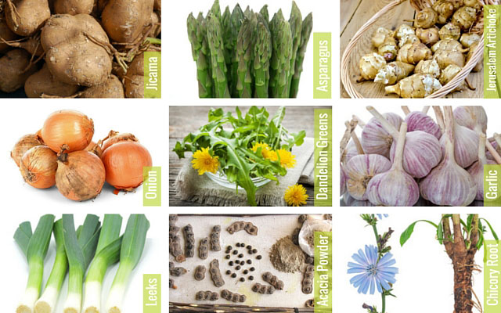
Quality High-Fiber Foods (Prebiotics)
…produce an “anti-inflammatory” gut microbiome

Slide 42
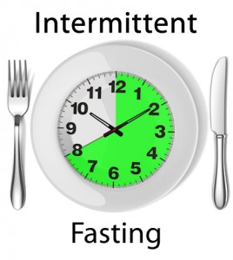
Time-Restricted Eating (TRE)
Time restricted feeding e.g. consume all food within 10-hour
Decreases in body weight and visceral fat
Significant reductions in breast cancer recurrence and improved prognosis (Patterson et al. UCSD: JAMA Oncol. 2016 August 1; 2(8): 1049–1055.)
Improved cardiovascular disease risk profile
Decreased inflammation (Biogerontology. 2015 Dec;16(6):775-88)
Decreased neuroinflammation (Neurobiol Aging. 2015 May;36(5):1914-23)
Autophagy (Autophagy, 2014;10:11, 1879-1882)
Effects of Intermittent Fasting on Health, Aging, and Disease: NEJM 381;26 December 26, 2019

Slide 43
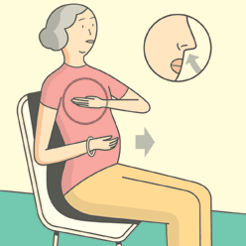
Stress Reduction and Inflammation
Many randomized controlled trials demonstrating alterations in gene expression of inflammation markers e.g. NFkB, IL-6, and C-reactive protein with meditation compared to controls (Benson et al)
Increased expression of telomerase and maintenance
of telomere length (Blackburn and Ornish)
Treatment group scored better on emotional wellness, resiliency
Positive psychology “How much better can it get”?

Slide 44
Forest Bathing
Shinrin-Yoku
Global health and quality of life improvements
Improvements in mind and mood
Grounding
Lower inflammation
www.shinrin-yoku.org
Int. J. Environ. Res. Public Health 2017, 14, 851; doi:10.3390/ijerph14080851

Slide 45
Saunas
Strong data on health promotion and disease prevention
30” minutes 3-4x/week
Steam or infrared
Stimulates our bodies defense mechanisms

Slide 46
Activity and Movement
Motion is the lotion
Aerobic, resistance, dance
Muscle as a metabolic engine
Decreased insulin resistance, decreased cortisol, increased endorphins, dopamine, and oxytocin
Enhanced strength, resilience, balance, concentration, mood
Decreased cardiovascular, diabetes, cancer risk
Longevity and quality of life profoundly enhanced

Slide 47
Loving relationships

Slide 48
An Anti-Inflammatory Lifestyle Script
Whole foods nutrition with reductions in sugar, refined grain-based flour, carbohydrate-dense foods
More healthy fats e.g. ghee, olive oil, coconut oil, nuts, avocados, grass-fed-organic dairy, fatty fish, eggs (yolks are best); pasture-raised meats and dairy
Plant-based fermentable fiber for the microbiome and nutrient density
Elimination trial e.g. gluten, wheat, dairy, refined grains, sugar, alcohol
Intermittent fasting or time-restricted feeding: 10-hour eating window
Liberal outdoor, full-spectrum light exposure i.e., Vitamin N
Sauna
Motion is the lotion!
Stress management e.g. yoga, tai chi, music, breath, meditation
Connection with others: we are born to bond !
Consider evaluation for mold in environment
Love yourself and others
Positive beliefs-thoughts
Notes:
(Stephanie Senef PhD: Entropy 2012, 14, 2265-2290; doi:10.3390/e14112265) GMO

Slide 49
Thank you.

