Slide 1
Men’s Health: Celebrating a Future of Possibility
Mark C Pettus MD, FACP
June 21, 2022
Associate Professor of Medicine
University of Massachusetts Medical School

Slide 2
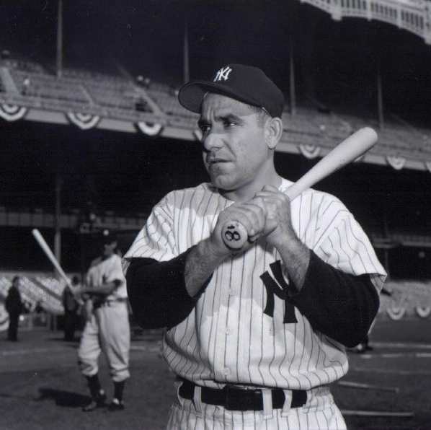
“The future ain’t what it used to be.”
Yogi Berra

Slide 3
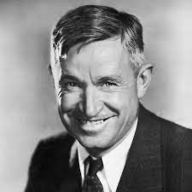
“It’s not what we don’t know that gets us into trouble. It’s what we know that ain’t so.”
Will Rogers

Slide 4
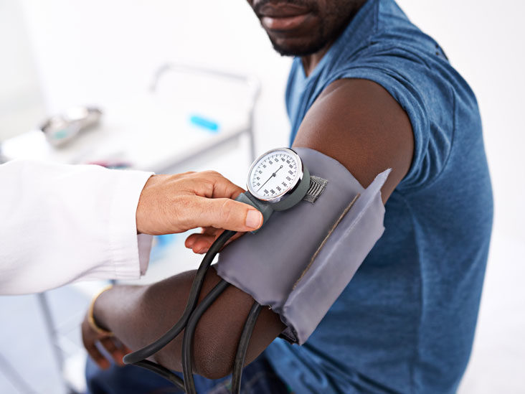
Points of Emphasis
Review the concept of metabolic health
Understand how diminished metabolic health drives all age-related diseases, erectile dysfunction, poor health span and reductions in longevity.
Explore the difference between chronologic age and biologic age
Explore the research linking powerful lifestyle medicine science with metabolic health.
The Turning Point !

Slide 5
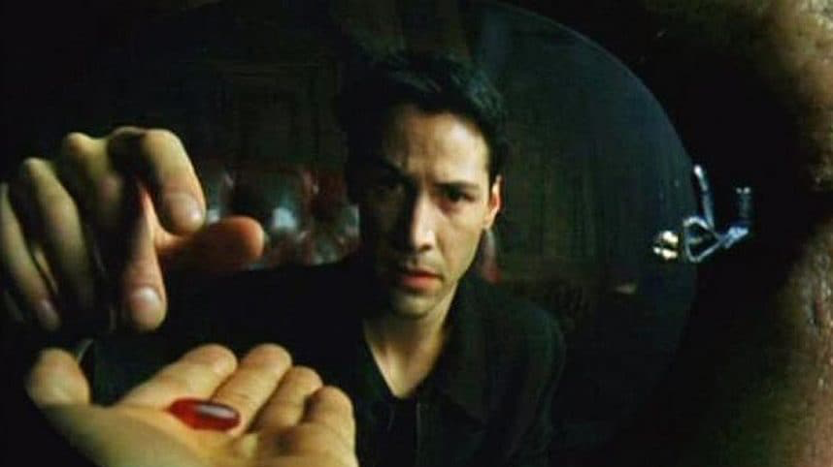

Slide 6
Healthspan
Notes:
Rectangularize the health curve
Healthspan…organ reserve

Slide 7
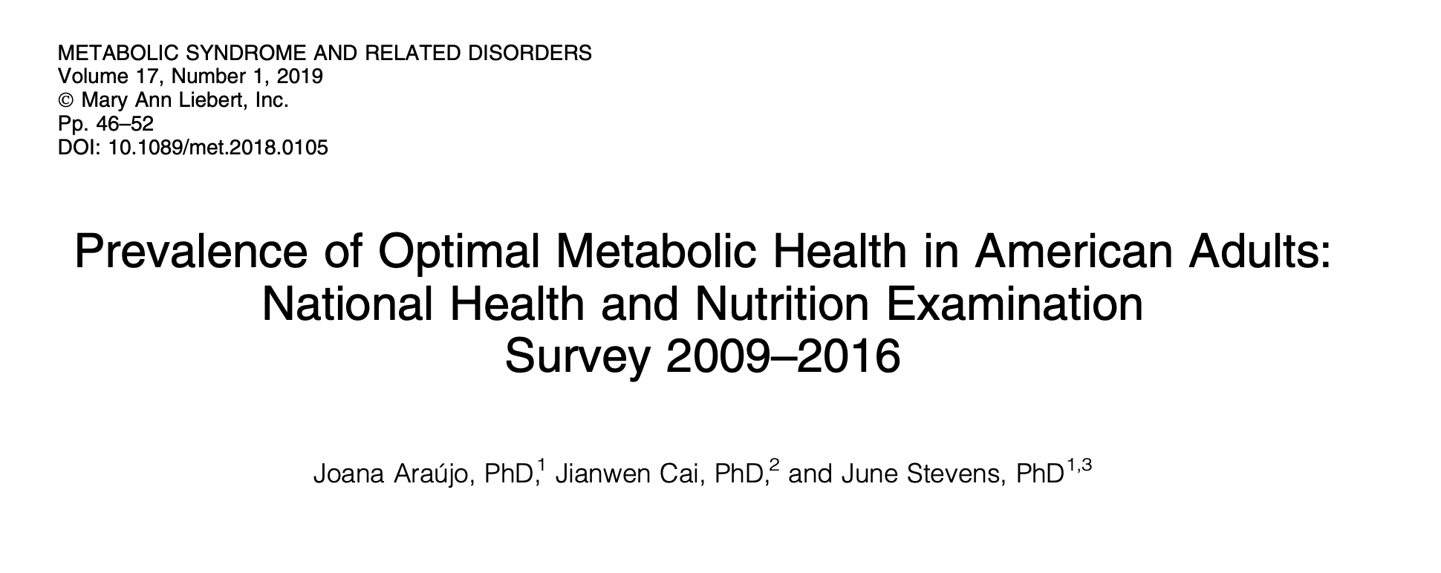
8721 individuals
Metabolic Health: Waist circumference < 40”; BP 120/80 or less;
FBS < 100; HbA1c < 5.7; TGA/HDL ratio < 3; No Meds
12.2% individuals met all criteria
Disrupted metabolic health greatly accelerates aging, reduces longevity and shrinks health span.

Slide 8
Epigenetic Science:
How we age

Slide 9
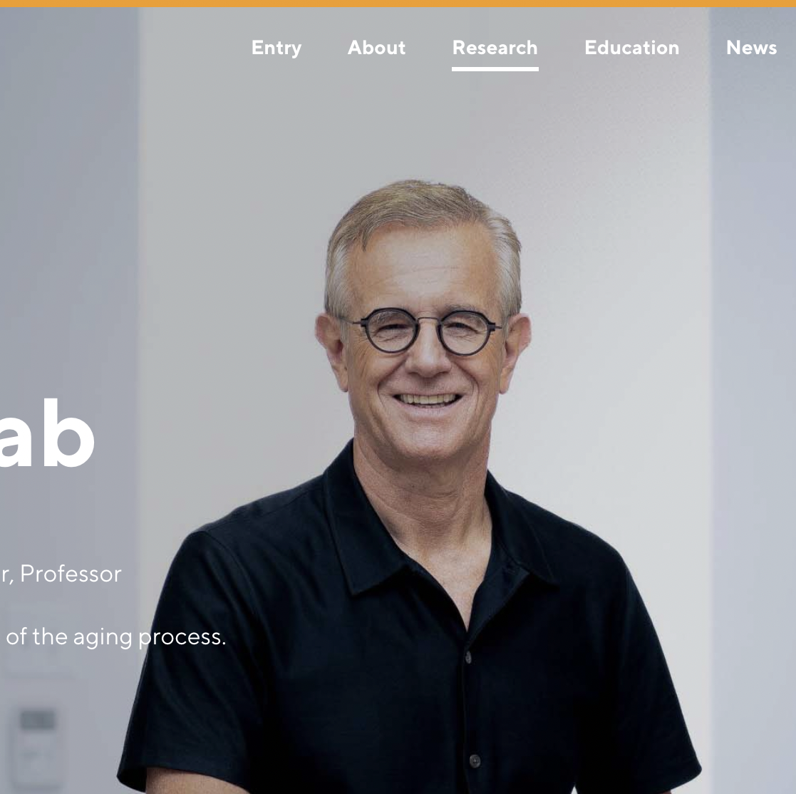
Lifestyle and Longevity
…nature via nurture
“Less than 10% of what contributes to longevity can be traced to genetic dterminism. Over 90% of what contributes to health span and lifespan is lifestyle.”
SALT NY 10-3-2021
Eric Verdin MD
President and CEO, Buck Institute

Slide 10
Epigenetics
Lifestyle/Environment
Food quality
Movement
Sleep quality
Stress load
Trauma
Circadian rhythm
Love and connection
Meaning and purpose
Natural light/time outdoors
Beliefs-thoughts
Socioeconomics
Education
Life
Metabolic
Health
Longevity
Health span
Resilience
Gene Expression
Microbiome
Consciousness-Energy

Slide 11
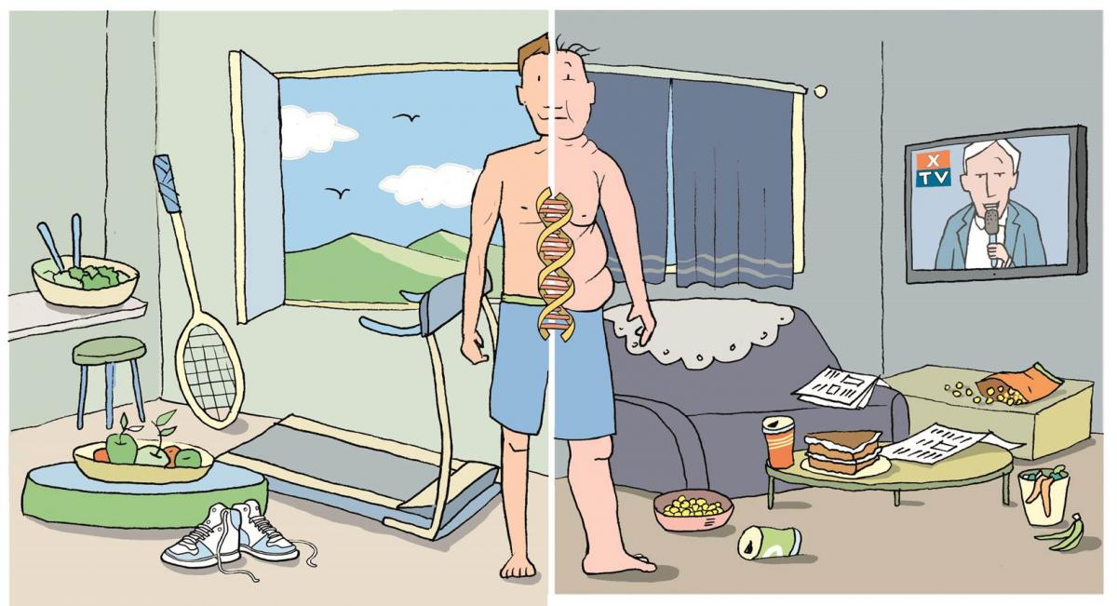
Epigenetic Reprogramming

Slide 12
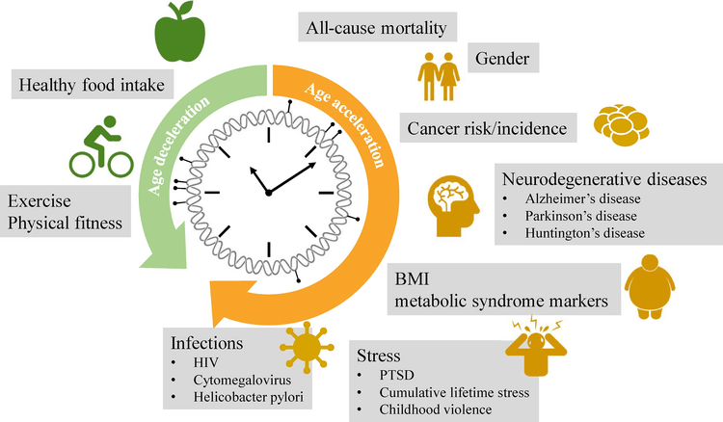
Back to the future: Epigenetic clock plasticity towards healthy aging
January 2018 Mechanisms of Ageing and Development DOI:10.1016/j.mad.2018.01.002

Slide 13
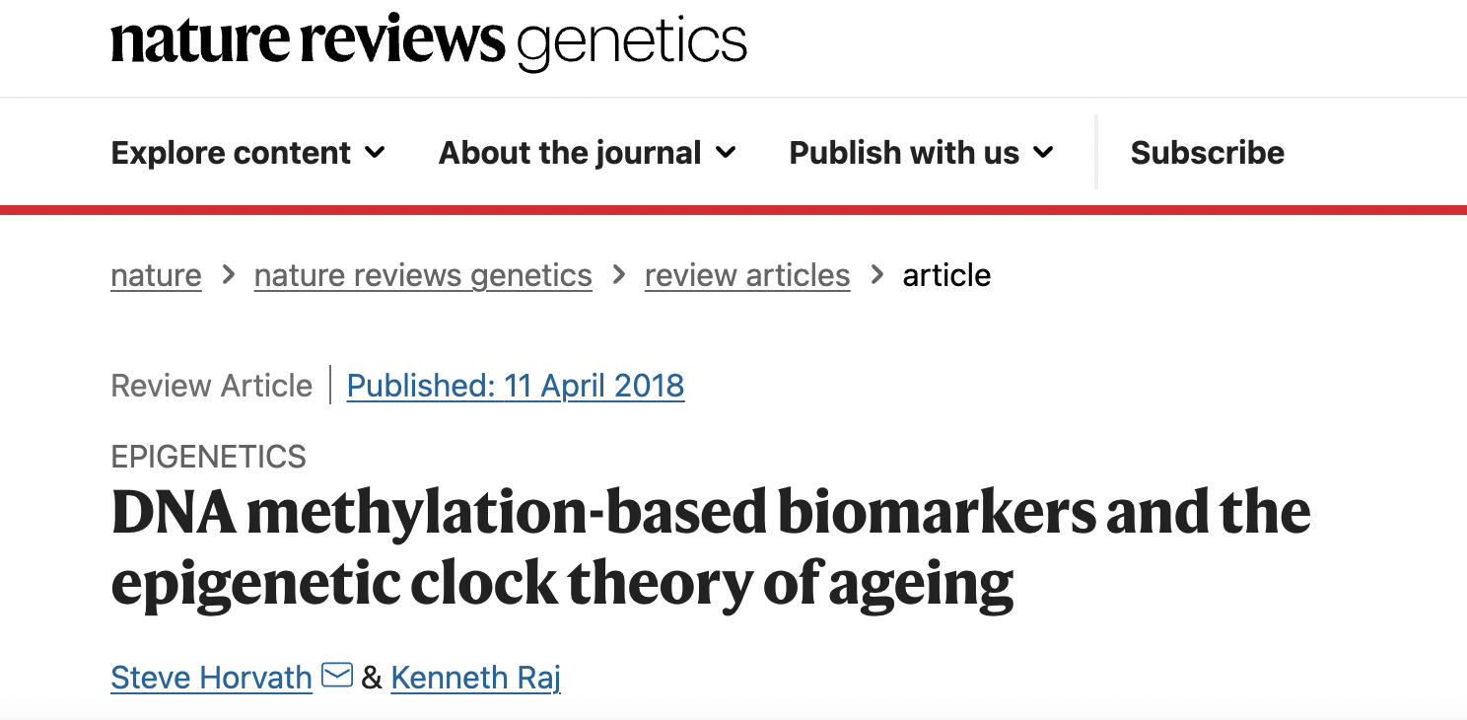

Slide 14
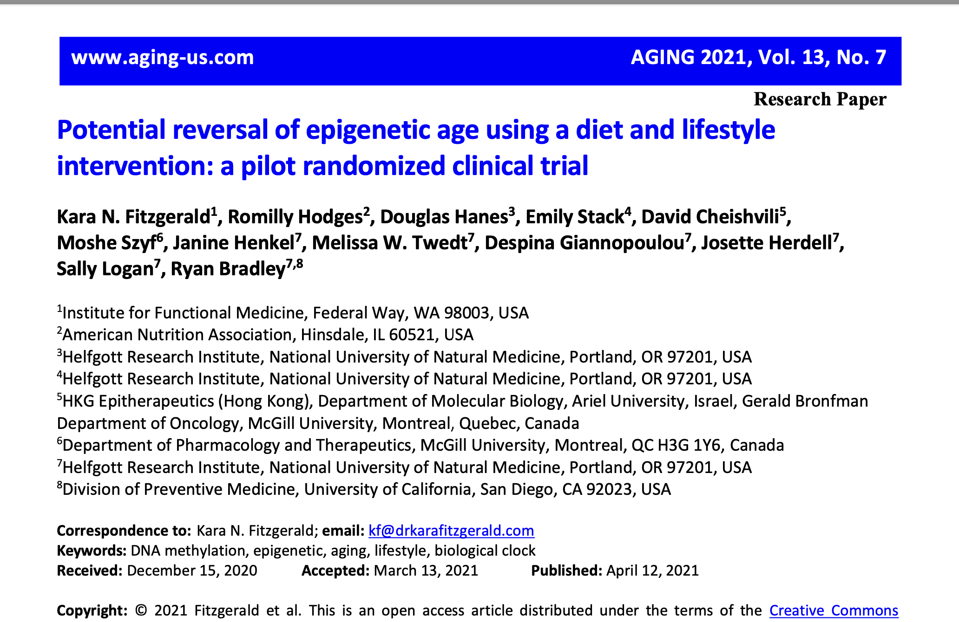

Slide 15
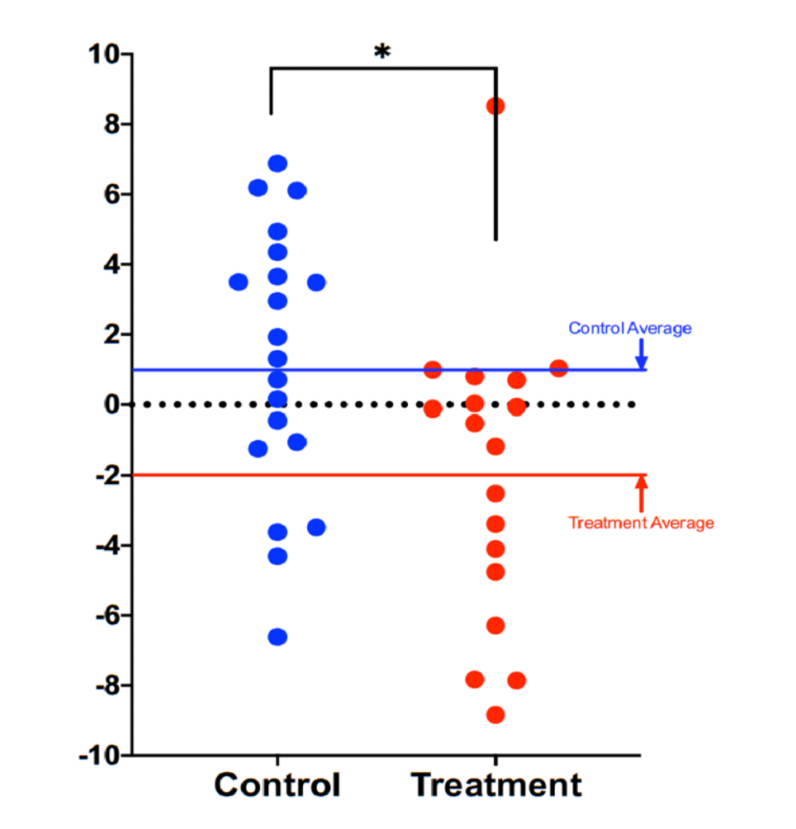
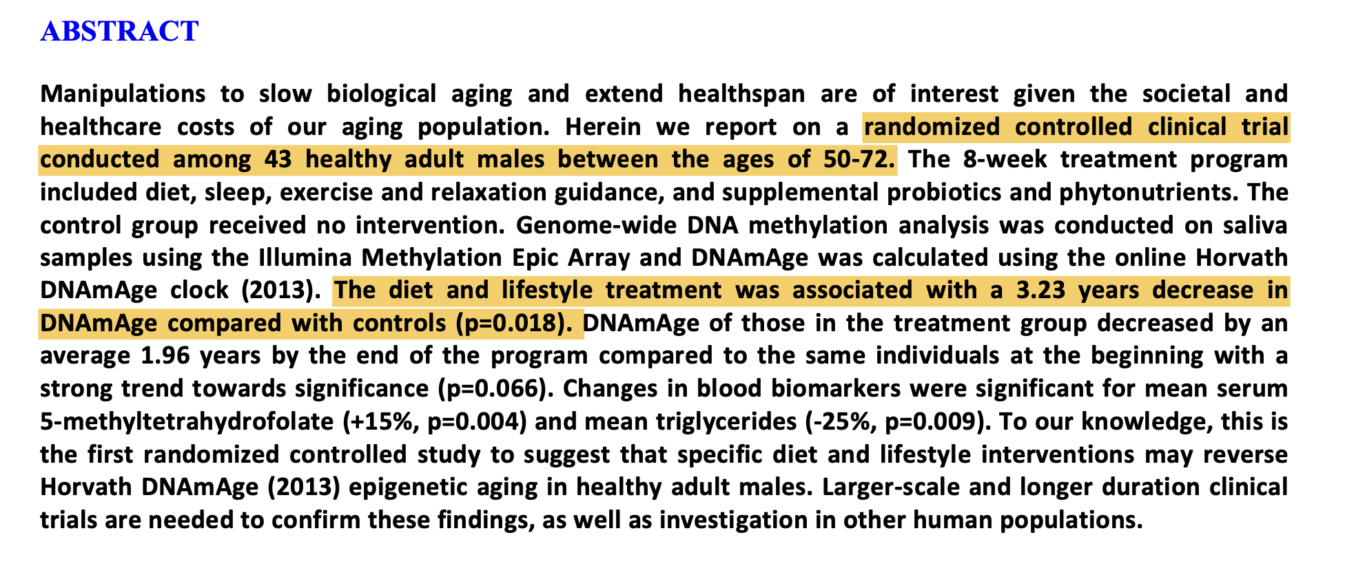

Slide 16
Is the choice I am about to make familiar with what my stone-age roots would recognize?

Slide 17
Courtesy Loren Cordain PhD

Slide 21
Reduce poor quality, processed, carbohydrate-dense foods
Added Sugar
Grain-based flour e.g. breads, cereal grains, pasta, pastries, desserts, bagels, chips, pretzels, granola bars.
Whole grains are still high-glycemic
Gluten-Free food options
Dried fruits e.g. raisins, apricots, cherries
Sweetened soft drinks
Beer is liquid bread
Lowered insulin and reduced inflammation “unlock” fat burning
All Carbs
Low
Glycemic

Slide 22
www.dietdoctor.com

Slide 23
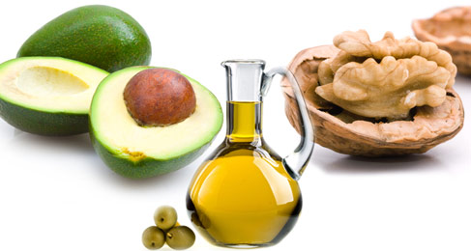
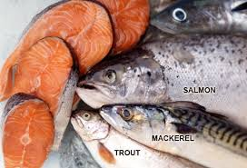
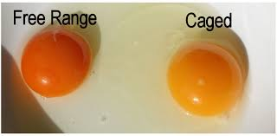
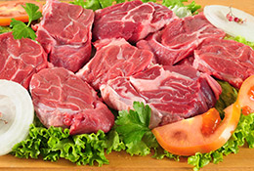
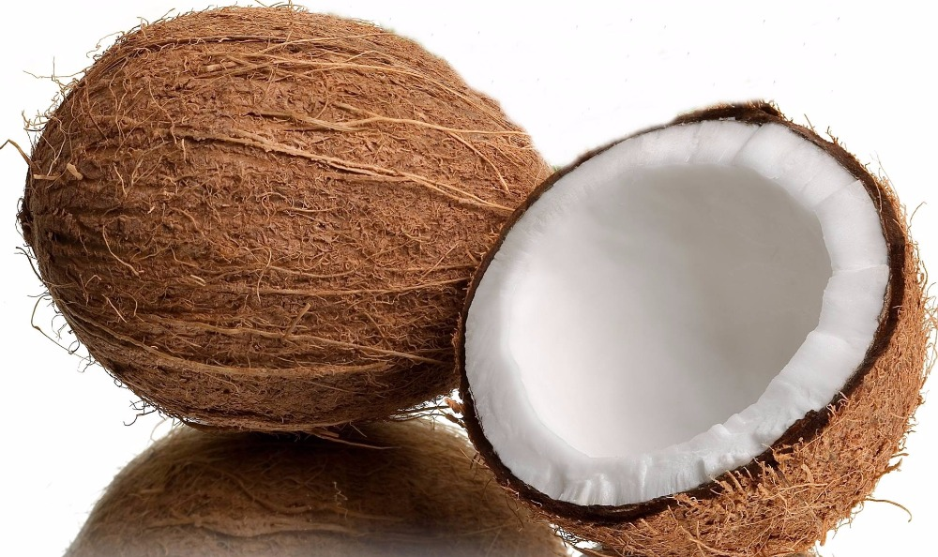
More quality fat sources
Pasture-raised eggs
Fatty fish e.g. salmon, sardines, mackerel
Grass-fed butter
Ghee
Pasture-raised meats
Shellfish
Whole fat yogurt, kefir
Extra virgin olive oil
Extra virgin coconut oil
Avocados, olives
Nuts - almonds, macadamia, walnuts

Slide 24
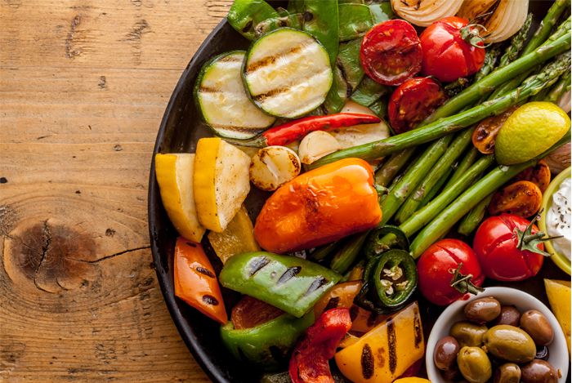
Plant-based foods
Fill half of plate with vegetables
2 cups greens/day is a nice goal
Cruciferous e.g. broccoli, cauliflower, collards, cabbage, kale, spinach, asparagus, romaine lettuce, arugula
Allium family e.g. onions, leeks, garlic
Beans and lentils
Lower glycemic fruits e.g. berries, grapefruit, kiwi
Anti-inflammatory spices e.g. turmeric, basil, ginger, rosemary, cayenne pepper
Fermentable Fiber essential for gut biome diversity
Fermentable foods e.g. yogurt, sauerkraut

Slide 25
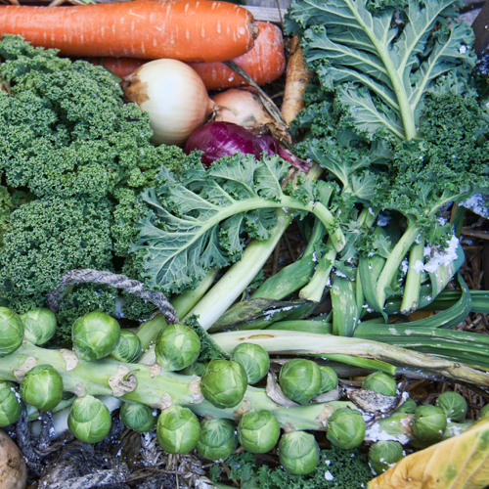
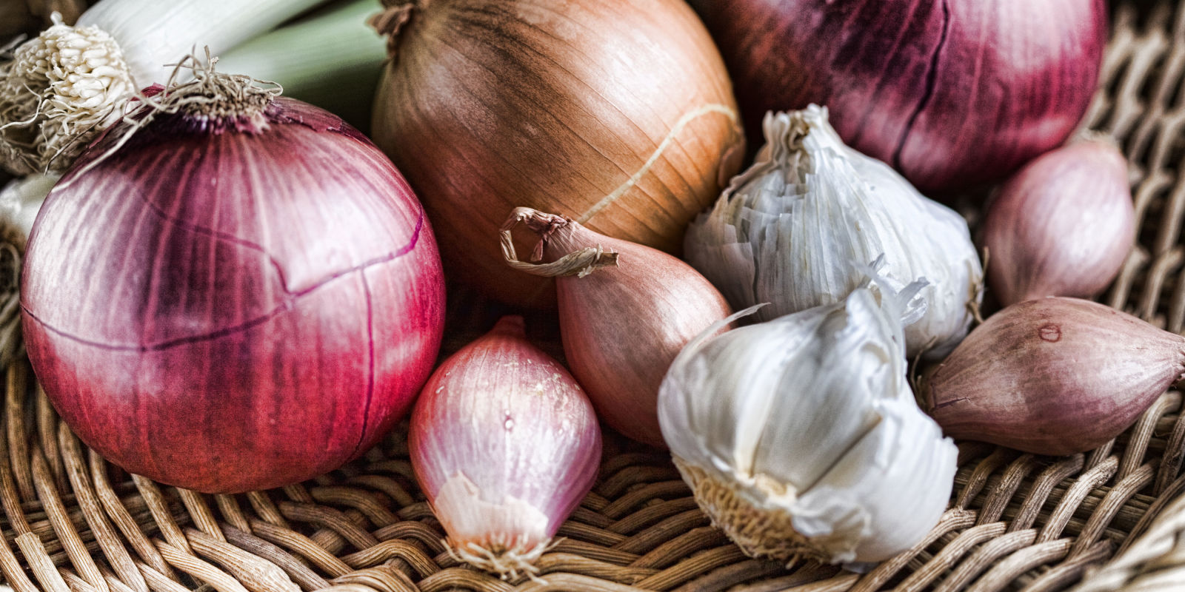
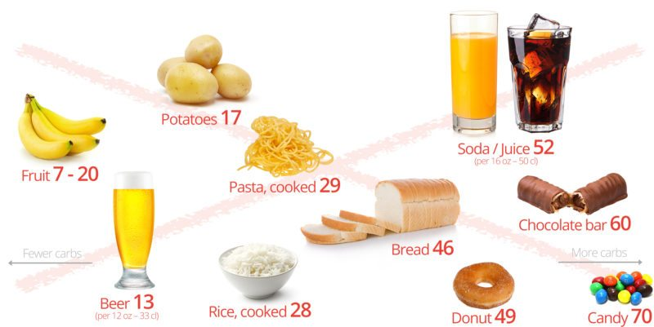
Sugar, Fructose and High-Glycemic Processed Grains
High-Quality Plant-Based Carbs
Oral and Gut
Microbiome
Inflammation
Neurotransmitter disruption
Insulin Resistance
Weight and Metabolism
Mitochondria-Oxidative stress
HPA axis –Stress Response
Protection from:
Inflammation
Diabetes
Cancer
Obesity

Slide 26
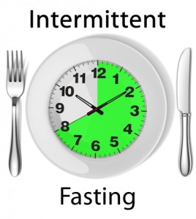
Time-Restricted Eating (TRE)
Time restricted feeding e.g. consume all food within 10-hour
Decreases in body weight and visceral fat
Significant reductions in breast cancer recurrence and improved prognosis (Patterson et al. UCSD)
Improved cardiovascular disease risk profile
Decreased inflammation
Decreased neuroinflammation
Autophagy, your ability to recycle

Slide 27
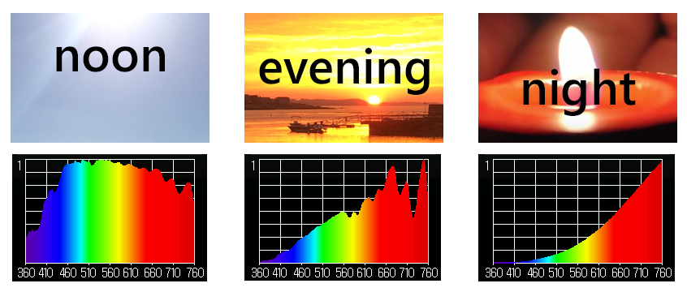
Circadian Rhythms

Slide 28
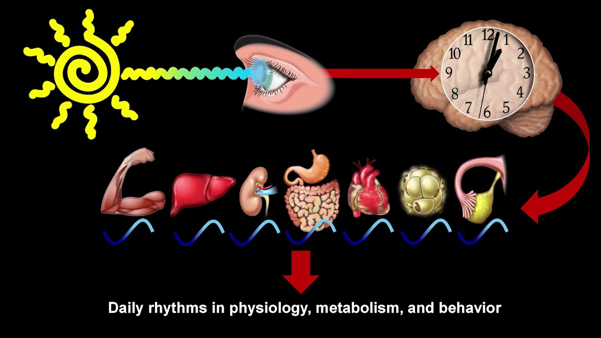
Satchin Panda PhD, The Salk Institute

Slide 30
Motion is the Lotion
Walk continuously and target 30”/day
Be efficient with exercise dose-response e.g. small doses of higher intensity
Resistance with emphasis on core e.g. 20” 3x/week
Dance to the music you love!
The Holy Grail from a disease risk-reduction perspective
Prolonged sitting is dangerous and not “undone” with regular exercise
Improved mood, resilience, less pain, less inflammation, improved insulin sensitivity, decreased anxiety

Slide 31
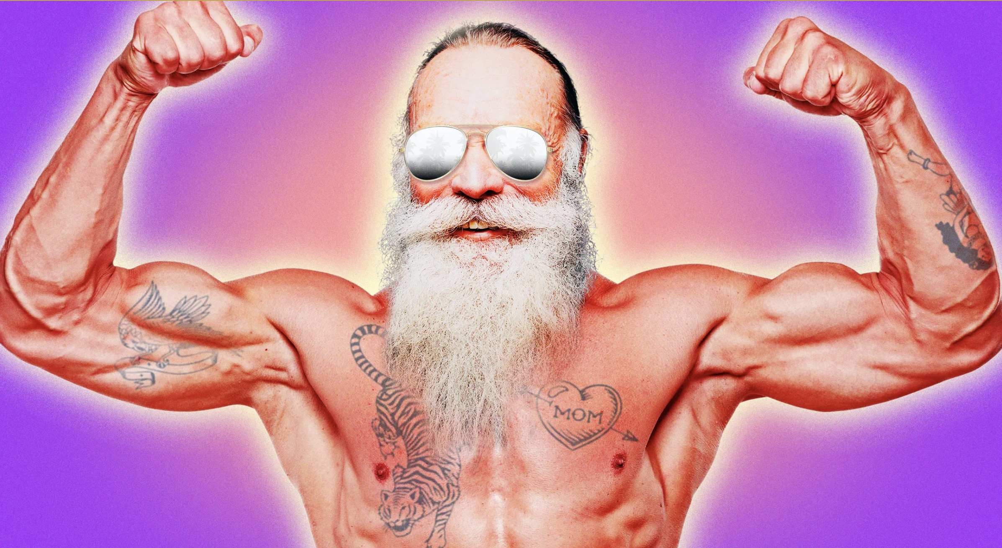
Testosterone
Whole foods, lower in high glycemic carbs and higher in healthy fats
Intermittent Fasting
HIT, resistance exercise
Circadian rhythm
Stress management

Slide 32
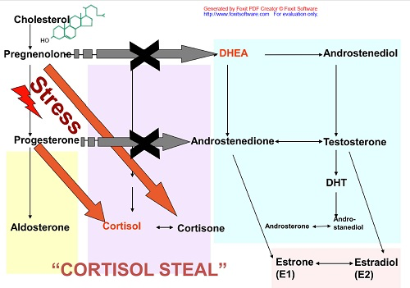

Slide 33
Embracing the moment you are in: The Power of the “Pause”
Mindfulness practices powerfully proven to reduce disease risk
Epigenetic effects shown to reduce inflammation, improve insulin sensitivity
Improved mood, resilience, reduced anxiety
Improved performance, creativity and problem-solving capacity
MBSR, meditation, prayer, yoga, journaling, tai chi

Slide 35
Forest Bathing
Shinrin-Yoku
Global health and quality of life improvements
Improvements in mind and mood
Lower inflammation and improved immunity
www.shinrin-yoku.org

Slide 36
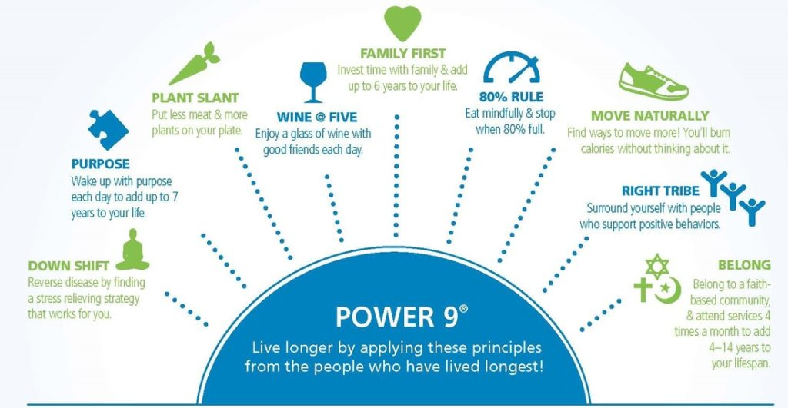

Slide 37
Look under the hood:
Know your numbers!
Fasting Blood Sugar (< 100)
HOMA IR a test of Insulin Resistance (< 1ideal)
Uric acid (< 5.5 ideal)
Hemoglobin A1c, less than 5.7 ideal
LDL particle #, cardiovascular risk
ApoB, cardiovascular risk
Vitamin D, want to be > 30
hsCRP, a measure of inflammation; < 1 is ideal
Triglycerides < 150, lower is ideal
Triglyceride/HDL ratio <2 ideal
Total and free testosterone levels (want to be at-above 50th percentile

Slide 38
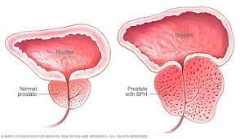
Prostate Health
3 out of 4 men > 60 years of age experience signs and symptoms of BPH, benign prostatic hypertrophy. This causes slower urinary stream, increased frequency of urination and urgency as the bladder does not fully empty.
1/7 men are at risk for prostate cancer over their lifetime. Risk is higher with a positive family history and in African Americans.
Currently, the USPSTF advises that in men aged 55 to 69 years, the decision of whether or not to undergo screening should be individualized. This is a grade C recommendation, meaning that there is at least moderate certainty that the net benefit is small. For men aged 70 years and older, the USPSTF recommends against PSA-based screening for prostate cancer.

Slide 40
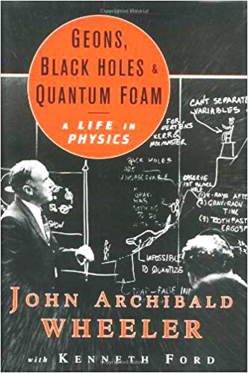
“It from bit symbolizes the idea that every item of the physical world has at bottom…an immaterial source and explanation…that all things physical are information-theoretic in origin and that this is a participatory universe”
John Archibald Wheeler
Notes:
﻿“Everything is Particles” evolved to “Everything is Fields” which eventually evolved to “Everything is Information”.
Virk, Rizwan. The Simulation Hypothesis: An MIT Computer Scientist Shows Why AI, Quantum Physics and Eastern Mystics All Agree We Are In a Video Game . Bayview Books. Kindle Edition.

Slide 41
Consciousness – Our Perceptions Create Our Reality
Mind
Perceptions-Beliefs
Thoughts
Emotions
Brain
Body-Life Experience
Notes:
Henry Ford quote: “Whether you believe you can or cannot, you are right”.

Slide 42
The Quantum-Consciousness Roadmap
Follow that which ignites your passion, that which creates meaning in your life
Take it as far as you possibly can to the best of your ability
Attach no expectations or insistence on the outcome
The more positive one’s interpretation and response to whatever outcome emerges, the greater the likelihood of your experiences “providing you” with what you need to learn and to evolve physically, mentally, emotionally and spiritually.
Go with the flow of synchronicity…..ride the wave.

Slide 44
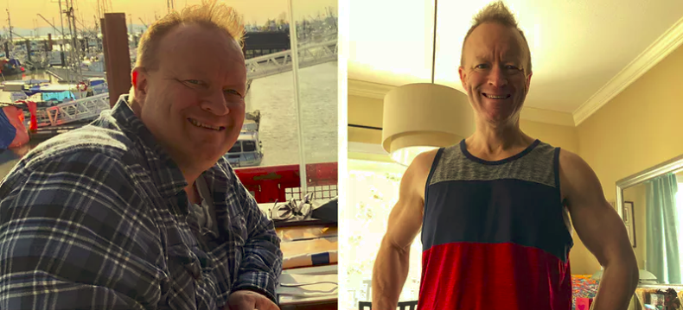

Slide 45
Thank You!

