Slide 1
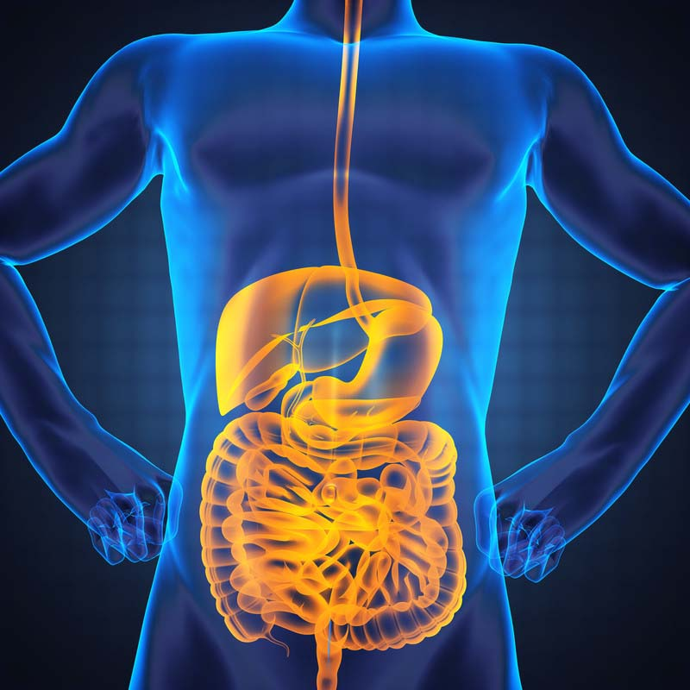
Key Microbiome Populations for Improved Clinical Outcomes John Bagnulo MPH, PhD

Slide 3
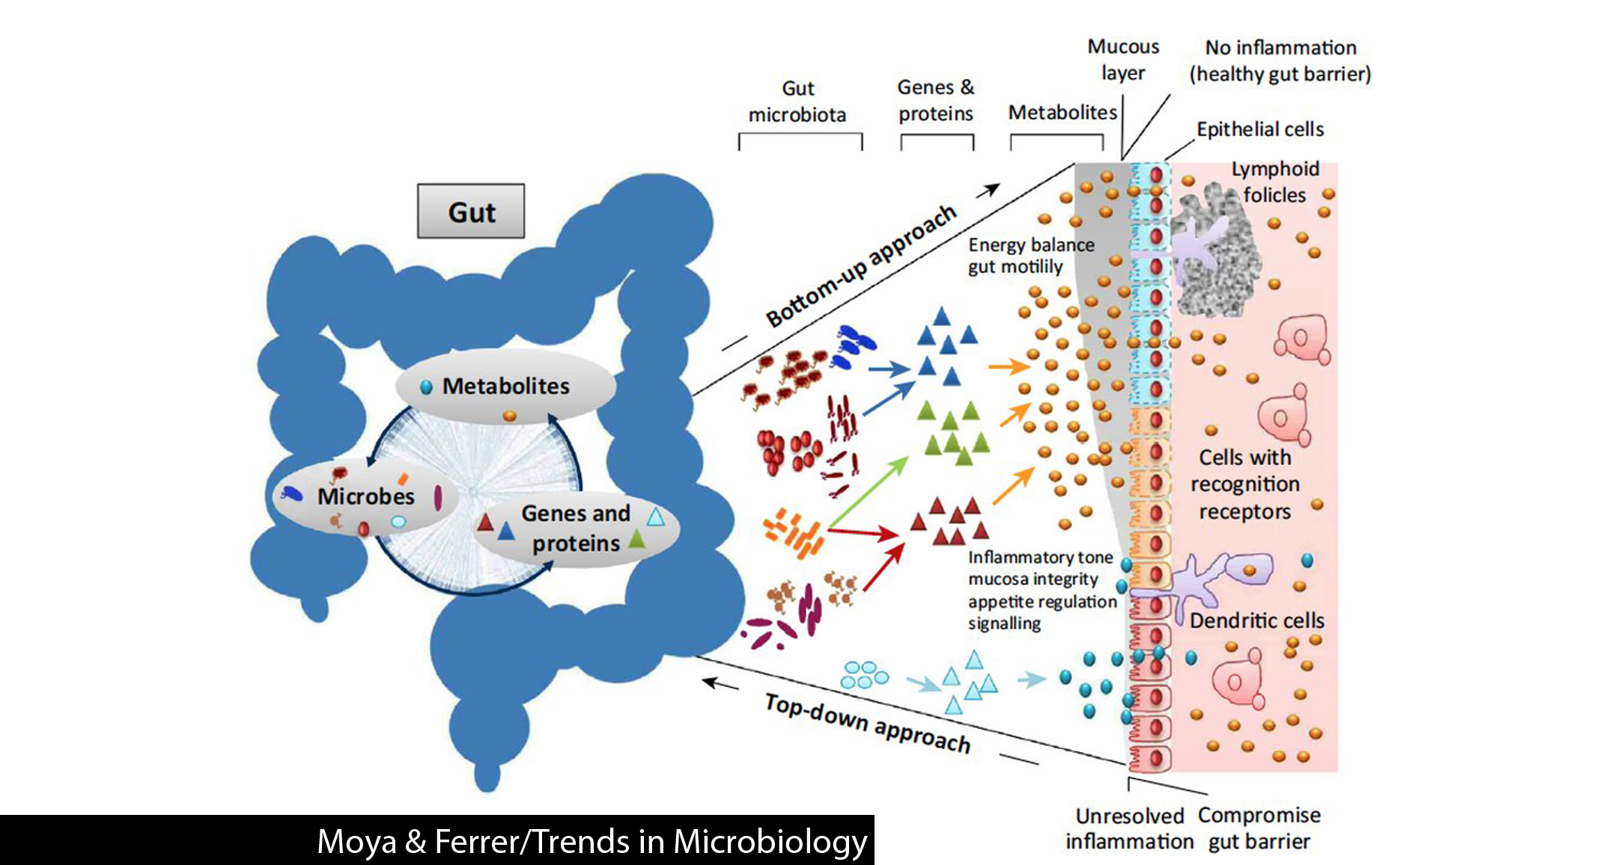
DeGruttola AK, Low D, Mizoguchi A, Mizoguchi E. Current Understanding of Dysbiosis in Disease in Human and Animal Models. Inflamm Bowel Dis. 2016;22(5):1137–1150.
Rinninella E, Raoul P, Cintoni M, et al. What is the Healthy Gut Microbiota Composition? A Changing Ecosystem across Age, Environment, Diet, and Diseases. Microorganisms. 2019;7(1):14. Published 2019 Jan 10. doi:10.3390/microorganisms7010014

Slide 4
Strains composing the RePOOPulate consortium.
Composition of Stool Substitute (RePOOPulate)
Acidaminococcus intestinalis
Bacteroides ovatus
Bifidobacterium adolescentis (two different strains)
Bifidobacterium longum (two different strains)
Blautia producta
Clostridium cocleatum
Collinsella aerofaciens
Dorea longicatena (two different strains)
Escherichia coli
Eubacterium desmolans
Eubacterium eligens
Eubacterium limosum
Eubacterium rectale (four different strains)
Eubacterium ventriosum
Faecalibacterium prausnitzii
Lachnospira pectinoshiza
Lactobacillus casei/paracasei
Lactobacillus casei
Parabacteroides distasonis
Raoultella sp.
Roseburia faecalis
Roseburia intestinalis
Ruminococcus torques (two different strains)
Ruminococcus obeum (two different strains)
Streptococcus mitis
Petrof EO, Gloor GB, Vanner SJ, et al. Stool substitute transplant therapy for the eradication of Clostridium difficile infection: 'RePOOPulating' the gut. Microbiome. 2013;1(1):3. Published 2013 Jan 9.

Slide 5
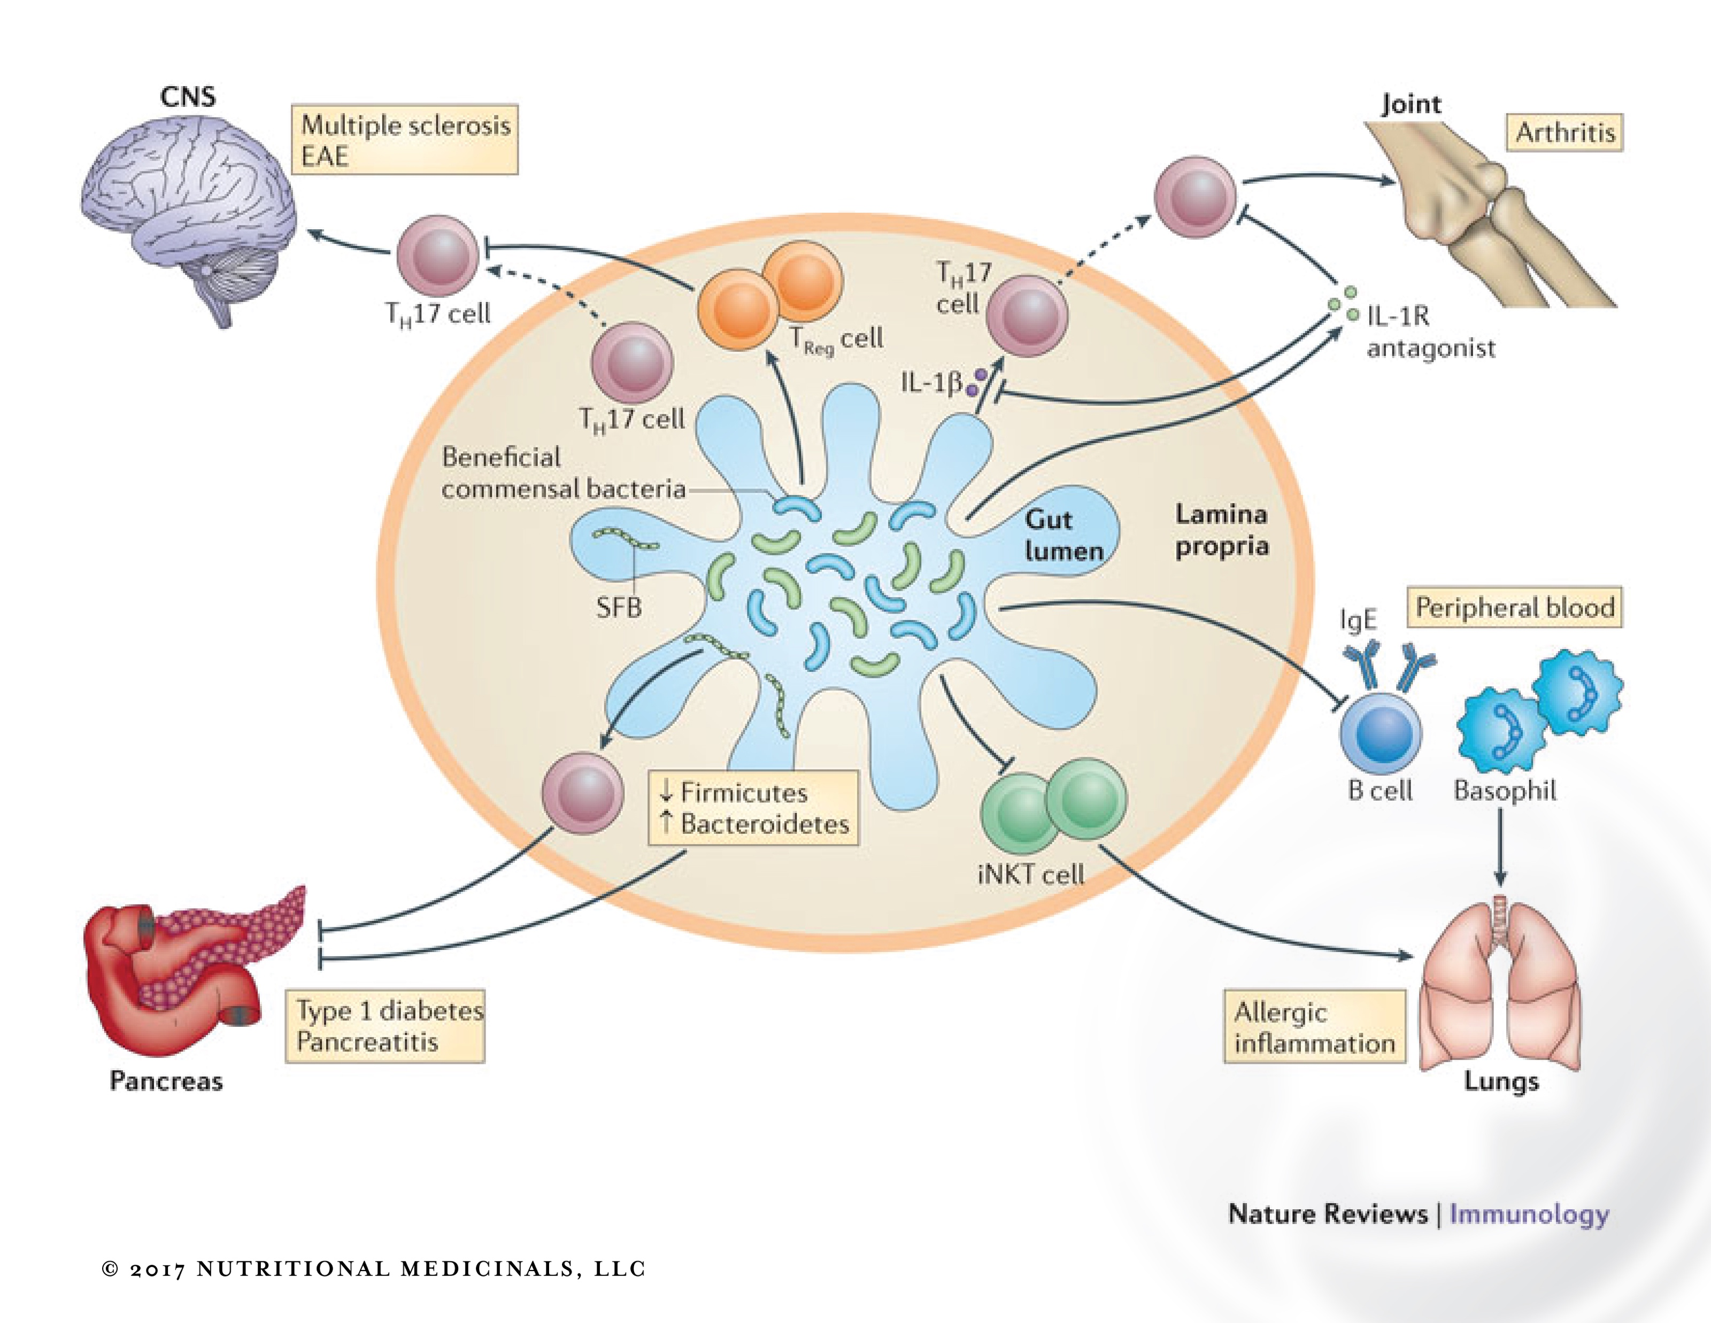

Slide 6
Are there specific families of microbes that we can now see as essential difference makers?
Protective/Favorable
Higher levels of these species Associated with higher risk
Akkermansia
Bacteroides fragilis
Bifido species (longum, infantis, brevis, animalis)
Faecalbacterium Prausnitzii
Ruminococcus bromii
Roseburia
Desulfovibrio
Clostridiales
Citrobacter
Klebsiella

Slide 7
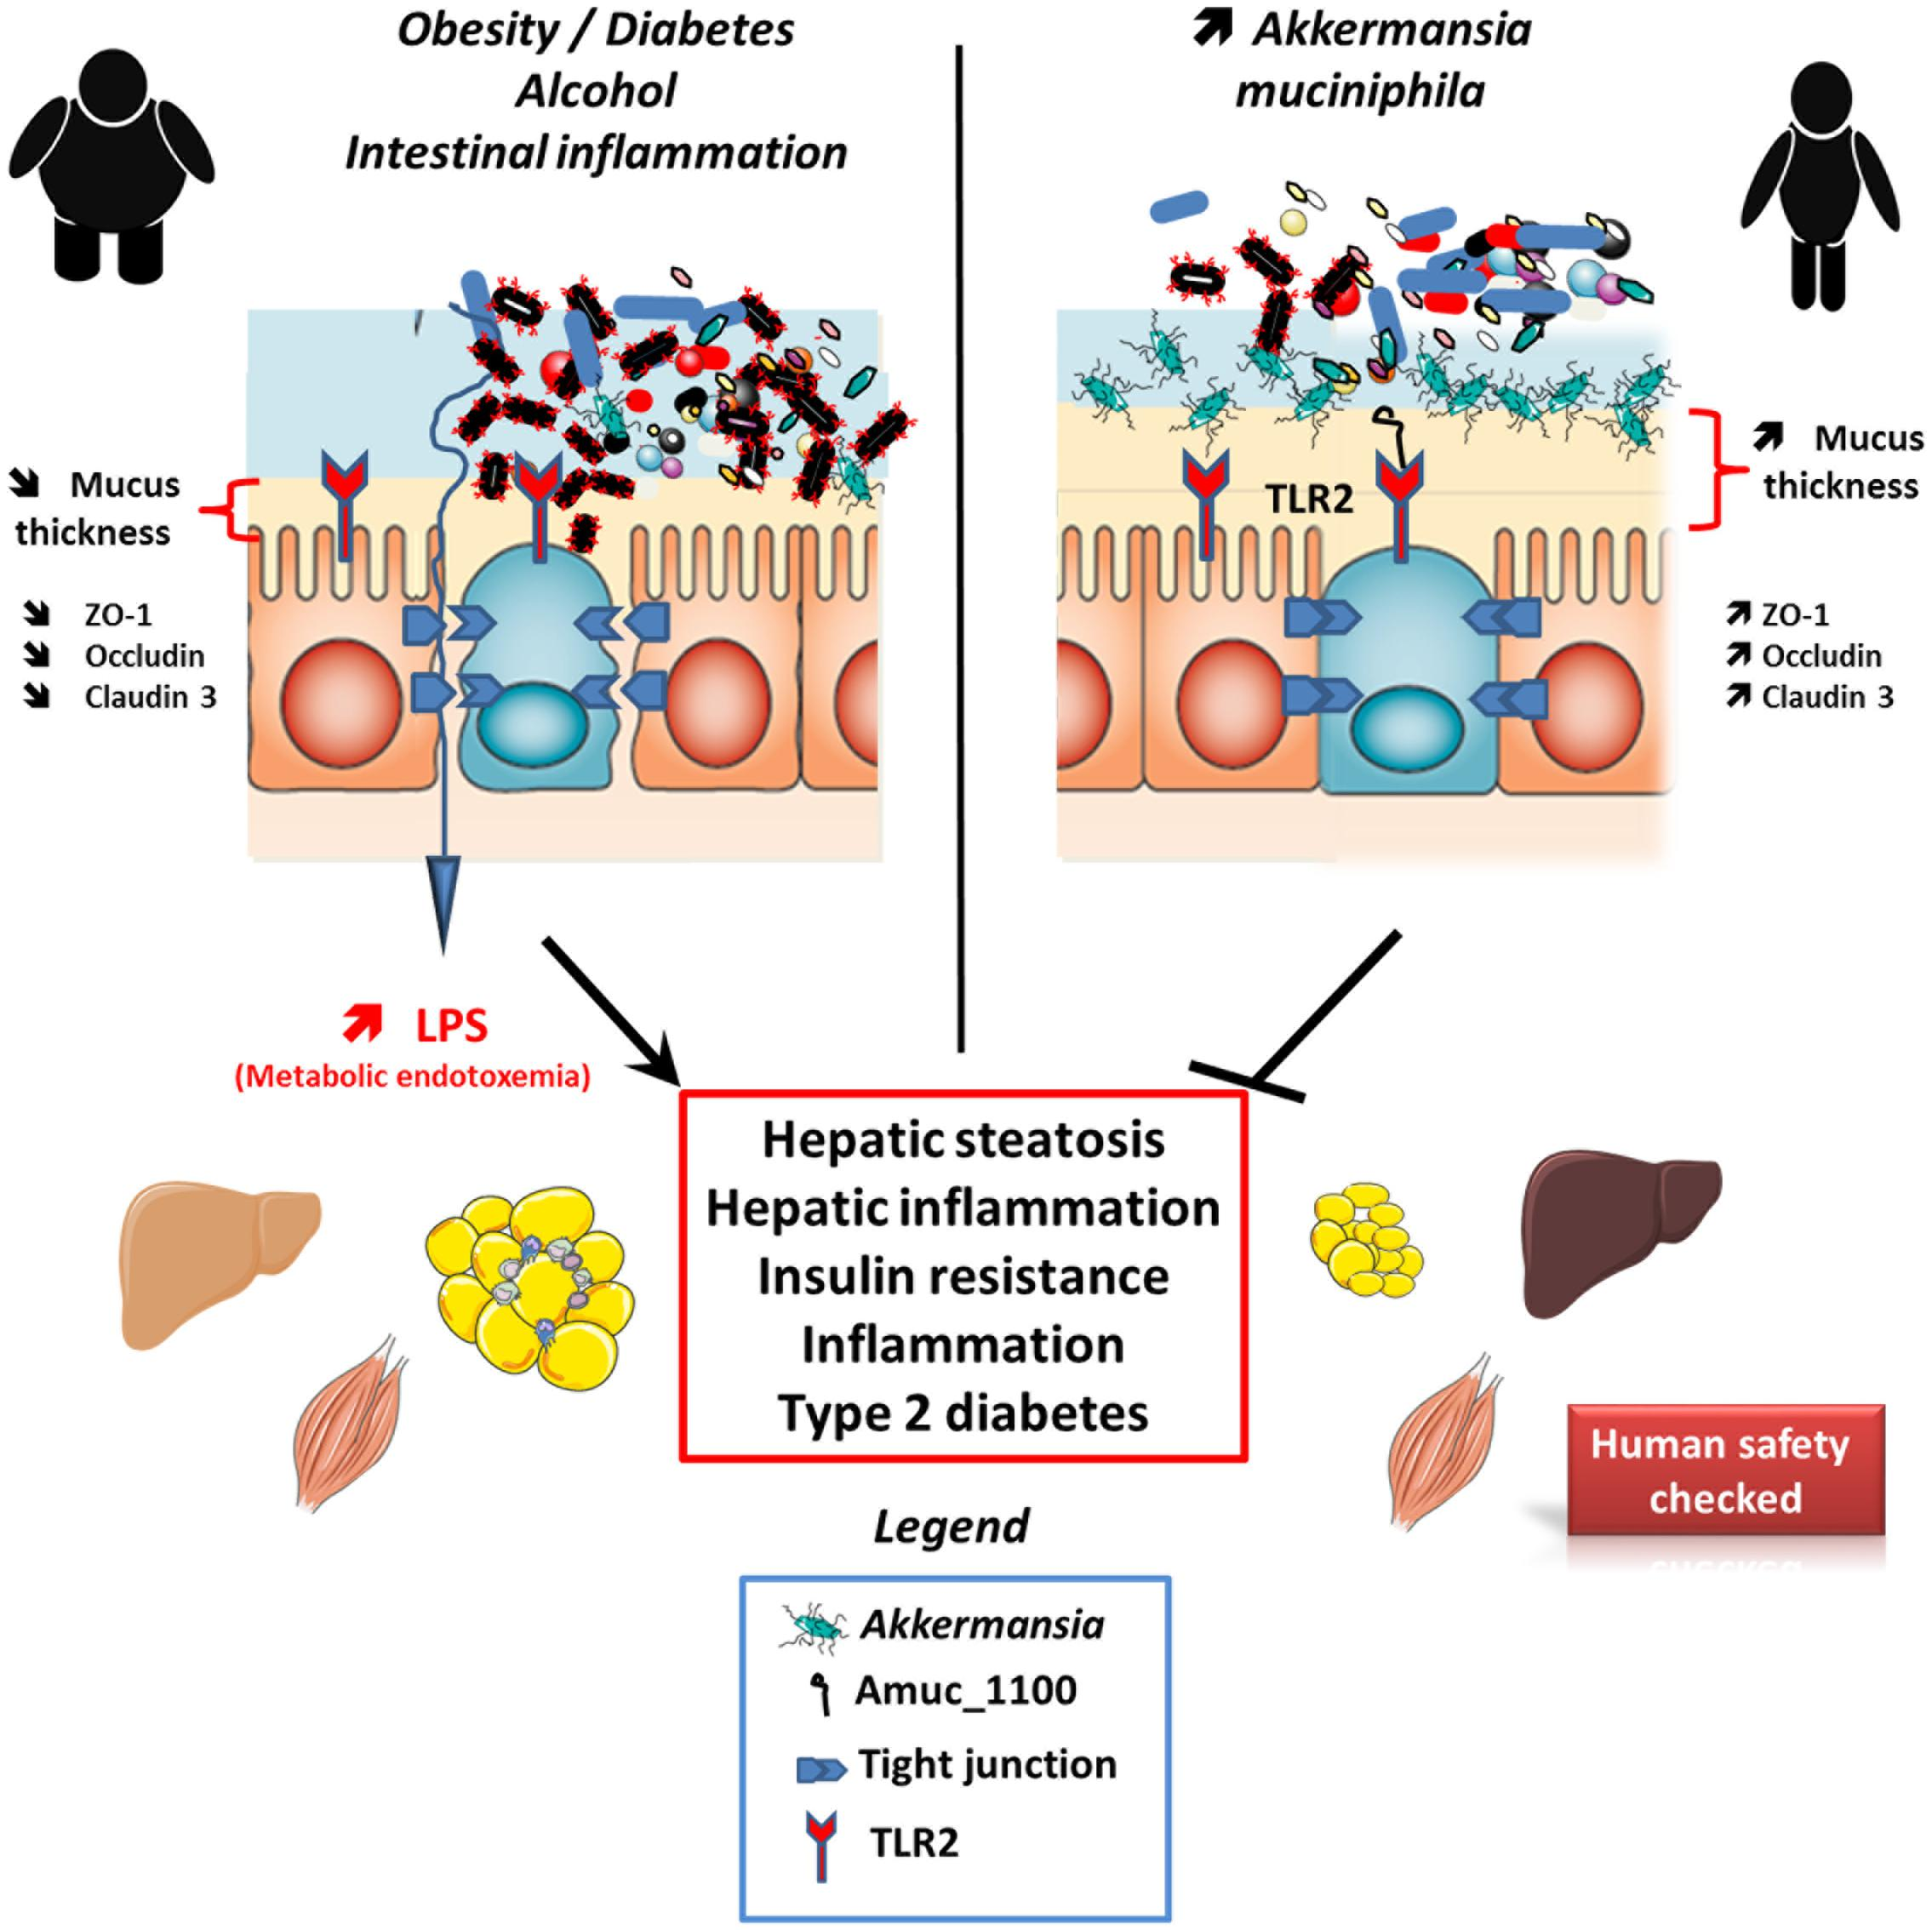
Cani PD, de Vos WM. Next-Generation Beneficial Microbes: The Case of Akkermansia muciniphila. Front Microbiol. 2017;8:1765. Published 2017 Sep 22. doi:10.3389/fmicb.2017.01765

Slide 8
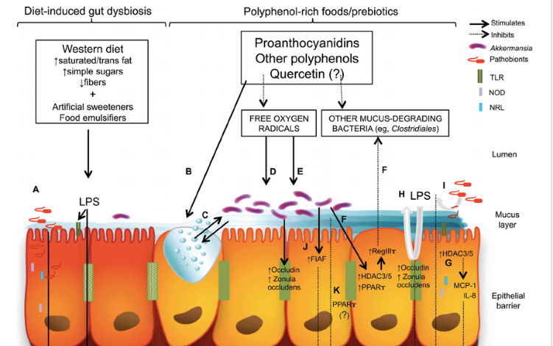
Forato Anhê, Fernando & Varin, Thibault & Le Barz, Mélanie & Desjardins, Yves & Levy, Emile & Roy, Denis & Marette, André. (2015).
Gut Microbiota Dysbiosis in Obesity-Linked Metabolic Diseases and Prebiotic Potential of Polyphenol-Rich Extracts. Current Obesity
Reports. 4. 10.1007/s13679-015-0172-9.

Slide 9
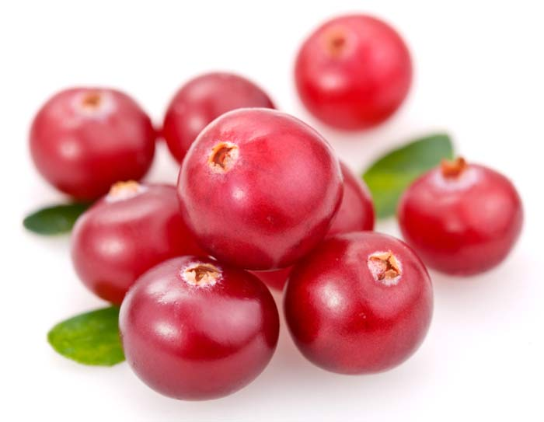
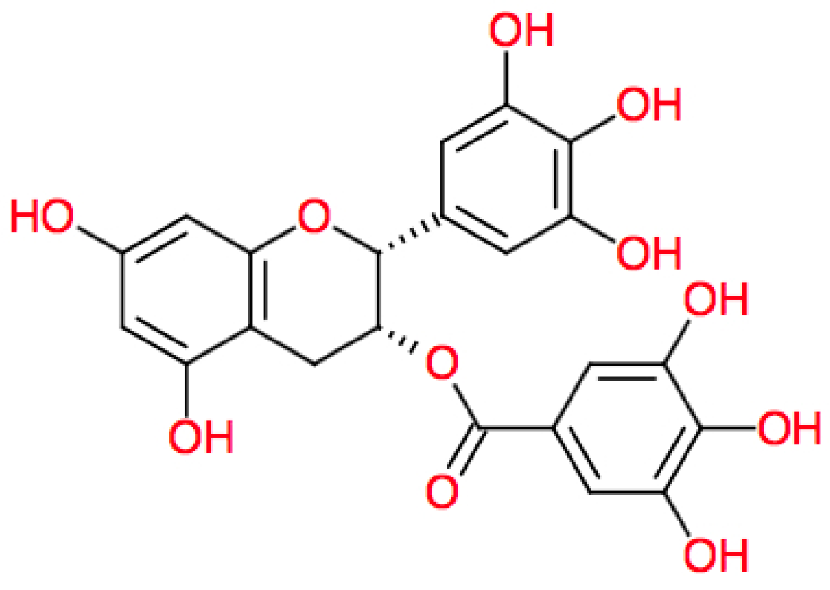
Wang L, Wu Y, Zhuang L, et al. Puerarin prevents high-fat diet-induced obesity by enriching Akkermansia muciniphila in the gut microbiota of mice. PLoS One. 2019;14(6):e0218490. Published 2019 Jun 24. doi:10.1371/journal.pone.0218490

Slide 10
Key Dietary and Lifestyle Factors Associated with Akkermansia
Favorable/Increased Populations
Unfavorable/Decreased Populations
Dietary polyphenolics
cranberries, vaccinium family
Fasting
Aerobic exercise
Ketogenic diet
Low fiber
High refined carbohydrate levels
Frequent food intake
Antibiotic use
Artificial sweeteners
Emulsifiers
Verhoog S, Taneri PE, Roa Díaz ZM, et al. Dietary Factors and Modulation of Bacteria Strains of Akkermansia muciniphila and Faecalibacterium prausnitzii: A Systematic Review. Nutrients. 2019;11(7):1565. Published 2019 Jul 11. doi:10.3390/nu11071565

Slide 11
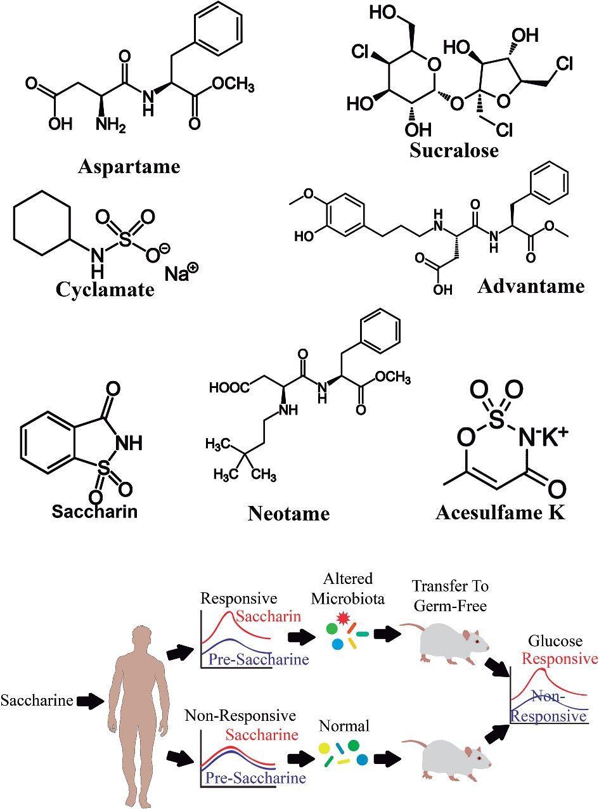
FIGURE 1 Effects of artificial sweeteners and saccharin on gut microbiota. Animal studies have reported specific ...
Olivier-Van Stichelen S, Rother KI, Hanover JA. Maternal Exposure to Non-nutritive Sweeteners Impacts Progeny's Metabolism and Microbiome. Front Microbiol. 2019;10:1360. Published 2019 Jun 20. doi:10.3389/fmicb.2019.01360

Slide 12
Bifidobacterium Species
B. longum
B. infantis
B. brevis
B. animalis
All are primary butyrate producers
Comprise majority of all microbial species in early years of life
Decline in composition associated with increased disease risk and aging

Slide 13
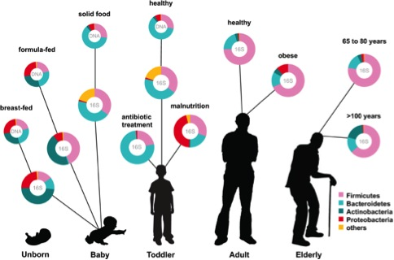

Slide 14
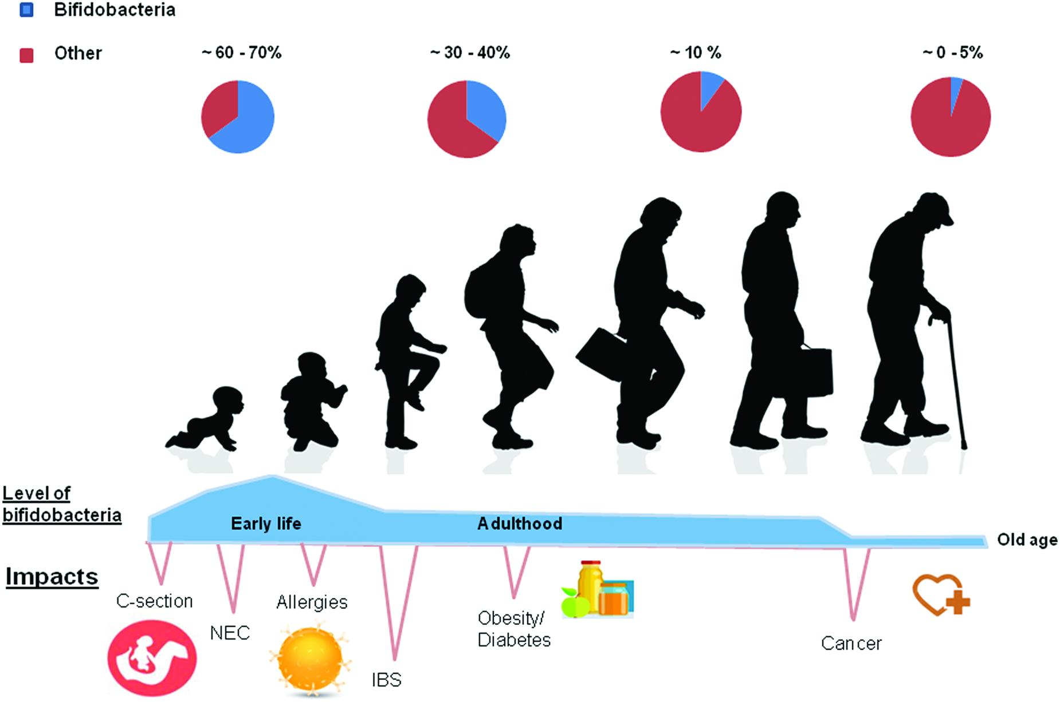

Slide 15
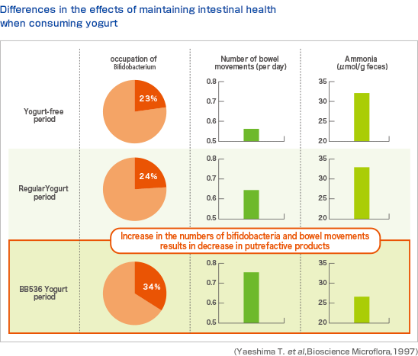

Slide 16
Wang H, Braun C, Murphy EF, Enck P. Bifidobacterium longum 1714™ Strain Modulates Brain Activity of Healthy Volunteers During Social Stress. Am J Gastroenterol. 2019;114(7):1152–1162.

Slide 17
Microbes Associated with MDD
Associated w/Risk Reduction
Increased Risk
Bifidobacterium species
Dialister
Faecalbacterium Prauznitzi
Ruminococcus
Roseburia
Klebsiella
Clostridium
Lachnospiracea
Parabacteroides
Streptococcus
Cheung SG, Goldenthal AR, Uhlemann AC, Mann JJ, Miller JM, Sublette ME. Systematic Review of Gut Microbiota and Major Depression. Front Psychiatry. 2019;10:34. Published 2019 Feb 11. doi:10.3389/fpsyt.2019.00034

Slide 18
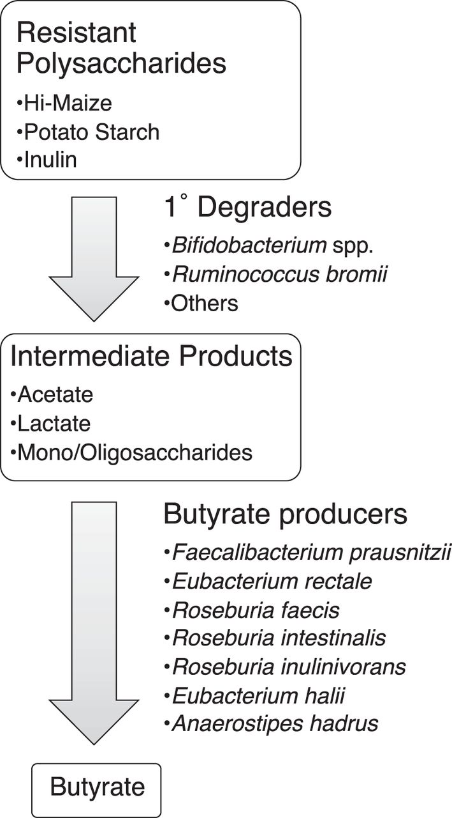
Proposed model of metabolites and microbes that catalyze the flow of carbon from resistant polysaccharides to butyrate.
Nielson T. Baxter et al. mBio 2019; doi:10.1128/mBio.02566-18

Slide 19
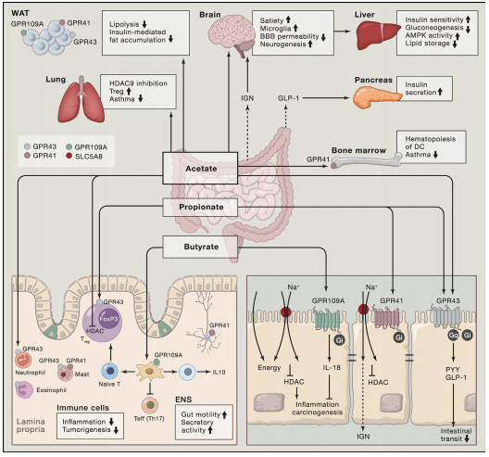

Slide 20
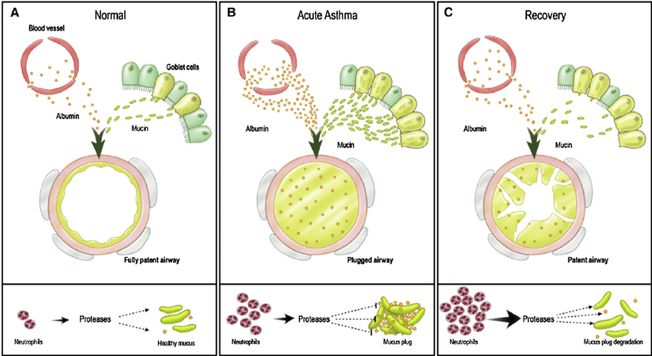
Karav S, Casaburi G, Frese SA. Reduced colonic mucin degradation in breastfed infants colonized by Bifidobacterium longum subsp. infantis EVC001. FEBS Open Bio. 2018;8(10):1649–1657. Published 2018 Sep 17

Slide 21
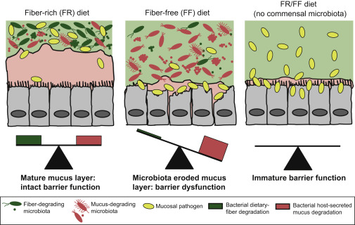

Slide 22
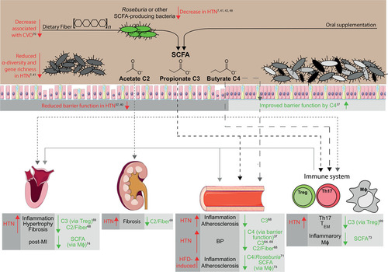
Precarious Symbiosis Between Host and Microbiome in Cardiovascular Health, Volume: 73, Issue: 5, Pages: 926-935, DOI: (10.1161/HYPERTENSIONAHA.119.11786)

Slide 23
Top β-Mannan Content of Plants
Chickpeas
Coconut
Associated with higher levels of health and better nutritional status (O’neil et al. J Nutr Food Science 2014)
When thoroughly cooked and/or fermented lectins are denatured but mannan content persists
Studies demonstrate a unique ability to feed most beneficial microbes
Consumed by many of the World’s healthiest populations daily
A high fat food associated with favorable microbiome diversity indexes in multiple species
Coconut fiber has no anti-nutrient effects
La Rosa SL, Leth ML, Michalak L, et al. The human gut Firmicute Roseburia intestinalis is a primary degrader of dietary β-mannans. Nat Commun. 2019;10(1):905. Published 2019 Feb 22. doi:10.1038/s41467-019-08812-y

Slide 24
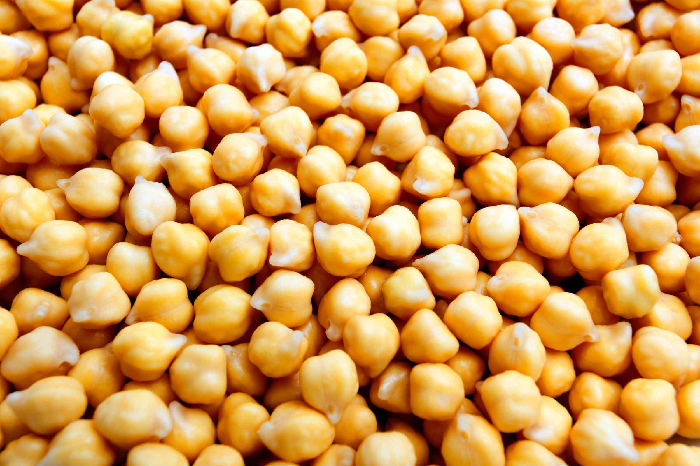
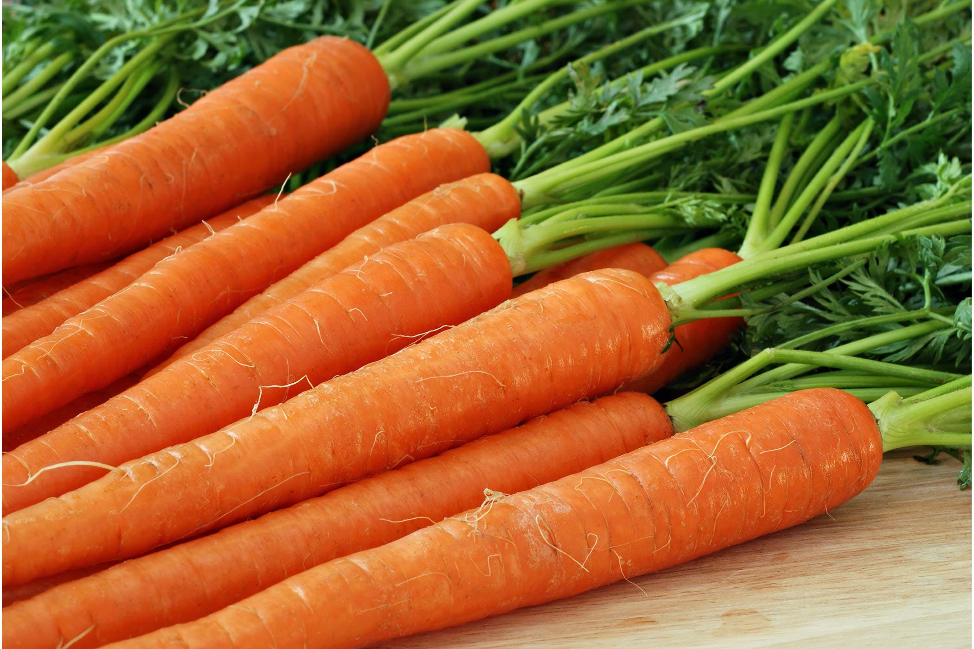
Graf D, Di Cagno R, Fåk F, et al. Contribution of diet to the composition of the human gut microbiota. Microb Ecol Health Dis. 2015;26:26164. Published 2015 Feb 4. doi:10.3402/mehd.v26.26164
Nielson T. Baxter, Alexander W. Schmidt, Arvind Venkataraman, Kwi S. Kim, Clive Waldron, Thomas M. Schmidt.
Dynamics of Human Gut Microbiota and Short-Chain Fatty Acids in Response to Dietary Interventions with Three Fermentable Fibers
mBio Jan 2019, 10 (1) e02566-18; DOI: 10.1128/mBio.02566-18

Slide 25
Common Microbial Overgrowth Patterns and Chronic Disease
Desulfovibrio – mood and psychiatric disorders
Veilonella-most chronic/inflammatory disease
Fusobacterium spp-colon inflammation, cancer, and compromised immune response
Klebsiella spp-autoimmune disease Crohn’s, ulcerative colitis

Slide 26
Fusobacterium Species Growth Factors
High energy density drinks
Low intake of polyphenols
Low intake of brightly colored vegetables
Refined grain products/flours
Foods containing added sugars
Carbohydrate-dense foods
Afra K, Laupland K, Leal J, Lloyd T, Gregson D. Incidence, risk factors, and outcomes of Fusobacterium species bacteremia. BMC Infect Dis. 2013;13:264. Published 2013 Jun 5. doi:10.1186/1471-2334-13-264

Slide 27
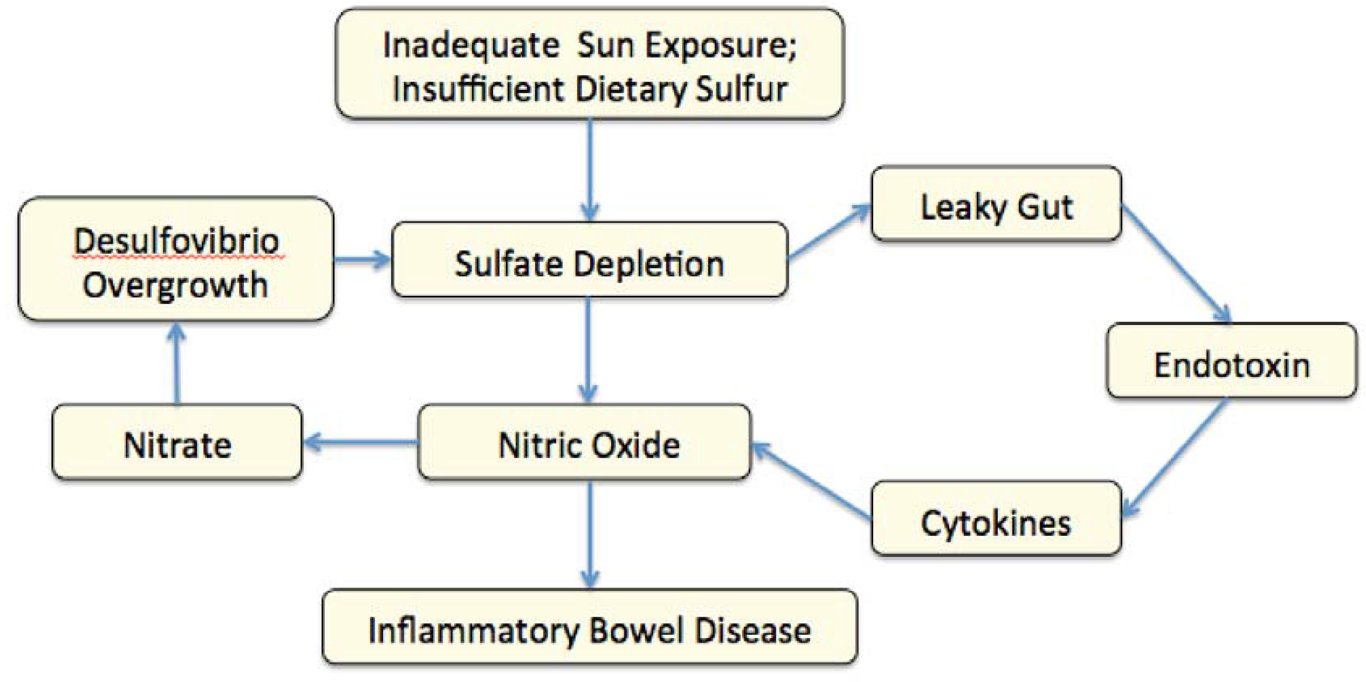
Goldstein EJ, Citron DM, Peraino VA, Cross SA. Desulfovibrio desulfuricans bacteremia and review of human Desulfovibrio infections. J Clin Microbiol. 2003;41(6):2752–2754. doi:10.1128/jcm.41.6.2752-2754.2003

Slide 28
Bruce-Keller AJ, Salbaum JM, Luo M, et al. Obese-type gut microbiota induce neurobehavioral changes in the absence of obesity. Biol Psychiatry. 2015;77(7):607–615. doi:10.1016/j.biopsych.2014.07.012

Slide 29
Klebsiella
A major, most significant risk factor, for development of autoimmune diseases of the GI and skeletomuscular system
Crohn’s, Ulcerative Colitis, Ankylosing spondylitis, Rheumatoid arthritis
Produces a digestive enzyme in metabolic response to dietary starch
Pullanase enzyme drives innate immune response and attack on self tissue

Slide 30
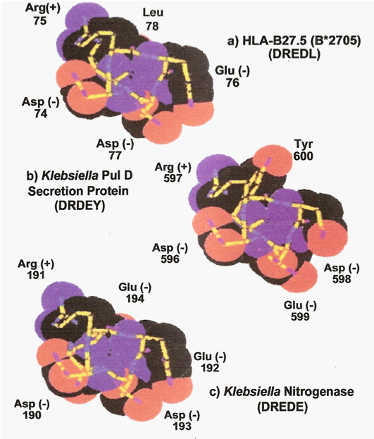

Slide 31
Research with Enteral Patient Microbiome Changes
Whole foods, plant-based formula supports greater diversity and higher lebvels of commensal/beneficial species
Majority of commercial enteral formulas cause loss of keystone species in relatively short periods of time
McClanahan, D., Yeh, A.S., Firek, B.A., Zettle, S., Rogers, M.S., Cheek, R., Nguyen, M.V., Gayer, C.P., Wendell, S.G., Mullett, S.J., & Morowitz, M.J. (2019). Pilot Study of the Effect of Plant-Based Enteral Nutrition on the Gut Microbiota in Chronically Ill Tube-Fed Children. JPEN. Journal of parenteral and enteral nutrition.
Gallagher, K. , Flint, A. , Mouzaki, M. , Carpenter, A. , Haliburton, B. , Bannister, L. , Norgrove, H. , Hoffman, L. , Mack, D. , Stintzi, A. and Marcon, M. (2018), Blenderized Enteral Nutrition Diet Study: Feasibility, Clinical, and Microbiome Outcomes of Providing Blenderized Feeds Through a Gastric Tube in a Medically Complex Pediatric Population. Journal of Parenteral and Enteral Nutrition, 42: 1046-1060. doi:10.1002/jpen.1049

Slide 32
Summary of Most Influential Lifestyle and Dietary Characteristics
Limit use of antibiotics and reduce exposure to antibiotic residues (choose organic)
Avoid chemical additives, artificial sweeteners, and emulsifiers
Choose fiber-rich vegetables at most meals
Select foods rich in polyphenols every day
Get aerobic exercise
Limit window of time to eat, less snacking
Avoid concentrated, high sugar and energy-based foods and formulas

