Slide 1
Health and the Application of
Mind-Body Science
July 8, 2020
Mark C. Pettus M.D. FACP
Director Population Health and Community Care
Berkshire Health Systems
Associate Professor of Medicine
University of Massachusetts Medical School

Slide 2
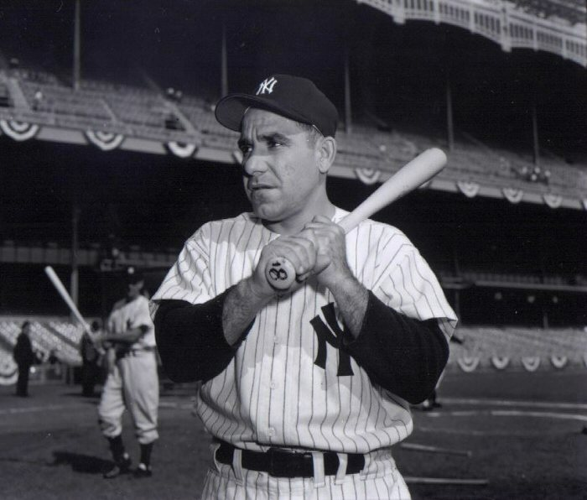
“The future ain’t what it used to be.”
Yogi Berra

Slide 3
Mind-Body Science: Moving beyond the scientific materialism paradigm

Slide 4
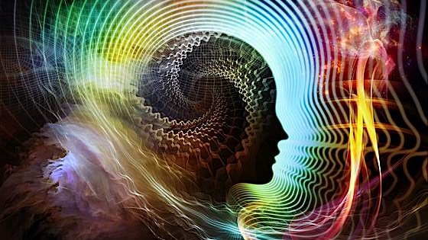
Mind-Body at the Quantum Level
Feedforward – Feedback of Information: A Science of possibility

Slide 5
Consciousness-Spirit
Spirit – Soul
Consciousness
Mind
Beliefs and Perceptions
Mind
Perceptions-Beliefs
Thoughts and Emotions
Brain-Body
Part of an Integrated system of information and communication that extends beyond the physical.

Slide 6
“It from bit symbolizes the idea that every item of the physical world has at bottom…an immaterial source and explanation…that all things physical are information-theoretic in origin and that this is a participatory universe”
John Archibald Wheeler
…from particles to energy to information
Notes:
﻿“Everything is Particles” evolved to “Everything is Fields” which eventually evolved to “Everything is Information”.
Virk, Rizwan. The Simulation Hypothesis: An MIT Computer Scientist Shows Why AI, Quantum Physics and Eastern Mystics All Agree We Are In a Video Game . Bayview Books. Kindle Edition.

Slide 7
Mind
Perceptions-Beliefs
Thoughts
Emotions
Brain
Body-Life Experience

Slide 8
Behavior = Values x Perceptions
B = V x P
Perceptions
Emotions and Thoughts
Your Behaviors
Your Experience of Life (Healthspan)
Perceptions
Subjective
Fragile
Personal
Idiosyncratic
Heavily programmed
Skew toward negative, fear-based beliefs
Infinitely malleable

Slide 9
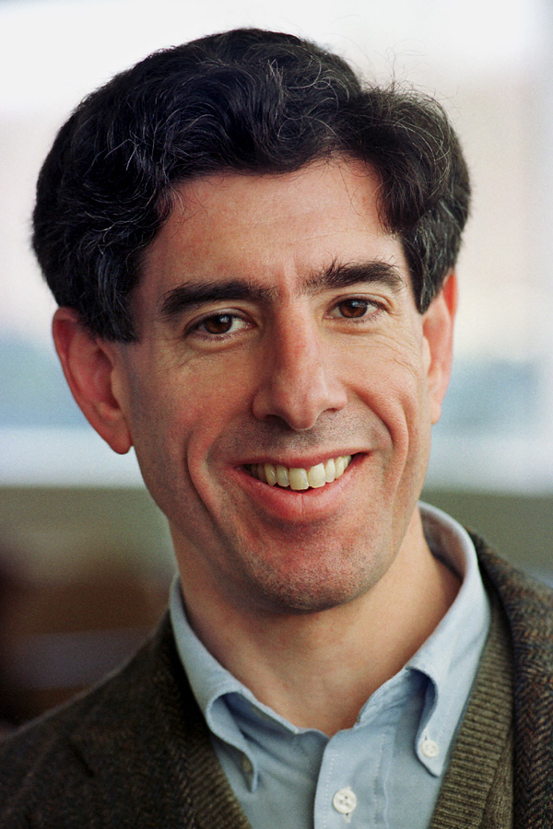
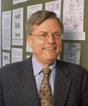
Richard Davidson PhD
Director, Waisman Lab Neurosciences
University of Wisconsin Medical School
Bruce S. McEwen, Ph.D.
Alfred E. Mirsky Professor
Harold and Margaret Milliken Hatch Laboratory of Neuroendocrinology, Rockefeller University

Slide 10
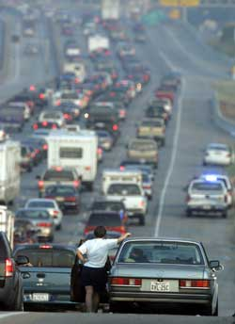
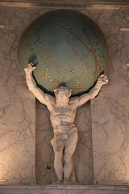
Fight-Flight or Sympathetic Tone

Slide 11
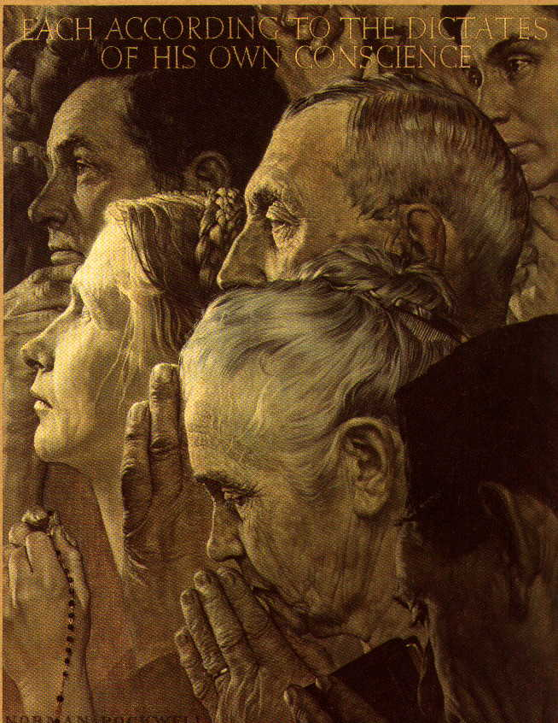
Calm or Parasympathetic Tone…..Get “Para”

Slide 12
Allostasis and Allostatic Load
Ability to achieve stability through change
Balance

Slide 13
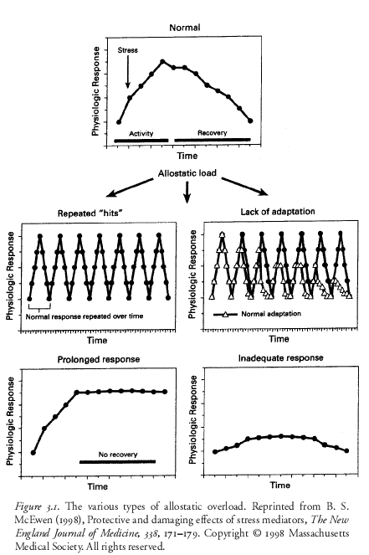

Slide 14
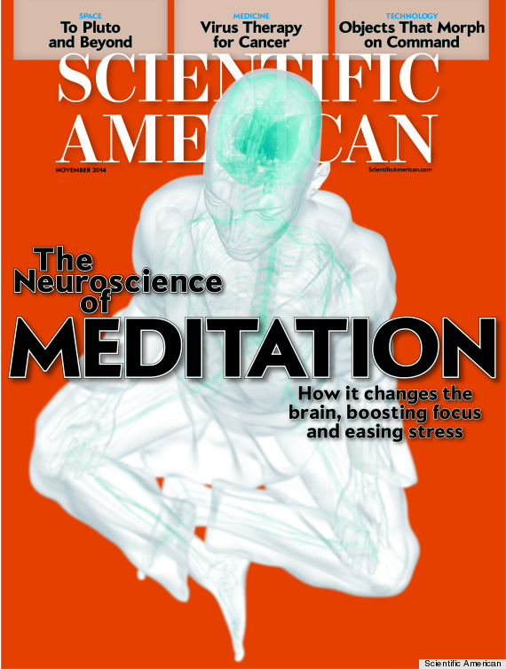

Slide 15
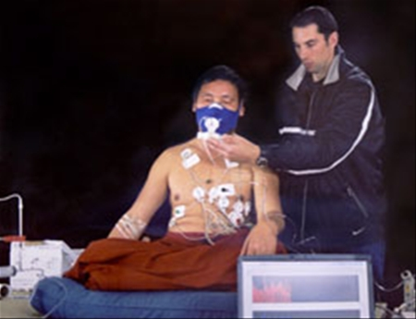
Courtesy Herb Benson MD

Slide 16
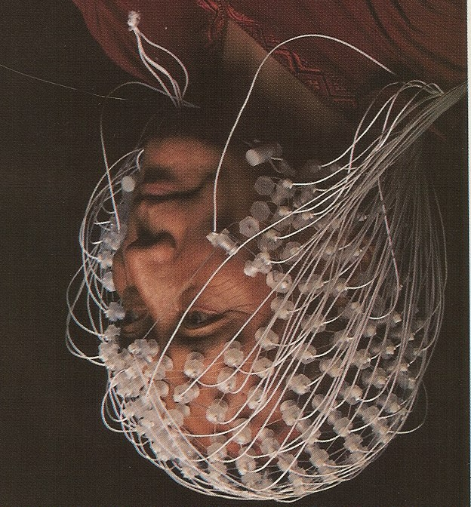
Courtesy Richard Davidson PhD

Slide 17
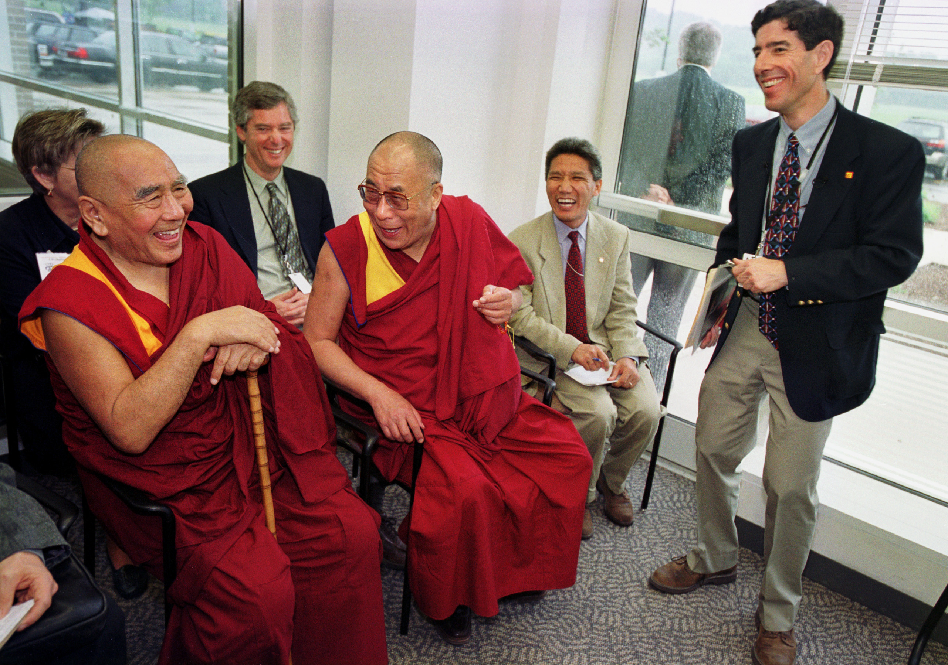
Courtesy Richard Davidson PhD

Slide 18
Courtesy Richard Davidson PhD

Slide 19
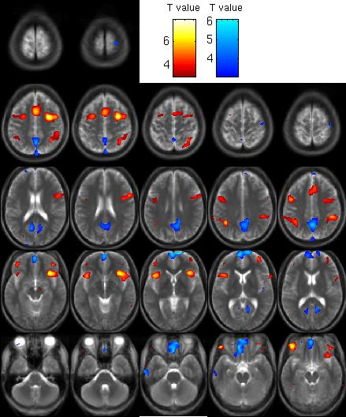
Courtesy Richard Davidson PhD

Slide 20
Courtesy Richard Davidson PhD

Slide 21
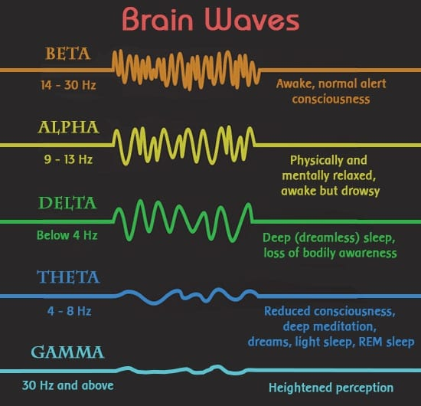
Theta/Gamma States
Love
Calm-still
Passion-creative expression
Meaning-maker
Flow state
Gratitude
Connection with others
Alignment of “self” with “Self”
Connection to the whole

Slide 22
Placebo Effect
“The power over which a person’s thoughts has over his body to heal it or to make it sick is a force which none of us are born without.”
Mark Twain
“Whether you think you can, or you think you can't--you're right.”
Henry Ford
HK Beecher “ The Powerful Placebo” 1955
Demonstrated effects in 30-40% of participants in clinical studies who receive placebo
Universal observation
Nocebo effect
MRI studies regarding pain perception
Hypnosis research
Creating the perception of better things to come.

Slide 23
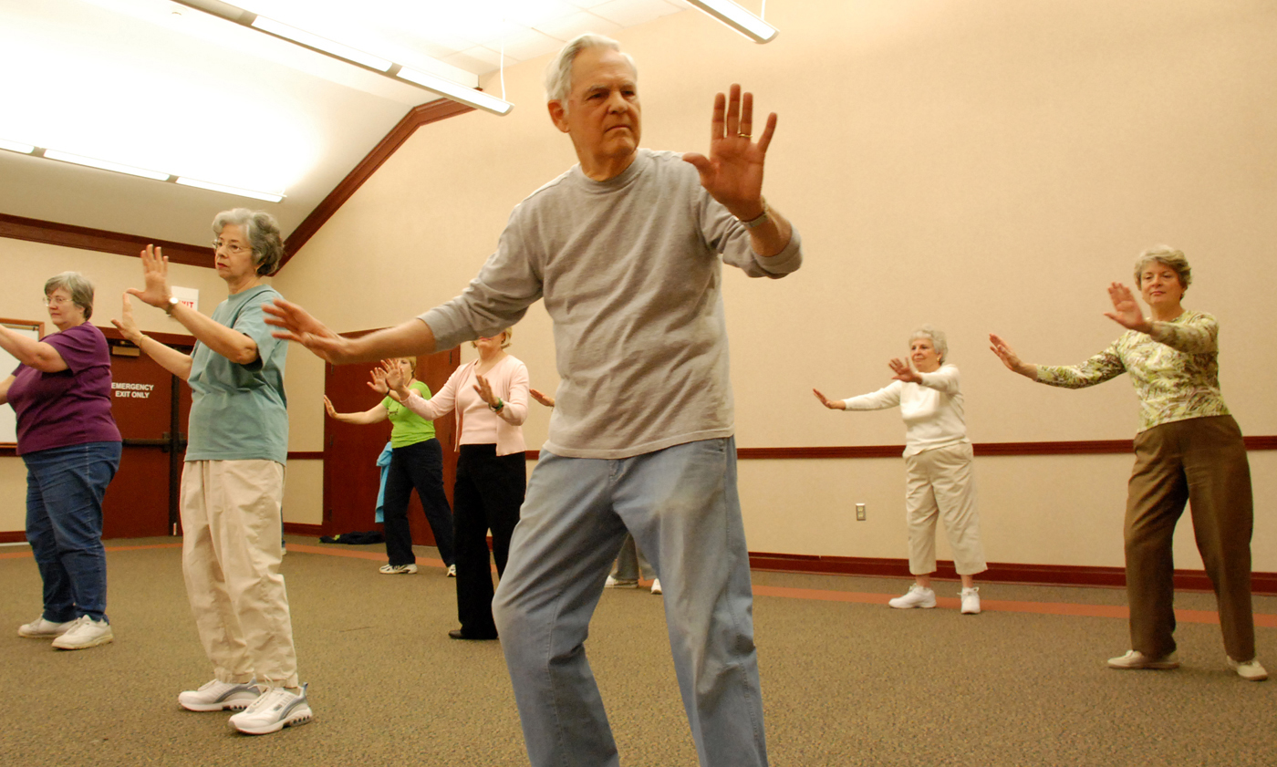
Managing Stress: The Power of Mindfulness
Mindfulness practices powerfully proven to reduce disease risk
Epigenetic effects shown to reduce inflammation, improve insulin sensitivity
Improved mood, resilience, reduced anxiety
Improved performance, creativity and problem-solving capacity
Qi Gong, Tai chi and yoga are superb for balance, reducing fall risk, and is a marvelous stress reduction activity
MBSR, meditation, prayer, guided imagery, journaling, etc.

Slide 24
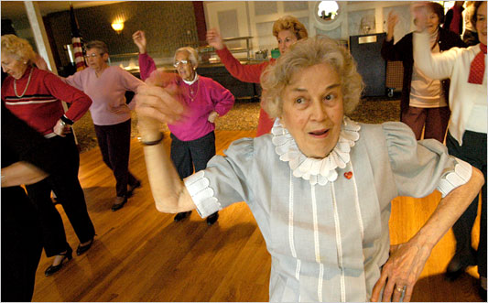
Motion is the Lotion
Walk as much as possible; outdoors is great!
Be efficient with activity e.g. small doses of higher intensity e.g. breathless; functional resistance for muscle strength
Dance to the music you love!
Improved mood, resilience, less pain, less inflammation, improved insulin sensitivity, decreased anxiety

Slide 25
Consciousness – Our Perceptions Shape Our Reality
Much of what impacts our biology and our biography can be traced to our beliefs-perceptions.
Beliefs-perceptions that are not serving you well will lead to emotions and thoughts that will tip the balance of your sympathetic fight-flight response vs your parasympathetic connection to the “whole”.
Changing one’s health and quality of life requires changing one’s beliefs-perceptions in a way that aligns with one’s passion.

Slide 26
The Quantum Roadmap
Follow that which ignites your passion, that which creates meaning in your life
Take it as far as you possibly can to the best of your ability
Attach no expectations or insistence on the outcome
The more positive one’s interpretation and response to whatever outcome emerges, the greater the likelihood of your experiences “providing you” with what you need to learn and to evolve physically, mentally, emotionally and spiritually.
Go with the flow of synchronicity…..ride the wave

Slide 27
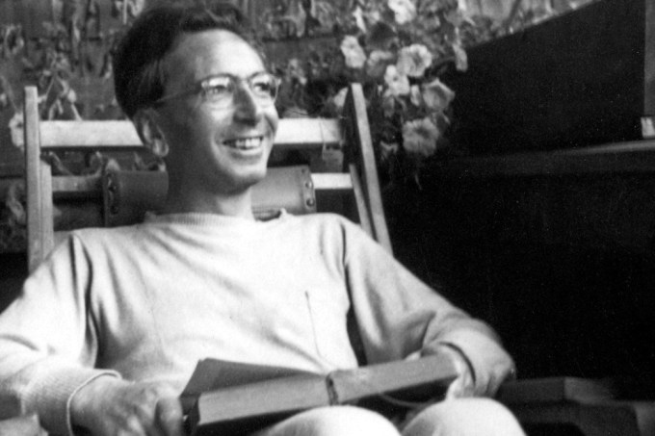
“Everything can be taken from a man but one thing: the last of the human freedoms-to choose one’s attitude in any given set of circumstances, to choose one’s own way.”
Viktor Frankl

Slide 28
Peace

