Slide 1
Population Health in the Berkshires
A Review of the County Health Rankings
July 21, 2020
Mark C. Pettus MD
Director Population Health and Community Care
Berkshire Health Systems
Associate Professor of Medicine
University of Massachusetts Medical School

Slide 2
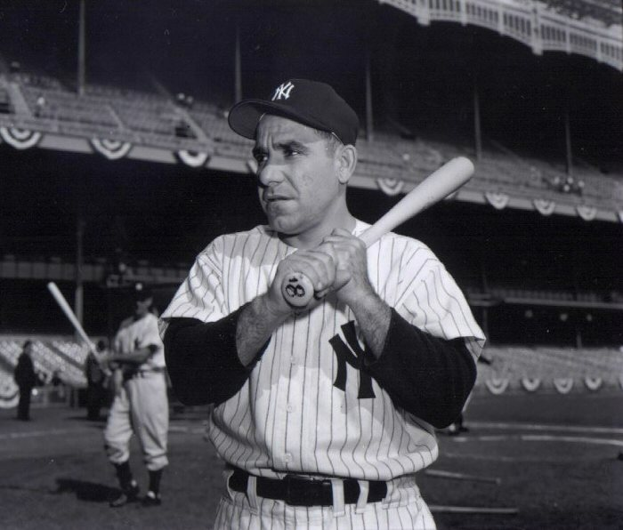
“The future ain’t what it used to be.”
Yogi Berra

Slide 3
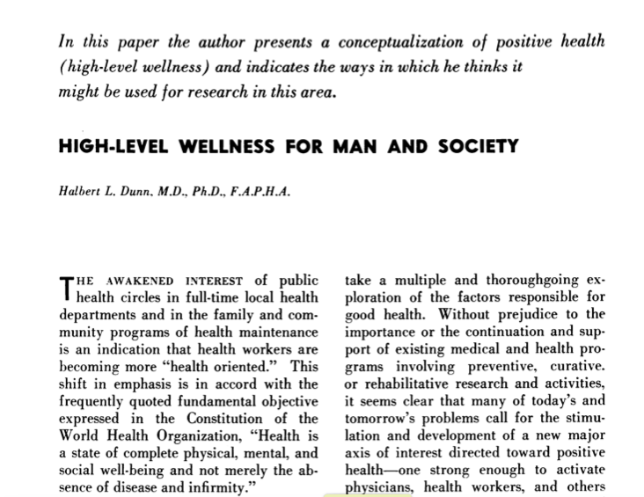
“When we learn how to diagnose high level wellness, we shall probably find that a substantial amount of creative expression, altruism, and love in daily life is essential for the approach to a high state of well-being. The needs are for a clear-cut concept and dedication to it; for money and research; for understanding, courage, and a reassessment of basic values; for a positive orientation toward life and society. We must dare to dream, dreams are the seedlings of realities.”

Slide 4
Healthspan
Notes:
Rectangularize the health curve
Healthspan…organ reserve

Slide 5
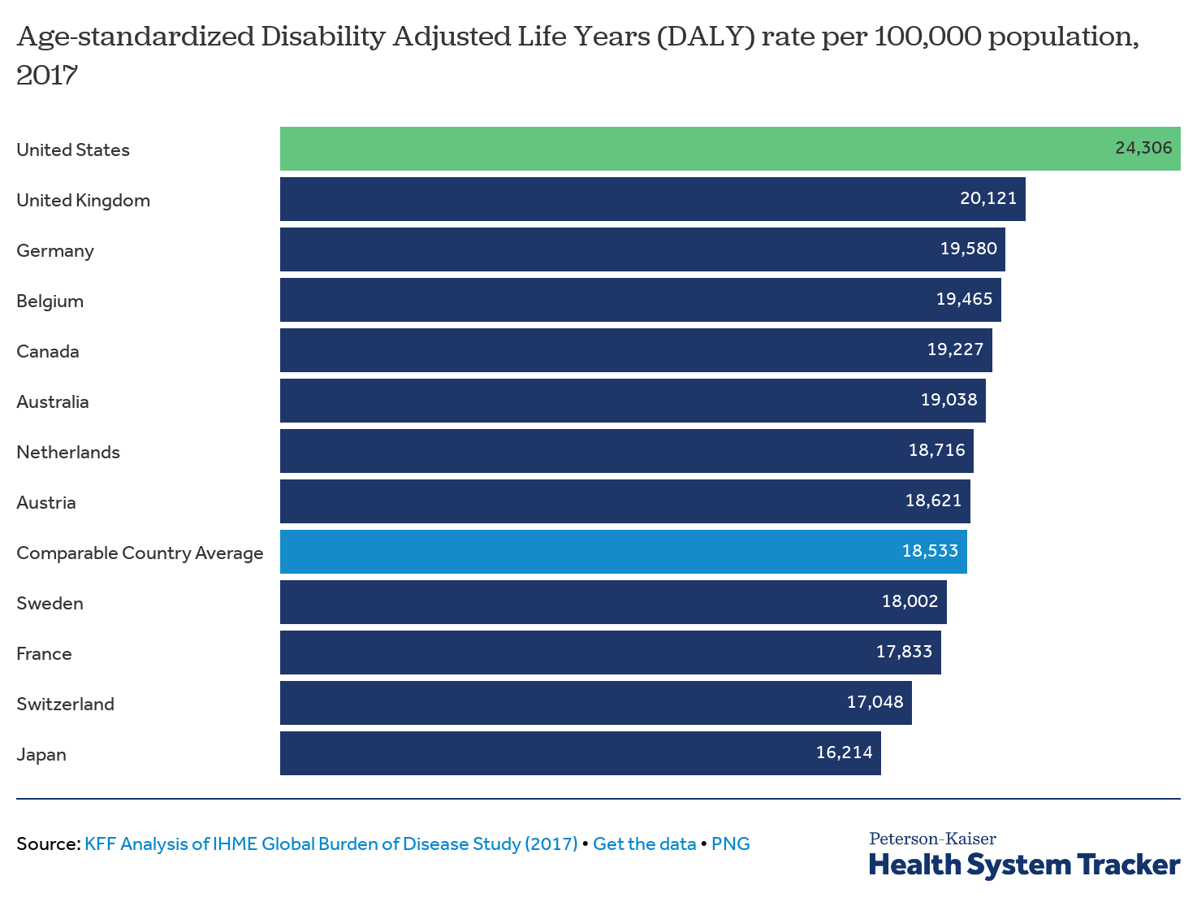
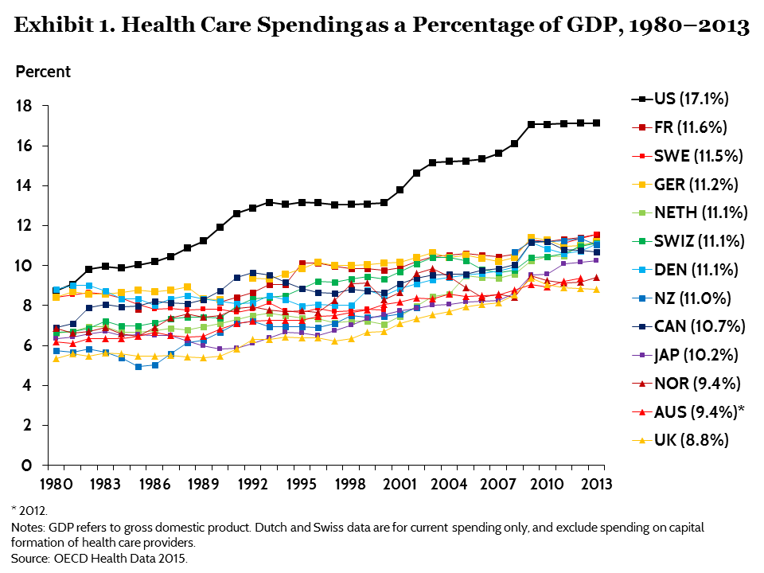
“It is, I guess, politically correct and widely believed that the American Health care system is the best in the world. It’s not”.
Don Berwick, Institute of Healthcare Improvement
Notes:
The Organisation for Economic Co-operation and Development.

Slide 6
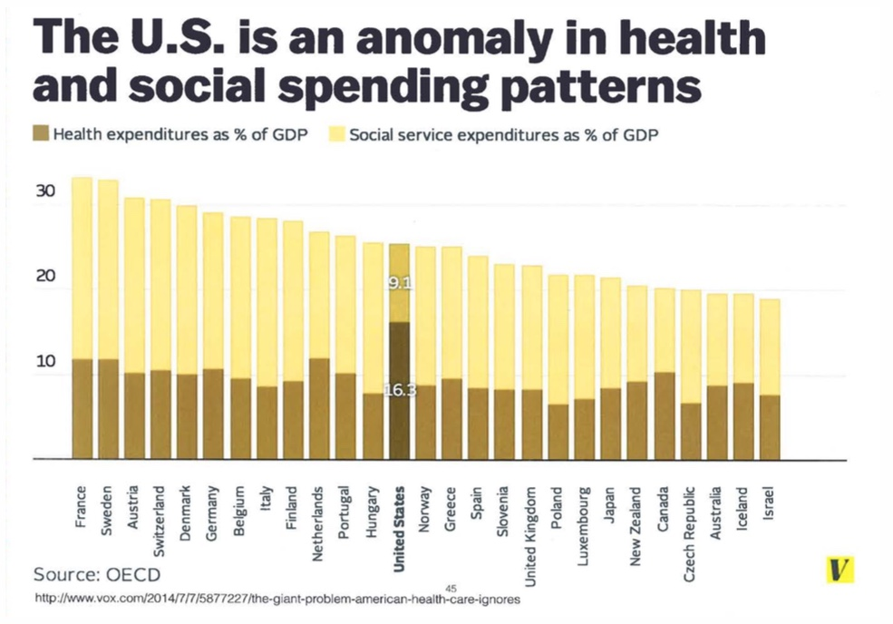

Slide 7
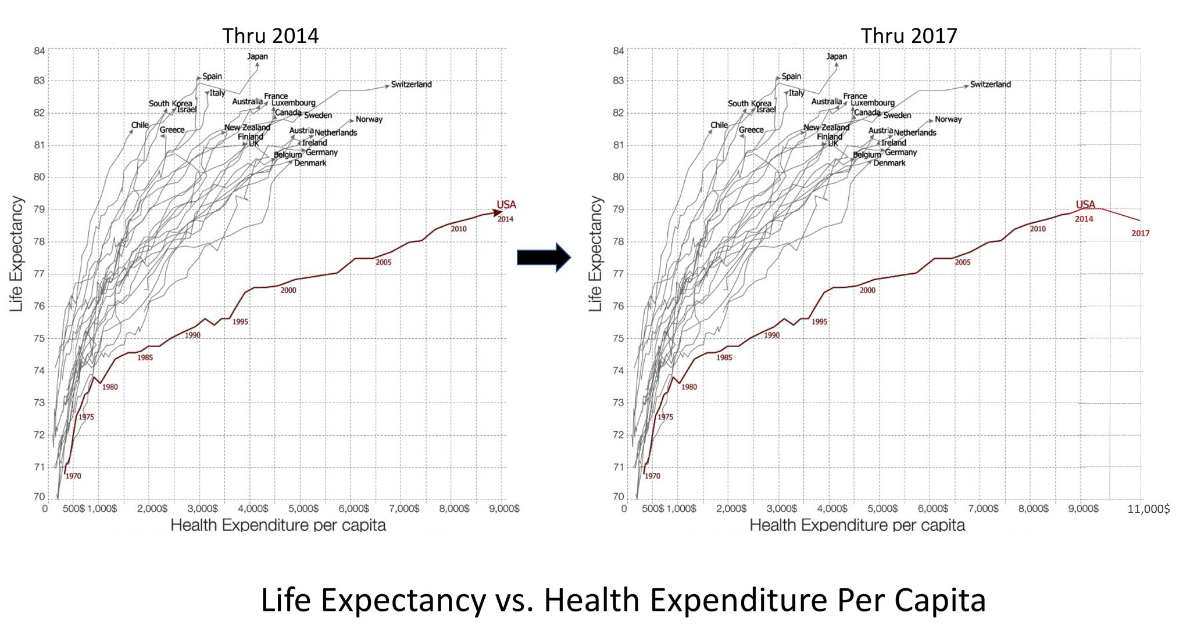
Life Expectancy vs. Health Expenditure Per Capita
Anne Case and Angus Deaton, Princeton University

Slide 8
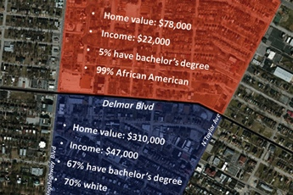
Your address and zip code might be a better predictor of your health and longevity than your genetic code.
The “Delmar Divide” (St. Louis, Missouri)

Slide 9
The term “population health” has been used to describe both a clinical perspective focused on delivering care to groups enrolled in a health system and a broader perspective that focuses on the health of all people in a given geographic area and emphasizes multisector approaches and incorporation of nonclinical interventions to address social determinants of health.
N Engl J Med 2015; 372:109-111 January 8, 2015

Slide 10
Quadruple Aim
Health of a Population
Experience of Care
Per Capita Cost
Care of the Provider/Joy in Work
Adapted from:
Berwick DM, Nolan TW, Whittington J. The Triple Aim: care, health, and cost. Health Aff (Millwood). 2008;27(3):759–769.
Bodenheimer T, Sinsky C. From Triple to Quadruple Aim: Care of the Patient Requires Care of the Provider. Ann Fam Med, November/December 2014 vol. 12 no. 6 573-576.

Slide 11
Rapidly moving from volume to value

Slide 12
County Health Rankings Model of Population Health
70%

Slide 13
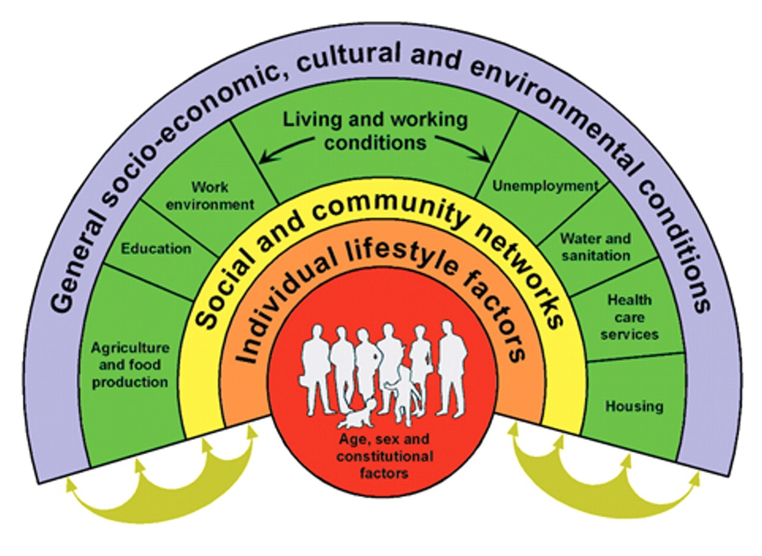
The Social Determinants of Health
Health Is More Than Health Care

Slide 14
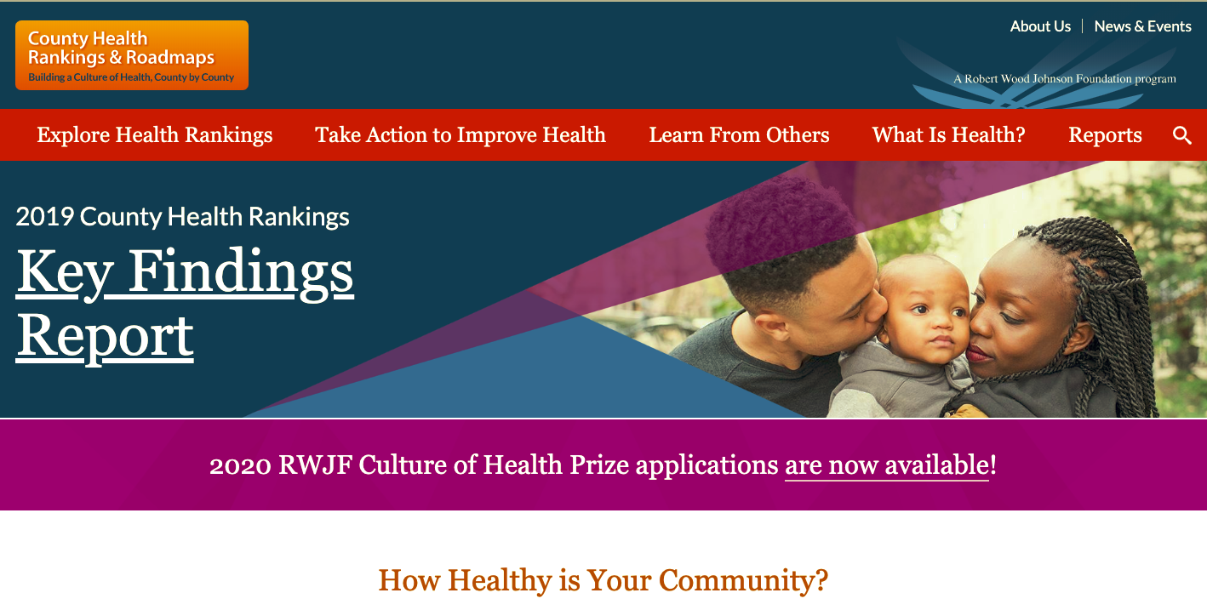

Slide 15
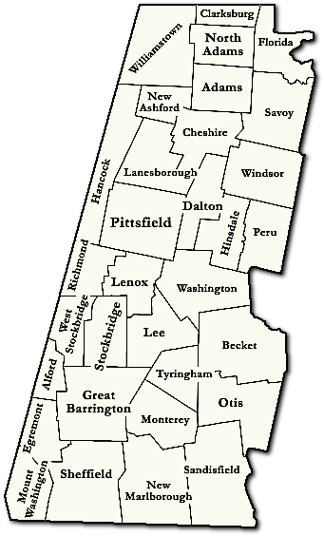
Berkshire County, Massachusetts
38 Zip Codes representing all of Berkshire County
Population (2018): 128,563
Project population changes 2016-2020:
Increase in the 65+ population
Decrease in the 19 yrs. and under populations
Growing diversity
Growing Asian, Black, and Latino populations
Disparities for Black and Latino residents
More likely to be living in poverty
Higher rates of stroke, heart disease, diabetes, and cancer mortality

Slide 16
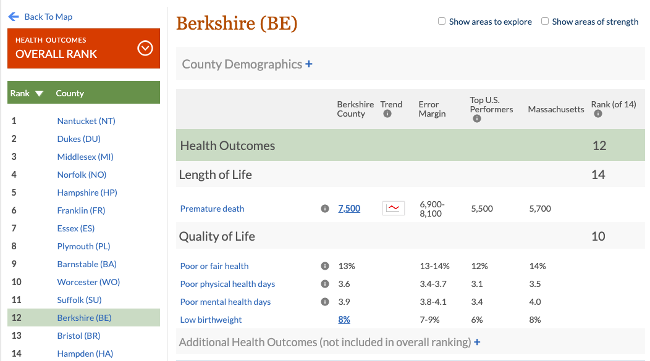

Slide 17
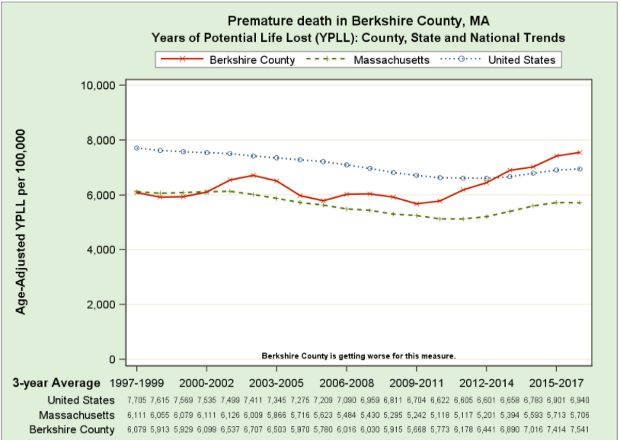

Slide 18
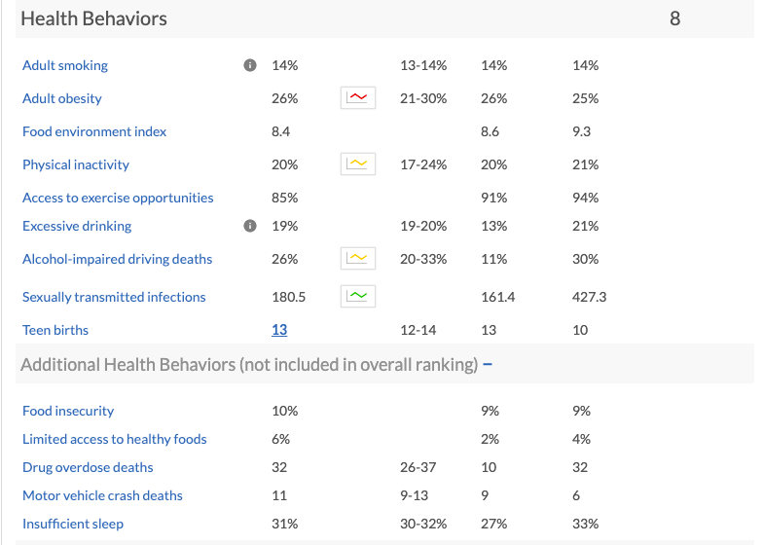

Slide 19
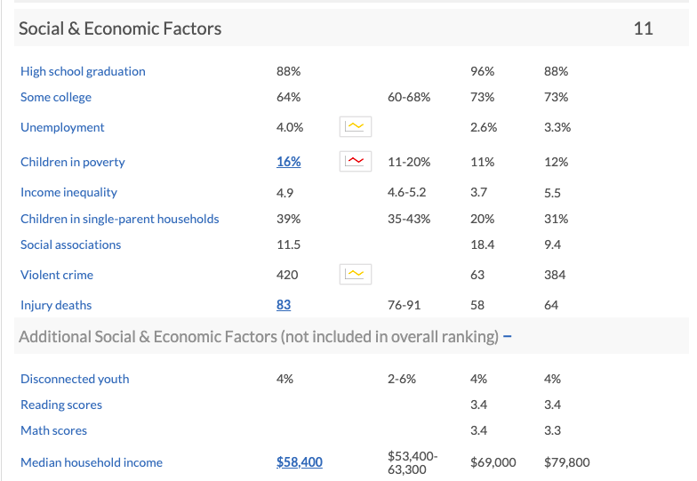

Slide 20
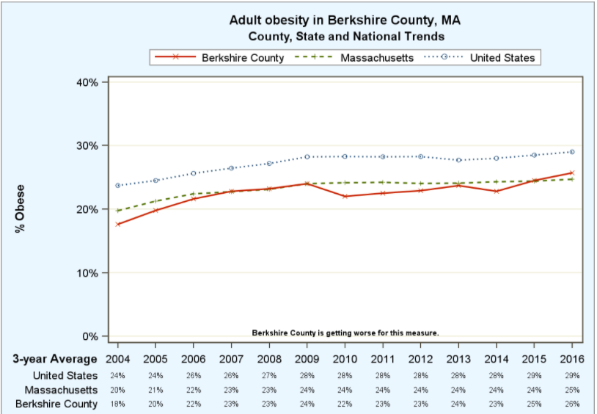

Slide 21
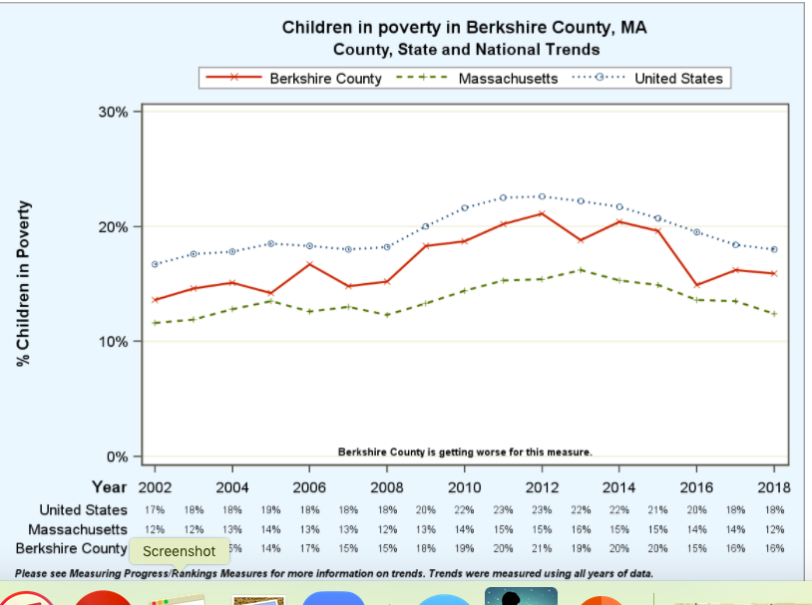

Slide 23
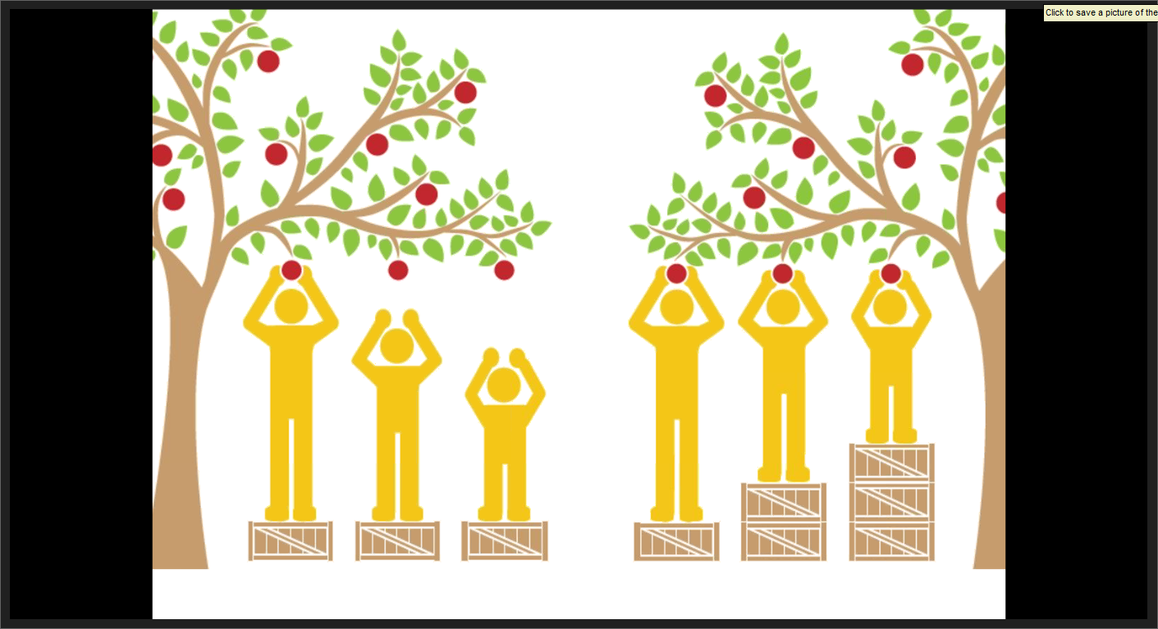

Slide 27
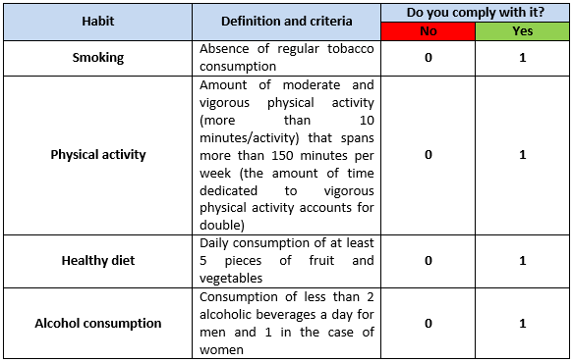
Optimal Lifestyle Metrics

Slide 30
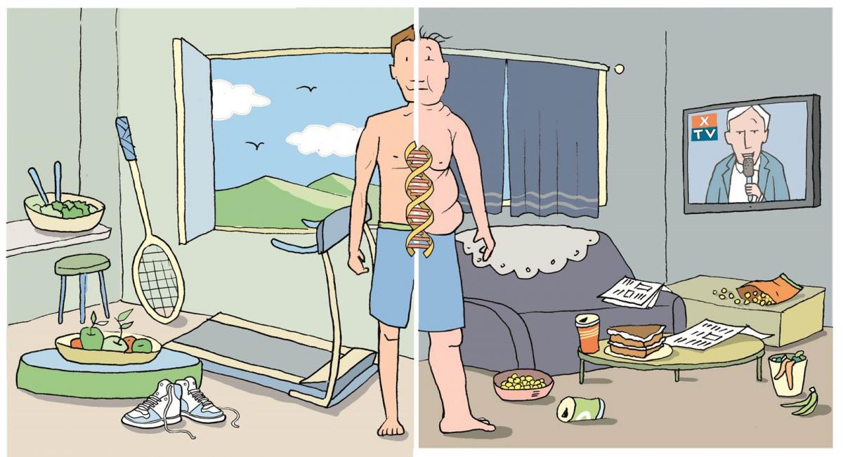
Epigenetics: DNA + Environment

Slide 31
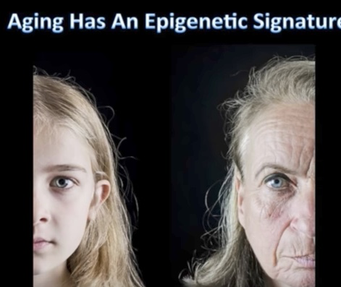
Aging has an Epigenetic Signature

Slide 32
The Healthcare Cost of Food Insecurity
55% of households had unpaid medical bills and 66% of households had to make the difficult choice between paying for food, paying for medicine or medical care, or both.
Hunger in America 2014 National Report
Food insecurity in children has resulted in $1.8 billion in additional children hospitalizations.
Essential Hospitals Institute 2016
Notes:
Medical care or medicine or food

Slide 33
Food Insecurity in Berkshire County
11.2% of the Berkshire County population (127,000) is Food Insecure
(2018 Census)
14,430 Berkshire County Residents are Food Insecure
70% of Berkshire County residents fall below 200% of the poverty level
30% of food insecure individuals earn too much to qualify for nutrition assistance programs.
Notes:
$3.49/meal
200% Poverty Level = Family 4 <$50,200
SNAP 130% = $32,630 WIC 185% = $46,400

Slide 34
States Getting Involved in Food Insecurity
Massachusetts Food is Medicine State Plan
What is Food is Medicine, and Why the Need for a Statewide Plan?
Food is Medicine describes the provision of nutritious food tailored to the medical needs of an individual who lives with one or more health conditions likely to be affected by diet, such as diabetes, heart disease, certain cancers, and HIV. In a small but growing number of cases in Massachusetts and across the country, Food is Medicine interventions are becoming integrated into holistic, patient-centered models of care for individuals with complex chronic illnesses.
Emerging research overwhelmingly suggests that connecting people with complex health conditions to Food is Medicine interventions is an effective and low-cost way to improve health outcomes, decrease utilization of expensive health services, and enhance quality of life for these individuals, who are often socially, as well as medically vulnerable.
Notes:
ACO looking at DSRIP funds for Nutrition & Housing

Slide 35
What can we do in a clinical setting?
Food Insecurity Hunger Vital Sign- 2 Questions
Within the past 12 months did you worry whether your food would run out before you got money to buy more?
Within the past 12 months did your food run out before you had money to buy more?
Notes:
Stigma/Pride/Fear
Bake into EHRs

Slide 36
Boston Medical Center
An on-site preventative food pantry and demonstration kitchen with a clinicians prescription
They serve 7,000 patients, distributing 15,000 pounds of nutritionally dense, culturally appropriate, therapeutic food monthly.
There has been an increase of 15% in enrollment of Federal Nutrition Programs since the program began.
Patients are given a three to four day supply of food twice a month for themselves and their families.
On site community and roof top gardens supplement food donations.
On-site WIC office to encourage patients to enroll in nutrition assistance programs
Notes:
Patients receive information from a registered dietitian concurrent with their visit. Education, instruction, and information are provided on campus.
On-site WIC office to encourage patients to enroll in nutrition assistance programs.

Slide 37
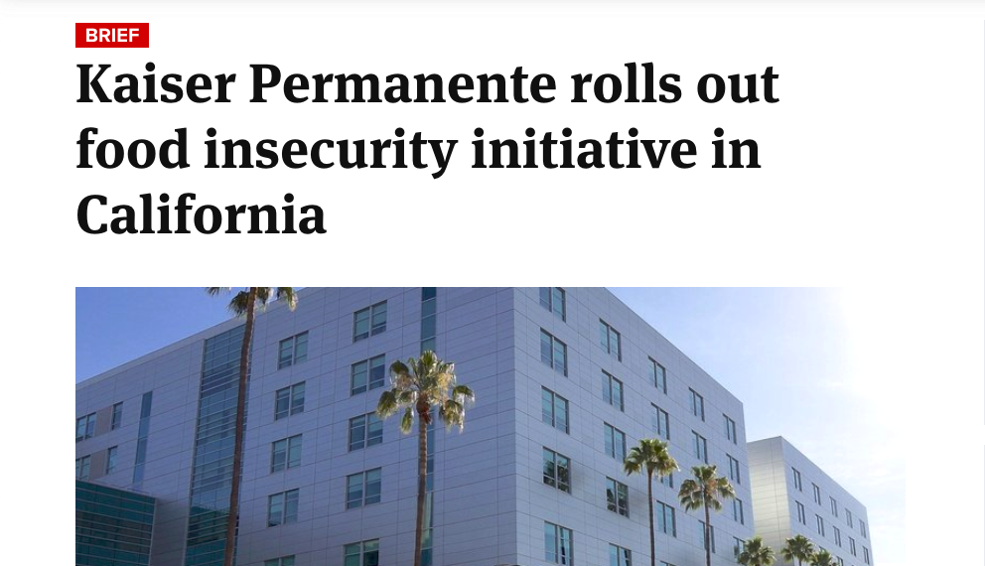

Slide 38
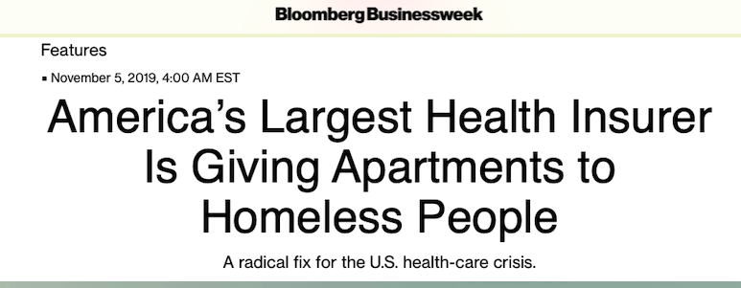

Slide 39
2019 Community Health Needs Assessment
Presented by:
Kimberly A. Kelly
Manager, Community Health & Public Health Initiatives

Slide 40
Community Health Needs Assessment Intent
Identify trends in health status
Data Driven
Develop comparisons to state and national benchmarks
Identify needs and vulnerable populations
Utilize findings for Community Benefits and hospital planning activities
Attorney General and IRS requirements

Slide 41
Biggest issues in Berkshire County
Drugs / violence
Transportation
Lack of jobs
Housing
Sense of community
“My vision for a healthy community is where every person has access to activities that strengthen the mind, body, and spirit.”- Anonymous

Slide 42
Berkshire Fallon Health Collaborative
15,000 covered lives
High prevalence of behavioral health, SUD, medical comorbidities
Clinical-claims data
Predictive analytics, risk-stratification
Team-based care
Emphasis of patient-directed goals
Social determinants of health

Slide 43
BMC
Primary Care
Transitions
of Care
ED/Urgent Care
ACO Pod Teams
CHW, RN, LiCSW
+
Client
Prison/sheriff
Brien/CPs
VNA

Slide 44
CHWs in the Community

Slide 45
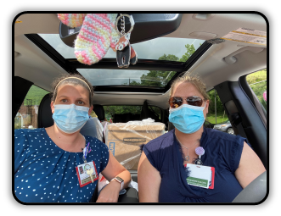
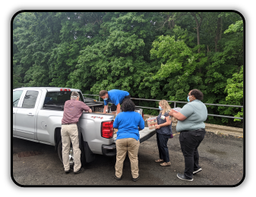
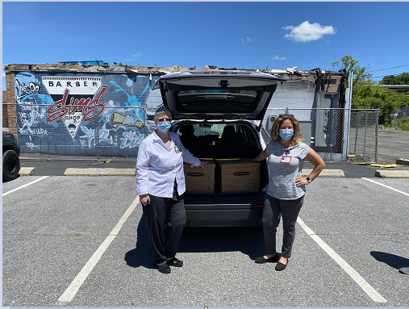
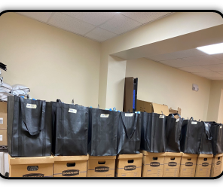
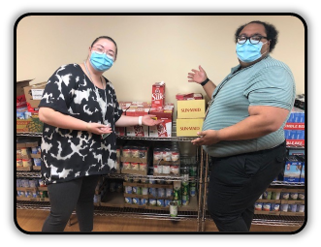
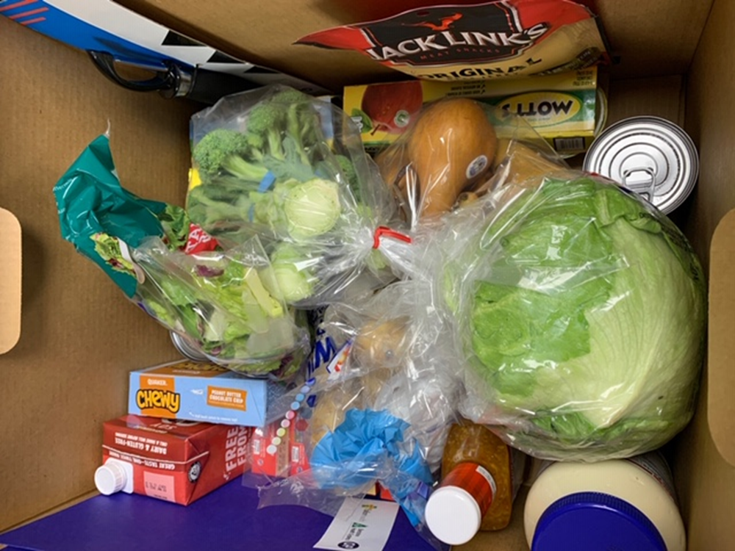

Slide 46
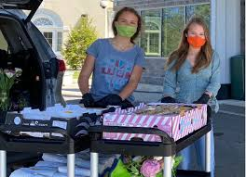

Slide 48
Population Health: How do we get there?
Access Points Across Berkshire County
Make it Easier: Reduce barriers, free
Provide electronic feedback to patient’s provider
Together we can do more!
Support/ Coaching from the community & clinical settings
Identification, education, referral & follow up

Slide 50
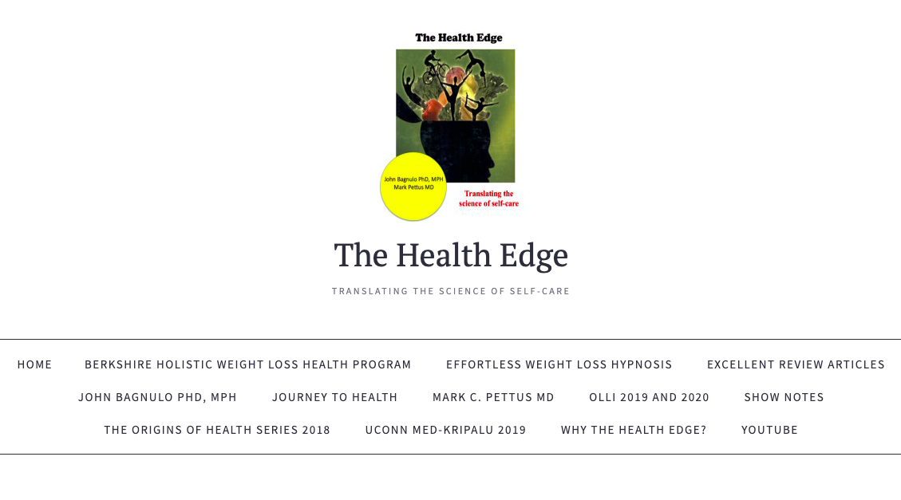
www.thehealthedgepodcast.com

Slide 51
Thank You!

