Slide 1
Building Immune Resilience
July 15, 2020
Mark C. Pettus MD
Director Population Health and Community Care
Berkshire Health Systems
Associate Professor of Medicine
University of Massachusetts Medical School

Slide 3
Immune-Resilience

Slide 4
Nutrition and Immune Resilience

Slide 5
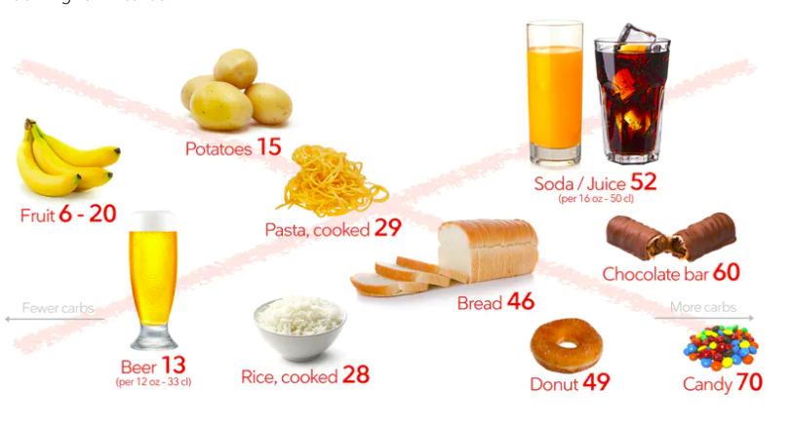
Reduce poor quality, processed, carbohydrate-dense foods
Added Sugar
Grain-based flour e.g. breads, cereal grains, pasta, pastries, desserts, chips, pretzels, granola bars.
Higher Fructose Fruits e.g. bananas, grapes, pears
Dried fruits e.g. raisins, apricots, cherries
Sweetened soft drinks
Beer is liquid bread
Gradual reintroduction of starchy vegetables after 8-12 weeks, e.g. white rice, carrots, parsnips, white potatoes
Lowered insulin and reduced inflammation “unlock” fat burning
All Carbs
Low
Glycemic

Slide 6
Nutritional Principles
Whole foods
Diversity
Nutrient – density/Vitamins
Low Glycemic
Fiber rich plant-based foods
Meal-timing
Supplements
Cod Liver Oil (Vit A/D/E)
Zinc 30 mg
Vitamin C 1-2,000 mg
Probiotics
Vitamin D (sun ideal); blood levels 30+

Slide 7
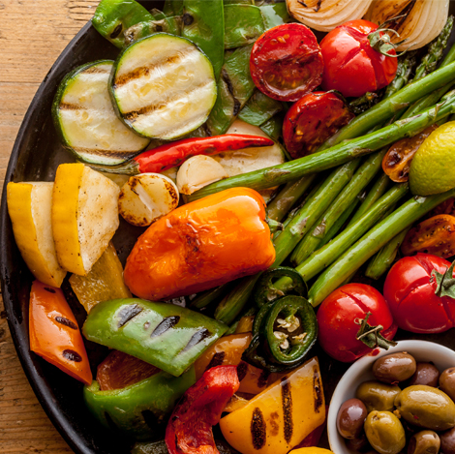
Plant-based foods
High nutrient density
Fermentable Fiber essential for gut biome diversity
2 cups greens/day is a nice goal
Cruciferous e.g. broccoli, cauliflower, collards, cabbage, kale, spinach, asparagus, romaine lettuce, arugula
Allium family e.g. onions, leeks, garlic
Beans and lentils; soaking and pressure cooking can be easier on the gut, reducing lectins
Lower glycemic fruits e.g. berries, grapefruit, kiwi
Fermentable foods e.g. yogurt, sauerkraut

Slide 8
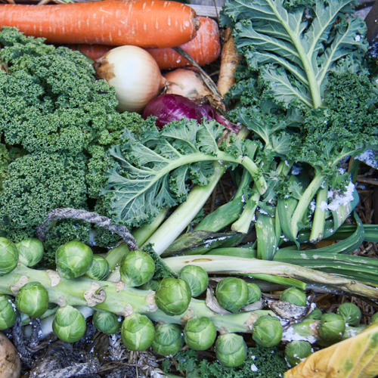
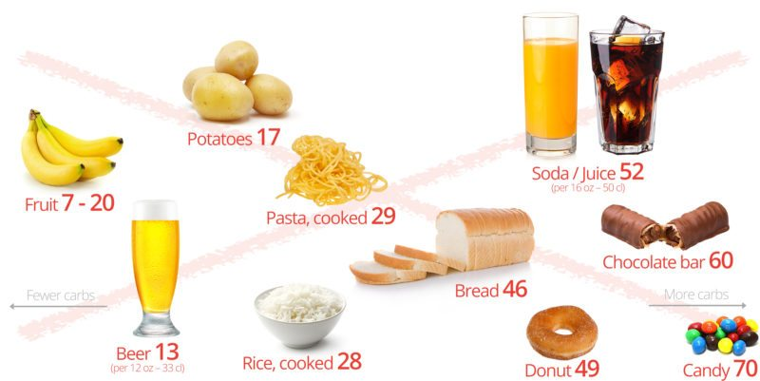
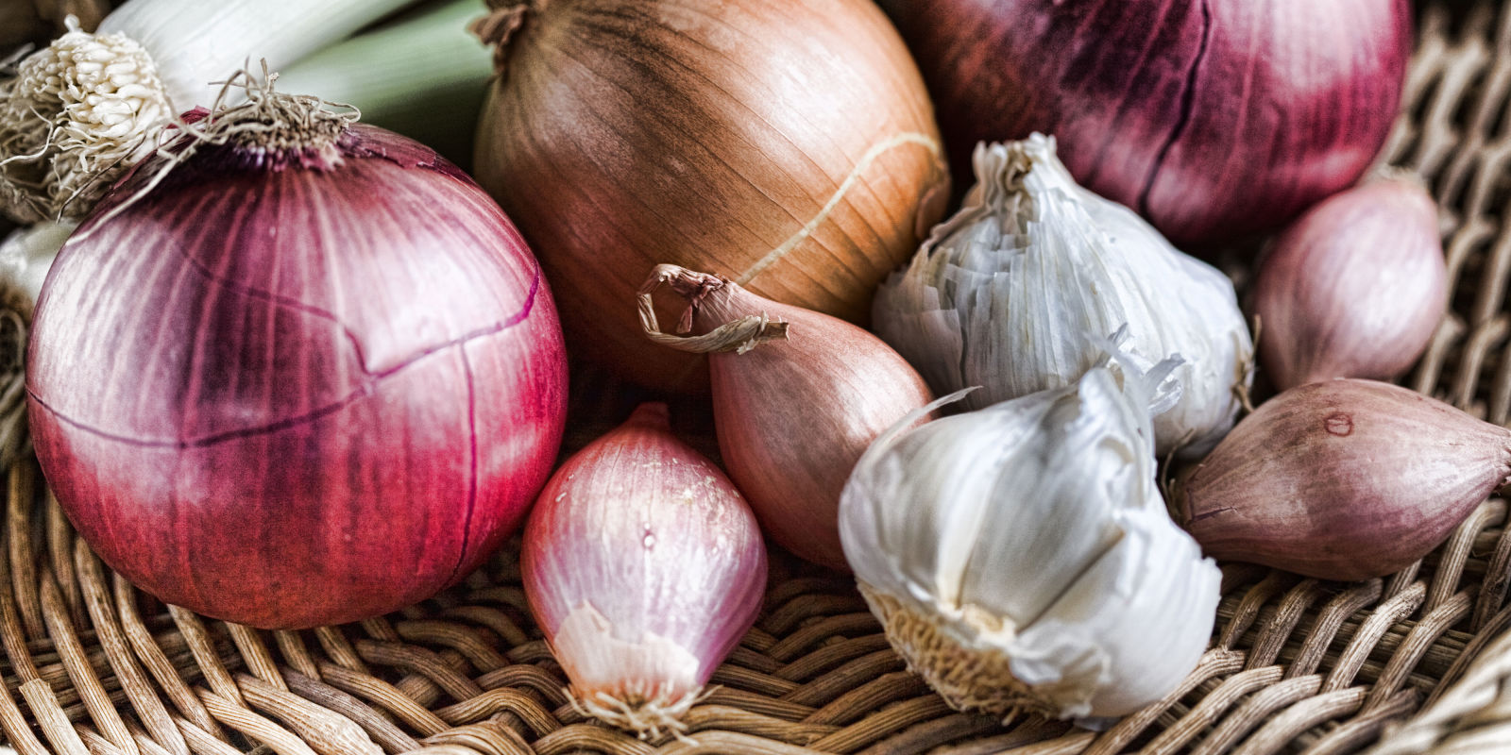
Diversify your Oral and Gut Biome
Sugar, Flour and Carbohydrate-Dense Grains
High-Quality Plant-Based Carbs
Oral and Gut
Microbiome
Inflammation
Neurotransmitters
Insulin Resistance
Weight and Metabolism
Mitochondria-Oxidative stress
HPA axis –Stress Response
Protection from:
Inflammation
Diabetes
Cancer
Obesity

Slide 9
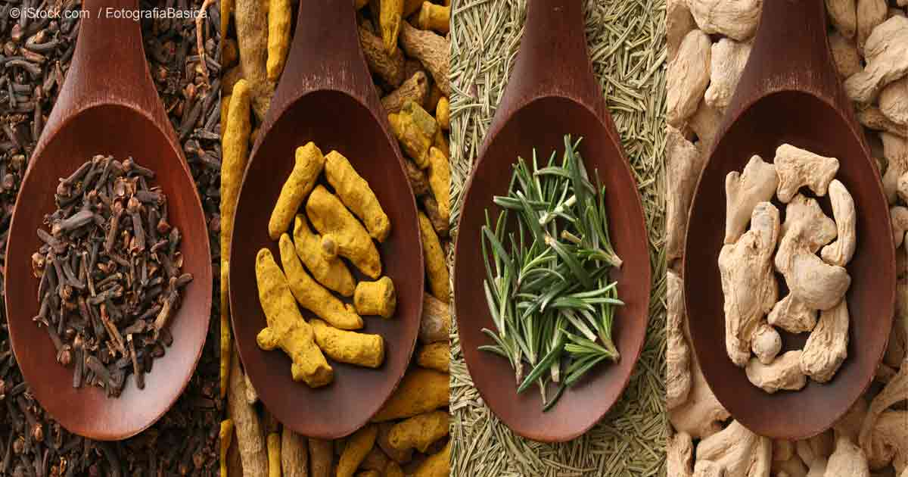
Anti-Inflammatory Spices
Black pepper
Turmeric
Rosemary
Ginger

Slide 10
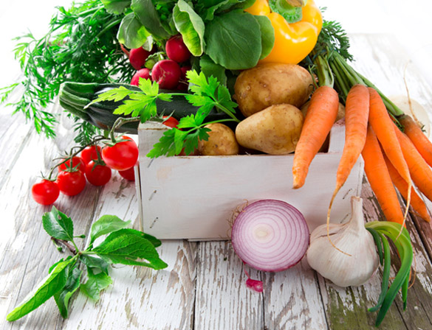
Phytonutrients
Polyphenols
Acanthocyanins
Flavanols
Carotenoids
Catechins
Glucosinolates

Slide 11
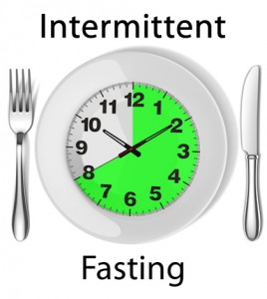
Time-Restricted Eating (TRE)
Time restricted feeding e.g. consume all food within 10-hour
Decreases in body weight and visceral fat
Significant reductions in breast cancer recurrence and improved prognosis (Patterson et al. UCSD: JAMA Oncol. 2016 August 1; 2(8): 1049–1055.)
Improved cardiovascular disease risk profile
Decreased inflammation (Biogerontology. 2015 Dec;16(6):775-88)
Decreased neuroinflammation (Neurobiol Aging. 2015 May;36(5):1914-23)
Autophagy (Autophagy, 2014;10:11, 1879-1882)
Effects of Intermittent Fasting on Health, Aging, and Disease: NEJM 381;26 December 26, 2019

Slide 12
Sleep Hygiene
Regular schedule-consistency
Limit daytime napping
Complete darkness
Cooler temperature
Bedroom for sleep and sex
Relaxing rituals
Limit screen time in the bedroom
Maximize comfort
Ideally not food consumption 2+ hours before bedtime
Minimize stimulants e.g. caffeine, alcohol

Slide 13
Let the photons flow

Slide 14
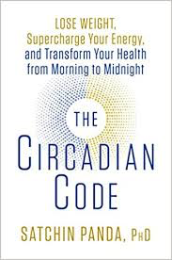
Circadian Entrainment
Sleep hygiene basics
15-30” full spectrum lighting twice/day (early morning and late afternoon-evening)
Vitamin D as an editor of our book of life
Blue light best from morning sunshine
Evening light: Incandescent 2700k, Halogen 3,000k, warm LED on dimmer
Blue light filters 2-3 hrs before bedtime (Iris pro)
Blue blocker glasses 2-3 hrs before bedtime
R. M. Lunn et al. “Health Consequences of Electric Lighting Practices in the Modern World: A Report on the National Toxicology of Shift Work, Artificial Light and Circadian Disruption.
Sci Tot Environment (2017): 1073-84

Slide 15
Forest Bathing
Shinrin-Yoku
Global health and quality of life improvements
Improvements in mind and mood
Lower inflammation
www.shinrin-yoku.org
Int. J. Environ. Res. Public Health 2017, 14, 851; doi:10.3390/ijerph14080851

Slide 16
Motion is the Lotion
Walk continuously
Make movement fun
Dance to the music you love!
The Holy Grail from a disease risk-reduction perspective
Prolonged sitting is dangerous and not “undone” with regular exercise
Improved mood, resilience, less pain, less inflammation, improved insulin sensitivity, decreased anxiety

Slide 17
Laughter Really is Good Medicine
Amazing capacity to reduce stress response
Social connection greatly enhanced
Lower markers of inflammation, pain, and anxiety
Enhanced secretory IgA production

Slide 18
Embracing the moment you are in: The Power of the “Pause”
Mindfulness practices powerfully proven to reduce disease risk
Epigenetic effects shown to reduce inflammation, improve insulin sensitivity
Improved mood, resilience, reduced anxiety
Improved performance, creativity and problem-solving capacity
MBSR, meditation, prayer, yoga, journaling, tai chi

Slide 19
News and Information Detox
Chronic states of fear are devastating to one’s immunity and health

Slide 20
Consciousness – Our Perceptions Shape Our Reality
Much of what impacts our biology and our biography can be traced to our beliefs-perceptions.
Beliefs-perceptions that are not serving you well will lead to emotions and thoughts that will tip the balance of your sympathetic fight-flight response vs your parasympathetic connection to the “whole”.
Changing one’s health and quality of life requires changing one’s beliefs-perceptions in a way that aligns with one’s passion.

Slide 21
The Quantum Roadmap
Follow that which ignites your passion, that which creates meaning in your life
Take it as far as you possibly can to the best of your ability
Attach no expectations or insistence on the outcome
The more positive one’s interpretation and response to whatever outcome emerges, the greater the likelihood of your experiences “providing you” with what you need to learn and to evolve physically, mentally, emotionally and spiritually.
Go with the flow of synchronicity…..ride the wave

Slide 22
“Everything can be taken from a man but one thing: the last of the human freedoms-to choose one’s attitude in any given set of circumstances, to choose one’s own way.”
Viktor Frankl

Slide 23
You are the person you’ve been waiting for!

