Slide 1
Improving Sleep Quality
May 28, 2020
Mark C. Pettus MD
Director Population Health and Community Care
Berkshire Health Systems

Slide 2
Circadian Disruption

Slide 3
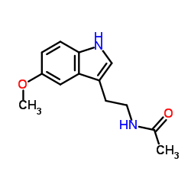
Melatonin
Hormone of darkness
Very sensitive to blue light
Facilitates sleep cycle
Increases cell regeneration
Anti-oxidant activity; ROS scavenger
Antagonizes Aromatase and lowers estrogen production in tissues
Modulates immune regulatory function
Antagonizes cortisol
Key substance for chronobiologic adaptation (day/night and summer/winter)

Slide 4
Earth, at the equator is spinning approximately 1,000 miles/hour around its axis
Earth is orbiting the sun, moving approximately 66,600 miles/hour
Diurnal rhythm is central to the existence of all life on our planet

Slide 5
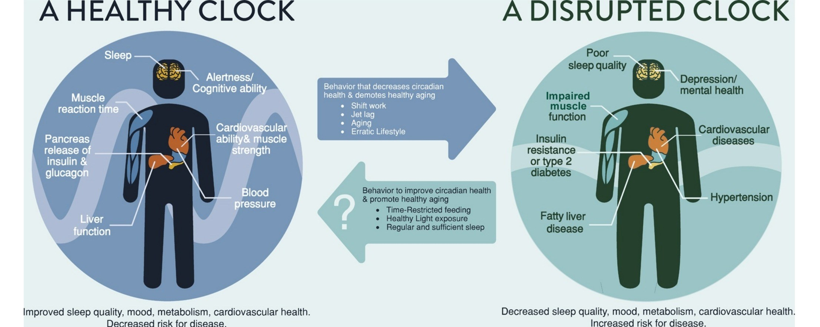
Satchin Panda PhD, Salk Institute

Slide 6
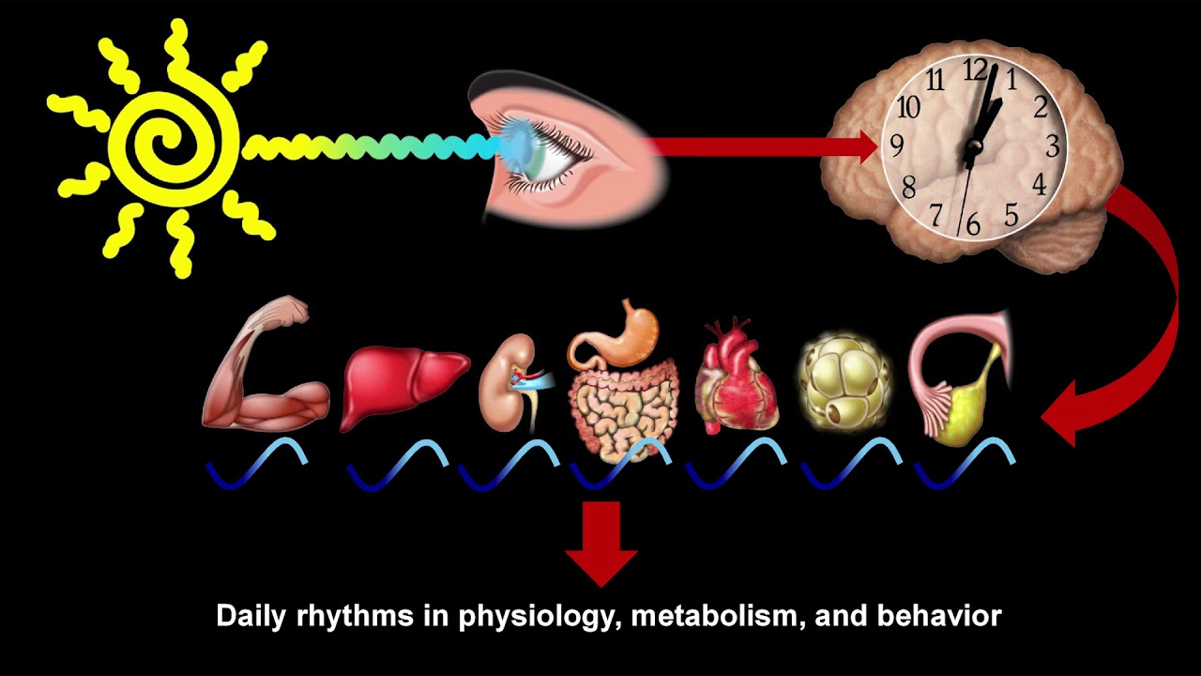
Satchin Panda PhD, The Salk Institute

Slide 7
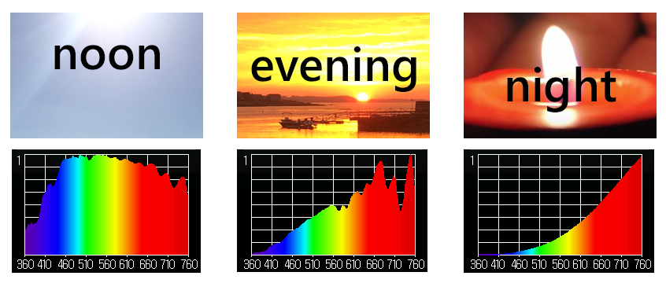
Sunlight and Circadian Entrainment
Blue Light: Turns on our circadian clocks in morning hours
Orange-Red: Healing frequencies that turn clocks off in evening-overnight

Slide 8
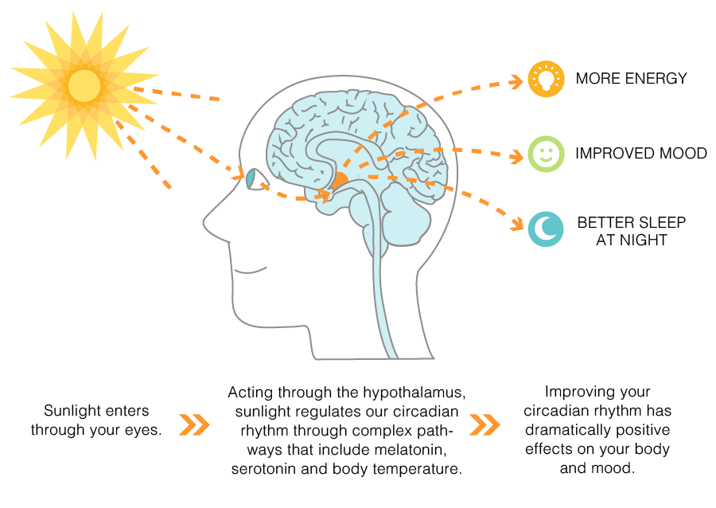

Slide 9
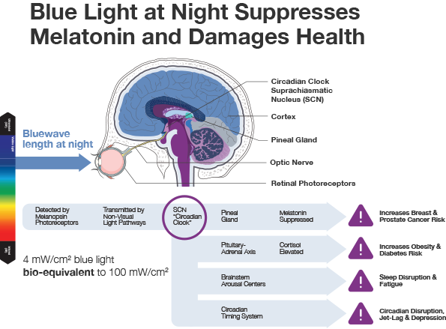
Aging and Mechanisms of Disease (2017) 3:9 ;

Slide 10
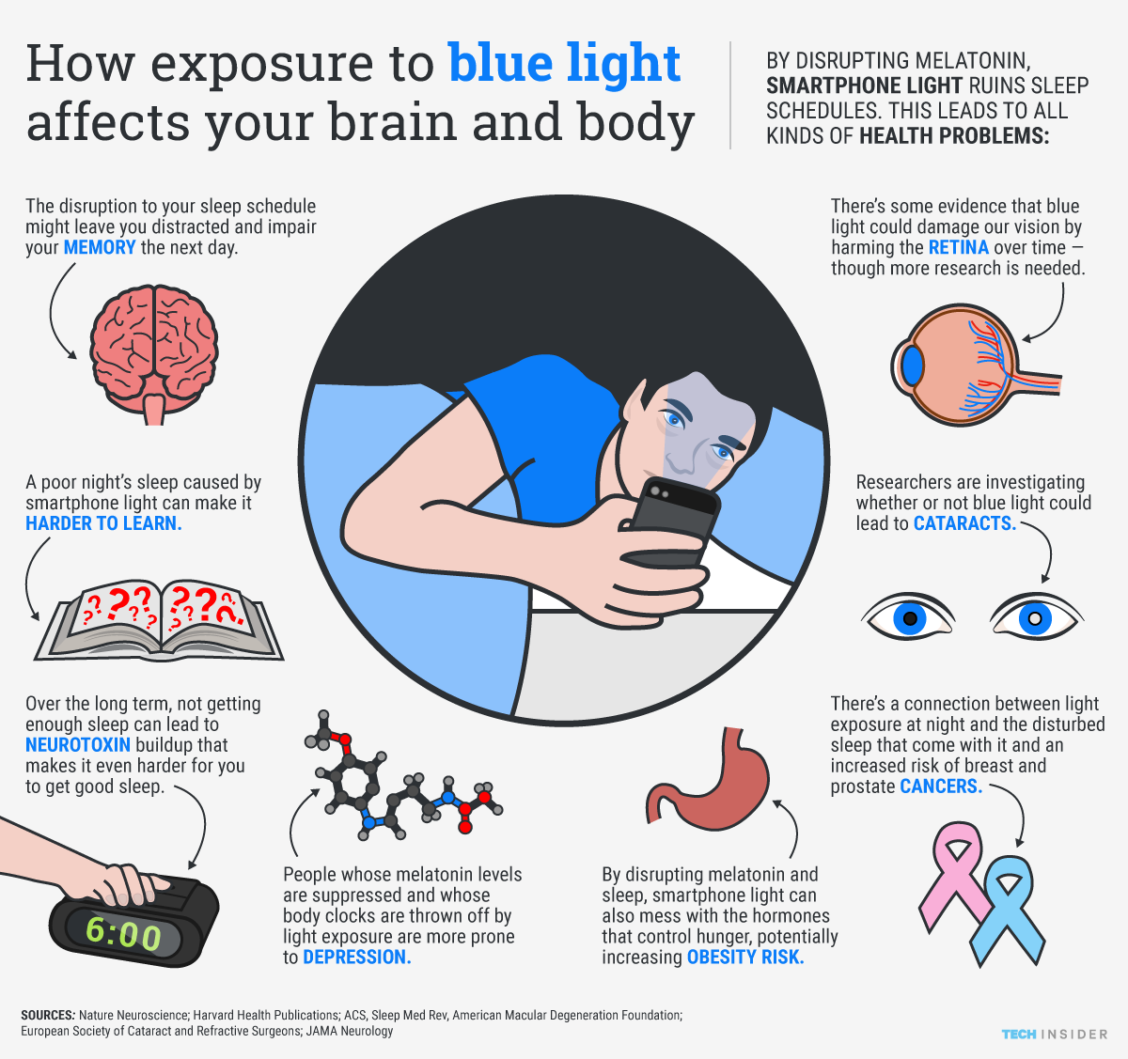
Aging and Mechanisms of Disease (2017) 3:9 ;

Slide 11
Sleep Hygiene
Regular schedule-consistency
Limit daytime napping
Complete darkness
Cooler temperature
Bedroom for sleep and sex
Relaxing rituals
Limit screen time in the bedroom
Maximize comfort
Ideally not food consumption 2+ hours before bedtime
Minimize stimulants e.g. caffeine, alcohol

Slide 12
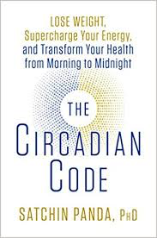
Circadian Entrainment
Sleep hygiene basics
Consider an evaluation for obstructive sleep apnea
30” full spectrum lighting/day (early morning and late afternoon-evening)
Blue light best from morning sunshine
Evening light: Incandescent 2700k, Halogen 3,000k, warm LED on dimmer
Blue light filters 2-3 hrs before bedtime (Iris pro)
Blue blocker glasses 2-3 hrs before bedtime
Time Restricted Feeding: 10-hr window a powerful intervention; nothing to eat 2-3 hrs prior to bedtime. Significant improvements in sleep quality.
R. M. Lunn et al. “Health Consequences of Electric Lighting Practices in the Modern World: A Report on the National Toxicology of Shift Work, Artificial Light and Circadian Disruption.
Sci Tot Environment (2017): 1073-84

Slide 13
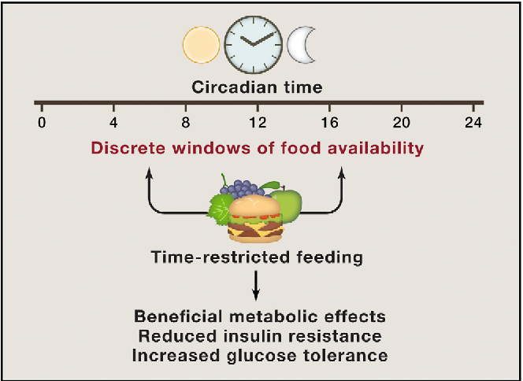

Slide 14
Embracing the moment you are in: The Power of the “Pause”
Mindfulness practices powerfully proven to reduce disease risk
Epigenetic effects shown to reduce inflammation, improve insulin sensitivity
Improved mood, resilience, reduced anxiety
Improved performance, creativity and problem-solving capacity
5-5-5 breath; guided imagery; be still for 3”
Gratitude journal

Slide 15
Supplements to Assist Sleep
Melatonin 3-5 mg
L-theanine 200-400 mg
Chamomile, Passionflower tea (Sleepy Time)
Glycine 3-5 grams
CBD/THC

Slide 16
Zeitgebers

Slide 17
Motion is the Lotion
Walk continuously
Be efficient with exercise dose-response e.g. small doses of higher exertion; functional resistance with emphasis on core.
Dance to the music you love!
The Holy Grail from a disease risk-reduction perspective
Prolonged sitting is dangerous and not “undone” with regular exercise
Improved mood, resilience, less pain, less inflammation, improved insulin sensitivity, decreased anxiety

Slide 18
Forest Bathing
Shinrin-Yoku
Global health and quality of life improvements
Improvements in mind and mood
Lower inflammation
www.shinrin-yoku.org
Int. J. Environ. Res. Public Health 2017, 14, 851; doi:10.3390/ijerph14080851

Slide 19
Thank You!

