Slide 1
Health and the Rhythm of Life
June 4, 2020
Mark C. Pettus MD
Director Population Health and Community Care
Berkshire Health Systems
Associate Professor of Medicine
University of Massachusetts Medical School

Slide 3

Circadian Disruption

Slide 4
In this life we are not separate from nature. We are a part of nature, part of a complex ecosystem.
Our biology is synchronized with the rhythms of nature.
When we become disconnected from our innate diurnal rhythms our biology becomes disrupted.
Over time, this impacts our health and quality of life at many levels.

Slide 5

Earth, at the equator is spinning approximately 1,000 miles/hour around its axis
Earth is orbiting the sun, moving approximately 66,600 miles/hour
Diurnal rhythm is central to the existence of all life on our planet

Slide 7
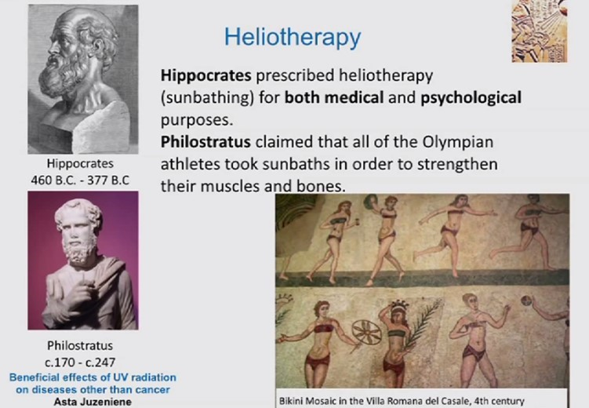

Slide 8
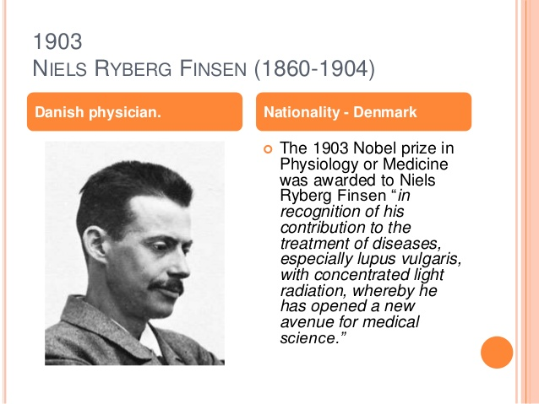

Slide 9
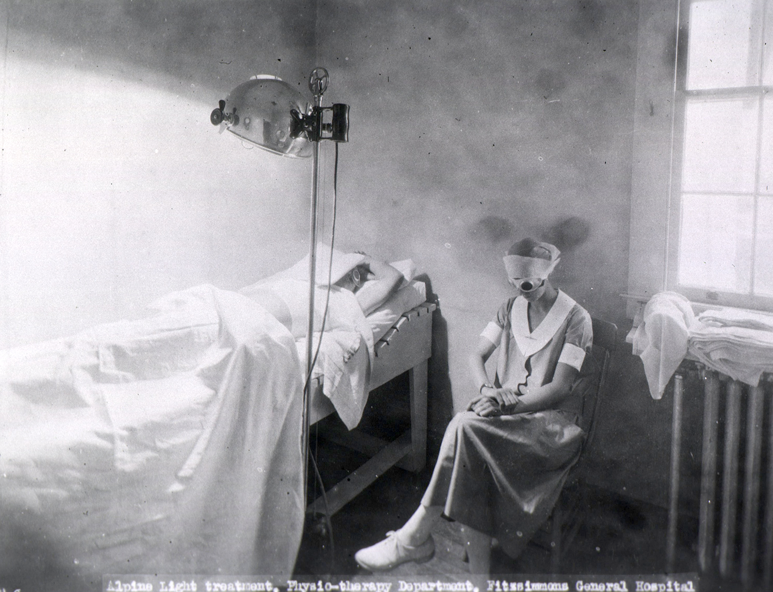

Slide 10
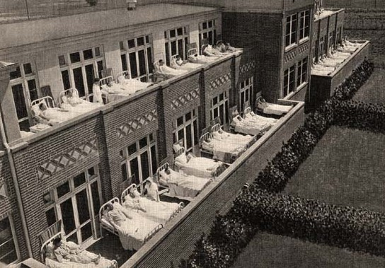

Slide 11
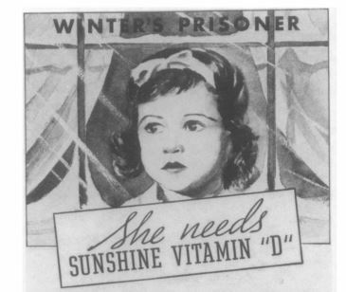
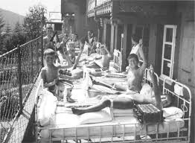
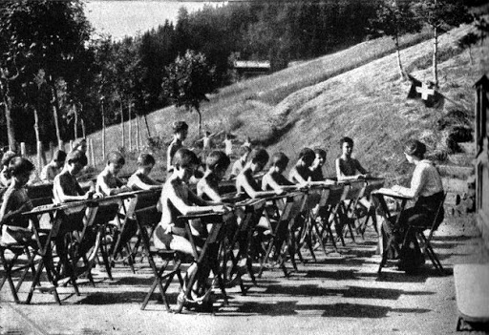

Slide 12
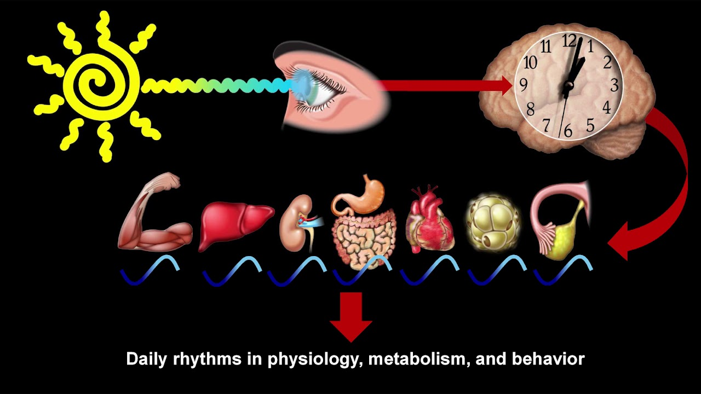
Satchin Panda PhD, The Salk Institute

Slide 13
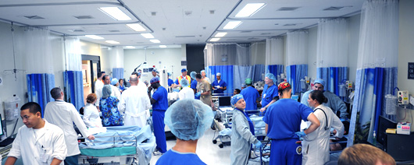
Fluorescent Lights and Night Shift Workers
NHS- Nurses Health Study (Harvard)
120,000 nurses followed 30+ years
30% increase of breast cancer after 15 years of night work
Other studies have shown increased risk up to 60%

Slide 14
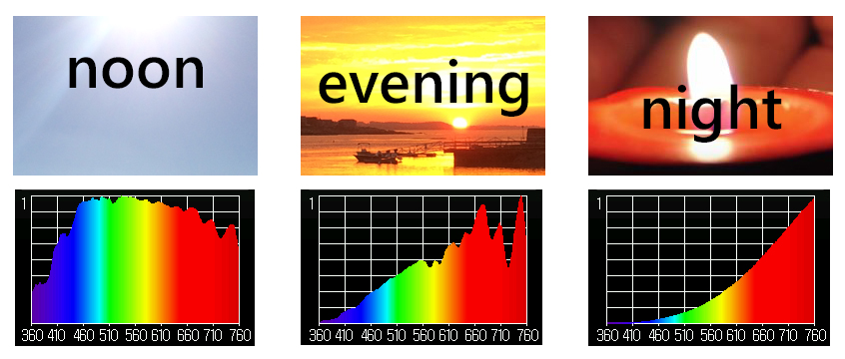
Sunlight and Circadian Entrainment
Blue Light: Turns on our circadian clocks in morning hours
Orange-Red: Healing frequencies that turn clocks off in evening-overnight

Slide 15
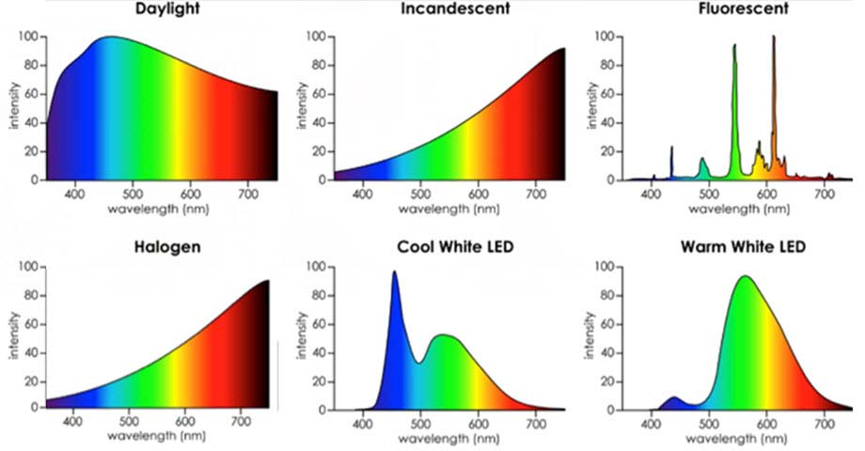
Desire Color Rendering Index (CRI) 95+ %
Color Temperature 2700-3000k

Slide 16
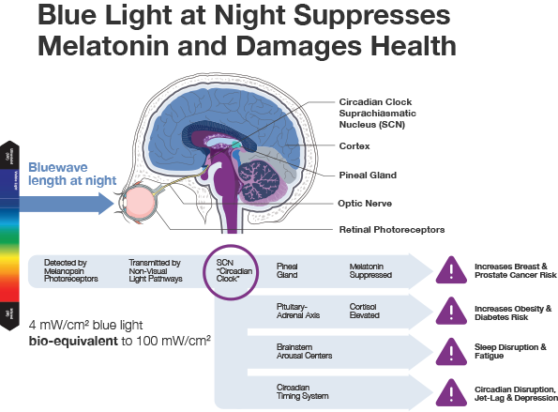
Aging and Mechanisms of Disease (2017) 3:9 ;

Slide 17
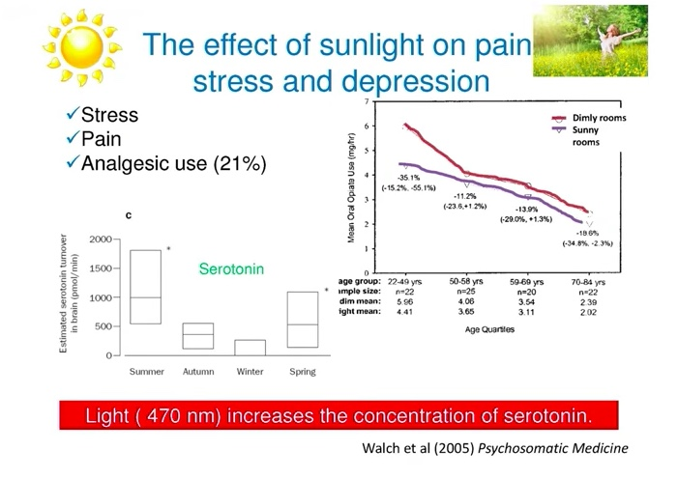

Slide 18
Sleep Hygiene
Regular schedule-consistency
Limit daytime napping
Complete darkness
Cooler temperature
Bedroom for sleep and sex
Relaxing rituals
Limit screen time in the bedroom
Maximize comfort
Ideally not food consumption 2+ hours before bedtime
Minimize stimulants e.g. caffeine, alcohol

Slide 19
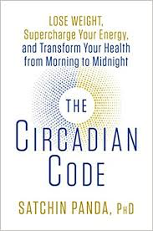

Circadian Entrainment
Sleep hygiene basics
15-30” full spectrum lighting twice/day (early morning and late afternoon-evening)
Vitamin D as an editor of our book of life
Blue light best from morning sunshine
Evening light: Incandescent 2700k, Halogen 3,000k, warm LED on dimmer
Blue light filters 2-3 hrs before bedtime (Iris pro)
Blue blocker glasses 2-3 hrs before bedtime
R. M. Lunn et al. “Health Consequences of Electric Lighting Practices in the Modern World: A Report on the National Toxicology of Shift Work, Artificial Light and Circadian Disruption.
Sci Tot Environment (2017): 1073-84

Slide 20
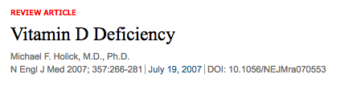
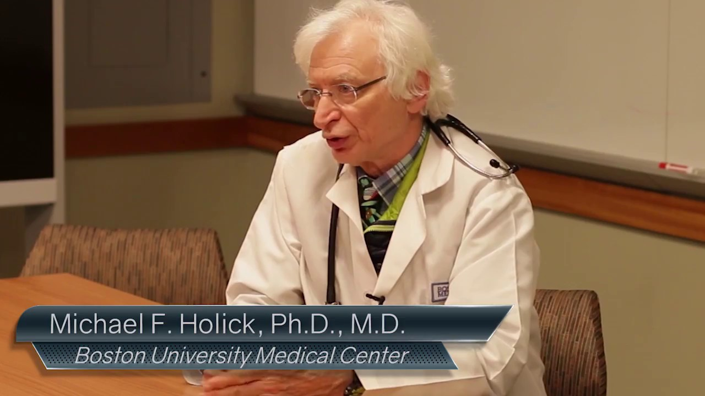
Author of the UV Advantage
Sunblocks with factor 15+ reduce sulfated cholcalciferol by 99.9%
More thoughtful dosed sunlight exposure could reduce cancer incidence in USA by as much as 50%
Melanoma risk significantly reduced with occupational sun exposure

Slide 21
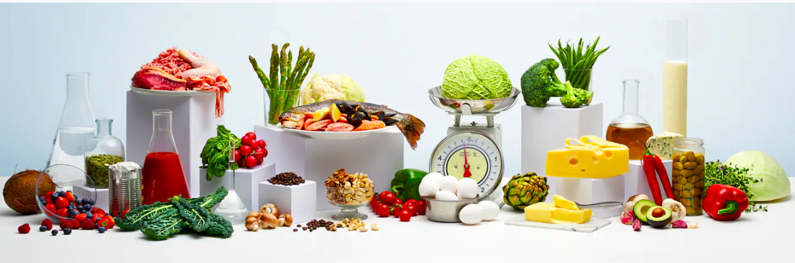
Nutrition and Immune Resilience

Slide 22
Nutritional Principles
Whole foods
Diversity
Nutrient – density/Vitamins
Low Glycemic
Fiber rich plant-based foods
Meal-timing
Supplements
Cod Liver Oil (Vit A/D/A)
Zinc 30 mg
Vitamin C 1-2,000 mg
Probiotics
Vitamin D (sun ideal); blood levels 30+

Slide 23
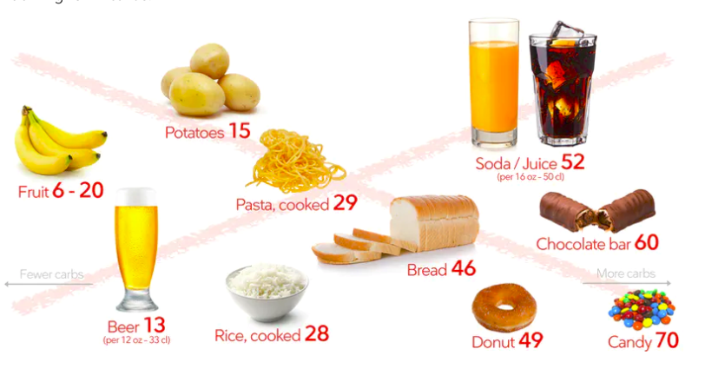
Reduce poor quality, processed, carbohydrate-dense foods
Added Sugar
Grain-based flour e.g. breads, cereal grains, pasta, pastries, desserts, chips, pretzels, granola bars.
Higher Fructose Fruits e.g. bananas, grapes, pears
Dried fruits e.g. raisins, apricots, cherries
Sweetened soft drinks
Beer is liquid bread
Gradual reintroduction of starchy vegetables after 8-12 weeks, e.g. white rice, carrots, parsnips, white potatoes
Lowered insulin and reduced inflammation “unlock” fat burning
All Carbs
Low
Glycemic

Slide 24
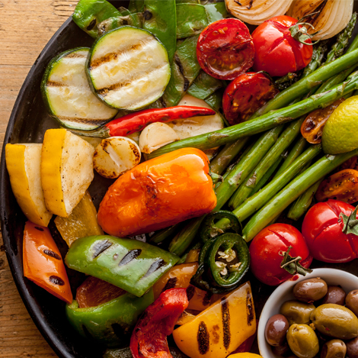
Plant-based foods
High nutrient density
Fermentable Fiber essential for gut biome diversity
2 cups greens/day is a nice goal
Cruciferous e.g. broccoli, cauliflower, collards, cabbage, kale, spinach, asparagus, romaine lettuce, arugula
Allium family e.g. onions, leeks, garlic
Beans and lentils; soaking and pressure cooking can be easier on the gut, reducing lectins
Lower glycemic fruits e.g. berries, grapefruit, kiwi
Fermentable foods e.g. yogurt, sauerkraut

Slide 25

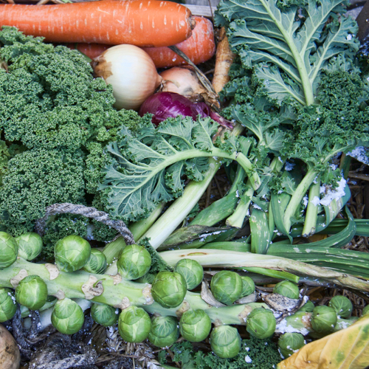
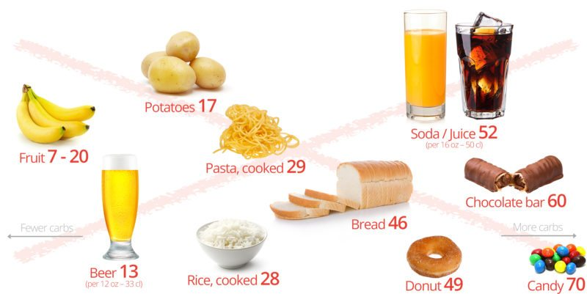
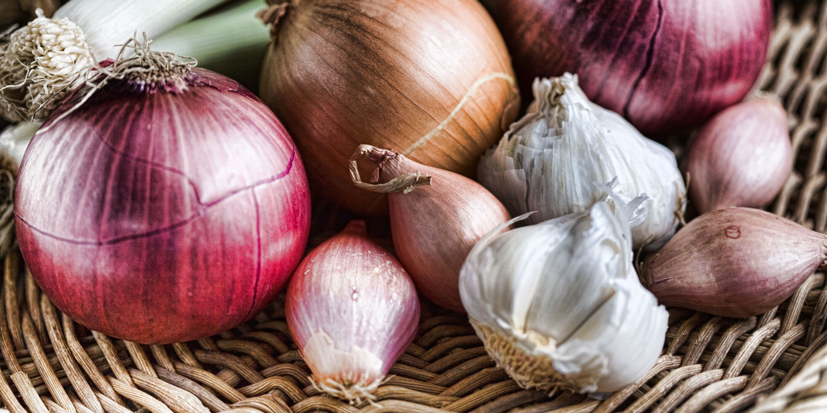
Diversify your Oral and Gut Biome
Sugar, Flour and Carbohydrate-Dense Grains
High-Quality Plant-Based Carbs
Oral and Gut
Microbiome
Inflammation
Neurotransmitters
Insulin Resistance
Weight and Metabolism
Mitochondria-Oxidative stress
HPA axis –Stress Response
Protection from:
Inflammation
Diabetes
Cancer
Obesity

Slide 26
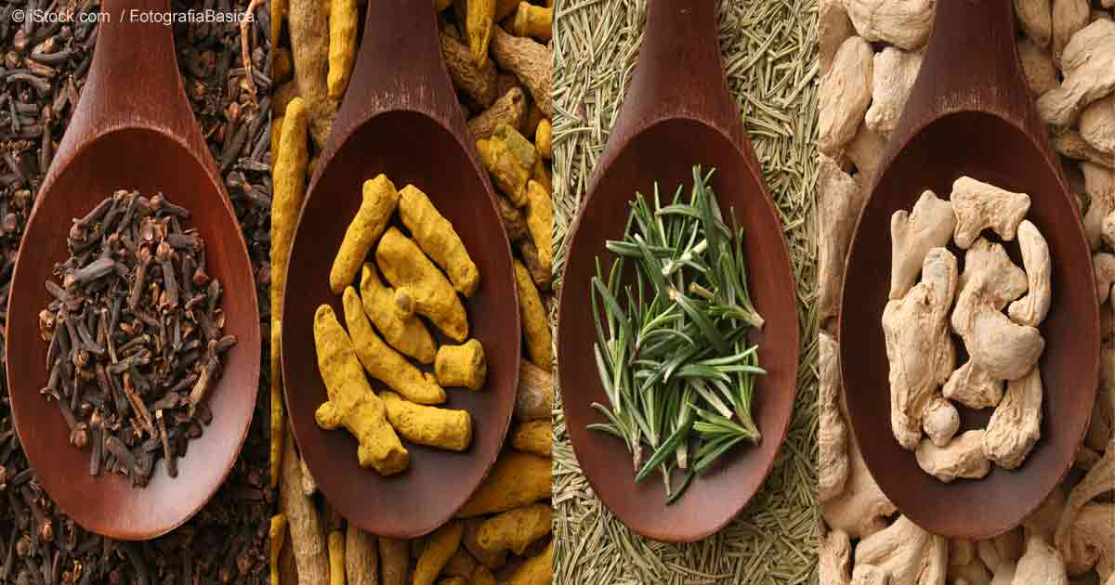
Anti-Inflammatory Spices

Slide 27
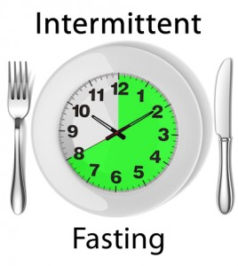
Time-Restricted Eating (TRE)
Time restricted feeding e.g. consume all food within 10-hour
Decreases in body weight and visceral fat
Significant reductions in breast cancer recurrence and improved prognosis (Patterson et al. UCSD: JAMA Oncol. 2016 August 1; 2(8): 1049–1055.)
Improved cardiovascular disease risk profile
Decreased inflammation (Biogerontology. 2015 Dec;16(6):775-88)
Decreased neuroinflammation (Neurobiol Aging. 2015 May;36(5):1914-23)
Autophagy (Autophagy, 2014;10:11, 1879-1882)
Effects of Intermittent Fasting on Health, Aging, and Disease: NEJM 381;26 December 26, 2019

Slide 28

Embracing the moment you are in:
The Power of the “Pause”
Mindfulness practices powerfully proven to reduce disease risk
Epigenetic effects shown to reduce inflammation, improve insulin sensitivity
Improved mood, resilience, reduced anxiety
Improved performance, creativity and problem-solving capacity
MBSR, meditation, prayer, yoga, journaling, tai chi

Slide 29
Forest Bathing
Shinrin-Yoku
Global health and quality of life improvements
Improvements in mind and mood
Grounding
Lower inflammation
www.shinrin-yoku.org
Int. J. Environ. Res. Public Health 2017, 14, 851; doi:10.3390/ijerph14080851

Slide 30
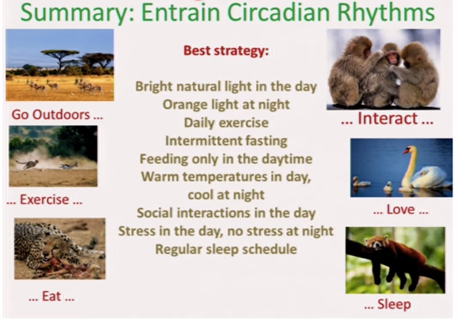
Zeitgebers: an environmental agent or event (such as the occurrence of light or dark) that provides the stimulus setting or resetting a biological clock

Slide 31
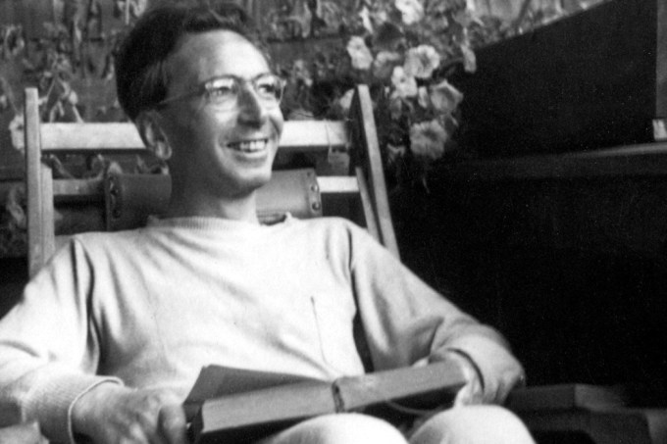
“Everything can be taken from a man but one thing: the last of the human freedoms-to choose one’s attitude in any given set of circumstances, to choose one’s own way.”
Viktor Frankl

Slide 32
Thank You!

