Slide 1
Thriving During Challenging Times
April 16, 2020
Mark C. Pettus MD
Director Population Health and Community Care
Berkshire Health Systems
Associate Professor of Medicine
University of Massachusetts Medical School

Slide 4
Immune-Metabolic Resilience

Slide 7
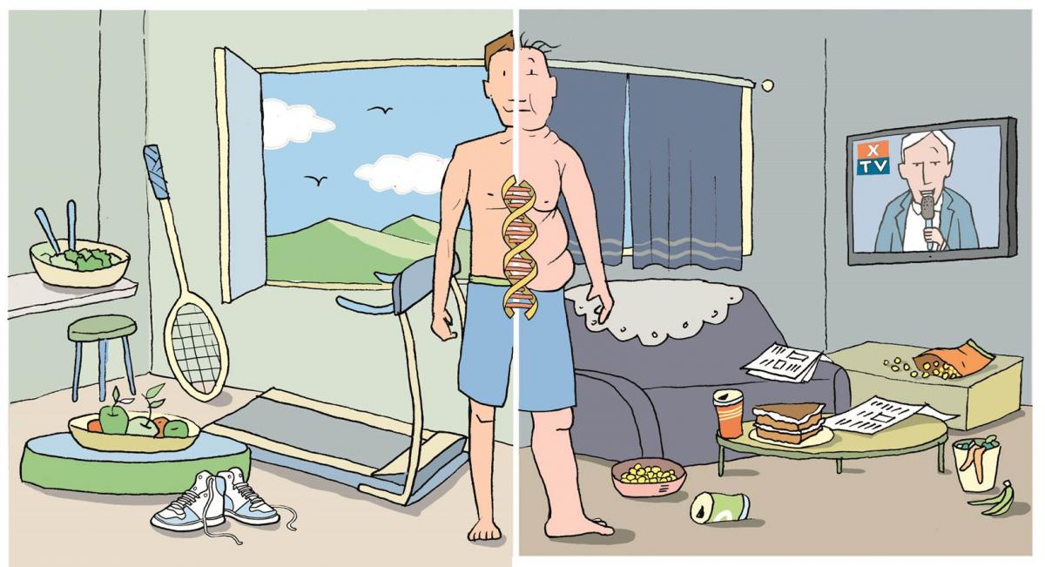
Epigenetics: a future of unlimited possibility
Life as a journey in a modern environment that can pose many challenges.

Slide 8
News and Information Detox

Slide 9
Nutrition and Immune Resilience

Slide 10
Nutritional Principles
Whole foods
Diversity
Nutrient – density
Low– Glycemic
Fiber – rich
Meal-timing
Metabolic Effects-Immune Resilience
Neuroplasticity
Anti-inflammatory
Increased Insulin sensitivity
Gut biome diversity-fermentation
Epigenetic modulation
Upregulate resiliency pathways

Slide 11
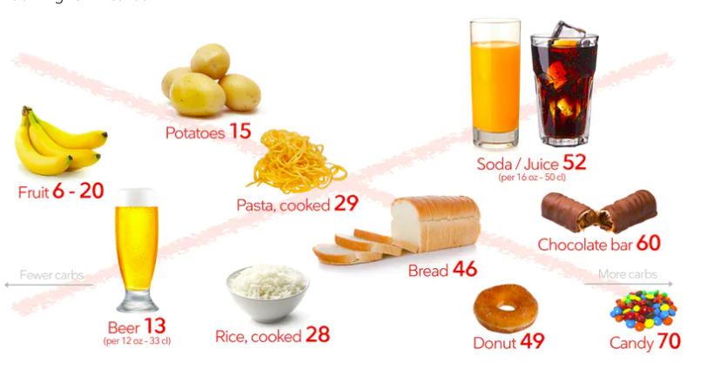
Reduce poor quality, processed, carbohydrate-dense foods
Added Sugar
Grain-based flour e.g. breads, cereal grains, pasta, pastries, desserts, chips, pretzels, granola bars.
Higher Fructose Fruits e.g. bananas, grapes, pears
Dried fruits e.g. raisins, apricots, cherries
Sweetened soft drinks
Beer is liquid bread
Gradual reintroduction of starchy vegetables after 8-12 weeks, e.g. white rice, carrots, parsnips, white potatoes
Lowered insulin and reduced inflammation “unlock” fat burning
All Carbs
Low
Glycemic

Slide 12
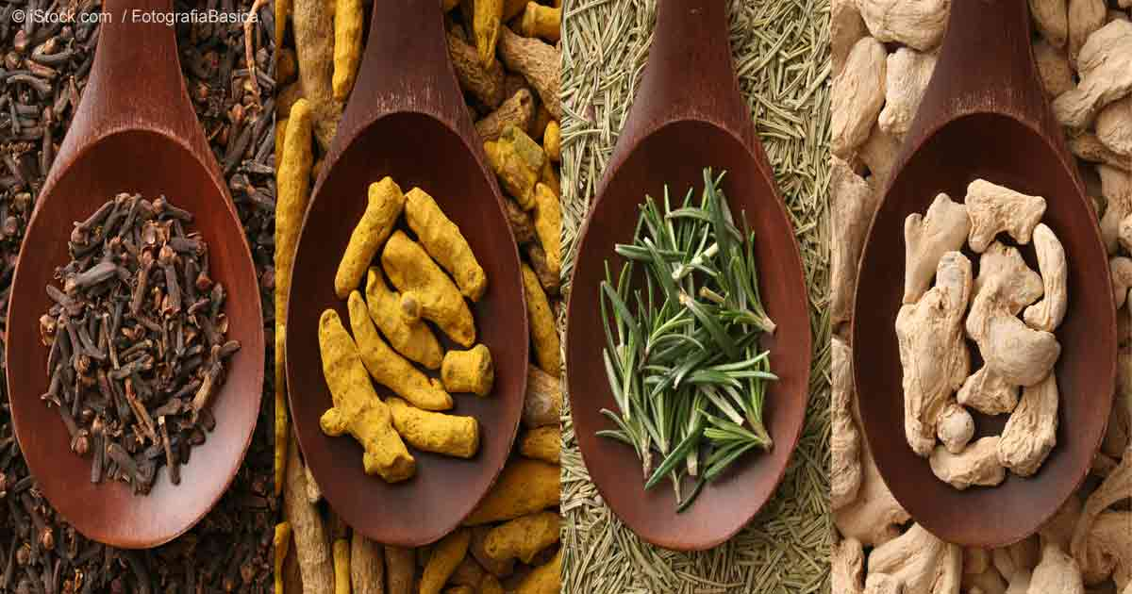
Anti-Inflammatory Spices

Slide 13
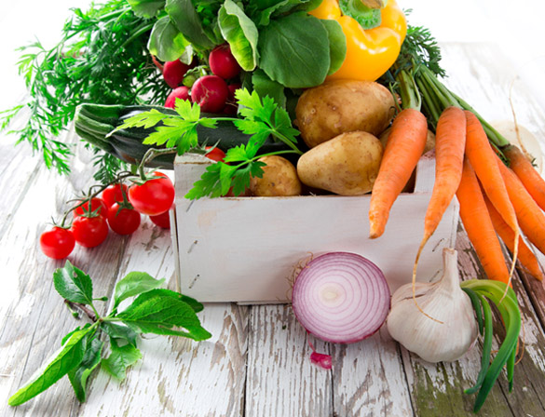
Phytonutrients
Polyphenols
Acanthocyanins
Flavanols
Carotenoids
Catechins
Glucosinolates

Slide 14
Let the photons flow

Slide 15
Forest Bathing
Shinrin-Yoku
Global health and quality of life improvements
Improvements in mind and mood
Lower inflammation
www.shinrin-yoku.org
Int. J. Environ. Res. Public Health 2017, 14, 851; doi:10.3390/ijerph14080851

Slide 16
Motion is the Lotion
Walk continuously
Make movement fun
Dance to the music you love!
The Holy Grail from a disease risk-reduction perspective
Prolonged sitting is dangerous and not “undone” with regular exercise
Improved mood, resilience, less pain, less inflammation, improved insulin sensitivity, decreased anxiety

Slide 17
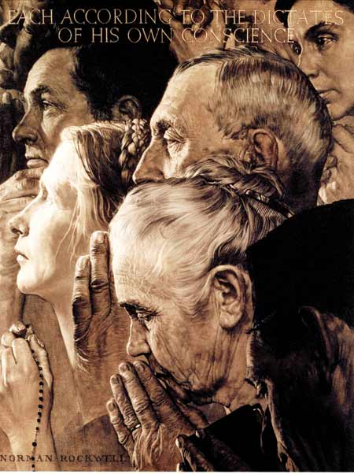
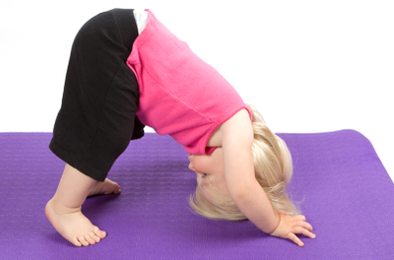
Stress Reduction Techniques and Healthspan
Scores of randomized controlled trials demonstrating alterations in gene expression of inflammation markers e.g. NFkB, IL-6, and C-reactive protein with meditation compared to controls (Benson, Davidson, McEwen)
Increased expression of telomerase and maintenance
of telomere length (Blackburn and Ornish)
Treatment group scored better on emotional wellness, resiliency (Benson, Ornish, Davidson)

Slide 18
Laughter Really is Good Medicine
Amazing capacity to reduce stress response
Social connection greatly enhanced
Lower markers of inflammation, pain, and anxiety
Enhanced secretory IgA production

Slide 19
Consciousness – Our Perceptions Influence Our Reality
Our thoughts interact with our DNA and morphogenic fields.
I am in a place of no control vs. I am able to influence many things in my mind and in my life.
I am a prisoner of my DNA versus I have endless possibilities.
I am alone versus I am connected to everything in this universe.
I am fearful of sunlight versus I am designed to be in relationship with light.

Slide 20
Heart Coherence Meditation
www.heartmath.com

Slide 21
“Everything can be taken from a man but one thing: the last of the human freedoms-to choose one’s attitude in any given set of circumstances, to choose one’s own way.”
Viktor Frankl

Slide 22
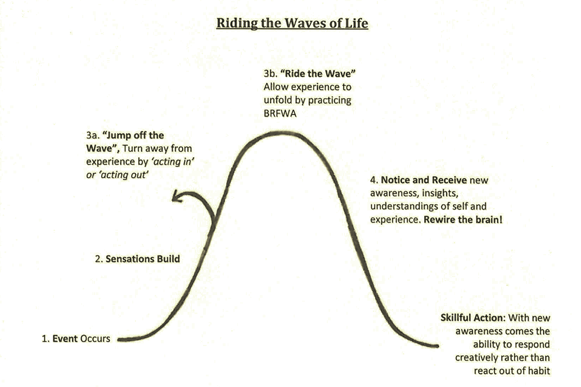
Breath
Relax
Feel
Watch
Action

Slide 23
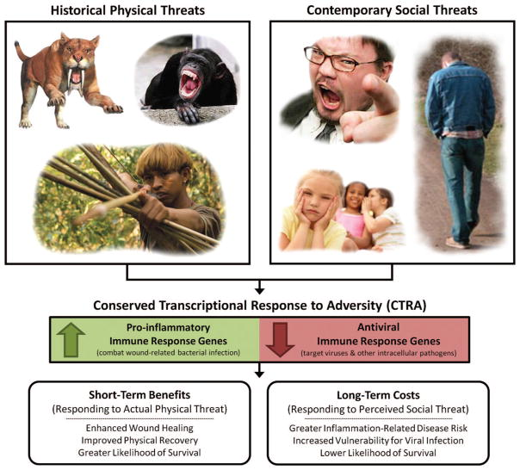
Slavich G et al. Psychological Bulletin © 2014 American Psychological Association 2014, Vol. 140, No. 3, 774–815

