Slide 1
Top 5 Lifestyle Medicine Themes for 2020
February 13, 2020
Mark Pettus MD
Director of Population Health and Community Care
Berkshire Health Systems

Slide 2
Journey to Health
Overview of popular wellness trends in 2020
Intermittent Fasting
Weight Loss Principles – Hypnosis
Improving Sleep for Overall Health: Dr. Jack Ringler
Breathing for Resilience: Angela Wilson, LMHC, CYT
Exercise for a healthy weight: Beth Piantoni CPT, CHWC

Slide 3
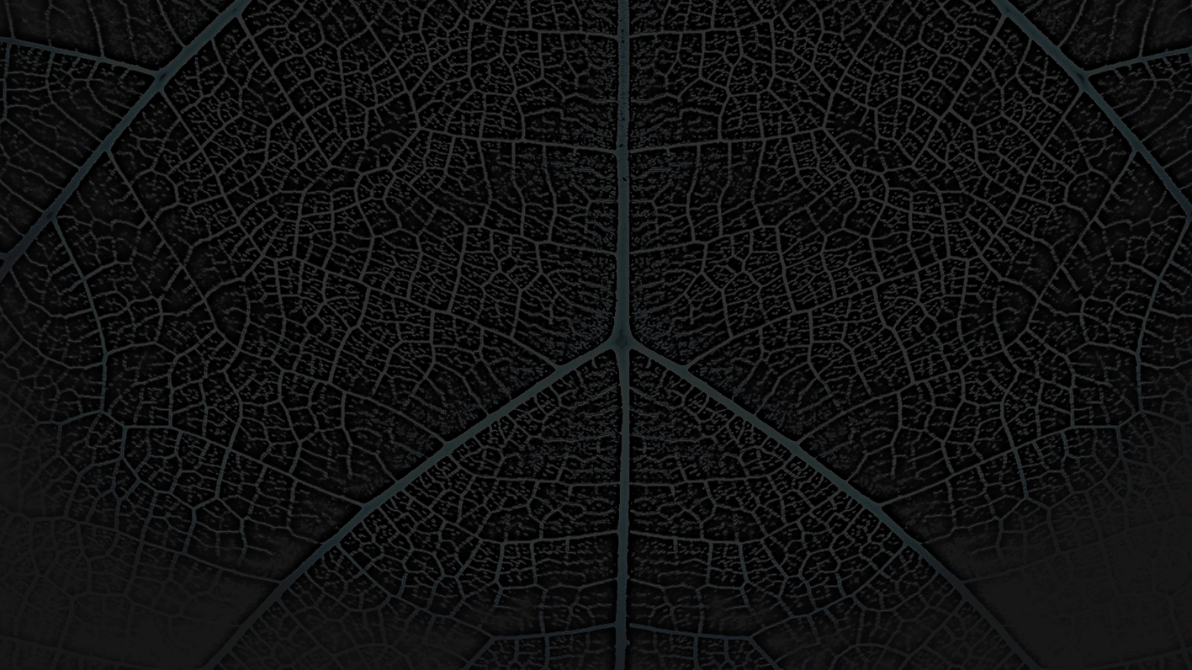
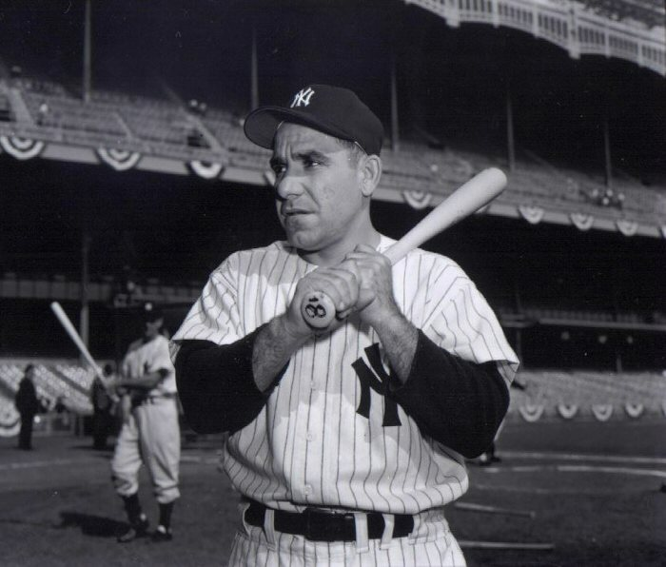
“The future ain’t what it used to be.”
Yogi Berra

Slide 4
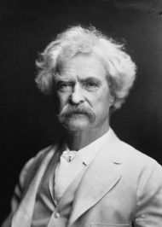
“It’s not what we don’t know that gets us into trouble. It’s what we know that ain’t so.”

Slide 5
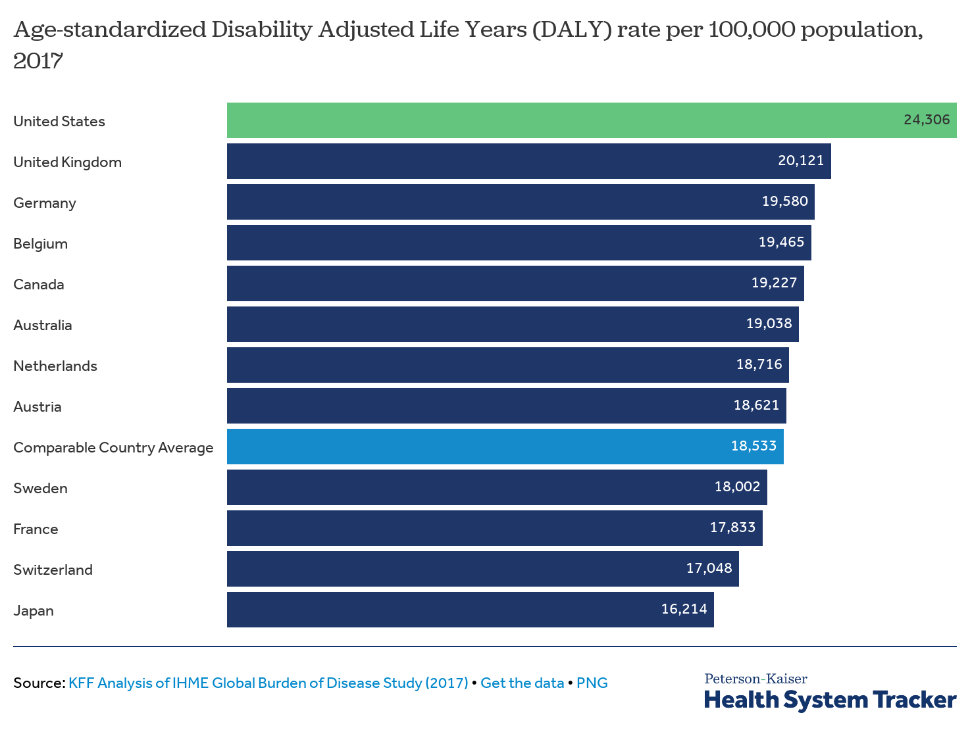
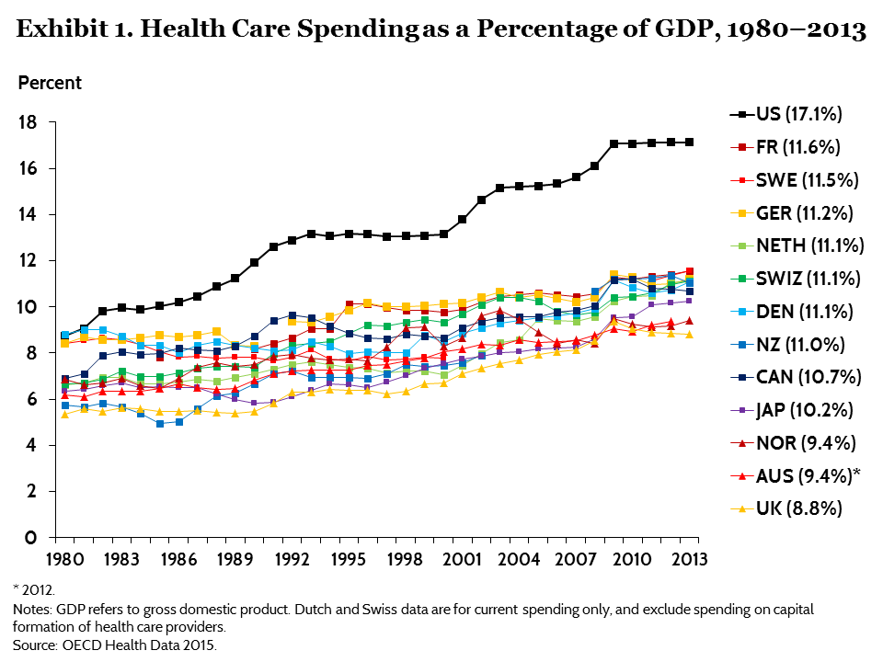
“It is, I guess, politically correct and widely believed that the American Health care system is the best in the world. It’s not”.
Don Berwick, Institute of Healthcare Improvement
Notes:
The Organisation for Economic Co-operation and Development.

Slide 6
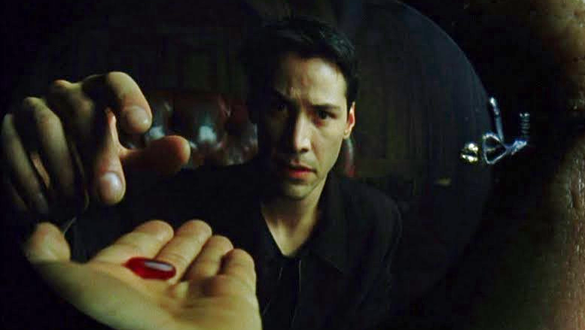
The Turning Point !

Slide 7
Current Biomedical Model
New Medicine
Lifestyle/IM
Diagnosis
Drugs, Surgery
Symptoms
Self-Care
Prevention
Root Causes
Drugs/Surgery
Notes:
Change colors for this

Slide 8
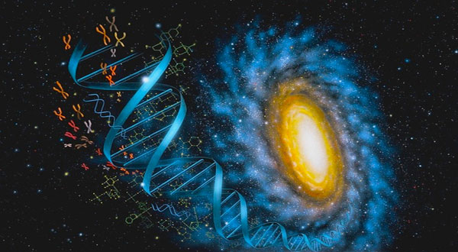
Hot areas of Lifestyle Medicine research
Epigenetics
Nutrition: Carb-restriction-keto diets
Microbiome
Social Connection - Love
Consciousness and Mind-Body Medicine

Slide 9
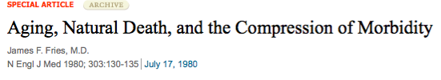
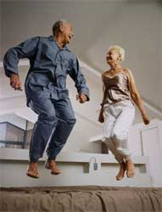
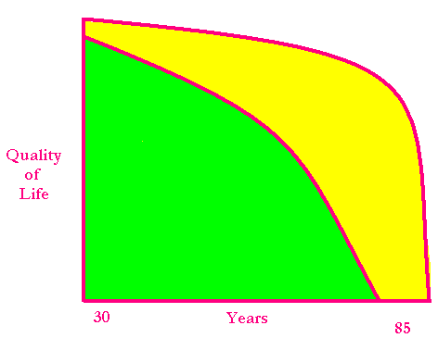
Healthspan
Notes:
Rectangularize the health curve
Healthspan…organ reserve

Slide 10
Lifestyle/Environment
Life
Genetics/Epigenetics
Microbiome
Consciousness-Spirituality-Meaning

Slide 11
“It from bit symbolizes the idea that every item of the physical world has at bottom…an immaterial source and explanation…that all things physical are information-theoretic in origin and that this is a participatory universe”
John Archibald Wheeler
Notes:
﻿“Everything is Particles” evolved to “Everything is Fields” which eventually evolved to “Everything is Information”.
Virk, Rizwan. The Simulation Hypothesis: An MIT Computer Scientist Shows Why AI, Quantum Physics and Eastern Mystics All Agree We Are In a Video Game . Bayview Books. Kindle Edition.

Slide 12
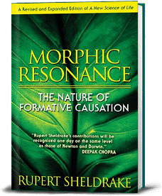
Rupert Sheldrake PhD
Morphogenic Fields and Morphic Resonance
Self-organizing systems inherit a memory from a previous similar systems
The extended mind
Knowing when someone is looking at you
Pets knowing when their “master’s are coming home”
Telepathy experiments
Psychedelics and collective consciousness
Mystical and spiritual experiences and health

Slide 13
Consciousness – Our Perceptions Create Our Reality
Our thoughts interact with our DNA and morphogenic fields.
The elusive answers are somewhere “out there to be found” versus inside and already present.
I am a prisoner of my DNA versus I have endless possibilities.
Slowing down and feeling poorly are normal, natural and inevitable consequences of getting older.
I am alone versus I am connected to everything in this universe.
I am fearful of sunlight versus I am designed to be in relationship with light.

Slide 14

We do not have to be prisoners of our DNA!

Slide 15
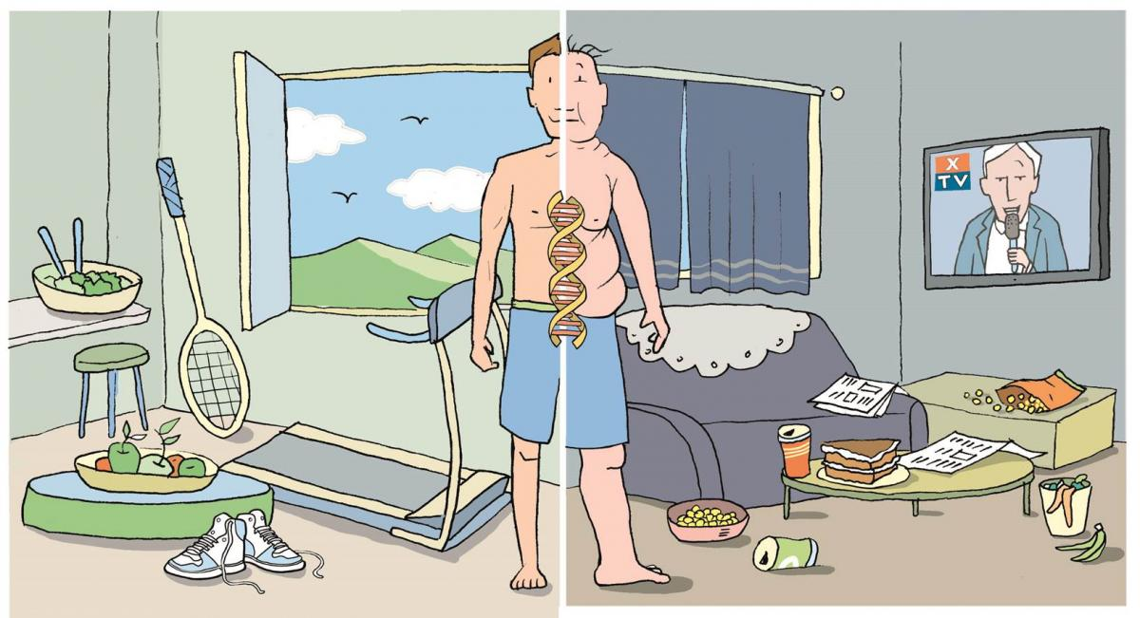
Epigenetics: a future of unlimited possibility
Life as a loving relationship between the observer and the observed.

Slide 16
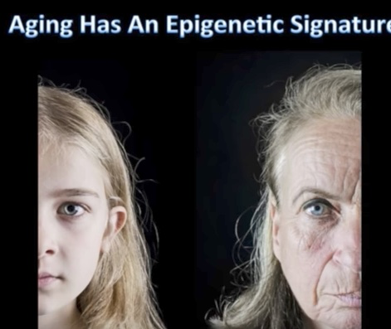
Aging has an Epigenetic Signature

Slide 17
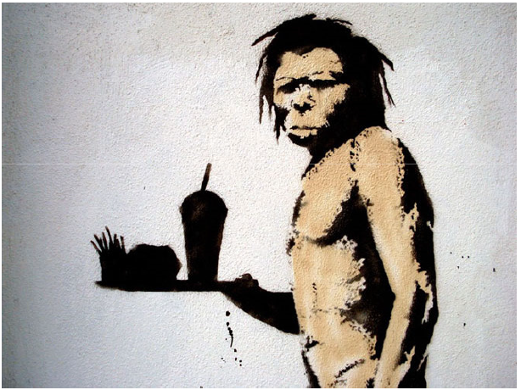
Health as a byproduct of environmental-gene-microbiome compatibility

Slide 18
Reduce poor quality, highly processed, carbohydrate-dense foods
Added Sugar
Grain-based flour e.g. breads, cereal grains, pasta, pastries, desserts, chips, pretzels, granola bars.
Wheat
Dried fruits e.g. raisins, apricots, cherries
Sweetened soft drinks
Beer – liquid bread
Lowered insulin and reduced inflammation “unlock” fat burning
All Carbs
Low
Glycemic

Slide 19
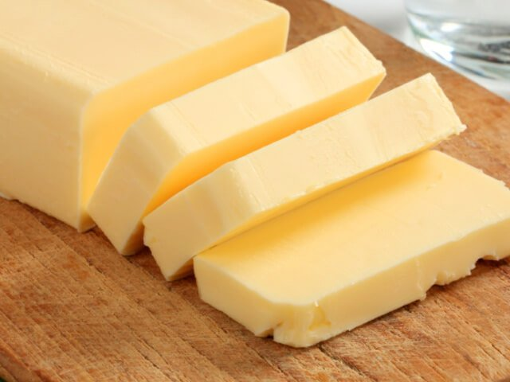
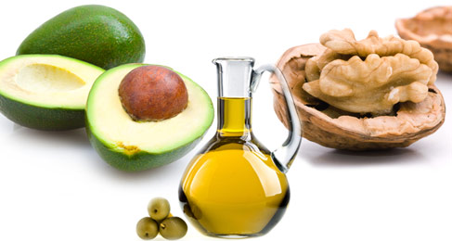
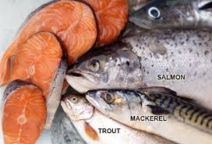
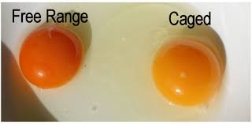
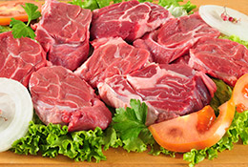
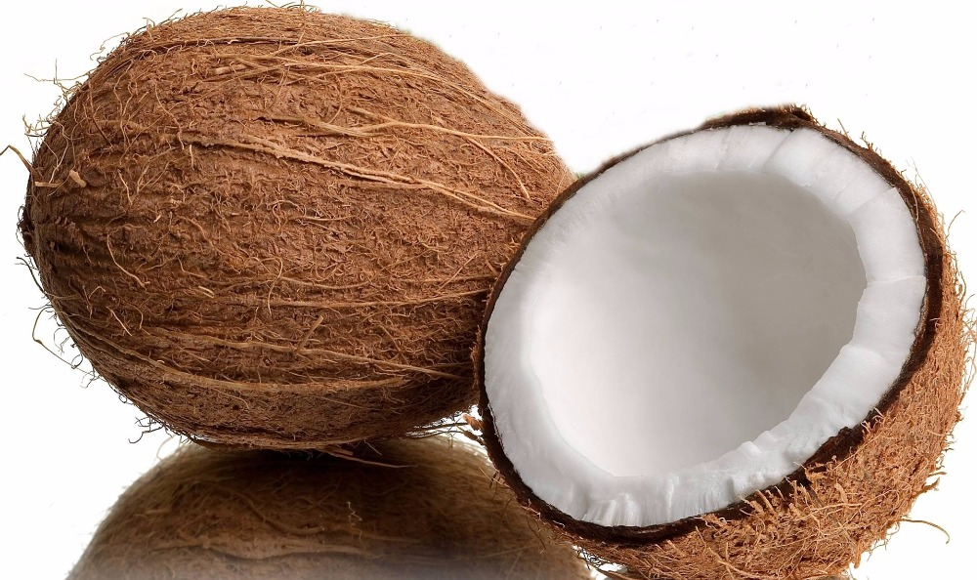
More quality fat sources
Pasture-raised eggs
Fatty fish e.g. salmon, sardines, mackerel
Grass-fed butter
Ghee
Pasture-raised meats
Shellfish
Whole fat yogurt, kefir
Extra virgin olive oil
Extra virgin coconut oil
Avocados, olives
Nuts - almonds, macadamia, walnuts

Slide 20

www.dietdoctor.com

Slide 21
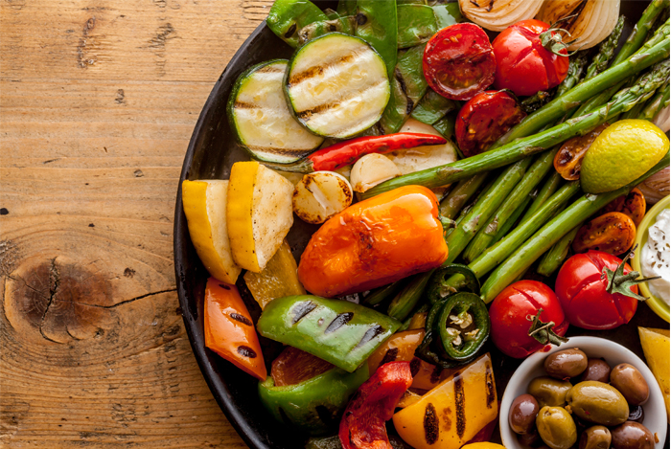
Plant-based foods
Fill half of plate with vegetables
2 cups greens/day is a nice goal
Cruciferous e.g. broccoli, cauliflower, collards, cabbage, kale, spinach, asparagus, romaine lettuce, arugula
Allium family e.g. onions, leeks, garlic
Beans and lentils; soaking and pressure cooking can be easier on the gut, reducing lectins
Lower glycemic fruits e.g. berries, grapefruit, kiwi
Anti-inflammatory spices e.g. turmeric, basil, ginger, rosemary, cayenne pepper
Fermentable Fiber essential for gut biome diversity
Fermentable foods e.g. yogurt, sauerkraut

Slide 22
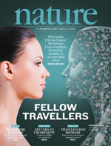
Take care of your microbiome
An emerging major contributor to human health and disease
An ecosystem of trillions of microbes that interact with us at the level of our DNA
Prebiotics are critical: Fermentable plant-based fiber
Probiotics for some
Cleaner sources e.g. USDA organic and GMO-free have fewer residues known to effect the gut ecosystem

Slide 23
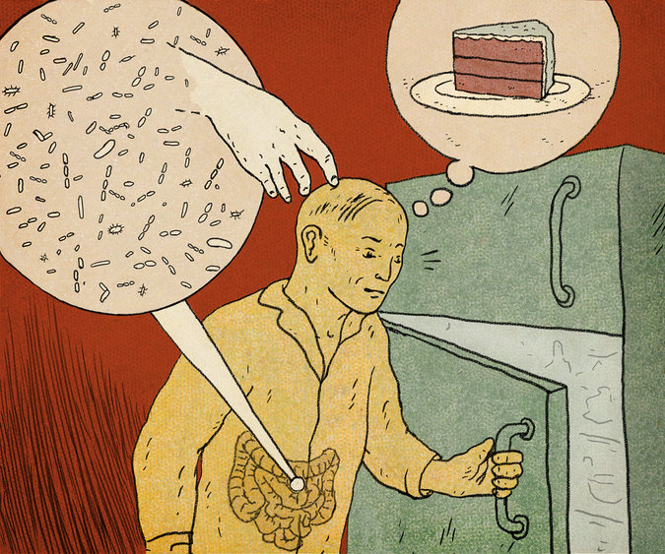

Slide 24
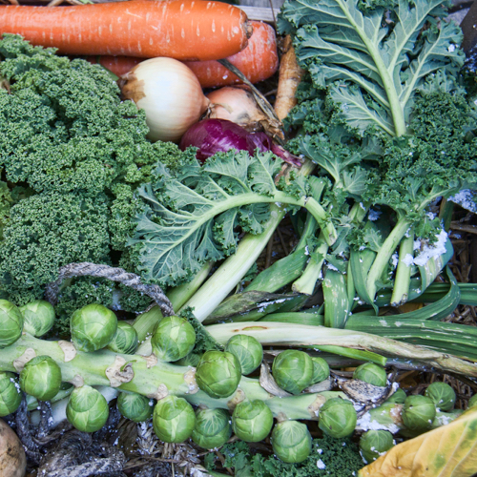
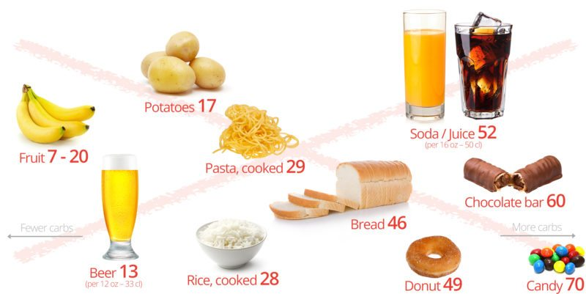
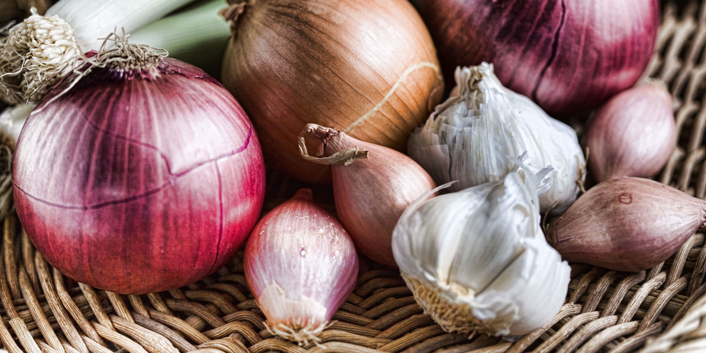
Take care of your microbiome
Sugar, Flour and Carbohydrate-Dense Grains
High-Quality Plant-Based Carbs
Oral and Gut
Microbiome
Inflammation
Neurotransmitters
Insulin Resistance
Weight and Metabolism
Mitochondria-Oxidative stress
HPA axis –Stress Response
Protection from:
Inflammation
Diabetes
Cancer
Obesity

Slide 25
Allostasis and Allostatic Load
The process of achieving stability or balance through physiological or behavioral change in response to changes in one’s environment.

Slide 26
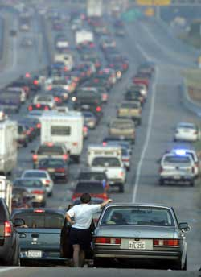

Fight-Flight or Sympathetic Tone

Slide 27
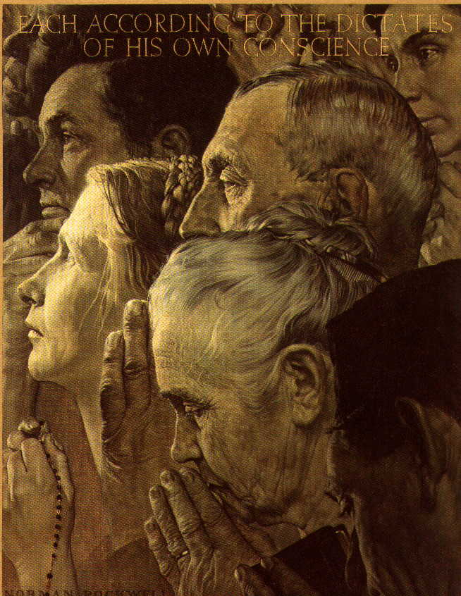
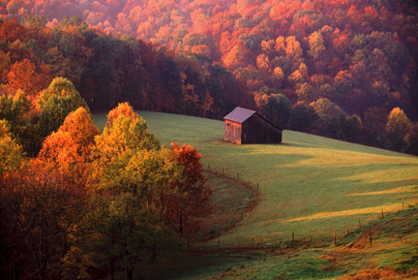
Calm or Parasympathetic Tone…..Get “Para”

Slide 28
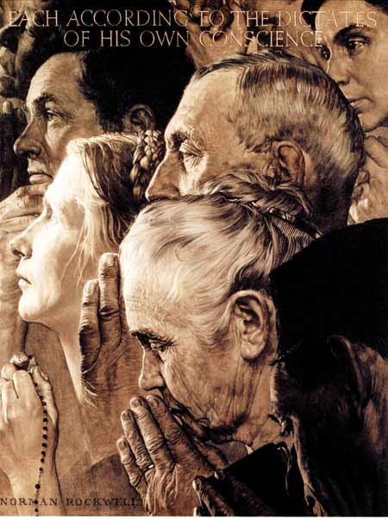



Stress Reduction Techniques and Healthspan
Scores of randomized controlled trials demonstrating alterations in gene expression of inflammation markers e.g. NFkB, IL-6, and C-reactive protein with meditation compared to controls (Benson, Davidson, McEwen)
Increased expression of telomerase and maintenance
of telomere length (Blackburn and Ornish)
Treatment group scored better on emotional wellness, resiliency (Benson, Ornish, Davidson)

Slide 29

Social Connection and Health
From an evolutionary biologic perspective we are born to bond
Powerful predictor of longevity and health, of the magnitude that smoking has.
Mirror neurons…EMF receivers/transmitters
Reduced stress states
Improved coping and resiliency
Reductions in chronic disease risk

Slide 30
Forest Bathing
Shinrin-Yoku
Global health and quality of life improvements
Improvements in mind and mood
Lower inflammation
www.shinrin-yoku.org

Slide 31
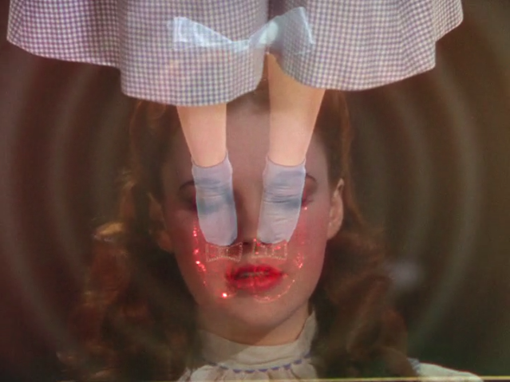
There’s no place like home…
and home is where you already are!

Slide 32
Thank You!
www.thehealthedgepodcast.com

