Slide 1
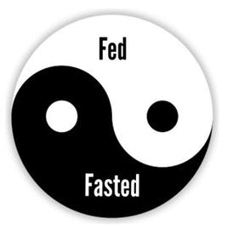
Fasting, Circadian Rhythms and Health
Mark Pettus MD
February 20, 2020
www.thehealthedgepodcast.com

Slide 2
Journey to Health
Overview of popular wellness trends in 2020
Intermittent Fasting - Circadian Rhythms
Weight Loss Principles – Hypnosis
Improving Sleep for Overall Health: Dr. Jack Ringler
Breathing for Resilience: Angela Wilson, LMHC, CYT
Exercise for a healthy weight: Beth Piantoni CPT, CHWC

Slide 3
Key Considerations:
All aspects of health and longevity are linked to circadian entrainment.
Meal timing and light quality are the two most powerful cues to circadian precision.
Modifying lifestyle and environment to create more effective circadian alignment is powerfully health promoting.

Slide 4
Cortisol and Melatonin Diurnal Rhythm

Slide 5
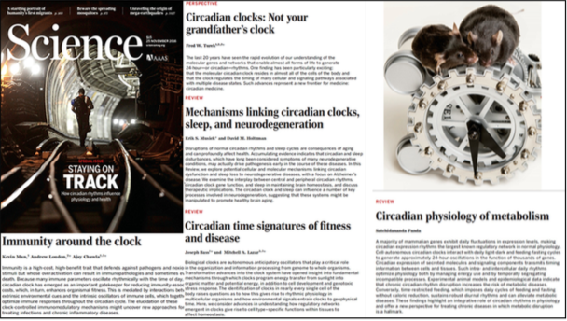

Slide 6
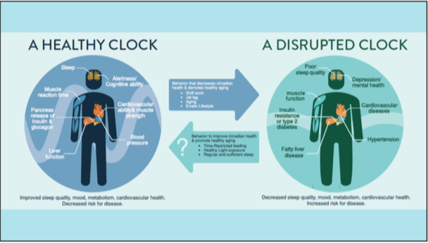

Slide 7
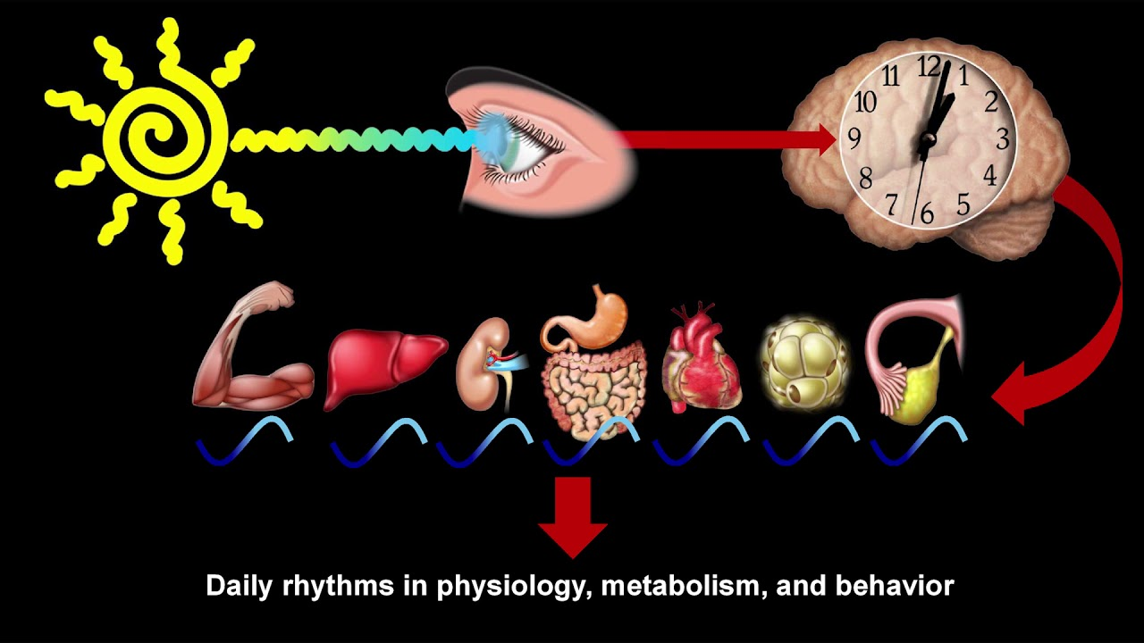

Slide 8
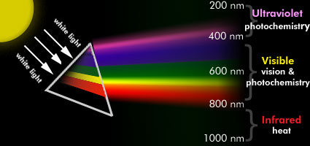

Slide 9
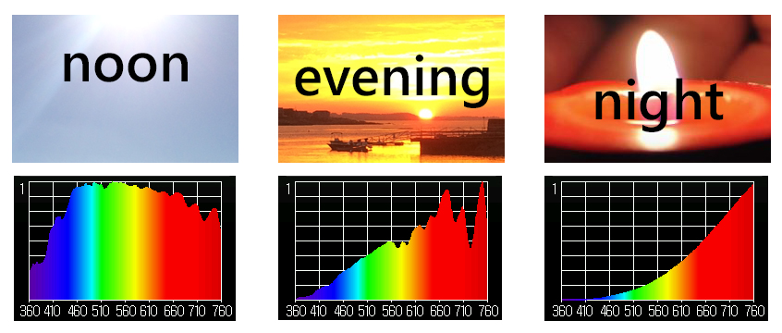

Slide 10
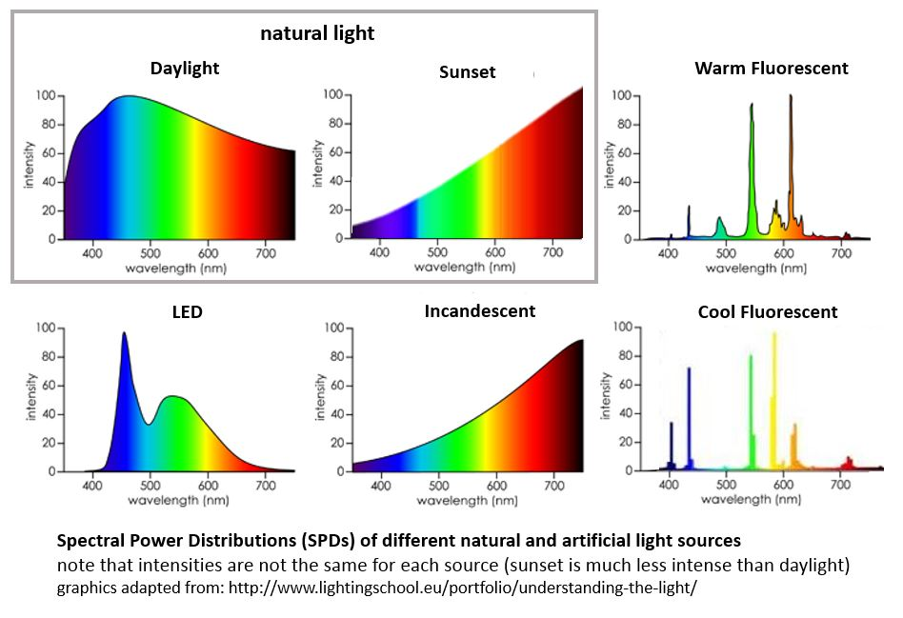

Slide 11
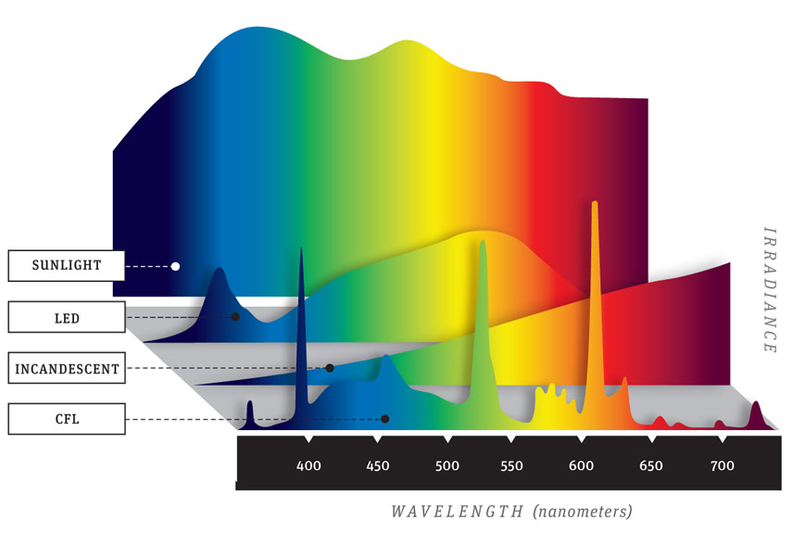

Slide 12
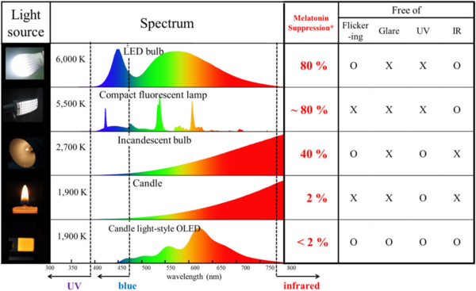

Slide 13
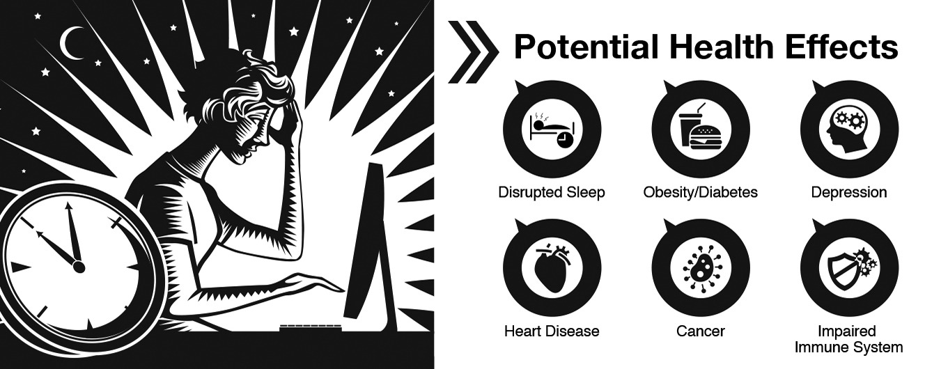

Slide 14
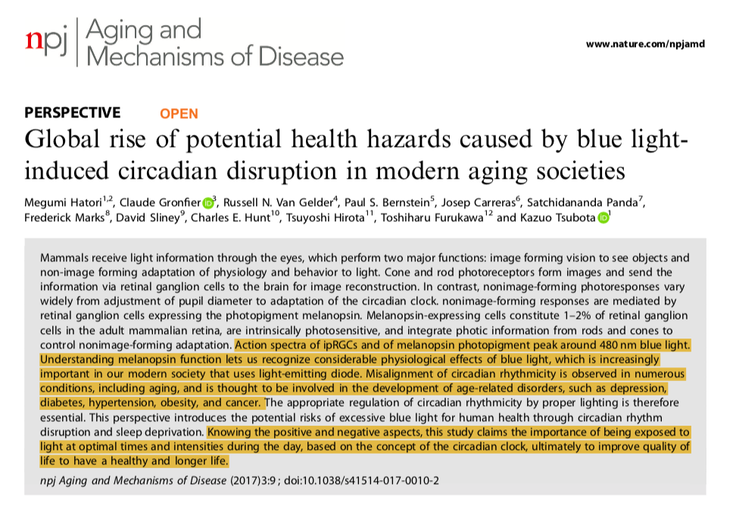

Slide 16
Fasting means many things…
The 5:2 IF – this is essentially ad lib intake 5 days/week with 2 days of caloric restriction in the 500-600 calorie/day range.
The 16:8 - this is time-restricted eating (TRE) where an individual consumes all their food in an 8-hour window, fasting for 16 hours. It is not intended to caloric-restrict. One eats what they want, just narrowing the window within which they consume. The smaller the window the better. While it is currently unproven, there may be a further advantage if the eating window is more closely aligned with sunrising and sunsetting circadian cycles for that time of year.
24-hour IF: This is essentially fasting (water only) for 24 hours at specific interval e.g. monthly or every other month.
Fasting-Mimicking Diet: This has been researched and popularized by Valter Luongo PhD. It involves predominantly plant-based foods with caloric restriction of 500-600 calories/day for 5-straight days from monthly to every 2-3 months depending on one’s health goals.

Slide 17
Eating Patterns in America
Duration of eating: 50% eat for 15 hours or longer
Weekend jet lag: 47% delay breakfast by > 1h in weekends
Eating frequency: 25% food eaten within 1.5 hours of previous meal
< 25% food consumed before noon
>36% of food is consumed after 6p
Satchin Panda, PhD The Salk Institute

Slide 18
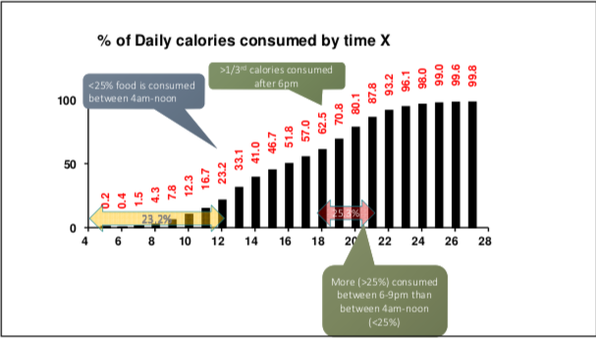

Slide 19
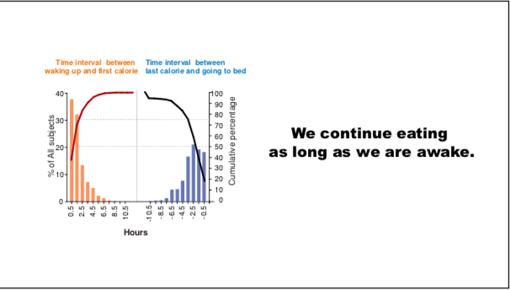

Slide 21
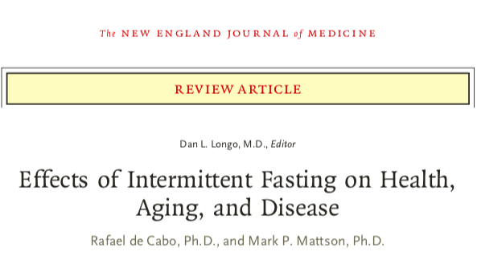
Greater metabolic -stress resiliency at the level of cellular function in many different tissues.
Improvements in longevity and healthspan (quality of life)
Improvements in sleep quality
Reductions in obesity and diabetes risks
Reduced cardiovascular risks
Reduced cancer risks and enhanced recovery/prognosis with cancer treatment
Improvements in neurodegenerative disorders like Parkinson’s, Alzheimer’s, ALS
Improvements in inflammatory arthritis and asthma
Improvements in wound healing and post-operative complications

Slide 22
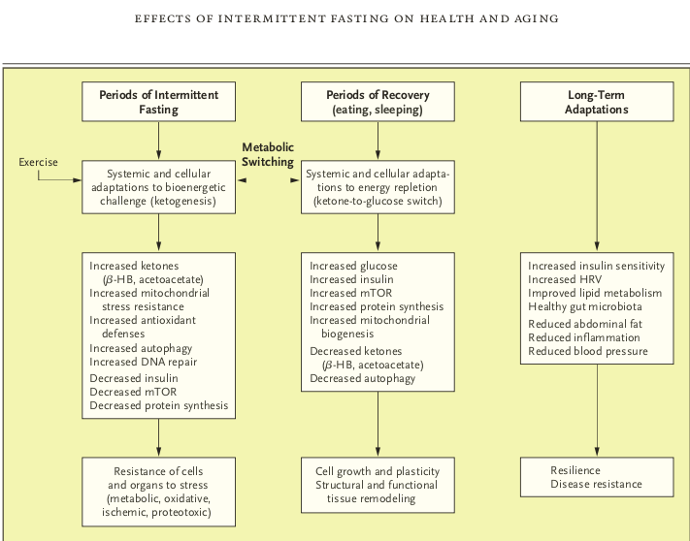

Slide 23
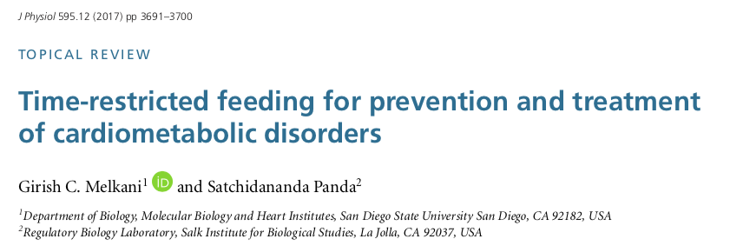
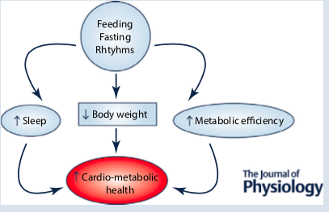

Slide 24
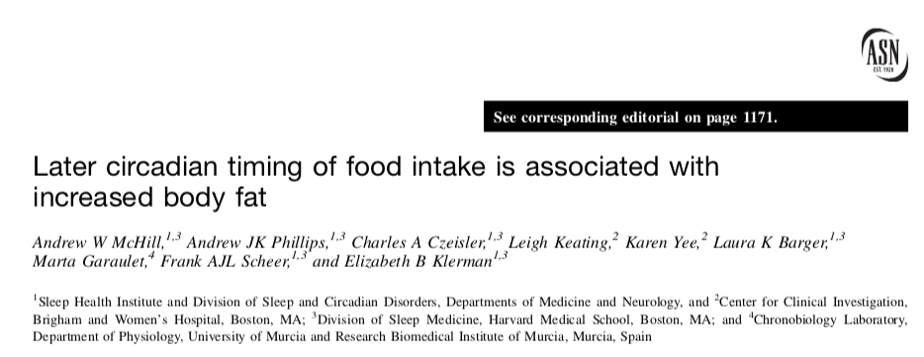
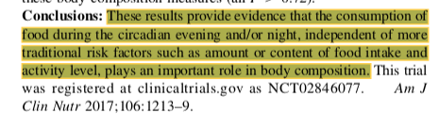

Slide 25
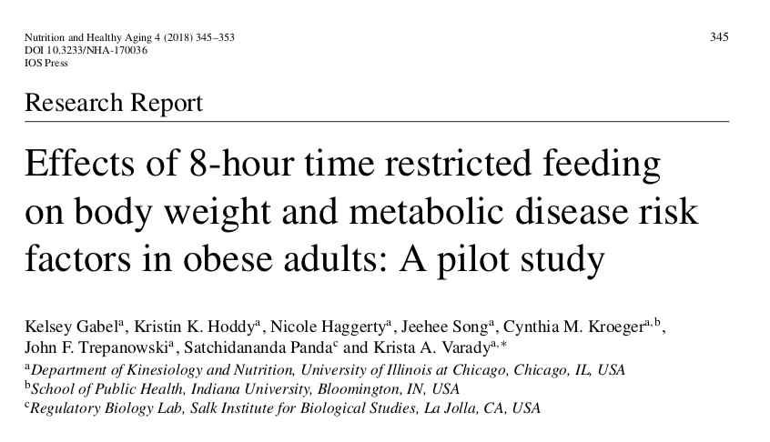
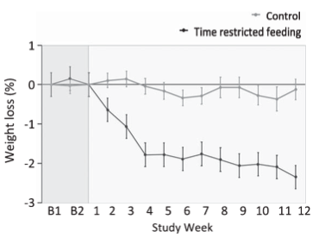

Slide 26

Intermittent Fasting
Time Restricted Eating (TRE)
Time restricted feeding e.g. consume all food within 8-10-hour window.
Ideally, no eating 2-3 hrs before bedtime
Excellent Circadian rhythm “calibration”
Decreases in body weight and visceral fat, insulin and glycemic control
Significant reductions in breast cancer recurrence and improved prognosis (Patterson et al. UCSD 2016)
Improved cardiovascular disease risk profile
Decreased neuroinflammation (Neurobiol Aging. 2015 May;36(5):1914-23)
Autophagy – recycling of senescent cells (Autophagy, 2014;10:11, 1879-1882)
Improved sleep!!

Slide 27
Circadian Entrainment
Sleep hygiene
Grounding…take your shoes off and stand outdoors
60” full spectrum outdoor lighting/day: within 2-3 hrs after sunrise and within 2-3 hours before sunset
Give your retina access; no sunglasses at key times of day for 5-10”
Evening light: Warm Halogen or warm LED 2500k
Orange-amber light at night
Blue light filters 2-3 hrs before bedtime; F*Lux, Night Shift, Iris apps;
Time Restricted Feeding 10 hours: no eating within 2-3 hours of bedtime
Movement during the daytime
Social interactions during the day
Stress during the day…not good after sunset
Satchin Panda, PhD The Circadian Code

Slide 28
Thank you !

Slide 29
Thank You!
www.thehealthedgepodcast.com

Slide 30
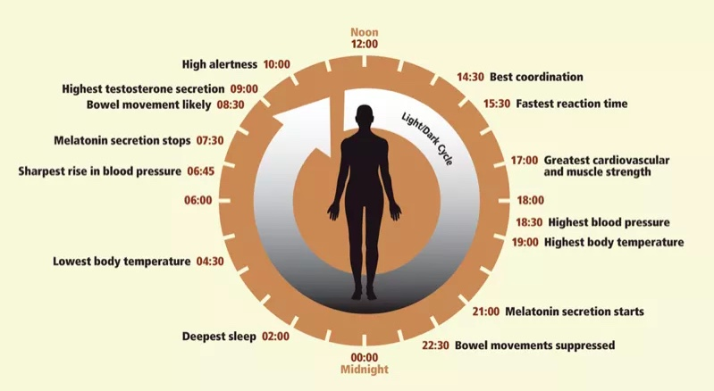

Slide 31
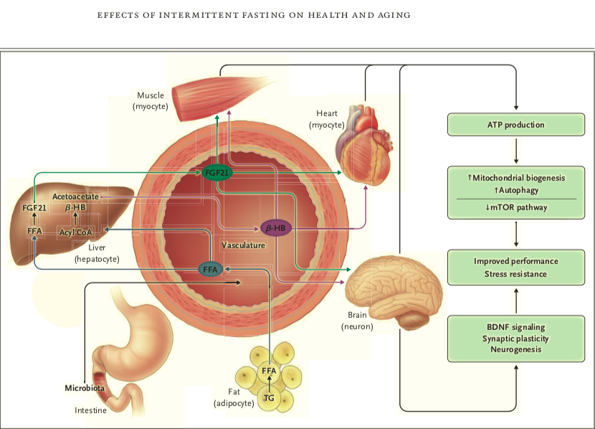

Slide 32
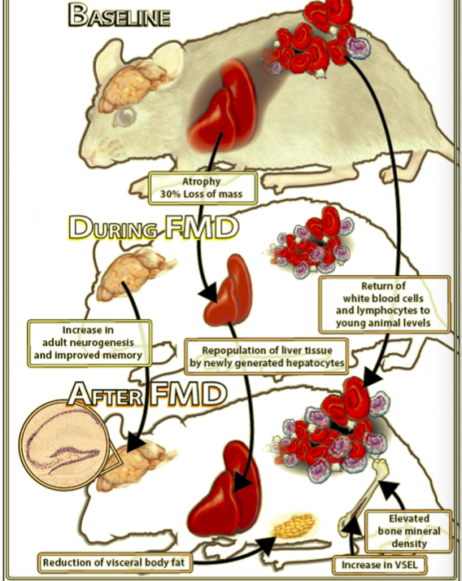
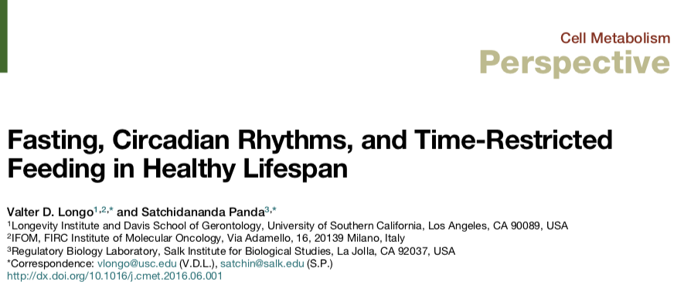

Slide 33
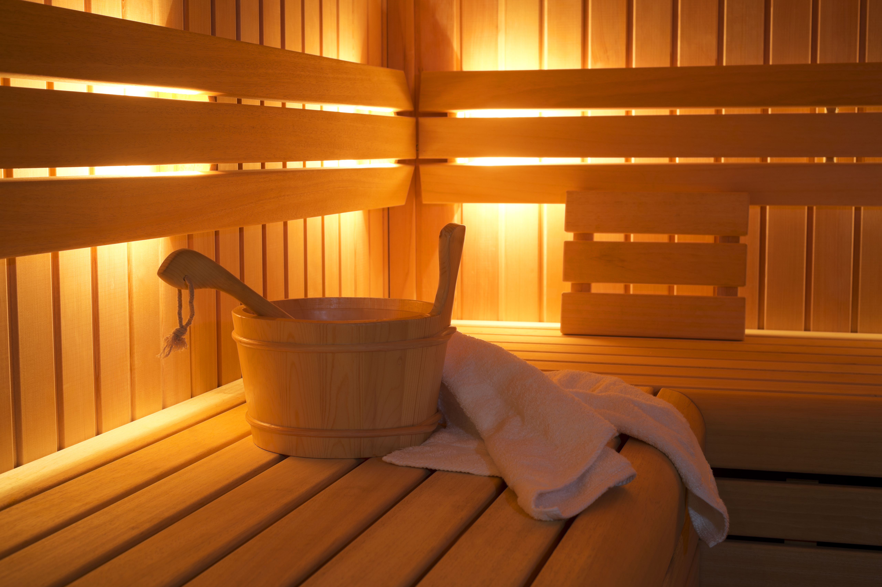
Saunas
Really good for health promotion and disease prevention
Upregultes HSP, defense/resiliency mechanisms
30” minutes 3-4x/week
Steam or infrared
Laukkanen T, Khan H, Zaccardi F, Laukkanen JA. Association between sauna bathing and fatal cardiovascular and all-cause mortality events. JAMA Intern Med. 2015;175(4):542-548
Sauna bathing and incident hypertension: A prospective cohort study. Am J Hypertens. 2017; Nov 1;30(11):1120-1125.
Sauna bathing is inversely associated with dementia and Alzheimer's disease in middle-aged Finnish men. Age Ageing. 2016; Mar 1;46(2):245-249.

Slide 34
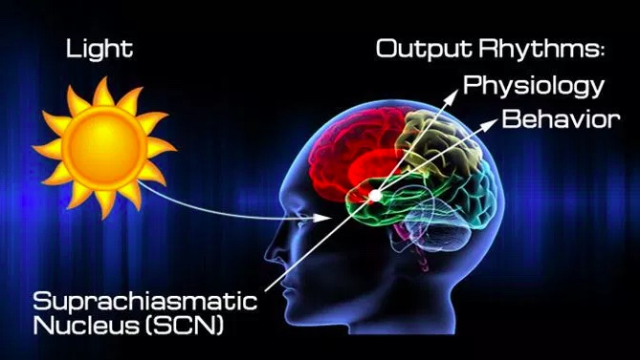

Slide 35
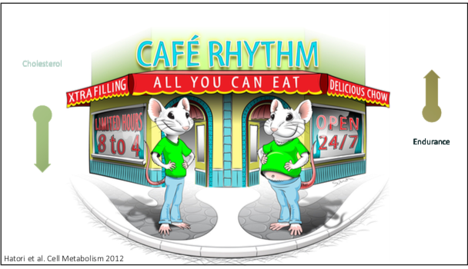

Slide 36
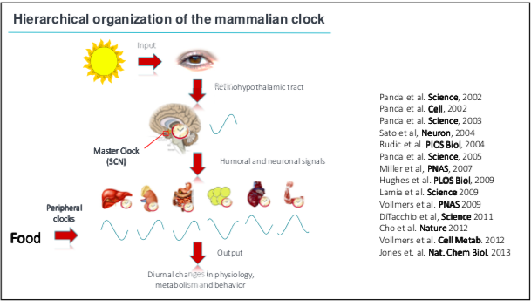

Slide 37
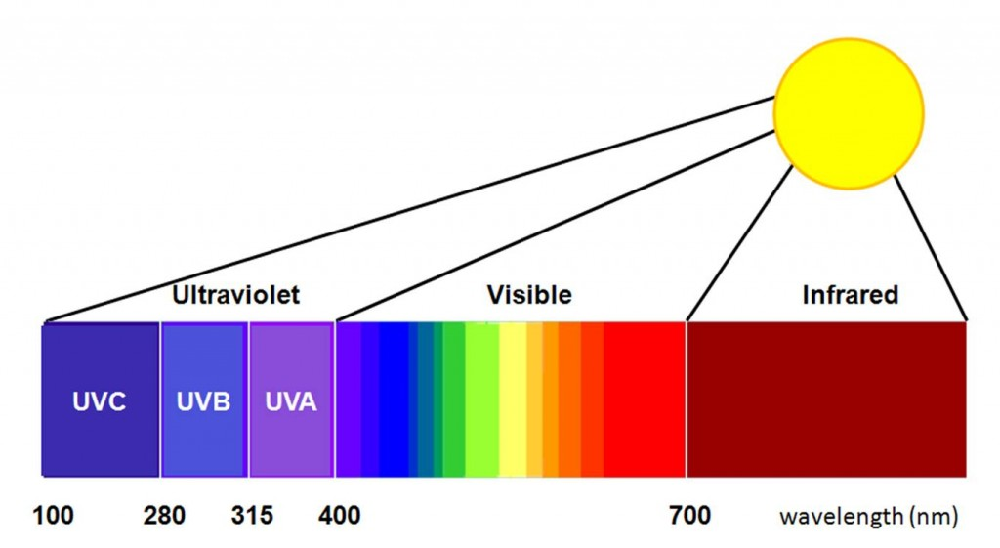

Slide 38
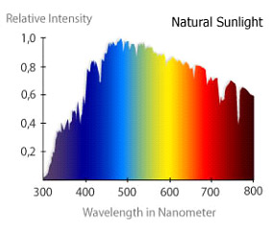

Slide 39
Circadian Entrainment
Sleep hygiene
30-60” full spectrum lighting/day (first and last 3 hours/day)
10,000 lux light box for 30” in am
Blue light during the day is important
Evening light: Incandescent 2700k, Halogen 3,000k, warm LED on dimmer
Blue light filters 2-3 hrs before bedtime
Time Restricted Feeding: 8-10-hr window a powerful intervention

