Slide 1
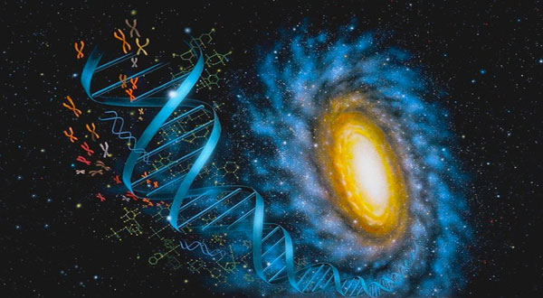
Consciousness, Quantum Access and Population Health:
The future ain’t what it used to be!
Mark Pettus MD, FACP, ABOIM
July 30, 2019
Director Wellness and Population Health
Berkshire Health Systems
Associate Professor of Medicine
University of Massachusetts Medical School

Slide 2
The Turning Point !

Slide 3
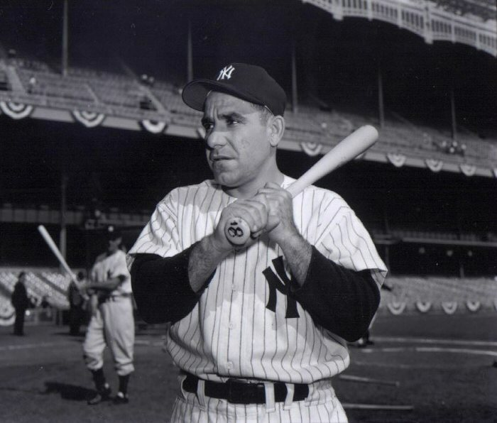
“The future ain’t what it used to be.”
Yogi Berra

Slide 5
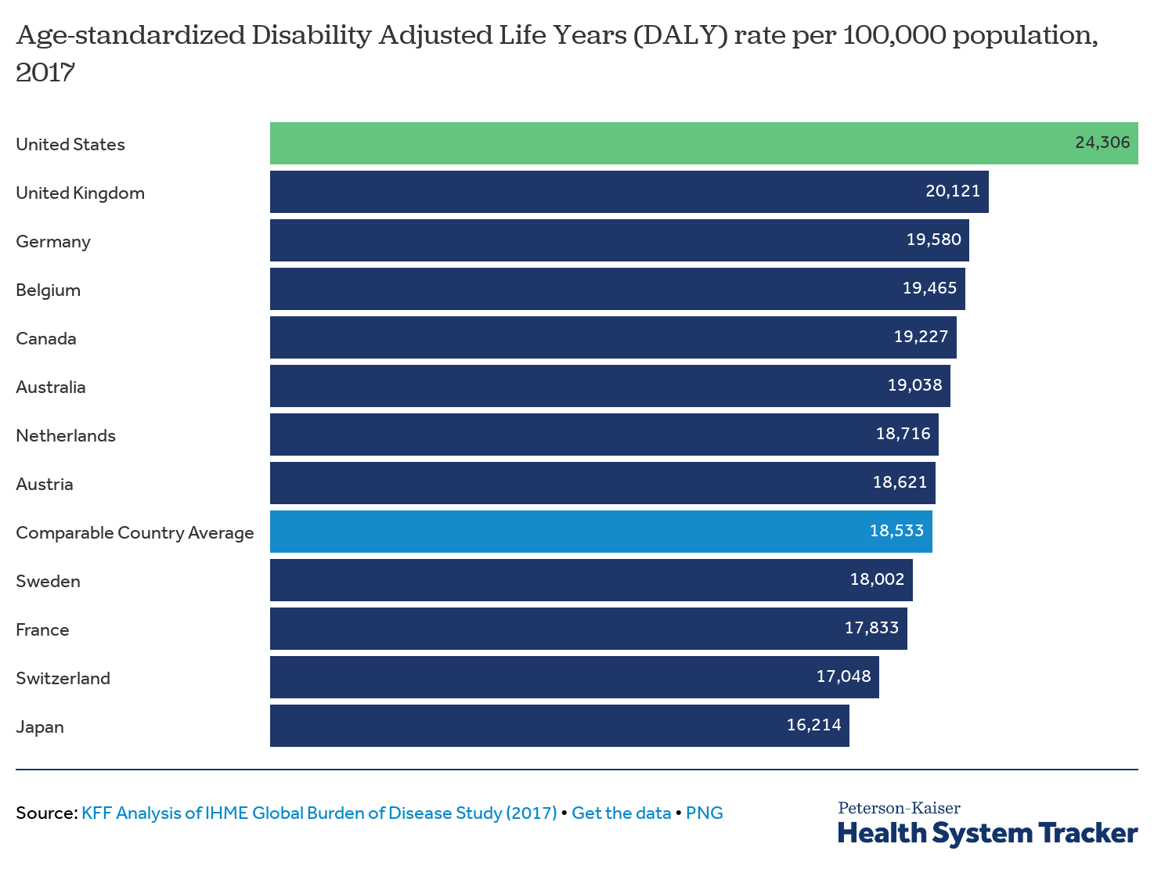
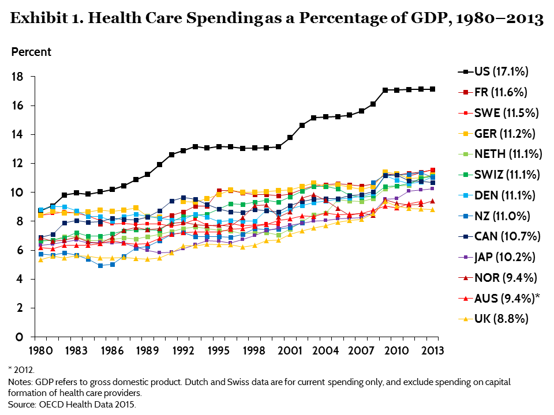
“It is, I guess, politically correct and widely believed that the American Health care system is the best in the world. It’s not”.
Don Berwick, Institute of Healthcare Improvement

Slide 6
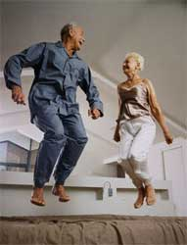
Healthspan
Notes:
Rectangularize the health curve
Healthspan…organ reserve

Slide 7
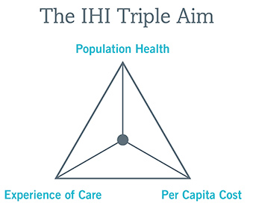
Health of a Population
Caring for the Caregiver
Experience of Care
Per Capita Cost
Care of the Provider
Berwick DM, Nolan TW, Whittington J. The Triple Aim: care, health, and cost. Health Aff (Millwood). 2008;27(3):759–769.
Bodenheimer T, Sinsky C. From Triple to Quadruple Aim: Care of the Patient Requires Care of the Provider. Ann Fam Med, November/December 2014 vol. 12 no. 6 573-576.

Slide 8
County Health Rankings Model of Population Health
75-80% of health outcomes are influenced by lifestyle and environment.
One’s social determinants of health are the underpinnings of lifestyle and environment.

Slide 9
Lifestyle/
Environment
Life
Genetics/
Epigenetics
Microbiome
Consciousness-Spirituality-Meaning

Slide 10
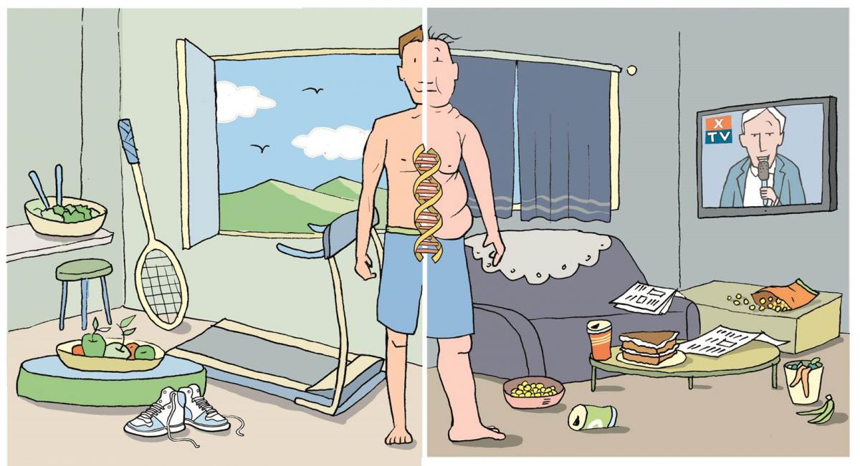
Epigenetics: a Future of Unlimited Possibility
Life as a loving relationship between the subject and the object.

Slide 11
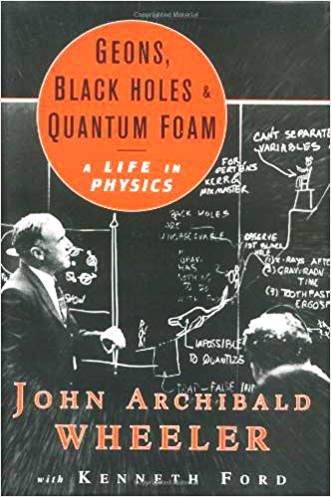
“It from bit symbolizes the idea that every item of the physical world has at bottom…an immaterial source and explanation…that all things physical are information-theoretic in origin and that this is a participatory universe”
John Archibald Wheeler
Notes:
﻿“Everything is Particles” evolved to “Everything is Fields” which eventually evolved to “Everything is Information”.
Virk, Rizwan. The Simulation Hypothesis: An MIT Computer Scientist Shows Why AI, Quantum Physics and Eastern Mystics All Agree We Are In a Video Game . Bayview Books. Kindle Edition.

Slide 13
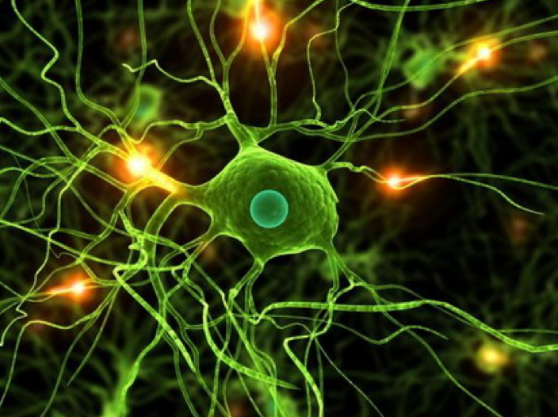
Fritz Albert Popp, Peter Gariev and Vladamir Poponin
Every animal and plant cell has biophoton emissions that orchestrate function.
Energetic architecture
Semi-crystalline matrix
Resonant frequency and vibration
Phantom DNA

Slide 14
Vladimir Poponin
DNA Phantom Effect

Slide 15
Peter Gariev

Slide 16
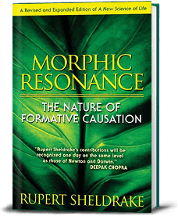
Rupert Sheldrake PhD
Morphogenic Fields and Morphic Resonance
Self-organizing systems inherit a memory from a previous similar systems
The extended mind
Laws of nature as habits
The evolutionary universe
Telepathy experiments
Psychedelics and collective consciousness
Mystical and spiritual experiences and health

Slide 17
Let the photons flow

Slide 18
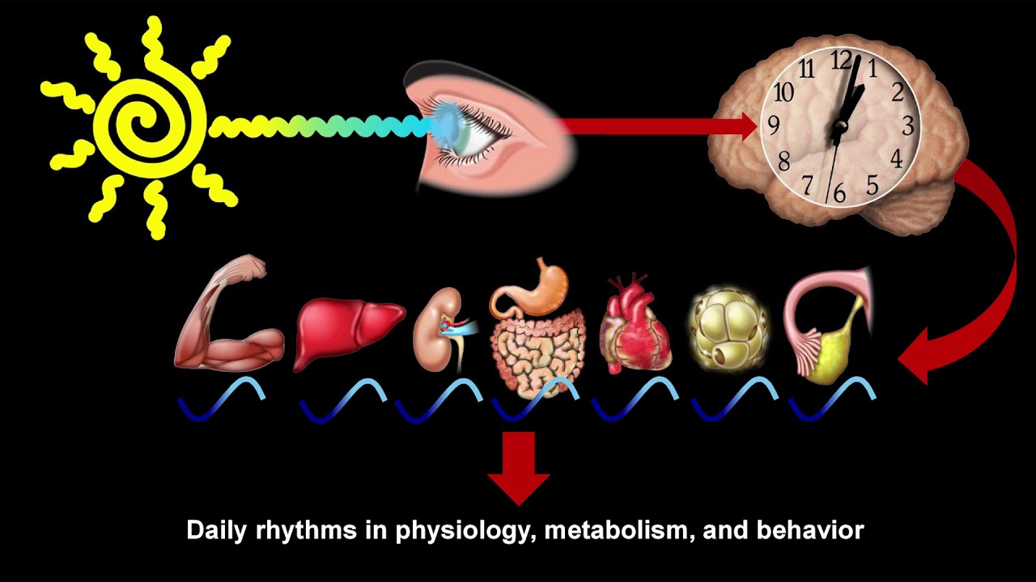
Satchin Panda PhD, The Salk Institute

Slide 19
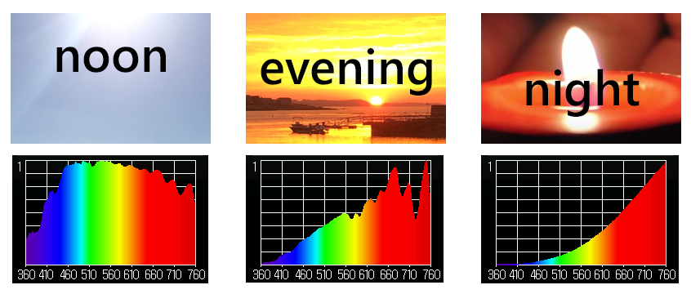
Sunlight and Circadian Entrainment

Slide 20
Zeitgebers: Circadian Entrainment
Grounding…take your shoes off and stand outdoors
60” full spectrum lighting/day: within 2-3 hrs after sunrise and within 2-3 hours before sunset
Give your retinas access
Evening light: Incandescent 2700k, Halogen 3,000k, warm LED on dimmer
Orange-amber light at night
Blue light filters 2-3 hrs before bedtime; F*Lux, Night Shift, Iris apps;
Computer settings: lower color temperature
Global rise of potential health hazards caused by blue light- nduced circadian disruption in modern aging societies Hatori M. et al. npj Aging and Mechanisms of Disease (2017)

Slide 21
Allostasis and Allostatic Load
The process of achieving stability or balance through physiological or behavioral change in response to changes in one’s environment.

Slide 22
Fight-Flight or Sympathetic Tone

Slide 23
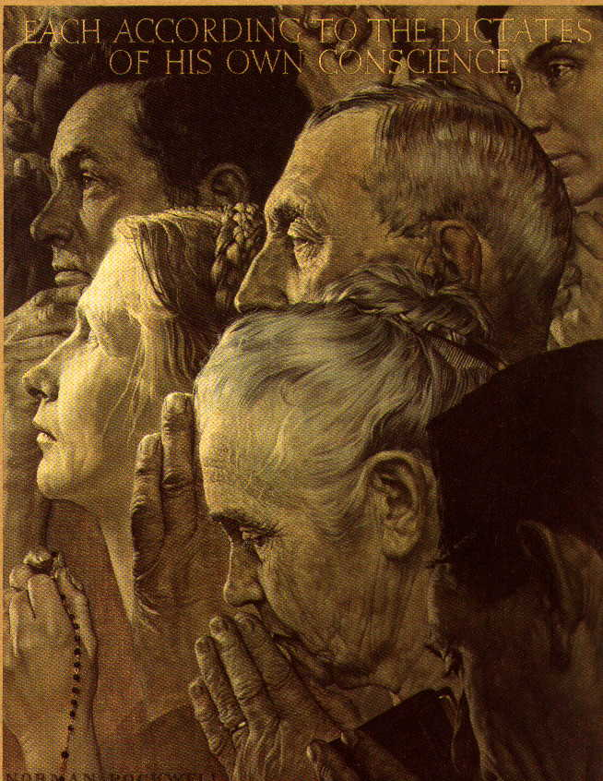
Calm or Parasympathetic Tone…..Get “Para”

Slide 24
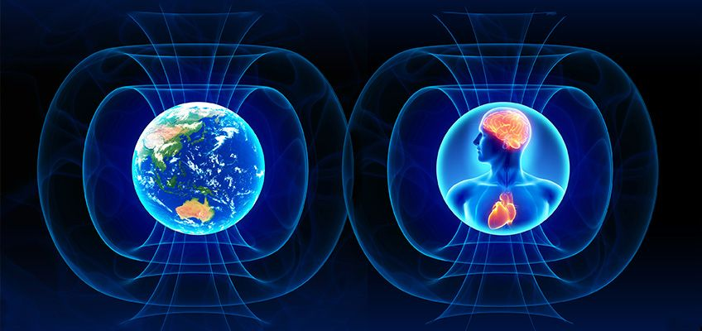
Heart Rate Variability (HRV) as a Biomarker of Health
www.heartmath.com

Slide 25
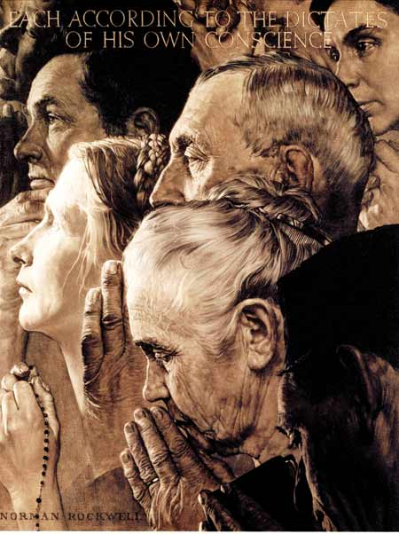
Stress Reduction Techniques and Healthspan
Scores of randomized controlled trials demonstrating alterations in gene expression of inflammation markers e.g. NFkB, IL-6, and C-reactive protein with meditation compared to controls (Benson, Davidson, McEwen)
Increased expression of telomerase and maintenance
of telomere length (Blackburn and Ornish)
Treatment group scored better on emotional wellness, resiliency (Benson, Ornish, Davidson)

Slide 26
Forest Bathing
Shinrin-Yoku
Global health and quality of life improvements
Improvements in mind and mood
Lower inflammation
www.shinrin-yoku.org

Slide 27
Social Connection and Health
From an evolutionary biologic perspective we are born to bond
Powerful predictor of longevity and health, of the magnitude that smoking has.
Mirror neurons…EMF receivers/transmitters
Reduced stress states
Improved coping and resiliency
Reductions in chronic disease risk

Slide 28
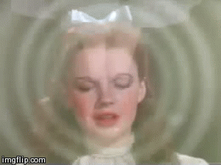
There’s no place like home…
and home is where you are!

Slide 29
Mortality and Morbidity in the 21st Century
Anne Case, Angus Deaton, Princeton University
BPEA Conference Drafts, March 23–24, 2017

Slide 31
“It’s not what we don’t know that gets us into trouble. It’s what we know that ain’t so.”
Mark Twain

Slide 32
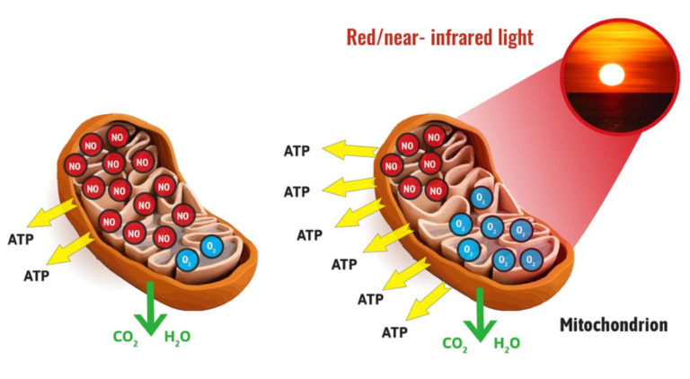
Association-Induction Theory
Light as the photoelectric source of cellular energy
Exclusion Zone “EZ”. Water – IR light as a capacitor energy source-superconductor (G. Pollack)
Life as structured flow of energy and information

Slide 33
Quantum Healing
How a conscious observer perceives their reality will influence the reality they perceive.

Slide 34
Consciousness – Our Perceptions Create Our Reality
Our thoughts interact with our DNA and morphogenic fields.
The elusive answers are somewhere “out there to be found” versus inside and already present.
I am a prisoner of my DNA versus I have endless possibilities.
Slowing down and feeling poorly are normal, natural and inevitable consequences of getting older.
I am alone versus I am connected to everything in this universe.
I am fearful of sunlight versus I am designed to be in relationship with sunlight.

Slide 35
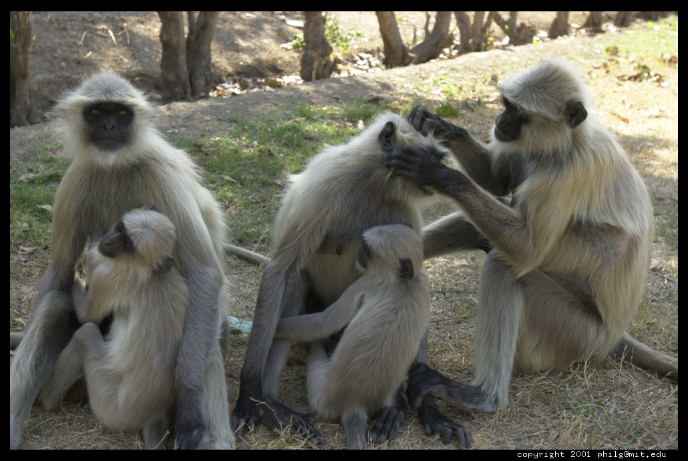
In Quantum Access leadership, human behavioral influence, social connection, epigenetic expression and in health…
Chest pounding is out.
Grooming is in!

Slide 36
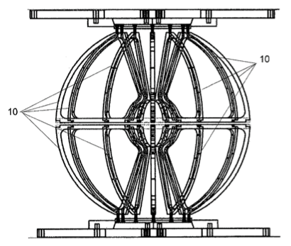
Biophysics and Quantum Access Technology:
The Future is Now
Rasha-Pegasus
Advanced Resonance Kinetics (ARK®) Magnetohydrodynamic Apparatus

Slide 37
Information:
Non-Material
Material

Slide 38
Quadruple Aim
Health of a Population
Experience of Care
Per Capita Cost
Care of the Provider
Adapted from:
Berwick DM, Nolan TW, Whittington J. The Triple Aim: care, health, and cost. Health Aff (Millwood). 2008;27(3):759–769.
Bodenheimer T, Sinsky C. From Triple to Quadruple Aim: Care of the Patient Requires Care of the Provider. Ann Fam Med, November/December 2014 vol. 12 no. 6 573-576.

