Slide 1

Circadian Entrainment, Weight and Health
Mark Pettus MD
Director Medical Education, Wellness and Population Health
June 3, 2019

Slide 2
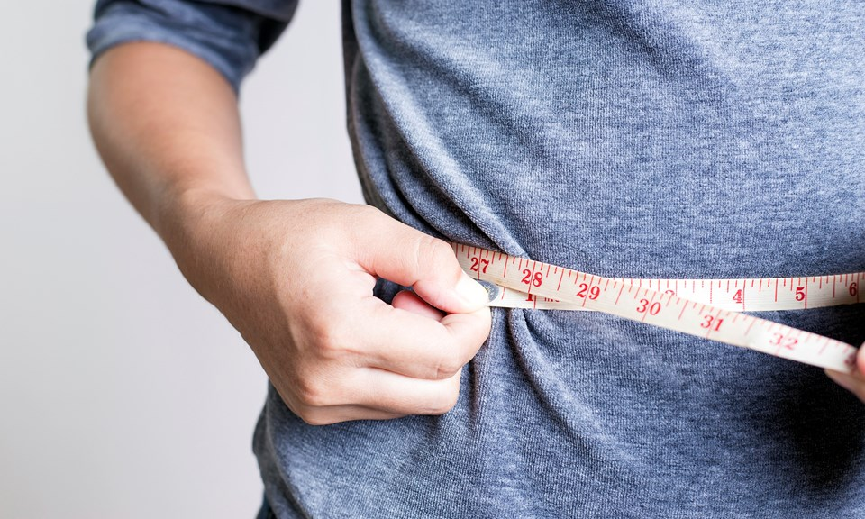
Four Part Series
Week 1: Insulin and Inflammation
Week 2: Leaky Gut and the Gut Biome
Week 3: Sleep and Circadian Rhythms
Week 4: Stress Response- Hypnosis Experience

Slide 3

Critical Considerations
Weight, metabolism and health appear tightly connected to our biologic synchronization with daily circadian rhythms.
Light interacts with human biology through our eyes and skin.
The timing and quality of our light and meal exposure appear to be of major influence on these rhythms.
Lifestyle changes can bring greater alignment to these critical relationships as an opportunity for improved health, disease prevention and disease management.

Slide 4
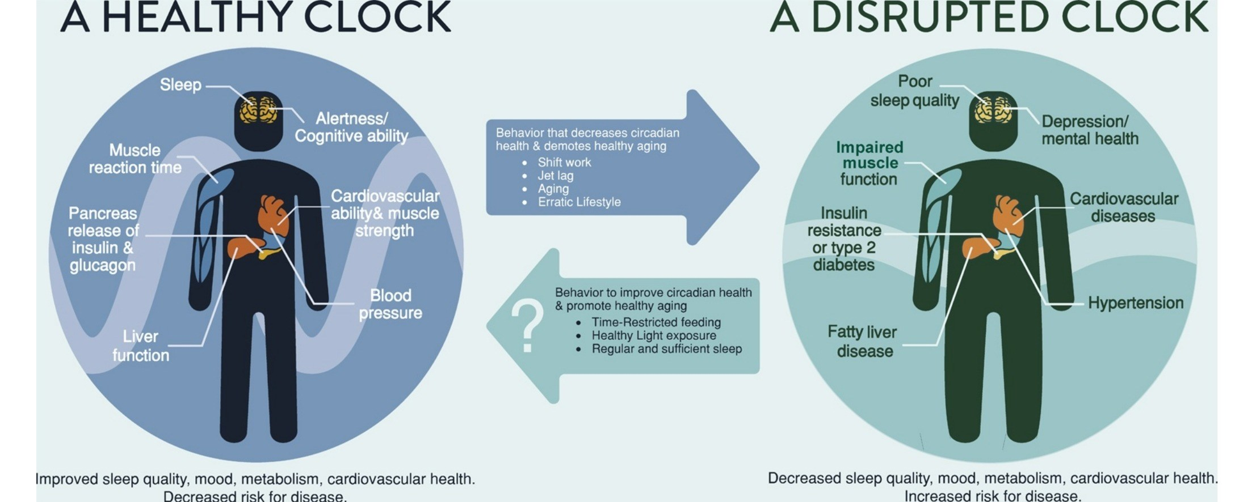
Satchin Panda PhD, Salk Institute

Slide 5


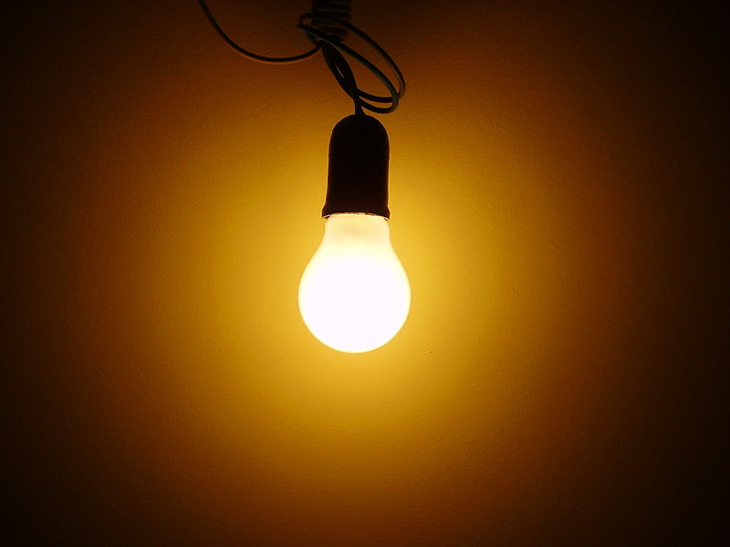
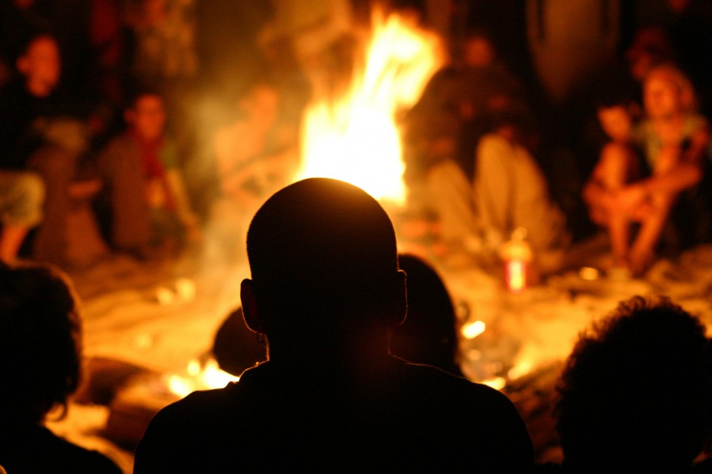


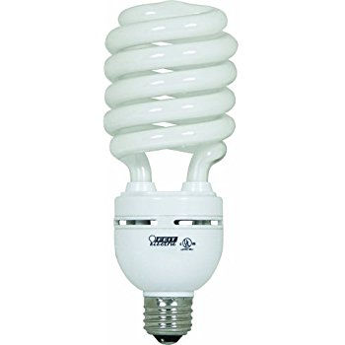

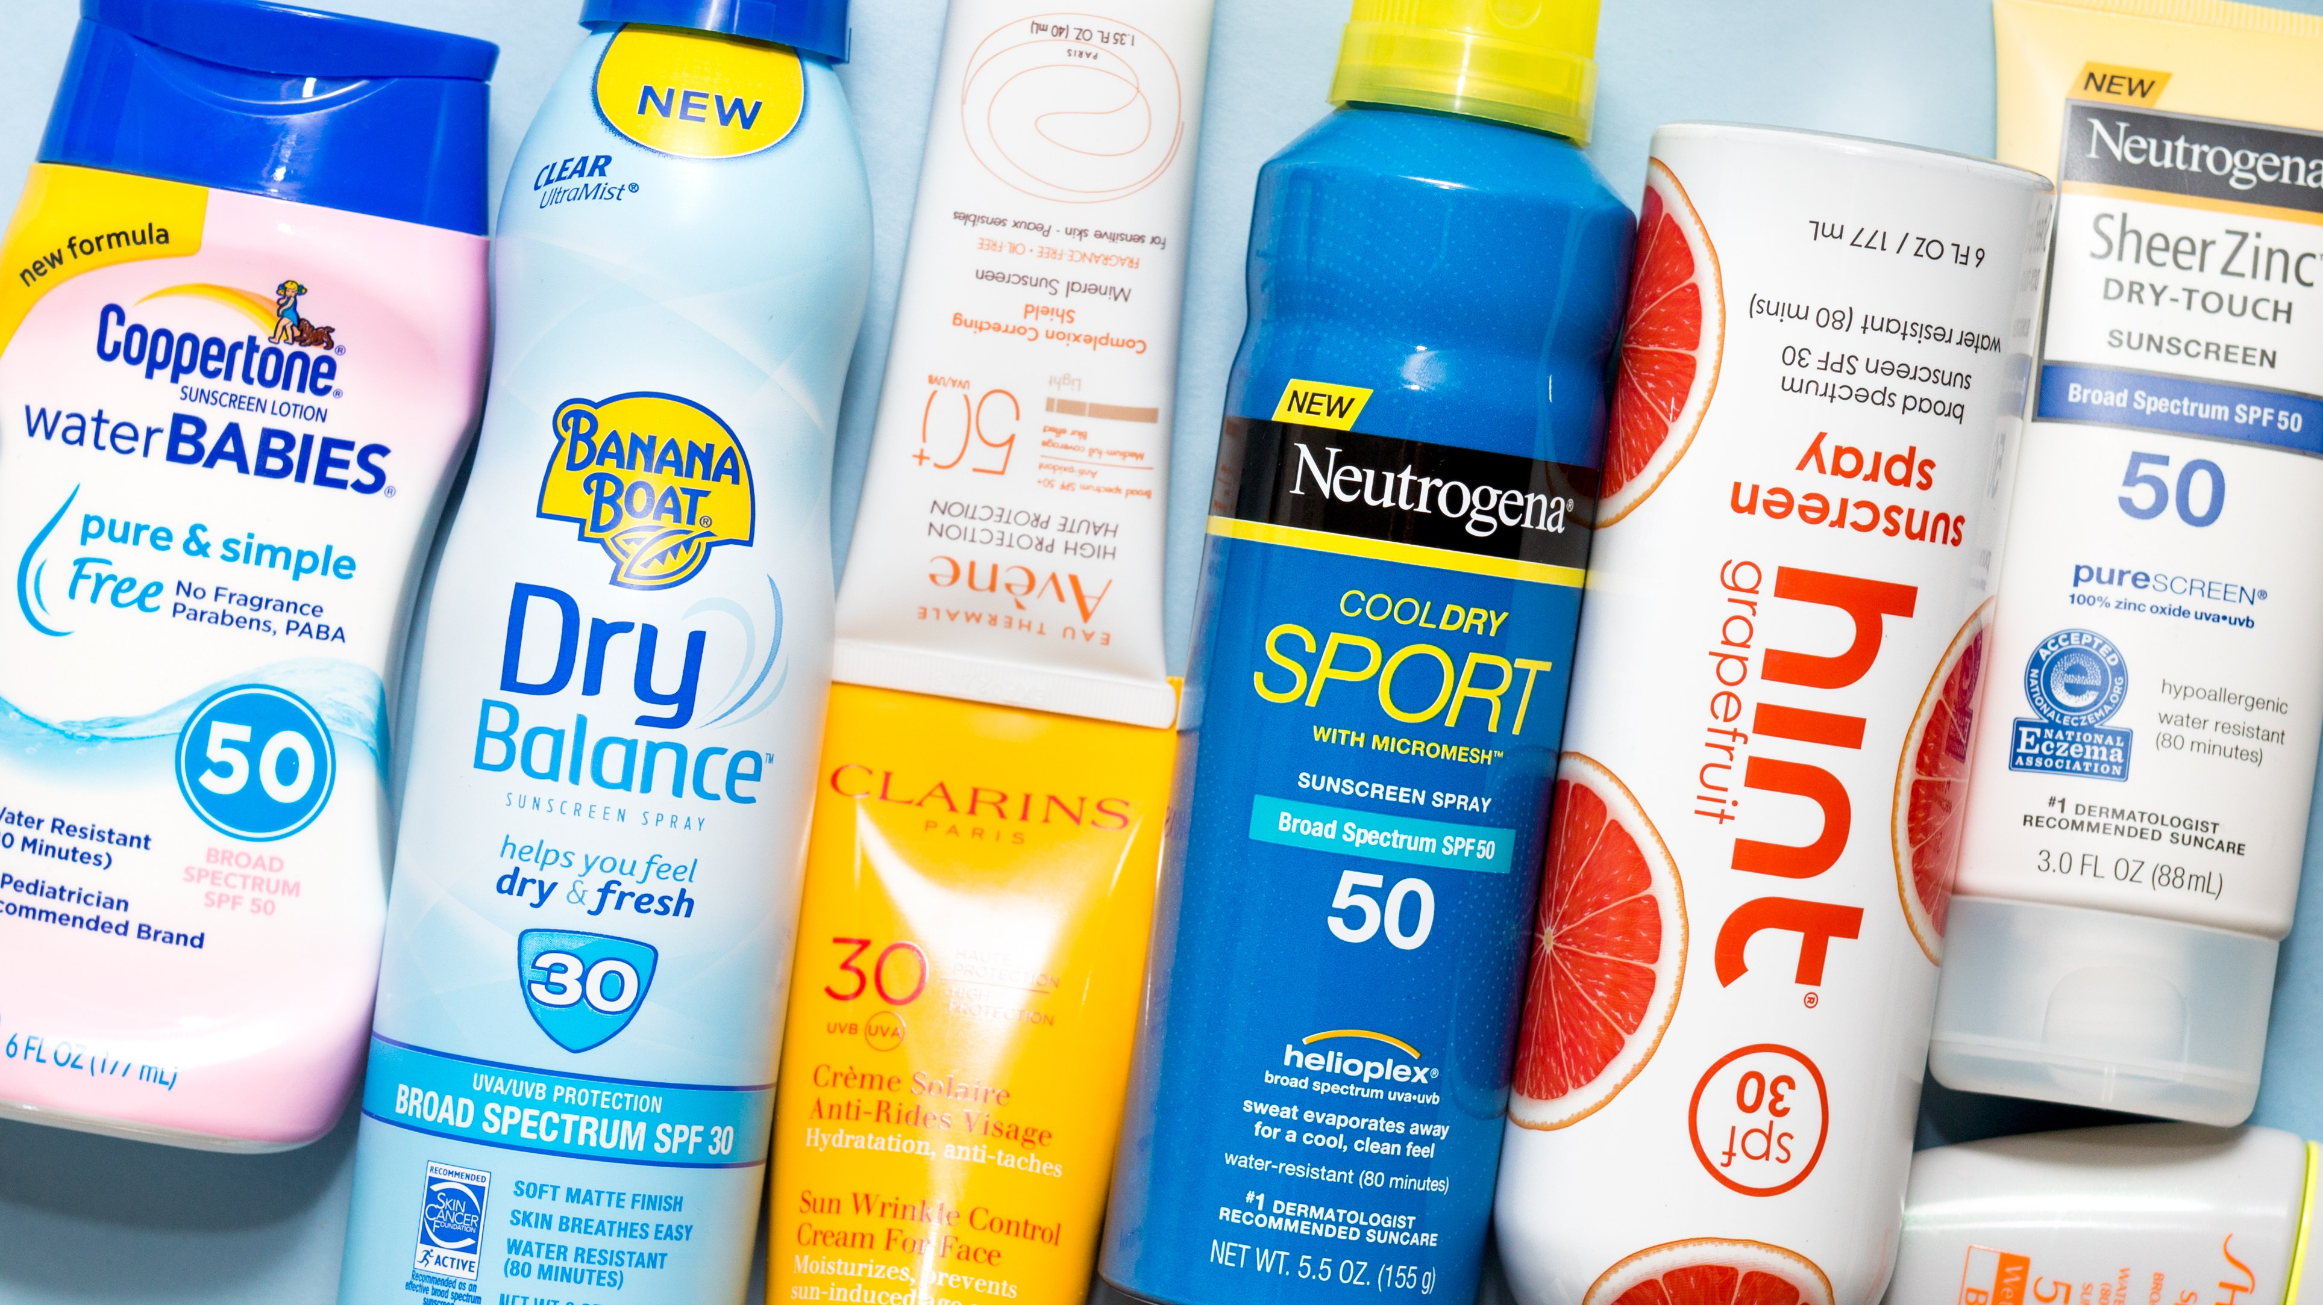
zeitgeber | a cue given by the environment, such as a change in light or temperature, to reset the internal body clock. from German Zeitgeber, from Zeit ‘time’ + Geber ‘giver’.
Too little of this:
Too much of this:

Slide 6

Earth, at the equator is spinning approximately 1,000 miles/hour around its axis
Earth is orbiting the sun, moving approximately 66,600 miles/hour
Diurnal rhythm is central to the existence of all life on our planet

Slide 7


Slide 8


Slide 9
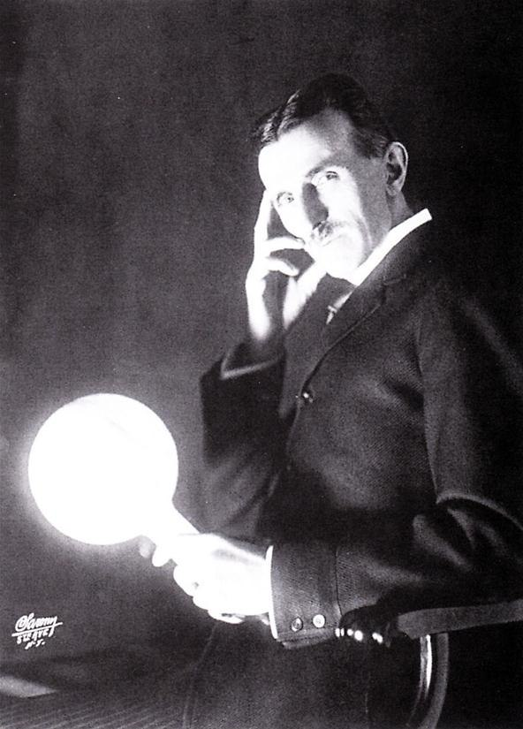
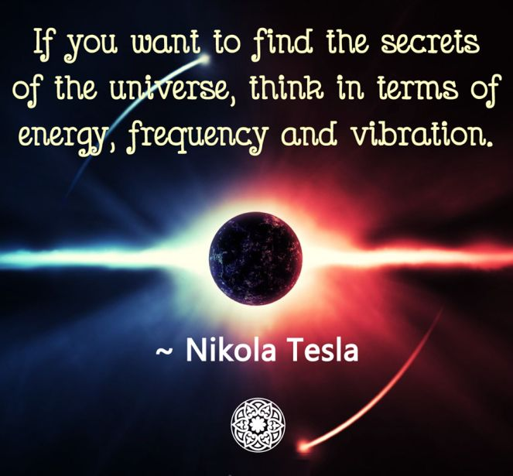

Slide 10
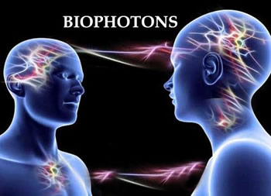

Slide 11
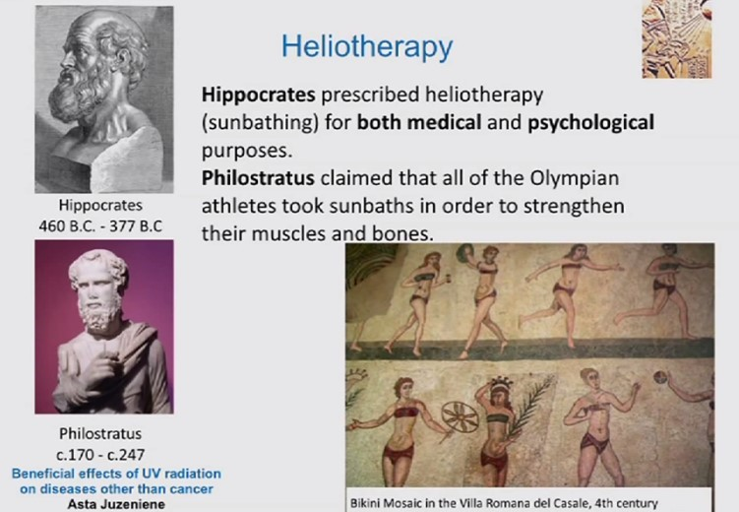

Slide 12
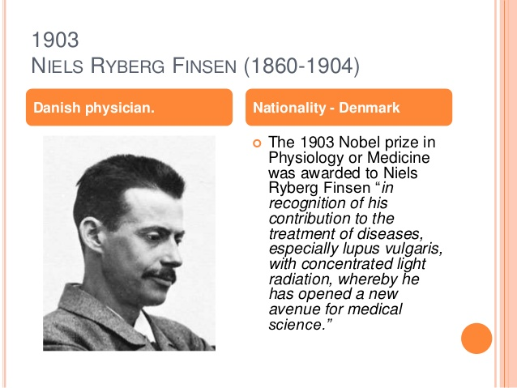

Slide 13
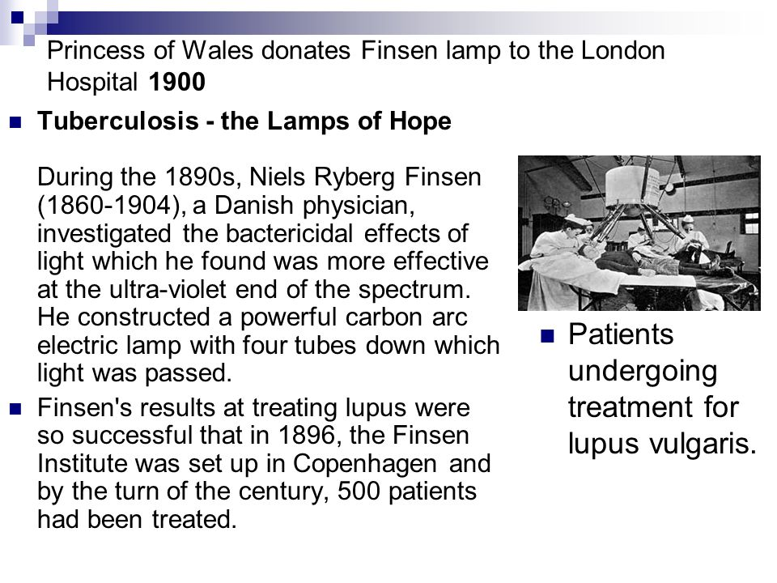

Slide 14
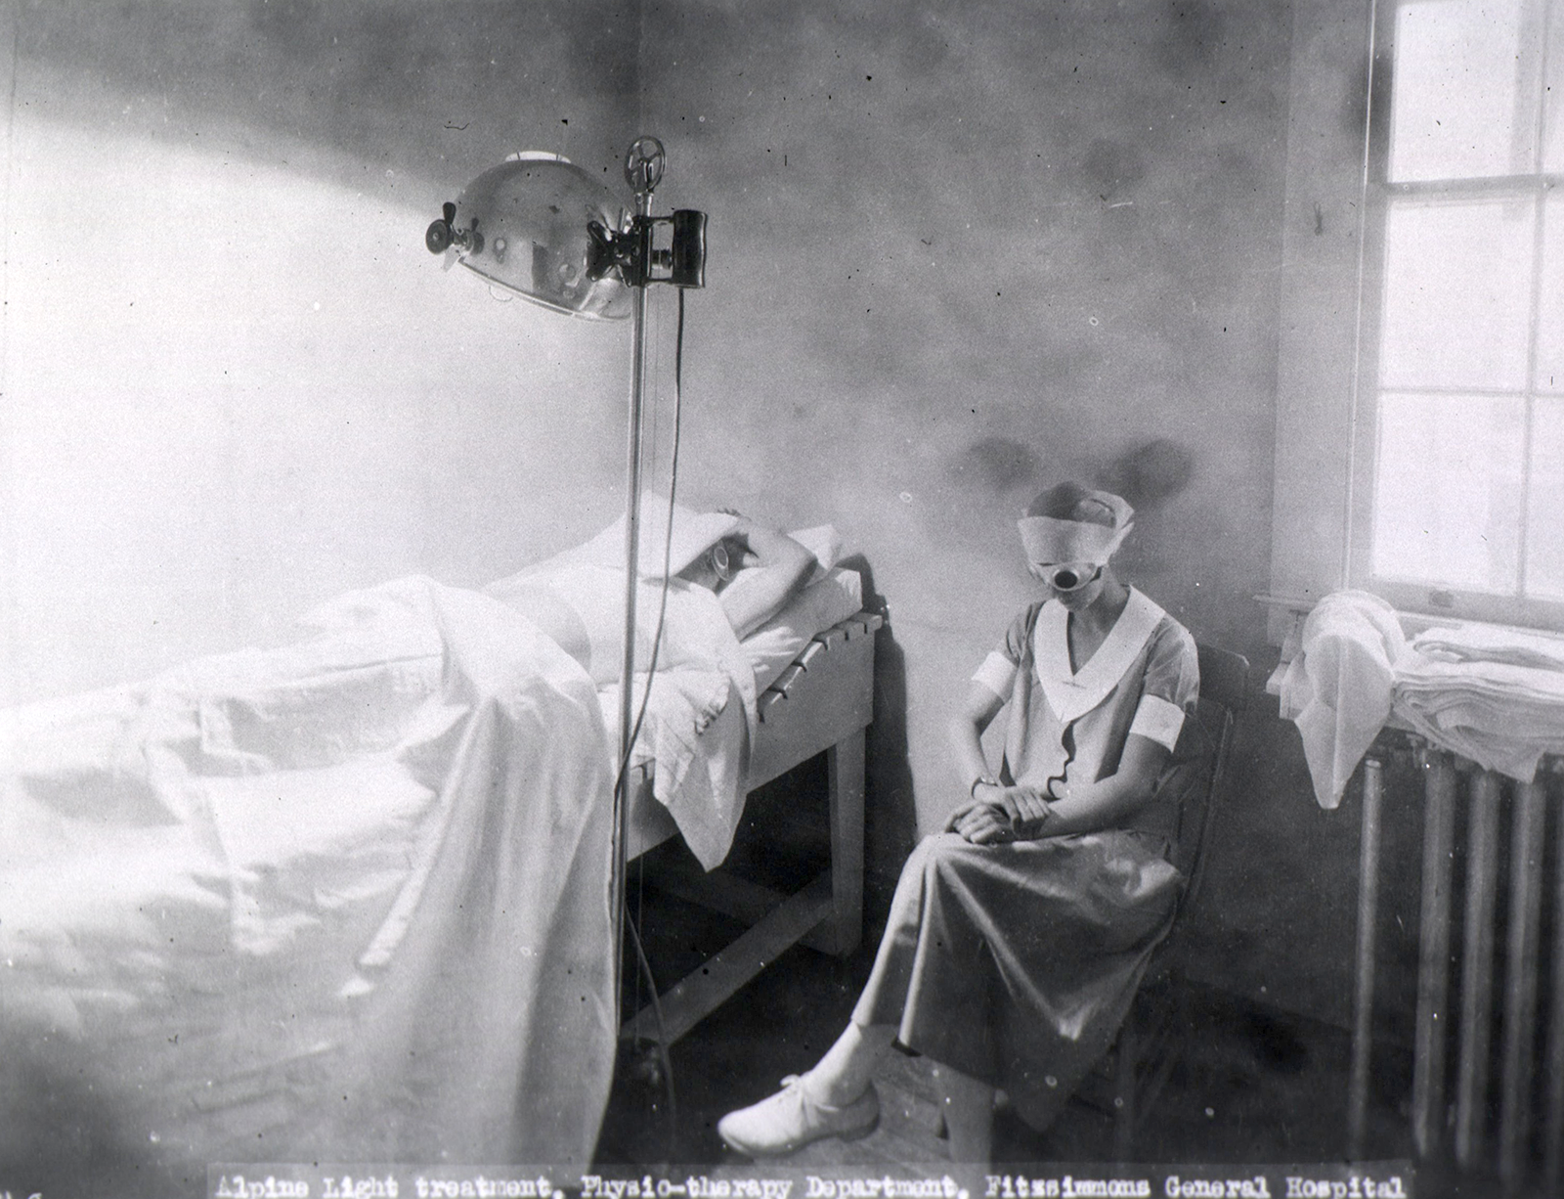

Slide 15
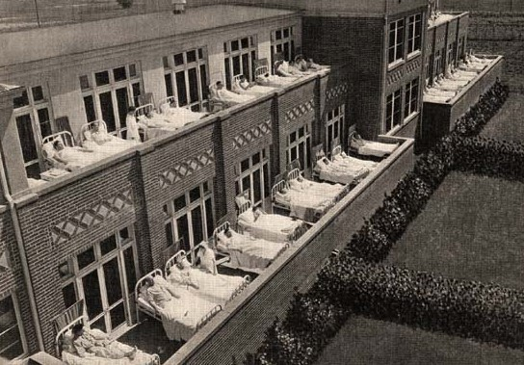

Slide 16
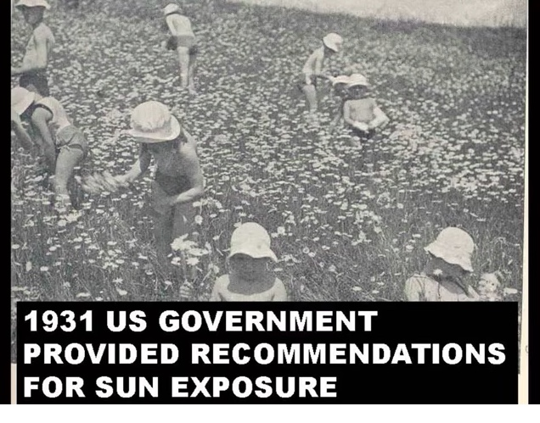

Slide 17
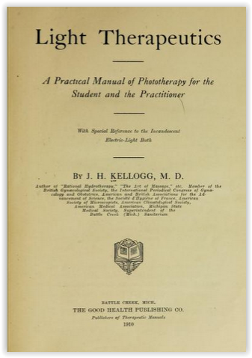
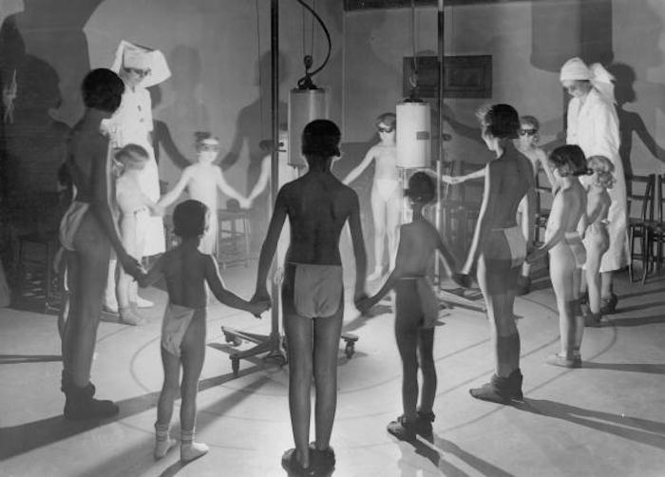

Slide 18
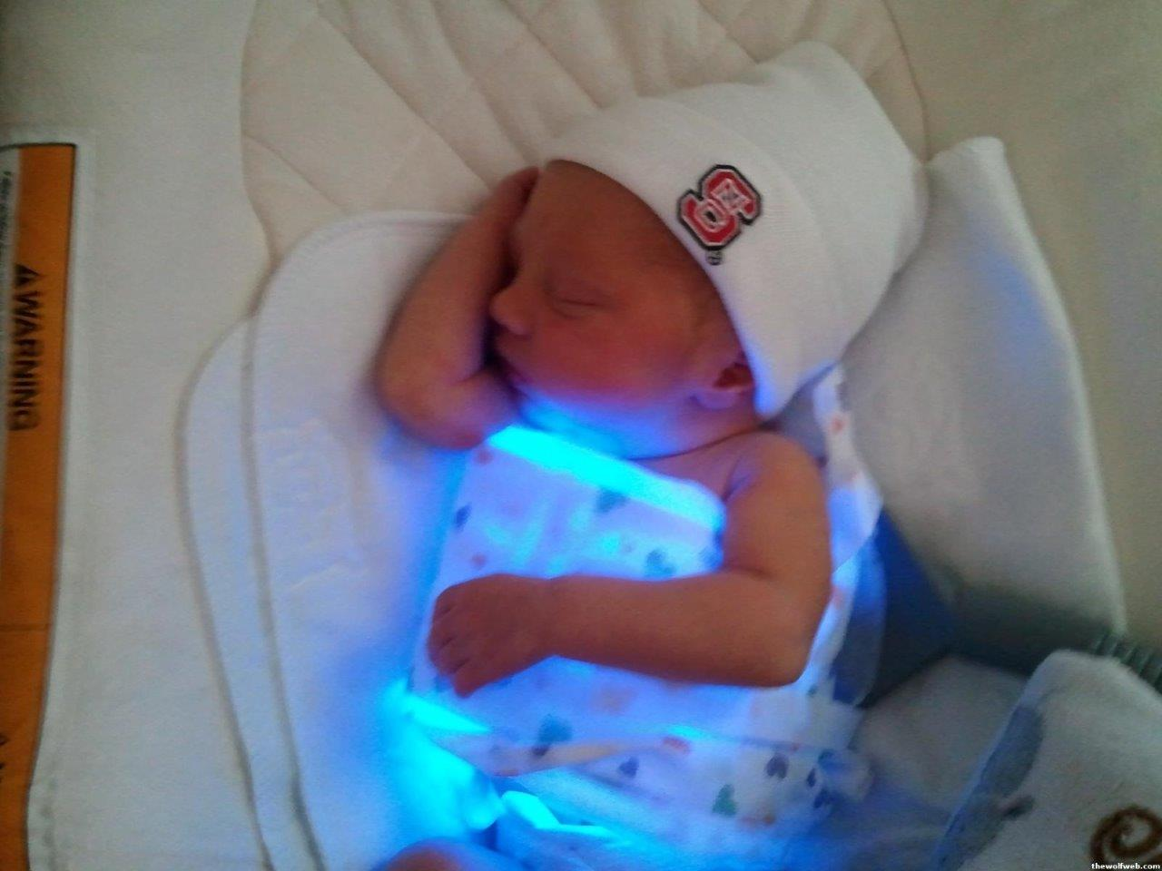
The “Billi Blanket”

Slide 19
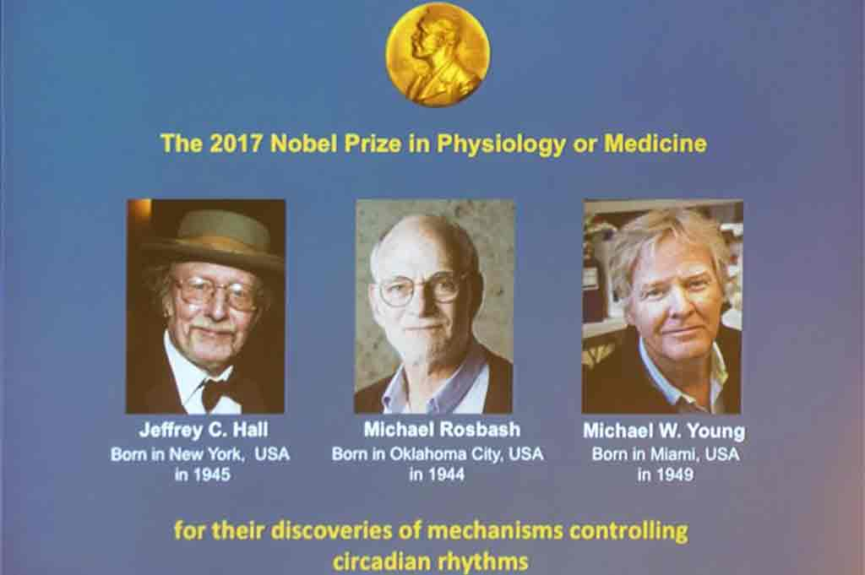

Slide 20
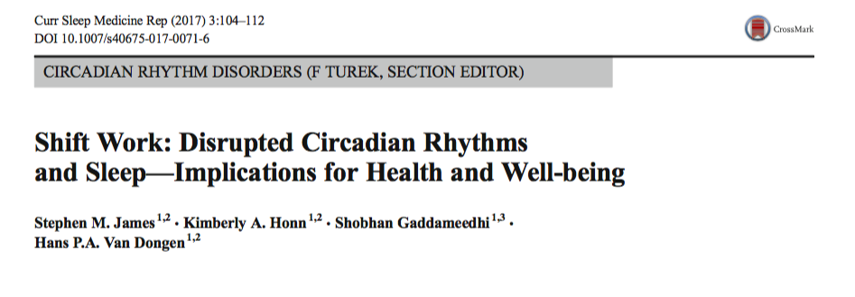
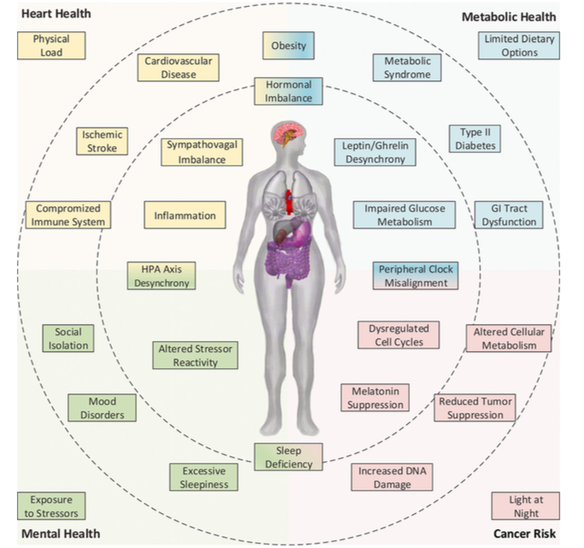

Slide 21
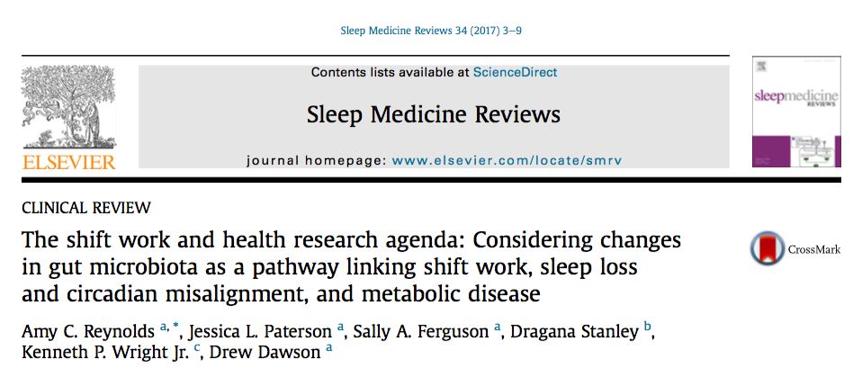
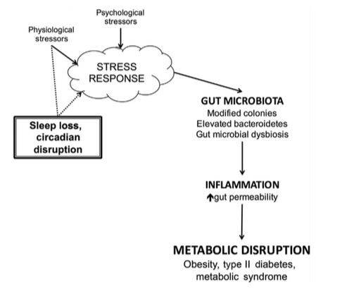

Slide 22
Cortisol and Melatonin Diurnal Rhythm

Slide 23
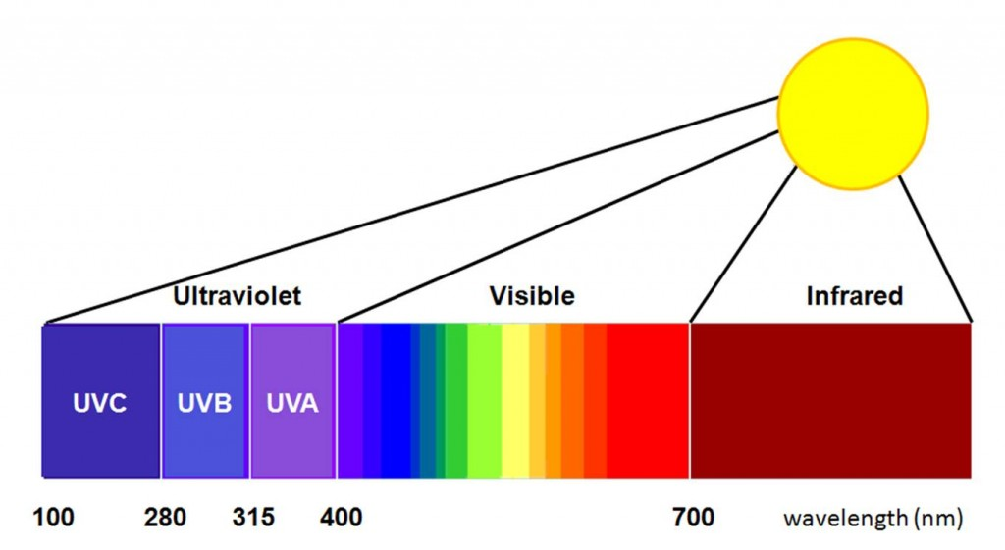

Slide 24
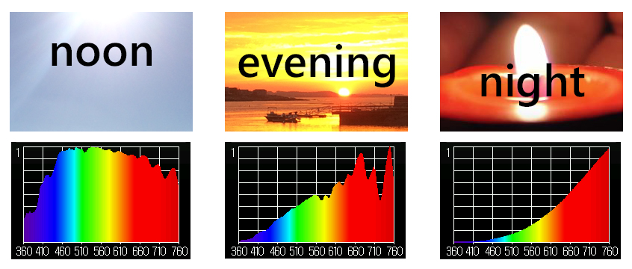

Slide 25
Courtesy Dr. Alexander Wunsch

Slide 26
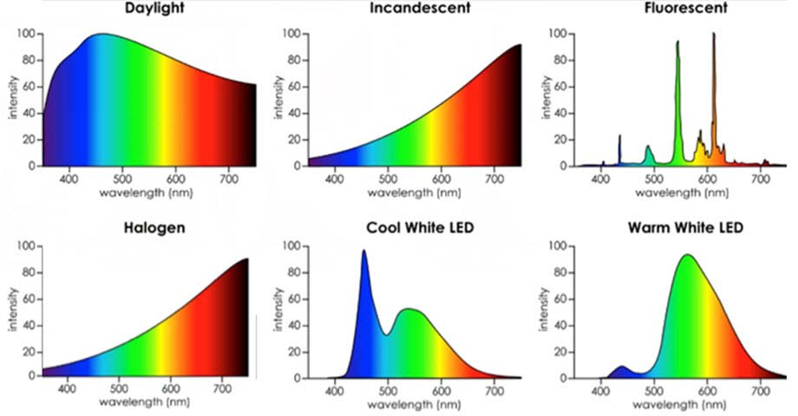
Desire Color Rendering Index (CRI) 95+ %
Color Temperature 2700-3000k

Slide 27
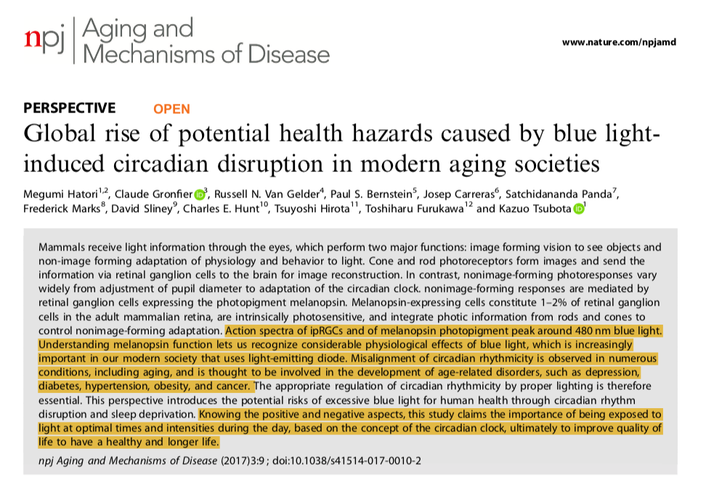

Slide 28
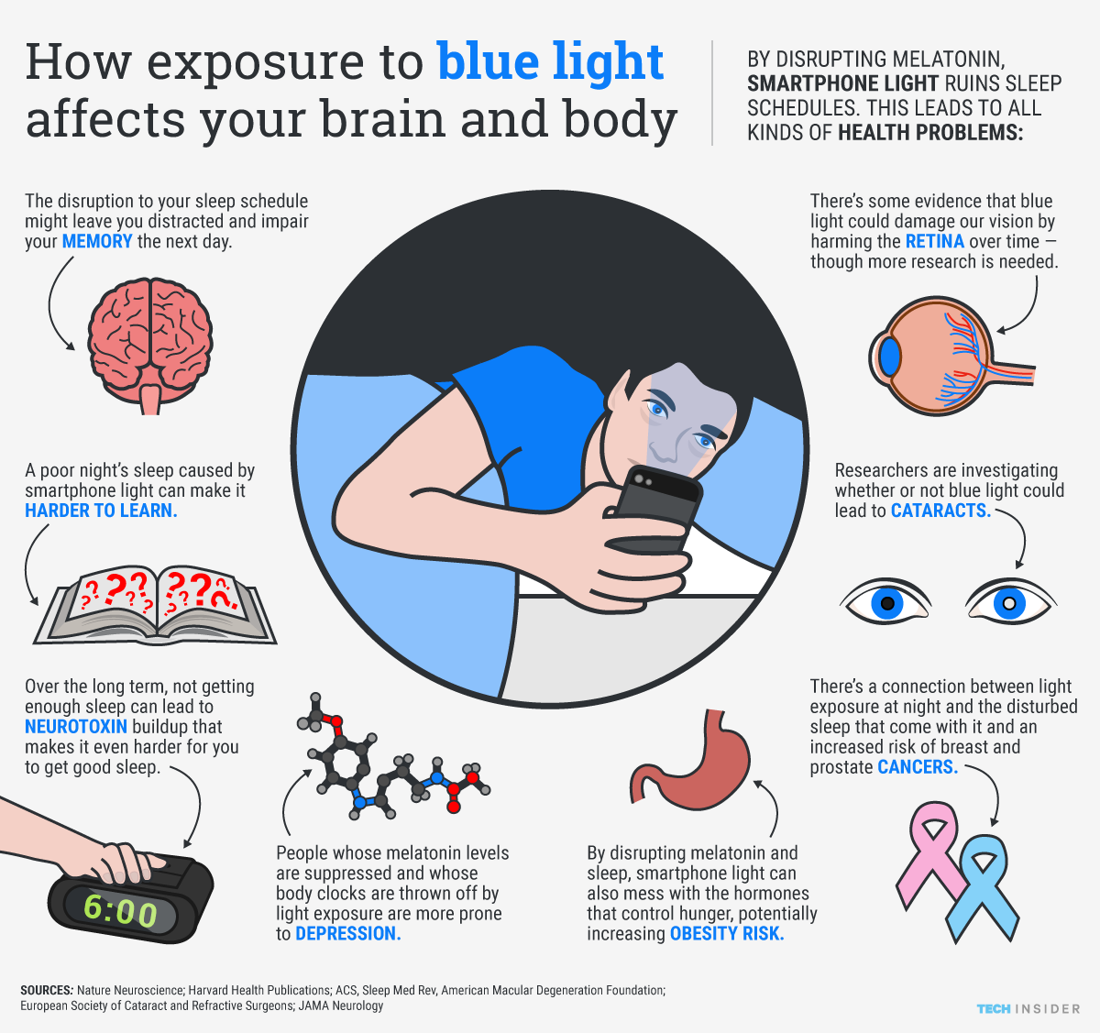
Aging and Mechanisms of Disease (2017) 3:9 ;

Slide 29
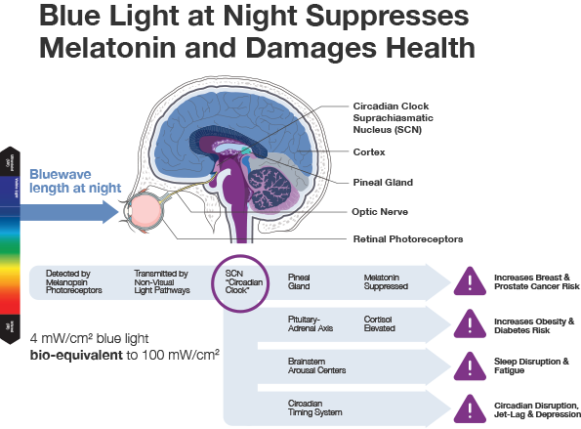
Aging and Mechanisms of Disease (2017) 3:9 ;

Slide 30
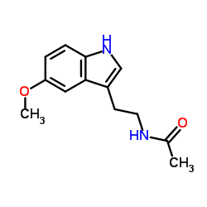
Melatonin
Hormone of darkness
Very sensitive to blue light
Facilitates sleep cycle
Increases cell regeneration
Anti-oxidant activity; ROS scavenger
Antagonizes Aromatase and lowers estrogen production in tissues
Modulates immune regulatory function
Antagonizes cortisol
Key substance for chronobiologic adaptation (day/night and summer/winter)

Slide 35
Courtesy Dr. Alexander Wunsch

Slide 36
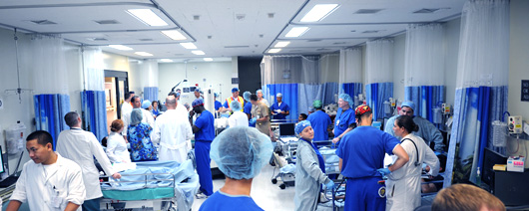
Fluorescent Light/
Night Shift Work
NHS- Nurses Health Study (Harvard)
120,000 nurses followed 30+ years
30-50% increase of breast cancer after 15 years of night work
Higher rates of obesity, diabetes, heart disease and depression

Slide 37
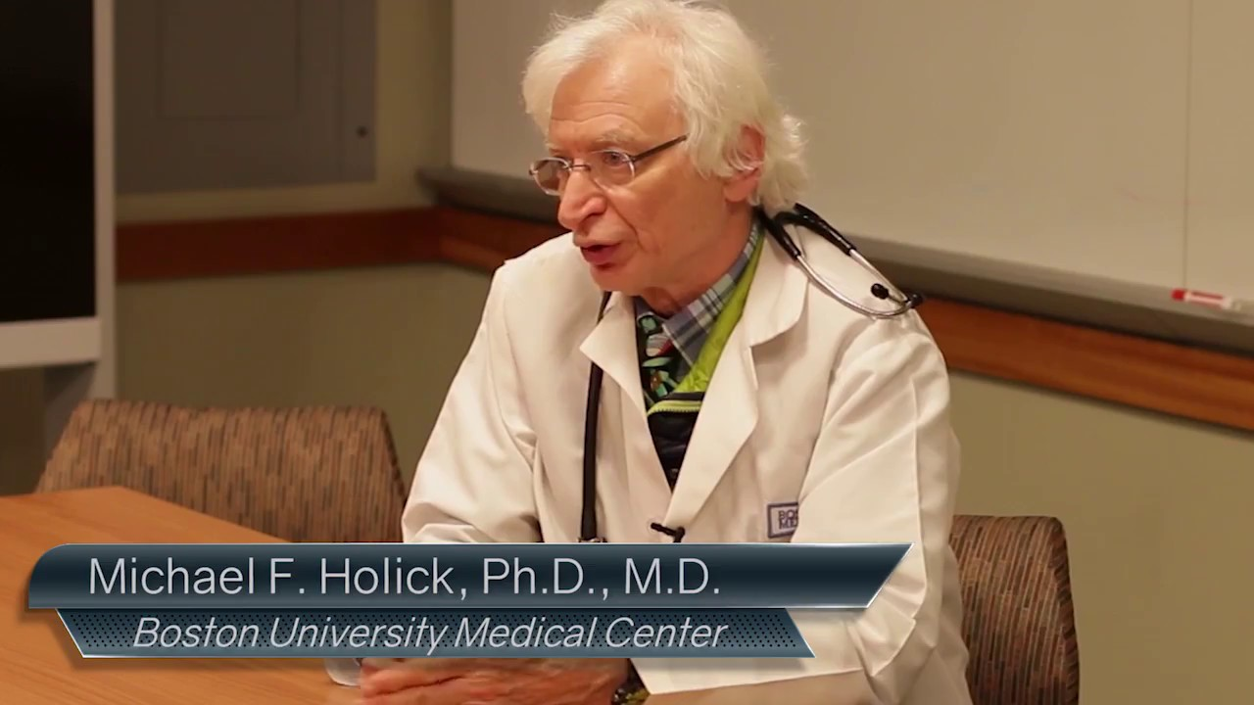
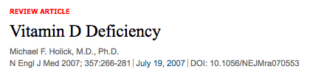
Author of the UV Advantage
Sunblocks with factor 15+ reduce Vitamin D by 99.9%
More thoughtful dosed sunlight exposure.g. 30-60”/day could reduce cancer incidence in USA by as much as 50%
Melanoma risk significantly reduced with occupational sun exposure

Slide 38
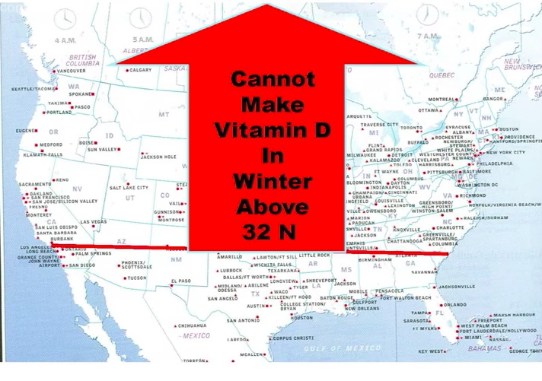

Slide 39
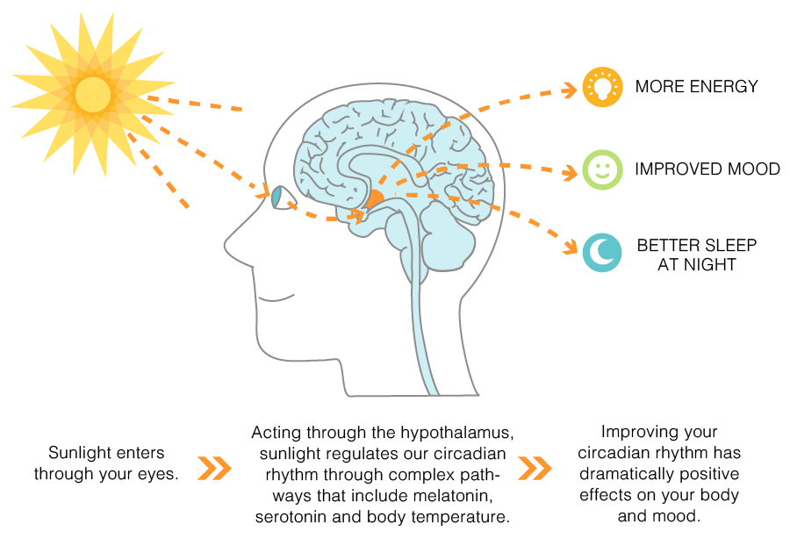

Slide 40
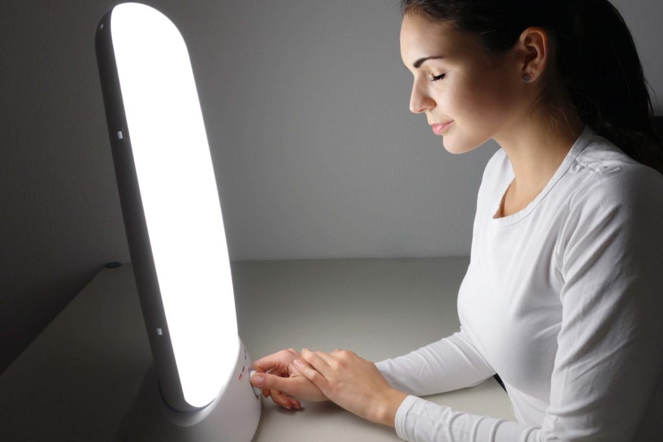
Full-spectrum light box: 10,000 lux

Slide 42
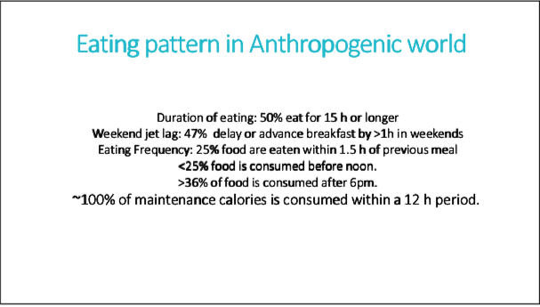
Satchin Panda, PhD The Circadian Code

Slide 44

Intermittent Fasting
Time Restricted Eating (TRE)
Time restricted feeding e.g. consume all food within 10-hour window. No eating 2-3 hrs before bedtime
Excellent Circadian rhythm “calibration”
Decreases in body weight and visceral fat, insulin and glycemic control
Significant reductions in breast cancer recurrence and improved prognosis (Patterson et al. UCSD 2016)
Improved cardiovascular disease risk profile
Decreased neuroinflammation (Neurobiol Aging. 2015 May;36(5):1914-23)
Autophagy (Autophagy, 2014;10:11, 1879-1882)
Improved sleep!!

Slide 45
Zeitgebers:
Circadian Entrainment
Sleep hygiene
Grounding…take your shoes off and stand outdoors
60” full spectrum outdoor lighting/day: within 2-3 hrs after sunrise and within 2-3 hours before sunset
Give your retina access; no sunglasses at key times of day
Evening light: Warm Halogen or warm LED
Orange-amber light at night
Blue light filters 2-3 hrs before bedtime; F*Lux, Night Shift, Iris apps;
Computer settings: lower color temperature
Time Restricted Feeding 10 hours: no eating within 2-3 hours of bedtime
Movement during the daytime
Social interactions during the day
Stress during the day…not good after sunset
Satchin Panda, PhD The Circadian Code

Slide 46
Thank you !

Slide 47
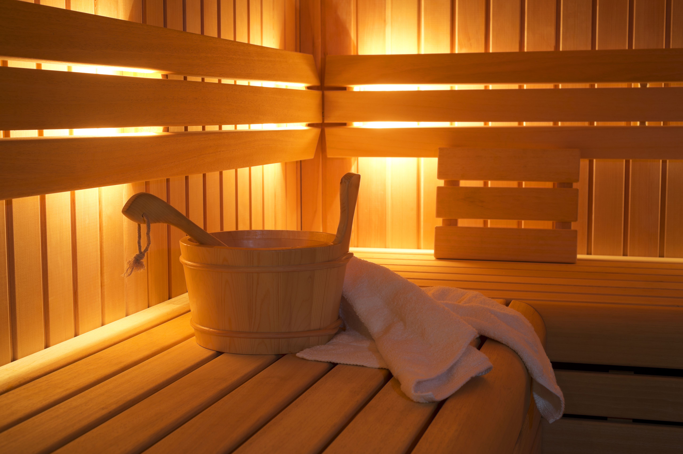
Saunas
Really good for health promotion and disease prevention
Upregultes HSP, defense/resiliency mechanisms
30” minutes 3-4x/week
Steam or infrared
Laukkanen T, Khan H, Zaccardi F, Laukkanen JA. Association between sauna bathing and fatal cardiovascular and all-cause mortality events. JAMA Intern Med. 2015;175(4):542-548
Sauna bathing and incident hypertension: A prospective cohort study. Am J Hypertens. 2017; Nov 1;30(11):1120-1125.
Sauna bathing is inversely associated with dementia and Alzheimer's disease in middle-aged Finnish men. Age Ageing. 2016; Mar 1;46(2):245-249.

Slide 48
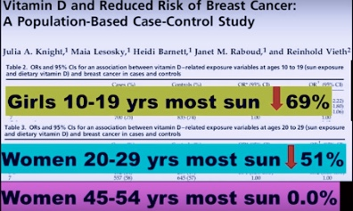
Courtesy Michael Holick MD, PhD

Slide 49

Disease (how things appear)
Pre-diabetes, Diabetes, Weight, HBP, Lipids, Heart Disease, Stroke, Depression, Autoimmunity,Arthritis Alzheimer’s, Cancer, Fibromyalgia, Chronic fatigue
The Origins of Health
Systems Biology
Core Metabolic Imbalances (what drives them)
Inflammation
Insulin Resistance
Gut-Barrier Function/Microbiome
Circadian Entrainment
Stress Response
Root Causes (what are their origins)
Environment+Epigenome/genes+Microbiome
Nutrition Movement Stress Response Environmental toxins Sleep Social Connection Trauma Conflict Management Forgiveness Mindfulness Spirituality-Meaning Medications
Light quality-entrainment

Slide 50
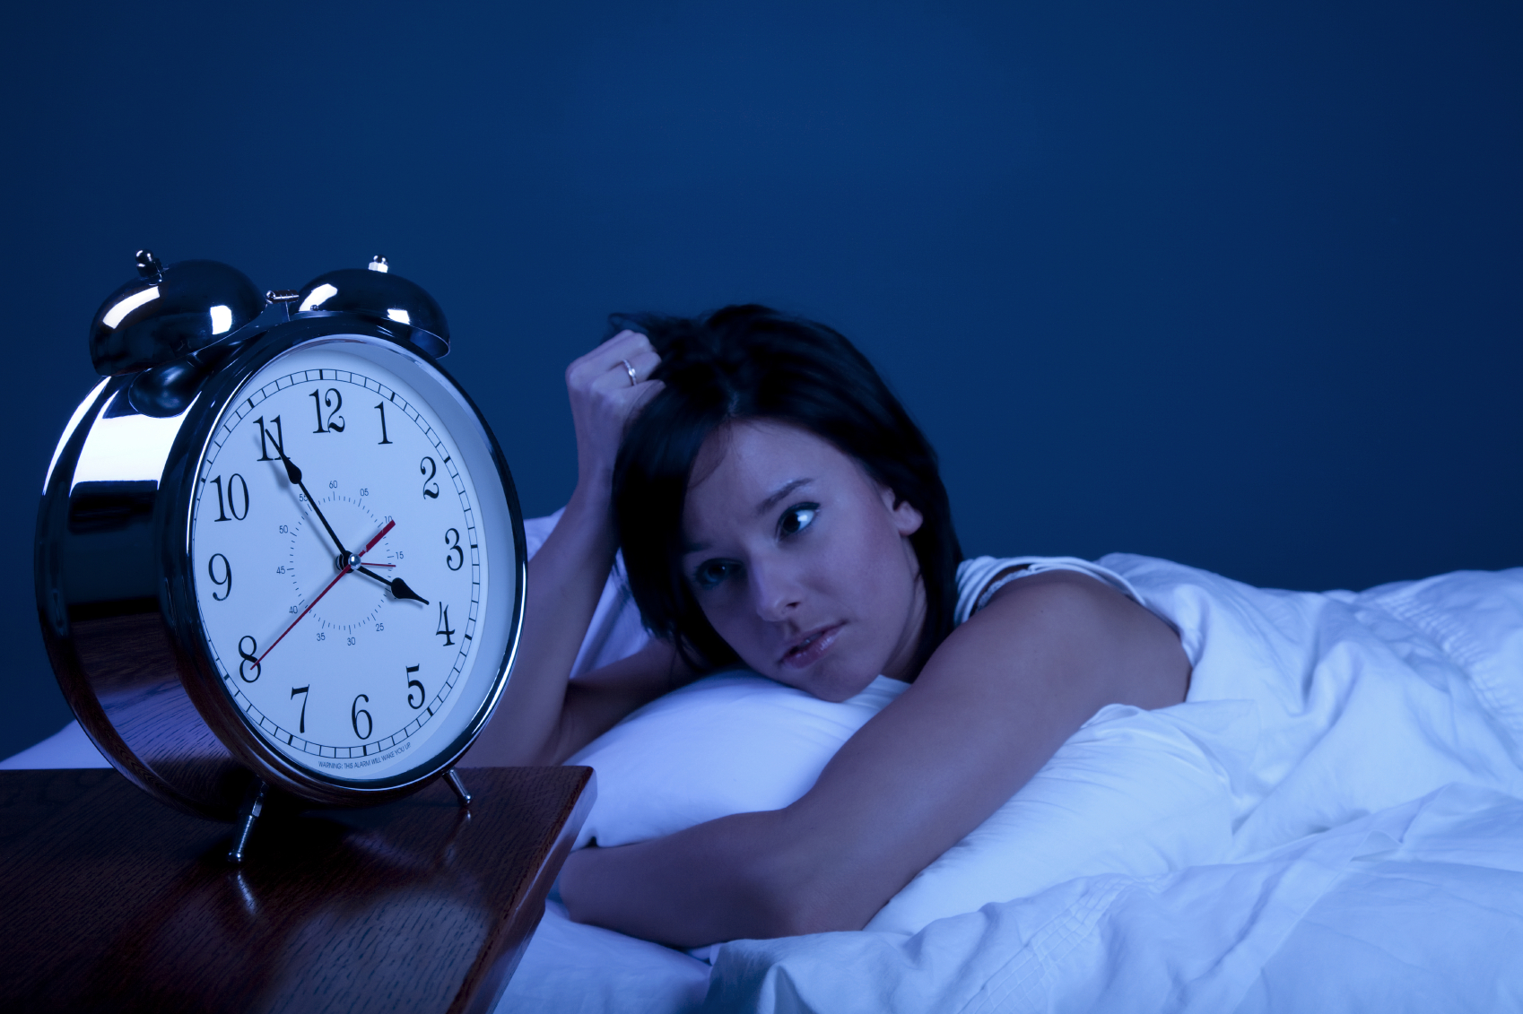
Sleep Hygiene 101
Consistent timing of sleep-wake
Dark bedroom (eye mask)
Cooler temperature (64-68)
Reduce ambient noise (ear plugs)
Obstructive sleep apnea underdiagnosed (neck circumfrence 16+” in women and 17+” in men)
No caffeine after 2p
Avoid eating within 2-3 hrs bedtime
Phone/laptops on airplane mode or turned off

Slide 51
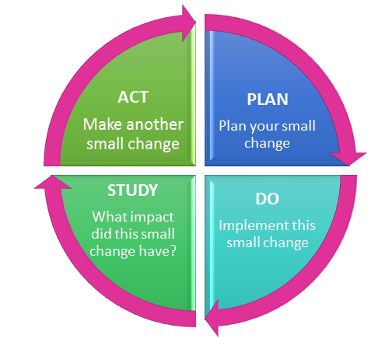
Continuous Self-Improvement PDSA Virtuous Cycle
30-60” full-spectrum light each day
Reduce Blue light at night
Consider Light Box
Change CFUs to warm LEDS
Journal response to stressors for 10” at end of day
Sleep
Walk outdoors
Sit-lunch outside
Sit near windows
Blue light filters
Incandescent/halogen bulb in family room/bedroom

Slide 52
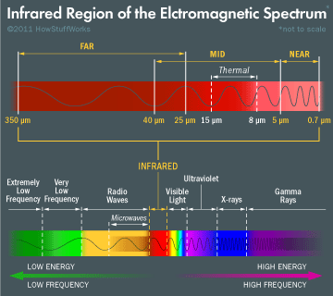
Red-IR (600-2000nm)
Mitochondrial function
Accelerated wound healing (NASA 2001, mouth ulcers in cancer, NASA 2011) J Invest Dermatol. 1999 Aug;113(2):221-3.
Hair regrowth
Arthritis: Cellular regeneration, anti-inflammatory effects (NASA) Photomed Laser Surg. 2009 Aug;27(4):577-84.
Allergic rhinitis (Israel)
MS (UWisconsin 2012)
Skin, collagen
Degenerative Neurologic Diseases (2010 Kanazawa University Japan; 2012 University of Cambridge)
Health benefits IR sauna
J Alzheimers Dis. 2011;23(3):521-35. doi: 10.3233/JAD-2010-100894.
IUBMB Life. 2010 Aug;62(8):607-10.

Slide 53
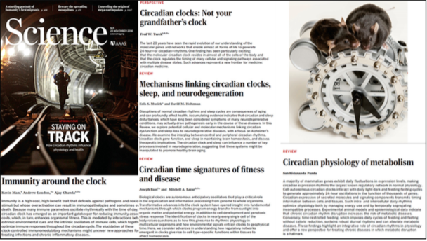

Slide 54
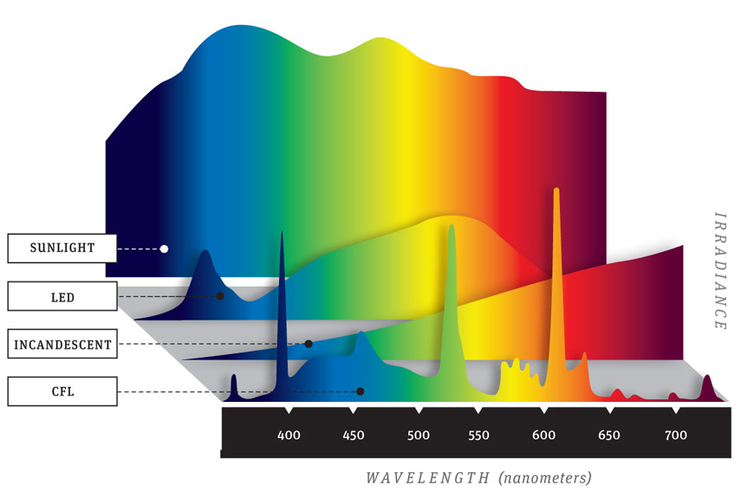

Slide 55
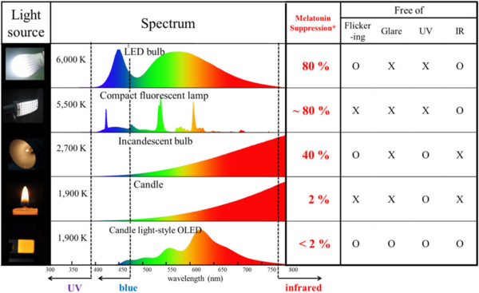

Slide 56
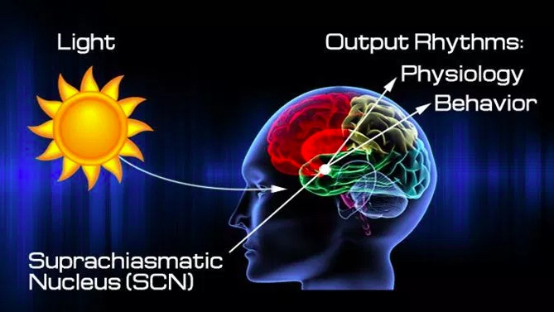

Slide 57
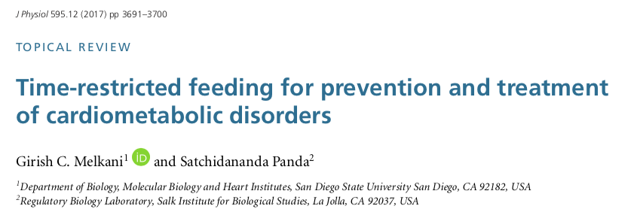
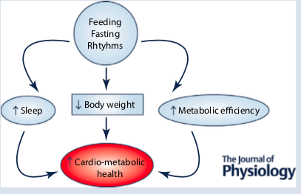

Slide 58
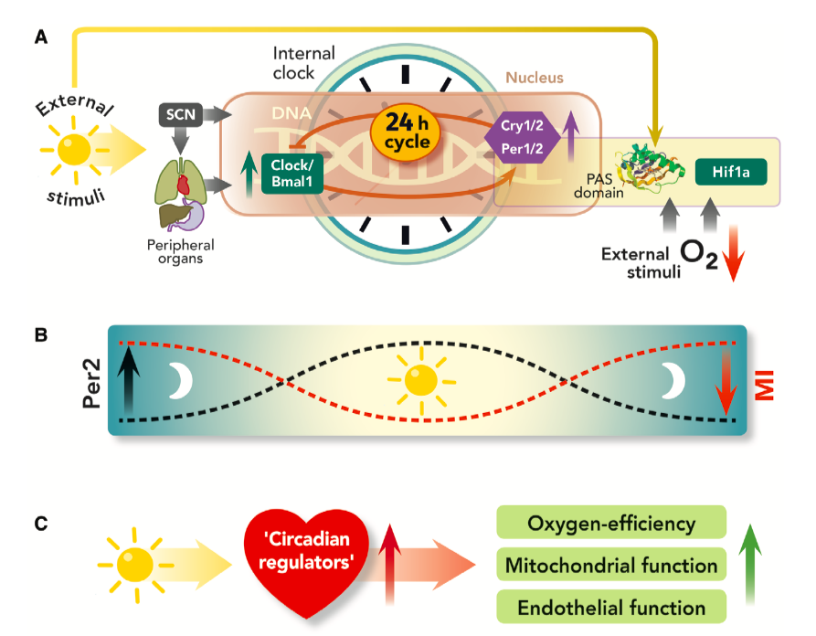
Anesthesiology 2015; 122:1170-5

Slide 59
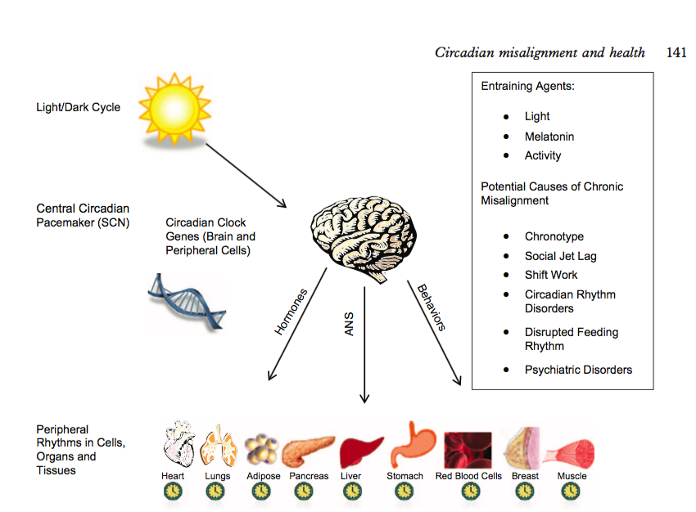
Nat Commun. 2017 Sep 12;8(1):417.
Misalignment with the external light environment drives metabolic and cardiac dysfunction.

