Slide 1
A Holistic Approach to Weight Loss and Better Health
Mark Pettus MD
Director Medical Education, Wellness and Population Health
May 13, 2019
www.thehealthedgepodcast.com

Slide 2
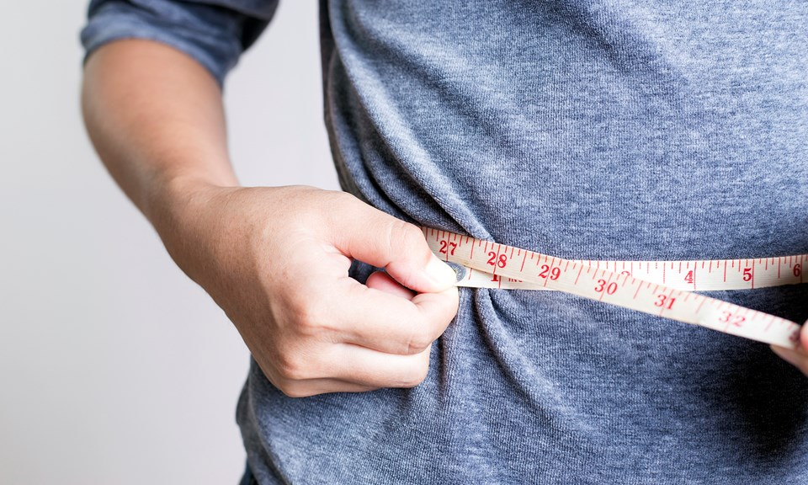
Four Part Series
Week 1: Insulin and Inflammation
Week 2: Leaky Gut and the Gut Biome
Week 3: Sleep and Circadian Rhythms
Week 4: Hypnosis Experience

Slide 3
Prevailing View
Obesity occurs when a person consumes more calories from food than he or she burns.
National Institute of Health
Overweight is the result of caloric imbalance (too few calories expended for the amount of calories consumed) and is mediated by genetics and health.
US Surgeon General

Slide 4
The Proposition
Calories in – Calories out is a limited a failed concept for understanding weight and metabolism.
Food is information that our bodies translate.
When the quality and timing of the information consumed lowers insulin and inflammation our weight, metabolism and global health potential will emerge.
Essential to weight loss and metabolic health is the extent to which our choices and our environment is “entrained” with deeply rooted day-night circadian rhythms.

Slide 5
Lifestyle
Life
Gene-Epigenome
Microbiome
Consciousness-Spirit

Slide 6
“It’s not what we don’t know that gets us into trouble. It’s what we know that ain’t so.”
Mark Twian
So what do we know that ain’t so?
There’s not much I can do about my DNA!

Slide 7
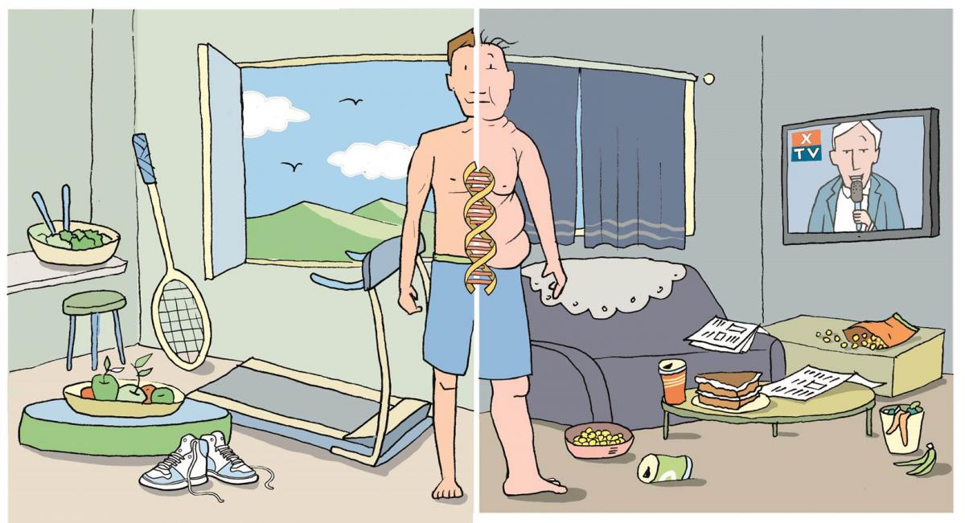

Slide 8
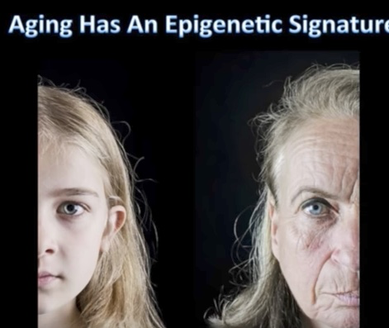
Aging has an Epigenetic Signature

Slide 9
Disease (how things appear)
Pre-diabetes, Diabetes, Weight, HBP, Lipids, Heart Disease, Stroke, Depression, Autoimmunity,Arthritis Alzheimer’s, Cancer, Fibromyalgia, Chronic fatigue
The Origins of Health
Systems Biology
Core Metabolic Imbalances (what drives them)
Inflammation
Insulin Resistance
Gut-Barrier Function/Microbiome
Circadian Entrainment
Root Causes (what are their origins)
Environment+Epigenome/genes+Microbiome
Nutrition Movement Stress Response Environmental toxins Sleep Social Connection Trauma Conflict Management Forgiveness Mindfulness Spirituality-Meaning Medications
Light quality-entrainment
Social Determinants

Slide 10
Is the choice I am about to make familiar with what my stone-age roots would recognize?

Slide 11
Robert Sapolsky PhD, Stanford

Slide 12
From Robert Sapolsky PhD

Slide 13
Robert Sapolsky PhD Stanford

Slide 15
Robert Sapolsky PhD

Slide 16
Heavier with increased BMI
Metabolic Syndrome
Insulin resistance with elevated
fasting and post-prandial insulin
levels
Increased TGAs
Move less
Socialize and play less
Less fertile
Die younger

Slide 17
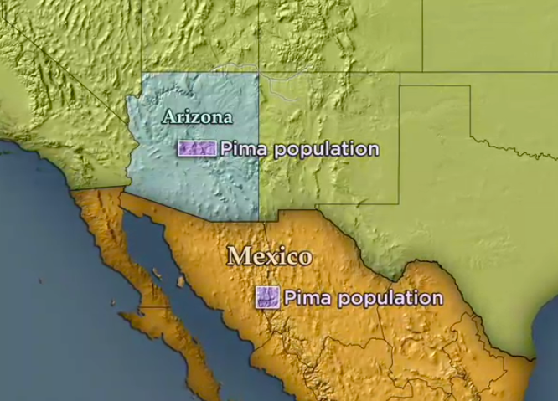

Slide 18
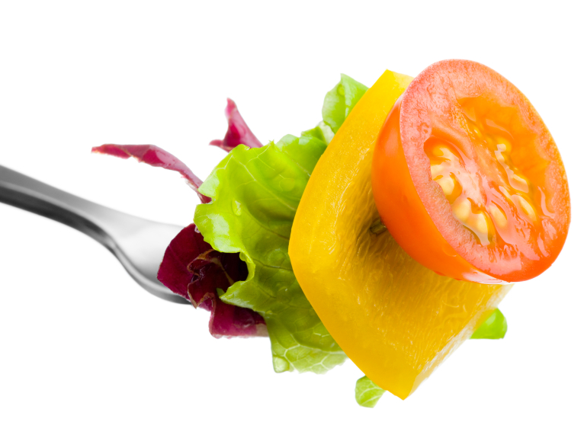
Food and Inflammation

Slide 19
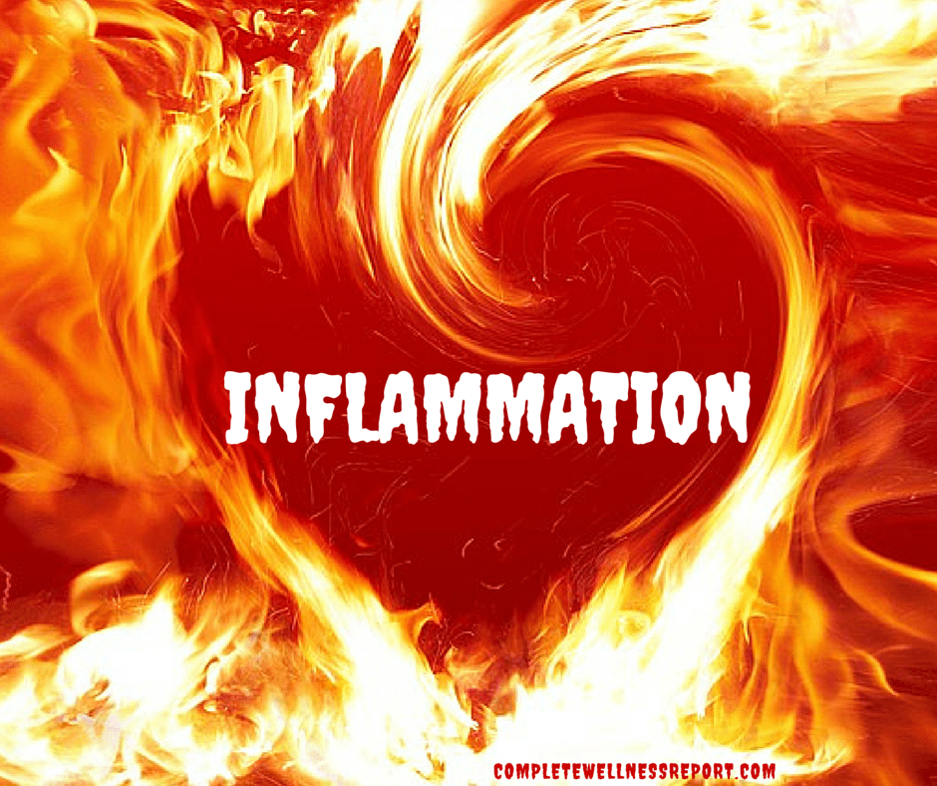
Inflammation
Over stimulation of our immune system
Raises our insulin levels (insulin resistance)
Raised the risk of all chronic, complex disease
Promotes weight gain
Modifiable with lifestyle choice

Slide 22
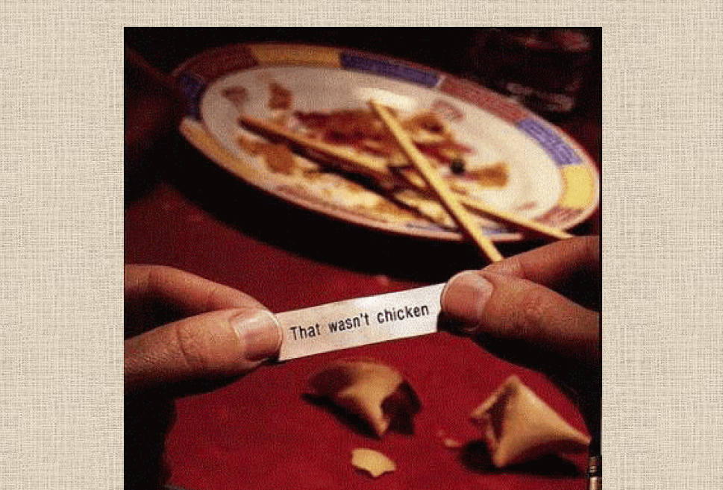

Slide 23
How much sugar is in the human body?

Slide 25
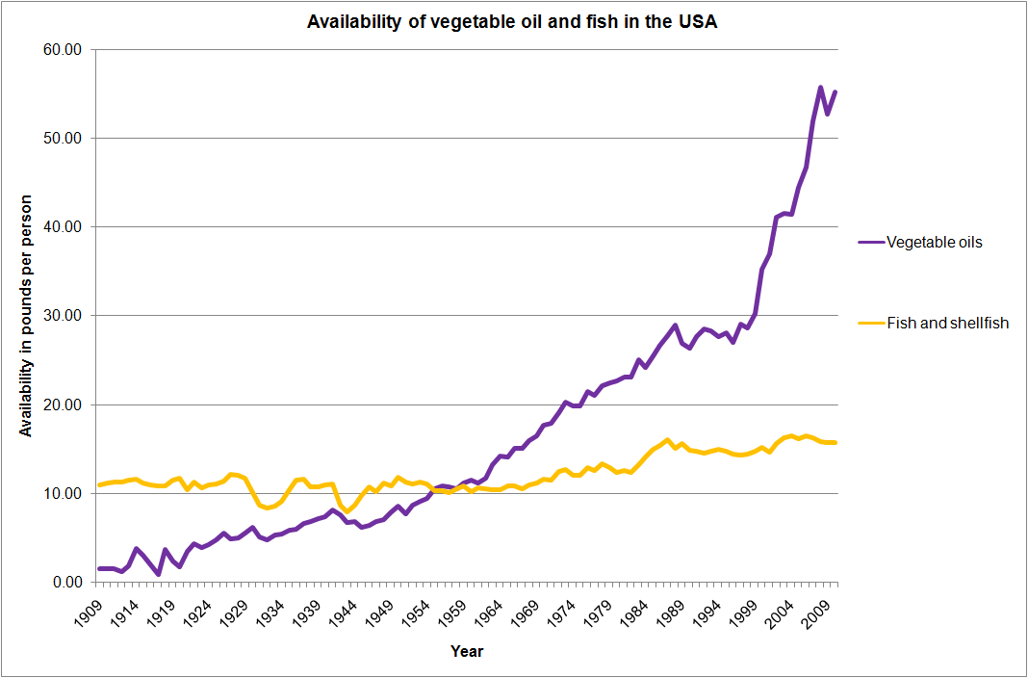
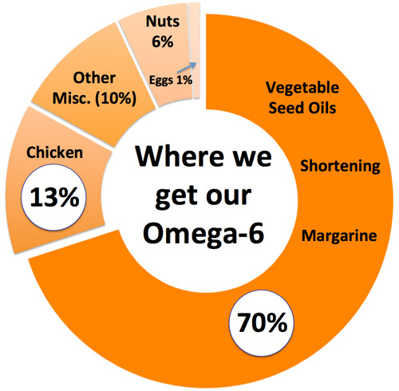

Slide 26
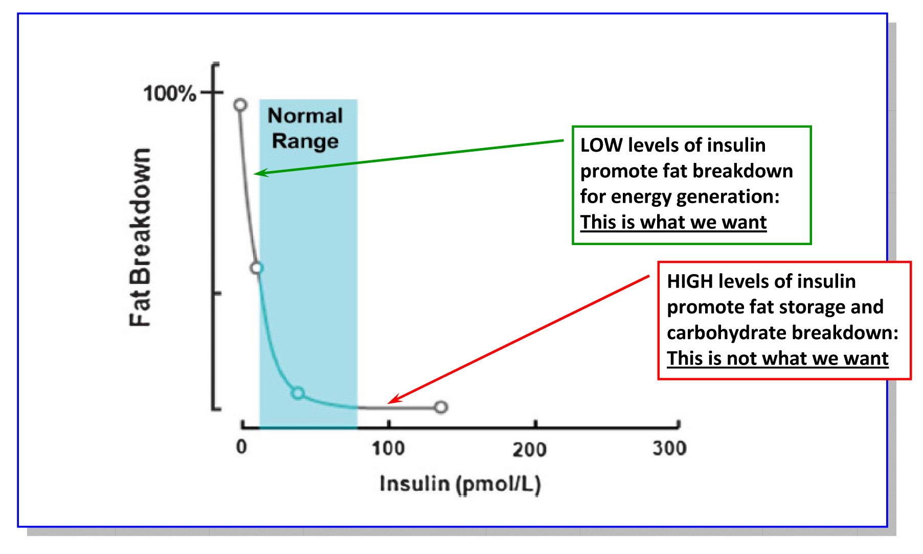
Lipolysis (burning fat) vs.
Lipogenesis (storing fat)

Slide 27
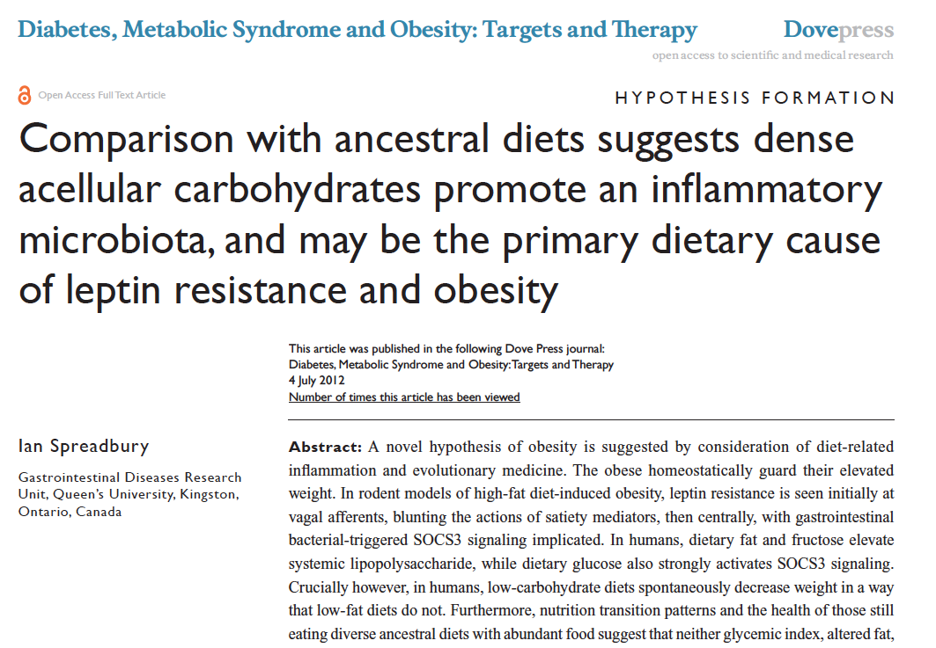

Slide 28
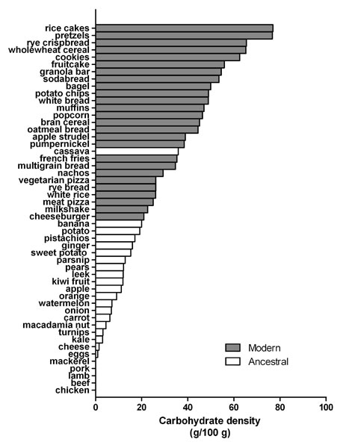
Reduce carbohydrate-dense foods
Major contributor of obesity, insulin resistance, changes in blood lipids, inflammation, and alterations of the organisms in the human microbiome
A huge area of opportunity in individuals with increased belly fat, pre-diabetes or diabetes…these are health features of carbohydrate intolerance.
For most, sugar and refined, grain-based foods are problematic: eliminate and observe.

Slide 29
Poor Quality Carbs
Acellular carbohydrate density
Inflammation
Stress
Sleep disruption
Altered gut-permeability/microbiome
Social isolation
Toxin excess
Sedentary states
VAT
Excess Insulin
VAT Fat storage-lipogenesis
Down-regulation of insulin receptors
Insulin Resistance
Leptin resistance
Eat more and do less

Slide 30
Will the choice I am about to make…
Raise my sugar-insulin or lower my sugar-insulin?
Rev up my immune system or relax my immune system?
Raise my stress levels (cortisol) or lower my stress levels (cortisol)
Be compatible with my ancestral roots?

Slide 31
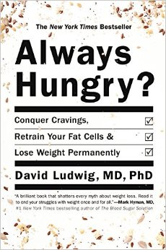
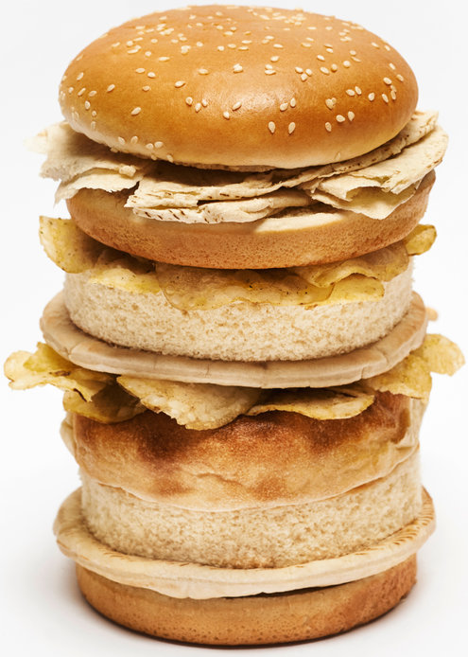
“ Are we fat because we eat too much or do we eat too much because we are fat ?”

Slide 32
Five hour rule after eating a meal
Am I hungry again within a few hours?
Am I tired and ready for a nap?
Does my mind feel less sharp, attentive and focused?
Am I experiencing bloating, gas, cramping?
…if the answer to any of these questions is consistently “yes” then there are significant problems with what you are eating!

Slide 33
A calorie is not a calorie…
Effects of Dietary Composition on Energy Expenditure During Weight-Loss Maintenance
Cara B. Ebbeling, PhD; David S. Ludwig, MD, PhD et al
Conclusion: Among overweight and obese young adults compared with pre–weight-loss energy expenditure, isocaloric feeding following 10% to 15% weight loss resulted in decreases in REE and TEE that were greatest with the low-fat diet, intermediate with the low–glycemic index diet, and least with the very low-carbohydrate diet.
Remarkable range between individuals
TEE: - 423 [–606 to –239] kcal/d for low fat diet
- 57 [–281 to 86] kcal/d for low carb diet
Equivalent of 1-hr moderate effort cardio difference
JAMA. 2012;307(24):2627-2634. doi:10.1001/jama.2012.6607
Notes:
TEE differed by approximately 300 kcal/d between these low fat and low carb diets, an effect corresponding with the amount of energy typically expended in 1 hour of moderate-intensity physical activity.

Slide 34
Food and Reward

Slide 35
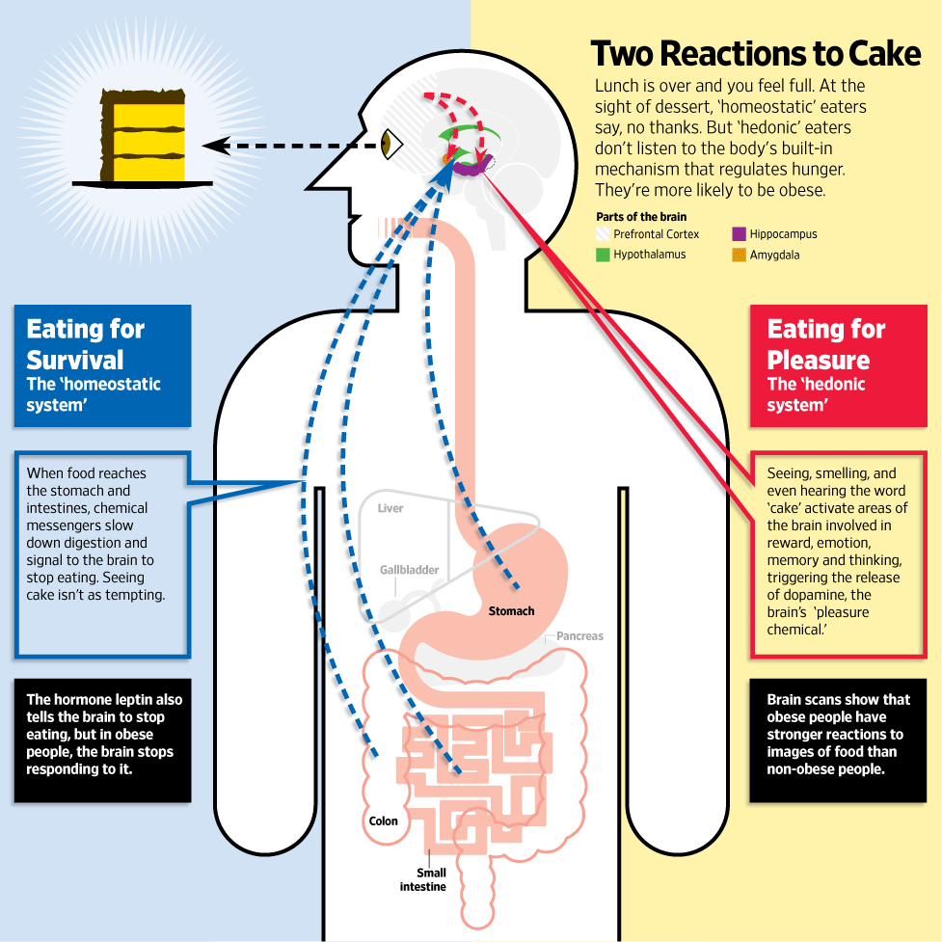
Jabr F, SA Mind December 2015

Slide 37
Low Carb-High Fat Fears
Saturated fats
Cholesterol
My brain needs carbs
Low-carb is bad for the environment
Too much protein
Not enough vitamins and minerals
Thyroid function
Kidney damage
Changes in mood
Hard to exercise
Changes to the gut flora
Constipation

Slide 38
If you have HBP and Diabetes
Lightheadedness may be a sign of a drop in BP; bone broth, bouillon, and may need to reduce medications
For symptoms of hypoglycemia e.g. sweating, palpitations, lethargy it is important to self-monitor BS as medications for diabetes frequently need to be reduced.
Follow-up with your primary or endocrinologist for needs regarding cutting back on medications for your blood pressure or diabetes management.

Slide 41
Reduce poor quality, processed, carbohydrate-dense foods
Added Sugar
Grain-based flour e.g. breads, cereal grains, pasta, pastries, desserts, chips, pretzels, granola bars.
Higher Fructose Fruits e.g. bananas, grapes, pears
Dried fruits e.g. raisins, apricots, cherries
Sweetened soft drinks
Beer is liquid bread
Gradual reintroduction of starchy vegetables after 8-12 weeks, e.g. white rice, carrots, parsnips, white potatoes
Lowered insulin and reduced inflammation “unlock” fat burning
All Carbs
Low
Glycemic

Slide 44
More fat of better quality
Reduce omega 6 vegetable oils e.g. corn, canola, soybean, sunflower
Eliminate trans fats found mostly in packaged desserts
More abundant healthy fat sources e.g. eggs, butter, full-fat dairy, nuts (macadamia, walnuts, pecans, walnuts), fatty fish e.g. salmon, sardines, trout, maceral, anchovies; grass fed meats, shellfish, avocados, extra virgin olive oil, coconut oil, ghee, macadamia nut oil, avocado oil
Fats
Fats

Slide 45
15%
55%
SAD
LCHF

Slide 46
www.dietdoctor.com

Slide 47
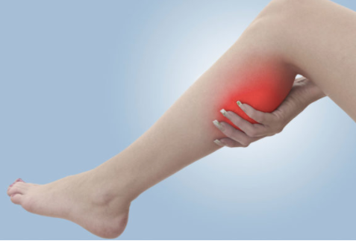
6 possible symptoms when starting a LCHF program
Flu-like symptoms
Frequent urination
Leg cramps
Constipation
Bad breath
Reduced tolerance to alcohol

Slide 48
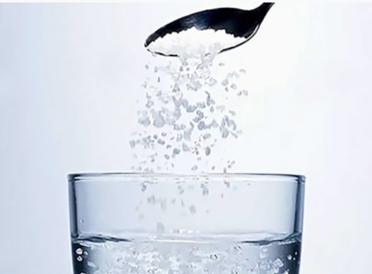
Precautionary steps
Lots of water (tsp salt/8oz) or bone broth, bouillon
Make sure you’re getting enough fat with each meal
Magnesium supplements: 2/day for 3 weeks, then 1/day thereafter (bedtime is a good time)
Miralax each day for constipation
Good oral hygiene; breath mints
Moderate alcohol e.g. 1 drink/day max

Slide 49
Summary: Enhancing metabolic efficiency: …. Reduce inflammation and insulin
Eliminate – reduce sugar in all it’s forms
Eliminate-reduce refined grain flours, and carbohydrate-dense processed foods. Try going wheat-free for a month.
Reduce hydrogenated oils and processed seed oils cooked at high temperatures
OK to consume pasture-raised meats and eggs
More abundant healthy fats sources e.g. extra virgin olive oil, fatty fish, grass-fed butter; eggs; extra virgin coconut oil (MCT Oil); pasture-raised animal fat, ghee, avocados, nuts (almonds, walnuts and macadamia) and nut butters
Plant-based foods with a lot of fiber and nutrient density

Slide 50
Thank You !

Slide 51
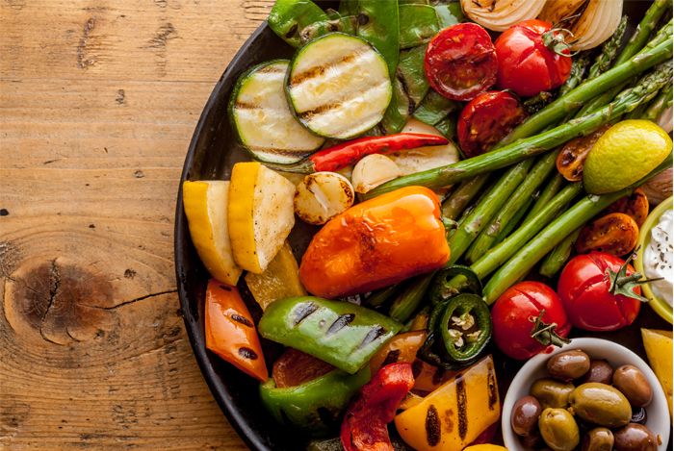
Plant-based foods
Fill half of plate with vegetables
2 cups greens/day is a nice goal
Cruciferous e.g. broccoli, cauliflower, collards, cabbage, kale, spinach, asparagus, romaine lettuce, arugula
Allium family e.g. onions, leeks, garlic
Beans and lentils; soaking and pressure cooking can be easier on the gut, reducing lectins
Lower glycemic fruits e.g. berries, grapefruit, kiwi
Anti-inflammatory spices e.g. turmeric, basil, ginger, rosemary, cayenne pepper
Fermentable Fiber essential for gut biome diversity
Fermentable foods e.g. yogurt, sauerkraut

Slide 52
Circadian Entrainment
Sleep hygiene basics
30-60” full spectrum lighting/day
Vitamin D as a nuclear transcription factor
Blue light during the day is important
Evening light: Incandescent 2700k, Halogen 3,000k, warm LED on dimmer
Blue light filters 2-3 hrs before bedtime
Blue blocker glasses 2-3 hrs before bedtime
Time Restricted Feeding: 10-hr window a powerful intervention; nothing to eat 2-3 hrs prior to bedtime.
Satchin Panda, PhD The Circadian Code
R. M. Lunn et al. “Health Consequences of Electric Lighting Practices in the Modern World: A Report on the National Toxicology of Shift Work, Artificial Light and Circadian Disruption.
Sci Tot Environment (2017): 1073-84

Slide 53
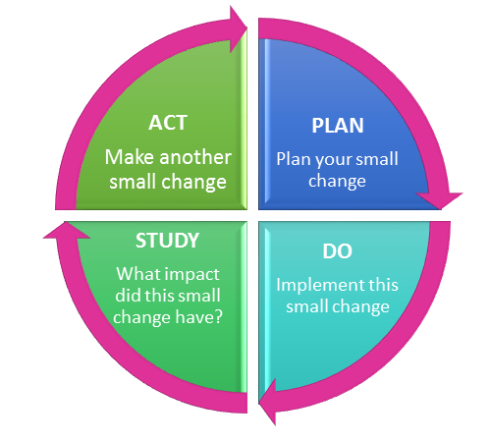
Continuous Self-Improvement PDSA Virtuous Cycle
Consider Light Box
Change CFUs to warm LEDS
30-60” full-spectrum light each day
Reduce Blue light at night
Walk outdoors
Sit-lunch outside
Sit near windows
Screen filters
Incandescent bulb in family room/bedroom
Journal response to stressors for 10” at end of day

Slide 54
Continuous Self-Improvement PDSA Cycle
Reduce sweetened soft drinks by 1/day
Take 2,000 more steps/day
Lose 10 lbs
Improve my BP
Take 1 – less medication
Cut out 2 portions of sugar/flour
Eat 2 more servings of greens/day
Add 1 more healthy fat source
Measure waist circumference
Measure weight
Monitor BP changes

Slide 55
Summary: Enhancing metabolic efficiency: …. Reduce inflammation, insulin and leptin resistance
Eliminate – reduce sugar in all it’s forms
Eliminate-reduce refined grain flours, and carbohydrate-dense processed foods.
Reduce hydrogenated oils and processed seed oils cooked at high temperatures
More abundant healthy fats sources e.g. extra virgin olive oil, fatty fish, grass-fed butter; eggs; extra virgin coconut oil (MCT Oil); pasture-raised animal fat, ghee, avocados, nuts (almonds, walnuts and macadamia) and nut butters
Time-restricted eating….all consumption within a 10-12-hour window e.g. nothing after 7p

Slide 56
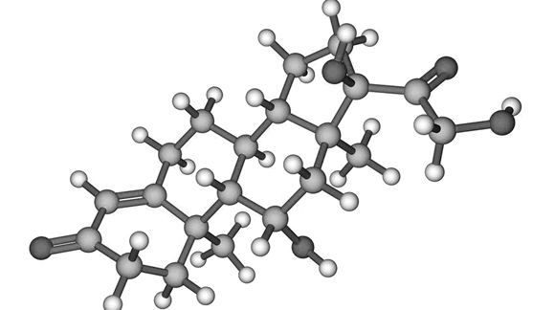
Summary: Enhancing metabolic efficiency …. Reduce inflammation, insulin and leptin resistance
OK to consume pasture-raised meats and eggs
Motion is the lotion: Walk as much as possible, stairs as tolerated, stand for 2-3” every hour
Stress management
Circadian rhythm – sleep entrainment; sleep hygiene
Full spectrum light; light box

