Slide 1
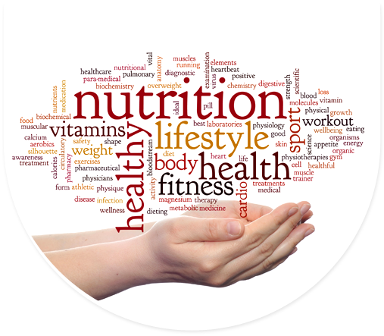
A Holistic Approach to Weight and Metabolism
Part 2
Mark Pettus MD
Director of Medical Education & Population Health
Berkshire Health Systems
February 15, 2019
www.thehealthedgepodcast.com
Notes:
The #1 cause of death and diminished quality of life are the choices we make Healthy living does not happen at the doctor’s office. Transform perceptions of Self-Care and what we as humans are capable of.
It’s not the hand you’re dealt but how you play your cards.
Unprecedented convergence This is about how you function How you function determines how you feel
Explore the key metabolic underpinnings of function
Your biology becomes you biography

Slide 2
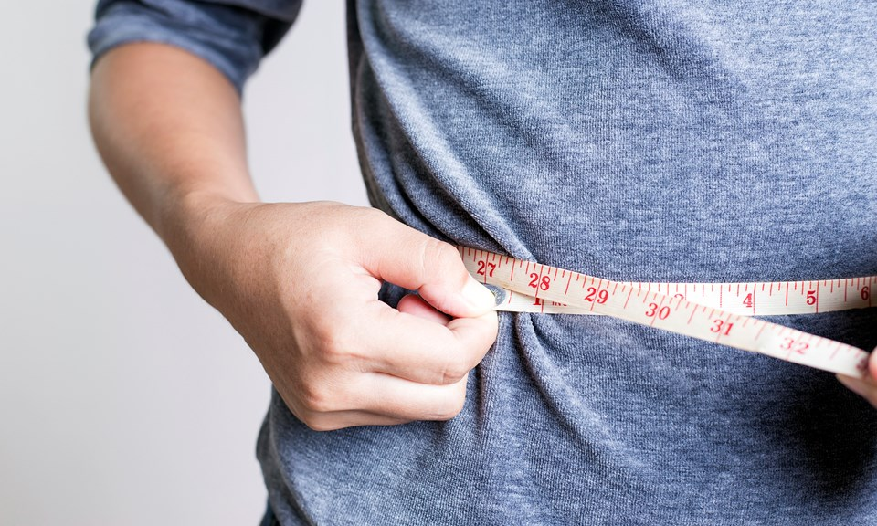
Two Part Series
Week 1: Insulin – Obesity Hypothesis
Week 2: Circadian Rhythms and Altered Gut Biome

Slide 3


Critical Considerations
Weight, metabolism and health appear tightly connected to our gut biome and biologic synchronization with daily circadian rhythms.
The diversity of the gut biome is very diminished in individuals with weight challenges.
Light interacts with human biology through our eyes and skin.
The timing and quality of our light and meal exposure appear to be of major influence on these rhythms.
Lifestyle changes can bring greater alignment to these critical relationships as an opportunity for improved health, disease prevention and disease management.

Slide 4
Lifestyle
Life
Gene-Epigenome
Microbiome
Consciousness-Spirit

Slide 5

Weight
Pre-diabetes, Diabetes, HBP, Lipids, Heart Disease, Stroke, Depression, Arthritis Alzheimer’s, Cancer,
The Origins of Health
Systems Biology
Core Metabolic Imbalances (what drives them)
Inflammation
High Insulin levels
Gut-Barrier Function/Microbiome
Circadian Rhythms- Entrainment
Root Causes (what are their origins)
Environment+Epigenome/genes+Microbiome
Nutrition Movement Interpret-Response to stressors, Environmental toxins Sleep Social Connection Trauma Conflict Management Forgiveness Mindfulness
Spirituality-Meaning
Light quality-entrainment
Social Determinants

Slide 6
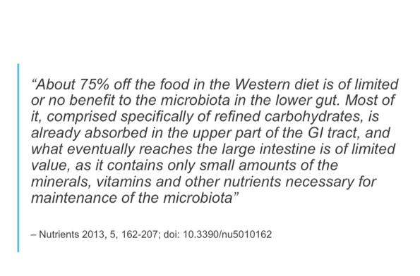

Slide 7
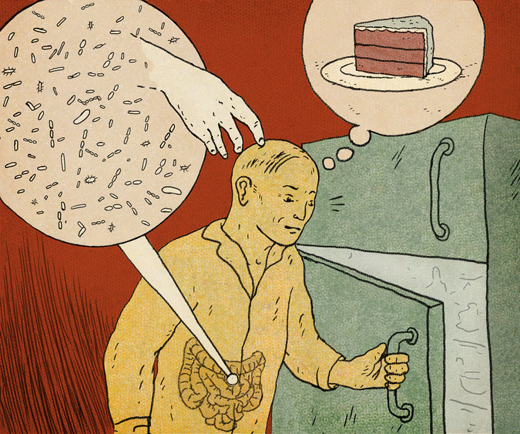

Slide 8
The gut as an ecosystem
Over 1,000 species of bugs
3+ lbs of bacteria
Gut “flora” when in balance facilitate:
-digestion
-detoxification
-production of vitamins
-produce healing metabolites
-regulate hormones
- Regulation of inflammation

Slide 9
Leaky Gut = Inflammation

Slide 10
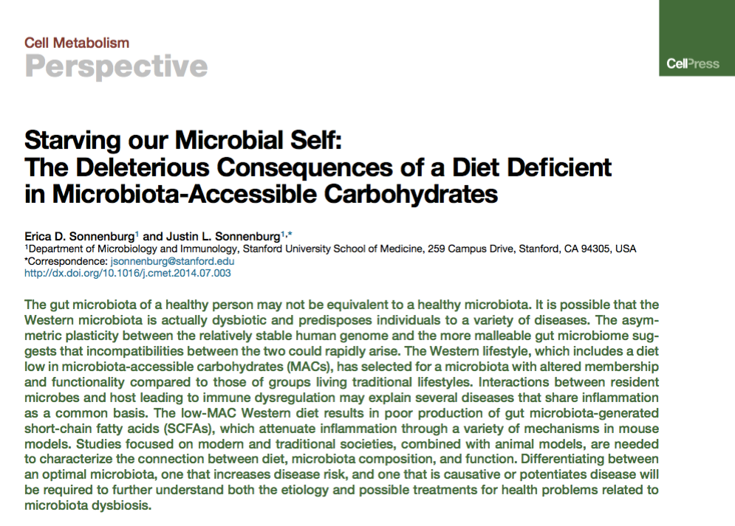
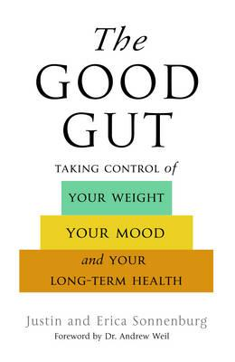

Slide 11
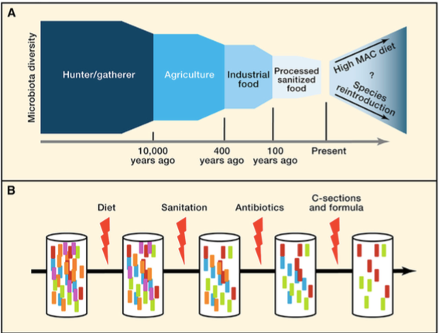

Slide 12
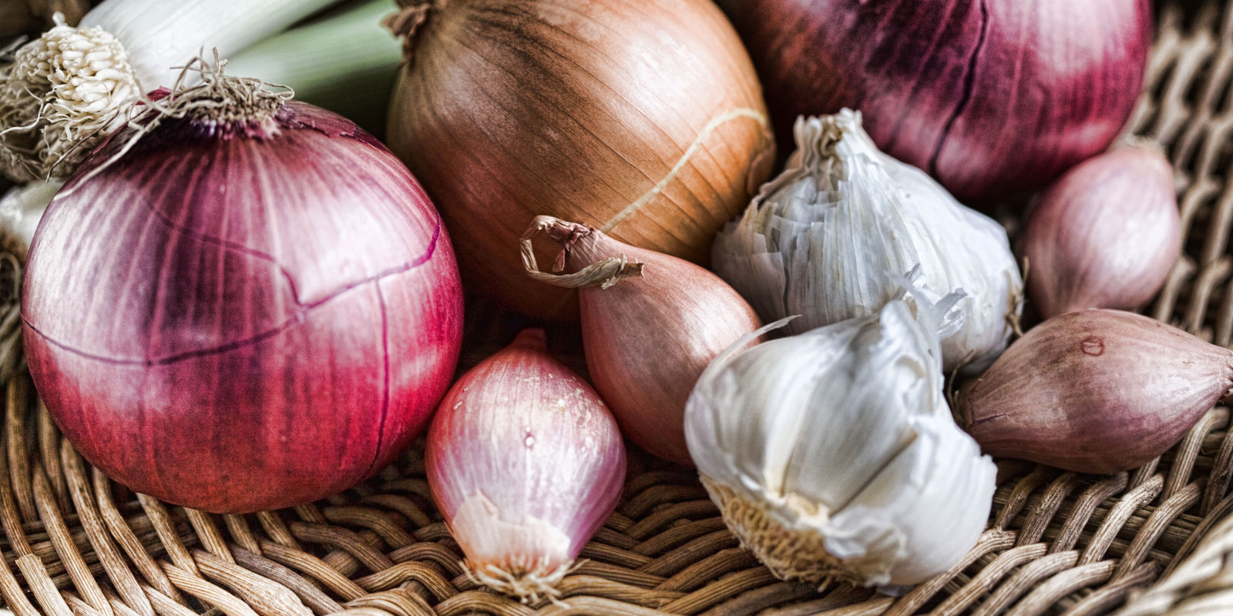
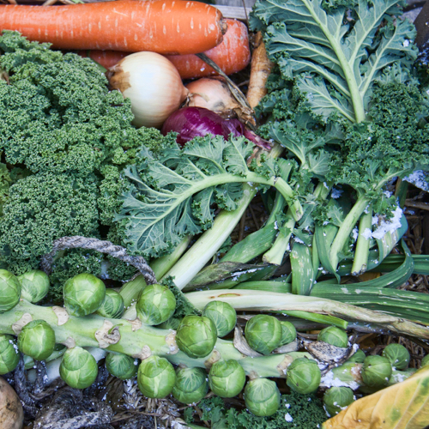
Sugar, Fructose and Carbohydrate-Dense Grains e.g. flour
High-Quality Plant-Based Carbs
Oral and Gut
Microbiome
Protection from:
Inflammation
Diabetes
Cancer
Obesity
Inflammation
Altered neurotransmitters
Insulin Resistance
Weight and Metabolism
Mitochondria-Oxidative stress
HPA axis –Stress Response

Slide 13
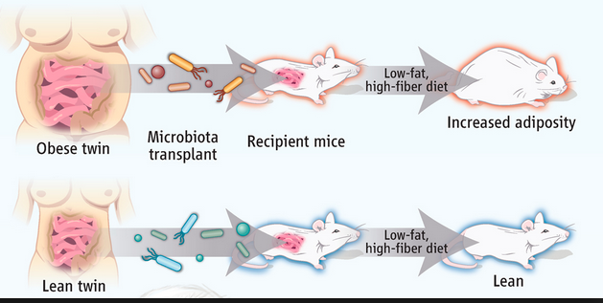
Cell 150, 470–480, August 3, 2012 ª2012 Elsevier Inc.

Slide 14
Take care of your microbiome
An emerging major contributor to human health and disease
Be prudent with antibiotics
Prebiotics are critical: Fermentable plant-based fiber
Probiotics for some
Cleaner sources e.g. USDA organic and GMO-free have fewer residues known to effect the gut ecosystem

Slide 15
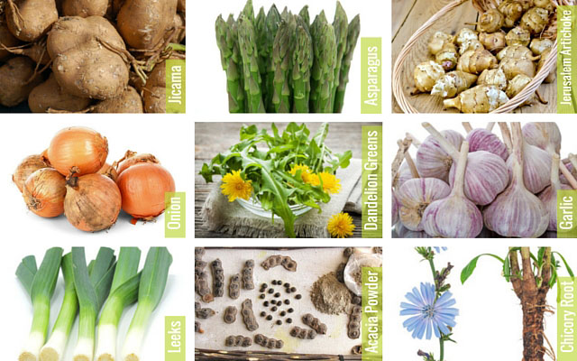
Quality High-Fiber Foods (Prebiotics)
…produce an “anti-inflammatory” gut microbiome

Slide 16
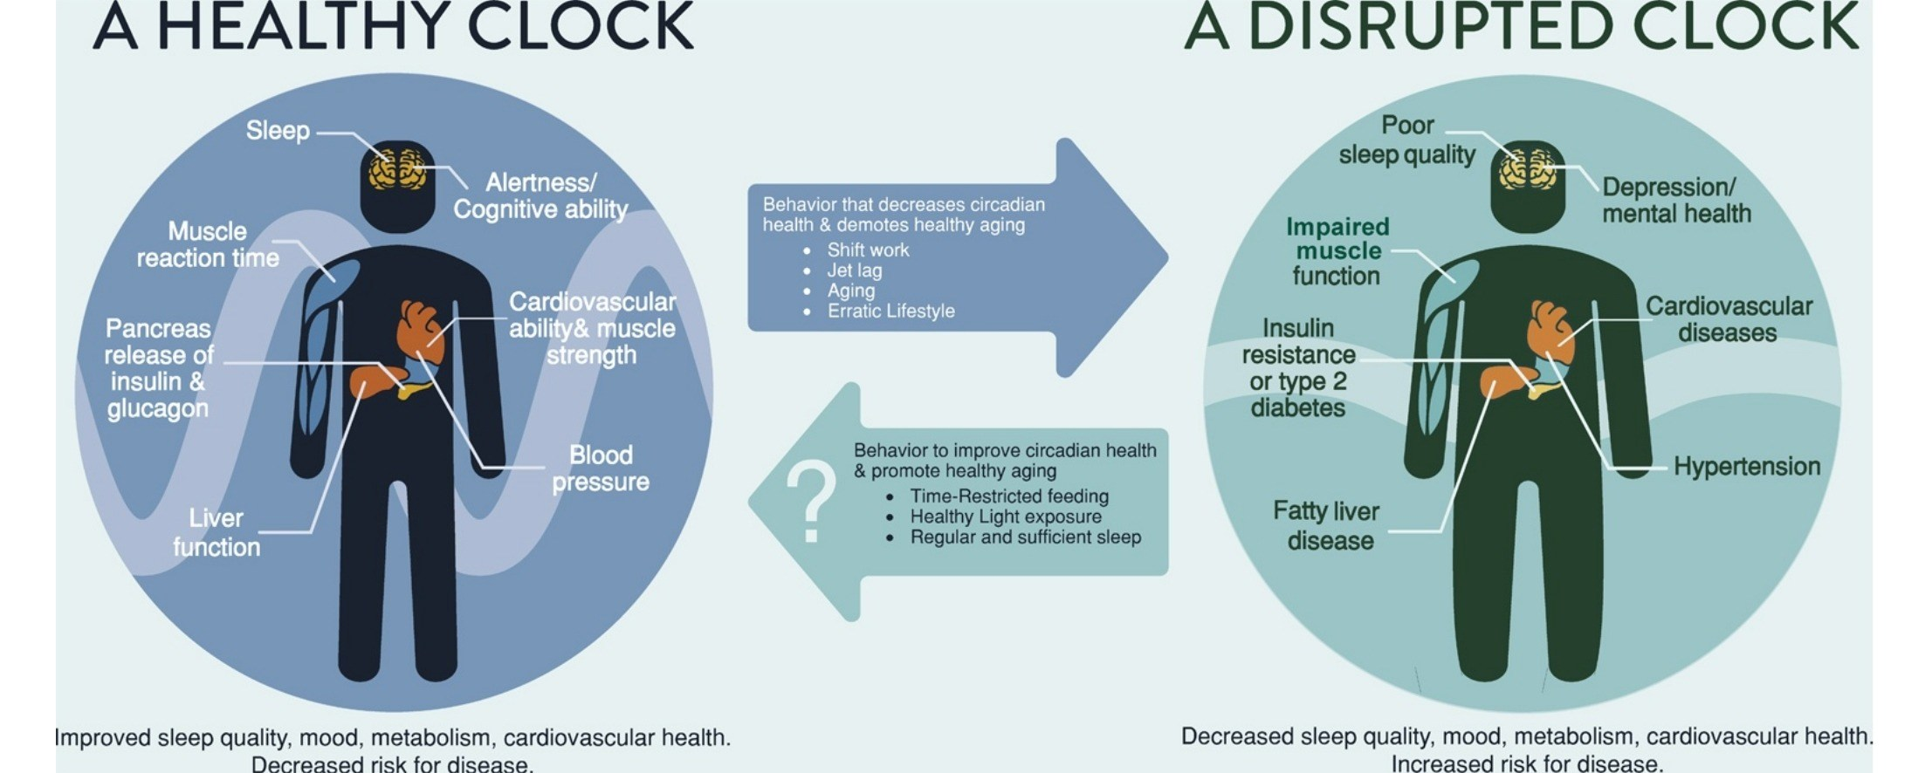
Satchin Panda PhD, Salk Institute

Slide 17

Earth, at the equator is spinning approximately 1,000 miles/hour around its axis
Earth is orbiting the sun, moving approximately 66,600 miles/hour
Diurnal rhythm is central to the existence of all life on our planet

Slide 18


Slide 19


Slide 20
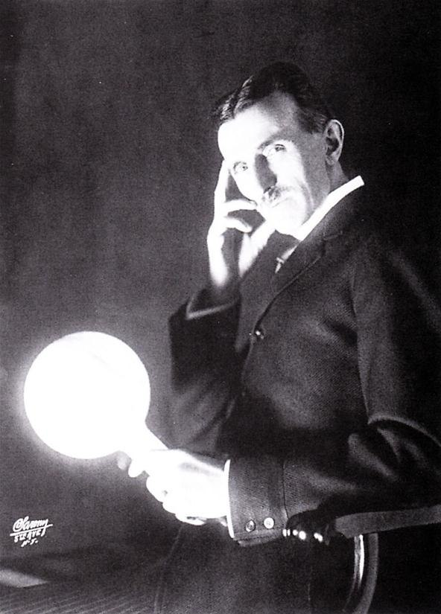
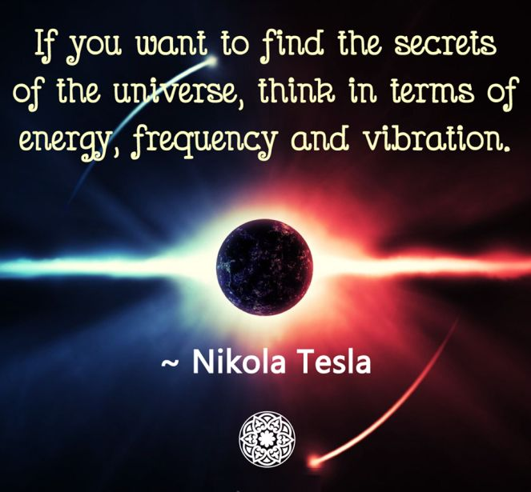

Slide 21
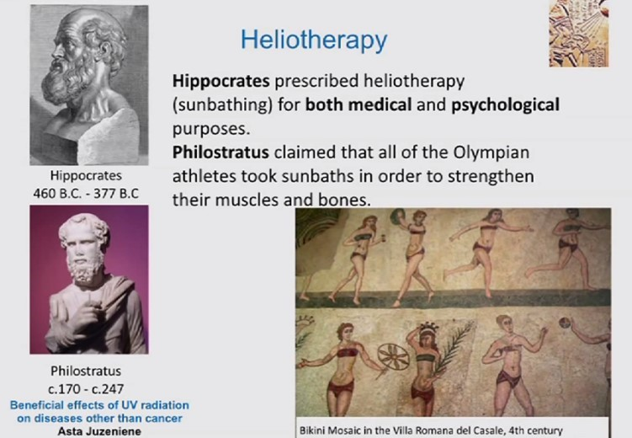

Slide 22
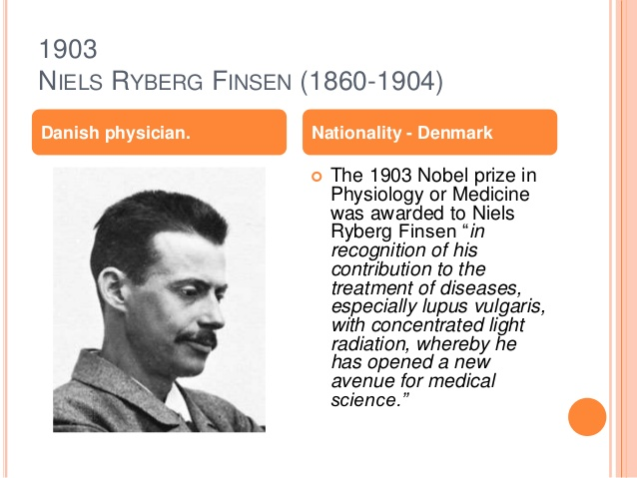

Slide 23
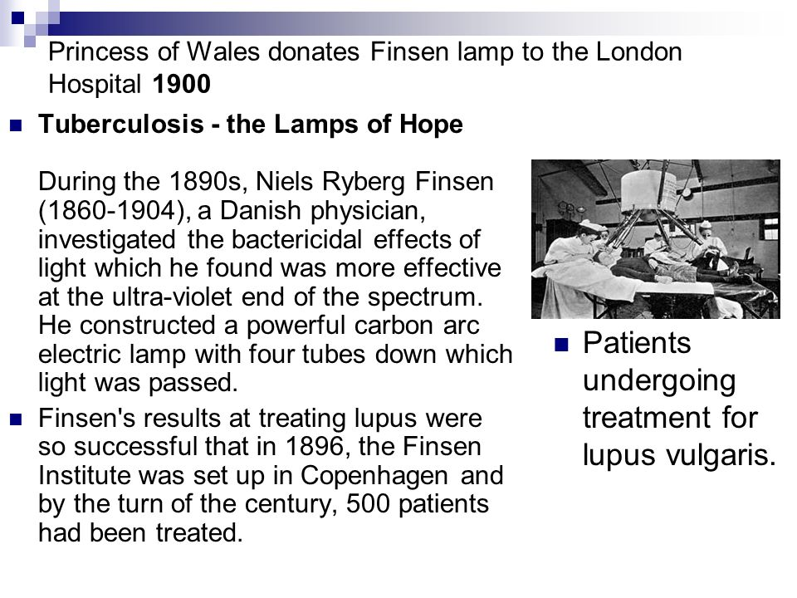

Slide 24
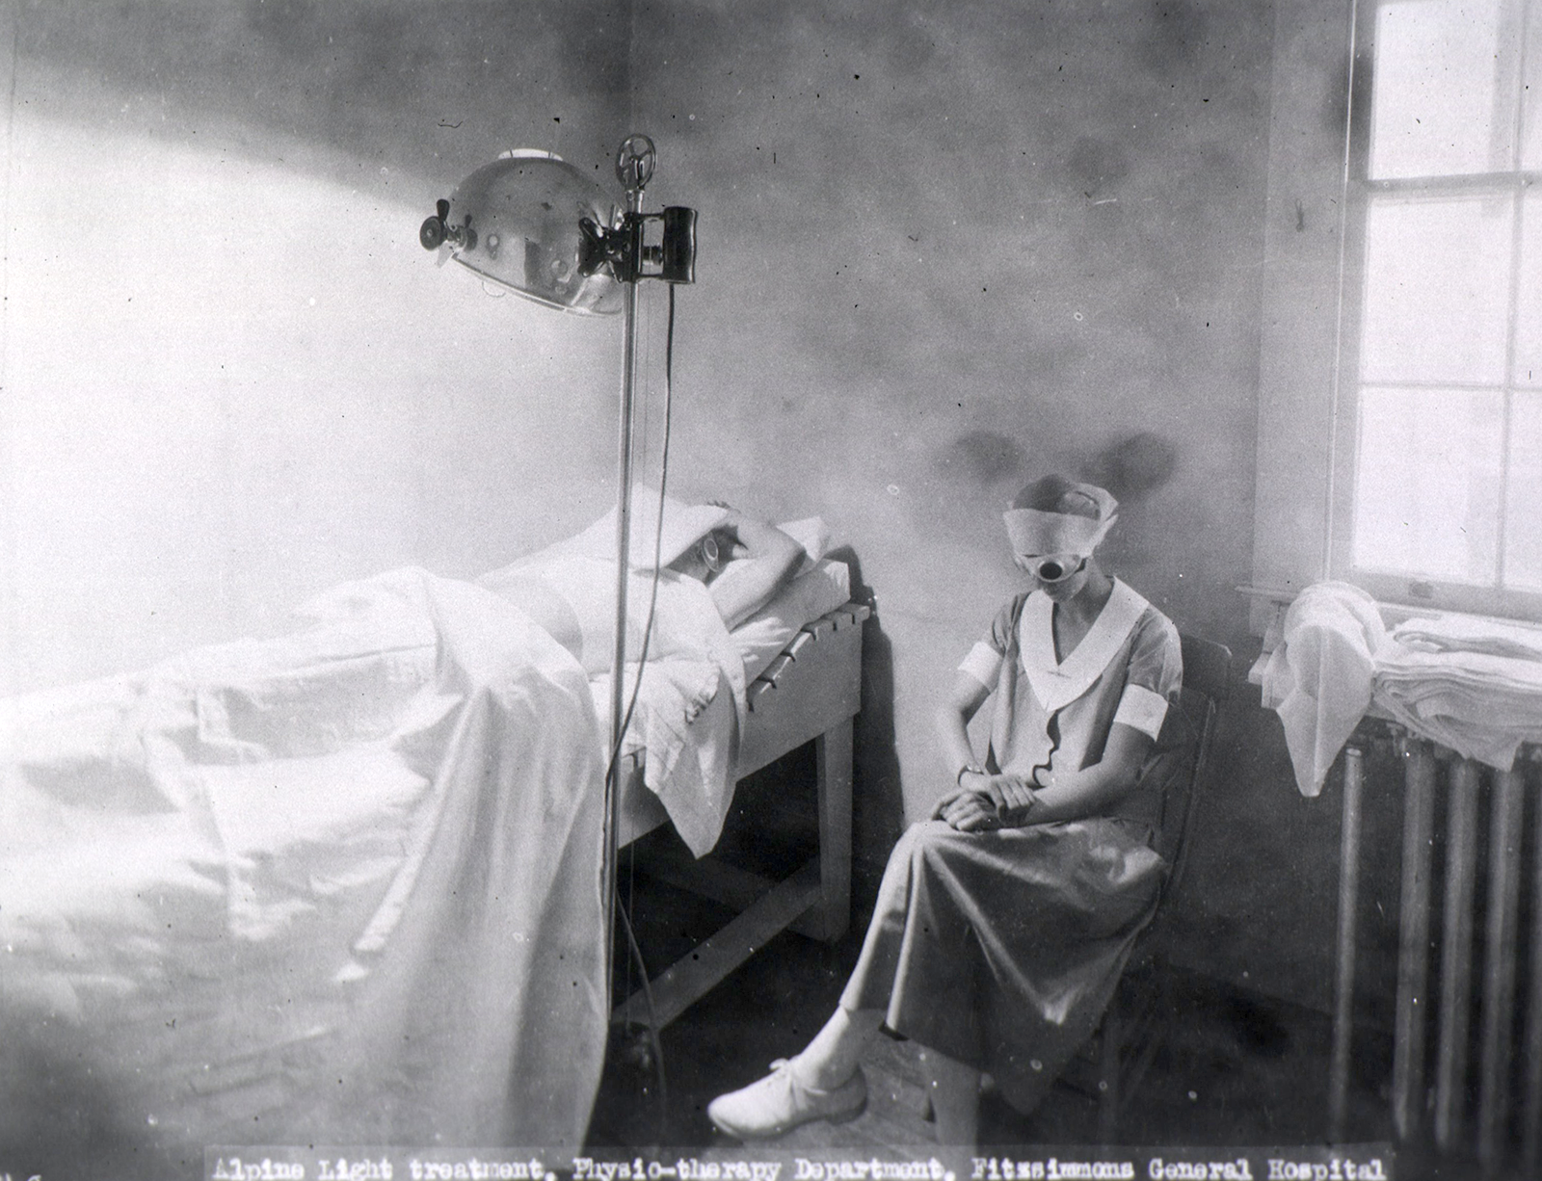

Slide 25
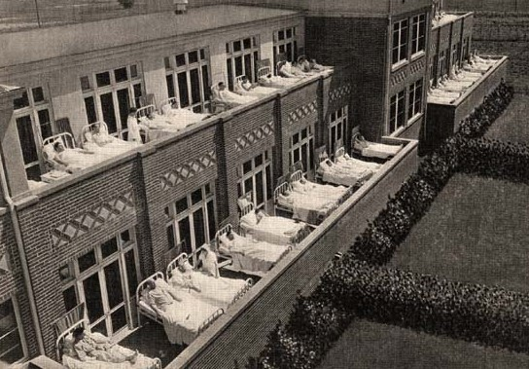

Slide 26


Slide 27
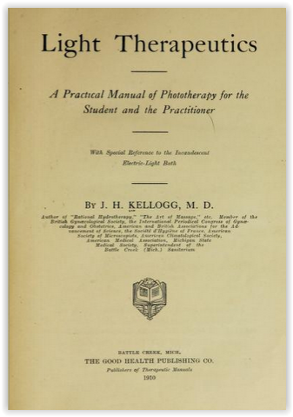
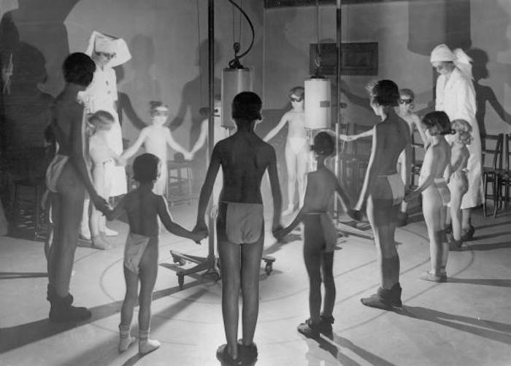

Slide 28
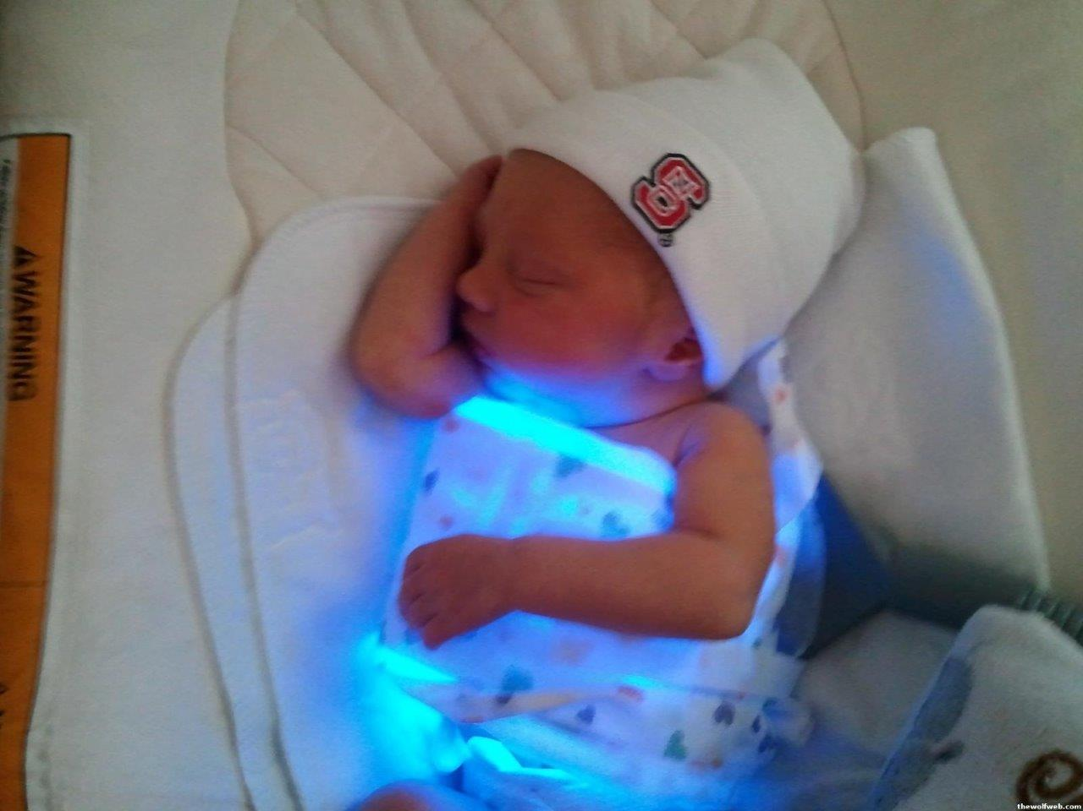
The “Billi Blanket”

Slide 29
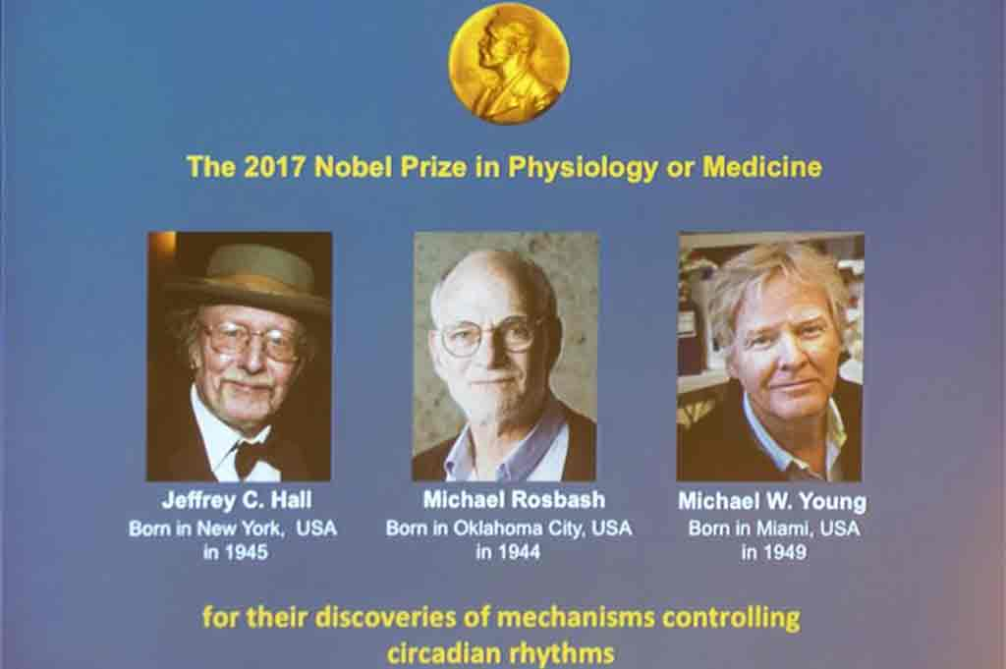

Slide 30
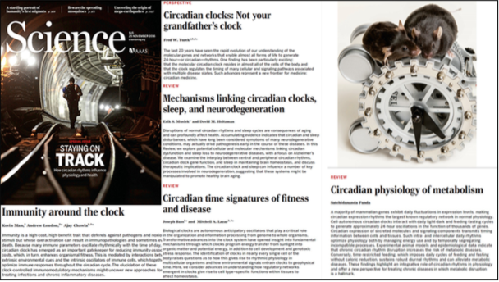

Slide 31
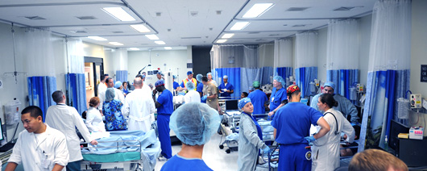
Fluorescent Light/
Night Shift Work
NHS- Nurses Health Study (Harvard)
120,000 nurses followed 30+ years
30-50% increase of breast cancer after 15 years of night work
Higher rates of obesity, diabetes, heart disease and depression

Slide 32
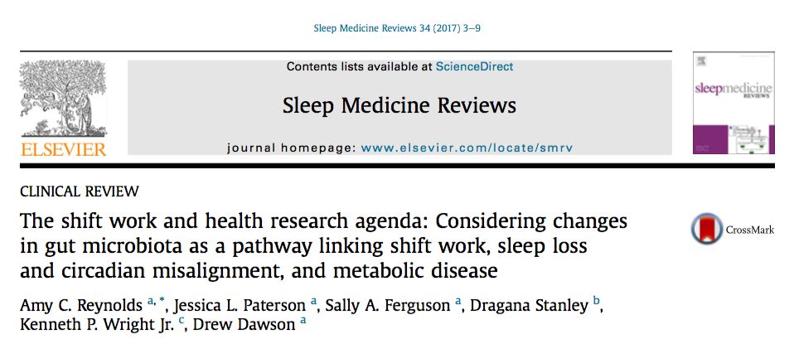
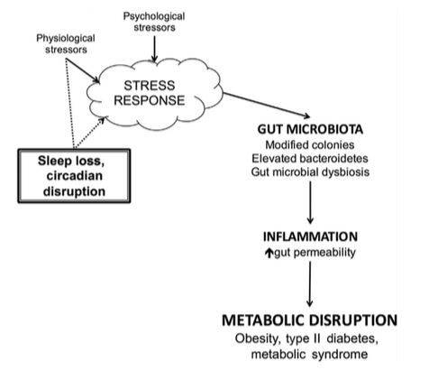

Slide 33
Cortisol and Melatonin Diurnal Rhythm

Slide 34
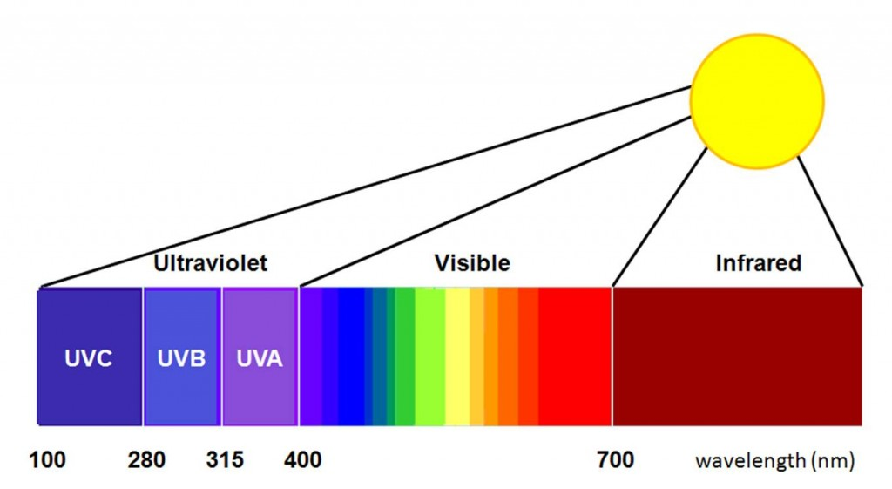

Slide 35
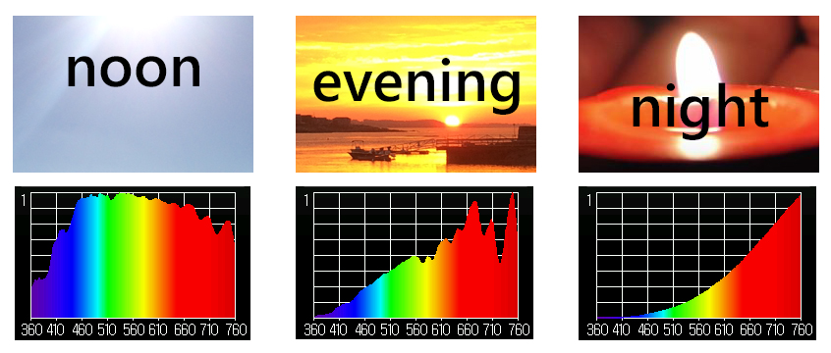

Slide 36
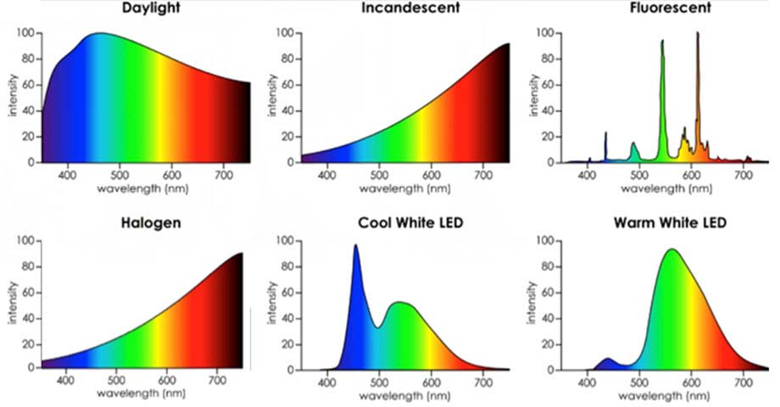
Desire Color Rendering Index (CRI) 95+ %
Color Temperature 2700-3000k

Slide 37
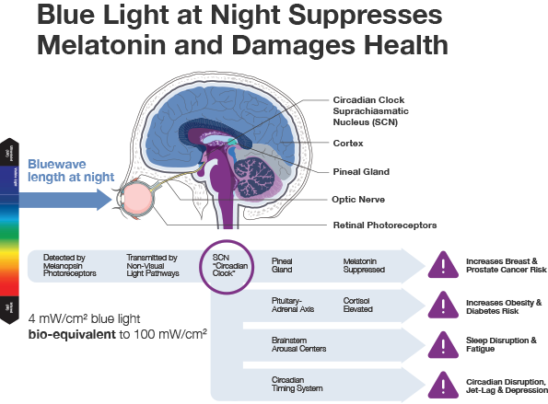
Aging and Mechanisms of Disease (2017) 3:9 ;

Slide 38

Full-spectrum light box: 10,000 lux

Slide 39

Intermittent Fasting
Time Restricted Eating (TRE)
Time restricted feeding e.g. consume all food within 10-hour window. No eating 2-3 hrs before bedtime
Excellent Circadian rhythm “calibration”
Decreases in body weight and visceral fat, insulin and glycemic control
Significant reductions in breast cancer recurrence and improved prognosis (Patterson et al. UCSD 2016)
Improved cardiovascular disease risk profile
Decreased neuroinflammation (Neurobiol Aging. 2015 May;36(5):1914-23)
Autophagy (Autophagy, 2014;10:11, 1879-1882)
Improved sleep!!

Slide 40
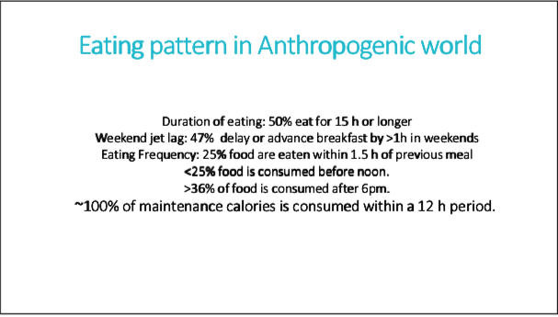
Satchin Panda, PhD The Circadian Code

Slide 42
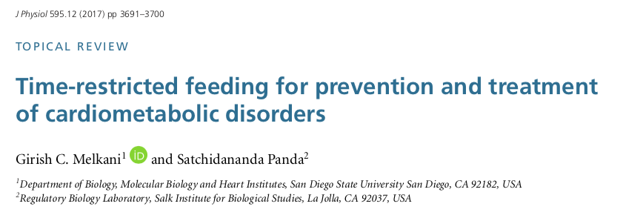
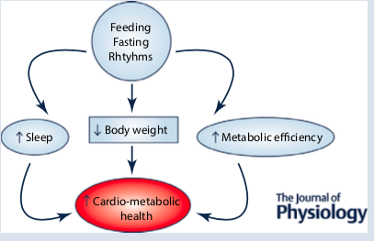

Slide 43






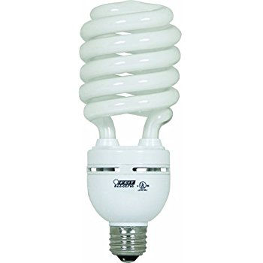


zeitgeber | a cue given by the environment, such as a change in light or temperature, to reset the internal body clock. from German Zeitgeber, from Zeit ‘time’ + Geber ‘giver’.
Too little of this:
Too much of this:

Slide 44
Zeitgebers:
Circadian Entrainment
Sleep hygiene
Grounding…take your shoes off and stand outdoors
60” full spectrum outdoor lighting/day: within 2 hrs after sunrise and within 2 hours before sunset
Give your retina access; no sunglasses at key times of day
Evening light: Incandescent 2700k, Halogen 3,000k, warm LED on dimmer
Orange-amber light at night
Blue light filters 2-3 hrs before bedtime; F*Lux, Night Shift, Iris apps;
Computer settings: lower color temperature
Time Restricted Feeding: no eating within 2-3 hours of bedtime
Movement during the daytime
Social interactions during the day
Stress during the day…not good after sunset
Satchin Panda, PhD The Circadian Code

Slide 45

Thank you !

