Slide 1
A Holistic Approach to Weight and Metabolism Part 1
Mark Pettus MD
Director of Medical Education & Population Health
February 8, 2019
Notes:
The #1 cause of death and diminished quality of life are the choices we make Healthy living does not happen at the doctor’s office. Transform perceptions of Self-Care and what we as humans are capable of.
It’s not the hand you’re dealt but how you play your cards.
Unprecedented convergence This is about how you function How you function determines how you feel
Explore the key metabolic underpinnings of function
Your biology becomes you biography

Slide 2
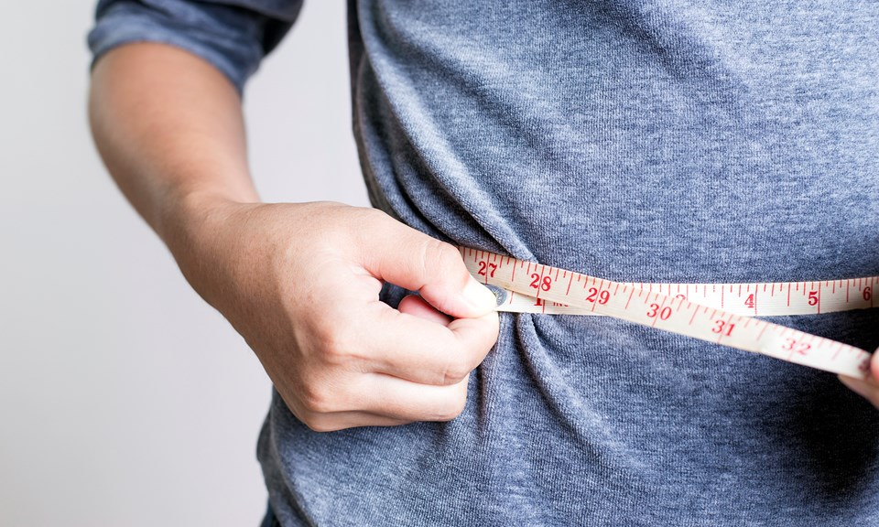
Two Part Series
Week 1: Insulin – Obesity Hypothesis
Week 2: Circadian Rhythms and Leaky Gut/
Altered Gut Biome

Slide 3
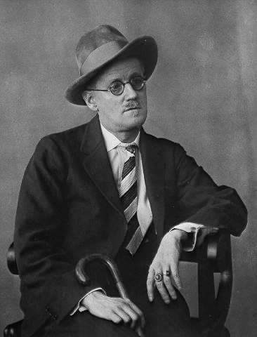
James Joyce from his short story Dubliners
“Mr. Duffy lived a short distance from his body”

Slide 5
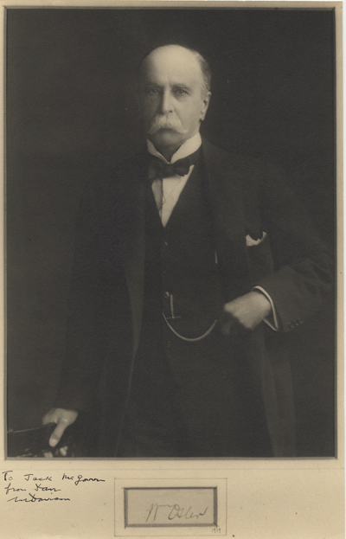
“The one thing that distinguishes man from other creatures is mans desire to take medications”
William Osler 1910

Slide 6
Prevailing View
Obesity occurs when a person consumes more calories from food than he or she burns.
National Institute of Health
Overweight is the result of caloric imbalance (too few calories expended for the amount of calories consumed) and is mediated by genetics and health.
US Surgeon General

Slide 7
Emerging View
A calorie is not a calorie
Macronutrients (carbs, proteins and fats) elicit different metabolic effects
Quality of macronutrients e.g. glycemic effect will substantially impact metabolic effects (food as information)
Quality of calories more important (and interesting) than quantity of calories
Quality fat sources less harmful than thought
Fat does not make you fat (sugar, flour, processed carbs-wheat are more harmful)

Slide 8
Lifestyle
Life
Gene-Epigenome
Microbiome
Consciousness-Spirit

Slide 9
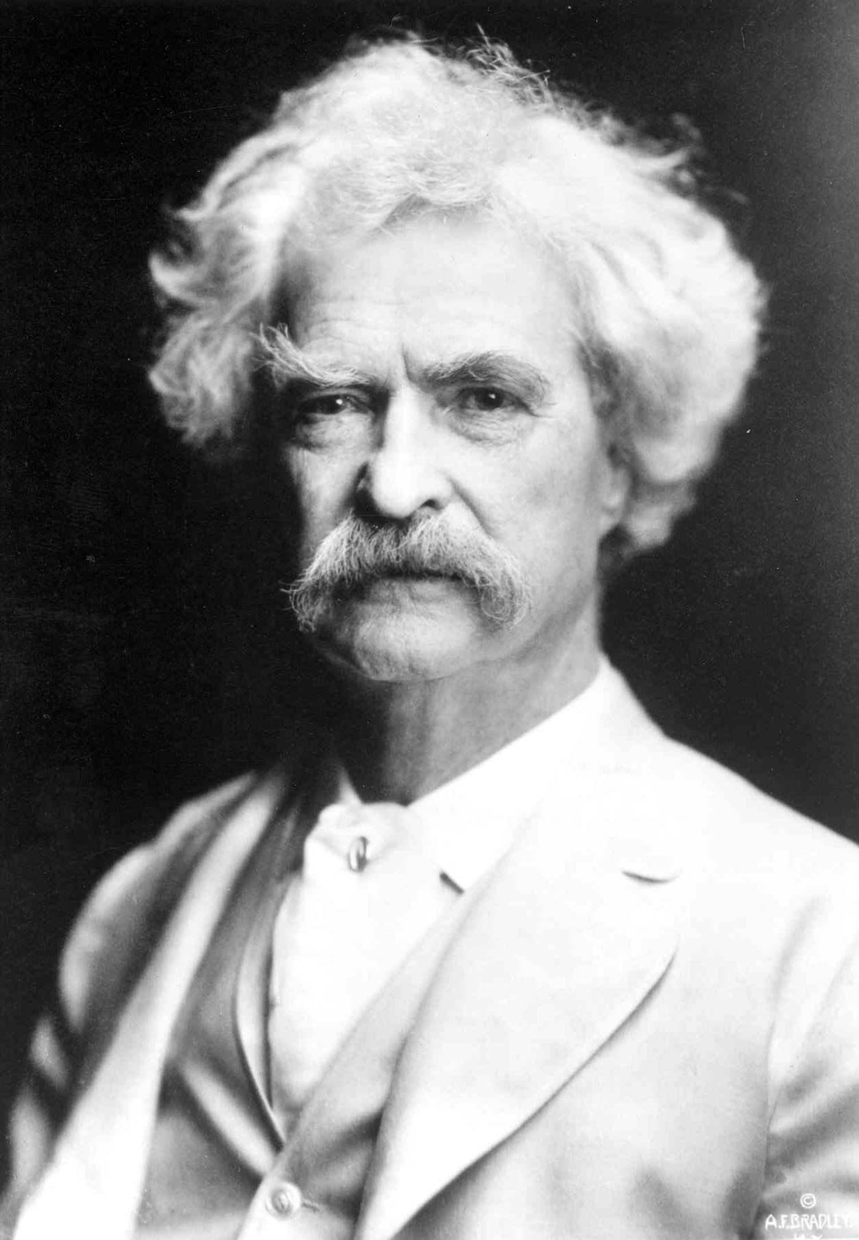
“It’s not what we don’t know that gets us into trouble, it’s what we know that ain’t so”
Mark Twain

Slide 10
So what do we know that ain’t so……
Eat less and do more = effective weight loss
Counting calories is a worthwhile effort
Fat makes you fat
Fat is dangerous for your heart and health
Low-fat foods are healthier choices
If saturated fat makes my cholesterol go up, it must be bad for me
Getting older means having more health problems and a diminished quality of life.

Slide 11
Healthspan
Notes:
Rectangularize the health curve
Healthspan…organ reserve

Slide 12
“It’s not what we don’t know that gets us into trouble. It’s what we know that ain’t so.”
Mark Twian
So what do we know that ain’t so?
There’s not much I can do about my DNA!

Slide 14
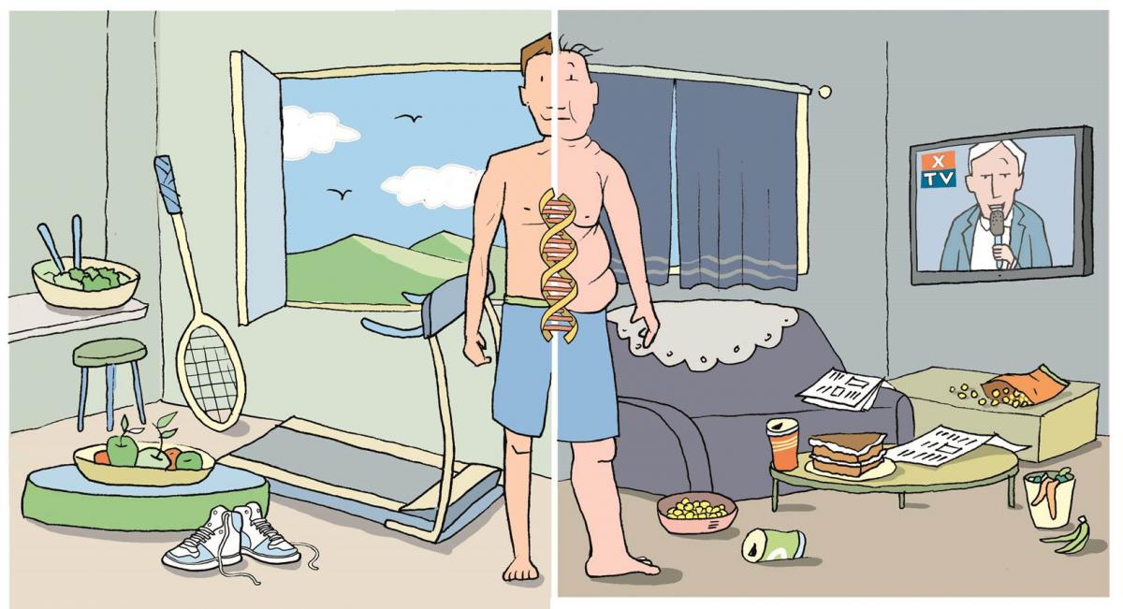

Slide 15
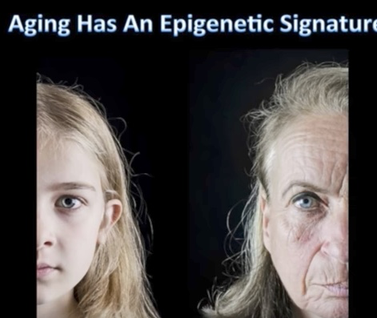
Aging has an Epigenetic Signature

Slide 16
Weight
Pre-diabetes, Diabetes, HBP, Lipids, Heart Disease, Stroke, Depression, Arthritis Alzheimer’s, Cancer,
The Origins of Health
Systems Biology
Core Metabolic Imbalances (what drives them)
Inflammation
High Insulin levels
Gut-Barrier Function/Microbiome
Circadian Rhythms- Entrainment
Root Causes (what are their origins)
Environment+Epigenome/genes+Microbiome
Nutrition Movement Interpret-Response to stressors, Environmental toxins Sleep Social Connection Trauma Conflict Management Forgiveness Mindfulness
Spirituality-Meaning
Light quality-entrainment
Social Determinants

Slide 17
What are the conditions of your soil?
What am I getting too much of that is undermining my health and how can I reduce it? Example: Grain-based carbs
What do I need more of that I am not getting to improve my health and how can I bring more of it in? Example: Veggies, sunshine and healthy fats
What advice would my great grandparents have given me if confronting ____?

Slide 18
Is the choice I am about to make familiar with what my stone-age roots would recognize?

Slide 19
Robert Sapolsky PhD, Stanford

Slide 20
From Robert Sapolsky PhD

Slide 21
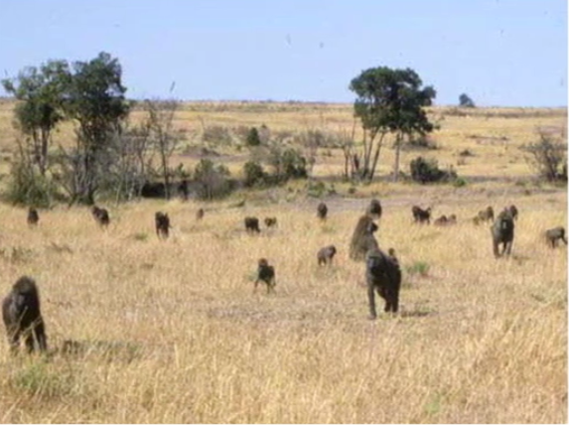
Robert Sapolsky PhD Stanford

Slide 23
Robert Sapolsky PhD

Slide 24
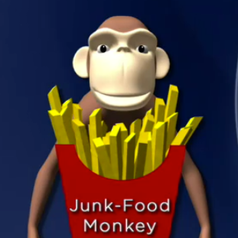
Heavier with increased BMI
Metabolic Syndrome
Insulin resistance with elevated
fasting and post-prandial insulin
levels
Increased TGAs
Move less
Socialize and play less
Less fertile
Die younger

Slide 25
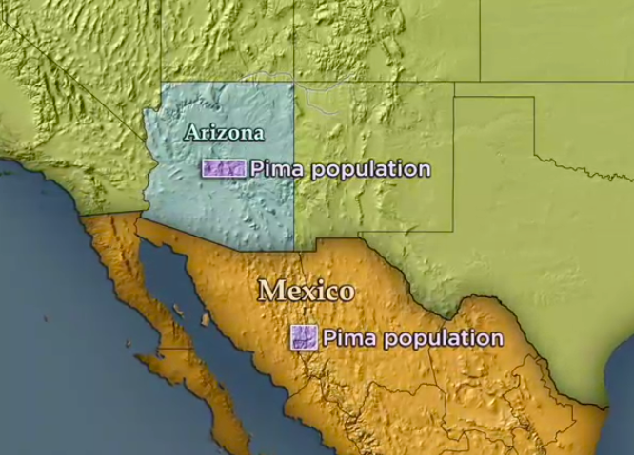

Slide 26
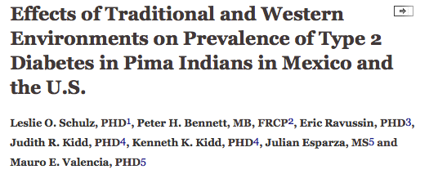
Prevalence of T2DM 5 times higher in Arizona
Pima’s compared to Mexican Pima’s
Diabetes Care August 2006 vol. 29 no. 8 1866-1871

Slide 28
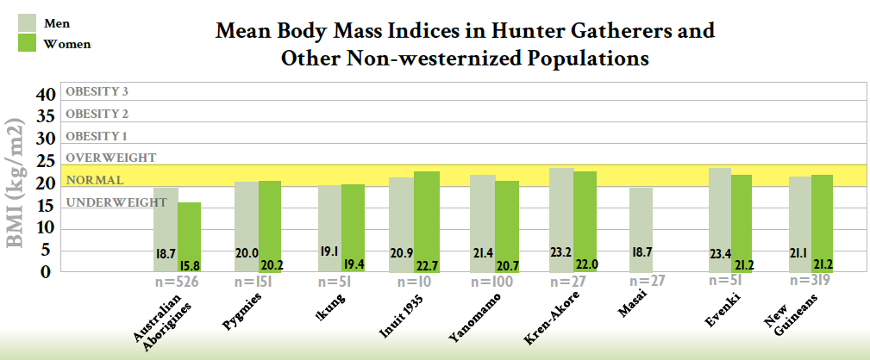
Courtesy Loren Cordain PhD

Slide 31
Insulin-Obesity Link
High Glycemic Carbohydrate-Dense Foods
Sedentary States
Stress Response
Disrupted Sleep
Social isolation
Lack of Meaning in work, love, play
Environmental Toxins
Poor quality light
Meal timing
Weight
Insulin
Insulin
Resistance
And Inflammation
Notes:
Endocrine disruptors tied to 300billion in annual healthcare costs
Organophophate disruptors; glyphosate; BPA; pthalates; PTFO flame retardants

Slide 33
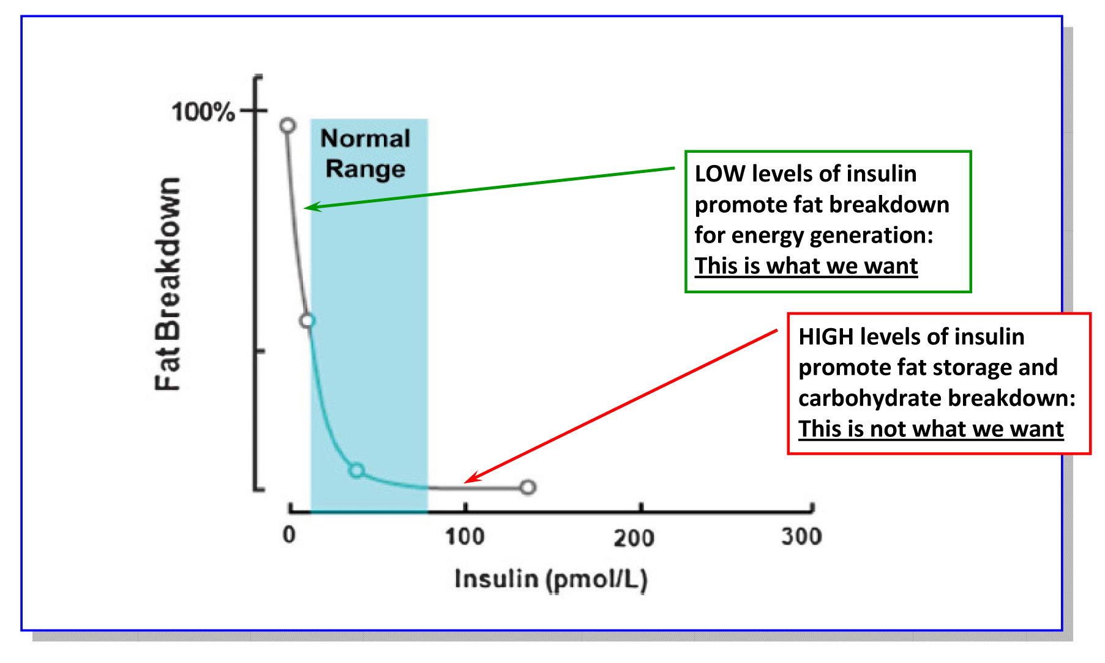
Lipolysis vs. Lipogenesis

Slide 34
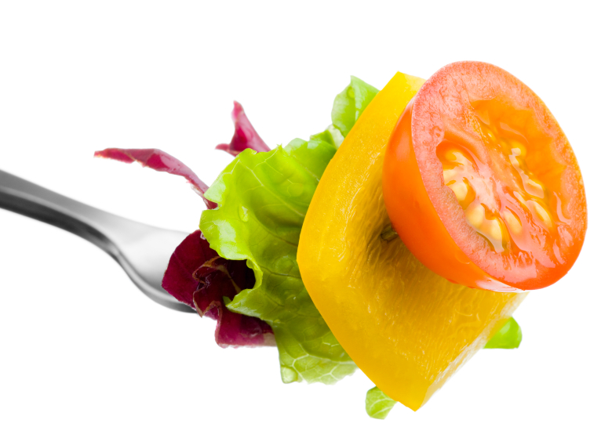
Food and Insulin

Slide 36
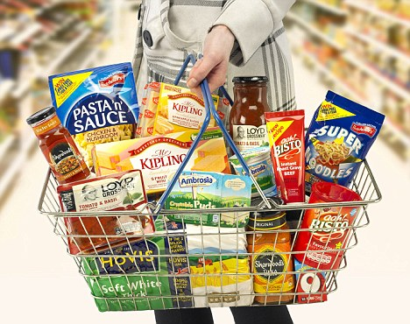

Slide 39
How much sugar is in the human body?

Slide 42
Reduce poor quality, processed, carbohydrate-dense foods
Added Sugar
Grain-based flour e.g. breads, cereal grains, pasta, pastries, desserts, chips, pretzels, granola bars.
Higher Fructose Fruits e.g. bananas, grapes, pears
Dried fruits e.g. raisins, apricots, cherries
Sweetened soft drinks
Beer is liquid bread
Gradual reintroduction of starchy vegetables after 8-12 weeks, e.g. white rice, carrots, parsnips, white potatoes
Lowered insulin and reduced inflammation “unlock” fat burning
All Carbs
Low
Glycemic

Slide 43
More fat of better quality
Reduce omega 6 vegetable oils e.g. corn, canola, soybean, sunflower
Eliminate trans fats found mostly in packaged desserts
More abundant healthy fat sources e.g. eggs, butter, full-fat dairy, nuts (macadamia, walnuts, pecans, walnuts), fatty fish e.g. salmon, sardines, trout, maceral, anchovies; grass fed meats, shellfish, avocados, extra virgin olive oil, coconut oil, ghee, macadamia nut oil, avocado oil
Fats
Fats

Slide 44
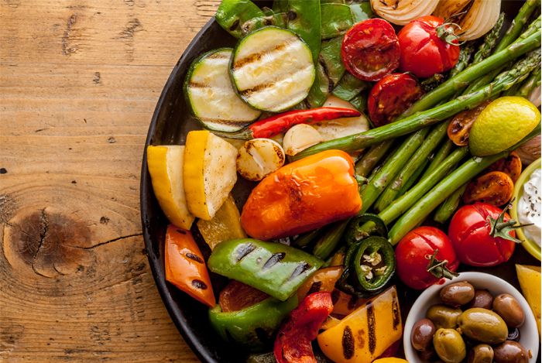
Plant-based foods
Fill half of plate with vegetables
2 cups greens/day is a nice goal
Cruciferous e.g. broccoli, cauliflower, collards, cabbage, kale, spinach, asparagus, romaine lettuce, arugula
Allium family e.g. onions, leeks, garlic
Beans and lentils; soaking and pressure cooking can be easier on the gut, reducing lectins
Lower glycemic fruits e.g. berries, grapefruit, kiwi
Anti-inflammatory spices e.g. turmeric, basil, ginger, rosemary, cayenne pepper
Fermentable Fiber essential for gut biome diversity
Fermentable foods e.g. yogurt, sauerkraut

Slide 45
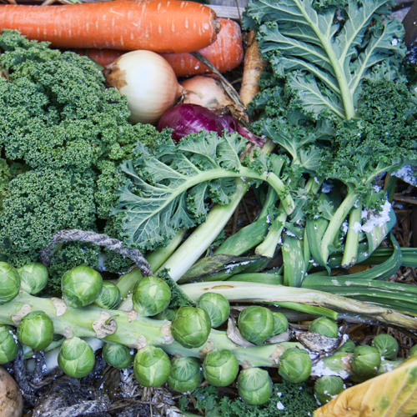
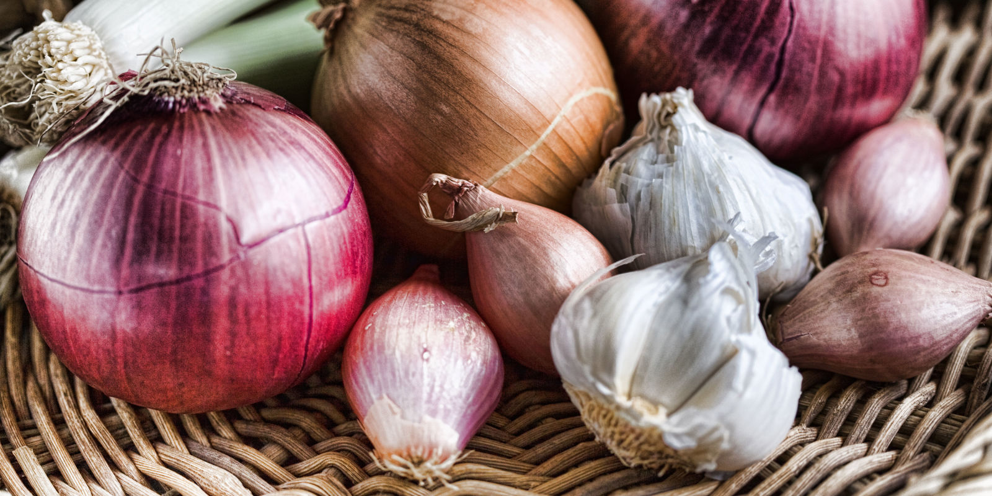
Sugar, Fructose and Carbohydrate-Dense Grains
High-Quality Plant-Based Carbs
Oral and Gut
Microbiome
Protection from:
Inflammation
Diabetes
Cancer
Obesity
Inflammation
Altered neurotransmitters
Insulin Resistance
Weight and Metabolism
Mitochondria-Oxidative stress
HPA axis –Stress Response

Slide 46
Will the choice I am about to make…
Raise my sugar-insulin or lower my sugar-insulin?
Rev up my immune system or relax my immune system?
Raise my stress levels (cortisol) or lower my stress levels (cortisol)
My gut biome more or less diverse?

Slide 47
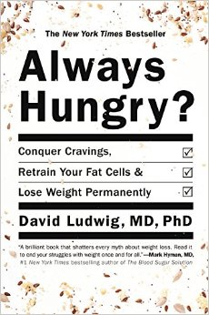
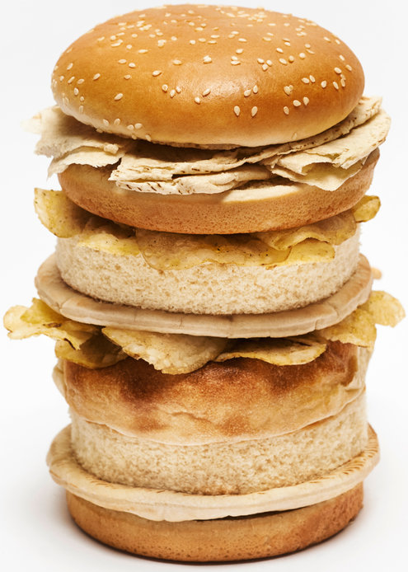
“ Are we fat because we eat too much or do we eat too much because we are fat ?”

Slide 48
From: Increasing Adiposity: Consequence or Cause of Overeating?
JAMA. 2014;():. doi:10.1001/jama.2014.4133
Copyright © 2014 American Medical Association. All rights reserved.

Slide 49
Five hour rule after eating a meal
Am I hungry again within a few hours?
Am I tired and ready for a nap?
Does my mind feel sharp, attentive and focused?
Am I experiencing bloating, gas, cramping?
…if the answer to any of these questions is consistently “yes” then there are significant problems with what you are eating!

Slide 50
Food and Reward

Slide 51
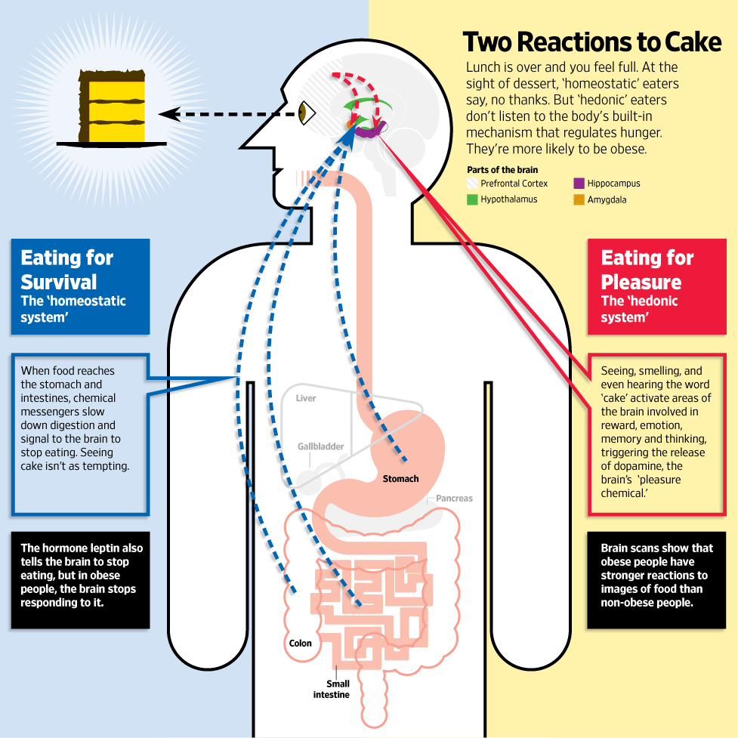
Jabr F, SA Mind December 2015

Slide 53
www.dietdoctor.com

Slide 54
Summary: Enhancing metabolic efficiency: …. Reduce inflammation, insulin and leptin resistance
Eliminate – reduce sugar in all it’s forms
Eliminate-reduce refined grain flours, and carbohydrate-dense processed foods. Try going wheat-free for a month.
Reduce hydrogenated oils and processed seed oils cooked at high temperatures
OK to consume pasture-raised meats and eggs
More abundant healthy fats sources e.g. extra virgin olive oil, fatty fish, grass-fed butter; eggs; extra virgin coconut oil (MCT Oil); pasture-raised animal fat, ghee, avocados, nuts (almonds, walnuts and macadamia) and nut butters
Plant-based foods with a lot of fiber and nutrient density

Slide 56
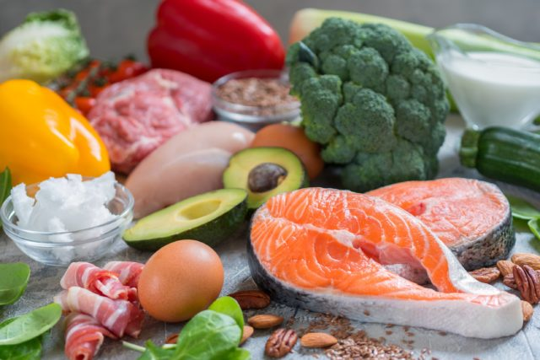

Slide 57
Thank You !
www.thehealthedgepodcast.com

