Slide 1
Light Quality and Health:
Are we at risk from poor quality “junk” light?
Mark Pettus MD
Director Medical Education, Wellness and Population Health
March 15, 2018

Slide 2
Key Considerations
With each passing generation we are less connected with the circadian rhythms of our environment.
Loss of entrainment (synchronization) is associated with most chronic, complex disease, shorter life and diminished quality of life.
Greater attention to alignment between light quality, timing and exposure are accessible interventions for current-future consideration.

Slide 3
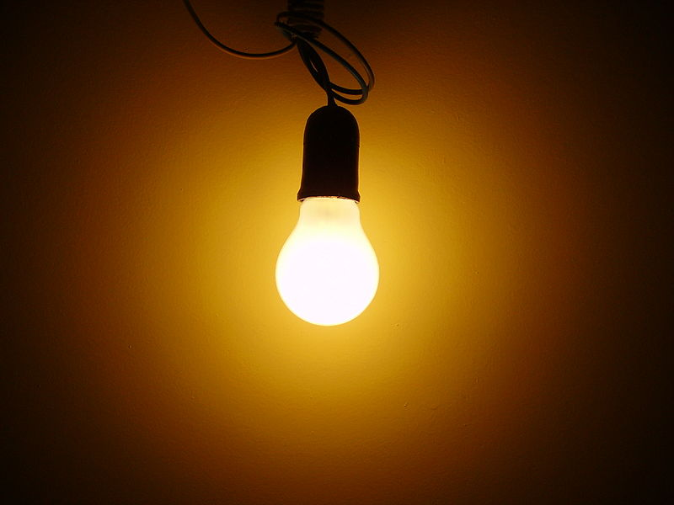
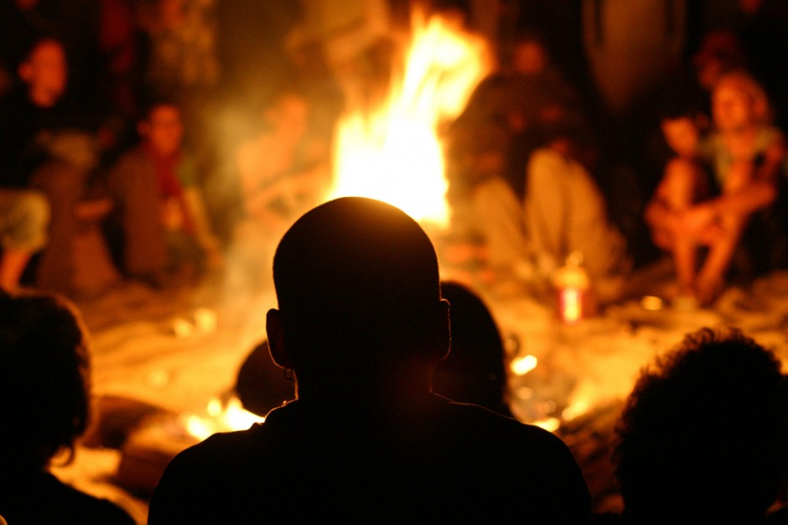
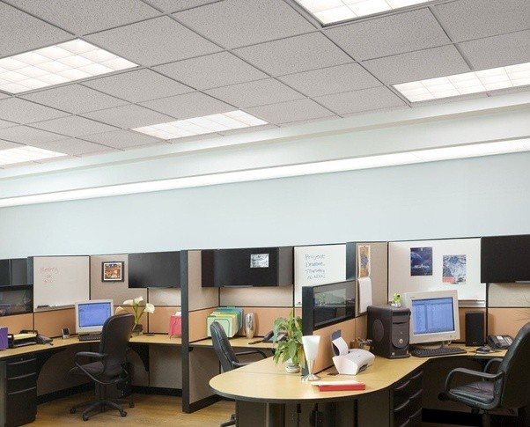
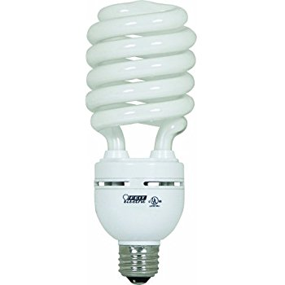
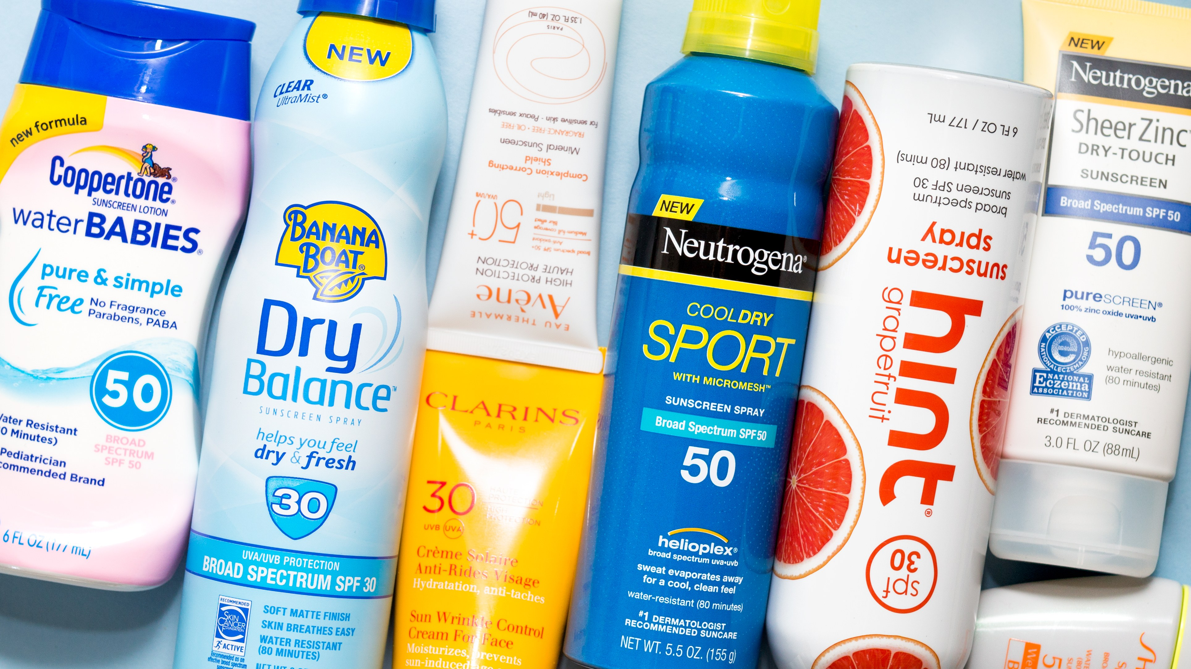
zeitgeber | a cue given by the environment, such as a change in light or temperature, to reset the internal body clock. from German Zeitgeber, from Zeit ‘time’ + Geber ‘giver’.
Too little of this:
Too much of this:

Slide 4
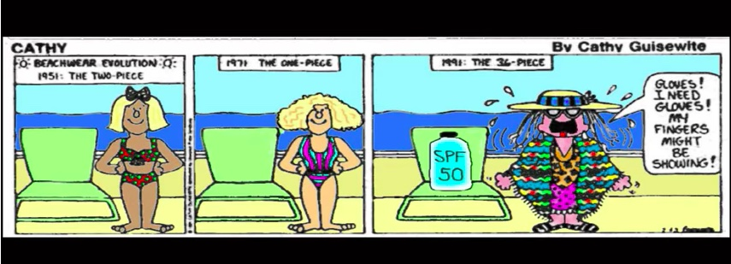

Slide 5
Earth, at the equator is spinning approximately 1,000 miles/hour around its axis
Earth is orbiting the sun, moving approximately 66,600 miles/hour
Diurnal rhythm is central to the existence of all life on our planet

Slide 7
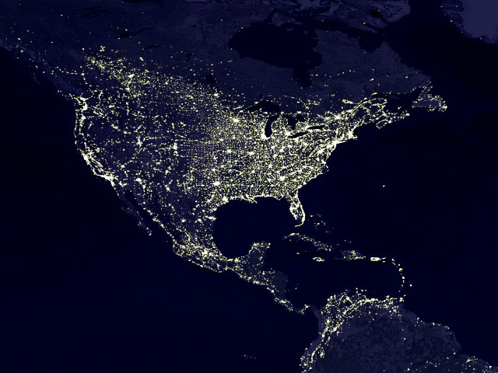

Slide 8
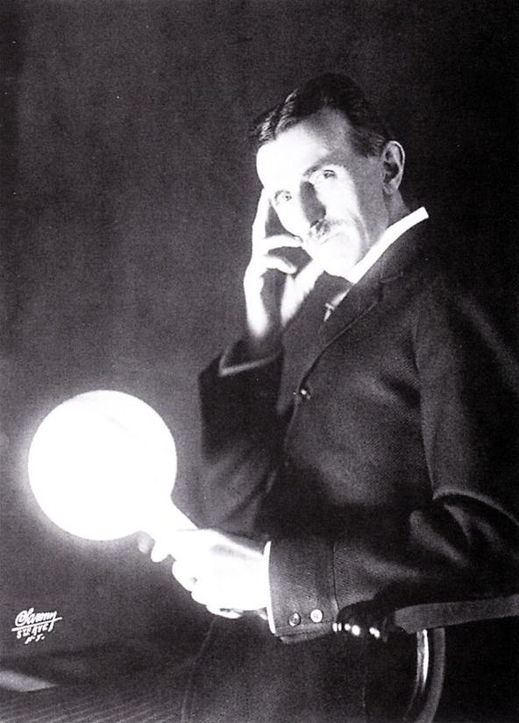
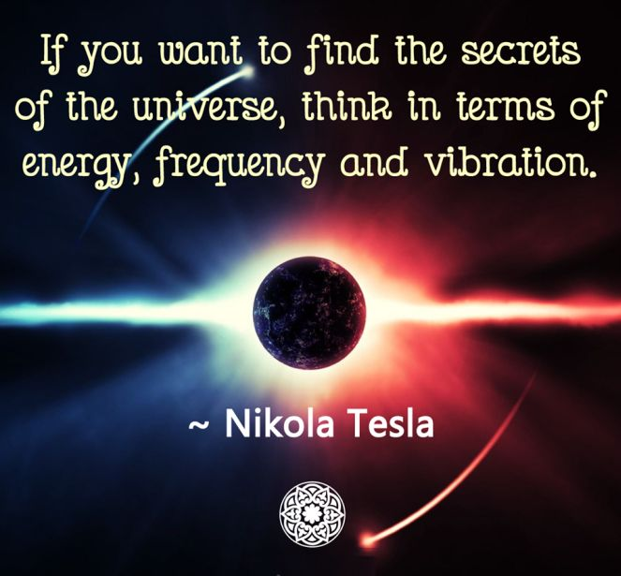

Slide 9
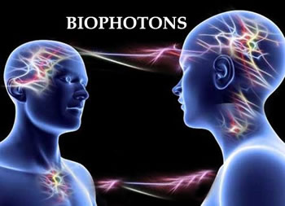

Slide 10
Drs Fritz Albert Popp, Peter Gariev and Vladamir Proponin
Every animal and plant cell has biophoton emissions that orchestrate function.
Energetic architecture
Semi-crystalline matrix
Resonant frequency and vibration
Phantom DNA

Slide 11
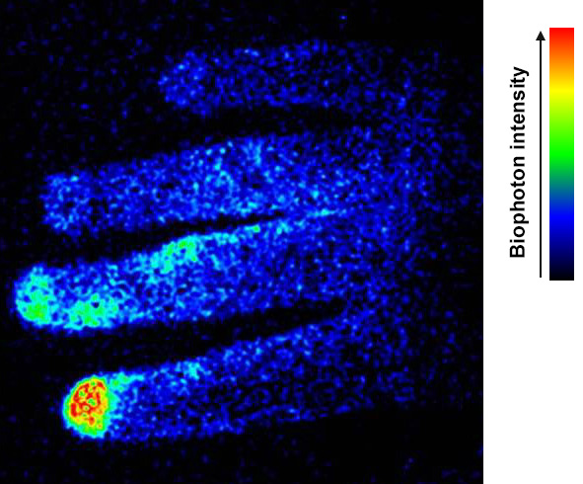

Slide 12
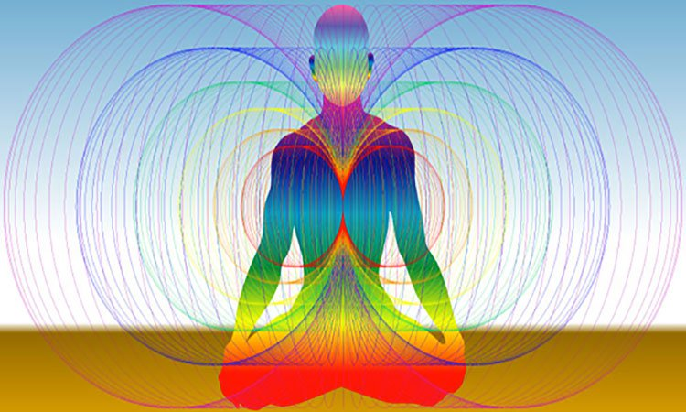
The Rainbow Body – Humans as “Light Beings”

Slide 18
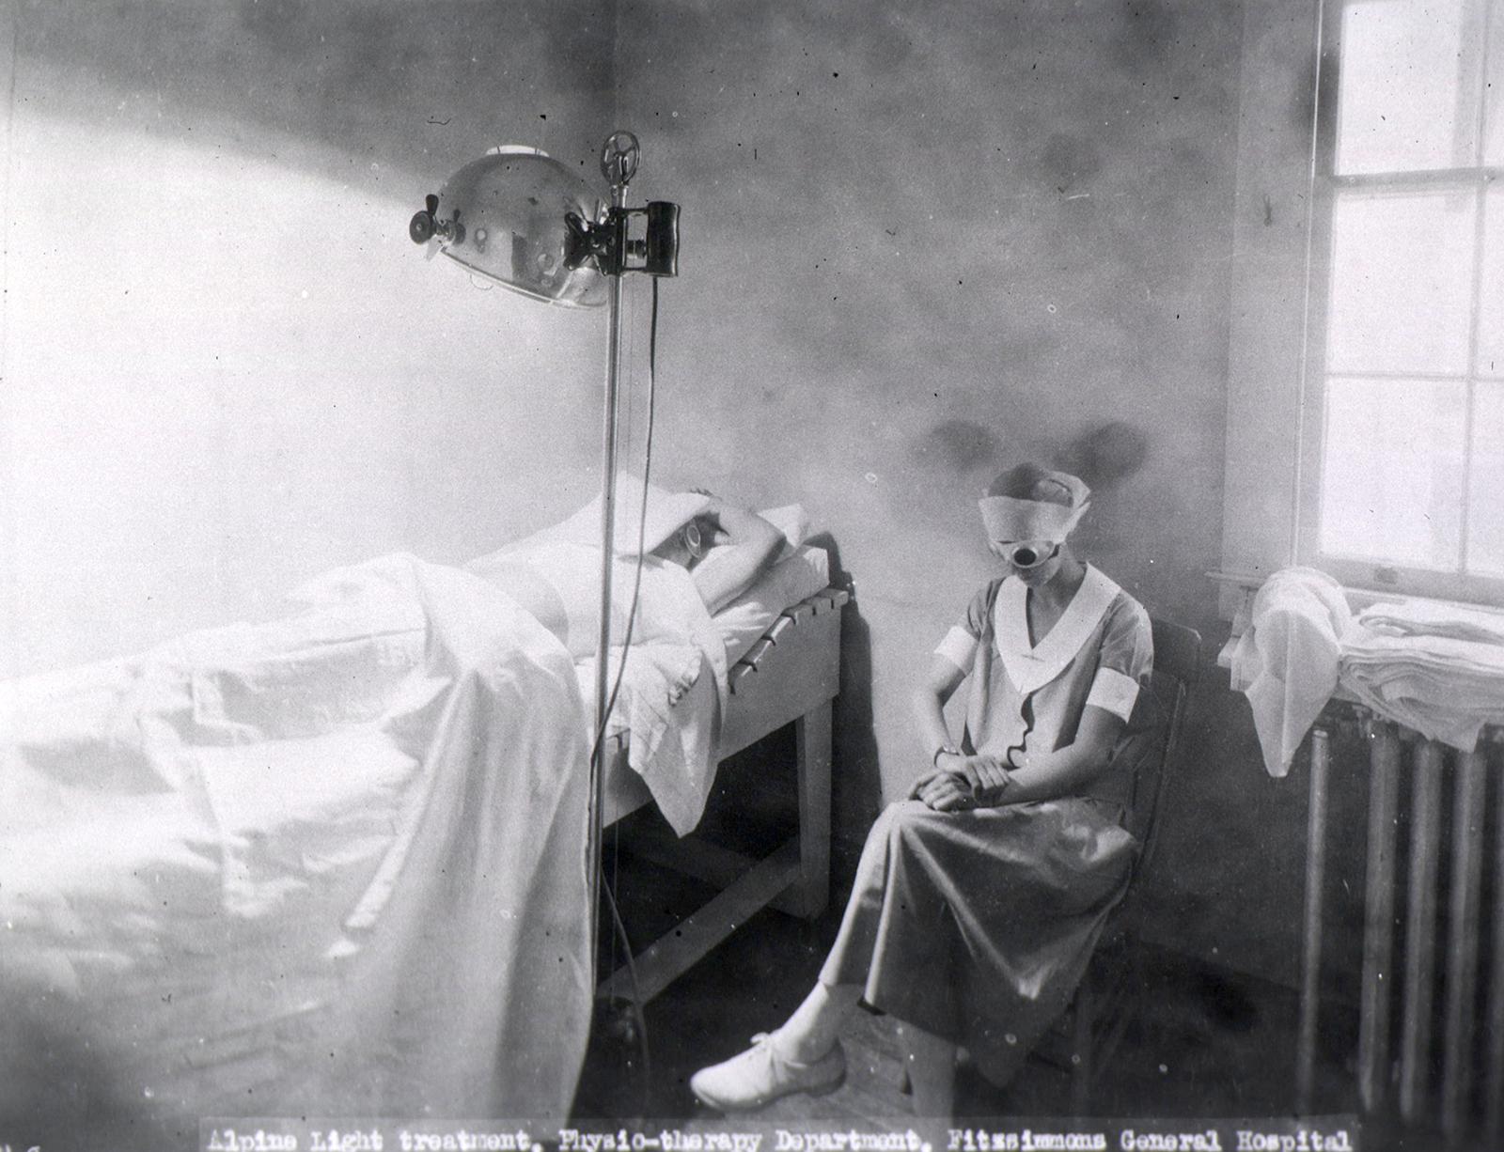

Slide 19
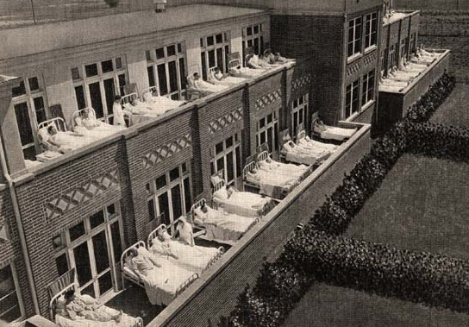

Slide 20
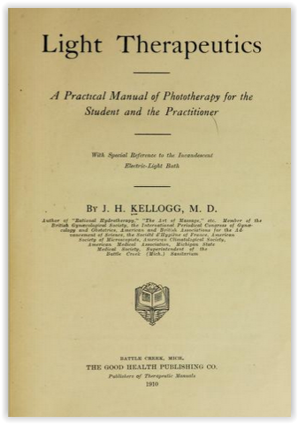
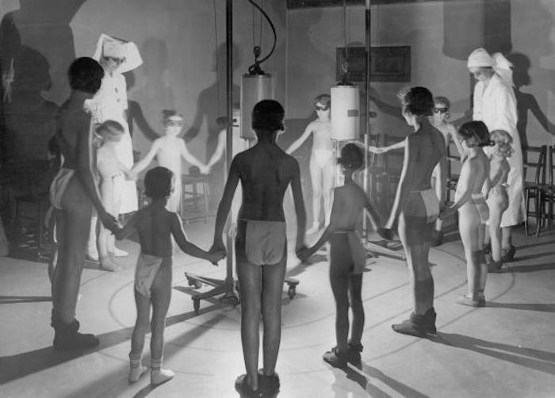

Slide 22
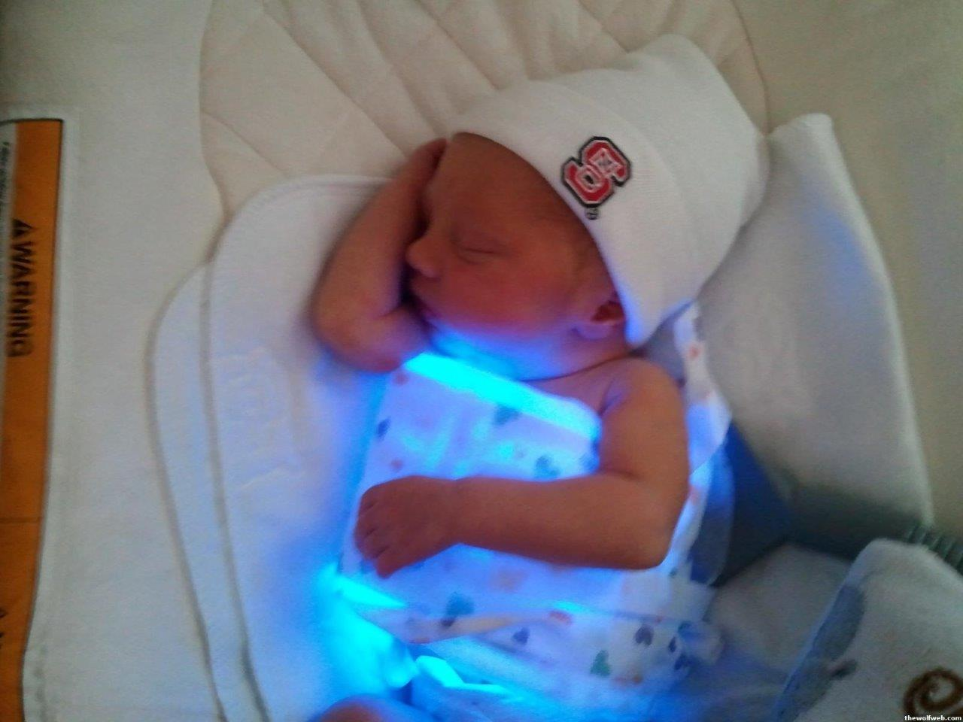
Cytochrome P450 – absorbs light at 450nm (blue) for high billirubin

Slide 23
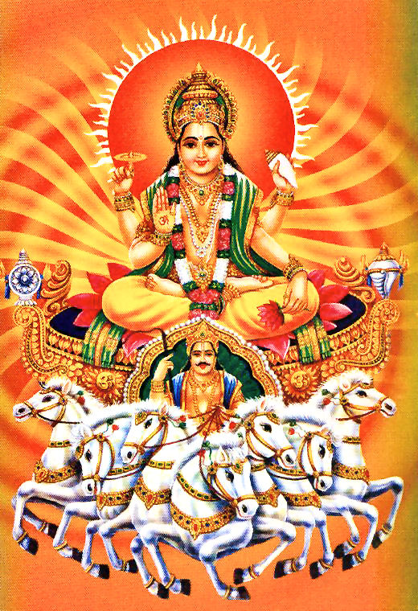
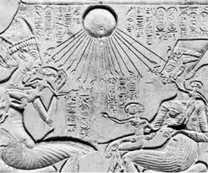
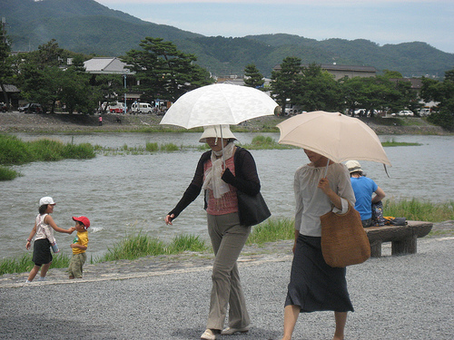
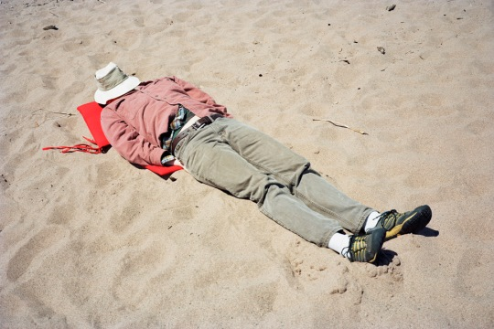

Slide 24
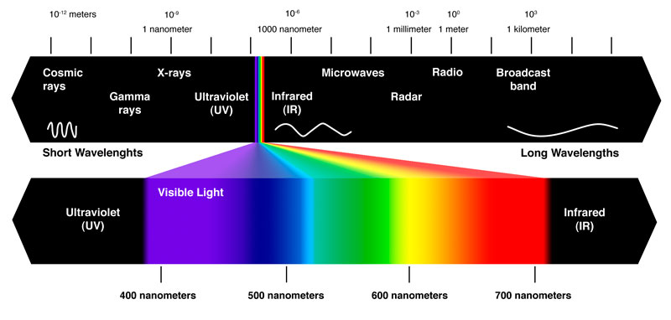
Mitochondrial
UVA and NO
Photosynthesis
Wound healing
Bilirubin
Collagen
UVB and Vit D
Nitric Oxide
Chronoactivity
Sulfation
Antimicrobial
EZ Water

Slide 26
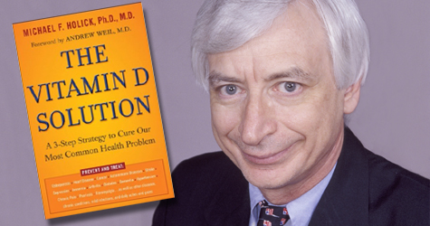
http://drholick.com/

Slide 28
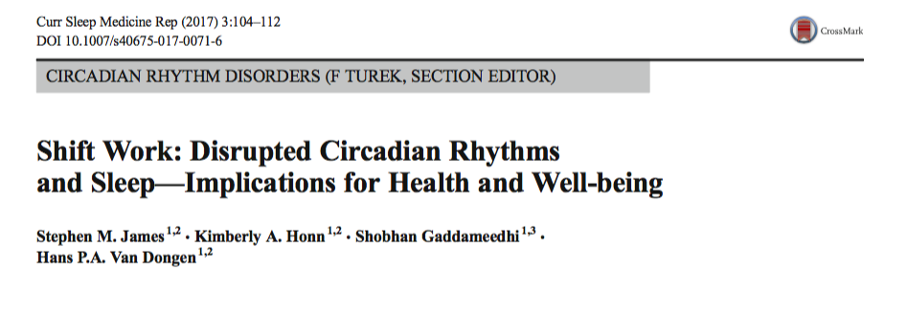
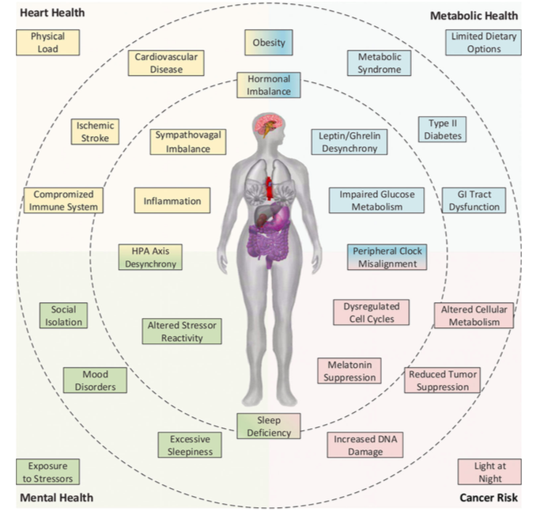

Slide 29
Circadian Rhythm and Health
MI, angina, stent thrombosis, stroke, arhythmia, aortic dissection more common in early morning hours
Braunwald E: On circadian variation of myocardial reperfusion injury. Circ Res 2012;
110:6–7)
Infarct size larger in morning hours
Circ Res 2012; 110:105–10)
Increased cancer and cardiovascular disease risk in night-shift workers.
Occup Environ Med 2006; 63:451–5 )
ICU delirium and ”post hospital syndrome”
JAMA Psychiatry 2014; 71:397–403 )
Obesity and insulin resistance
Proc Natl Acad Sci U S A. 2016 Mar 8;113(10)
Behavioral health: Depression, PTSD, GAD, BPD
International Review of Psychiatry, April 2014; 26(2): 139–154

Slide 30
Desynchronization Mechanisms
Circadian misalignment causes internal desynchronization of the HPA axis as can be seen in people with chronic stress:
Sympathovagal balance is then disrupted, meaning more fight-flight.
Mechanisms underlying elevated risk for CVD due to shift work include disrupted 24-h rhythms of blood pressure and vascular function, proinflammatory states, and altered lipid and glucose metabolism, aka metabolic syndrome.
Obes Rev. 2013;14(5):405–16
Proc Natl Acad Sci U S A. 2016 Mar 8;113(10):E1402-11.
Hypertension. 2016;68(1): 243–50.
Sleep Med Rev. 2016
Scand J Work Environ Health. 2010;36(2):96–108.
Horm Mol Biol Clin Investig. 2014;18(1): 47– 54

Slide 31
Circadian Disruption and Cancer
Maintaining synchronized circadian rhythms in peripheral systems is critical for the fine-tuning of cellular processes including cell cycles, DNA repair, apoptosis, and immune modulation Dysregulation of the cell cycle, accumulation of DNA damage, and reduced tumor suppression (Cell Metab. 2016;24(2):324–31)
Melatonin is protective against oxidative DNA damage (Occup Environ Med. 2016;73(8)
Adipokines (cell-signaling proteins) secreted by fat tissue and involved in immune responses—and more generally the development of a compromised immune system due to circadian misalignment—may connect these different factors (Chronobiol Int. 2016;33(6):581–8 )

Slide 32
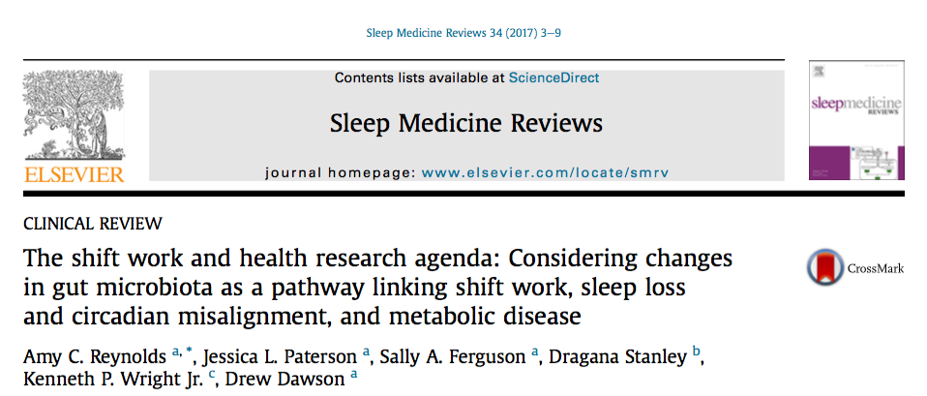
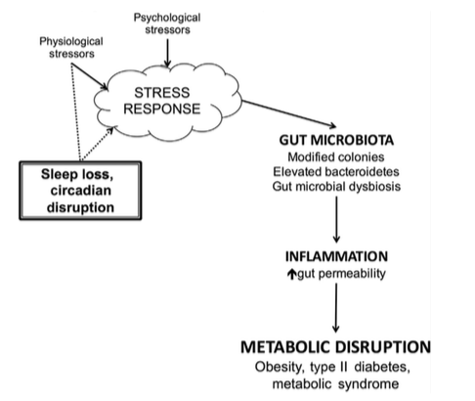

Slide 33
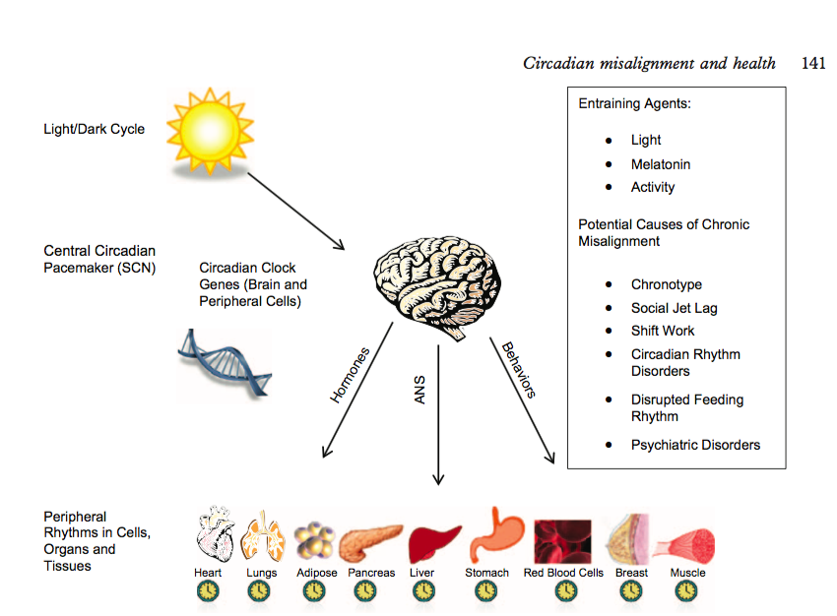
Nat Commun. 2017 Sep 12;8(1):417.
Misalignment with the external light environment drives metabolic and cardiac dysfunction.

Slide 36
Courtesy Dr. Alexander Wunsch

Slide 37
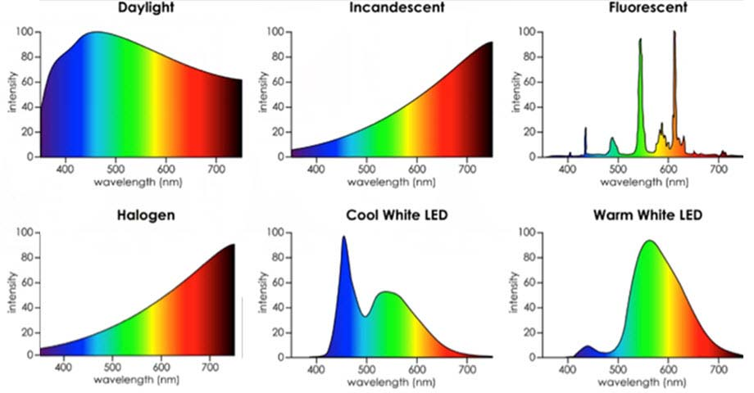
Desire Color Rendering Index (CRI) 95+ %
Color Temperature 2700-3000k

Slide 42
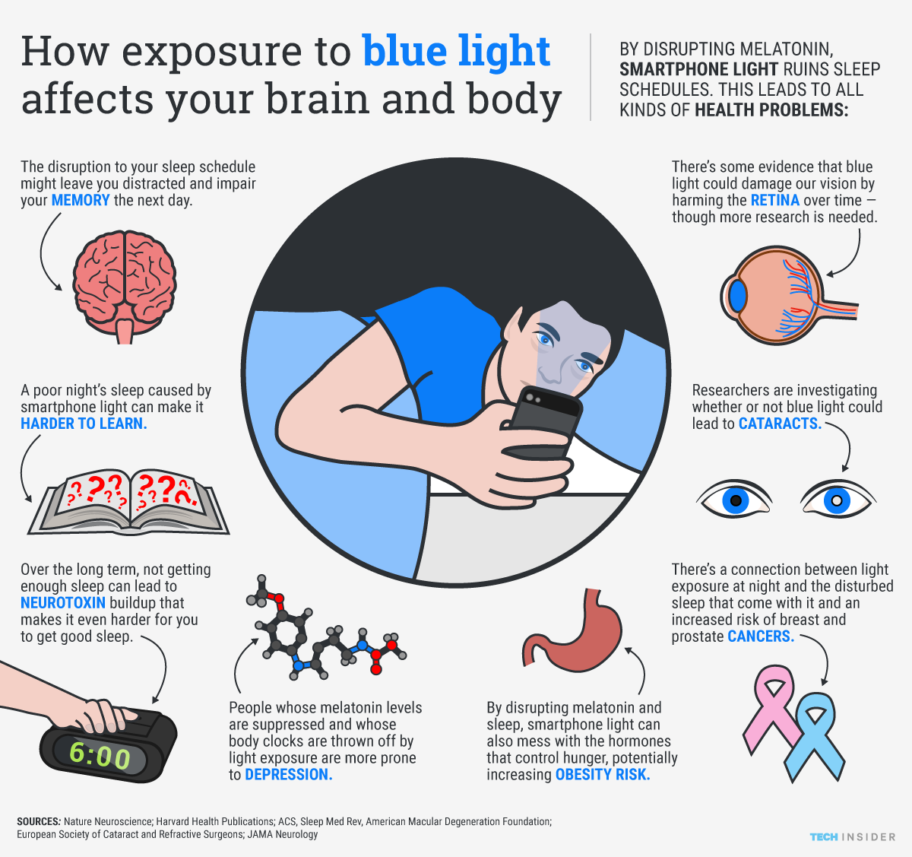
Aging and Mechanisms of Disease (2017) 3:9 ;

Slide 43
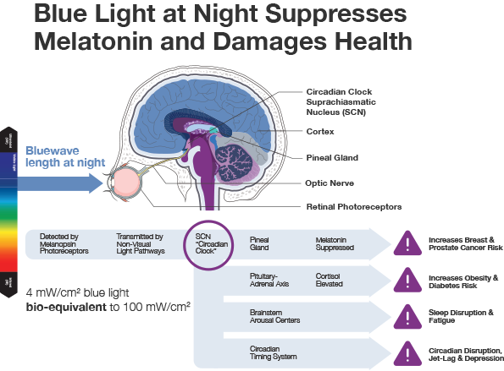
Aging and Mechanisms of Disease (2017) 3:9 ;

Slide 44
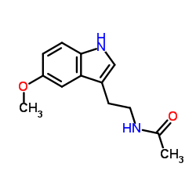
Melatonin
Hormone of darkness
Very sensitive to blue light
Facilitates sleep cycle
Increases cell regeneration
Anti-oxidant activity; ROS scavenger
Antagonizes Aromatase and lowers estrogen production in tissues
Modulates immune regulatory function
Antagonizes cortisol
Key substance for chronobiologic adaptation (day/night and summer/winter)

Slide 45
Courtesy Dr. Alexander Wunsch

Slide 46
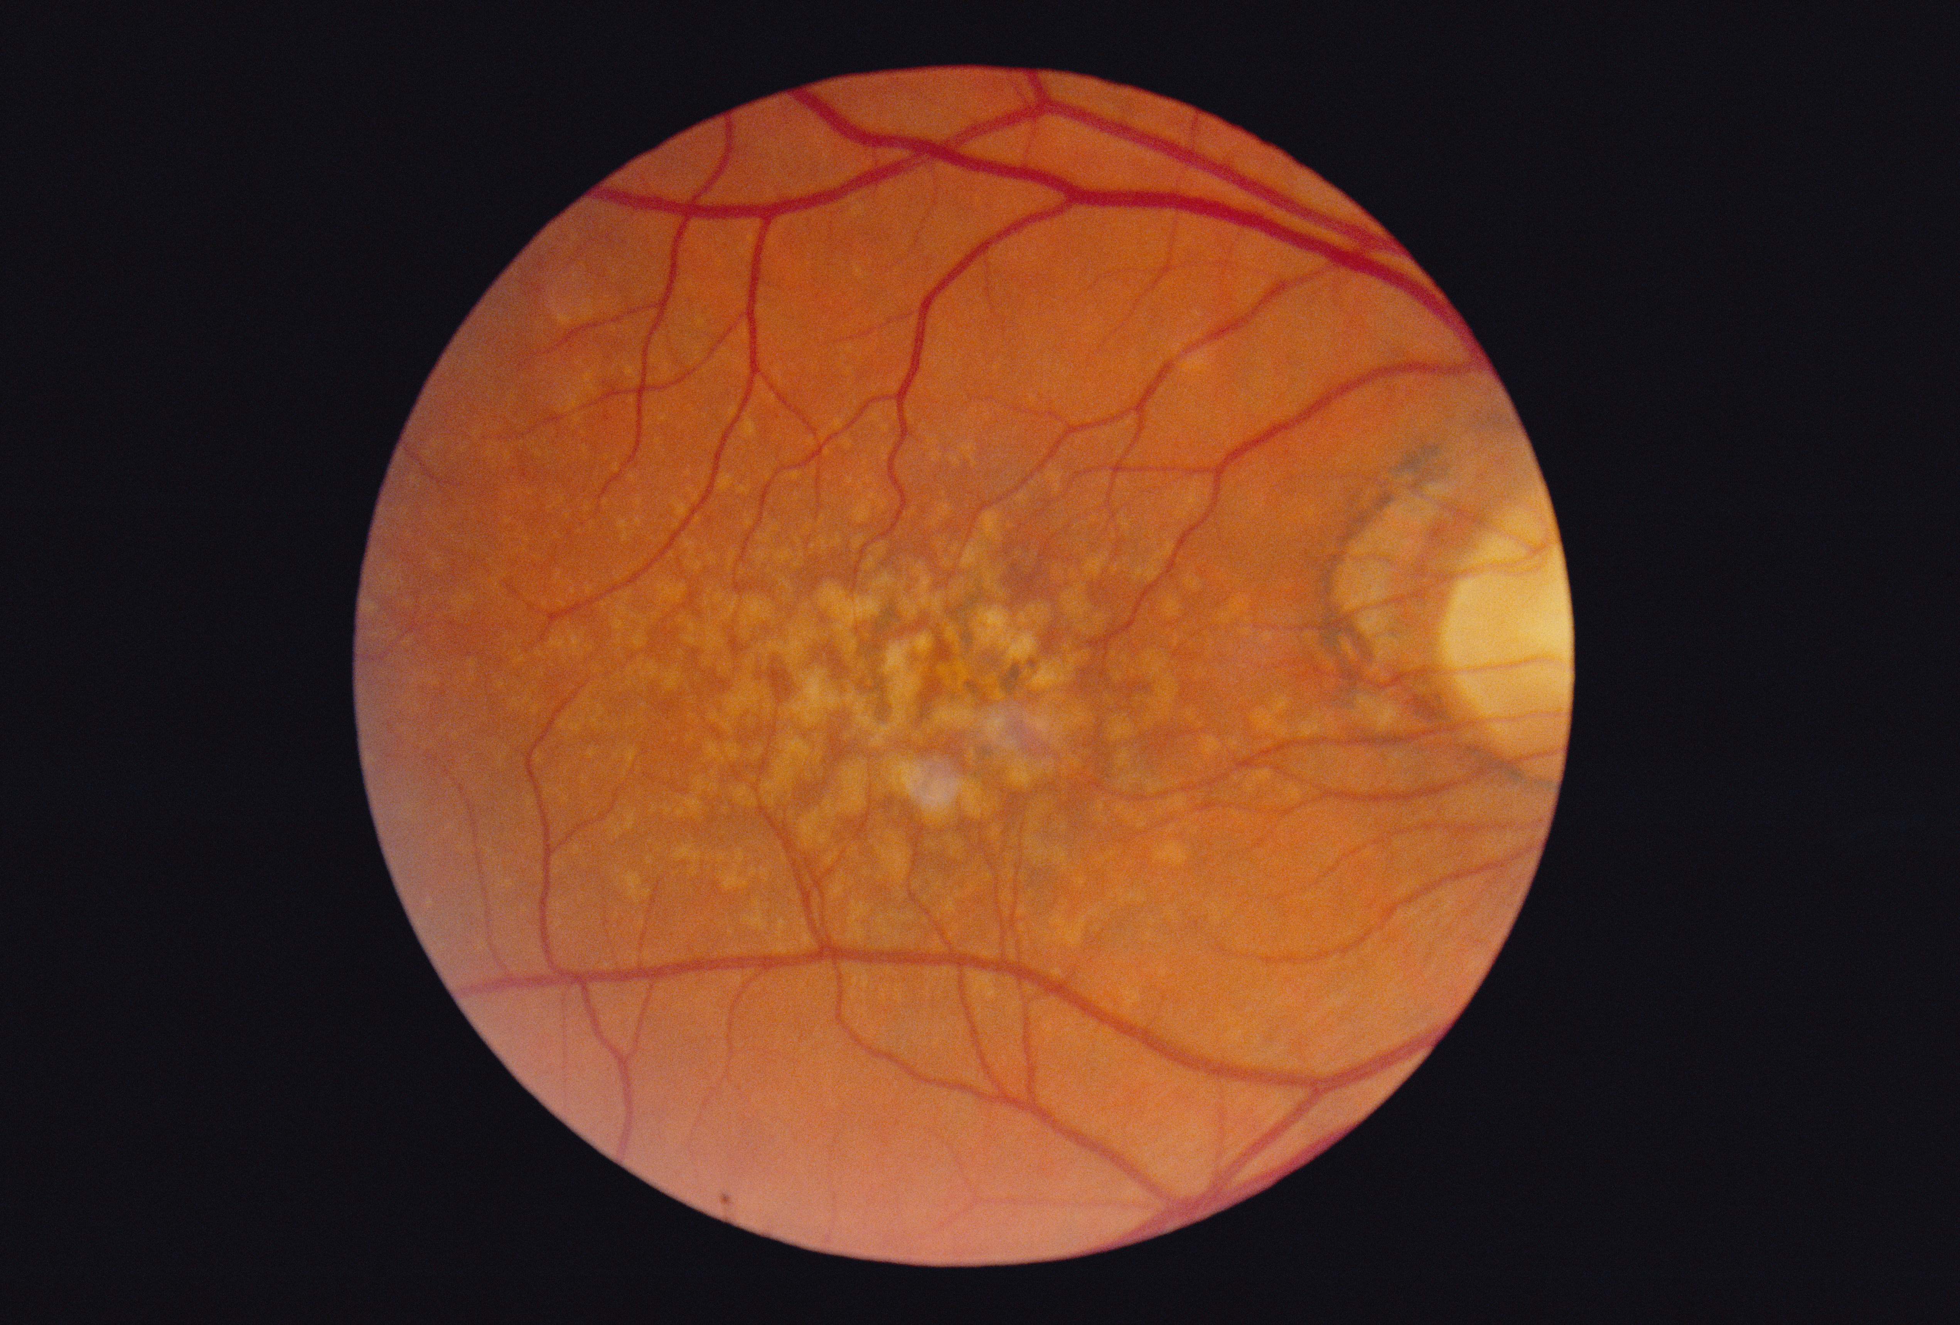
Age-Related Macular Degeneration
In modern societies 30-50% of people over 65 years of age show signs of AMD
For 85% of cases there is no cure
Progression leads to blindness
Statistical correlation with chronic complex disease disease and changes in light exposition
Melanopsin receptors sensitive to the oxidative stress of blue light
Molecular Vision 2016; 22:61-72

Slide 47
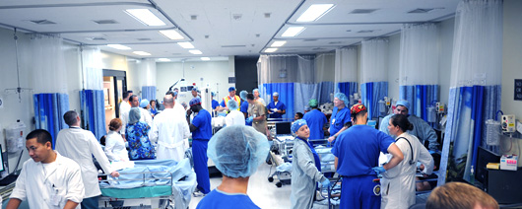
Fluorescent Light
NHS- Nurses Health Study (Harvard)
120,000 nurses followed 30+ years
30% increase of breast cancer after 15 years of night work
Other studies have shown increased risk up to 60%

Slide 48
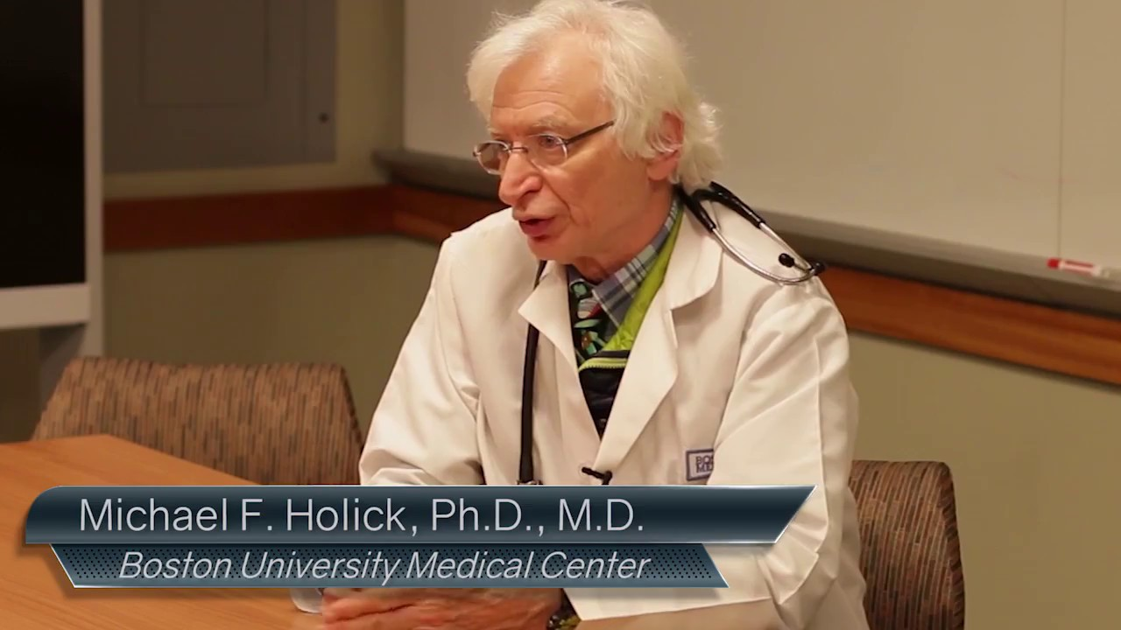
Author of the UV Advantage
Sunblocks with factor 15+ reduce sulfated cholcalciferol by 99.9%
More thoughtful dosed sunlight exposure could reduce cancer incidence in USA by as much as 50%
Melanoma risk significantly reduced with occupational sun exposure

Slide 49
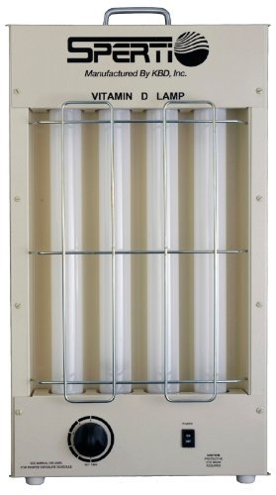
Many epidemiologic studies associate low vitamin D levels with most chronic, complex diseases.
Modulates 3% human genome
Anti-inflammatory, DNA repair, apoptosis, anti-oxidant, etc.
Sunlight = sulfation
Sunlight is the ultimate source of vitamin D
Studies suggest a desirable blood level of at least 30 - 50 ng/ml
? Sunlight vs. supplement

Slide 50
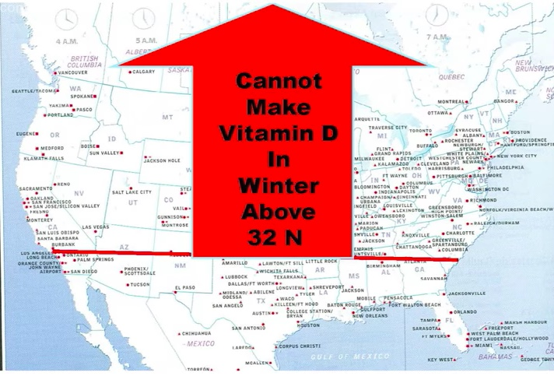

Slide 52
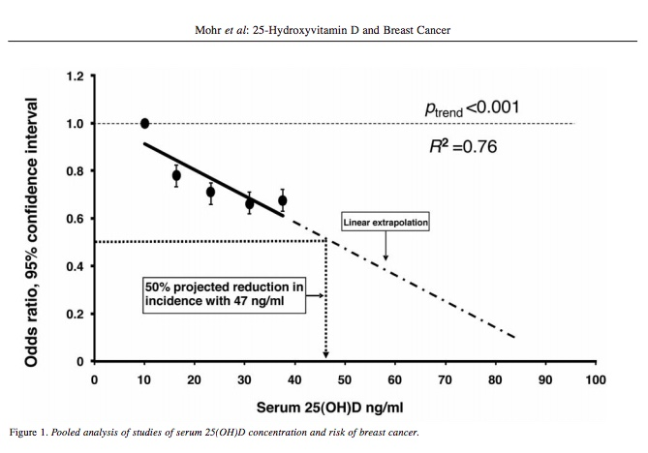
ANTICANCER RESEARCH 31: 2939-2948 (2011)

Slide 53
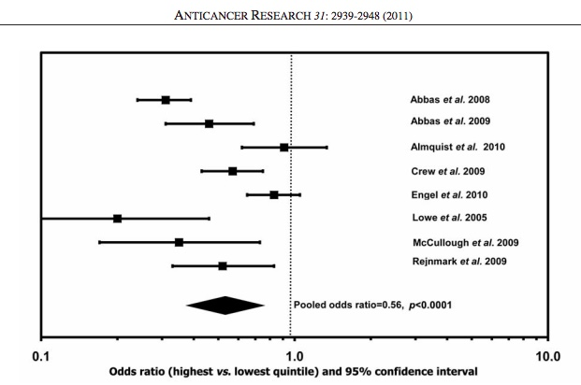

Slide 54
Courtesy Michael Holick MD, PhD

Slide 57
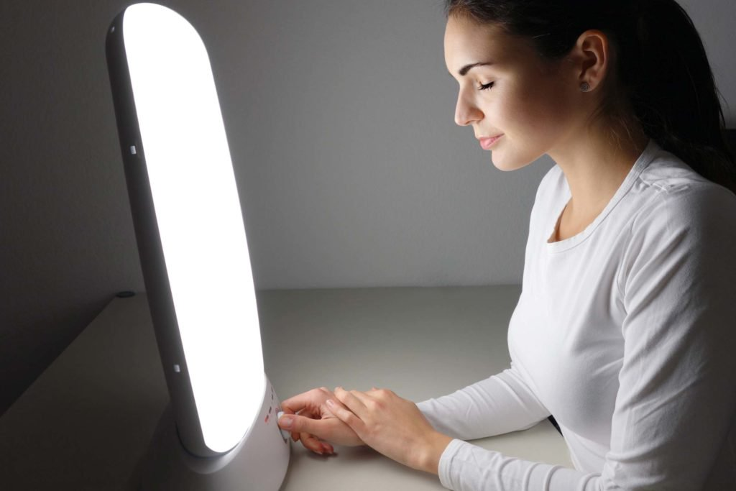
Full-spectrum light box: 10,000 lux

Slide 58
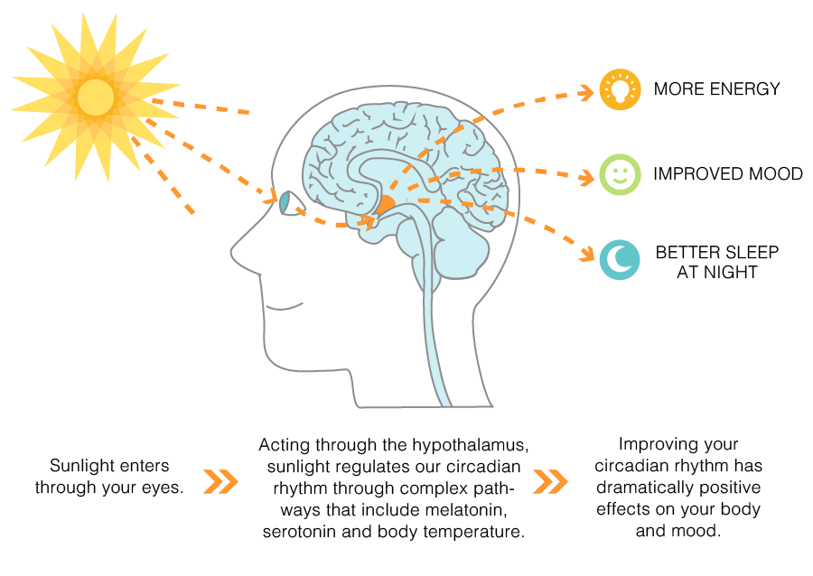

Slide 59
UVA and Nitric Oxide (NO)
Dermato-Endocrinology 4:2, 109–117; April/May/June 2012; G 2012 Landes Bioscience

Slide 60
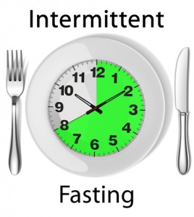
Time-Restricted Feeding
Time restricted feeding e.g. consume all food within 10-hour
Decreases in body weight and visceral fat
Significant reductions in breast cancer recurrence and improved prognosis (Patterson et al. UCSD)
Improved cardiovascular disease risk profile
Decreased inflammation (Biogerontology. 2015 Dec;16(6):775-88)
Decreased neuroinflammation (Neurobiol Aging. 2015 May;36(5):1914-23)
Autophagy (Autophagy, 2014;10:11, 1879-1882)

Slide 61
Is this always a good idea?

Slide 62
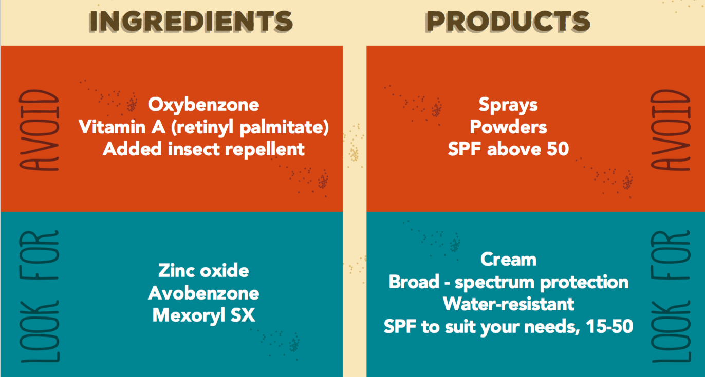

Slide 63
Summary
Decreased sunlight exposure and increased “junk light” exposure are major contributors to chronic complex disease.
Sensible sunlight e.g. 30” /day or more unprotected as tolerated to avoid burning
Allow full spectrum dawn light to access your retina
Incandescent, halogen, warm LED; CRI (color rendering index) 95+
Ditch the CFUs, fluorescents when able
Blue blocker glasses after sunset
Full-spectrum light at 10k lux for 30” for seasonal affective disorder, sleep disruption, improved cognition.
Blue blocker apps for adjustment color temperature and blue blocking (2500 Kelvin an ideal setting for light intensity on computers, tablets, smart phones)
Time-restricted feeding a powerful Zeitgeber

Slide 64
Zeitgebers

Slide 65
Thank you !

