Slide 1
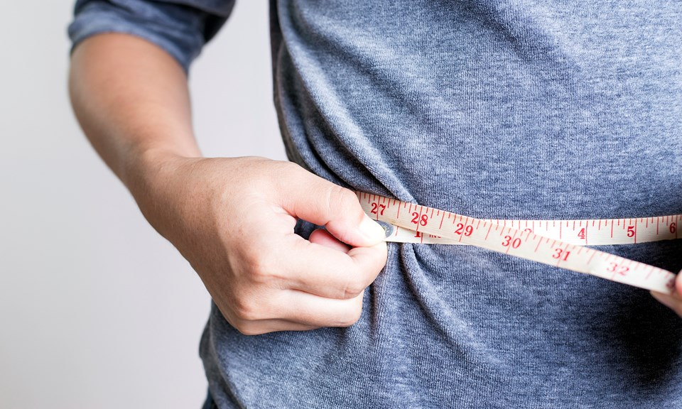
New Insights on Weight Loss and Metabolism
How do I turn the fat switch off?
Mark Pettus MD
Director Medical Education and Population Health
Berkshire Health Systems
February 15, 2018

Slide 2
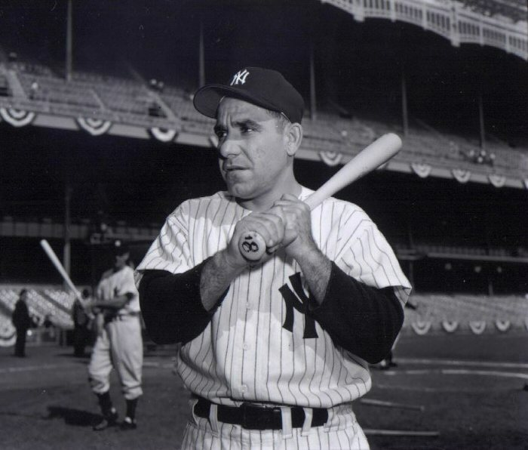
“The future ain’t what it used to be.”
Yogi Berra

Slide 3
The Origins of Health …exploring the causes of the causes
Creating Health and Epigenetics: How well do you fit into your genes?
Understanding Weight and Metabolism: How do I turn the fat switch off?
Inflammation: Are you playing with fire?
Gut-microbiome barrier function: Do you have the guts for health?
Relationship between light and health
The science of mind: Neuroplasticity and brain health
Social connection and health
Environmental toxins and health

Slide 4
Environment and Lifestyle
Life
Gene-Epigenetics
Microbiome
Consciousness/Spirituality

Slide 5
Disease (how things appear)
Pre-diabetes, Diabetes, Weight/Obesity, Metabolic Syndrome, Heart Disease, Stroke, Depression, Autoimmunity, Alzheimer’s, Cancer, Autism, ADD, Hypertension
Core Metabolic Imbalances (what drives them)
Inflammation
Fight-Flight (HPA axis)
Microbiome – Leaky Gut
High Insulin levels
Root Causes (what are their origins)
Gene-Environment-Microbiome
Nutrition Movement Stress Response Light Quality
Environmental toxins Sleep Social Connection
Traumatic events Conflict Management Mindfulness Meaning in Work, Love & Play

Slide 6
Prevailing View
Obesity occurs when a person consumes more calories from food than he or she burns.
National Institute of Health
Overweight is the result of caloric imbalance (too few calories expended for the amount of calories consumed) and is mediated by genetics and health.
US Surgeon General

Slide 7
Emerging View
A calorie is not a calorie
Macronutrients i.e., carbs, fats and protein, elicit different metabolic effects (food as information)
Quality of macronutrients e.g. sugar and refinement of grains will substantially impact metabolic effects
Quality of calories more important (and interesting) than quantity of calories
Quality fat sources less harmful than thought
Poor-quality carbs more harmful than thought

Slide 8
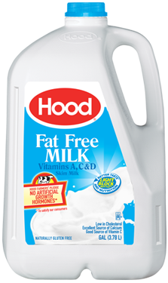
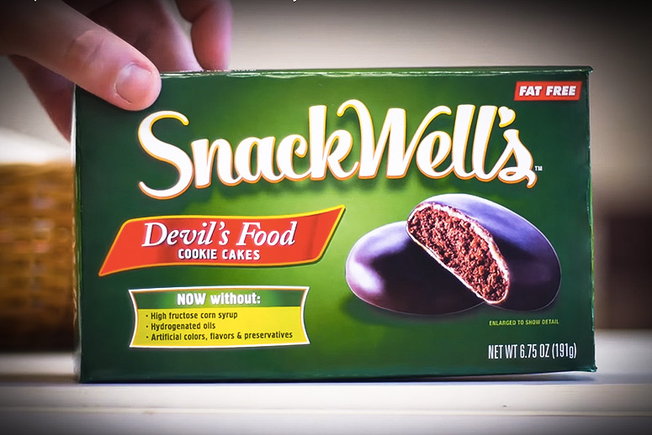
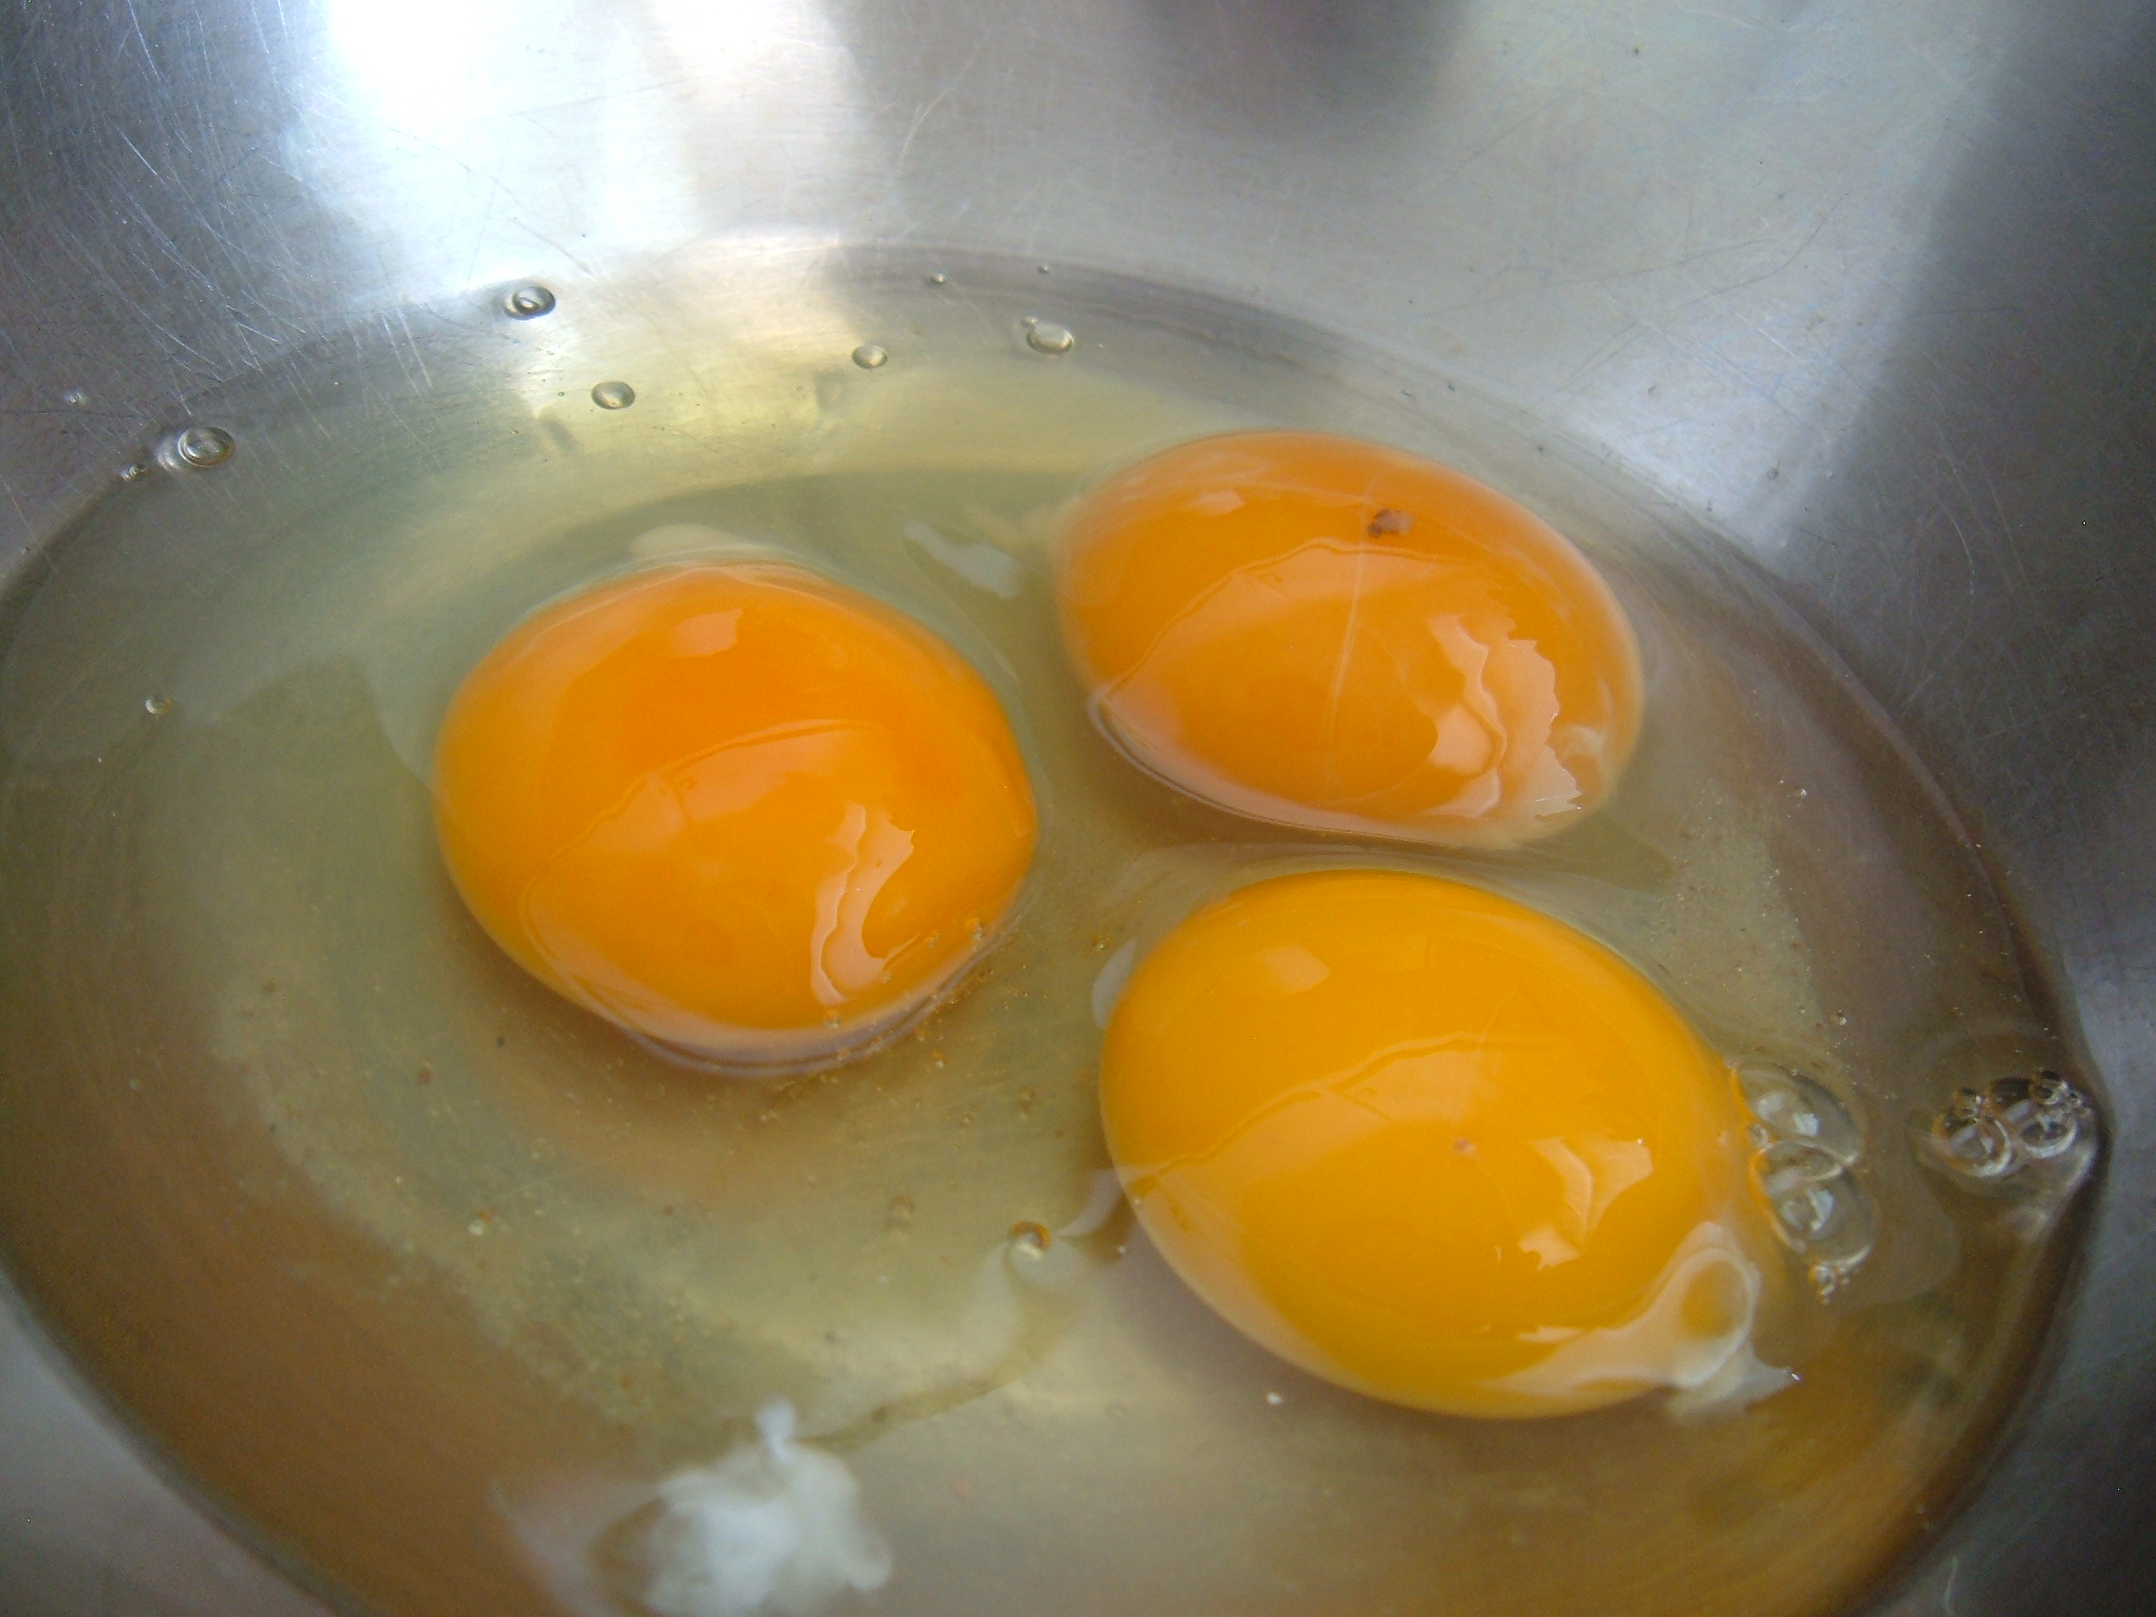
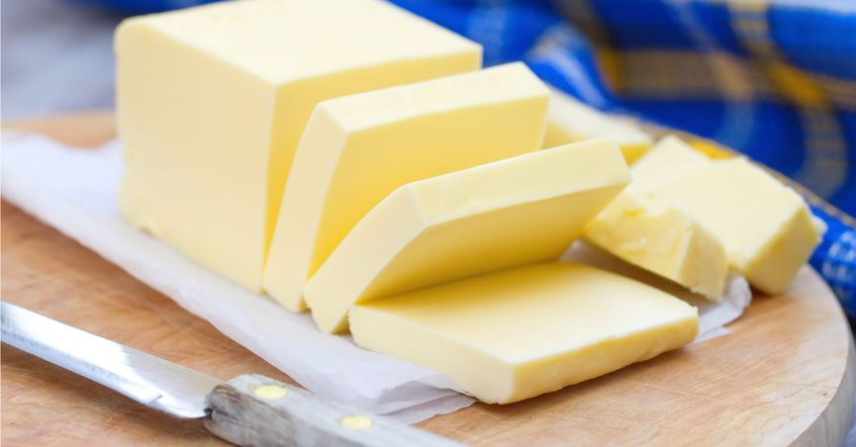
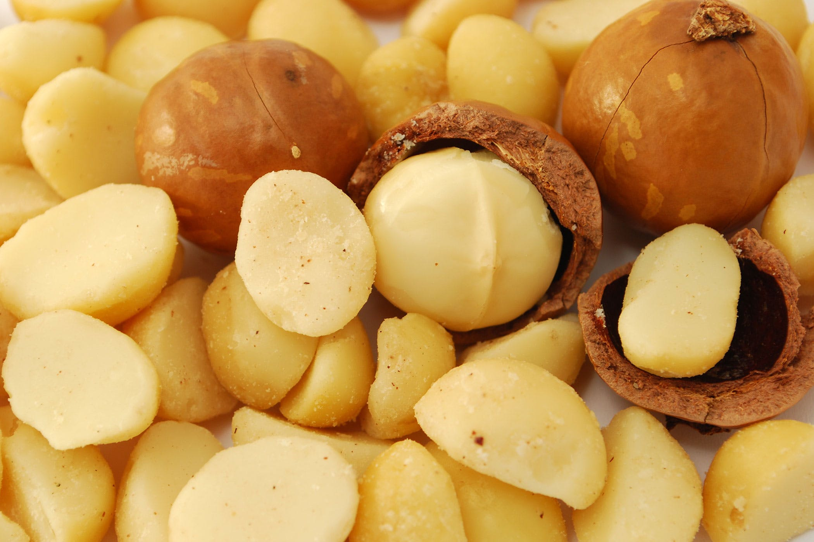
“What we know that ain’t so…” Fat Free or Cholesterol Free = Healthy
Vs.

Slide 9
These are the 4 key points to take away:
Carbohydrates from sugar, flour (grain) and fructose will sabotage your success.
Fat from healthy sources are good for you!
Vegetables and the fiber they contain are essential to your gut “critters” ecosystem.
Eating within a 10-hour window will change everything (time-restricted feeding)

Slide 25
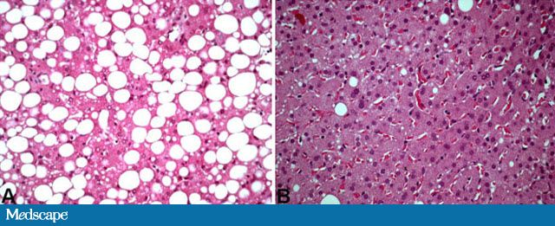
NAFLD
Non-alcohol fatty liver disease
Has become one of the most common diseases in America from not having been described until 1980.
45% of all Latinos
33% of all Caucasians
25% of all African Americans
5% of all progress to NASH
25% NASH progress to cirrhosis
100% Preventable

Slide 26
How much
Sugar is in
the human body?

Slide 27
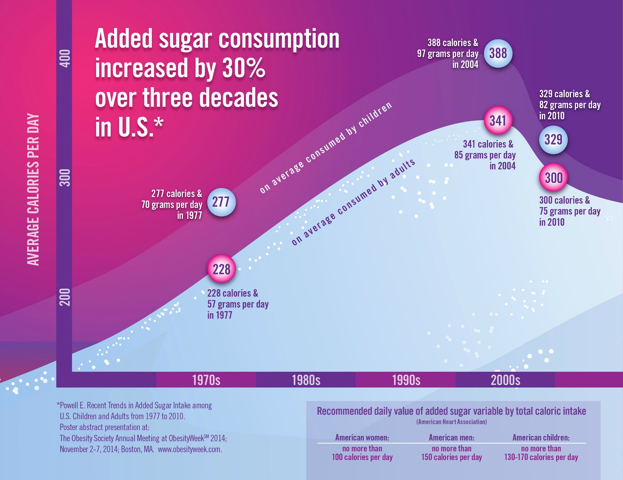

Slide 28
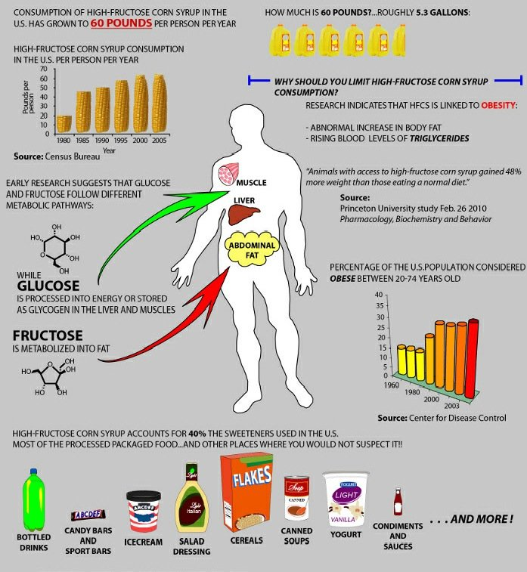

Slide 30
Limitations of Weight and BMI
BMI of limited value with higher lean body mass
Body composition (lean body mass and fat stores)
VAT vs. SAT
TOFI – “thin outside, fat inside”
Most adipose is VAT
Most adipose is SAT
Same weight and waist circumference:
Different metabolic risks!
Notes:
Need to build lean body mass in addition to reduction of fat stores

Slide 31
Lifestyle-Environmental Inputs
Nutrition
Movement
Stress Response
Sleep Hygiene
Social Connection
Meaning in work, love, play
Environmental Toxins
Full-spectrum light deprivation
Weight
Inflammation
Insulin
Resistance
Notes:
Endocrine disruptors tied to 300billion in annual healthcare costs
Organophophate disruptors; glyphosate; BPA; pthalates; PTFO flame retardants

Slide 32
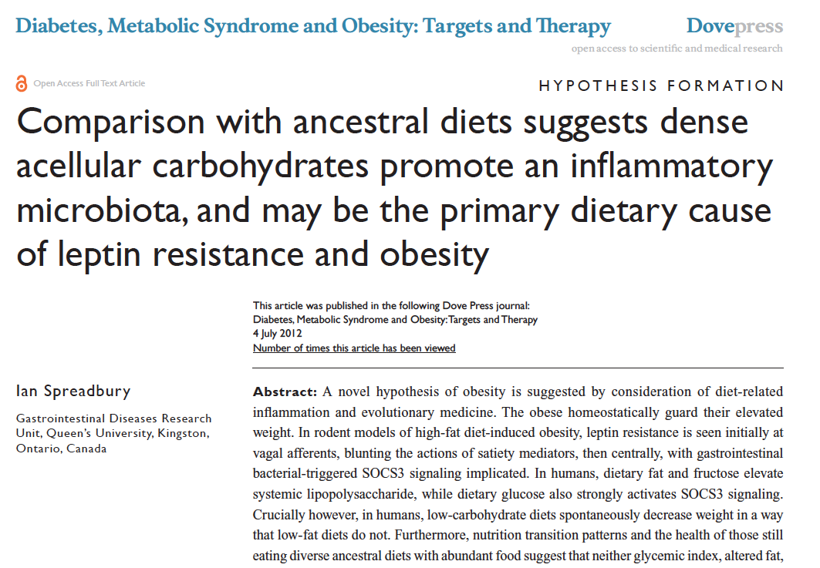

Slide 33
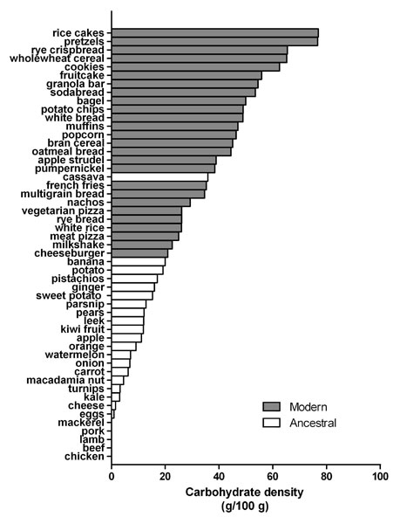
Reduce carbohydrate-dense foods
Major contributor of obesity, insulin resistance, changes in blood lipids, inflammation, and alterations of the organisms in the human microbiome
A huge area of opportunity in individuals with increased belly fat, pre-diabetes or diabetes…these are health features of carbohydrate intolerance.
For most, sugar and refined, grain-based foods are problematic: eliminate and observe.

Slide 34
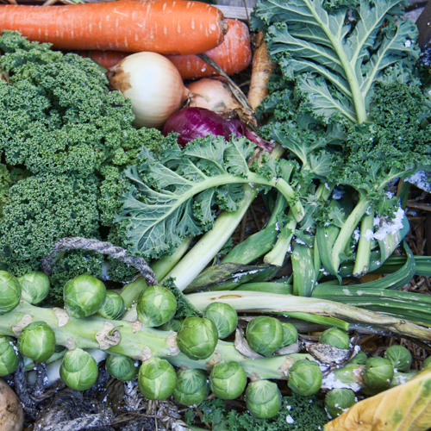
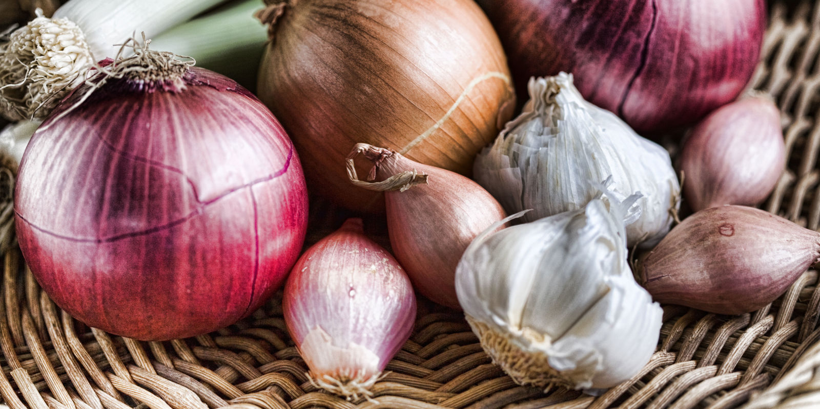
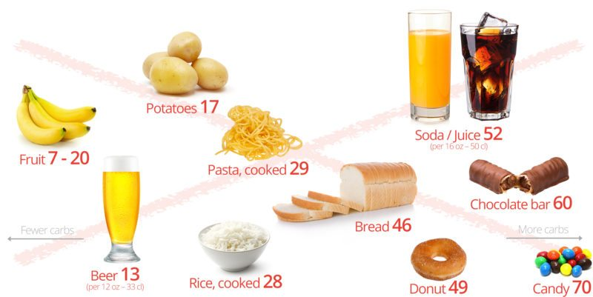
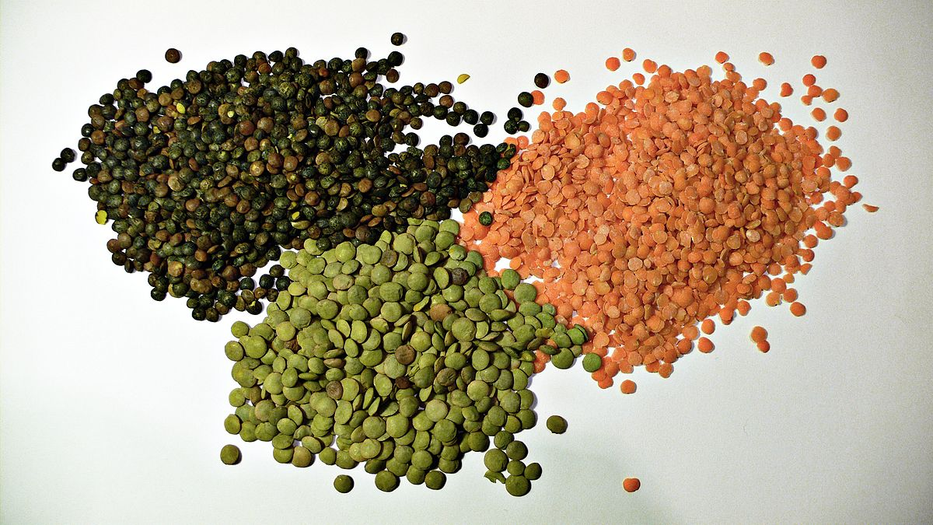
High-Quality Plant-Based Carbs
Sugar, Fructose and Carbohydrate-Dense Grains
Oral and Gut
Microbiome
Risks for:
Inflammation
Neurotransmitters
Insulin Resistance
Weight and Metabolism
Mitochondria-Oxidative stress
HPA axis –Stress Response
Protection from:
Inflammation
Diabetes
Cancer
Obesity

Slide 36
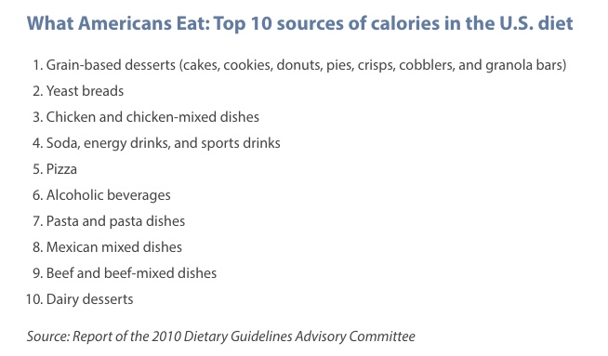
These are mostly carbohydrate-dense foods from processed grains !

Slide 38
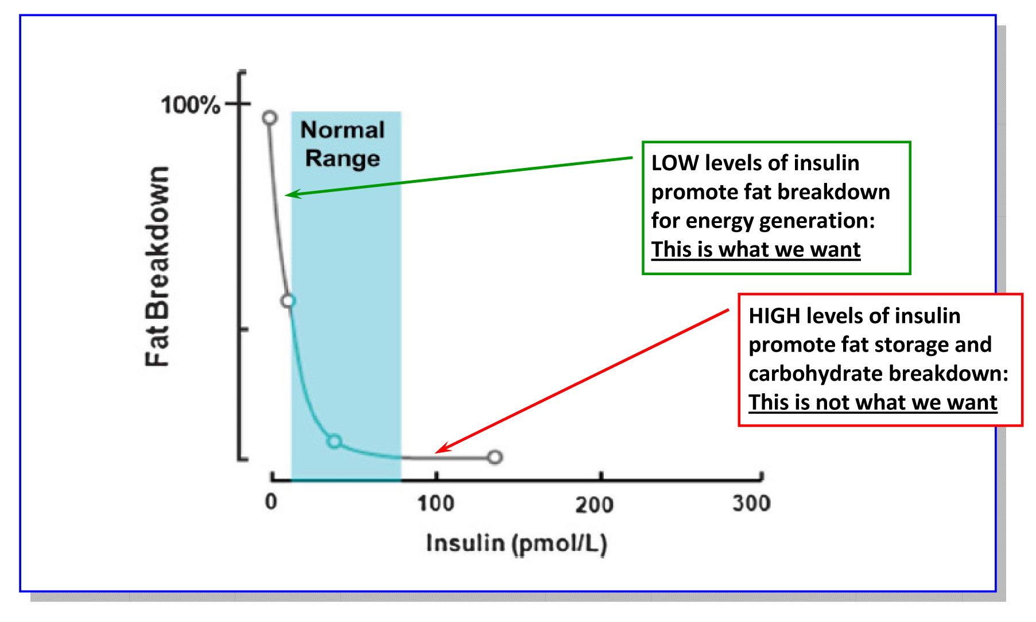
Lipolysis vs. Lipogenesis

Slide 39
Poor Quality Carbs
Acellular carbohydrate density
Inflammation
Stress
Sleep disruption
Altered gut-permeability/microbiome
Social isolation
Toxin excess
Sedentary states
VAT
Excess Insulin
VAT Fat storage-lipogenesis
Down-regulation of insulin receptors
Insulin Resistance
Leptin resistance
Eat more and do less

Slide 40
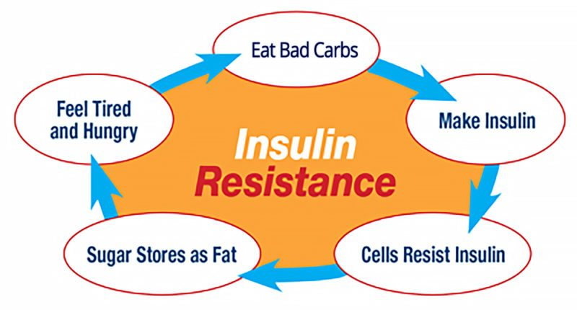

Slide 41
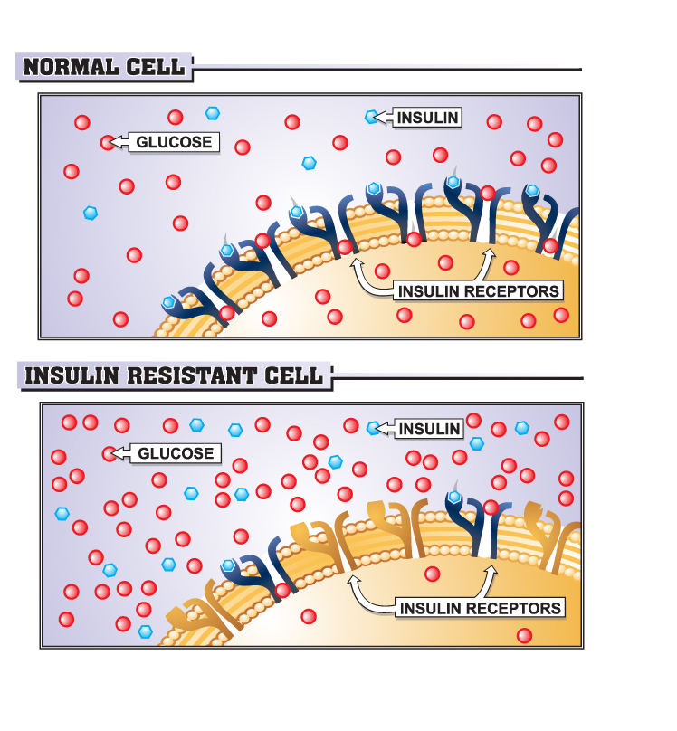

Slide 43
Will the choice I am about to make…
Raise my sugar-insulin or lower my sugar-insulin?
Rev up my immune system or relax my immune system?
Raise my stress levels (cortisol) or lower my stress levels (cortisol)
Be reasonably compatible with my ancestral roots?

Slide 44
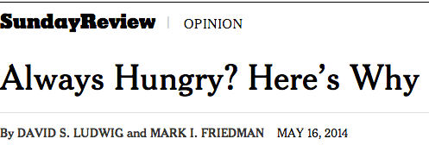
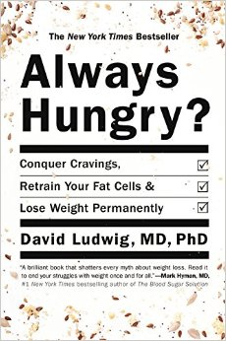
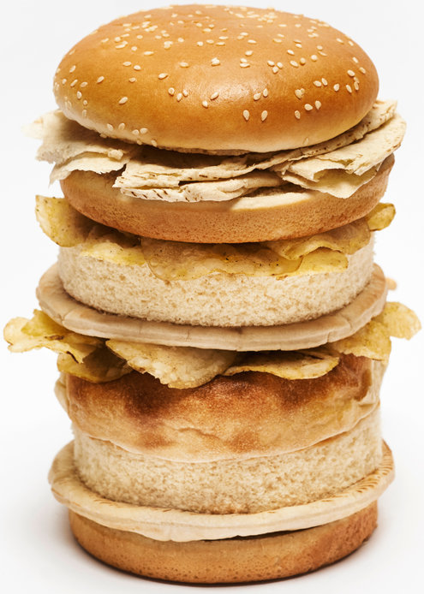
“ Are we fat because we eat too much or do we eat too much because we are fat ?”

Slide 45
From: Increasing Adiposity: Consequence or Cause of Overeating?
JAMA. 2014;():. doi:10.1001/jama.2014.4133
Copyright © 2014 American Medical Association. All rights reserved.

Slide 46
Five hour rule after eating a meal
Am I hungry again within a few hours?
Am I tired and ready for a nap?
Does my mind feel sluggish, inattentive and foggy?
Am I experiencing bloating, gas, cramping?
…if the answer to any of these questions is consistently “yes” then there are significant problems with what you are eating!

Slide 47
A calorie is not a calorie…
Effects of Dietary Composition on Energy Expenditure During Weight-Loss Maintenance
Cara B. Ebbeling, PhD; David S. Ludwig, MD, PhD et al
Conclusion: Among overweight and obese young adults compared with pre–weight-loss energy expenditure, isocaloric feeding following 10% to 15% weight loss resulted in decreases in REE and TEE that were greatest with the low-fat diet, intermediate with the low–glycemic index diet, and least with the very low-carbohydrate diet.
Remarkable range between individuals
TEE: - 423 [–606 to –239] kcal/d for low fat diet
- 57 [–281 to 86] kcal/d for low carb diet
Equivalent of 1-hr moderate effort cardio difference
JAMA. 2012;307(24):2627-2634. doi:10.1001/jama.2012.6607
Notes:
TEE differed by approximately 300 kcal/d between these low fat and low carb diets, an effect corresponding with the amount of energy typically expended in 1 hour of moderate-intensity physical activity.

Slide 49
15%
55%
SAD
LCHF

Slide 50
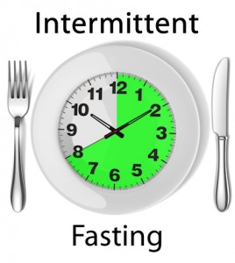
Intermittent fasting or Time-restricted feeding
Time restricted feeding for 8-10 hrs
Decreases in body weight and visceral fat
Improved cardiovascular disease risk profile
Decreased inflammation (Biogerontology. 2015 Dec;16(6):775-88)
Decreased neuroinflammation (Neurobiol Aging. 2015 May;36(5):1914-23)
Autophagy (Autophagy, 2014;10:11, 1879-1882)
Valter Luongo PhD: https://prolonfmd.com/fasting-mimicking-diet/
Satchin Panda PhD: https://www.salk.edu/scientist/satchidananda-panda/

Slide 52
Food and Reward

Slide 53
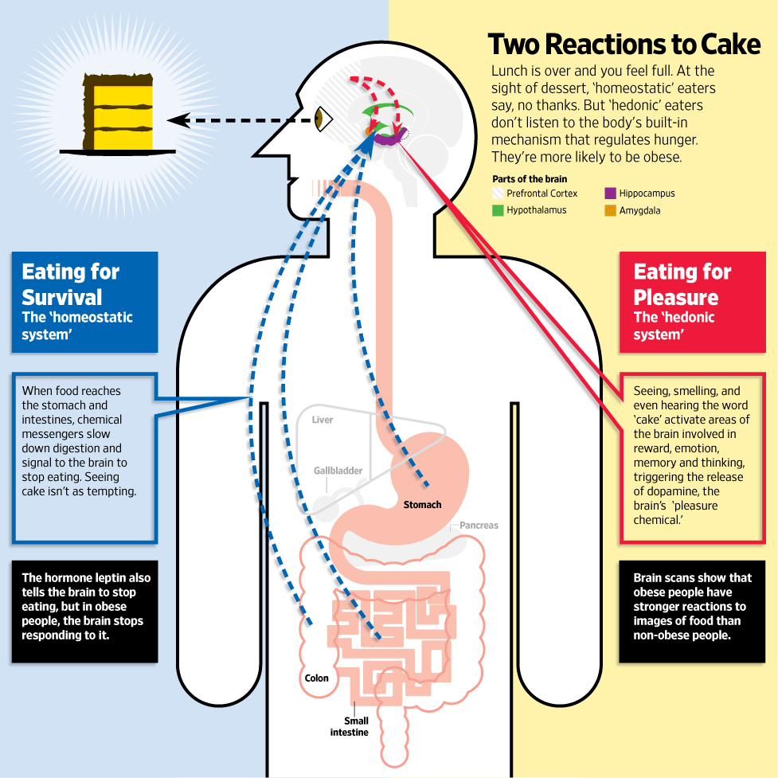
Jabr F, SA Mind December 2015

Slide 55
www.dietdoctor.com
www.dietdoctor.com

Slide 60
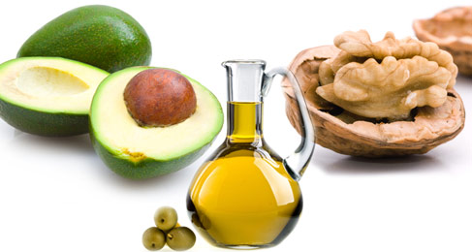
More quality fat sources
Pasture-raised eggs
Fatty fish e.g. salmon, sardines, anchovies, mackeral, trout
Grass-fed butter
Whole fat dairy, yogurt
Extra virgin olive oil
Extra virgin coconut oil
Avocados, olives
Nuts - almonds, macadamia, walnuts

Slide 61
Low fat (restricting calories) vs.
Low carb-high fat (LCHF – no restriction of calories)
for weight loss.

Slide 62
Westman, E et al. Nutrition 31 (2015) 1-13

Slide 63
Westman, E et al. Nutrition 31 (2015) 1-13

Slide 64
Westman, E et al. Nutrition 31 (2015) 1-13

Slide 65
In weight loss trials, low-carbohydrate interventions led to significantly greater weight loss (along with better metabolic RF reduction) than did the low-fat interventions.
When compared with dietary interventions of similar intensity, evidence from RCTs does not support low-fat diets over other dietary interventions for long-term weight loss.
Lancet Diabetes Endocrionol 2015 Dec:3(12)

Slide 66
Meta-analysis comparing VLCHF (no more than 50g CHO/day)with traditional calorie restricted low fat (< 30% calories from fat for weight loss and CV RF modification efficacy.
13 RCTs with at least 12-month f/u. Individuals assigned to a VLCHF achieve greater weight loss than those assigned to a LFD
Br J Nutr 2013 Oct: 110(7)

Slide 67
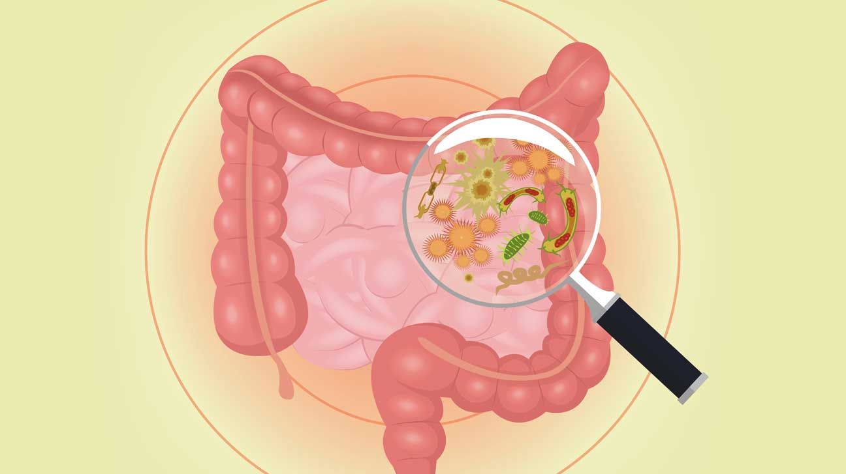
Mechanisms that link alterations of the microbiome with weight and metabolism
Increased energy harvest from the diet
Altered fatty acid metabolism in liver, muscle, and fat tissue
Modification of gut hormones e.g. cholecystikinin, peptide YY and GLP-1
Activation of LPS- TLR 4 axis and cytokine expression i.e., metabolic endotoxemia
Altered gut barrier function and molecular trafficking
Bile acid metabolism
SCFA production

Slide 68
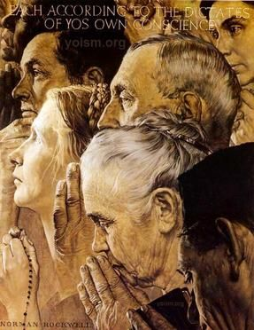
Stress Management …lowering cortisol is key
Prayer, meditation, qigong, breath-relaxation response, guided imagery, yoga, tai chi, biofeedback, gratitude journal
Exercise excellent for managing stress
Decreased cortisol, flight-fight response
Improved mood, concentration, pain tolerance, resilience
Positive epigenetic effects on inflammation, insulin sensitivity and energy efficiency e.g. mitochondrial health
Decreased cardiovascular risk
Cultivate love, compassion, forgiveness, acceptance of one’s beautiful and perfect nature
More time outdoors

Slide 69
Motion is the lotion
Calories burned not most important attribute
Children model fun play
Walk a lot
Move to the music you love
Interval training….20” - 3x/week to the point of challenges speaking without losing breath
Resistance training…20” - 3x/week
Embrace the outdoors
Share with friends-pets

Slide 70
Sleep Hygiene
Consistent bedtime and awakening
Lavender; chamomile tea, soft belly breath
Warm LED lights in bedroom; after dark
Maximally darkened room; unplug anything that is lit
Filter blue light after sundown (f•lux); orange lens glasses
Cooler temp - 65°
No caffeine after 2p
Avoid late night dining-snacking (within 2-hrs bedtime)…time-restricted feeding is ideal
Melatonin; glycine

Slide 71
Summary: Weight Loss and Lifestyle
Eliminate – reduce sugar in all it’s forms
Eliminate-reduce refined grain flours, and carbohydrate-dense processed foods.
Reduce hydrogenated oils and processed seed oils cooked at high temperatures
More abundant healthy fats sources e.g. extra virgin olive oil, fatty fish, grass-fed butter; eggs; extra virgin coconut oil (MCT Oil); pasture-raised animal fat, ghee, avocados, nuts (almonds, walnuts and macadamia) and nut butters
Time-restricted eating….all consumption within a 10-12-hour window e.g. nothing after 7p

Slide 72
Summary: Weight Loss and Lifestyle
OK to consume pasture-raised meats and eggs
Increase fermentable plant-based fiber and fermentable foods
Motion is the lotion: Walk as much as possible, stairs as tolerated, stand for 2-3” every hour
Stress management techniques
Circadian rhythm – sleep entrainment; sleep hygiene
Time in Nature; light box

Slide 73
Thank You

