Slide 1
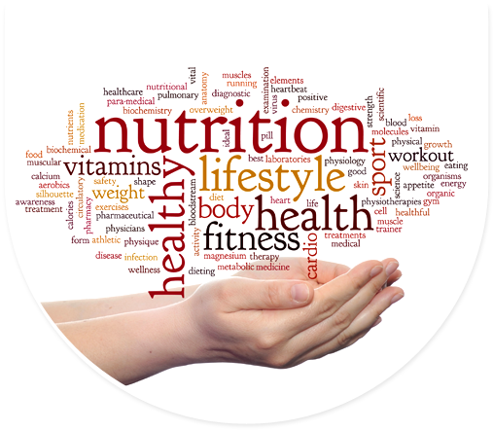
The Origins of Health and Longevity: A wellness roadmap for thriving in 2018
Mark Pettus MD
Director of Medical Education & Population Health
February 8, 2018
Notes:
The #1 cause of death and diminished quality of life are the choices we make Healthy living does not happen at the doctor’s office. Transform perceptions of Self-Care and what we as humans are capable of.
It’s not the hand you’re dealt but how you play your cards.
Unprecedented convergence This is about how you function How you function determines how you feel
Explore the key metabolic underpinnings of function
Your biology becomes you biography

Slide 2
Health through an ecological lens
Notes:
No adult left behind

Slide 3
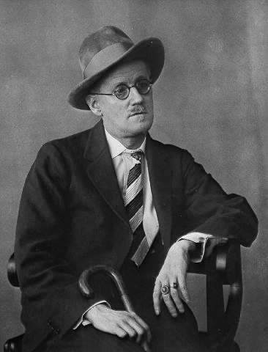
James Joyce from his short story Dubliners
“Mr. Duffy lived a short distance from his body”

Slide 4
The Origins of Health …exploring the causes of the causes
Creating Health and Epigenetics: How well do you fit into your genes?
Understanding Weight and Metabolism
Inflammation: Are you playing with fire?
Gut-microbiome barrier function: Do you have the guts for health?
Relationship between light and health
The science of mind: Neuroplasticity and brain health
Social connection and health
Environmental toxins and health

Slide 5
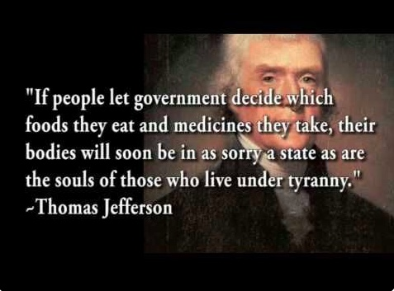

Slide 6
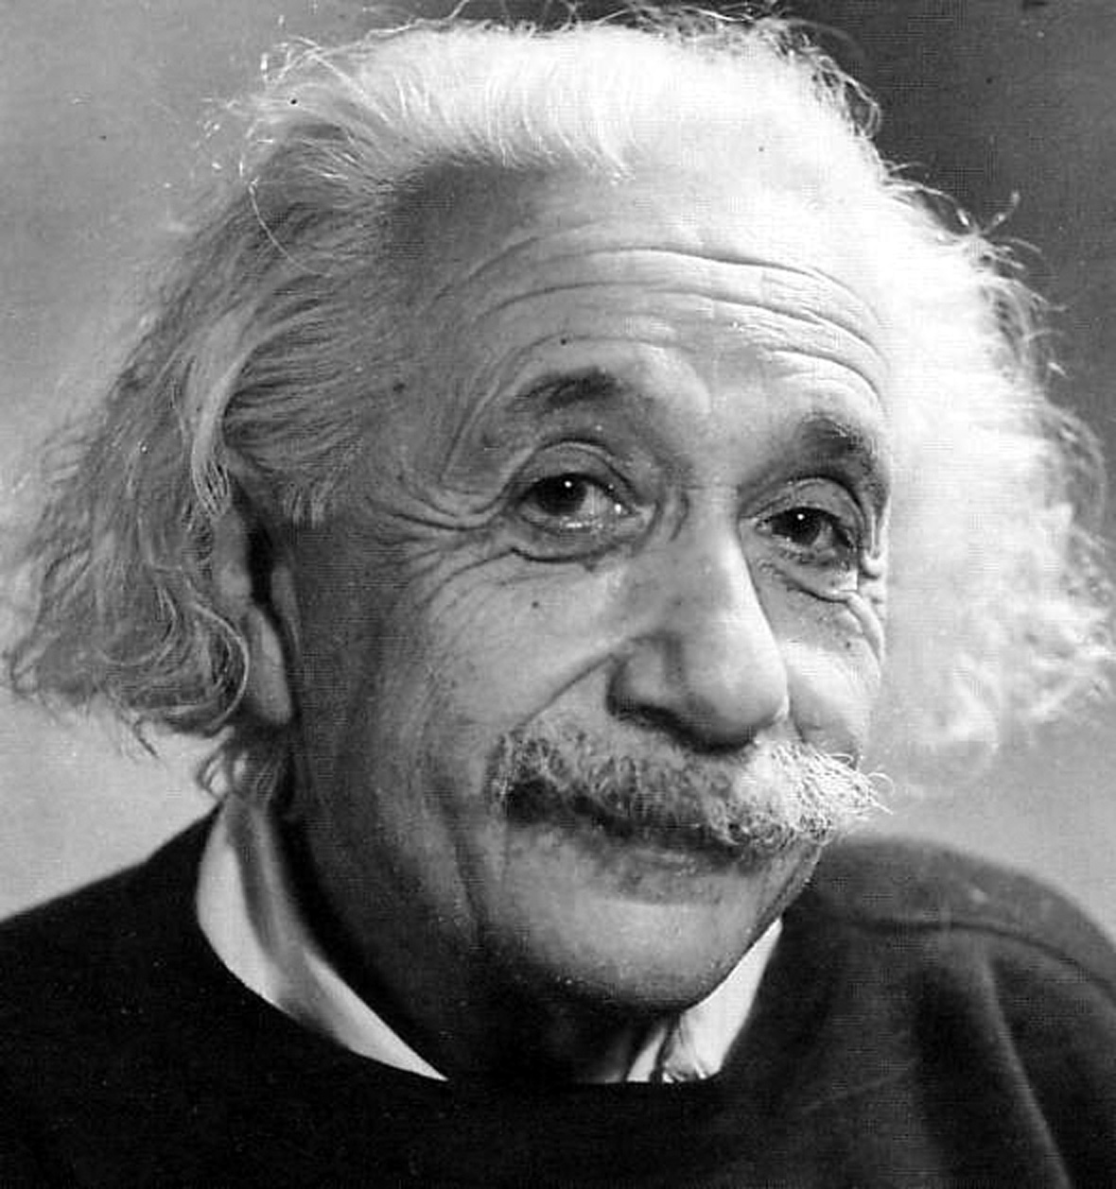
“Reality is an illusion, albeit a persistent one.”
Albert Einstein
Notes:
Its not what you know….

Slide 7
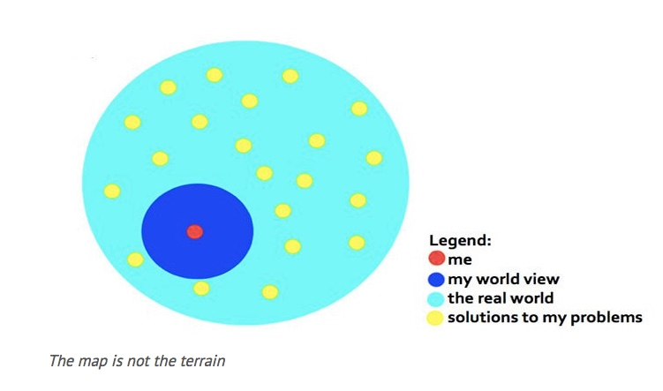

Slide 8
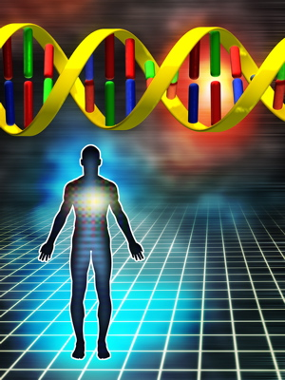
The Origins of Health
Longevity and quality of life as an intricate dance between your DNA, your environment and the choices you make.
Your DNA i.e., your “Book of Life” have a Stone Age imperative, not often compatible with 21st century lifestyle.
This incompatibility creates a disrupted biology e.g. changes in our microbiome, inflammation, and fight-flight overdrive that forms the basis of chronic complex disease, poor performance and diminished quality of life.
Epigenetics is the relationship between our choices and how our genes function.
You can assist longevity and quality of life by aligning your lifestyle choices with that which your DNA are best suited for.

Slide 9
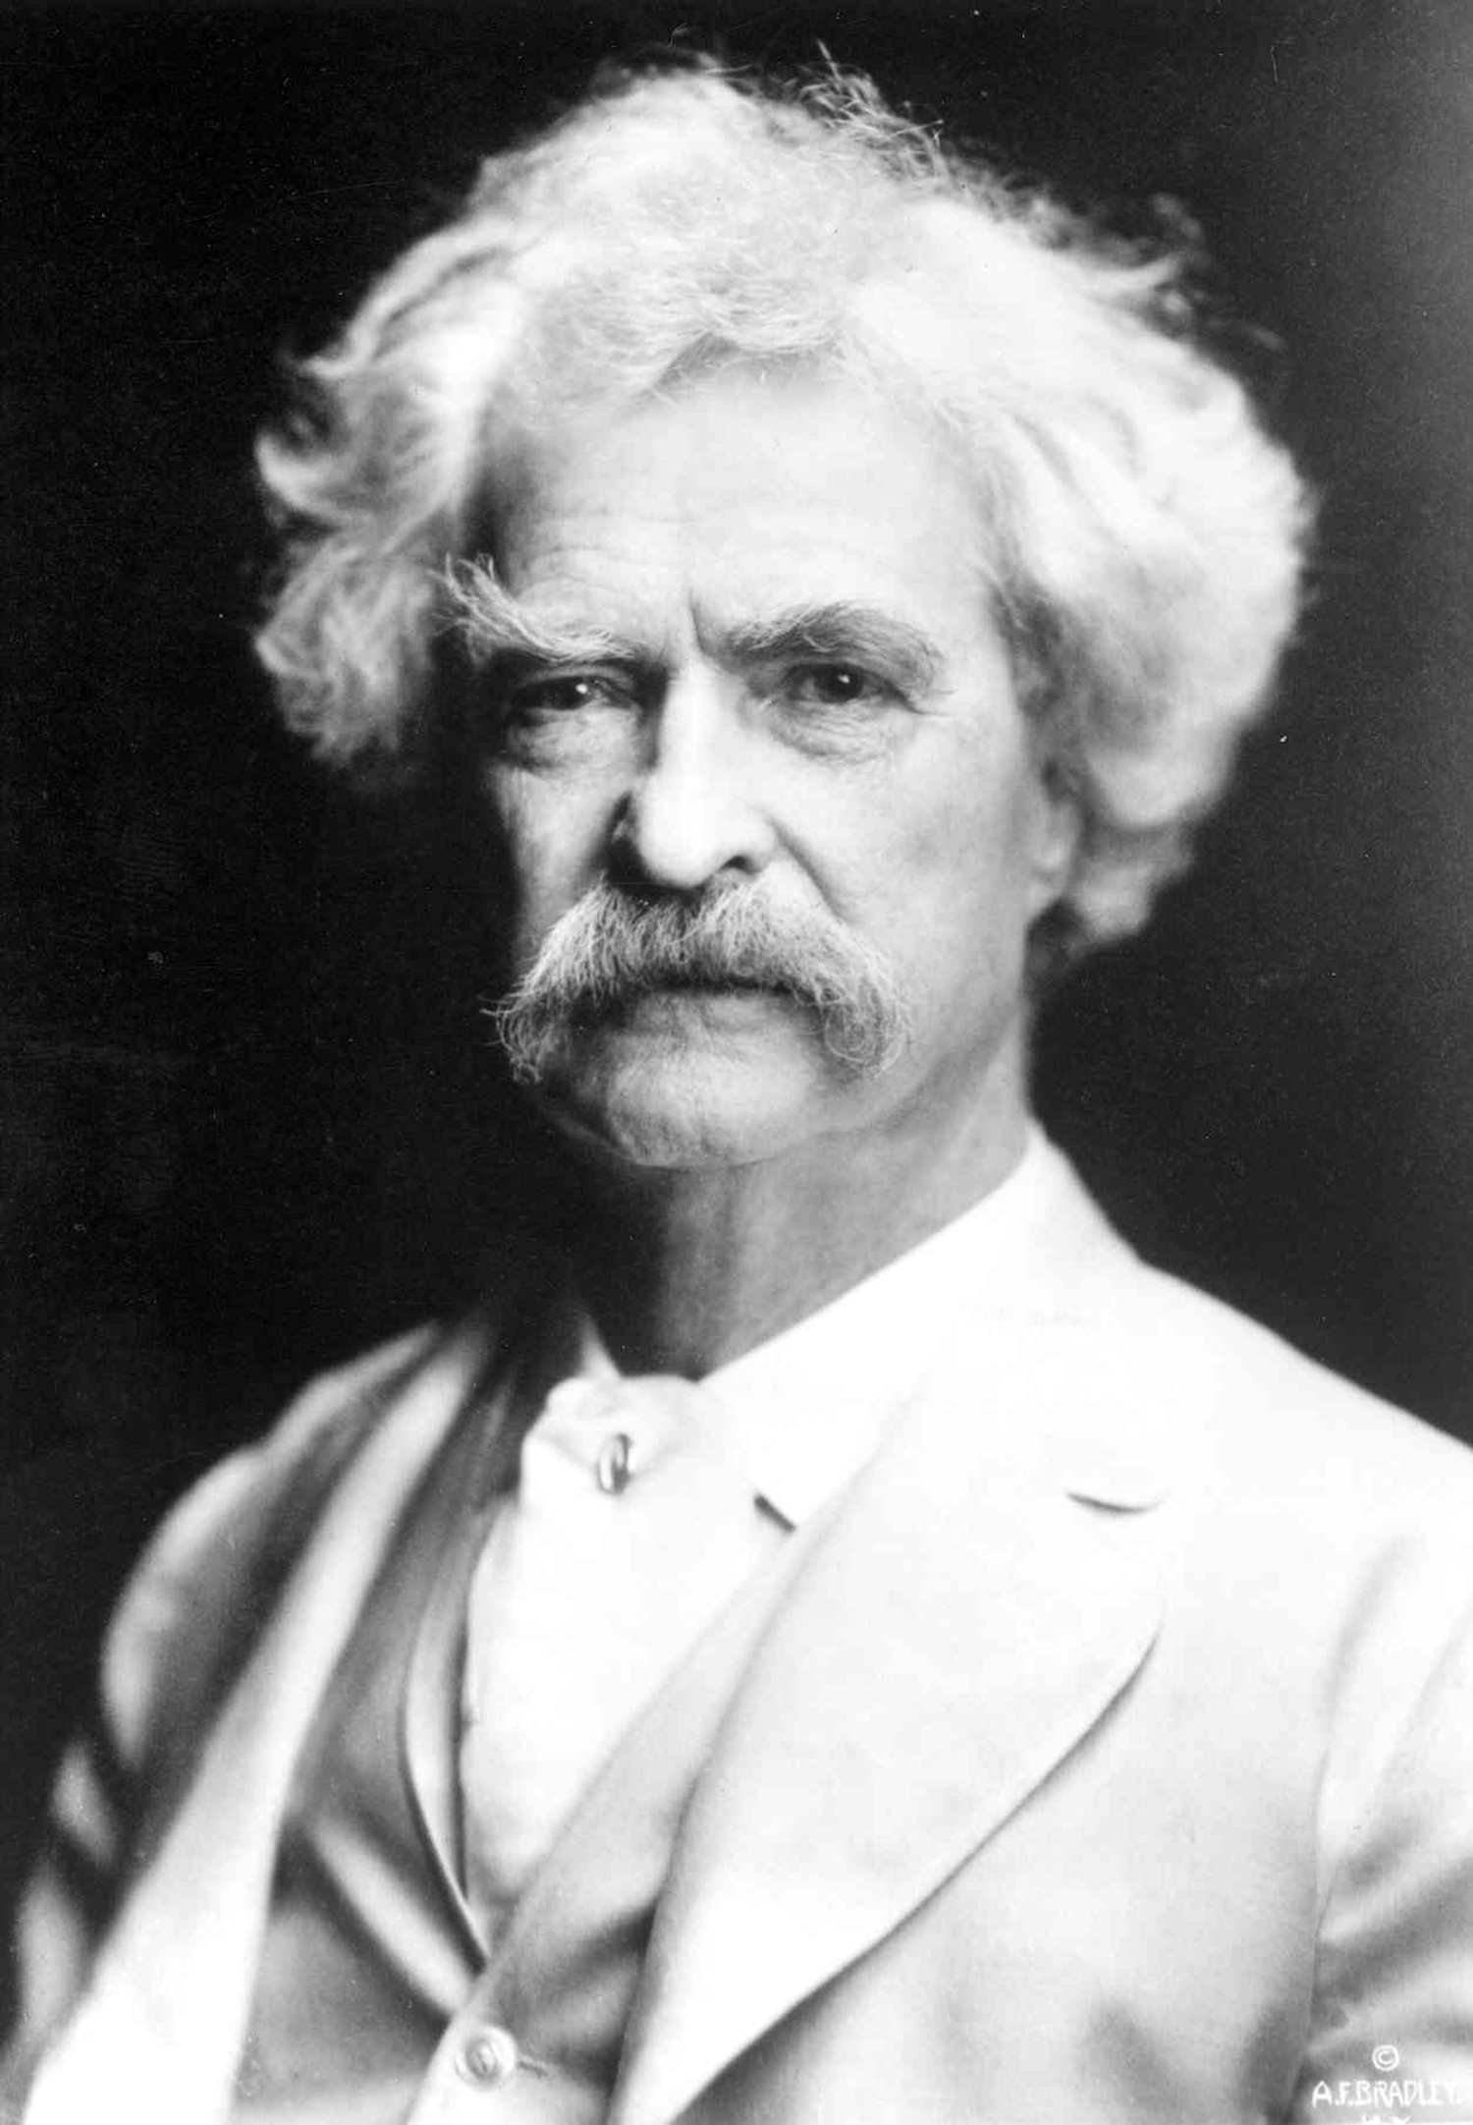
“It’s not what we don’t know that gets us into trouble, it’s what we know that ain’t so”
Mark Twain

Slide 10
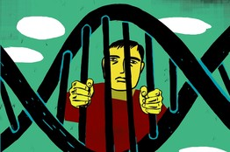
So what else do we know that ain’t so?
You are a prisoner of your DNA.

Slide 11
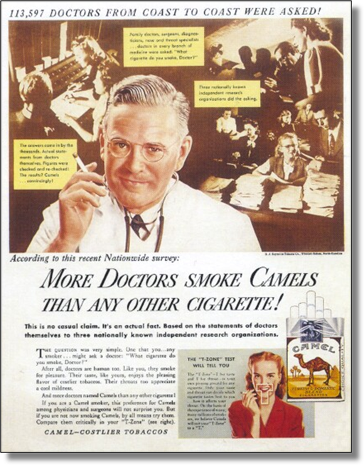
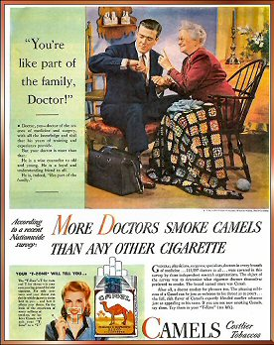
…so what did we once know that turned out not to be so?
…smoking is not bad for your health!

Slide 12
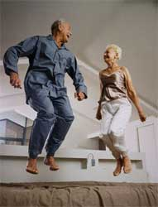
“My doctor told me I am feeling poorly because I am just getting old…”
Opportunity !
Notes:
Rectangularize the health curve
Healthspan…organ reserve

Slide 13
“What we know that ain’t so” If you live long enough you will get hypertension The Relationship Between Systolic BP and Age in Various Populations
Processed-Western diet
Whole-foods, unprocessed diet
High sodium/Low potassium
Lower sodium/Higher potassium

Slide 15
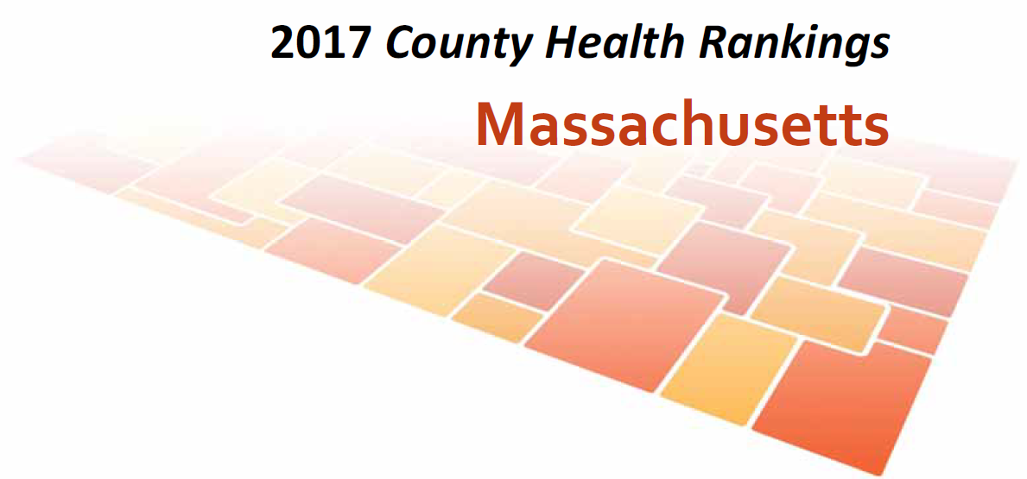
2017 Report

Slide 16
County Health Rankings Model of Population Health

Slide 17
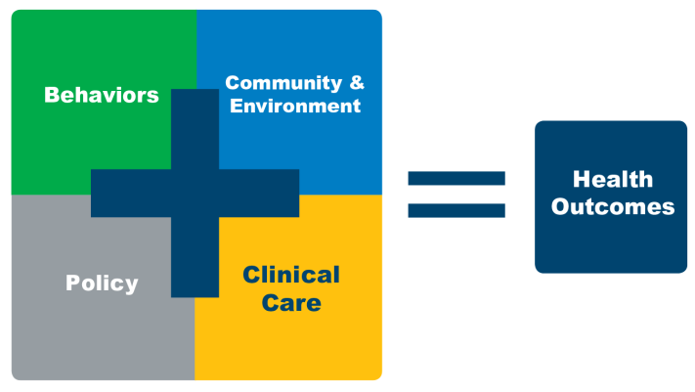
Massachusetts Ranks 2nd in the U.S.
America’s Health Rankings

Slide 18
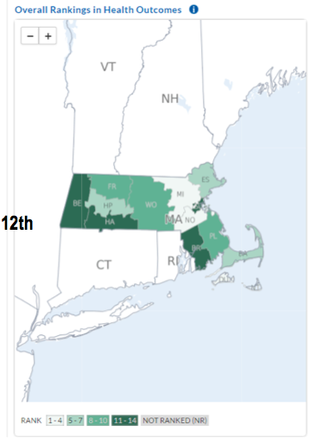

Slide 19
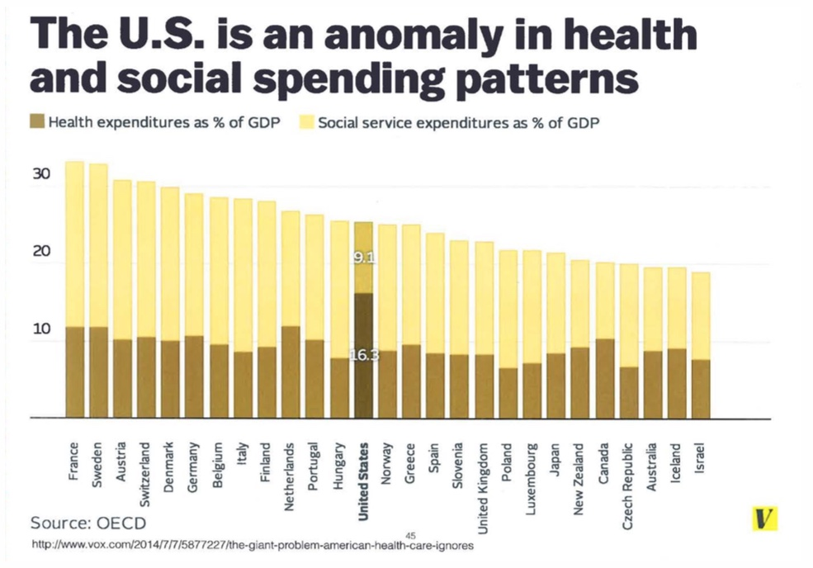

Slide 20
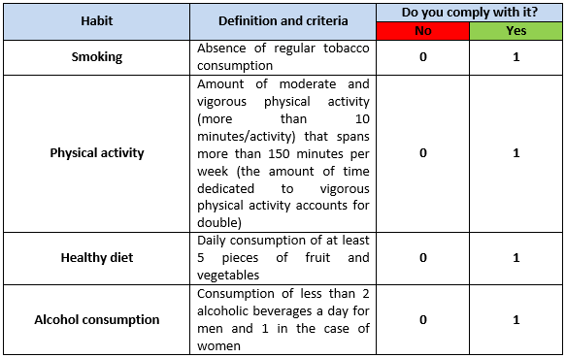
Optimal Lifestyle Metrics

Slide 25
It is estimated that 75% of all health issues are on the basis of lifestyle and preventable.

Slide 26
The Growing Burden of Chronic Complex Disease
7 out of 10 deaths among Americans each year are from chronic diseases. Heart disease, cancer and stroke account for more than 50% of all deaths each year.
In 2015, 140 million Americans – almost 1 out of every 2 adults – had at least one chronic illness.
Obesity has become a major health concern. 70% American adults overweight and almost 40% adults are obese. One in 5 youth between the ages of 6 and 19 is obese.
About one-fourth of people with chronic conditions have one or more daily activity limitations
Approximately 45% of Americans are either diabetic or pre-diabetic!

Slide 27
Health Patterns of Our Children and Young Adults
Asthma: in 1980 - 1 out of 30 kids were diagnosed. In 2010 - 1 out of 10 kids
Allergies: according to JACI, the rate of serious peanut allergies has tripled over the last 10 years
1 in 10 Americans is on an antidepressant
1 out of 4 adults has a “psychiatric” diagnosis
Over 40 million people have anxiety
Over 20 million more have depression
ADHD is a label we now give 8.7% of children between the ages of 8 and 15
Alzheimer’s Disease will affect 30-50% of ALL people > 85 years of age.

Slide 28
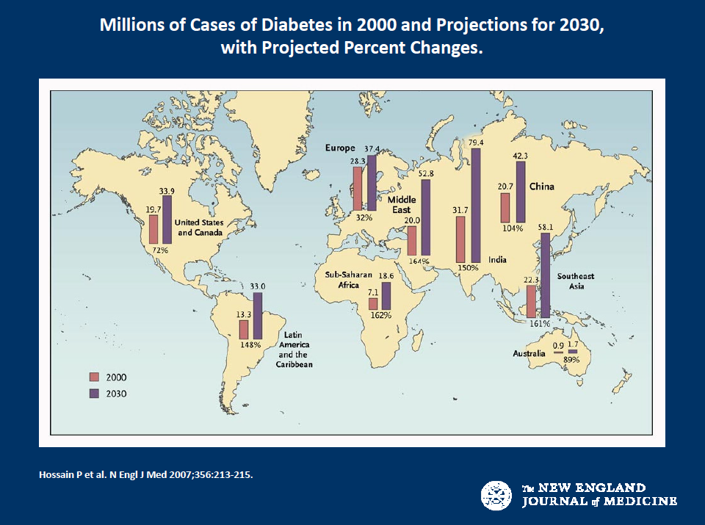
28
Notes:
Today one in four Americans over 60 years old has type 2 diabetes. By 2020, one in two Americans will have pre-diabetes or diabetes.From 1983 to 2008, world-wide diabetes incidence has increased 7 fold from 35 to 240 million. Remarkably, in just the last 3 years from 2008 to 2011, we have added another 110 million to the diabetes roll call. And increasingly small children as young as eight are being diagnosed with type 2 diabetes (formerly called adult onset diabetes). They are having strokes at 15 years old and needing cardiac bypasses at 25 year old. The economic burden of caring for these people with pre-diabetes and diabetes will be $3.5 trillion over 10 years.

Slide 29
29
Notes:
Growth beyond maturity-macroeconomics

Slide 30
There is good news and bad news.
The bad news is…
We can no longer afford our current systems of health care
The good news is…
We are designed to heal ourselves when the conditions are right.

Slide 31
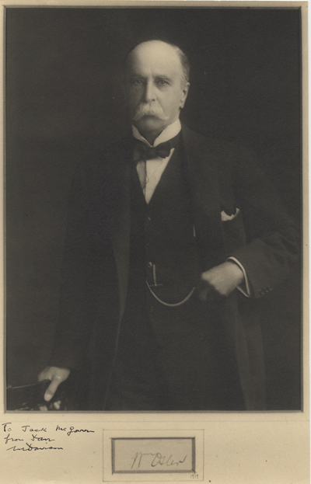
“The one thing that distinguishes man from other creatures is mans desire to take medications”
William Osler 1910

Slide 32
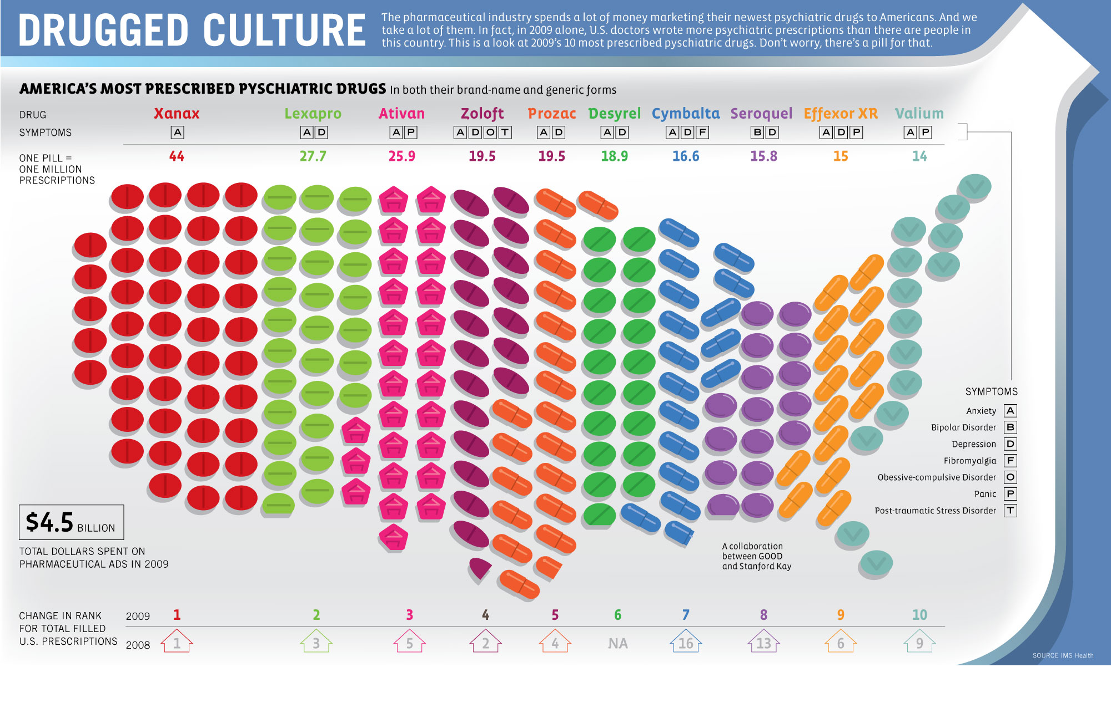
Notes:
Some 253 million prescriptions for antidepressants were written in 2010

Slide 33
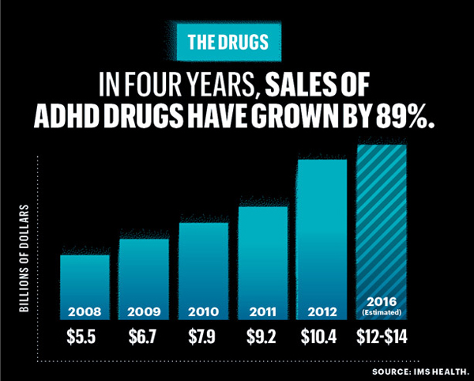

Slide 34
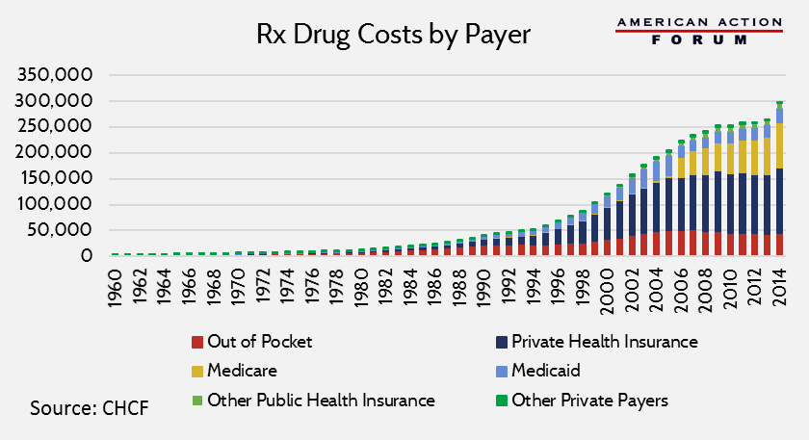

Slide 35
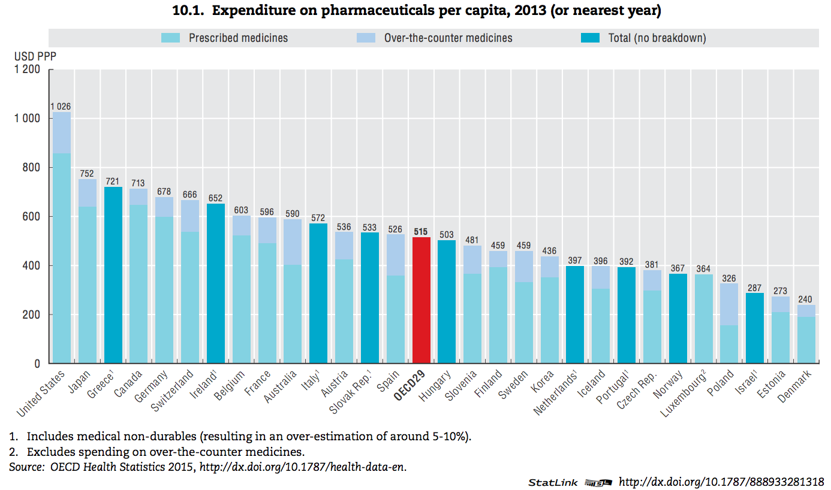

Slide 36
When it comes to health nothing is more important than L________ !
Lipitor
Liposuction
Lipids in my blood
Love

Slide 37
Integrative Holistic Model

Slide 38
Environment and Lifestyle
Life
Gene-Epigenetics
Microbiome
Consciousness/Spirituality

Slide 39
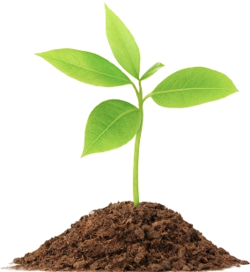
Disease (how things appear)
Pre-diabetes, Diabetes, Obesity, Metabolic Syndrome, Heart Disease, Stroke, Depression, Autoimmunity, Alzheimer’s, Cancer, Autism, ADD, Hypertension
Core Metabolic Imbalances (what drives them)
Inflammation
Fight-Flight (HPA axis)
Microbiome – Leaky Gut
High Insulin levels
Root Causes (what are their origins)
Gene-Environment-Microbiome
Nutrition Movement Stress Response Light Quality
Environmental toxins Sleep Social Connection
Traumatic events Conflict Management Mindfulness Meaning in Work, Love & Play

Slide 40
What are the conditions of your soil?
What am I getting too much of that is undermining my health and how can I reduce it?
What do I need more of that I am not getting to improve my health and how can I bring more of it in?
What would my great grandparents have done if confronting ____?

Slide 41
Health as a byproduct of DNA-environment compatibility

Slide 44
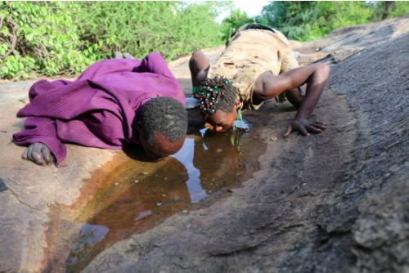
Courtesy Jeff Leach PhD

Slide 45
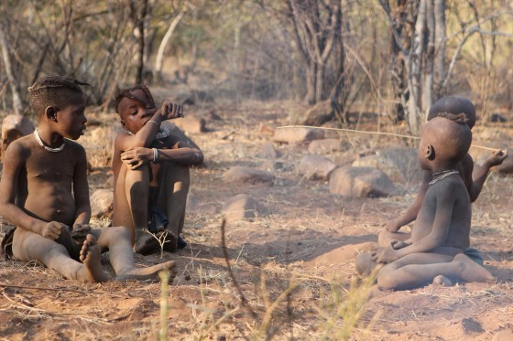
Courtesy Jeff Leach PhD

Slide 46
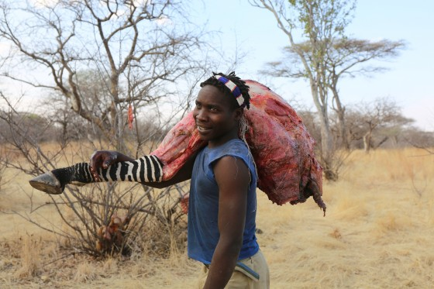
Courtesy Jeff Leach PhD

Slide 48
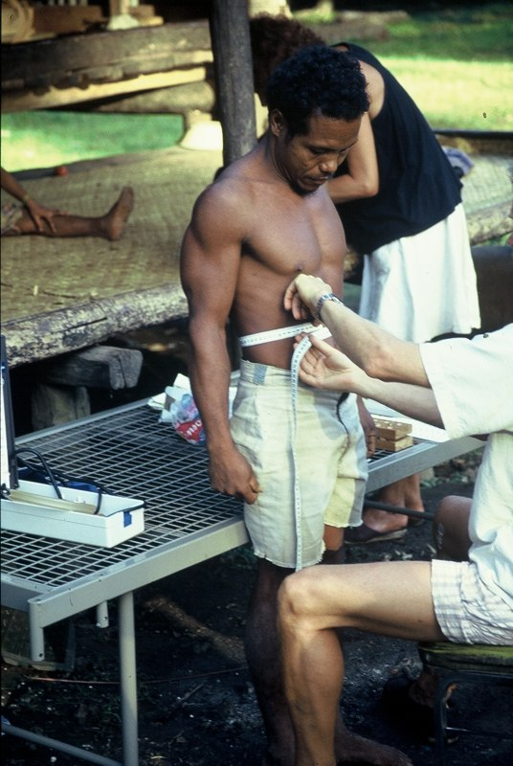

Slide 49
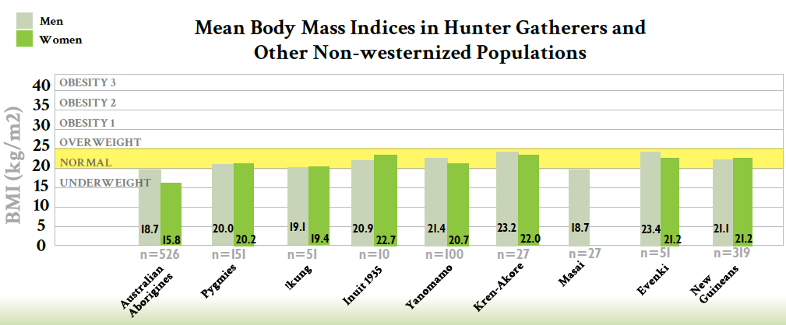
Courtesy Loren Cordain PhD

Slide 50
Environment and Lifestyle
Life
Gene-Epigenetics
Microbiome
Consciousness/Spirituality

Slide 51
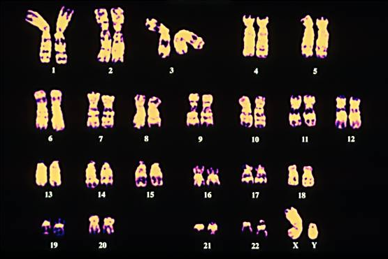
Your “Book of Life” in 23 Chapters

Slide 52
What have we learned from the human genome project?
The genome has far fewer genes than expected ~ 23k
The variation of the genes is far greater than expected with 3 million SNPs
There are only a small number specific “disease genes”.
Our phenotype results from genes and environment that work through our epigenome, nature via nurture

Slide 54
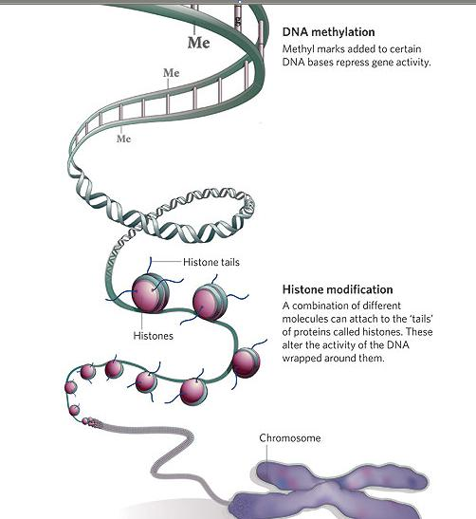
Your epigenome is your “Book of Life’s” memory of prior environmental events and conditions.

Slide 55
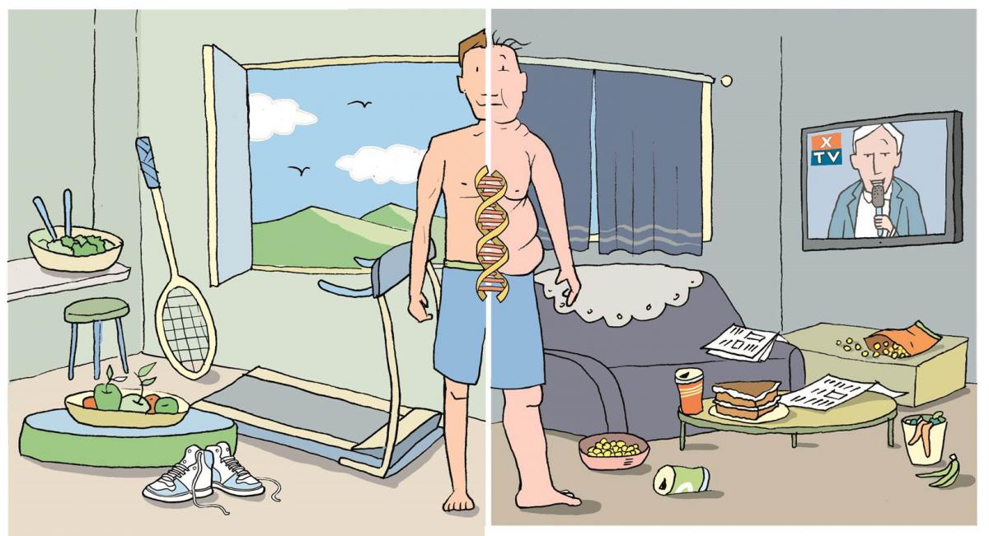

Slide 56
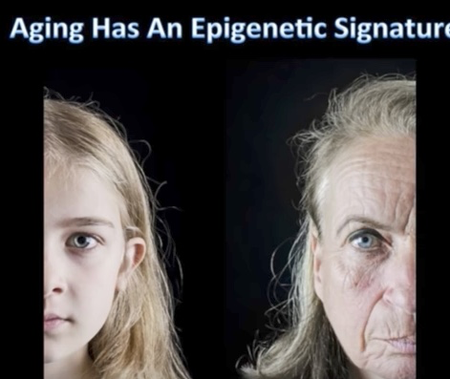
Aging has an Epigenetic Signature

Slide 57
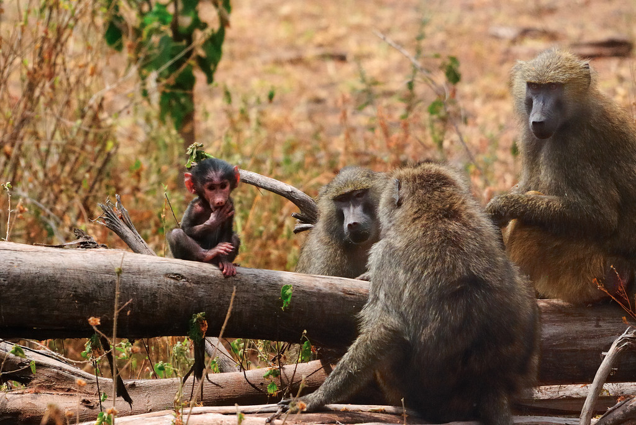
Robert Sapolsky PhD, Stanford

Slide 58
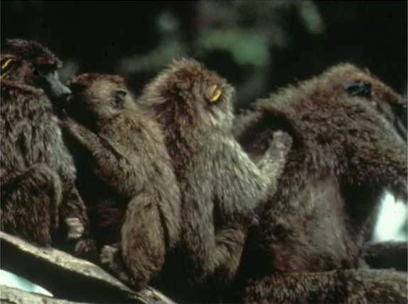
From Robert Sapolsky PhD

Slide 59
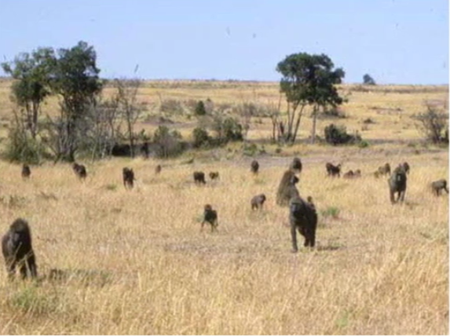
Robert Sapolsky PhD Stanford

Slide 60
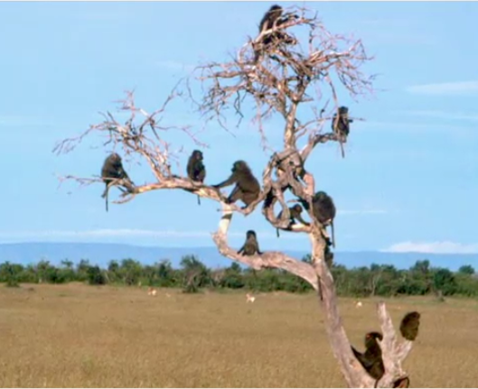

Slide 61
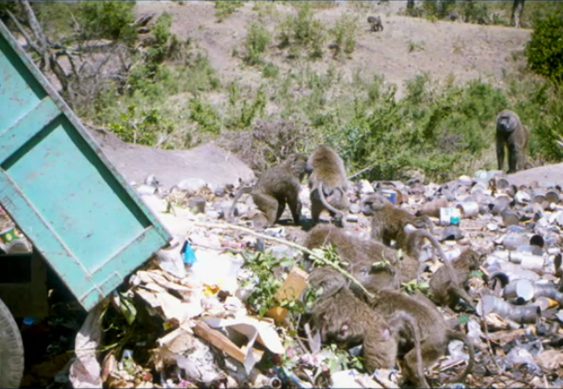
Robert Sapolsky PhD

Slide 62
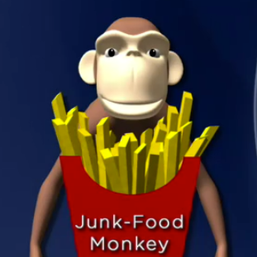
Heavier with increased BMI
Metabolic Syndrome
Insulin resistance with elevated
fasting and post-prandial insulin
levels
Increased TGAs
Move less
Socialize and play less
Less fertile
Die younger

Slide 63
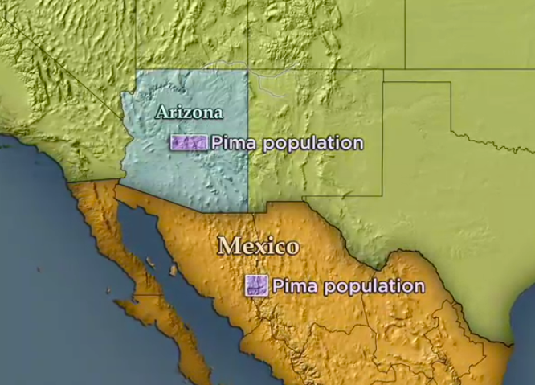

Slide 64
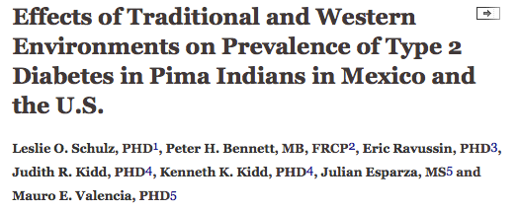
Prevalence of type 2 DM 5 times higher in Arizona Pima’s compared to Mexican Pima’s.
Diabetes Care August 2006 vol. 29 no. 8 1866-1871

Slide 65
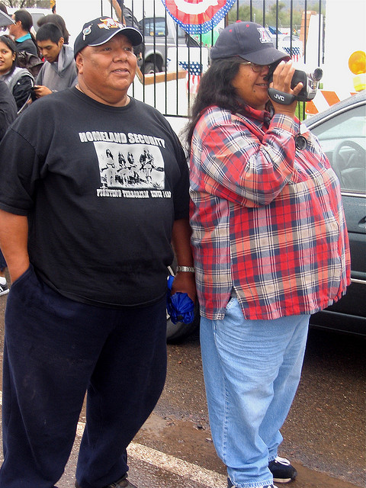
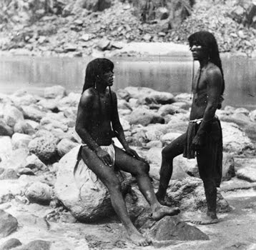
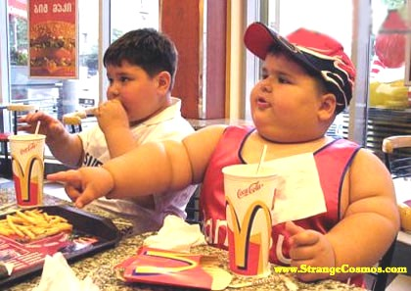

Slide 66
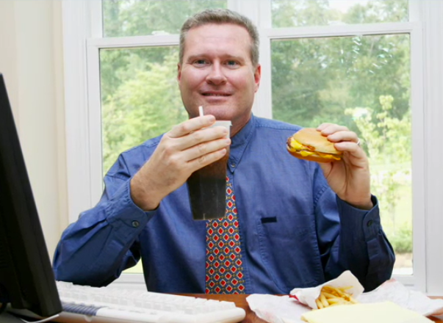

Slide 67
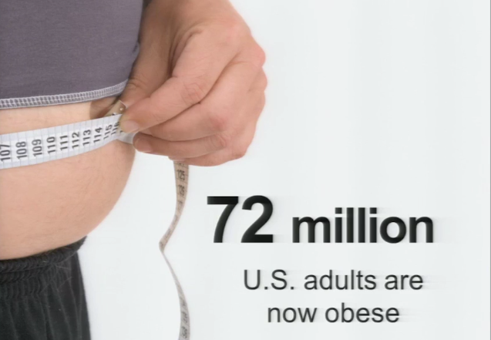

Slide 69
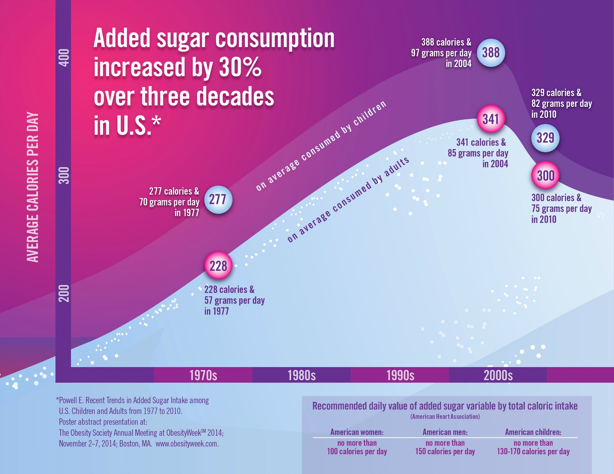

Slide 70
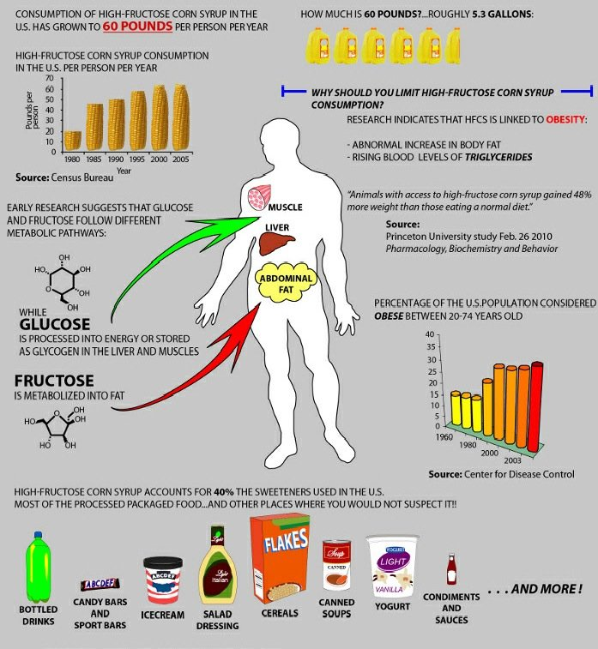

Slide 71
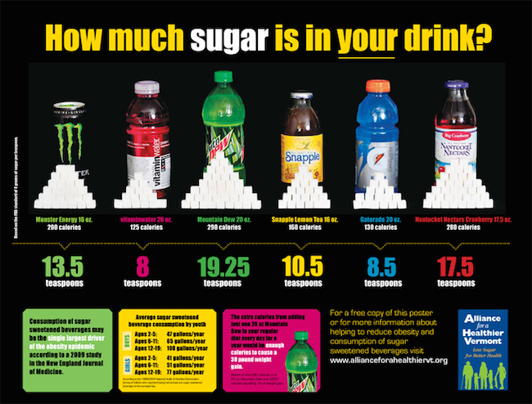

Slide 73
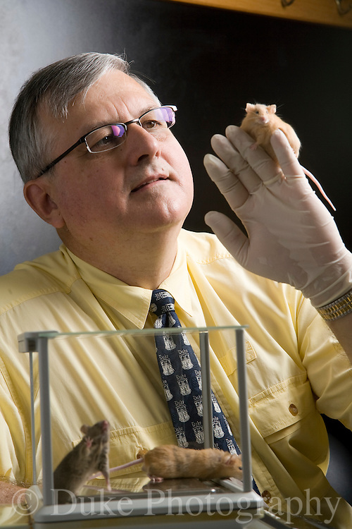
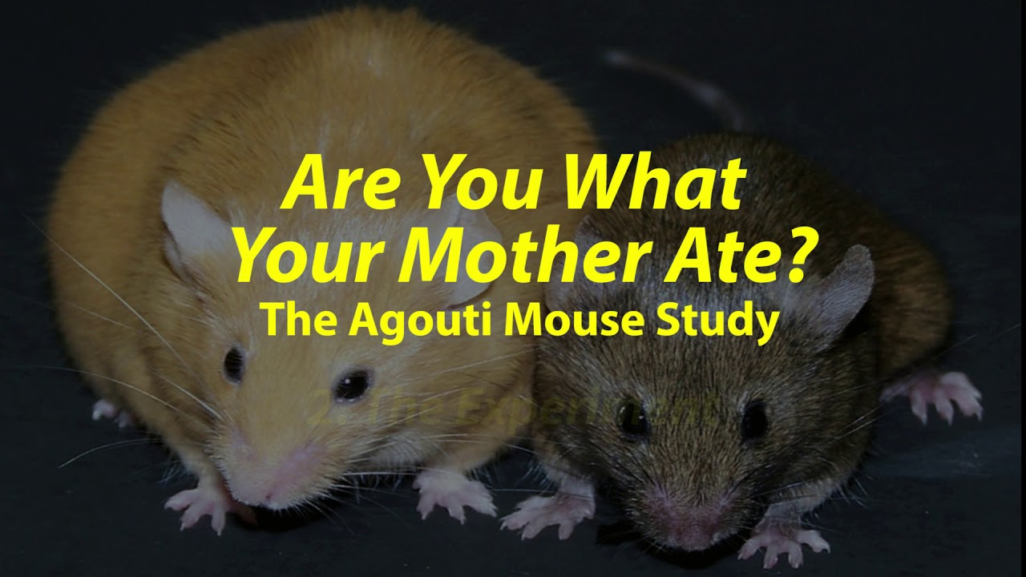
Randy Jirtle PhD
Nutritional Epigenetics

Slide 76
BPA exerts epigenetic effect in both male and female reproduction. In males BPA affects spermatogenesis and sperm quality and possible transgenerational effects on reproductive ability. In women, BPA affects ovary, embryo development and gamete quality.

Slide 77
Environmental Programming of Gene Activity- Bonding
Glucocorticoid Receptor Gene
Child Abuse
Bonding
GR Gene
GR Gene
GR Receptors
GR Receptors
Stress Response
Stress Response
McGowan PO, Sasaki A, D’Alessio AC, Dymov S, Labonte B, Szyf M, Turecki G, Meaney MJ. Epigenetic regulation of the glucocorticoid receptor in human brain associates with childhood abuse. Nat Neurosci. 2009;12(3):342-348.

Slide 78
Conclusions
“These data provide first evidence in humans supporting the conclusion that PNMS results in a lasting, broad, and functionally organized DNA methylation signature in several tissues in offspring. We can infer that the epigenetic effects found in Project Ice Storm are due to objective levels of hardship experienced by the pregnant women.”

Slide 80
MBSR and Reduction in Inflammatory Biomarkers
Several randomized controlled trials demonstrating alterations in gene expression of NFkB, IL-6 with meditation compared to controls (Benson et al)
Increased expression of telomerase and maintenance
of telomere length (Blackburn and Ornish)
Treatment group scored better on emotional wellness
C-reactive protein reduced

Slide 82
Motion is the lotion !

Slide 83
Examined methylation patterns in skeletal muscle of sedentary men and women before and after 45 minutes of moderate-intense exercise.
Methylation patterns changed significantly in genes coding for PPAR gamma, NfΚB and IL-6
Suggestive of more favorable gene expression patterns as they relate to inflammation and insulin signaling.
Lindholm et al. Epigenetics December 2014

Slide 85
Representative Clinical Conditions Suggested to Have Epigenetic Origins
Type 2 DM and Metabolic Syndrome
Coronary artery disease
Autoimmune Diseases
Cancer
Allergic Disorders
Depression
Neurologic: Alzheimer’s, PD, ALS, Autism

Slide 90
Thank You
Remember, you are the one you have been waiting for!
www.thehealthedgepodcast.com

Slide 91
Our behavior is a function of our values as mediated by our perceptions.
B = V × P
What is most important to you about _________?
Help me understand how you see things.

Slide 92
Disclosures
Serve on faculty for The Center for Mind-Body Medicine
Serve on the faculty for The American Meditation Institute
Medical Advisor for Functional Formularies
Clinical Innovator for Novolux Technologies
The Health Edge Podcast (www.thehealthedgepodcast.com)

Slide 97
The ecology of health
What’s good for you is good for the planet and vice versa
Humans, not as individuals, but as part of an ecosystem
Your experience of life is the best teacher
Create new experiences and examine the lessons learned
Greater awareness of cause and effect
Discernment is critical; challenge conventional wisdom if what you are doing is not helping you.
Our modern environment is poorly designed to promote your health.
You are the doctor-healer of you.

Slide 100
Courtesy Vincent Felliti MD, FACP

Slide 101
If you don’t change direction you might end up where you’re heading.

Slide 102
Notes:
Organization for economic cooperation and development 26th life expectancy

Slide 103
Notes:
32nd infant mortality

Slide 104
The Illusion of Knowledge
“The greatest obstacle to discovering the shape of the earth, the continents, and the oceans was not ignorance but the illusion of knowledge.”
~ Daniel Boorstin

