Slide 1
Inflammation and Health:
Are you playing with fire?
Mark Pettus MD
February 22, 2018
Director Medical Education and Population Health
Berkshire Health Systems
Associate Dean of Medical Education
University of Massachusetts Medical School

Slide 2
The Origins of Health …exploring the causes of the causes
Creating Health and Epigenetics: How well do you fit into your genes?
Understanding Weight and Metabolism: How do I turn the fat switch off?
Inflammation: Are you playing with fire?
Gut-microbiome barrier function: Do you have the guts for health?
Relationship between light and health
The science of mind: Neuroplasticity and brain health
Social connection and health
Environmental toxins and health

Slide 3
We do not have to be prisoners of our DNA!

Slide 4
Long-Latency Diseases
Disease (how things appear)
Pre-diabetes, Diabetes, Obesity, Metabolic Syndrome, Heart Disease, Stroke, Depression, Autoimmunity, Alzheimer’s, Cancer, Fibromyalgia, Chronic fatigue
ADDHD, GAD, PTSD, Autism spectrum
Core Metabolic Imbalances (what drives them)
Inflammation
Stress HPA Axis (fight-flight)
Gut Barrier Function
Mitochondria-Bioenergetics
Detoxification
Root Causes (what are their origins)
Microbiome-Gene-Epigenome-Environment
Nutrition Movement Stress Response Environmental toxins Sleep Social Connection Trauma Conflict Management Mindfulness Spirituality-Meaning in Work, Love, Play

Slide 5
Health as a byproduct of gene-environment compatibility

Slide 7
Origins of Health

Slide 8
Most interesting and meaningful attributes of any food
Nutrient density
Impact on glucose and insulin
Impact on the gut microbiome
Macronutrient quality
Phytonutrient complexity
Impact on our immune system

Slide 9
“The Cause of Everything?”
“Inflammaging”

Slide 10
Inflammation is a highly evolved response of our immune systems that protects us after injury, from pathogens and is essential for survival. A system well-designed for acute events can become maladaptive when chronically turned-on.

Slide 11
Causes of Inflammation
Poor Diet
Lack of Movement
Allostatic load: Too much stress to manage
Waistline 36+” in women and 40+” in men
Imbalanced Gut ecosystem-barrier function
Disrupted sleep (circadian rhythm)
Social isolation
Environmental toxins e.g. mold, plastics, glyphosate
? Low vitamin D
History of Tick-borne illness

Slide 12
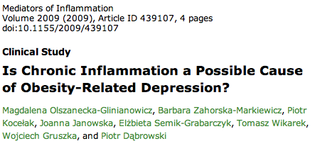
Inflammation

Slide 13
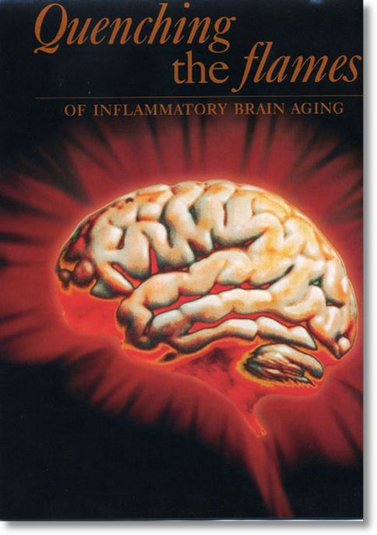
Evidence for increased inflammation in:
Alzheimer’s disease
Depression
Pain
PD
MS
ADD and ADDHD
Brain fog
Anxiety and Panic
Autism spectrum

Slide 14
An Ancient Design For Survival in Modern Times …our design has maintained many of the Stone Age imperatives, but life in the fast lane has not.
Then
Now
Anxiety, fear, PTSD, depression, all chronic, complex diseases
Obesity and Metabolic Syndrome
Autoimmunity and allergy
Heart attack and stroke
Targeted Fight-flight
Energy conservation
Immunity
Promotion of clotting

Slide 15
Causes of Inflammation
Poor Diet
Lack of Movement
Allostatic load: Too much stress to manage
Waistline > 35” in women and 40+” in men
Imbalanced Gut ecosystem-barrier function
Disrupted sleep (circadian rhythm)
Social isolation
Perpetual conflict
Environmental toxins e.g. BPA, mold
Inability to forgive
? Low vitamin D

Slide 16
Food and Inflammation

Slide 18
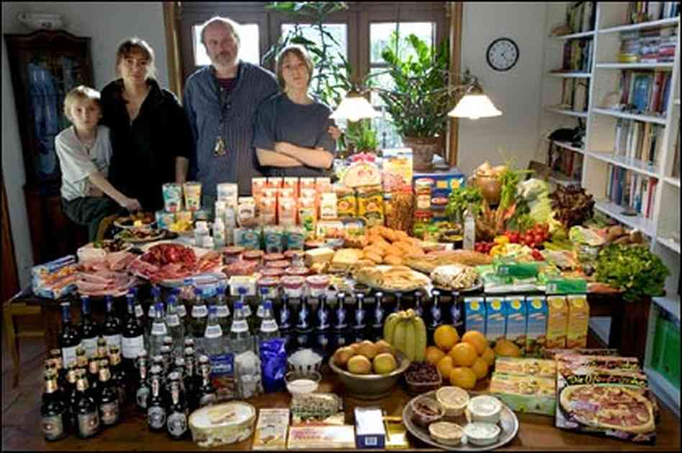

Slide 22
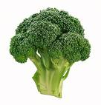
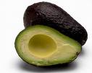
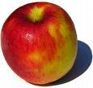
CHANGES IN HUMAN DIETS WITH INTENSIFIED AGRICULTURE, COOKING, AND FOOD PROCESSING
Glycemic Load: More sugar, fructose, flour
Fatty Acid Composition: Omega 3/6 ratio
Macronutrient Composition
Micronutrient Density: Processed foods remove
Sodium-Potassium Ratio: Much too high
Fiber Content: very low- gut microbiome

Slide 23
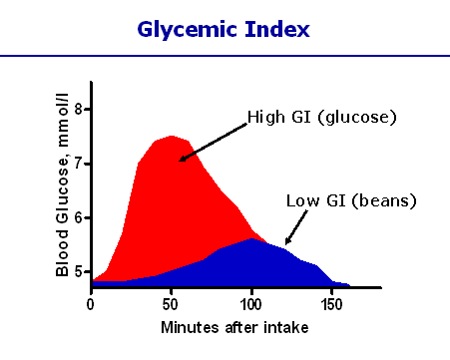
Different carbohydrates produce unique genomic responses!
High Glycemic Carbs Low Glycemic Carbs
62 genes regulating Same genes turned off;
Inflammation, stress, Genes regulating same insulin signaling production turned off. gene responses activated.
Kalle et al. Am J Clin Nutr;2007:851:1417-27

Slide 24
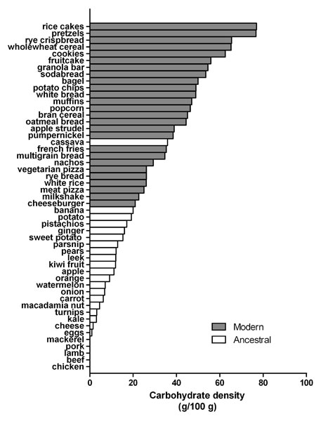
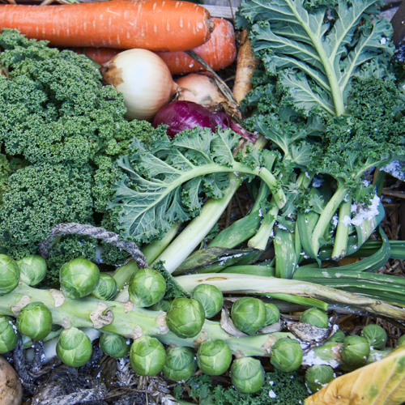
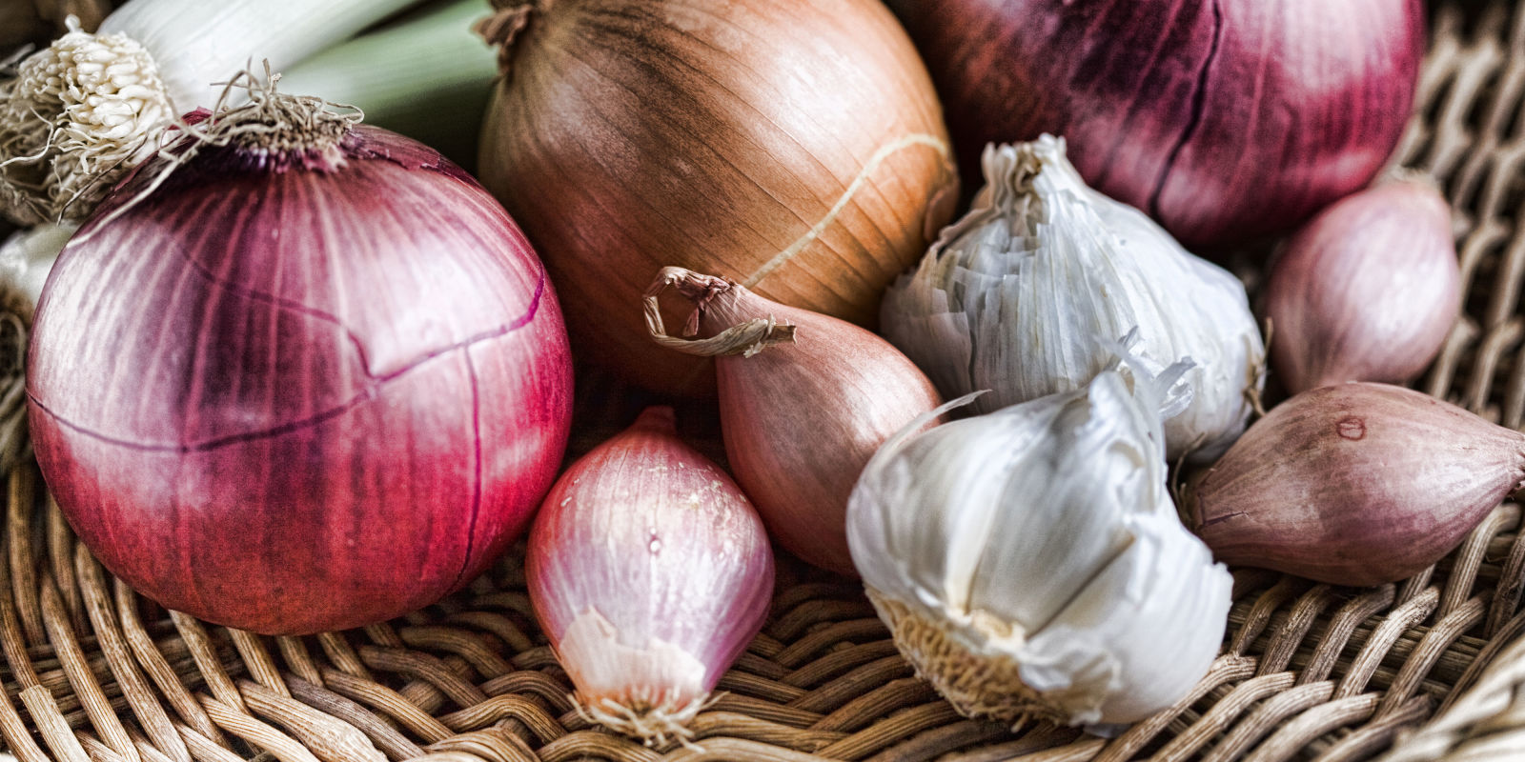
Sugar, Fructose and Carbohydrate-Dense Grains
High-Quality Plant-Based Carbs
Oral and Gut
Microbiome
Protection from:
Inflammation
Diabetes
Cancer
Obesity
Inflammation
Altered neurotransmitters
Insulin Resistance
Weight and Metabolism
Mitochondria-Oxidative stress
HPA axis –Stress Response

Slide 25
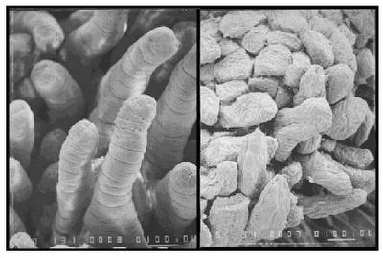
Wheat: Health Considerations
Modern cultivars:
High-Glycemic amylopectin
Changes in Gliadin
Anti-nutrients e.g. lectins wheat germ agglutinin (WGA)
Glyphosate “Round Up” browning – dessication
Effects on microbiome
Deception of “whole grain” labeling
Notes:
References:(i) Ludvigsson JF, Montgomery SM, Ekbom A, Brandt L, Granath F. Small-intestinal histopathology and mortality risk in celiac disease. JAMA. 2009 Sep 16;302(11):1171-8.(ii) Rubio-Tapia A, Kyle RA, Kaplan EL, Johnson DR, Page W, Erdtmann F, Brantner TL, Kim WR, Phelps TK, Lahr BD, Zinsmeister AR, Melton LJ 3rd, Murray JA. Increased prevalence and mortality in undiagnosed celiac disease. Gastroenterology. 2009 Jul;137(1):88-93(iii) Green PH, Neugut AI, Naiyer AJ, Edwards ZC, Gabinelle S, Chinburapa V. Economic benefits of increased diagnosis of celiac disease in a national managed care population in the United States. J Insur Med. 2008;40(3-4):218-28.(iv) Farrell RJ, Kelly CP. Celiac sprue. N Engl J Med. 2002 Jan 17;346(3):180-8. Review.(v) Sedghizadeh PP, Shuler CF, Allen CM, Beck FM, Kalmar JR. Celiac disease and recurrent aphthous stomatitis: a report and review of the literature. Oral Surg Oral Med Oral Pathol Oral Radiol Endod. 2002;94(4):474-478.(vi) Margutti P, Delunardo F, Ortona E. Autoantibodies associated with psychiatric disorders. Curr Neurovasc Res. 2006 May;3(2):149-57. Review.(vii) Ludvigsson JF, Reutfors J, Osby U, Ekbom A, Montgomery SM. Coeliac disease and risk of mood disorders–a general population-based cohort study. J Affect Disord. 2007 Apr;99(1-3):117-26. Epub 2006 Oct 6.(viii) Ludvigsson JF, Osby U, Ekbom A, Montgomery SM. Coeliac disease and risk of schizophrenia and other psychosis: a general population cohort study. Scand J Gastroenterol. 2007 Feb;42(2):179-85.(ix) Hu WT, Murray JA, Greenaway MC, Parisi JE, Josephs KA. Cognitive impairment and celiac disease. Arch Neurol. 2006 Oct;63(10):1440-6.(x) Bushara KO. Neurologic presentation of celiac disease. Gastroenterology. 2005 Apr;128(4 Suppl 1):S92-7. Review.(xi) Millward C, Ferriter M, Calver S, Connell-Jones G. Gluten- and casein-free diets for autistic spectrum disorder. Cochrane Database Syst Rev. 2004;(2):CD003498. Review.

Slide 27
Courtesy Thomas O’Bryan DC, CCN

Slide 28
Courtesy Thomas O’Bryan DC, CCN

Slide 29
Courtesy Thomas O’Bryan DC, CCN

Slide 30
Courtesy Thomas O’Bryan DC, CCN

Slide 31
Courtesy Thomas O’Bryan DC, CCN

Slide 32
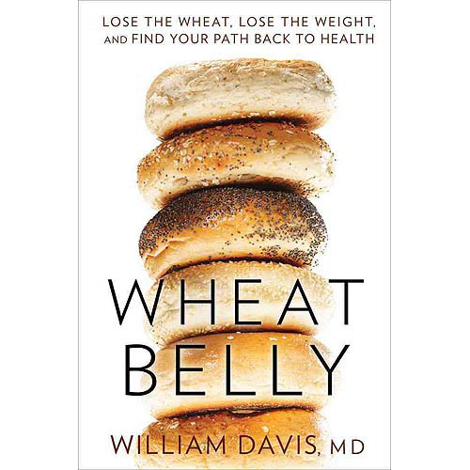
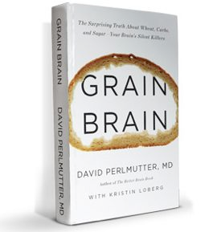

Slide 33
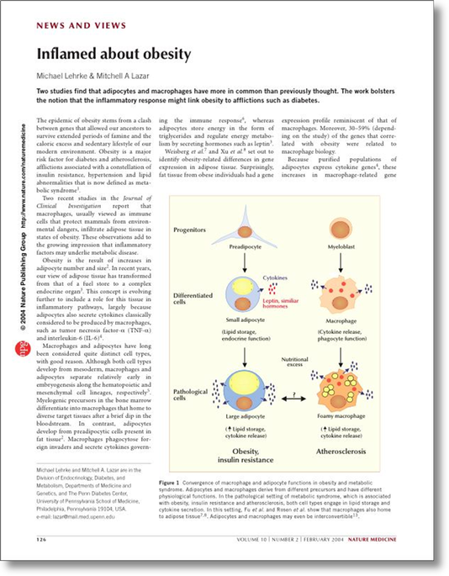
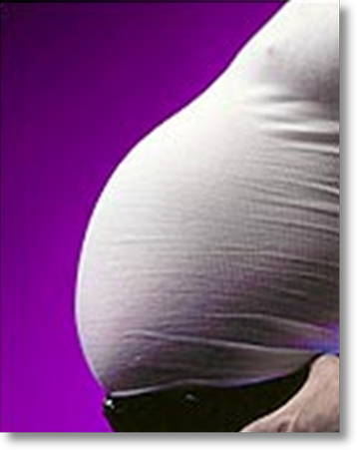
Ideal:
BMI < 25
%Body fat < 25-30%
Origins of Health

Slide 36
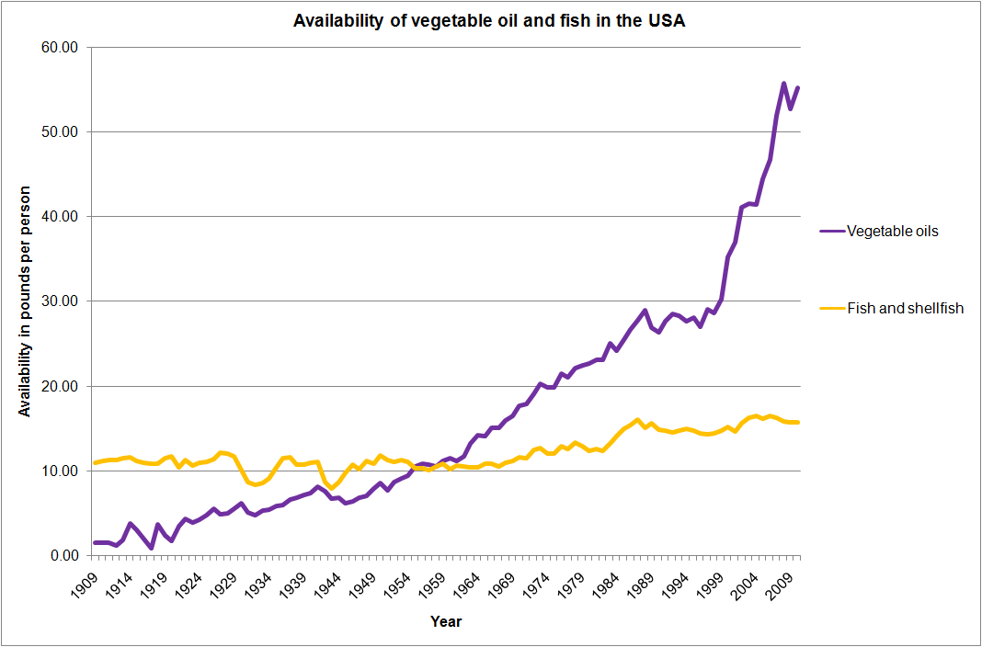
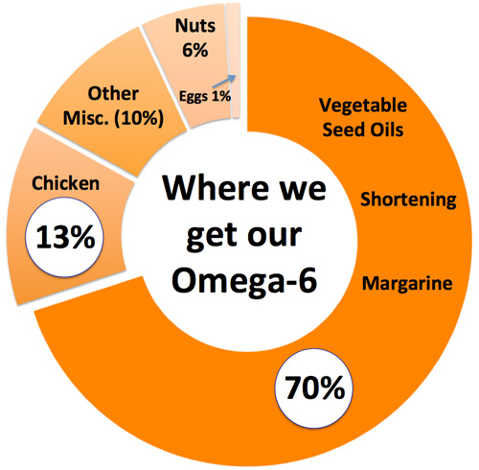

Slide 37
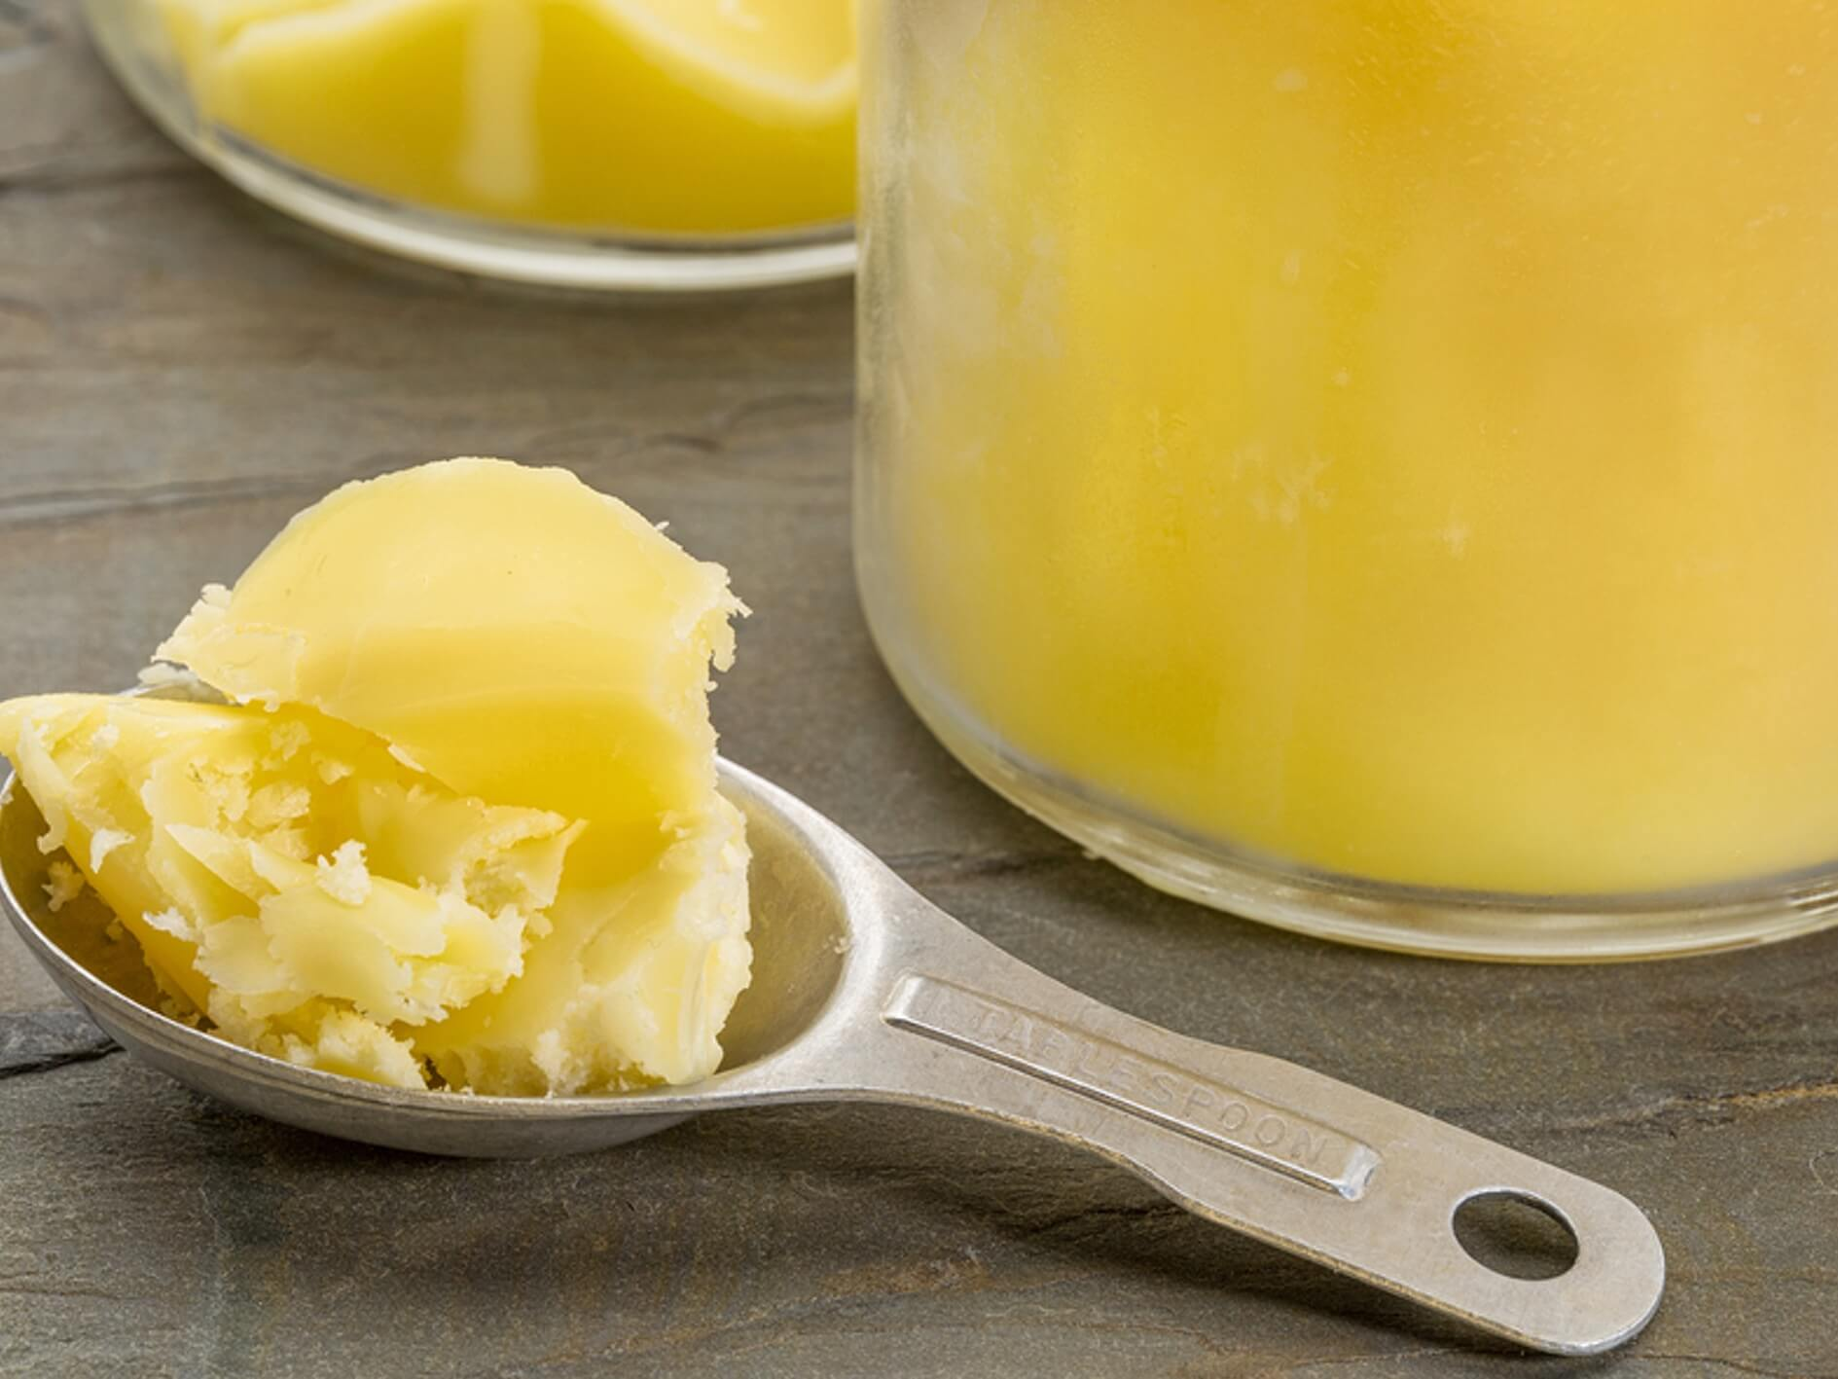
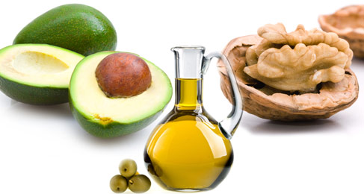
More quality fat sources
Pasture-raised eggs
Fatty fish e.g. salmon, sardines, anchovies, mackeral, trout
Ghee
Grass-fed butter
Whole fat dairy, yogurt
Extra virgin olive oil
Extra virgin coconut oil
Avocados, olives
Nuts - almonds, macadamia, walnuts
Pasture-raised and uncured meats

Slide 38
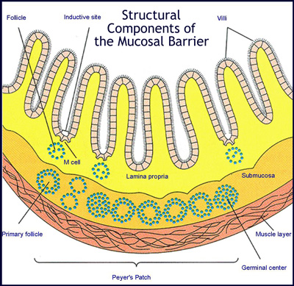
When the barrier breaks down, disease risk increases
Small intestine surface area could cover a doubles tennis court
It is only 1 cell layer thick
Damage can lead to increased permeability of toxins, referred to as “leaky gut” that fuels inflammation

Slide 39
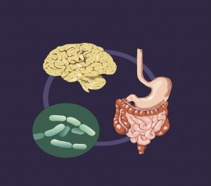
Intestinal Permeability
Uncontrolled Trafficking of Molecules
Food sensitivites
Lectins
Dysbiosis
SIBO
Acid suppression
Stress response
Environmental toxins
Medications e.g. NSAIDs

Slide 40
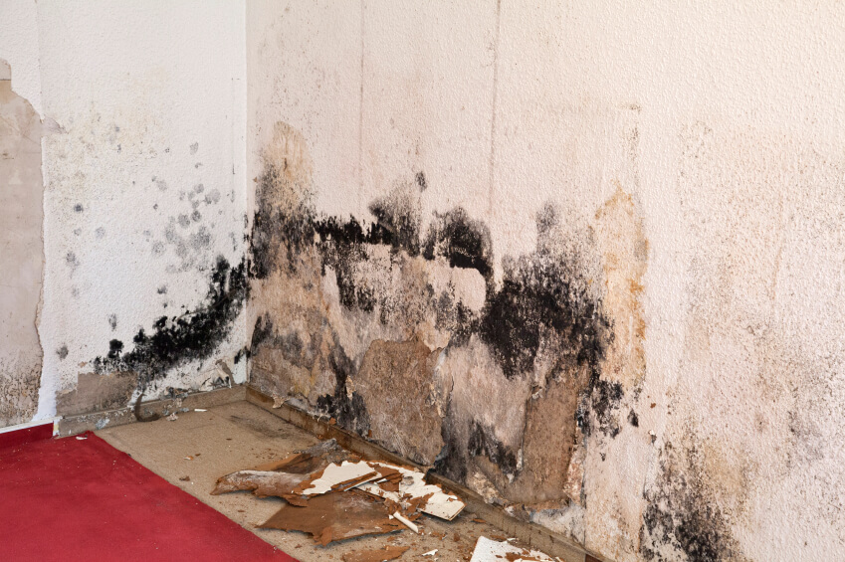
Mold - Biotoxins
Mold Exposure Risk
25 % people with genetic susceptability
2-3% at high risk for illness
50% homes and office buildings with water damage
An overlooked cause of chronic systemic inflammation

Slide 43
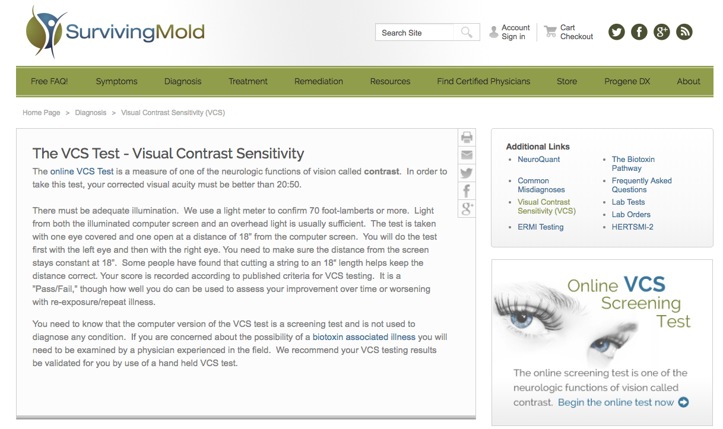
http://www.survivingmold.com/
Dr. Ritchie Shoemaker

Slide 44
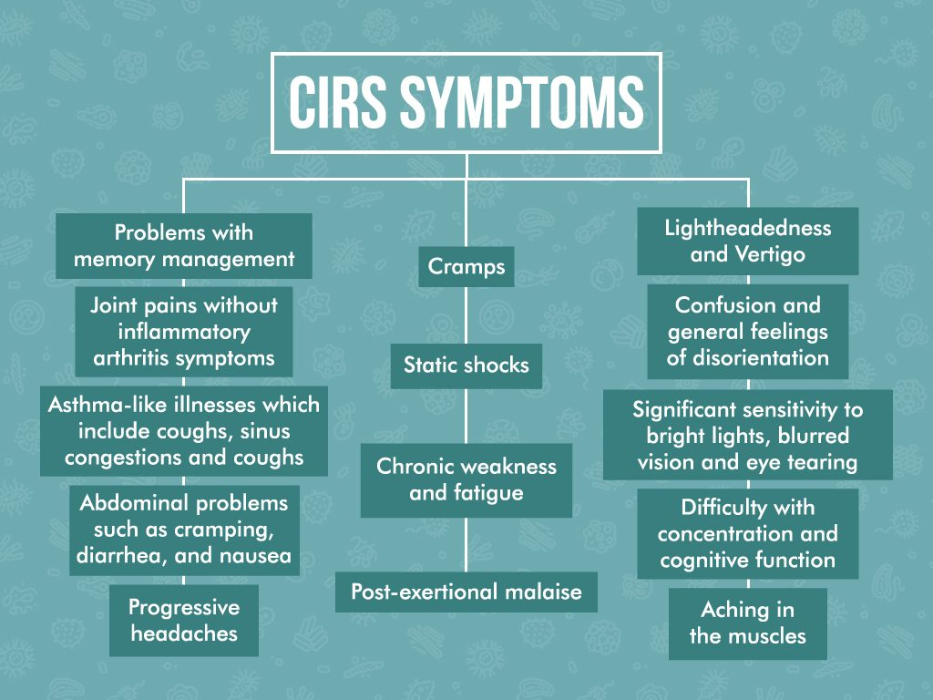

Slide 45
hsC-REACTIVE PROTEIN
Detects hidden inflammation though says nothing of the source(s)
Inflammation is connected to every modern disease not just obvious ones such as asthma, arthritis, or infections
It is associated with heart disease, cancer, dementia, diabetes, obesity, and more.
There is a “range” of normal (ideal < 1)
CV risk factor stratification
Useful to monitor as a biomarker of inflammation in response to lifestyle changes so tracking over time is most helpful

Slide 46
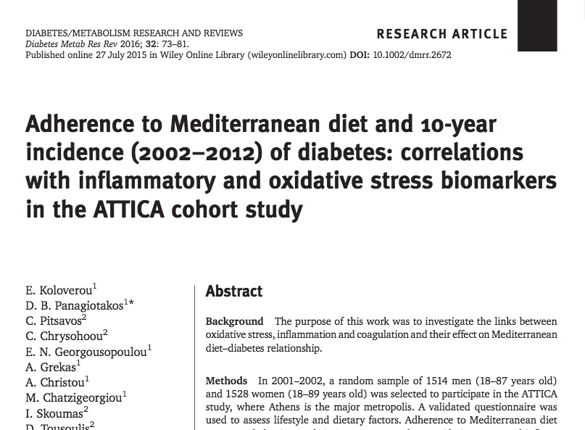
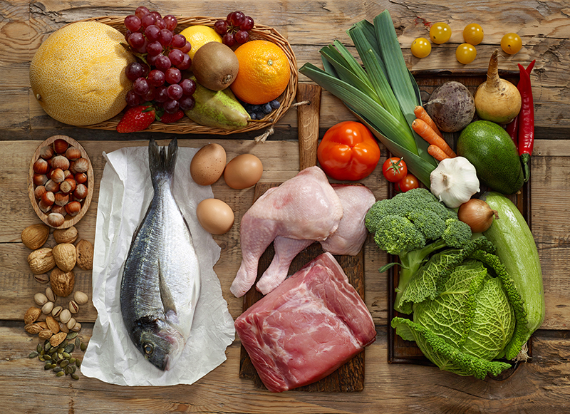

Slide 47
How Do You Treat Inflammation?
“Eat food. Not too much. Mostly plants.” ~ Michael Pollan
Eat whole foods—plant-based diet with a low GL (glycemic load) and high PI (phytonutrient index)
Stop inflammatory foods: processed, refined foods with sugar, HFCS, flour and trans fats; feedlot animal sources e.g. red meat, poultry, dairy
Get an oil change—anti-inflammatory fats such as omega-3 fats from small fish like sardines, sable, herring, and wild salmon, and monounsaturated fats such as avocadoes, nuts, and olive oil.
Consider an elimination trial e.g. grains, gluten, dairy
Red wine
Fiber is essential! 2 cups greens/veggies per day

Slide 48
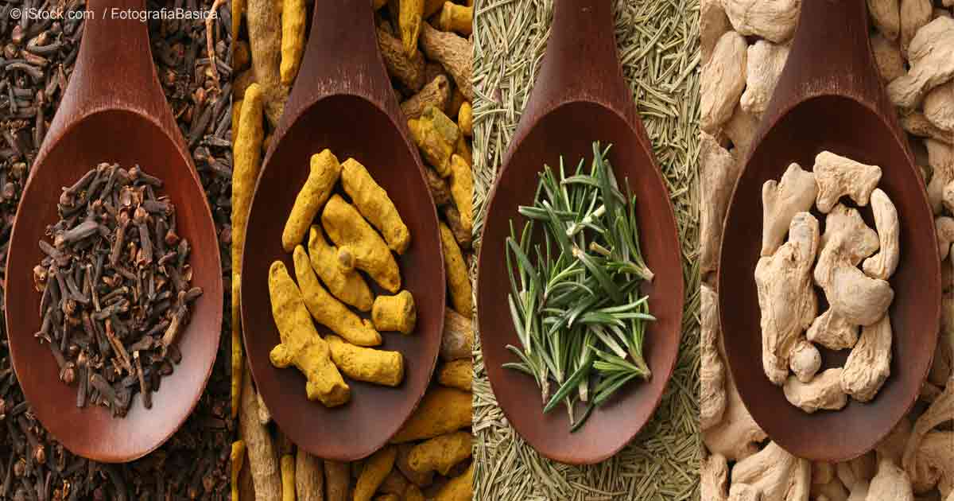
Anti-Inflammatory Spices

Slide 49
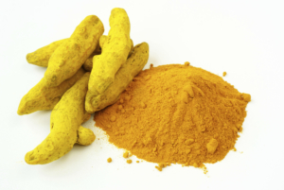
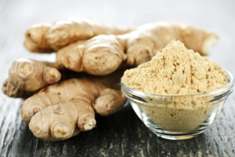
Turmeric
Ginger

Slide 50
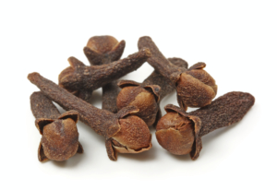
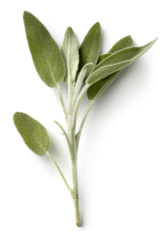
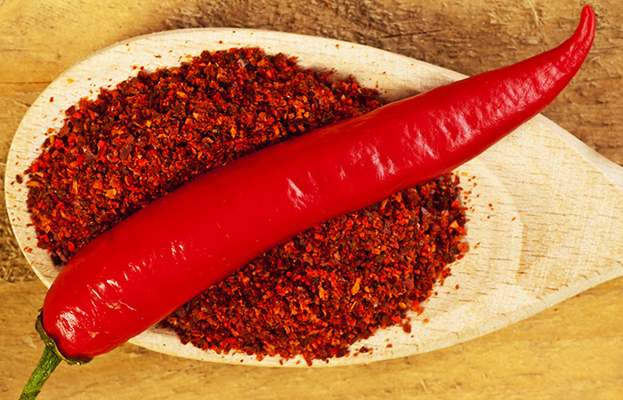
Cloves
Sage
Cayenne Pepper

Slide 51
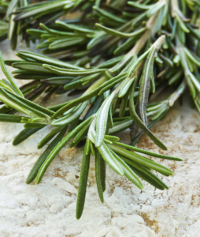
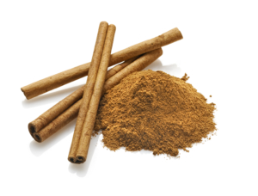
Rosemary
Cinnamon

Slide 52
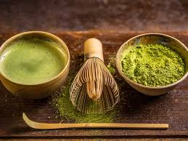
Coffee
Green tea- Matcha

Slide 53
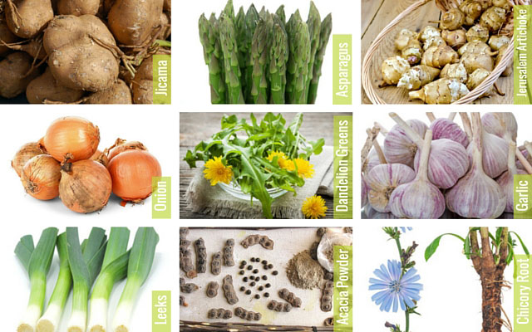
Quality High-Fiber Foods (Prebiotics)
…produce an “anti-inflammatory” gut microbiome

Slide 55
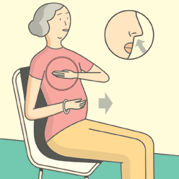
Stress Reduction and Inflammation
Several randomized controlled trials demonstrating alterations in gene expression of inflammation markers e.g. NFkB, IL-6, and C-reactive protein with meditation compared to controls (Benson et al)
Increased expression of telomerase and maintenance
of telomere length (Blackburn and Ornish)
Treatment group scored better on emotional wellness, resiliency

Slide 56
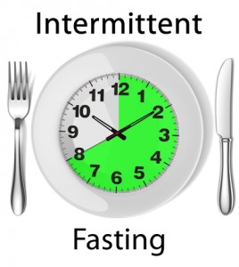
Time-Restricted Eating (TRE)
Time restricted feeding e.g. consume all food within 10-hour
Decreases in body weight and visceral fat
Significant reductions in breast cancer recurrence and improved prognosis (Patterson et al. UCSD)
Improved cardiovascular disease risk profile
Decreased inflammation (Biogerontology. 2015 Dec;16(6):775-88)
Decreased neuroinflammation (Neurobiol Aging. 2015 May;36(5):1914-23)
Autophagy (Autophagy, 2014;10:11, 1879-1882)

Slide 57
Saunas
Really good for health promotion and disease prevention
30” minutes 3-4x/week
Steam or infrared
Stimulates our bodies defense mechanisms

Slide 58
Disrupted Sleep
Loss of entrainment
15% Americans experience chronic insomnia
1 out of 3 has sleep disruption on one or more nights each week
Major risk factor for many chronic complex diseases including obesity
Neuro-endocrine-immune disruption
Obstructive sleep apnea underdiagnosed (neck circumfrence 16+” in women and 17+” in men)
Sleep hygiene

Slide 59
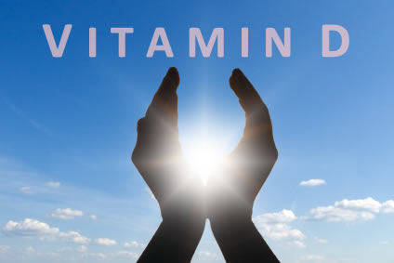
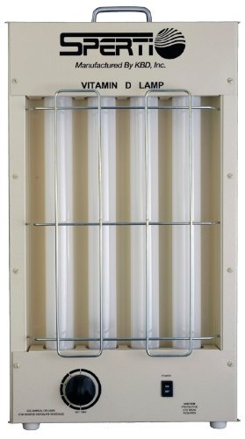
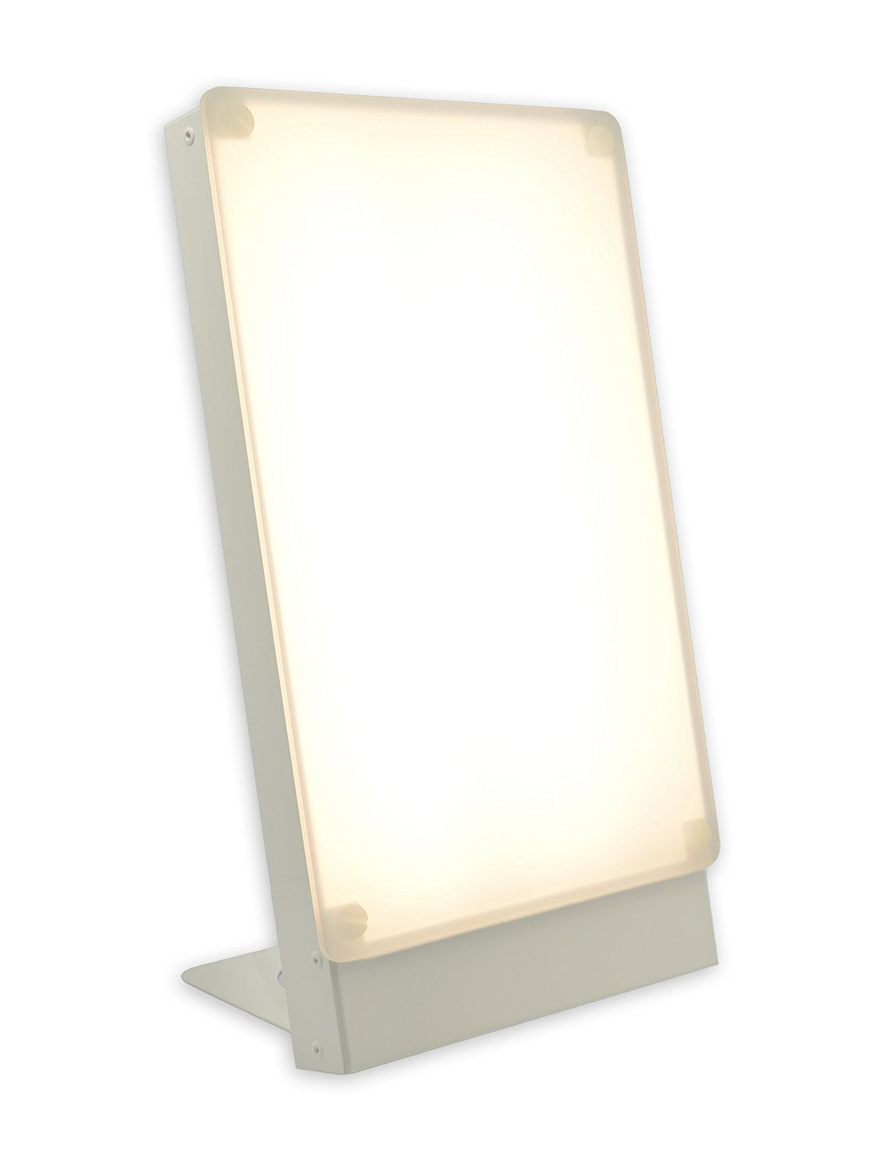
Many epidemiologic studies associate low vitamin D levels with most chronic, complex diseases including cancer.
Sunlight is the ultimate source
Studies suggest a desirable blood level of at least 30 - 50 ng/ml
? Sunlight vs. supplement

Slide 60
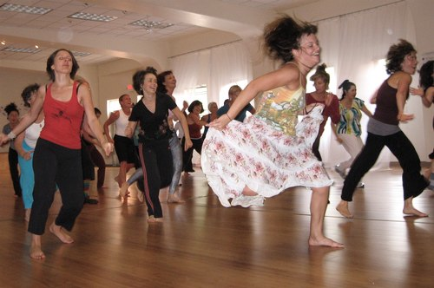
Activity and Movement
Motion is the lotion
Aerobic, resistance, dance
Muscle as a metabolic engine
↓ insulin resistance, ↓ cortisol, ↑endorphins and dopamine
Enhanced strength, resilience, balance, concentration, mood
Decreased cardiovascular, diabetes, cancer risk
Longevity and quality of life profoundly enhanced

Slide 61
An Anti-Inflammatory Lifestyle Script
Whole foods with reductions in sugar, refined grain-based flour, acellular carbohydrate dense foods
More healthy fats e.g. ghee, olive oil, coconut oil, nuts, avocados, butter, fatty fish, eggs (yolks are best)
Plant-based fermentable fiber for the microbiome and nutrient density
Cruciferous, allium, berries great for detoxification
Elimination trial e.g. gluten, refined grains, sugar, casein
Intermittent fasting or time-restricted feeding
Liberal outdoor, full-spectrum light exposure
Sauna
Motion is the lotion!
Stress management e.g. yoga, tai chi, music, breath, meditation
Connection with others: we are born to bond !
Consider evaluation for mold in environment
Notes:
(Stephanie Senef PhD: Entropy 2012, 14, 2265-2290; doi:10.3390/e14112265) GMO

Slide 62
Thank you.

