Slide 1
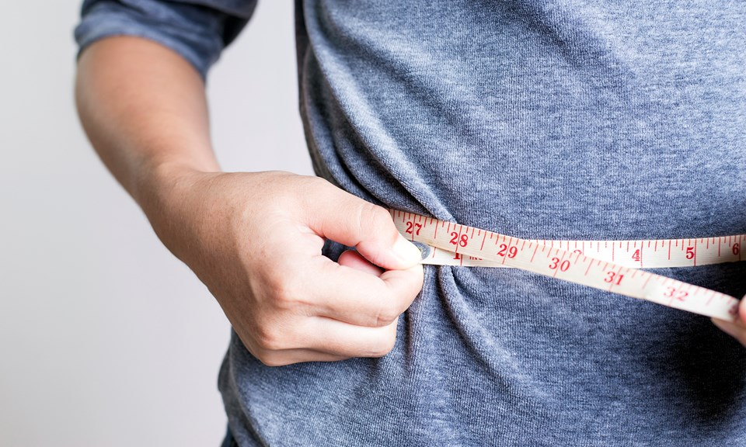
A New Atkins Metabolic Transformation
Inflammation, Insulin Resistance, Metabolism and Life
Mark Pettus
October 25, 2016

Slide 2
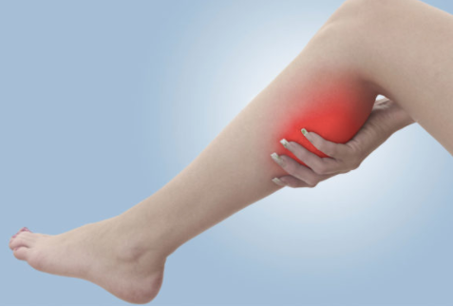
6 possible symptoms when starting a LCHF program
Flu-like symptoms
Frequent urination
Leg cramps
Constipation
Bad breath
Reduced tolerance to alcohol
Aggravation of gallstones

Slide 3
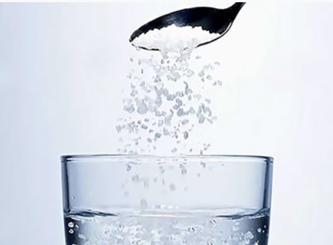
Precautionary steps
Lots of water (tsp salt/8oz) or bone broth, bouillon
Make sure you’re getting enough fat with each meal
Magnesium supplements: 2/day for 3 weeks, then 1/day thereafter (bedtime is a good time)
Miralax each day for constipation
Good oral hygiene; breath mints
Moderate alcohol e.g. 1 drink/day max

Slide 4
If you have HBP and Diabetes
Lightheadedness may be a sign of a drop in BP; bone broth, bouillon, and may need to reduce medications
For symptoms of hypoglycemia e.g. sweating, palpitations, lethargy it is important to self-monitor BS as medications for diabetes frequently need to be reduced
Wellness staff can assist with BP readings and BS results

Slide 5
Environment
Life
Gene-Epigenome
Microbiome
Consciousness-Spirit

Slide 6
15%
55%
SAD
LCHF

Slide 8
Learning Objectives
Challenge the notion of weight loss-management as a simple calorie accounting proposition.
Examine the relationship between macronutrient content, lipogenesis (the biologic imperative to store fat) and leptin-insulin resistance
Review some lifestyle medicine strategies for facilitating and maintaining weight loss.

Slide 13
Five essential clinical pearls
Calorie restriction decreases metabolic rate, enhances hunger and reduces the drive to move. For most, eat less-do more is not an effective or sustainable strategy.
Food is information. Different macronutrients and phytonutrients produce different effects on metabolism e.g. in thermogenesis, neuroendocrine-immune regulation, and on the gut microbiome.
In the battle between mind and metabolism, metabolism will trump most of the time.
The metabolism one hopes to achieve is one that reduces oxidative stress, inflammatory drive, mitochondrial dysfunction and leptin and insulin resistance.
There are many evidence-based modifiable lifestyle interventions known to achieve this.

Slide 14
Prevailing View
Obesity occurs when a person consumes more calories from food than he or she burns.
National Institute of Health
Overweight is the result of caloric imbalance (too few calories expended for the amount of calories consumed) and is mediated by genetics and health.
US Surgeon General

Slide 15
Emerging View
A calorie is not a calorie
Macronutrients elicit different metabolic effects
Quality of macronutrients e.g. glycemic effect will substantially impact metabolic effects (food as information)
Quality of calories more important (and interesting) than quantity of calories
Quality fat sources less harmful than thought

Slide 16
Top 5 most interesting and meaningful attributes of any food
Nutrient density
Phytonutrient complexity
Amount of Microbiota Accessible Carbohydrates (MACs)
Macronutrient quality
To what extent has it been processed

Slide 19
Health as a byproduct of gene-environmental compatibility

Slide 21
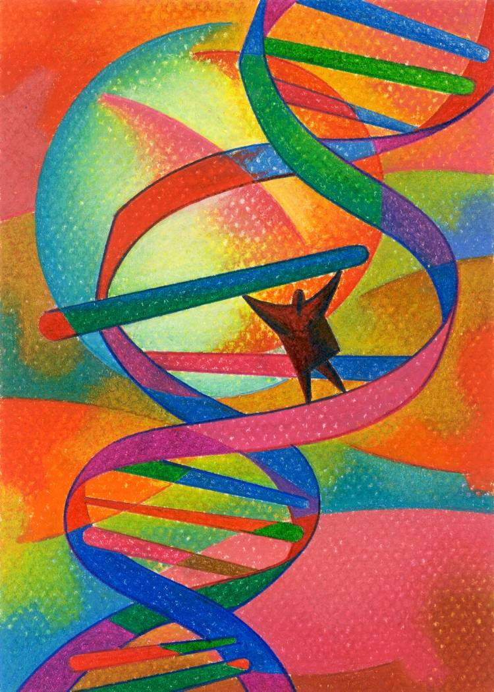
The proposition
All health and disease are byproducts of complex individualized gene-environment interactions that may go back more than a generation before conception and continue throughout our lives.
Your DNA i.e., your “Book of Life” has a Stone Age imperative, not often compatible with 21st century environmental inputs.
This incompatibility creates a distorted metabolic trajectory e.g. inflammation and insulin resistance that forms the basis of chronic complex disease e.g. cardiometabolic syndrome at least in part, via epigenetic pathways.
Through epigenetic alteration, our gene expression patterns can be profoundly modulated to promote optimal function and health throughout the life continuum.

Slide 22
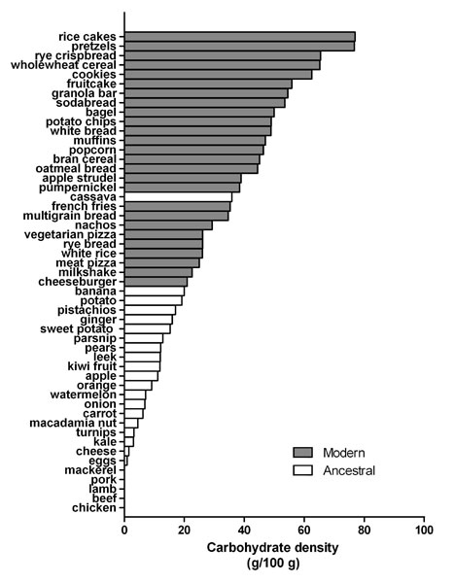
Reduce carbohydrate-dense foods
Major contributor of obesity, insulin resistance, changes in blood lipids, inflammation, and alterations of the organisms in the human microbiome
A huge area of opportunity in individuals with increased belly fat, pre-diabetes or diabetes…these are health features of carbohydrate intolerance.
For most, sugar and refined, grain-based foods are problematic: eliminate and observe.

Slide 23
Poor Quality Carbs
Acellular carbohydrate density
Inflammation
Stress
Sleep disruption
Altered gut-permeability/microbiome
Social isolation
Toxin excess
Sedentary states
VAT
Excess Insulin
VAT Fat storage-lipogenesis
Down-regulation of insulin receptors
Insulin Resistance
Leptin resistance
Eat more and do less

Slide 26
Hyperinsulinemia
weight gain and abdominal obesity
insulin resistance and diabetes
leptin resistance
hormonal dysfunction/anovulation
independent risk factor for heart disease due to effects of insulin on blood vessels
increased risk of breast, prostate, colon, skin and other cancers
Notes:
women in the upper third for insulin level were more than twice as likely to develop breast cancer compared with women in bottom third for insulin level 2009 Intl Journal of cancer
JNCI 1999 >5000 colon cancer assoc w/ elevations in fasting and post prandial BS and insulin levels

Slide 27
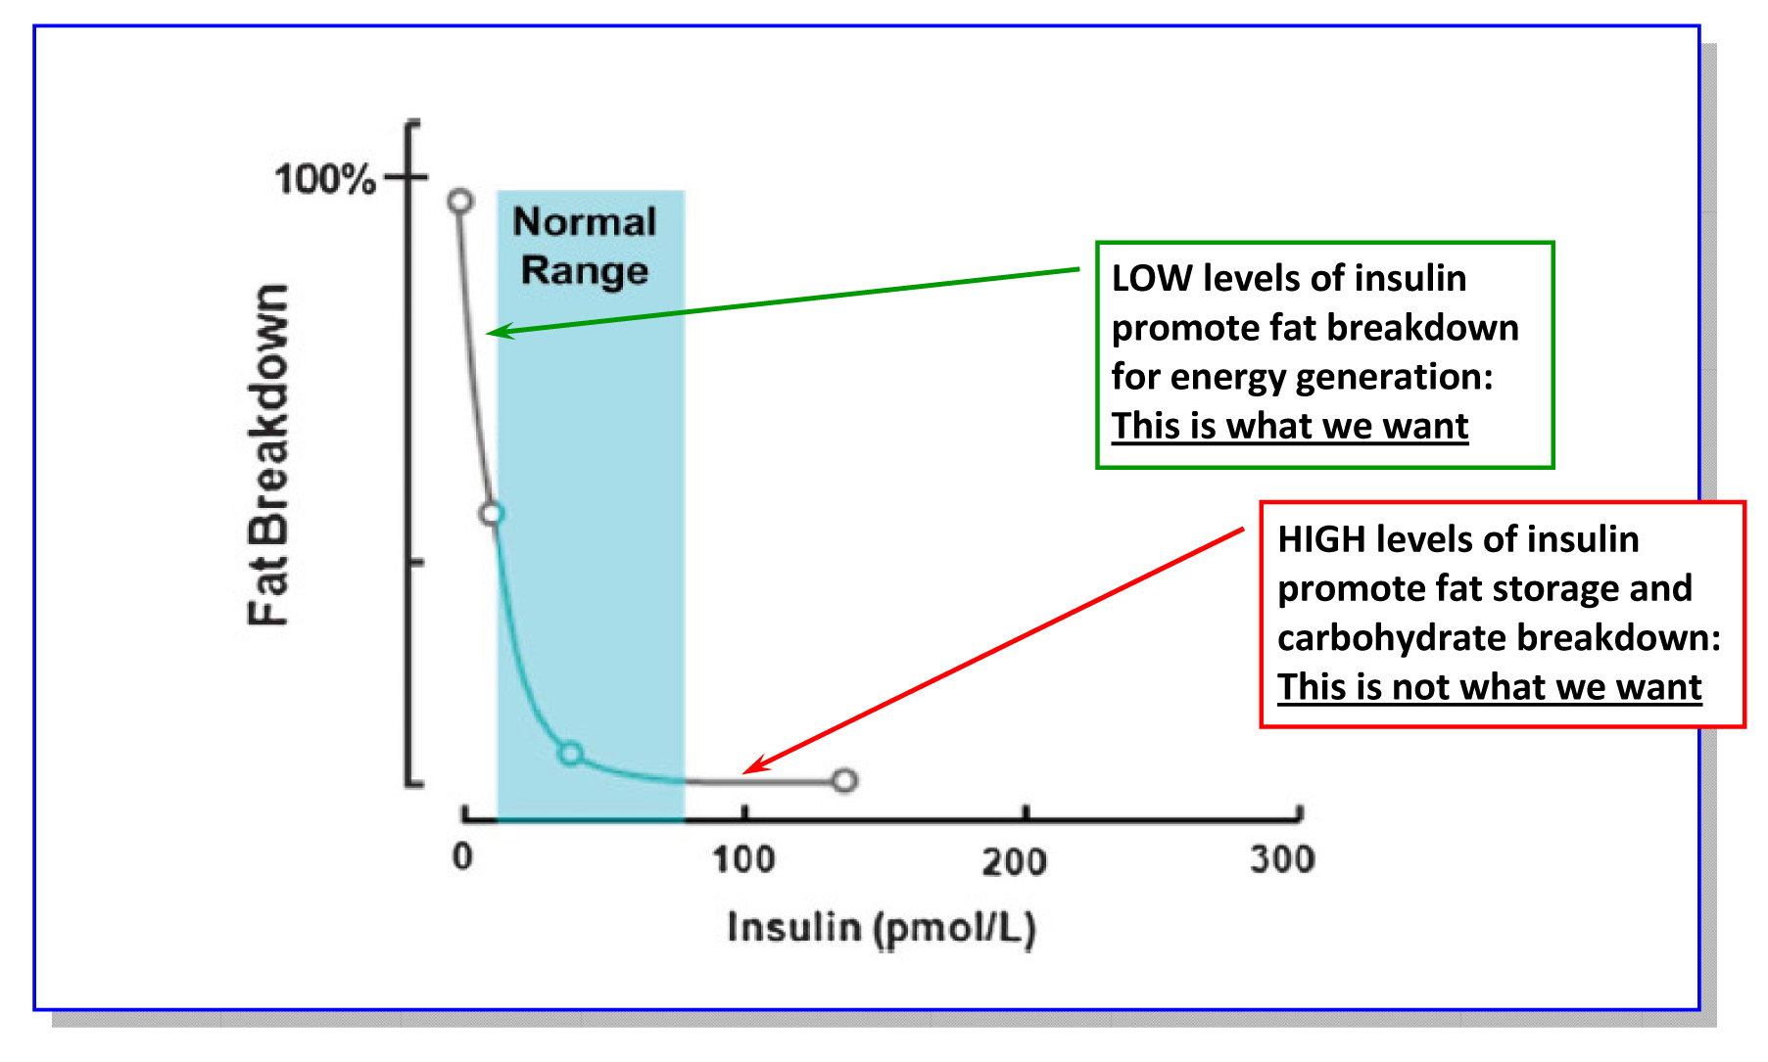
Lipolysis vs. Lipogenesis

Slide 29
Disrupted Sleep
Loss of entrainment
15% Americans experience chronic insomnia
1 out of 3 has sleep disruption on one or more nights each week
Major risk factor for many chronic complex diseases including obesity
Neuro-endocrine-immune disruption
Obstructive sleep apnea underdiagnosed (neck circumfrence 16+” in women and 17+” in men)
Sleep hygiene

Slide 30
Stress Management
Meditation, prayer, relaxation response, guided imagery, yoga, tai chi, biofeedback, gratitude journal
HRV-HeartMath
Decreased cortisol, flight-fight response, BP,
Increased parasympathetic tone
Improved mood, concentration, pain tolerance, resilience
Positive epigenetic effects on inflammation, insulin sensitivity and energy efficiency e.g. mitochondrial health
Decreased cardiovascular risk
Enhanced neuroplasticity

Slide 31
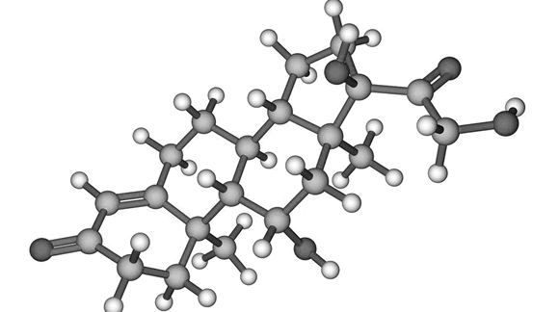
Summary: Enhancing metabolic efficiency: …. Reduce inflammation, insulin and leptin resistance
Eliminate – reduce sugar-fructose in all it’s forms
Eliminate-reduce refined grain flours, and carbohydrate-dense processed foods.
Reduce hydrogenated oils and processed seed oils cooked at high temperatures
More abundant healthy fats sources e.g. extra virgin olive oil, fatty fish, grass-fed butter; extra virgin coconut oil (MCT Oil); pasture-raised animal fat, ghee, avocados, nuts (almonds, walnuts and macadamia) and nut butters

Slide 32
Summary: Enhancing metabolic efficiency: …. Reduce inflammation, insulin and leptin resistance
OK to consume pasture-raised meats and eggs
Gut health-microbiome: dysbiosis, SIBO, intestinal barrier function; more MACs and fermented foods; probiotics
Motion is the lotion: PAI-Physical Activity Intelligence
Lower stress (HeartMath)
Environmental toxins e.g. ewg.org Dirty Dozen, BPA, cosmetics
Circadian rhythm – sleep entrainment; sleep hygiene
Full spectrum light

Slide 33
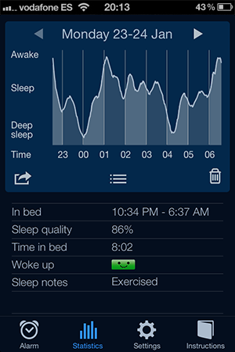
Apps
ewg.org Food Scores, Dirty Dozen, Skin Deep
Sleep Cycle
f•lux (filters blue light)

Slide 34
Thank You !

Slide 35
A calorie is not a calorie…
Effects of Dietary Composition on Energy Expenditure During Weight-Loss Maintenance
Cara B. Ebbeling, PhD; David S. Ludwig, MD, PhD et al
Conclusion: Among overweight and obese young adults compared with pre–weight-loss energy expenditure, isocaloric feeding following 10% to 15% weight loss resulted in decreases in REE and TEE that were greatest with the low-fat diet, intermediate with the low–glycemic index diet, and least with the very low-carbohydrate diet.
Remarkable range between individuals
TEE: - 423 [–606 to –239] kcal/d for low fat diet
- 57 [–281 to 86] kcal/d for low carb diet
Equivalent of 1-hr moderate effort cardio difference
JAMA. 2012;307(24):2627-2634. doi:10.1001/jama.2012.6607
Notes:
TEE differed by approximately 300 kcal/d between these low fat and low carb diets, an effect corresponding with the amount of energy typically expended in 1 hour of moderate-intensity physical activity.

Slide 37
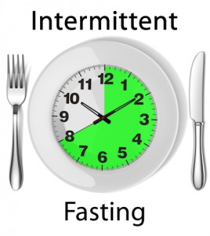
Intermittent fasting
Time restricted feeding (6-8 hrs) or complete periods of fasting for 24 hrs.
Decreases in body weight and visceral fat
Improved cardiovascular disease risk profile
Decreased inflammation (Biogerontology. 2015 Dec;16(6):775-88)
Decreased neuroinflammation (Neurobiol Aging. 2015 May;36(5):1914-23)
Autophagy (Autophagy, 2014;10:11, 1879-1882)

Slide 38
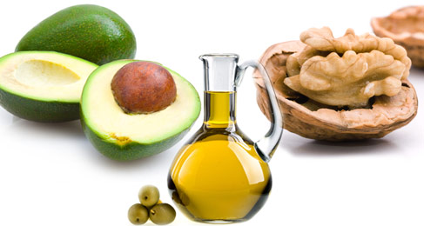
More quality fat sources
Pasture-raised eggs
Fatty fish e.g. salmon, sardines, anchovies, mackeral, trout
Grass-fed butter
Whole fat dairy, yogurt
Extra virgin olive oil
Extra virgin coconut oil
Avocados, olives
Nuts - almonds, macadamia, walnuts

Slide 45
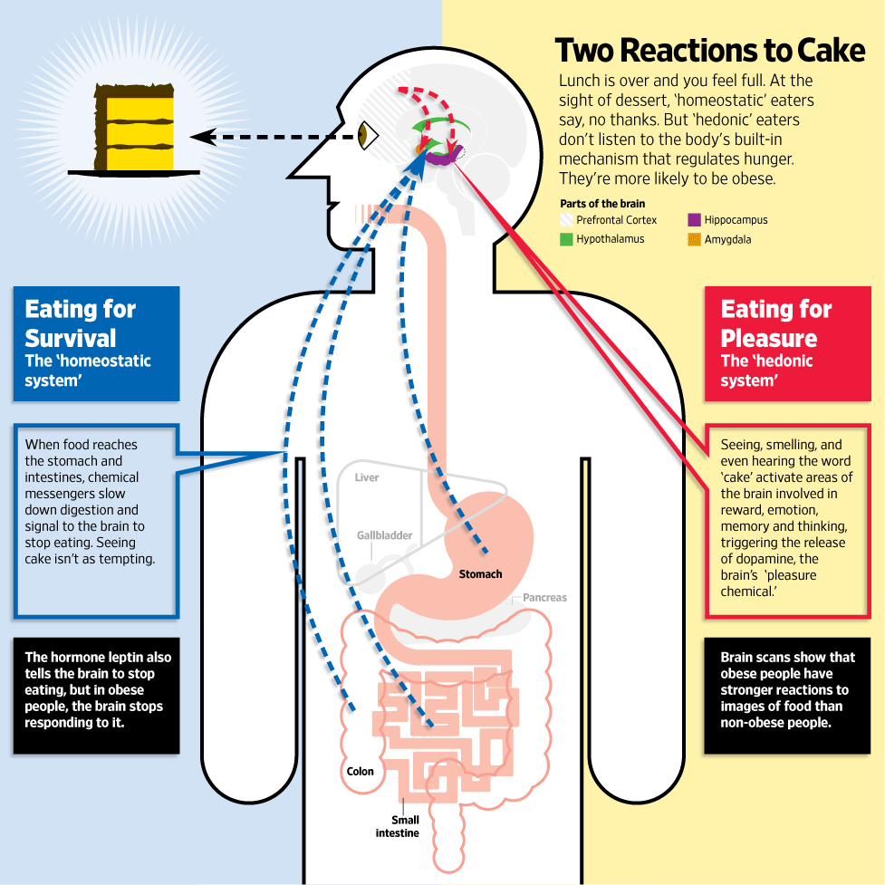
Jabr F, SA Mind December 2015

Slide 47
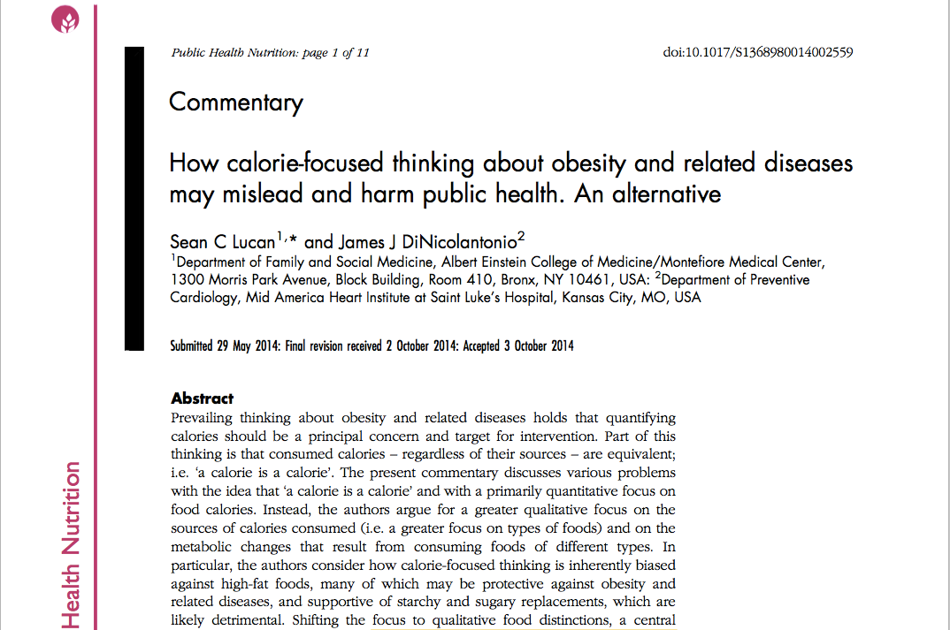
Changing Calorie-Centric Thinking
From quantity to quality of calories
“low-fat” = buyer beware
“high-fat” …it’s all about the quality
A carb is not a carb
Lucan SC, DiNicolantonio JJ Public Health Nutr. 2015 Mar;18(4):571-81.
.

Slide 49
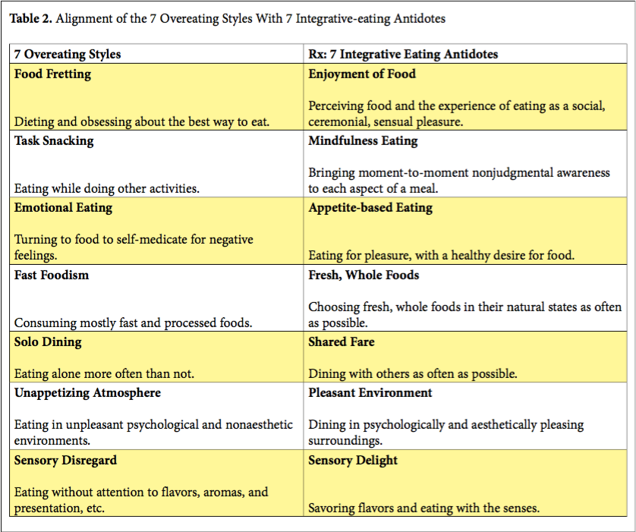

Slide 51
Food and Reward

Slide 52
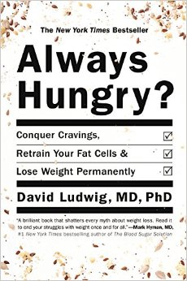
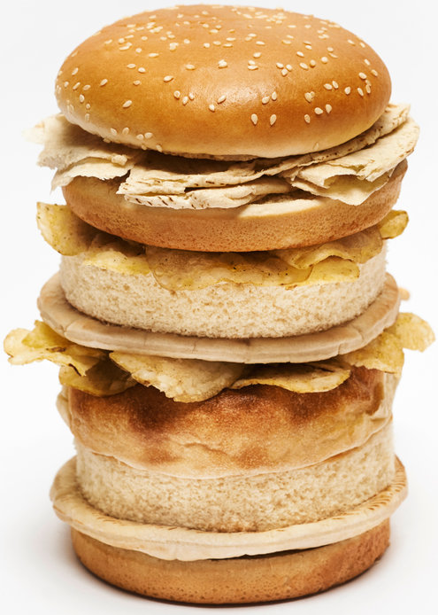
“ Are we fat because we eat too much or do we eat too much because we are fat ?”

Slide 53
From: Increasing Adiposity: Consequence or Cause of Overeating?
JAMA. 2014;():. doi:10.1001/jama.2014.4133
Copyright © 2014 American Medical Association. All rights reserved.

Slide 54
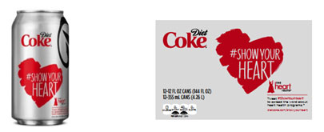

Slide 57
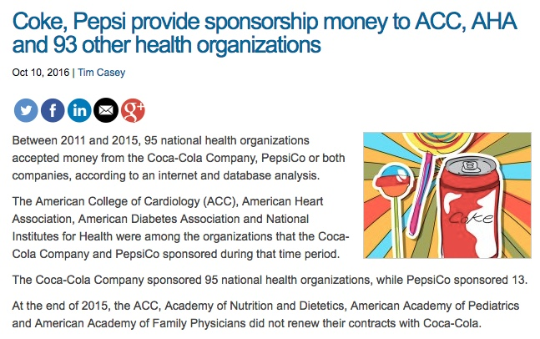

Slide 58
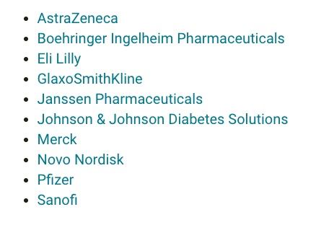
10 largest sponsors of the ADA

Slide 59
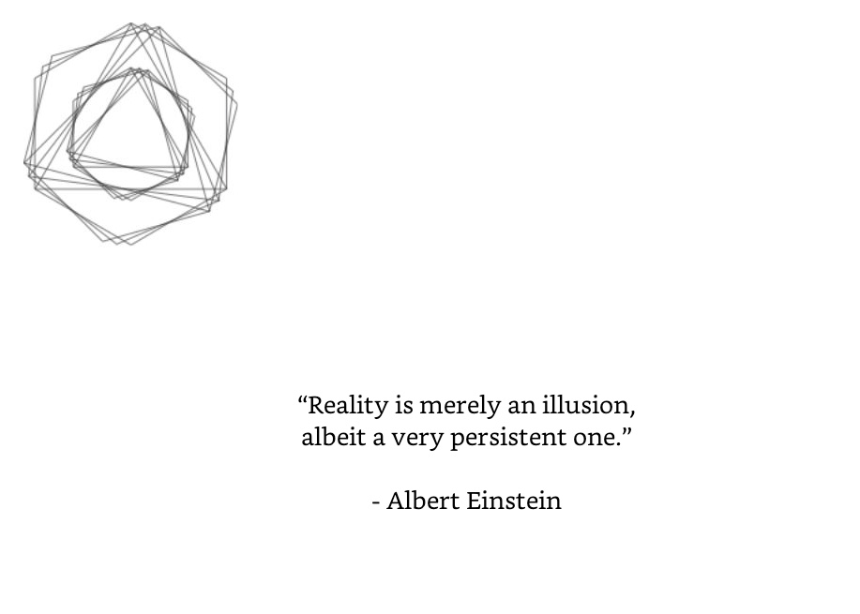

Slide 61
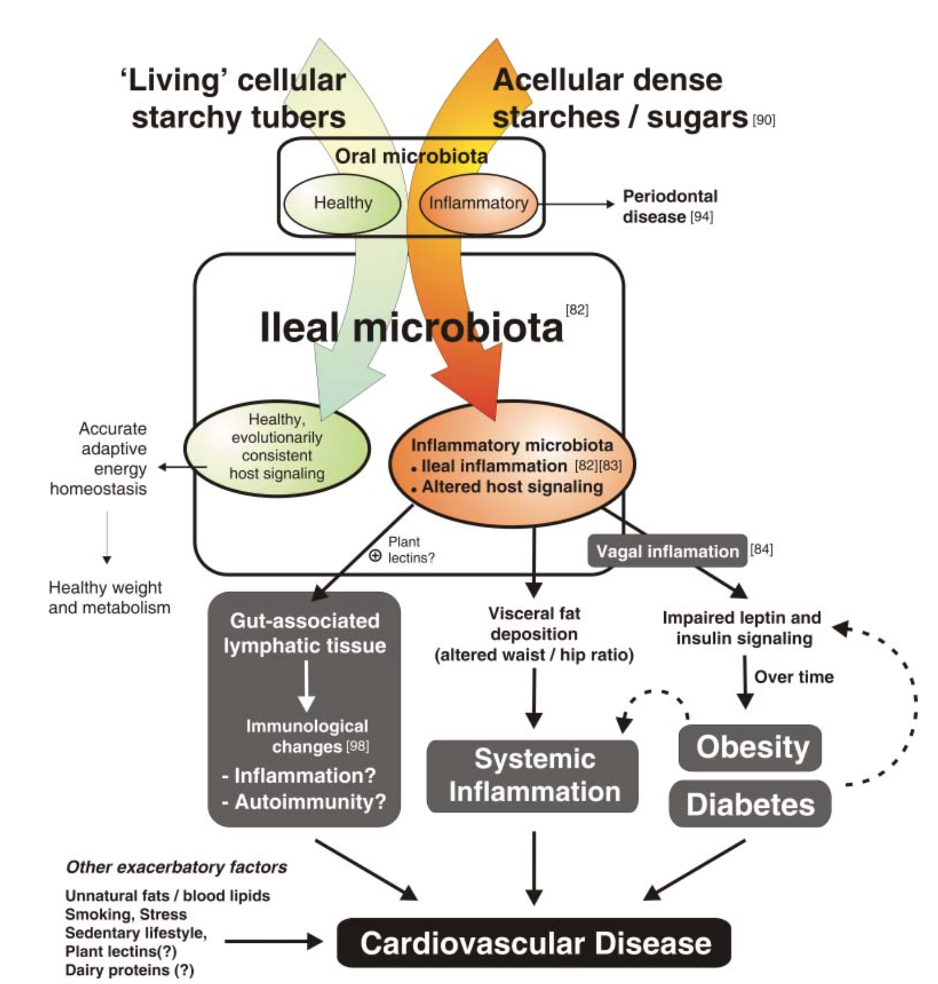
Courtesy Ian Spreadbury PhD
Cancer

Slide 62
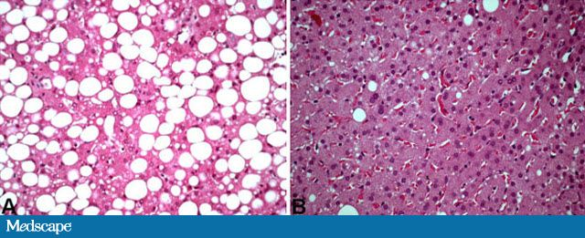
NAFLD
Has become one of the most common diseases in America from not having been described until 1980.
45% of all Latinos
33% of all Caucasians
25% of all African Americans
5% of all progress to NASH
25% NASH progress to cirrhosis
Preventable

Slide 63
A window of opportunity
300
Insulin resistance
Relative function
(units)
200
Normal insulin level
100
At risk for
diabetes
Beta cell failure
0
-10
-5
0
5
10
15
20
25
30
Years of Diabetes
While beta cells can still produce insulin, insulin resistance and hyperglycemia can be reversed
Adapted from D. Kendall, R. Bergenstal © International Diabetes Center

Slide 64
Stress Management
Meditation, prayer, relaxation response, guided imagery, yoga, tai chi, biofeedback, gratitude journal
Decreased cortisol, flight-fight response, BP,
Increased parasympathetic tone
Improved mood, concentration, pain tolerance, resilience
Positive epigenetic effects on inflammation, insulin sensitivity and energy efficiency e.g. mitochondrial health
Decreased cardiovascular risk
Enhanced neuroplasticity

Slide 65
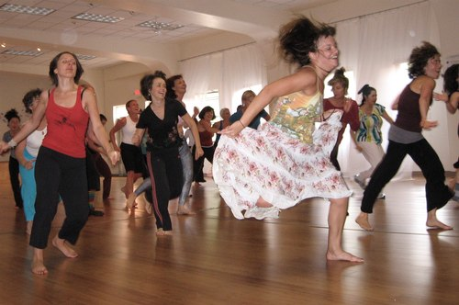
Activity and Movement
Motion is the lotion
Aerobic, resistance, dance
Muscle as a metabolic engine
↓ cortisol, ↑endorphins and dopamine
Positive Epigenetic effects on inflammation, insulin sensitivity and energy efficiency
Enhanced strength, resilience, balance, concentration, mood
Decreased cardiovascular, diabetes, cancer risk
Longevity and quality of life profoundly enhanced

Slide 68
Disease spectrum model
Well-being
Disregulation
Disease
Normal labs & vital signs
⬆BP
⬆lipids
⬆insulin
obesity
Diabetes
Heart disease
Dementia
Stroke

Slide 69
A window of opportunity
300
Insulin resistance
Relative function
(units)
200
Normal insulin level
100
At risk for
diabetes
Beta cell failure
0
-10
-5
0
5
10
15
20
25
30
Years of Diabetes
While beta cells can still produce insulin, insulin resistance and hyperglycemia can be reversed
Adapted from D. Kendall, R. Bergenstal © International Diabetes Center

Slide 70
Key steps for preventing-reversing cardiometabolic syndrome
Focus more on quality of calories as opposed to quantity
Whole foods always preferable to processed foods
Cut – reduce sugar-fructose in all it’s forms
Reduce refined grain flours, and carbohydrate-dense processed foods.
Liberalize healthy fat sources e.g. fatty fish, EVOO, shellfish, lean meats, nuts, grass-fed butter, eggs, ghee while reducing trans-hydrogenated fats and industrial-processed seed oils (O-6 oils)
Coconut Oil: Lauric acid; MCTs, gut permeability improved
Motion is the lotion: target: 30” x 5 d/week; HIT; Resistance 15” x 2d/week
Mind-Body techniques; MBSR, yoga, guided imagery, HRV
Environmental toxins e.g. BPA as a hormone disruptor; organic produce (ewg.org)
Circadian rhythm – sleep hygiene
Supplements e.g. chromium, magnesium, SKRMs, zinc, ALA, cinnamon, berberine

Slide 71
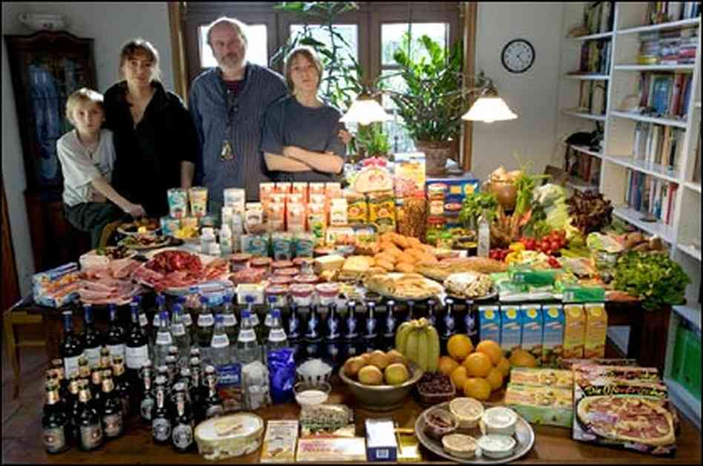

Slide 72
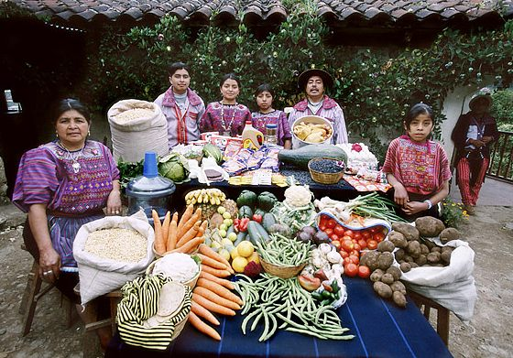

Slide 74
