Slide 1
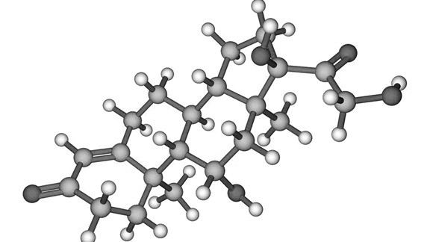
An Integrative Approach to Weight Loss and Metabolism
Turning Off the Fat Switch
Mark C Pettus MD, FACP
December 6, 2017
Director of Medical Education and Population Health
Associate Dean of Medical Education
University of Massachusetts Medical School

Slide 2
Learning Objectives
Challenge the notion of weight loss-management as a simple calorie accounting proposition.
Examine the relationship between macronutrient content, lipogenesis (the biologic imperative to store fat) and leptin-insulin resistance
Review some lifestyle medicine strategies for facilitating and maintaining weight loss.

Slide 4

The guidelines go where the monies flow.

Slide 5
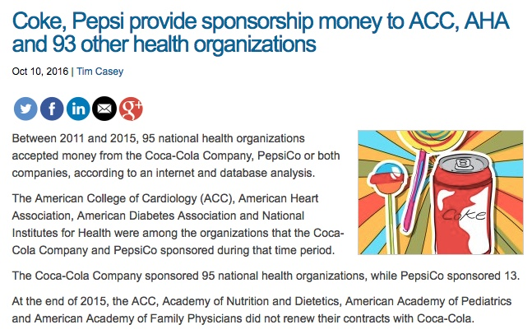

Slide 6



Slide 7


Slide 8

10 largest sponsors of the ADA

Slide 9
"If people let the government decide what foods they eat and what medicines they take, their bodies will soon be in as sorry a state as are the souls who live under tyranny"
Thomas Jefferson (1743 - 1826)

Slide 11
Five essential clinical pearls
Calorie restriction decreases metabolic rate, enhances hunger and reduces the drive to move. For most, eat less-do more is not an effective or sustainable strategy.
Food is information. Different macronutrients and phytonutrients produce different effects on metabolism e.g. in thermogenesis, neuroendocrine-immune regulation, and on the gut microbiome.
In the battle between mind and metabolism, metabolism will trump most of the time.
The metabolism one hopes to achieve is one that reduces oxidative stress, inflammatory drive, mitochondrial dysfunction and leptin and insulin resistance.
There are many evidence-based modifiable lifestyle interventions known to achieve this.

Slide 12
Prevailing View
Obesity occurs when a person consumes more calories from food than he or she burns.
National Institute of Health
Overweight is the result of caloric imbalance (too few calories expended for the amount of calories consumed) and is mediated by genetics and health.
US Surgeon General

Slide 13
Emerging View
A calorie is not a calorie
Macronutrients elicit different metabolic effects
Quality of macronutrients e.g. glycemic effect will substantially impact metabolic effects (food as information)
Quality of calories more important (and interesting) than quantity of calories
Quality fat sources less harmful than thought

Slide 14
Top 5 most interesting and meaningful attributes of any food
Nutrient density
Phytonutrient complexity
Amount of Microbiota Accessible Carbohydrates (MACs)
Macronutrient quality
To what extent has it been processed

Slide 15
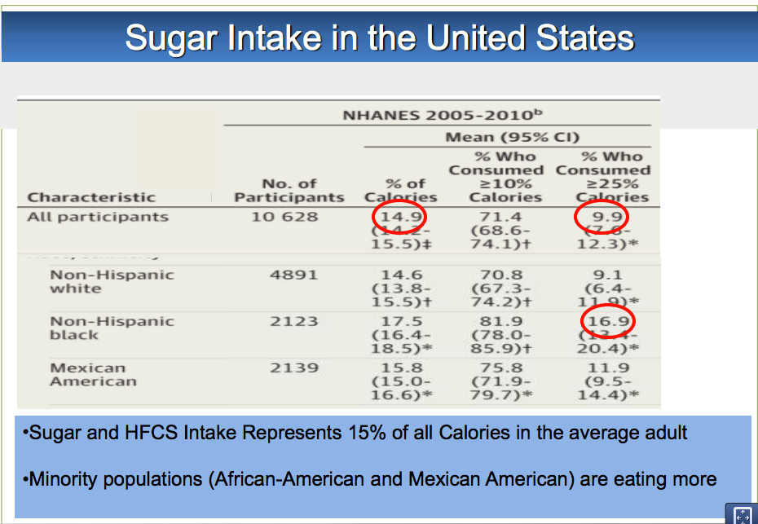

Slide 16
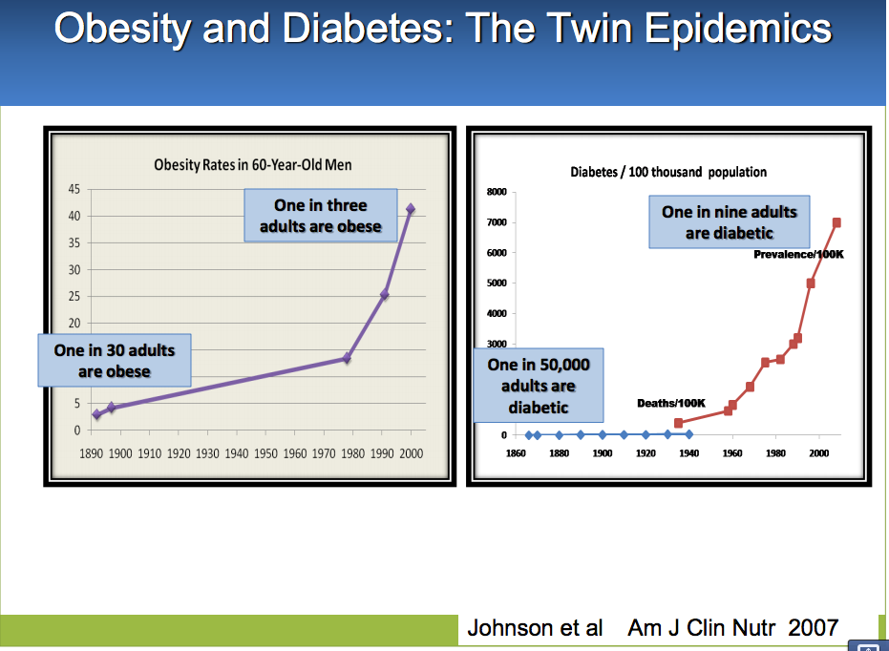

Slide 18
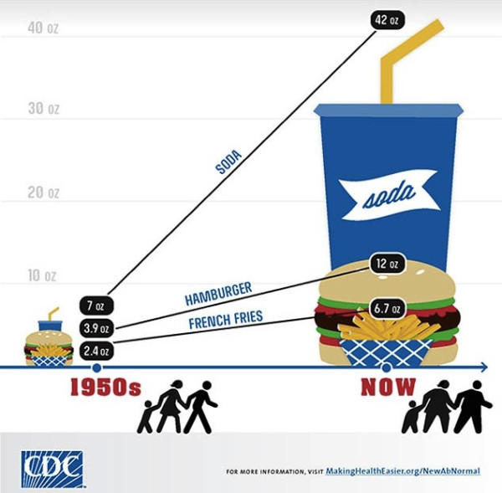

Slide 20
Limitations of Weight and BMI
BMI of limited value with higher lean body mass
Body composition (lean body mass and fat stores)
VAT vs. SAT
TOFI – “thin outside, fat inside”
Most adipose is VAT
Most adipose is SAT
Same weight and waist circumference:
Different metabolic risks!
Notes:
Need to build lean body mass in addition to reduction of fat stores

Slide 21
Lifestyle-Environmental Inputs
Nutrition
Movement
Stress Response
Sleep Hygiene
Social Connection
Meaning in work, love, play
Environmental Toxins
Full-spectrum light deprivation
Weight
Inflammation
Insulin
Resistance
Notes:
Endocrine disruptors tied to 300billion in annual healthcare costs
Organophophate disruptors; glyphosate; BPA; pthalates; PTFO flame retardants

Slide 22
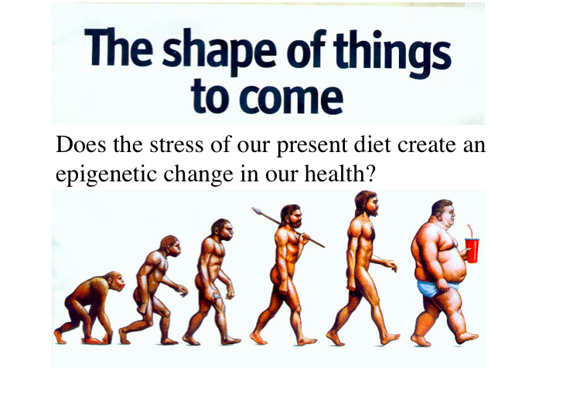

Slide 23
“The connection between the gut microbiota and energy homeostasis and inflammation and its role in the pathogenesis of obesity-related disorders are increasingly recognized. The role of the Western diet, antibiotics and lifestyle in promoting an obesogenic microbiota is increasingly clear.”

Slide 24
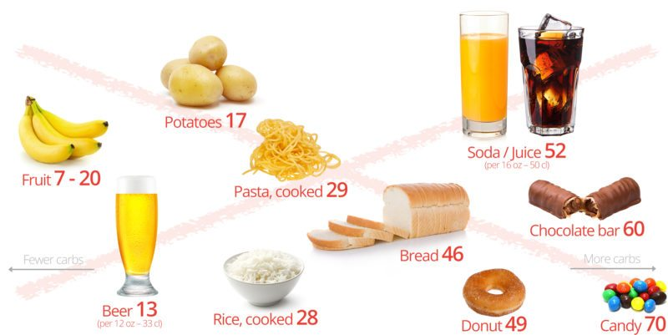
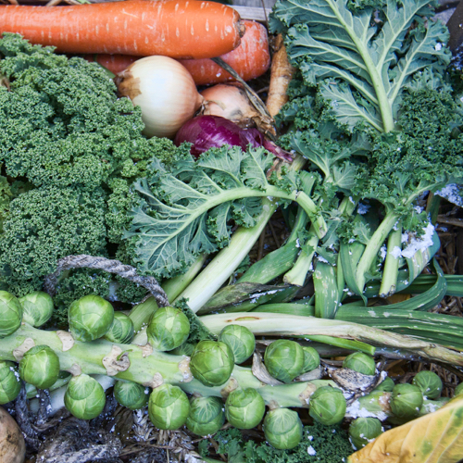

Sugar, Fructose and Carbohydrate-Dense Grains
High-Quality Plant-Based Carbs
Oral and Gut
Microbiome
Inflammation
Neurotransmitters
Insulin Resistance
Weight and Metabolism
Mitochondria-Oxidative stress
HPA axis –Stress Response
Protection from:
Inflammation
Diabetes
Cancer
Obesity

Slide 25
Courtesy: Loren Cordain PhD

Slide 26
Hyperinsulinemia
weight gain and abdominal obesity
insulin resistance and diabetes
leptin resistance
hormonal dysfunction/anovulation
independent risk factor for heart disease due to effects of insulin on blood vessels
increased risk of breast, prostate, colon, skin and other cancers
Notes:
women in the upper third for insulin level were more than twice as likely to develop breast cancer compared with women in bottom third for insulin level 2009 Intl Journal of cancer
JNCI 1999 >5000 colon cancer assoc w/ elevations in fasting and post prandial BS and insulin levels

Slide 27
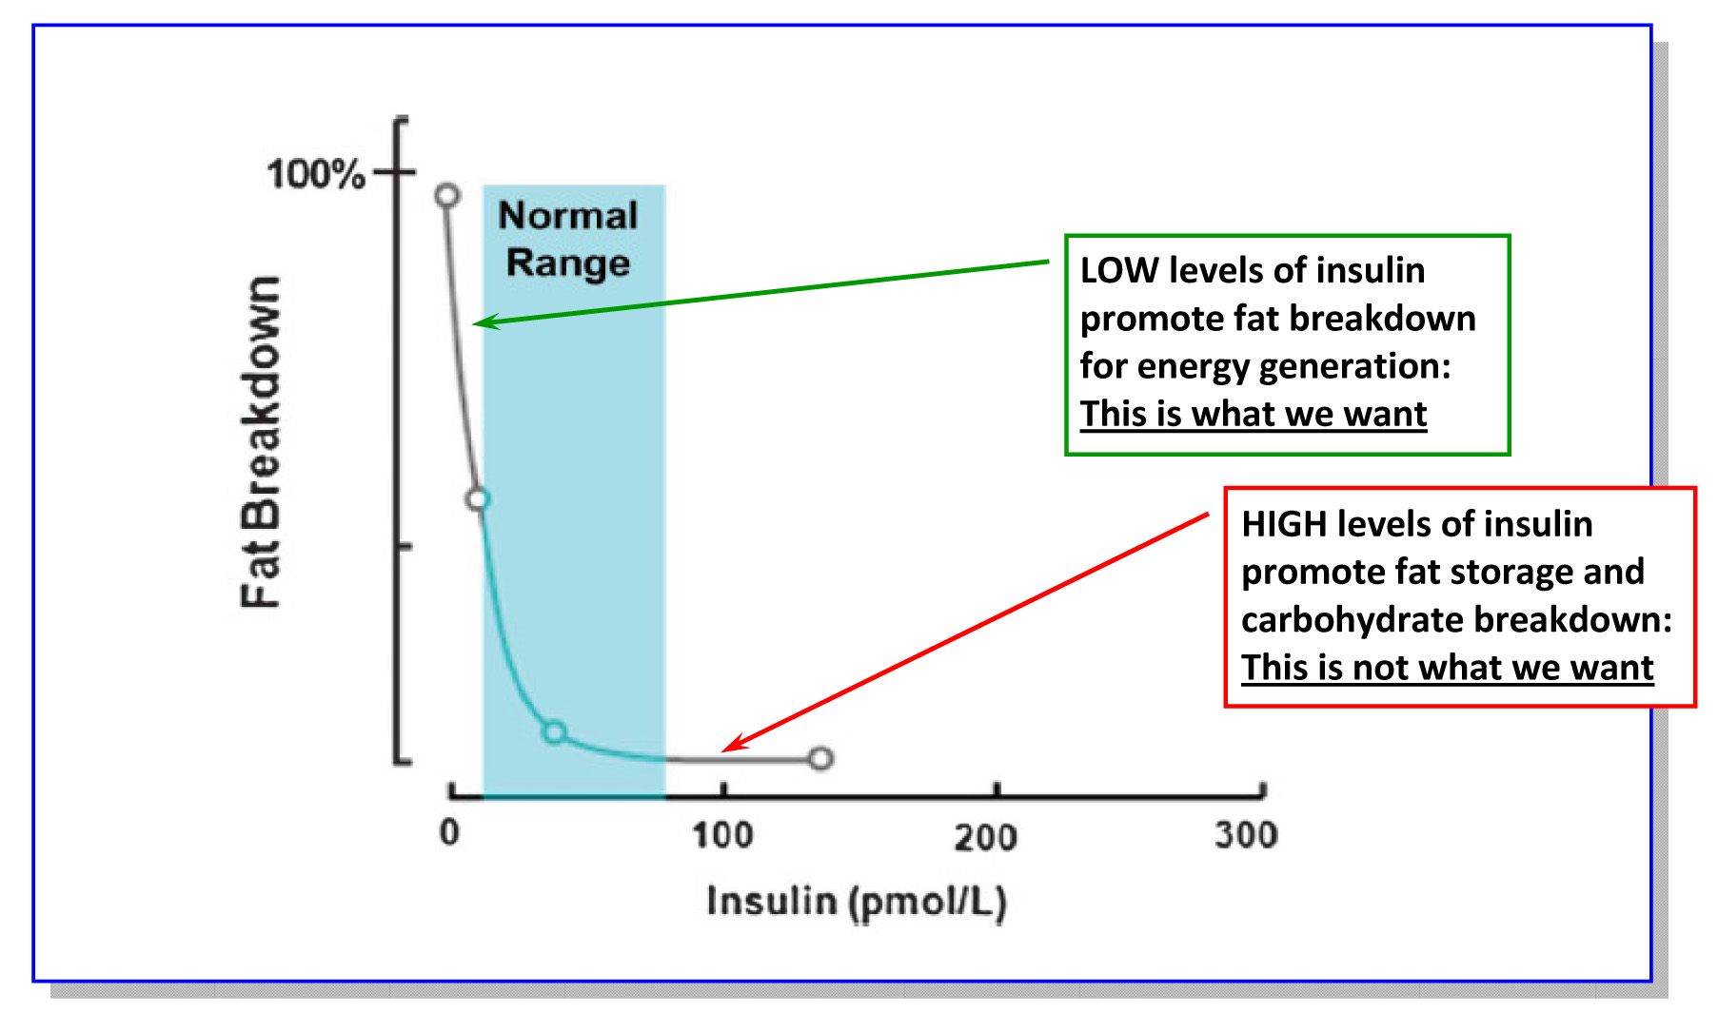
Lipolysis vs. Lipogenesis

Slide 28

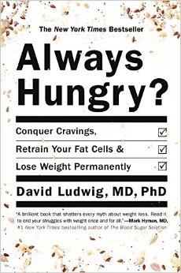

“ Are we fat because we eat too much or do we eat too much because we are fat ?”

Slide 29

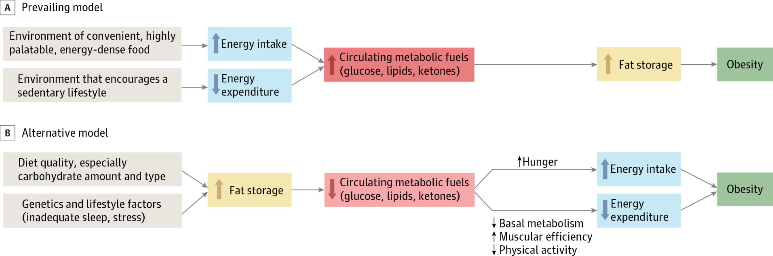
From: Increasing Adiposity: Consequence or Cause of Overeating?
JAMA. 2014;():. doi:10.1001/jama.2014.4133
Copyright © 2014 American Medical Association. All rights reserved.

Slide 30
Leptin
Discovered in 1994 by Jeffrey Friedman, Rockefeller University
Signals satiety in the brain (hypothalamus)
Signals “readiness” to move
Leptin resistance = weight gain, hard to control hunger, and a deep desire to minimize activity
Insulin resistance is associated with leptin resistance
Chronic inflammatory burden (many causes) is associated with both insulin and leptin resistance.

Slide 31
Poor Quality Carbs
Acellular carbohydrate density
Inflammation
Stress
Sleep disruption
Altered gut-permeability/microbiome
Social isolation
Toxin excess
Sedentary states
VAT
Excess Insulin
VAT Fat storage-lipogenesis
Down-regulation of insulin receptors
Insulin Resistance
Leptin resistance
Eat more and do less

Slide 34
A calorie is not a calorie…
Effects of Dietary Composition on Energy Expenditure During Weight-Loss Maintenance
Cara B. Ebbeling, PhD; David S. Ludwig, MD, PhD et al
Conclusion: Among overweight and obese young adults compared with pre–weight-loss energy expenditure, isocaloric feeding following 10% to 15% weight loss resulted in decreases in REE and TEE that were greatest with the low-fat diet, intermediate with the low–glycemic index diet, and least with the very low-carbohydrate diet.
Remarkable range between individuals
TEE: - 423 [–606 to –239] kcal/d for low fat diet
- 57 [–281 to 86] kcal/d for low carb diet
Equivalent of 1-hr moderate effort cardio difference
JAMA. 2012;307(24):2627-2634. doi:10.1001/jama.2012.6607
Notes:
TEE differed by approximately 300 kcal/d between these low fat and low carb diets, an effect corresponding with the amount of energy typically expended in 1 hour of moderate-intensity physical activity.

Slide 35
Mechanisms that link alterations of the microbiome with weight and metabolism
Increased energy harvest from the diet
Altered fatty acid metabolism in liver, muscle, and fat tissue
Modification of gut hormones e.g. cholecystikinin, peptide YY and GLP-1
Activation of LPS- TLR 4 axis and cytokine expression i.e., metabolic endotoxemia
Altered gut barrier function and molecular trafficking
Bile acid metabolism
SCFA production

Slide 36
Low fat versus Low carb-high fat (LCHF)

Slide 37
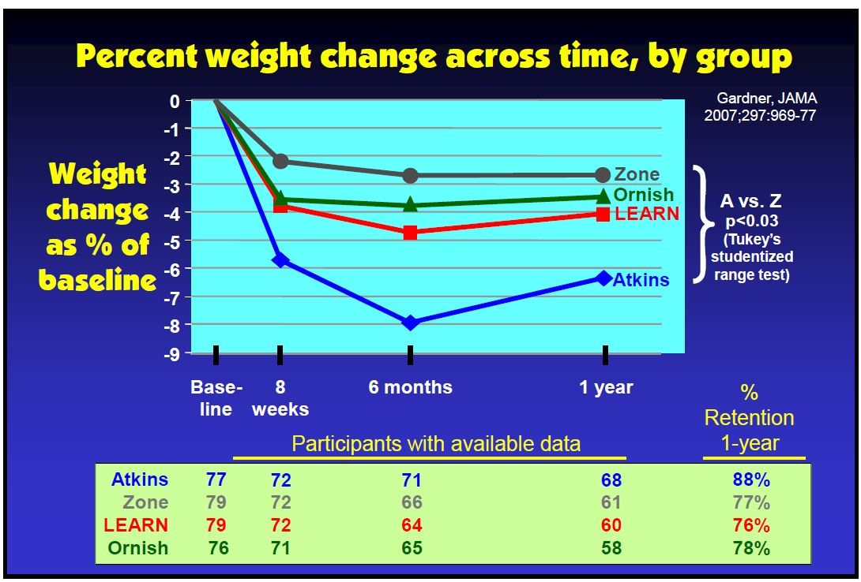

Slide 38
Westman, E et al. Nutrition 31 (2015) 1-13

Slide 39
In weight loss trials, low-carbohydrate interventions led to significantly greater weight loss (along with better metabolic RF reduction) than did the low-fat interventions.
When compared with dietary interventions of similar intensity, evidence from RCTs does not support low-fat diets over other dietary interventions for long-term weight loss.
Lancet Diabetes Endocrionol 2015 Dec:3(12)

Slide 40
Meta-analysis comparing VLCHF (no more than 50g CHO/day)with traditional calorie restricted low fat (< 30% calories from fat for weight loss and CV RF modification efficacy.
13 RCTs with at least 12-month f/u. Individuals assigned to a VLCHF achieve greater weight loss than those assigned to a LFD
Br J Nutr 2013 Oct: 110(7)

Slide 41
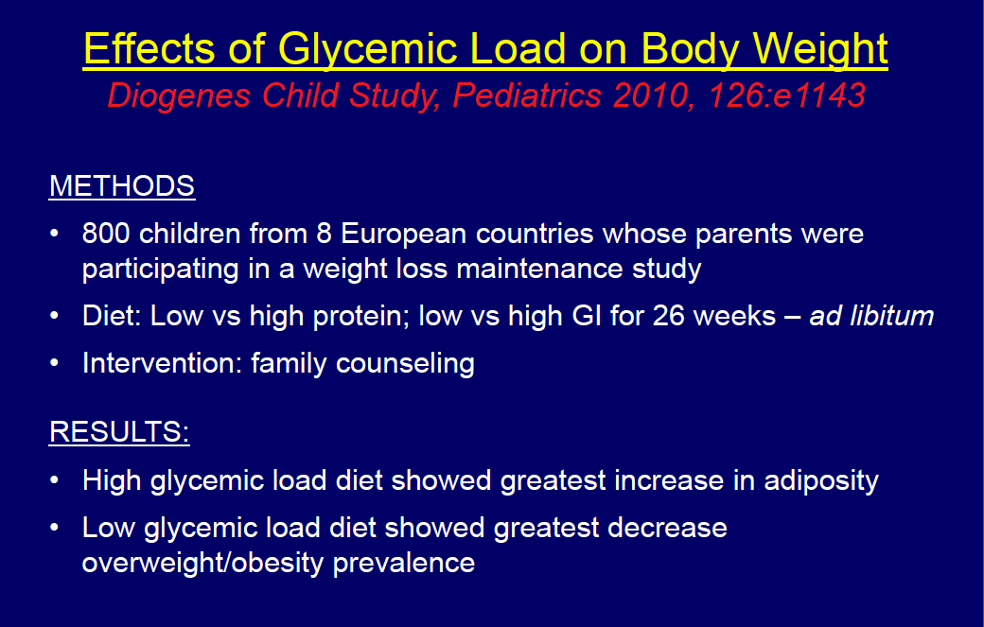
Courtesy: Dr. David Ludwig

Slide 42
Westman, E et al. Nutrition 31 (2015) 1-13

Slide 43
Westman, E et al. Nutrition 31 (2015) 1-13

Slide 45
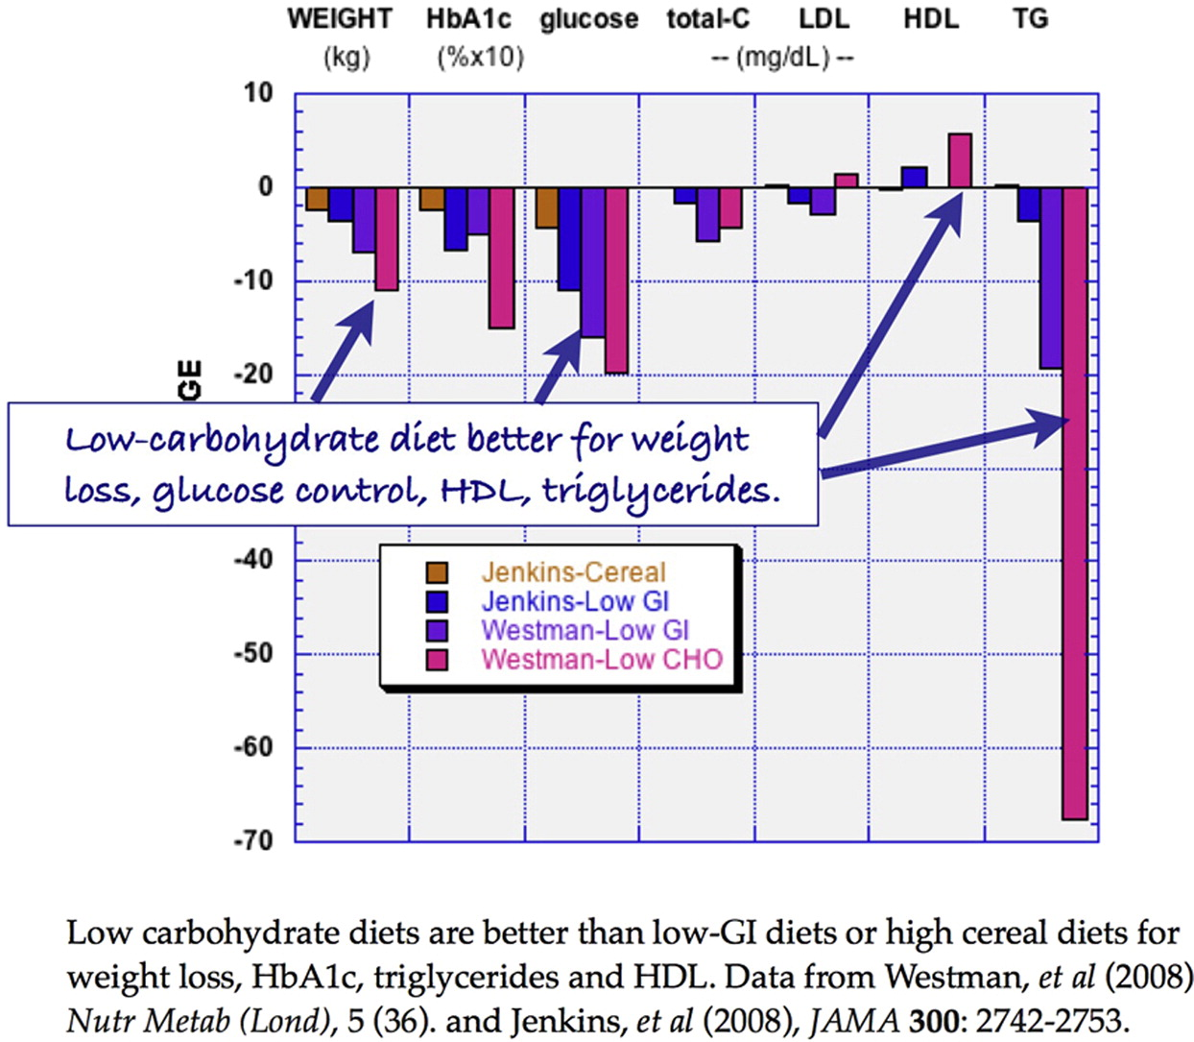
Nutrition 2015 31, 1-13DOI: (10.1016/j.nut.2014.06.011)

Slide 47
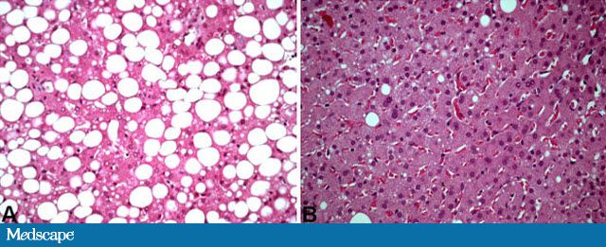

NAFLD
Has become one of the most common diseases in America from not having been described until 1980.
45% of all Latinos
33% of all Caucasians
25% of all African Americans
5% of all progress to NASH
25% NASH progress to cirrhosis
Preventable

Slide 49
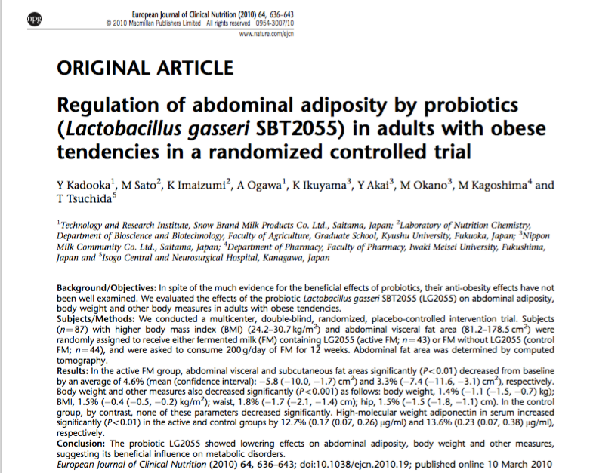
Multi-center, double-blinded randomized, placebo-controlled intervention trial
87 subjects with high BMI and VAT
FM vs. placebo for 12 weeks
Improved wt. loss and body comp in treated group compared with control
Higher adiponectin in treated group. Enhanced insulin sensitivity, glucose regulation and fat oxidation

Slide 50
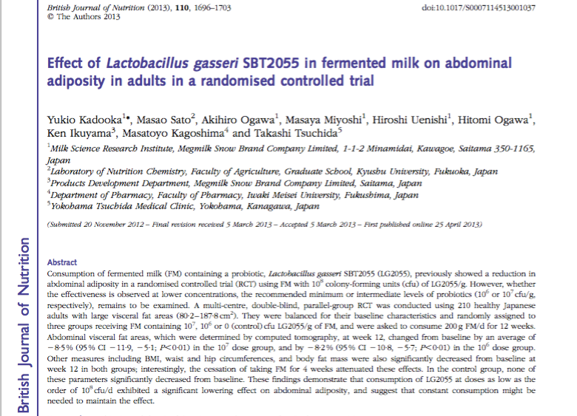
Intervention with FM in 210 healthy overweight adults.
Significant lowering of abdominal adiposity was seen.
Effects were reversed after discontinuation of FM

Slide 51
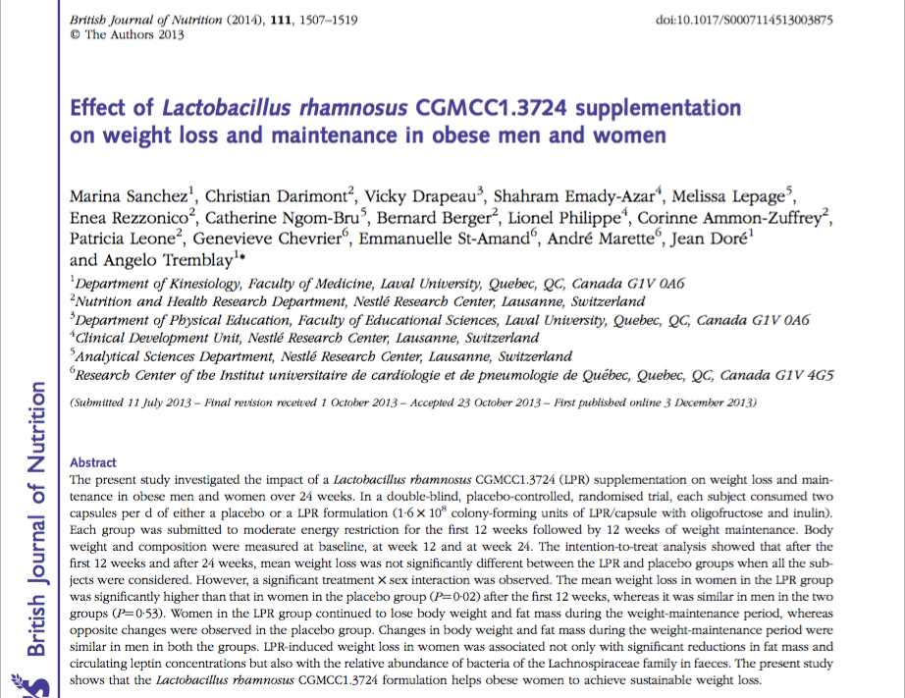
Double-blind, randomized, placebo-controlled trial in obese men and women
Probiotic supplementation with L rhamnosus for 24 weeks
Each group had moderate caloric restriction
Treatment effect more pronounced in women: greater weight loss, reduced fat mass and leptin levels

Slide 52

Food and Reward

Slide 53
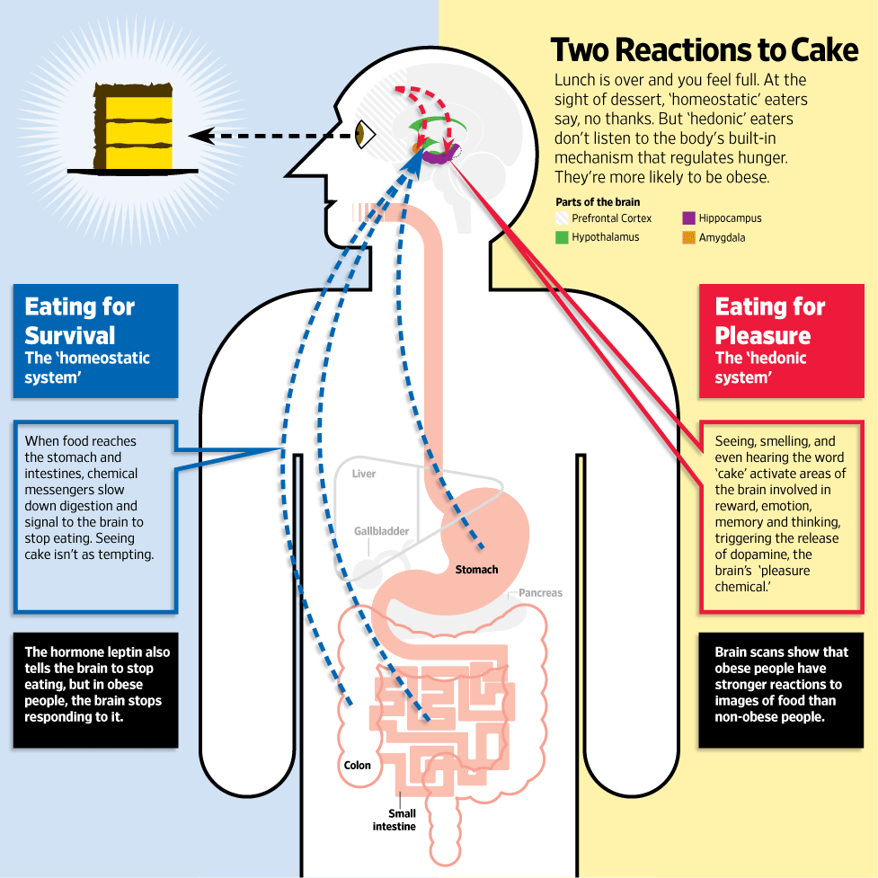
Jabr F, SA Mind December 2015

Slide 54
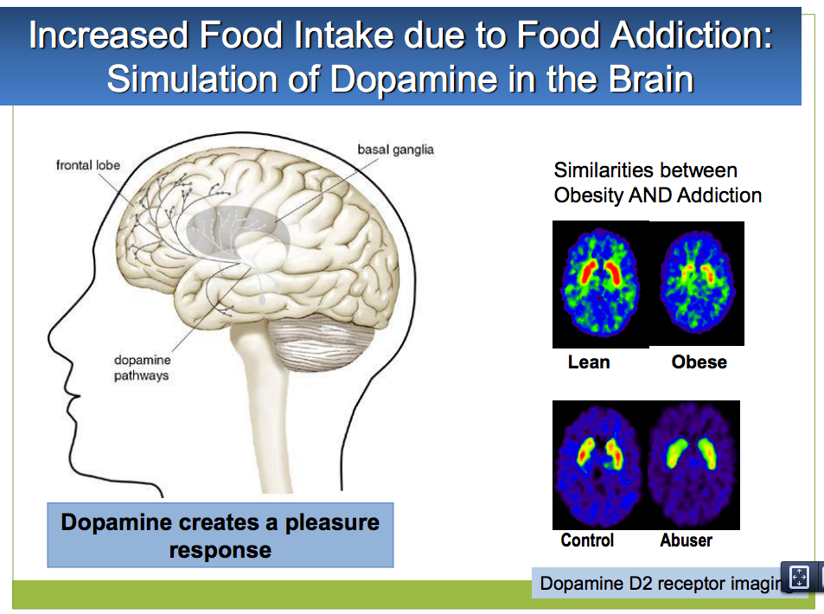

Slide 55
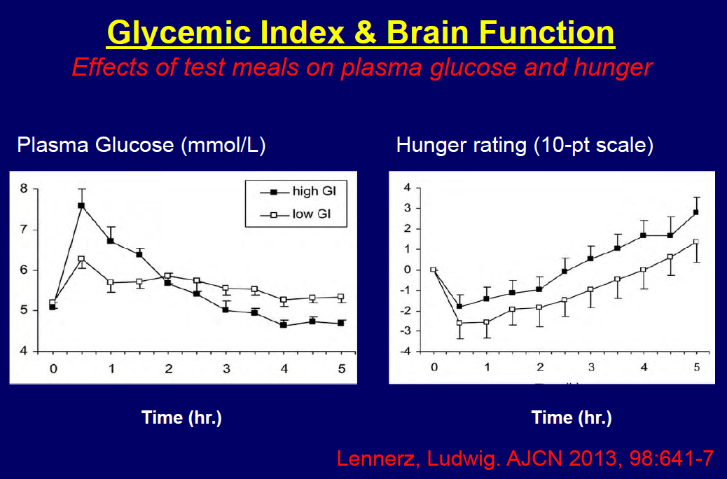

Slide 56
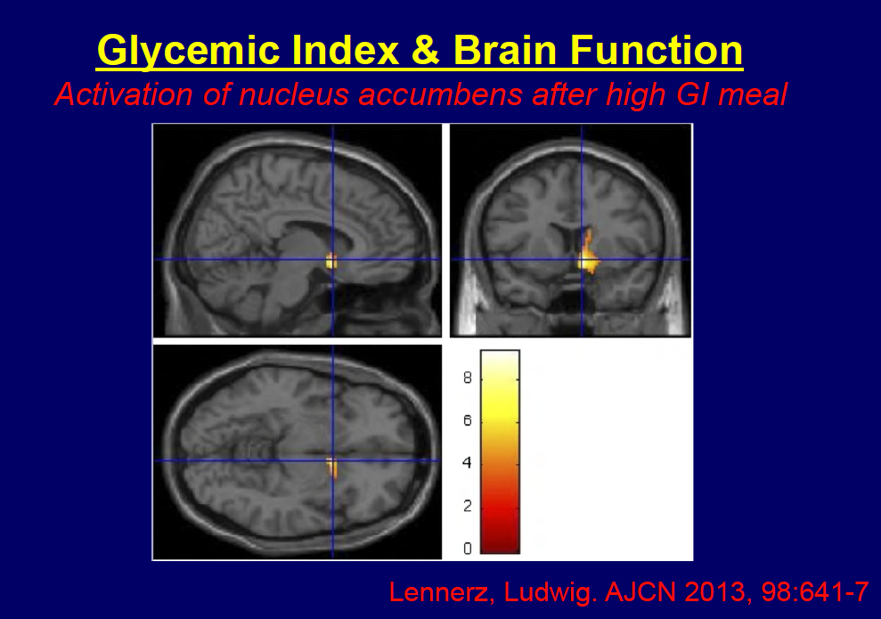

Slide 58
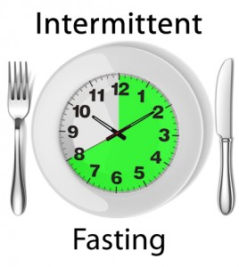
Time-restricted feeding
Time restricted feeding 10 hrs
Decreases in body weight and visceral fat
Improved cardiovascular disease risk profile
Decreased inflammation
Decreased neuroinflammation
Autophagy and apoptosis

Slide 60
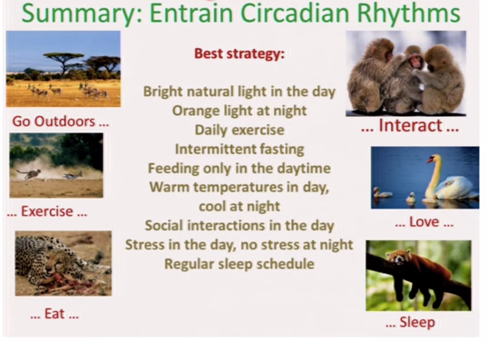

Slide 61

Stress Management
Meditation, qigong, prayer, relaxation response, guided imagery, yoga, tai chi, biofeedback, gratitude journal
HRV-HeartMath
Decreased cortisol, flight-fight response, BP,
Increased parasympathetic tone
Improved mood, concentration, pain tolerance, resilience
Positive epigenetic effects on inflammation, insulin sensitivity and energy efficiency e.g. mitochondrial health
Decreased cardiovascular risk
Enhanced neuroplasticity

Slide 62
Summary: Enhancing metabolic efficiency:
…. Reduce inflammation, insulin and leptin resistance
Eliminate – reduce sugar in all it’s forms
Eliminate-reduce refined grain flours, and carbohydrate-dense processed foods.
Reduce hydrogenated oils and processed seed oils cooked at high temperatures
More abundant healthy fats sources e.g. extra virgin olive oil, small fatty fish, grass-fed butter; eggs; extra virgin coconut oil; pasture-raised animal fat, ghee, avocados, nuts e.g. almonds, and macadamia and nut butters
Time-restricted eating….all consumption within a 10-12-hour window e.g. nothing after 7p

Slide 63
Summary: Enhancing metabolic efficiency
…. Reduce inflammation, insulin and leptin resistance
OK to consume pasture-raised meats and eggs
Motion is the lotion: Walk as much as possible, stairs as tolerated, stand for 2-3” every hour
Stress management
Circadian rhythm – sleep entrainment; sleep hygiene
Full spectrum light; light box

Slide 64

Thank You !

Slide 65
Summary: Enhancing metabolic efficiency:
…. Reduce inflammation, insulin and leptin resistance
Eliminate-reduce sugar and fructose
Eliminate-reduce refined grain flours, and carbohydrate-dense processed foods
Reduce omega-6 containing oils, replacing them with healthy fats e.g. extra virgin olive oil, grass-fed butter and coconut oil; lard, tallow, ghee, avocados, nuts (almonds and macadamia)
Consume pasture-raised meats, eggs
Consider gut health-microbiome: dysbiosis, leaky gut
Remember, Motion is the lotion!
Lower stress response e.g. meditation, yoga, tai chi, qigong,.
Align your circadian rhythms – sleep entrainment

Slide 66
In animal models, giving VSL#3 probiotics modulates microbiota induction of butyrate and GLP-1.
These metabolic changes enhance insulin signaling, increase fat oxidation, decrease appetite, improve colonic epithelial function-integrity and barrier function.

Slide 67
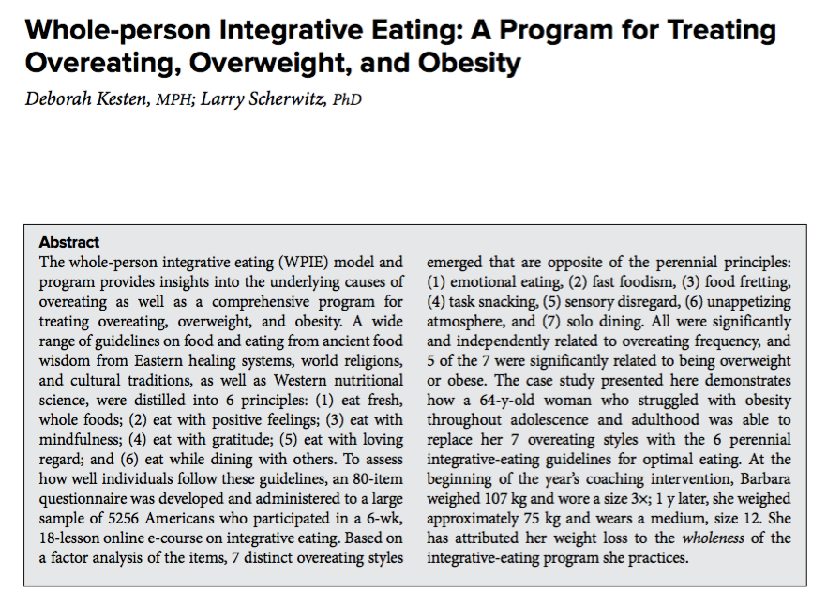

Slide 70
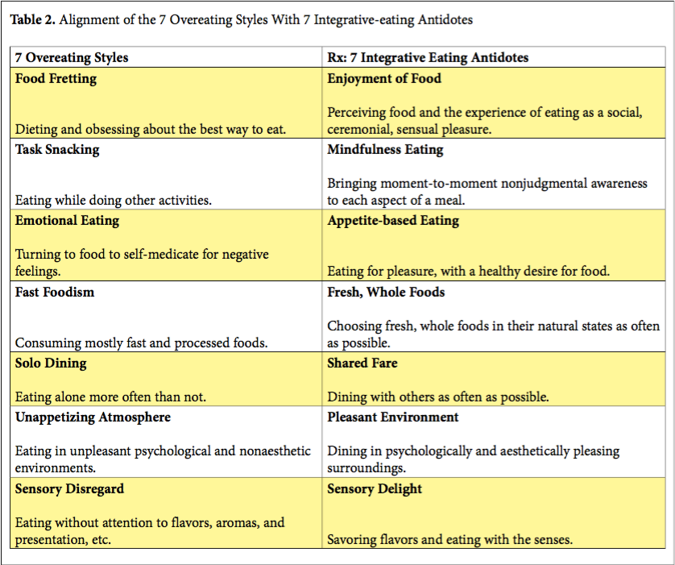

Slide 73
Saturated fats
Palmitic acid: 16-C found in palm oil, beef, eggs, milk, poultry, and seafood.
Greatest likelihood of raising LDL
? Beneficial role in cognition in lower doses
Higher levels from carbohydrate-grain CHO excess when glycogen stores replete
Blunts leptin sensitivity
Cardio-metabolic syndrome risk

Slide 74
Saturated fats
Stearic acid: 18-C found in meat, eggs, and chocolate.
Neutral with regard to LDL
Shown to decrease inflammatory markers
Saturated fats most dangerous with high intake of carbs, grains leading to high insulin levels and liver synthesis of small-dense LDL particles e.g. TGAs with predominantly palmitic acid.

Slide 75
Monounsaturated fats (MUFA)
Oleic acid: 18-C found mainly in plant sources, e.g. olive oil, avocados, and nuts
Improved insulin sensitivity
Improved glucagon response
Decreased cholesterol levels
Natural sources accompanied by fat-soluble antioxidants
Primary fat of ancestral diet

Slide 76
Polyunsaturated fats (PUFAs)
Essential..i.e., we do not make them
Higher n-3/n-6 are good. Sources are grass-fed meats and wild fish
Ancestral ratios n-3/n-6 were approx. 1:1
Modern diet ratio is 1:10-20 which is disruptive
Corn, soy, canola, safflower, and similar vegetable oils are sources of excessive n-6 fats in our diet

Slide 77
Omega-3s
ALA alpha-linolenic acid: 18-C found in flax, hemp, other plant sources
Poor conversion to more active EPA/DHA
EPA eicosapentaenoic acid: 20-C PUFA essential to life!
Potent anti-inflammatory, decreases platelet aggregation, blocks angiogenesis
DHA docosahexaenoic acid: 22-C PUFA critical for brain function, anti-inflammatory and anti-tumor activity
Important in pregnancy

Slide 78
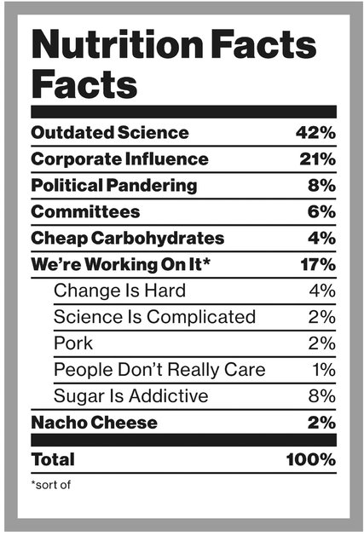

Slide 89
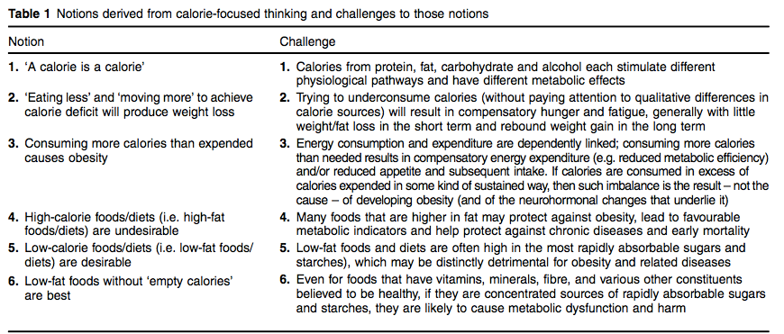
Lucan SC1, DiNicolantonio JJ2.Public Health Nutr. 2015 Mar;18(4):571-81. doi: 10.1017/S1368980014002559. Epub 2014 Nov 24.

Slide 90
Meta-analysis comparing VLCHF (no more than 50g CHO/day)with traditional calorie restricted low fat (< 30% calories from fat for weight loss and CV RF modification efficacy.
13 RCTs with at least 12-month f/u. Individuals assigned to a VLCHF achieve greater weight loss than those assigned to a LFD
Br J Nutr 2013 Oct: 110(7)

Slide 91
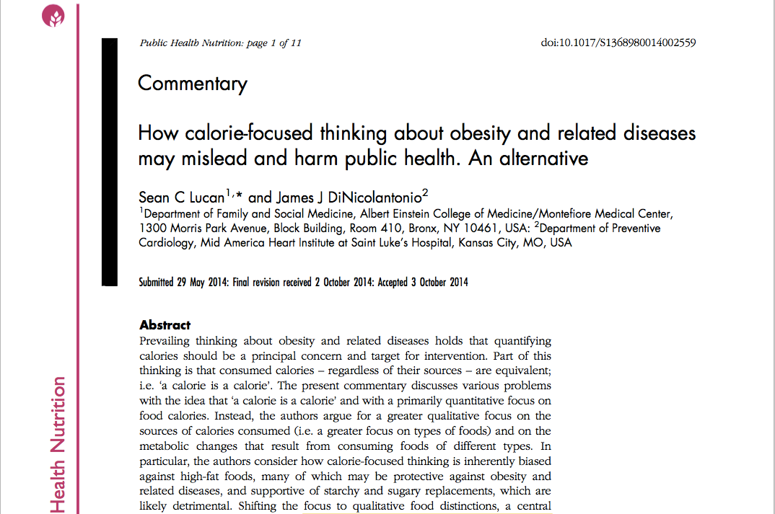
Changing Calorie-Centric Thinking
From quantity to quality of calories
“low-fat” = buyer beware
“high-fat” …it’s all about the quality
A carb is not a carb
Lucan SC, DiNicolantonio JJ Public Health Nutr. 2015 Mar;18(4):571-81.
.

Slide 92
Courtesy: Dr. David Ludwig

Slide 93
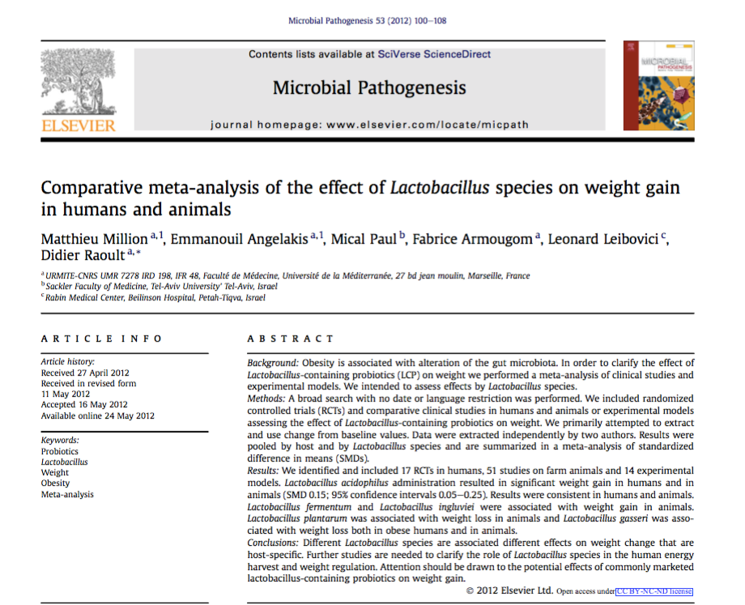
Different Lactobacillus species appear to have varied effects on metabolism and weight loss.
Review of 17 RCTs in human adults reveal positive effects with L plantarum and L gasseri with weight gain with L acidophilus.

Slide 95
Immune Network 2014:14(6) 277-288

Slide 96
Multi-center, double-blinded randomized, placebo-controlled intervention trial
87 subjects with high BMI and VAT
FM vs. placebo for 12 weeks
Improved wt. loss and body comp in treated group compared with control
Higher adiponectin in treated group. Enhanced insulin sensitivity, glucose regulation and fat oxidation

Slide 97
Intervention with FM in 210 healthy overweight adults.
Significant lowering of abdominal adiposity was seen.
Effects were reversed after discontinuation of FM

Slide 98
Double-blind, randomized, placebo-controlled trial in obese men and women
Probiotic supplementation with L rhamnosus for 24 weeks
Each group had moderate caloric restriction
Treatment effect more pronounced in women: greater weight loss, reduced fat mass and leptin levels

Slide 99
“The connection between the gut microbiota and energy homeostasis and inflammation and its role in the pathogenesis of obesity-related disorders are increasingly recognized. The role of the Western diet, antibiotics and lifestyle in promoting an obesogenic microbiota is increasingly clear.”

Slide 102
NAFLD
Has become one of the most common diseases in America from not having been described until 1980.
45% of all Latinos
33% of all Caucasians
25% of all African Americans
5% of all progress to NASH
25% NASH progress to cirrhosis
Preventable

