Slide 1
The New Frontier of Epigenetics and Health:
The Interface of Lifestyle, Inflammation and Allostatic Load
Mark Pettus MD, FACP
December 4, 2017
Director Medical Education and Population Health
Berkshire Health Systems
Associate Dean of Education
University of Massachusetts Medical School

Slide 2
Disclosures
Chief Innovation Officer NovoLux lighting technologies
Chief Medical Officer for Functional Formularies

Slide 3
Learning Objectives
Examine the drivers of health-disease from a systems-biology perspective with an emphasis on inflammation and allostatic load
Review the evolving science and application of epigenetics
Examine accessible lifestyle strategies for creating and maintaining health

Slide 4
Environment-Lifestyle
Life
Epigenome
Microbiome
Consciousness-Spirit

Slide 5
“If you want to find the secrets of the universe, think in terms of energy, frequency and vibration.”
Nikola Tesla

Slide 6
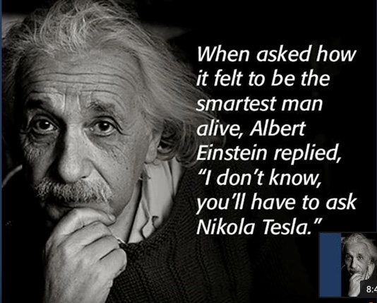

Slide 7
Health as a byproduct of gene-environment compatibility

Slide 8
Long-Latency Diseases
Disease (how things appear)
Pre-diabetes, Diabetes, Obesity, Metabolic Syndrome, Heart Disease, Stroke, Depression, Autoimmunity, Alzheimer’s, Cancer, Fibromyalgia, Chronic fatigue
ADDHD, GAD, PTSD, Autism spectrum
Core Metabolic Imbalances (what drives them)
Inflammation and oxidative stress
Stress HPA Axis (fight-flight)
Gut Barrier Function
Mitochondria-Bioenergetics
Detoxification
Root Causes (what are their origins)
Microbiome-Gene-Epigenome-Environment
Nutrition Movement Stress Response Environmental toxins Sleep Social Connection Trauma Conflict Management Mindfulness Spirituality-Meaning in Work, Love, Play

Slide 10
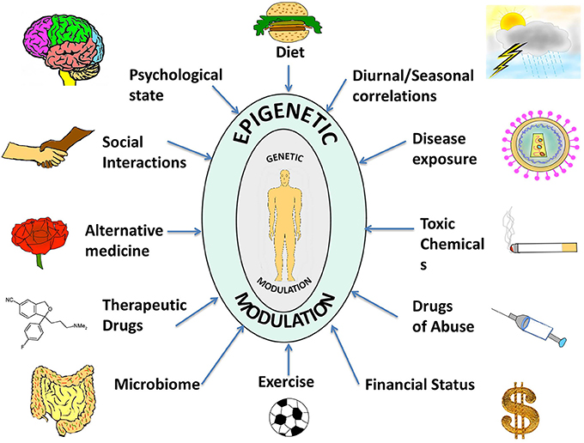

Slide 11
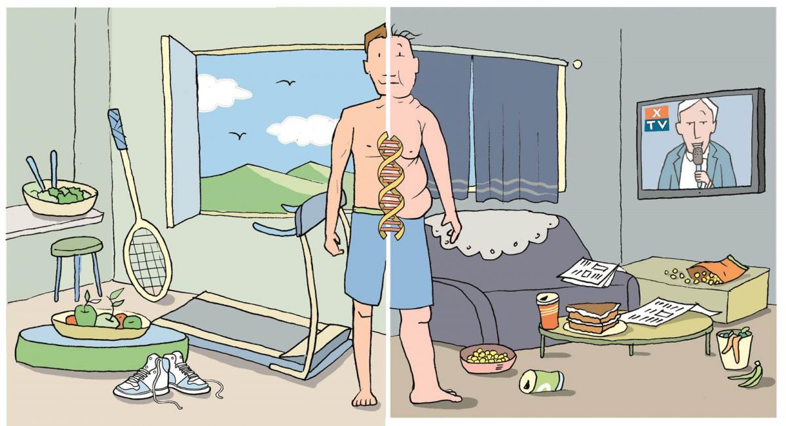

Slide 12
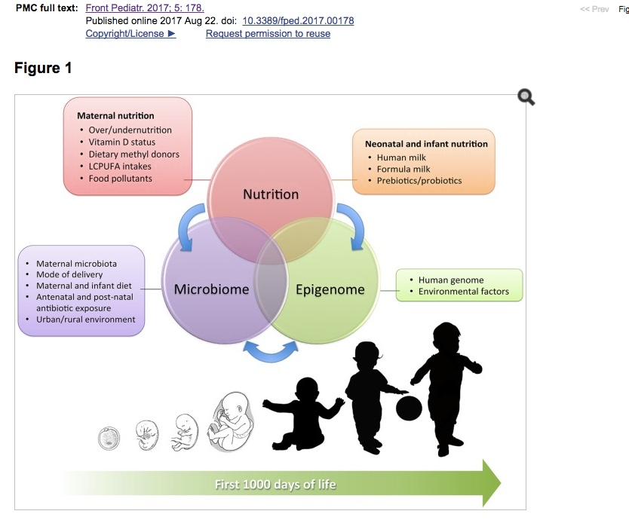
Front Pediatr. 2017; 5:178

Slide 13
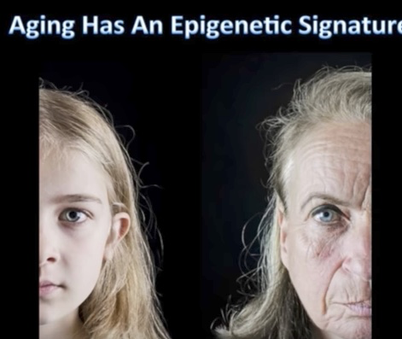
Aging has an Epigenetic Signature

Slide 14
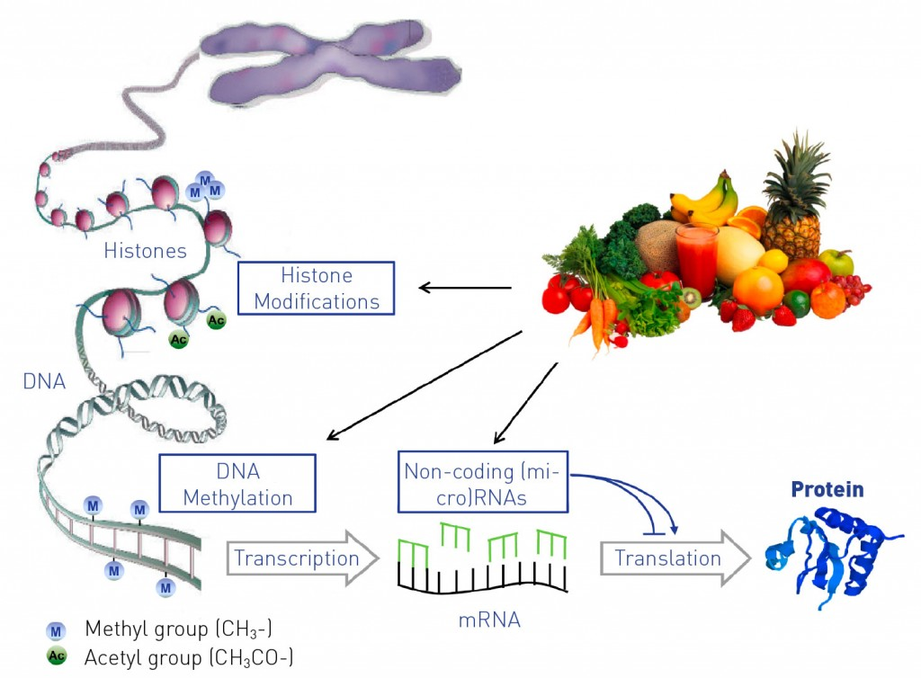

Slide 15
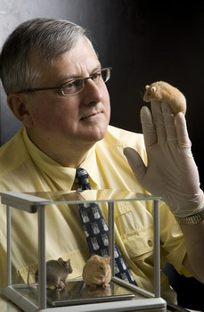
Nutritional Epigenetics
Randy Jirtle PhD
Relationship between nutrition, methylation and gene expression
Protection against BPA toxicity in nutrient-methylation models

Slide 17
Nrf2 upregulation and NfκB down-regulation…a critical intracellular defense
Caloric restriction
Flavanols
Coffee
Sulfurophane
Curcumin
Meditation
Movement

Slide 18
Brain Derived – Neurotrophic Factor (BDNF)
Decreased in depression, Alzheimer’s, epilepsy, schizophrenia and OCD
BDNF Expression Increased with:
Exercise
Caloric restriction
DHA
Curcumin
EGCG
Meditation
Results of the MIDAS trial: Effects of docosahexaenoic acid on physiological and safety parameters in age-related cognitive decline. Karin Yurko-Mauro, Deanna McCarthyMIDAS Investigators
Alzheimer's & Dementia: The Journal of the Alzheimer's Association, July 2009 (Vol. 5, Issue 4, Supplement, Page P84).

Slide 19
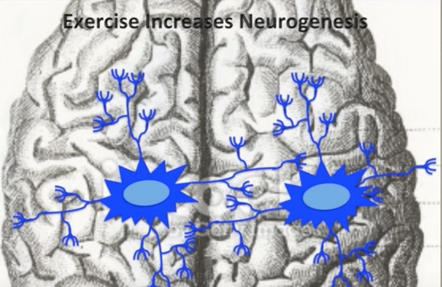

Slide 20
Michael Skinner PhD
Transgenerational Epigenomics
“The ability of environmental factors to promote a disease state not only for the individual but also subsequent progeny for successive generations is termed transgenerational inheritance.”
“Epigenetic changes in methylation of the genome of germ cells after specific environmental toxin exposure that become permanently programmed allow transmission of epigenetic transgenerational phenotypes.
M Skinner Scientific American 2013

Slide 21
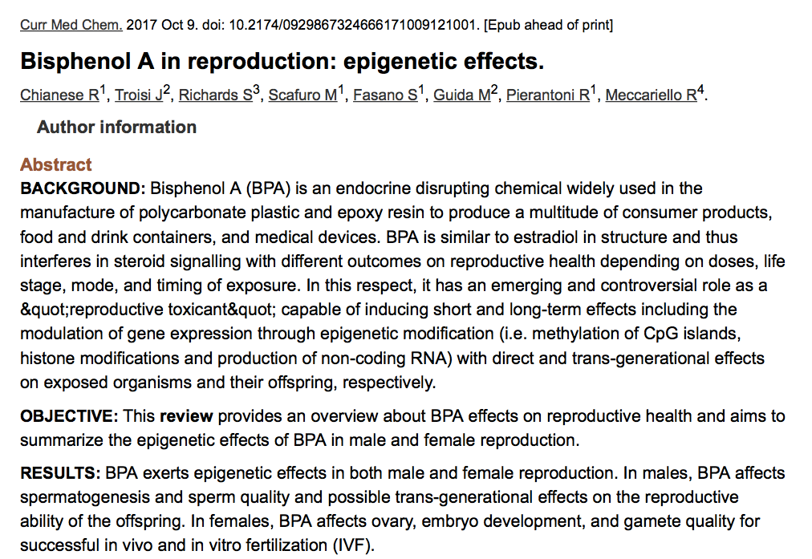
BPA exerts epigenetic effect in both male and female reproduction. In males BPA affects spermatogenesis and sperm quality and possible transgenerational effects on reproductive ability. In women, BPA affects ovary, embryo development and gamete quality.

Slide 22
Environmental Programming of Gene Activity- Bonding
Glucocorticoid Receptor Gene
Child Abuse
Bonding
GR Gene
GR Gene
GR Receptors
GR Receptors
Stress Response
Stress Response
McGowan PO, Sasaki A, D’Alessio AC, Dymov S, Labonte B, Szyf M, Turecki G, Meaney MJ. Epigenetic regulation of the glucocorticoid receptor in human brain associates with childhood abuse. Nat Neurosci. 2009;12(3):342-348.

Slide 23
Conclusions
“These data provide first evidence in humans supporting the conclusion that PNMS results in a lasting, broad, and functionally organized DNA methylation signature in several tissues in offspring. We can infer that the epigenetic effects found in Project Ice Storm are due to objective levels of hardship experienced by the pregnant women.”

Slide 24
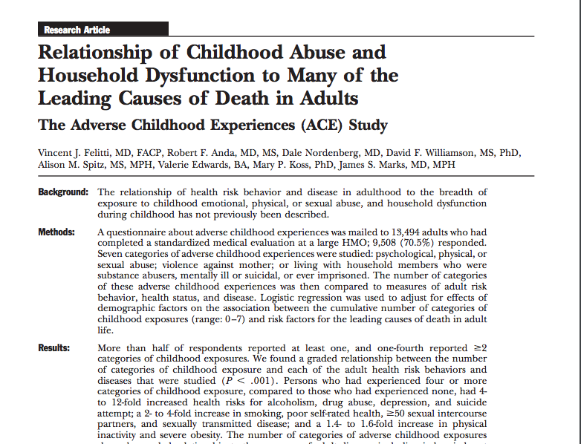

Slide 25
Courtesy Vincent Felliti MD, FACP

Slide 26
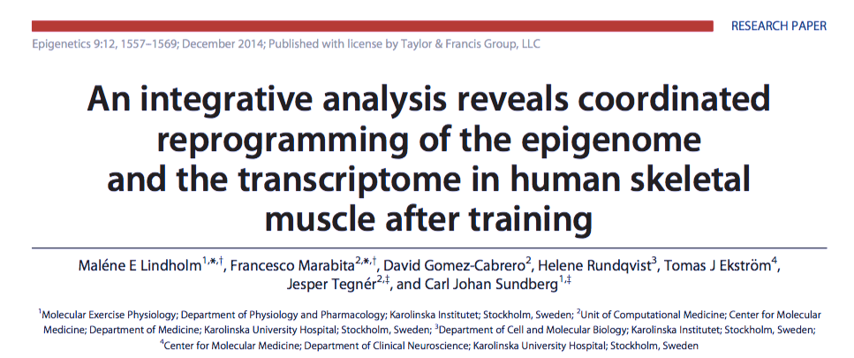
Examined methylation patterns in skeletal muscle of sedentary men and women before and after 45 minutes of moderate-intense exercise.
Methylation patterns changed significantly in genes coding for PPAR gamma, NfΚB and IL-6
Suggestive of more favorable gene expression patterns as they relate to inflammation and insulin signaling.
Lindholm et al. Epigenetics December 2014

Slide 28
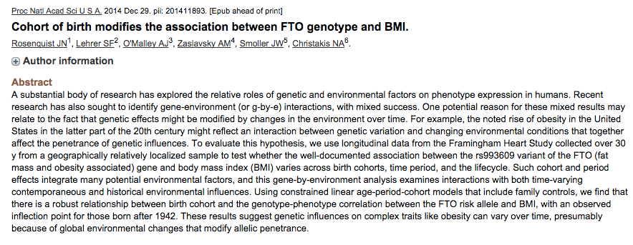
FTO genotype did not predict obesity in people born before 1942
Higher risk when born after 1972
Greatest risk when born after 2000
As it turns out, it’s not just about who you are but in addition, when you are!

Slide 30
Health as a byproduct of gene-environment compatibility

Slide 32
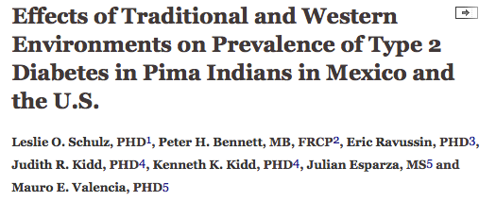
Prevalence of type 2 DM 5 times higher in Arizona Pima’s compared to Mexican Pima’s.
Diabetes Care August 2006 vol. 29 no. 8 1866-1871

Slide 34
Diet and Inflammation

Slide 38
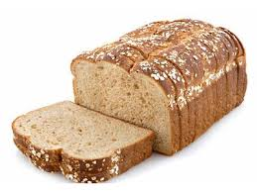
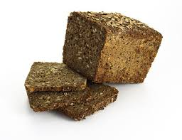
Different carbohydrates produce unique genomic responses
high glycemic carbs low glycemic carbs
62 genes up-regulated 71 genes down-regulated
linked to oxidative stress, regulating insulin signaling
Cytokine mediated immunity and and adipocyte cell size
Interleukin pathways Improved insulin index
Source: Kallio et al. Am J Clin Nutr;2007:851:1417-27
Notes:
47 subjects with metabolic syndrome, 12 weeks trial. No wt loss. Isocaloric.
II = change in I/change in G

Slide 39
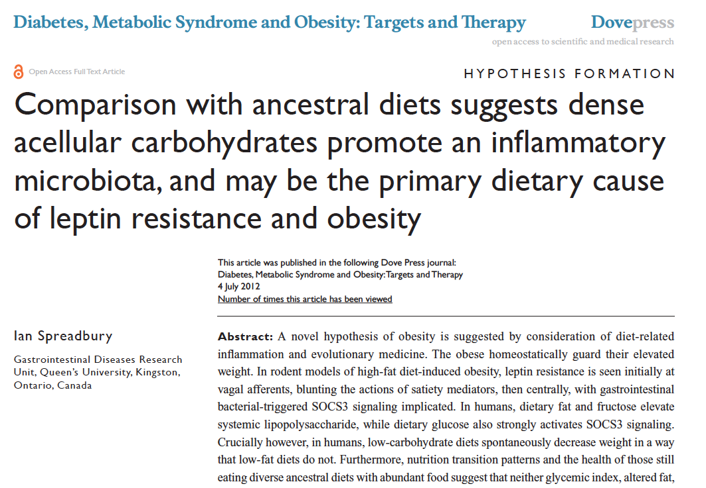

Slide 40
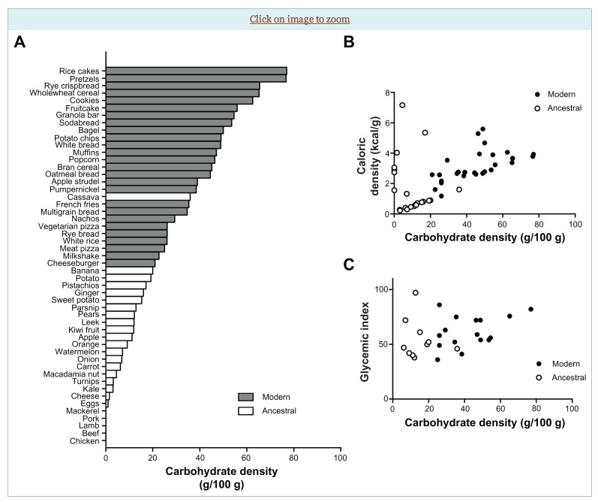

Slide 41
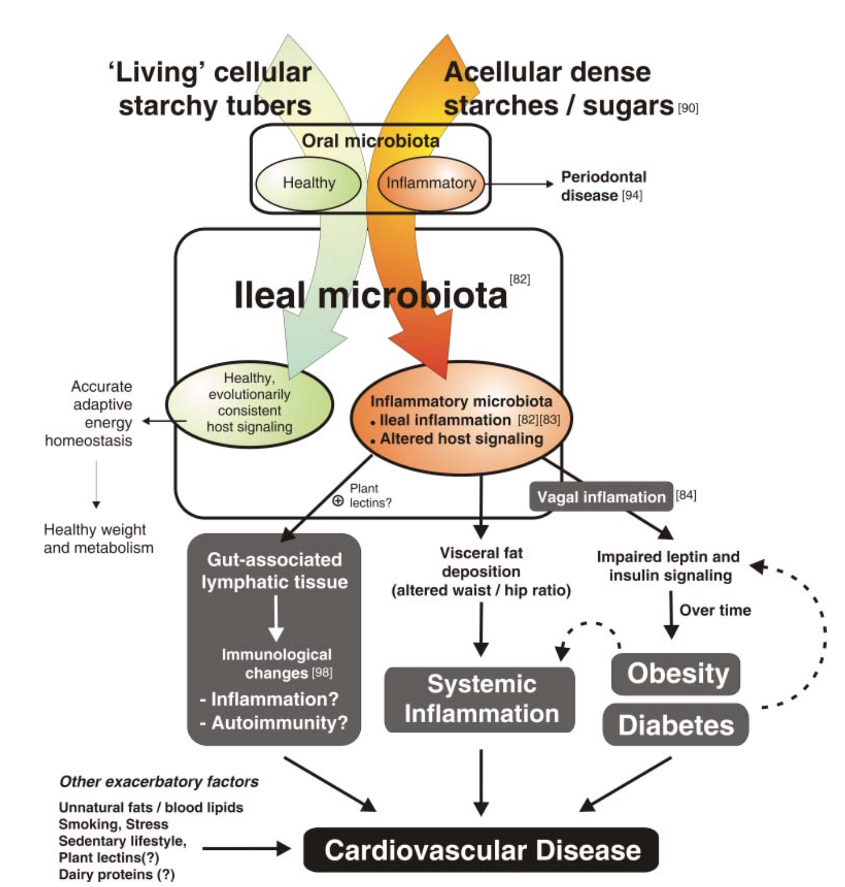
Cancer
Courtesy Ian Spreadbury PhD

Slide 42
Poor Quality Carbs
Acellular carbohydrate density
Inflammation
Stress
Sleep disruption
Altered gut-permeability/microbiome
Social isolation
Toxin excess
Sedentary states
VAT
Excess Insulin
VAT Fat storage-lipogenesis
Down-regulation of insulin receptors
Insulin Resistance
Leptin resistance
Chronic Complex Disease

Slide 43
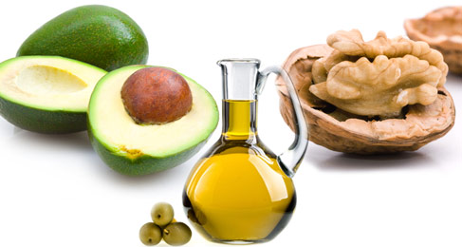
More quality fat sources
Pasture-raised eggs
Fatty fish e.g. salmon, sardines, anchovies, mackeral, trout
Ghee
Grass-fed butter
Whole fat dairy, yogurt
Extra virgin olive oil
Extra virgin coconut oil
Avocados, olives
Nuts - almonds, macadamia, walnuts
Pasture-raised and uncured meats

Slide 44
Allostasis and Allostatic Load
The process of achieving stability or balance through physiological or behavioral change in response to changes in one’s environment.

Slide 45
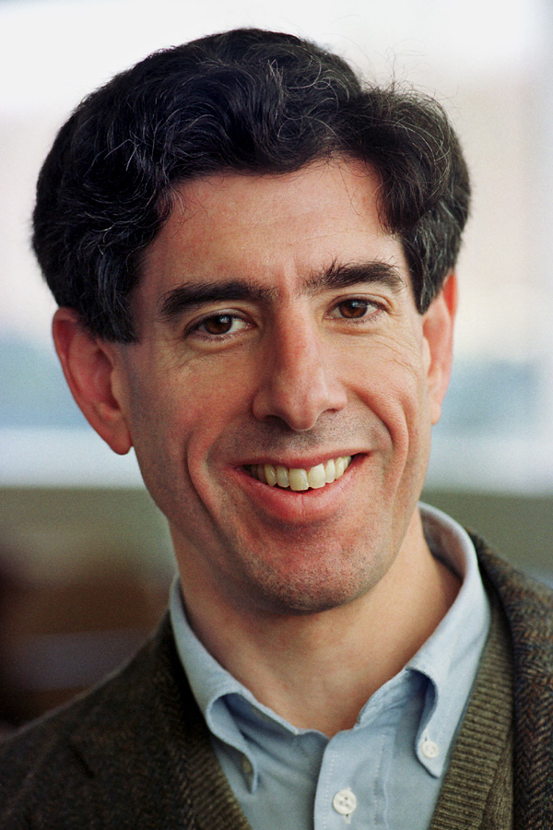
Richard Davidson PhD
Director, Waisman Lab Neurosciences
University of Wisconsin Medical School
Bruce S. McEwen, Ph.D.
Alfred E. Mirsky Professor
Harold and Margaret Milliken Hatch Laboratory of Neuroendocrinology, Rockefeller University

Slide 46
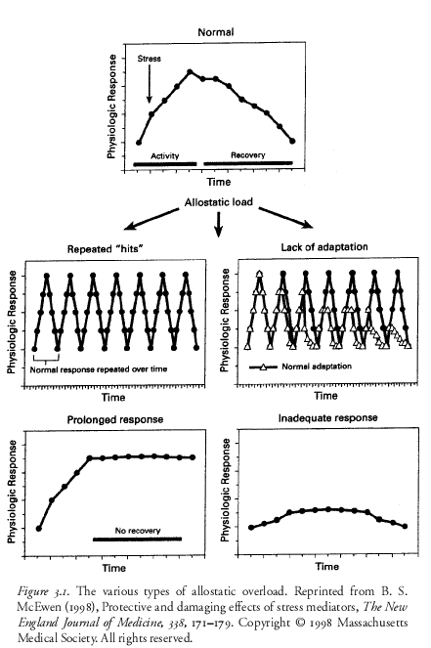

Slide 47
McEwen NEJM 2000

Slide 48
Fight-Flight or Sympathetic Tone

Slide 49
Calm or Parasympathetic Tone…..Get “Para”

Slide 50
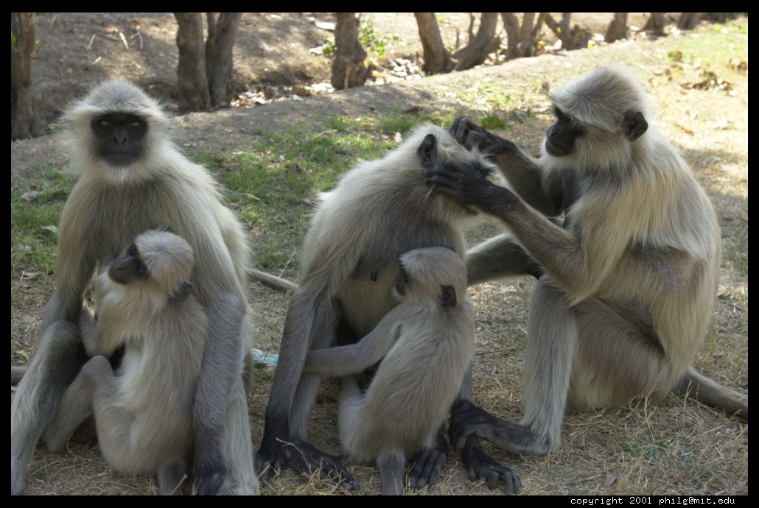
In leadership, human behavioral influence, social connection, epigenetic expression and in health…
Chest pounding is out.
Grooming is in!

Slide 52
www.heartmath.com

Slide 53
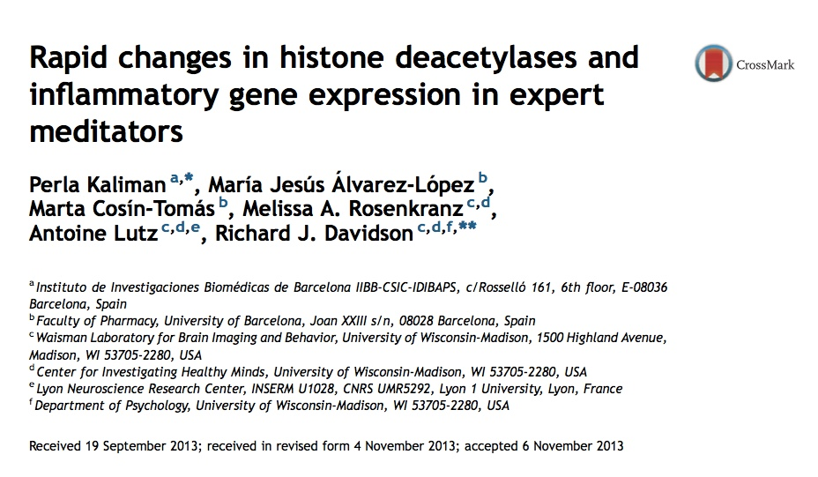
…. after the brief intervention we detected reduced expression of histone deacetylase genes (HDAC 2, 3 and 9), alterations in global modification of histones (H4ac; H3K4me3) and decreased expression of pro-inflammatory genes (RIPK2 and COX2) in meditators compared with controls. We found that the expression of RIPK2 and HDAC2 genes was associated with a faster cortisol recovery to the TSST in both groups.

Slide 54
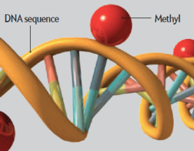
MBSR and Reduction in Inflammatory Biomarkers
Several randomized controlled trials demonstrating alterations in gene expression of NFkB, IL-6 with meditation compared to controls (Benson et al)
Increased expression of telomerase and maintenance
of telomere length (Blackburn and Ornish)
Treatment group scored better on emotional wellness
C-reactive protein reduced

Slide 55
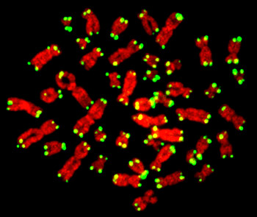

Slide 56
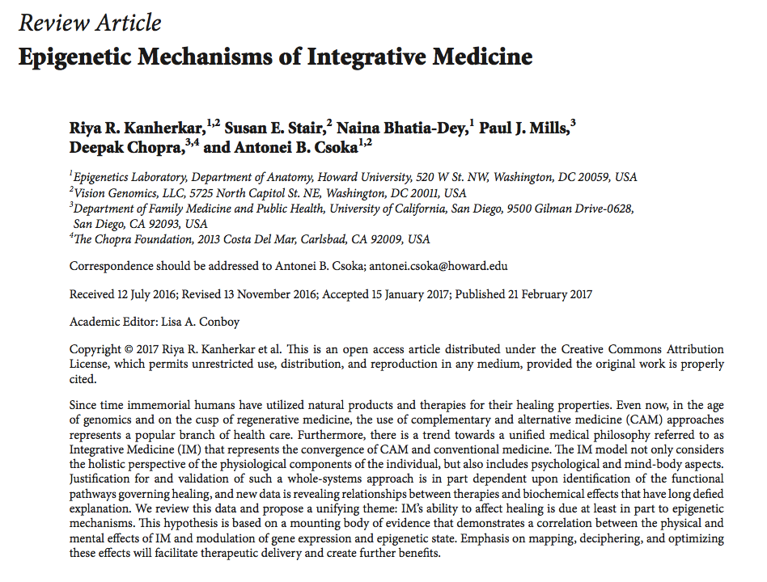

Slide 57
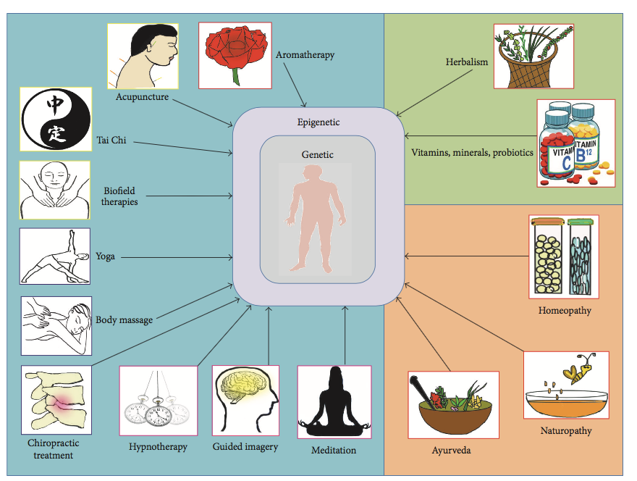

Slide 58
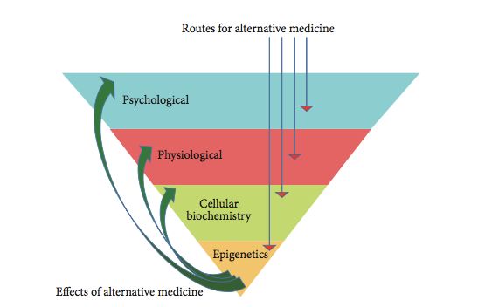

Slide 59
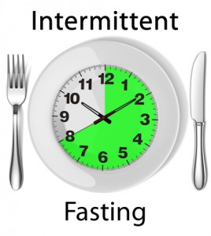
Intermittent fasting
Time restricted feeding e.g. consume all food within 10-hour
Decreases in body weight and visceral fat
Significant reductions in breast cancer recurrence and improved prognosis (Patterson et al. UCSD 2016)
Improved cardiovascular disease risk profile
Decreased inflammation (Biogerontology. 2015 Dec;16(6):775-88)
Decreased neuroinflammation (Neurobiol Aging. 2015 May;36(5):1914-23)
Autophagy (Autophagy, 2014;10:11, 1879-1882)

Slide 60
Courtesy Rhonda Patrick PhD

Slide 61
A Script for Epigenetic Health
Whole foods with reductions in sugar, refined grain-based flour, acellular carbohydrate dense foods
More healthy fats e.g. ghee, olive oil, coconut oil, nuts, avocados, butter, fatty fish, eggs (yolks are best)
Plant-based fiber for the microbiome and nutrient density
Cruciferous, allium, berries great for detoxification
Elimination trial e.g. gluten, refined grains, sugar, casein
Intermittent fasting or time-restricted feeding
Liberal outdoor, full-spectrum light exposure
Sauna
Motion is the lotion!
Stress management e.g. yoga, tai chi, music, breath, meditation
Connection with others: we are born to bond !
Notes:
(Stephanie Senef PhD: Entropy 2012, 14, 2265-2290; doi:10.3390/e14112265) GMO

Slide 62
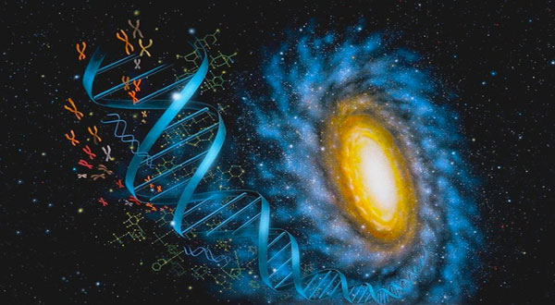
You are the one you have been waiting for!
Thank You
www.thehealthedgepodcast.com

Slide 63
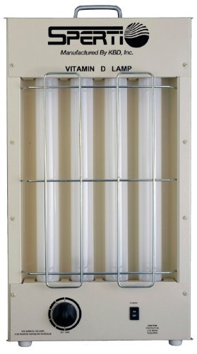
Many epidemiologic studies associate low vitamin D levels with most chronic, complex diseases including cancer.
Sunlight is the ultimate source
Studies suggest a desirable blood level of at least 30 - 50 ng/ml
? Sunlight vs. supplement

Slide 64
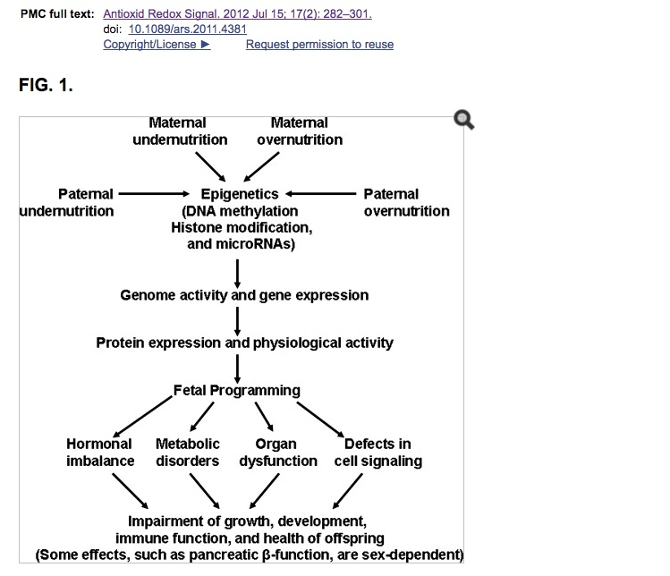

Slide 68
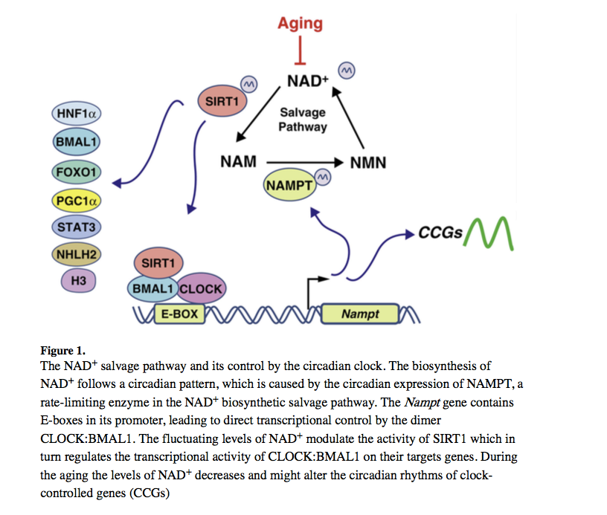

Slide 69
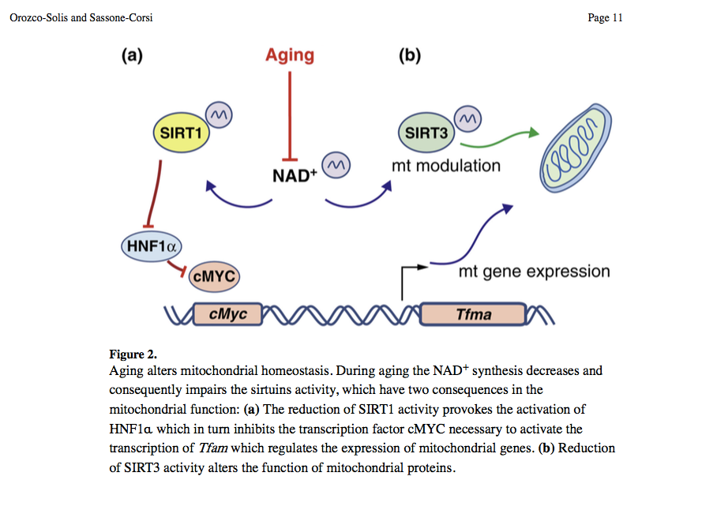

Slide 70
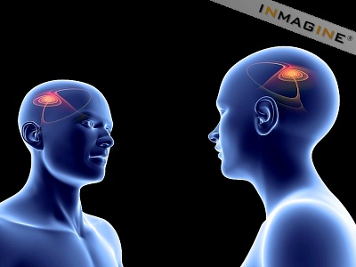
Mirror Neurons
…a biologic basis for empathy?

Slide 72
Allostatic Load Opportunities for Intervention

Slide 73
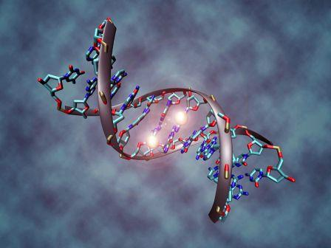
Representative Clinical Conditions Suggested to Have Epigenetic Origins
Obesity
Type 2 DM and Metabolic Syndrome
Coronary artery disease
Autoimmune Diseases
Cancer
Allergic Disorders
Depression
Neurologic: Alzheimer’s, PD, ALS, Autism

Slide 74
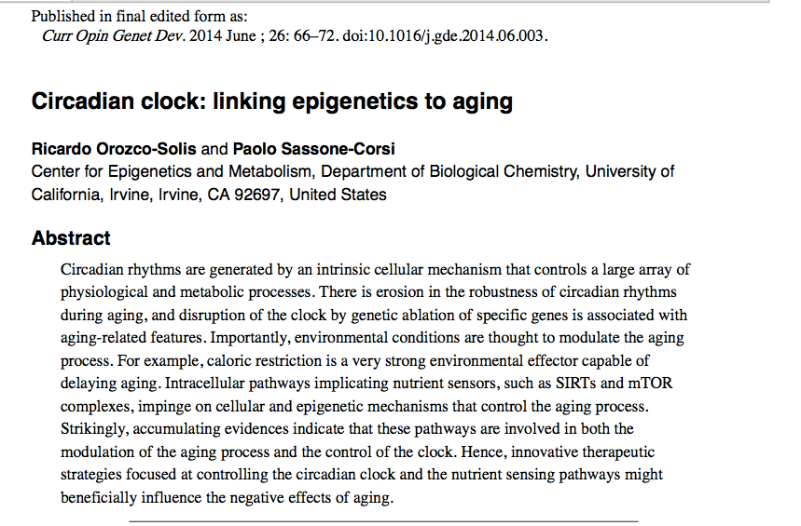

Slide 75
